Slide 1


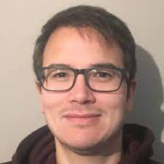
Einstein Telescope OSB
Div 4 MMO: Multi Messenger Observations
May 8 2024
Giancarlo Ghirlanda Susanna Vergani [Stephen Smartt] Andrew Levan
[giancarlo.ghirlanda@inaf.it, susanna.vergani@obspm.fr, a.levan@astro.ru.nl ]

Slide 2
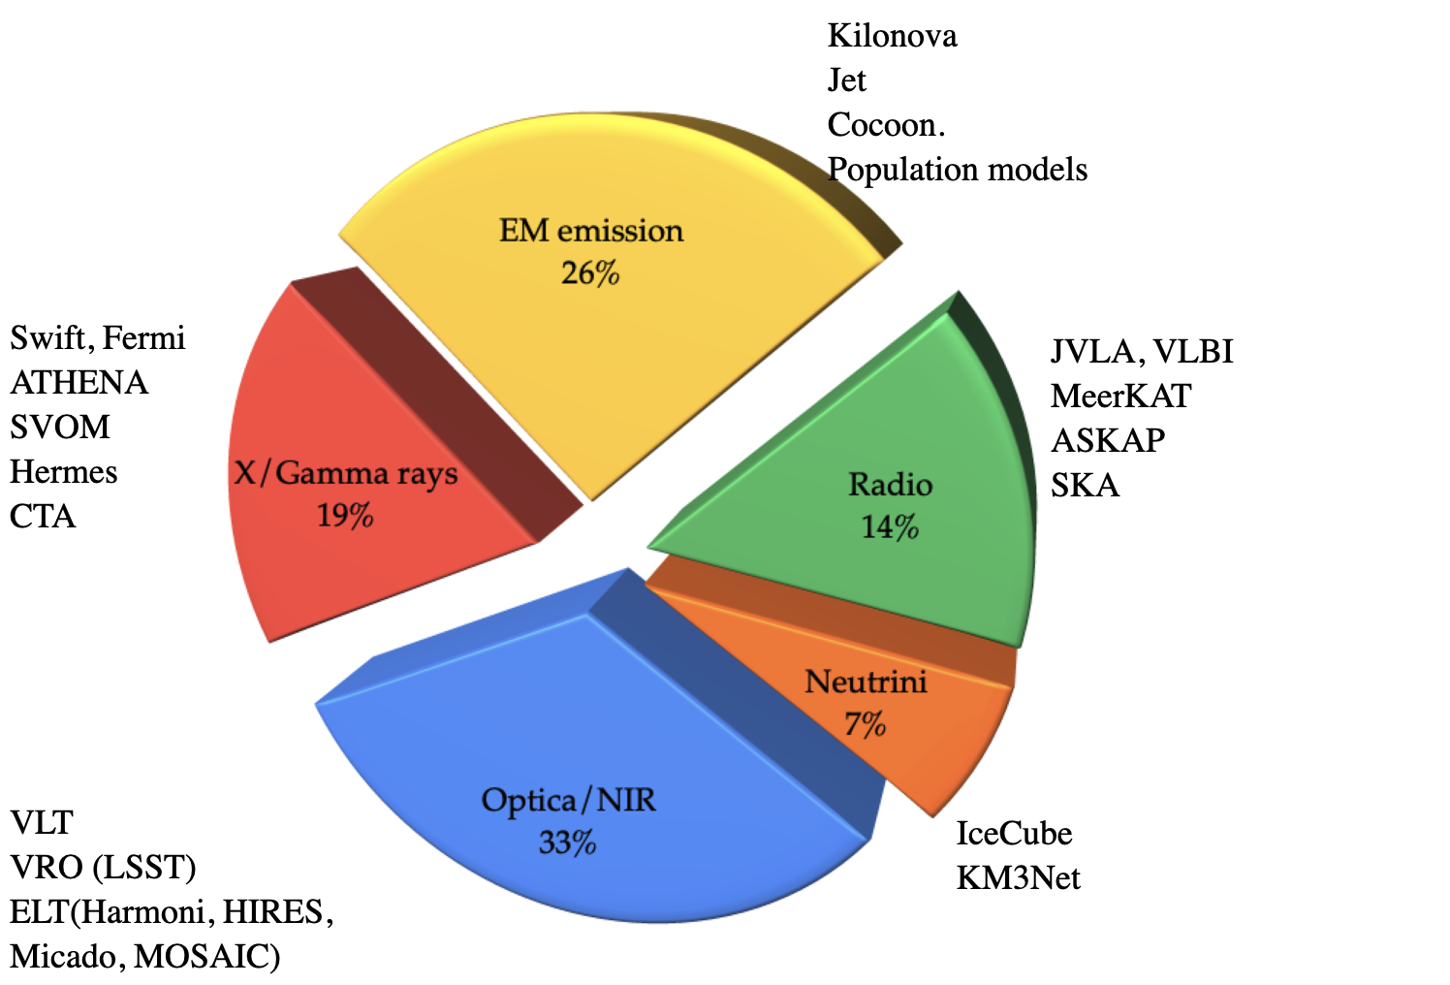
OSB4-Members & Expertise
OSB Div.4 (13 Feb 2024)
157 subscribers
3 Coordinators
S. D. Vergani
G. Ghirlanda
S. Smartt → A. Levan
Promote a collaborative environment and gather the MMO community
Contribute to the Blue Book

Slide 3
OSB4-Multi Messenger Observations
Multi Messenger science cases offered by the detection and follow up of counterparts of ET sources
https://wiki.et-gw.eu/OSB/MultimessengerObs/WebHome
WP1: “Counterpart predictions”
WP2: “Observations, facilities, strategies”
What counterparts?
What facilities?
BNS
BHNS
BBH (?)
… others
Space
Ground
Enabled science
Trigger
Follow up
Remnants
Ejecta
Power
Dissipation/emission
Kilonova
GRB jet
Cocoon
Non EM (?)
FoV, Sensitivity
Strategy
…
(+ transformational, undetected, unexpected …)
(+evolve within the next years)

Slide 4
Div4 - Multi Messenger Observations
“BLUE BOOK”
Section 1: State of the art: observational picture and strategies (A. Levan)
    170817 what we have learned
    GRBs and KN as counterparts of CB mergers
    Search strategies and follow up strategies based on past/current experience
Section 2: Modelling the EM counterparts of ET detected CB mergers (G. Ghirlanda)
2.1 Population synthesis models:
        BNS merger population synthesis code —> EM emission (KN, GRB)
        BHNS merger population synthesis code —> EM emission (KN, GRB)
  2.2 EM emission component detectability (generic bands/limiting sensitivity)
        Kilonova
        GRB prompt and afterglow
Section 3: Observational facilities/strategies (S. Vergani)
    The ET change of paradigma on EM counterpart search and characterisation
    Expected EM facilities (2035 survey)
    Examples of Performances on (2)
    Requirements, needs, etc.

Slide 5
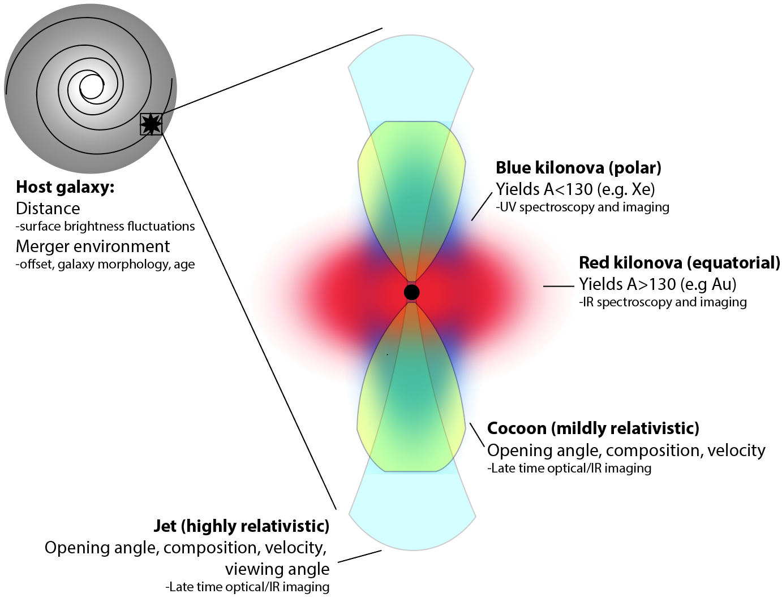
Div4 - Multi Messenger Observations
Section 1: State of the art: observational picture and strategies
Set the scene for GW-EM observations:
What are the likely signatures
What have they told us to date about compact object mergers?
What have they told us to date about other questions, r-process enrichment, NS EoS, H₀ etc (brief so as not to duplicate work in other OSB divisions)?
What are likely to be the open questions in the ET era?

Slide 6
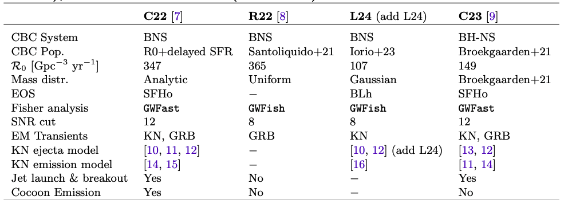
Div4 - Multi Messenger Observations
Section 2: Modelling the EM counterparts of ET detected CB mergers (G. Ghirlanda)
2.1 Population synthesis models:
        BNS merger population synthesis code —> EM emission (KN, GRB)
        BHNS merger population synthesis code —> EM emission (KN, GRB)
  2.2 EM emission component detectability (generic bands/limiting sensitivity)
        Kilonova
        GRB prompt and afterglow
O. S. Salafia, S. Ronchini, A. Colombo, F. Iacovelli, J. Dupletsa, S. Ascenzi, E. Loffredo
Colombo A. presentation
Loffredo E. presentation

Slide 7
Div4 - Multi Messenger Observations
GRB prompt emission

Slide 8
Div4 - Multi Messenger Observations
GRB afterglow emission

Slide 9
Div4 - Multi Messenger Observations
Kilonovae

Slide 10
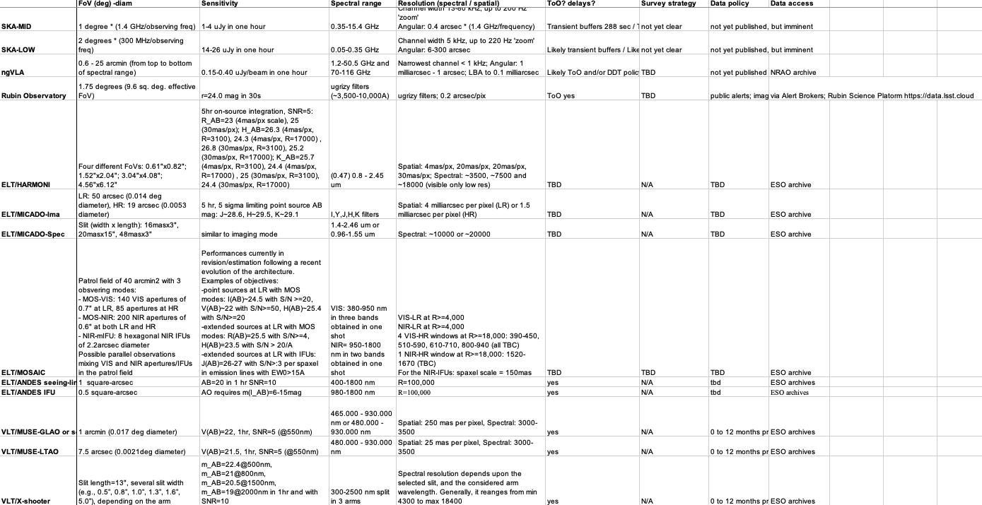
Div4 - Multi Messenger Observations
“BLUE BOOK”
Section 3: Observational facilities/strategies (S. Vergani)
+ lots more

Slide 11



Div4 - Multi Messenger Observations
“BLUE BOOK”
Section 3: Observational facilities/strategies (S. Vergani)
Our survey is a list of current, planned and proposed facilities that can map to the expected ET populations.
It is not a list of requirements for ET success, things not on this list may be more optimal, and there is still (some) time, but will likely need substantial community buy-in.

Slide 12
OSB4-MMO Science meetings
The critical path to the OSB chapter
Section 1, first draft => full version
Sec.2, complete first draft
Complete instrument survey, decide how to fold various instrument sensitivities, likelihood of existence, difficulty of discovery vs detection etc. through predictions.

Slide 13
Div4 - Multi Messenger Observations
“TAKEAWAYS” for the larger community
•Lots of possible counterparts, need to pair them effectively (kilonova in the local Universe, GRBs at larger distances)
•Plenty of uncertainty in the expected EM counterpart properties that couples with broad range of rates à but realistic worst case still should give a large number of counterparts (orders of magnitude larger than LVK O5 sensitivity). A very careful job has been to consider the expected properties of the counterparts.
•Because of the large distances of ET events, EM follow-up should not be taken for granted. Should consider routes to make error boxes smaller (CE, keeping LVK online etc) and make sure that EM capability is developed in tandem, not left until the last minute (EM facilities for ET follow—up will be much larger than for LVK alerts).
Sifting out false positives is likely to be an even bigger problem for ET than for LVK (larger horizons, fainter counterparts), but much extra science can be done if this is effective.

