Slide 1
Request For Changes
Document ID | ET-0221A-24
Document type | Slides
Document status | RELEASED
Author | L. Latronico
Verified by | L. Orsini, L. Lucchesi, C. Olivetto
Approved by | A. Variola
How to manage changes in the ET Project
ET Symposium, Maastricht, May 7th 2024

Slide 2
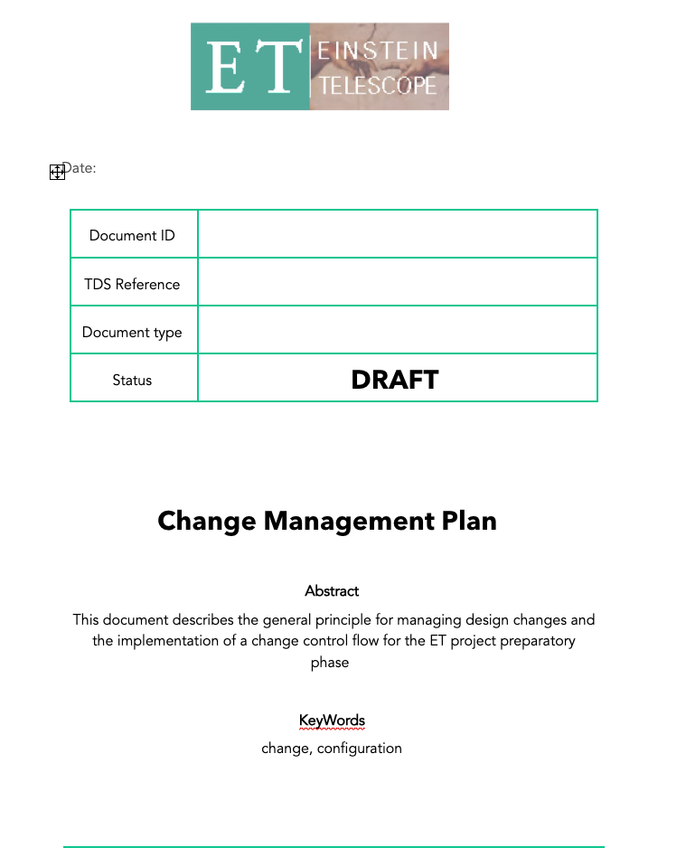
Outline
Context
Definitions
Flowchart
Discussion

Slide 3
Context
We now operate in the ET Preparatory Phase
R&D is ongoing
Baseline design not yet established
Many changes are expected
PO prepares to support the entire ET lifecycle with
delivery of project documents (TDR, PMP, QAP…) to the BGR for approving ET
Configuration Management during engineering, construction and integration
Changes must be managed to ensure quality, i.e. distribution of information and traceability

Slide 4
Basic definitions
Change | Owner | Root system | Request For Change RFC | Change Control Board CCB
Deviation from released info or configuration (docs, specs, requirements, tech drawings) | Initiator and responsible of the management process | Physical or data system where the change originates | Process for instantiating a request of a change and seeking approval | Board of technical experts and relevant system managers to analyze and dispose (applies to major changes only)

Slide 5
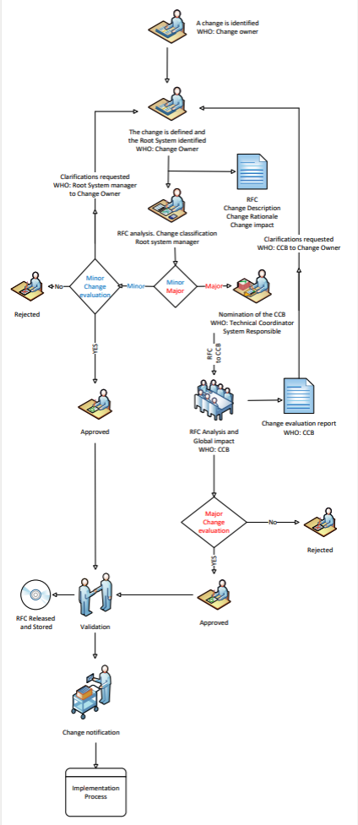
Main Change management steps
Identification and description
Specifies nature, reason, owner and root system
Impact analysis and classification
Defines which systems are affected
Class is major if impact extends root system, else minor
Approval
Evaluation of the impact
Recommendation (approve/ reject/ re-analyze)
Validation
Independent re-analysis of the approval process
Notification
distribution of change-related information
Implementation
Separate process not covered here

Slide 6
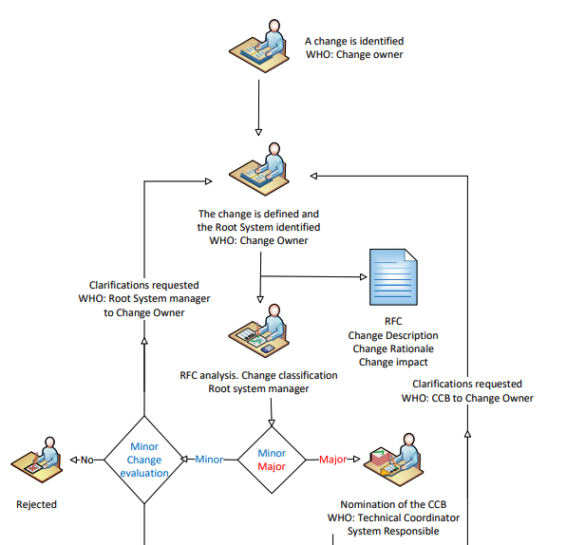
RFC Flowchart
Identification
Description
Classification
Start of approval

Slide 7
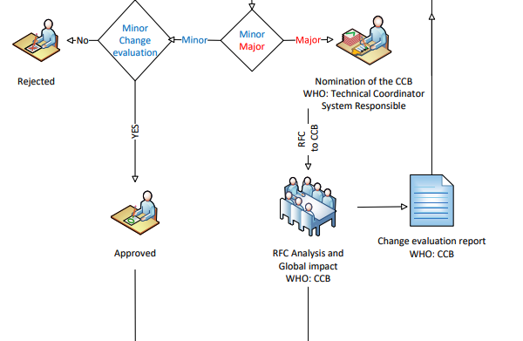
RFC Flowchart
Impact analysis

Slide 8
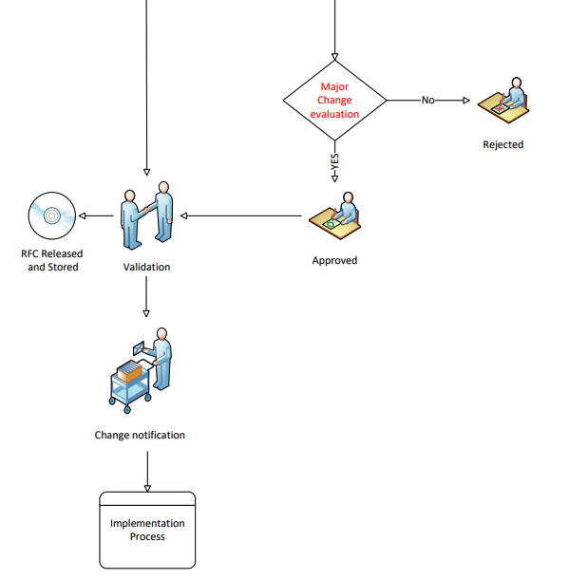
RFC Flowchart
Validation
Notification
Implementation

Slide 9
Discussion points
Documents support change process
RFC
Change evaluation report
Many changes are expected
Change Register
Change notification
Key actors
Change owner
Root system manager
Technical coordinator
Definition of boards (CCB, Validation) on a case-by-case basis
shall ensure technical competence, independent and redundant evaluations
As far as the validation processes are concerned, the relevant board and processes should be defined a priori, associated to the relevant roles.

