Slide 1
Progress on ET Pilot Sector and its future ET – CERN collaboration
Luigi SCIBILE on behalf of the ET-CERN Collaboration
XIV ET Symposium, Maastricht, 06-10 May 2024

Slide 2
CERN activities on ET beampipe vacuum
Collaboration
agreement
CERN-INFN-NIKHEF
Q4
Official start of the activities
Q1 (January)
Peer review of the pilot sector
Q4
Start construction of the ET beampipe pilot sector
Q4
Writing of TDR
2019
2020
2021
2022
2023
2024
2025
Addendum on
CERN contribution to ET beampipes
IFAE joins the collaboration agreement
Q3-Q4
Preliminary vacuum pipe TDR [ET-PP]
The main objectives are:
Coordinate the contributions of all parties involved in the study of ET beampipes.
Design, manufacture, assemble, and test a pilot sector of the selected ET beampipe vacuum systems.
Preparing and writing the ‘Technical Design Report’ for the vacuum systems of the ET’s arms, including cost estimations.
Contact and sharing of information with the Cosmic Explorer community.
Courtesy of Carlo Scarcia

Slide 3
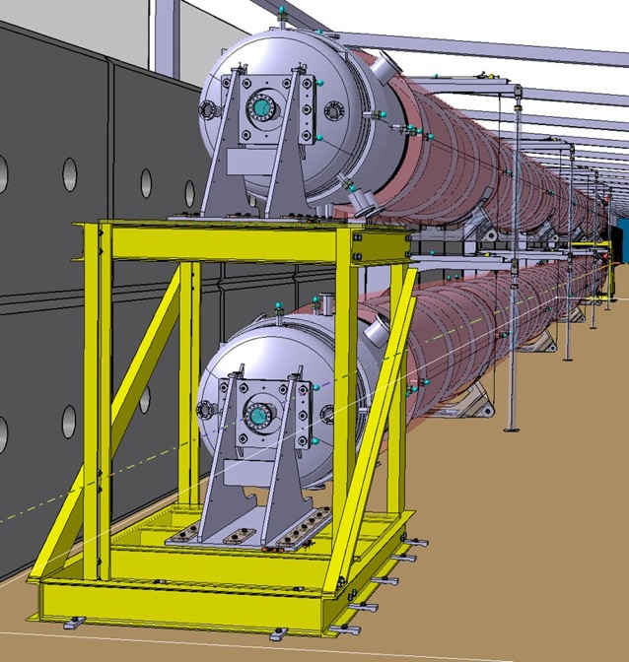
ET pilot sector
The pilot sector aims to test the design, fabrication, installation and commissioning of the proposed beampipes and support system. It also aims to compare the feasibility of a selected number of technical choices.
Q1 2024 (January)
Project peer reviewed (international experts panel) with recommendations.
Q2-Q4 2024
Manufacturing and procurement of the ancillary components/equipment.
From Q4 2024/Q1 2025
Start of installation of a
AISI 441 VIRGO-like pipe Ø 1.08 m x 4 mm x 36 m
Courtesy of Carlo Scarcia

Slide 4
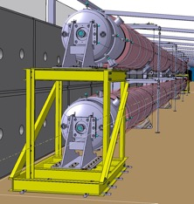
ET Pilot sector - Organisation
WP8
Overall Coordination
WP1
WP2
WP4
WP5
WP7
Mechanical design team/ Integration
+
Metallurgical analysis team
+
Infrastructure, logistics and coordination
+
CERN design office
CERN’s metallurgy and mechanical measurement labs
CERN’s site services
WP3
WP6
WP2
Post manufacturing Chemical cleaning
+
Vacuum system and bakeout
+
Fabrication team
+
CERN’s surface finishing facility and chemical/surface analysis labs
CERN’s vacuum labs
CERN’s workshop and subcontracting service
Manufacturing
Suppliers

Slide 5
ET pilot sector – Procurement and manufacturing
ET Pilot sectors parts
Materials and compontents procurement
Manufacturing/Procurement
AISI 441 Materials
Firm | Country
Aperam | B
Firm | Country
CADINOX | ES
Alca Technologies | IT
CNIM | FR
VDL | NL
Beampipe sections
Endcaps, Pumping modules
CERN workshops
Support system
CERN frame contract
Bellows (AISI 316L)
CERN stores
Firm | Country
Witzenmann | DE
Skodock | DE
HKS | DE
Flexomat | DE
Teddington | GB
Bird bellows | GB
Heitz GmbH | DE
Kompaflex | CH
Klinger | DK
Valves, pumps, instrumentation
CERN Stores
CERN frame contracts
Small orders
Thermal insulation and Bakeout systems
Monitoring and control system
Assembled by CERN

Slide 6
ET pilot sector – Procurement and manufacturing
ET Pilot sectors parts
Materials and compontents procurement
Manufacturing/Procurement
Firm | Country
Aperam | B
AISI 441 Materials
100%
Firm | Country
CADINOX | ES
Alca Technologies | IT
CNIM | FR
VDL | NL
End Q4-24
Beampipe sections
Endcaps, Pumping modules
End Q4-24
CERN workshops
Support system
End Q3-24
CERN frame contract
100%
Firm | Country
Witzenmann | DE
Skodock | DE
HKS | DE
Flexomat | DE
Teddington | GB
Bird bellows | GB
Heitz GmbH | DE
Kompaflex | CH
Klinger | DK
Bellows (AISI 316L)
CERN stores
End Q4-24
Valves, pumps, instrumentation
CERN Stores
CERN frame contracts
Small orders
Thermal insulation and Bakeout systems
75%
Monitoring and control system
End Q1-25
Assembled by CERN

Slide 7
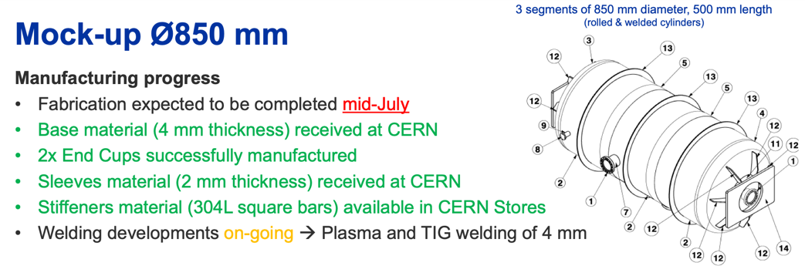
ET pilot sector – Procurement and manufacturing
ET Pilot sectors parts
AISI 441 Materials
Beampipe sections
Endcaps, Pumping modules
Support system
Bellows (AISI 316L)
Valves, pumps, instrumentation
Courtesy of M. Dakshinamurthy and A. T. Pérez
Thermal insulation and Bakeout systems
Monitoring and control system

Slide 8
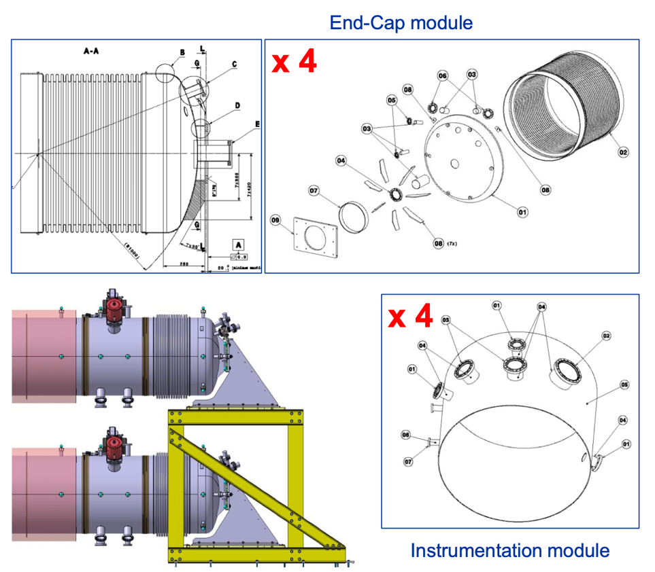
ET pilot sector – Procurement and manufacturing
ET Pilot sectors parts
AISI 441 Materials
Beampipe sections
Endcaps, Pumping modules
Support system
Bellows (AISI 316L)
Valves, pumps, instrumentation
Thermal insulation and Bakeout systems
Monitoring and control system
Courtesy of G. Favre

Slide 9
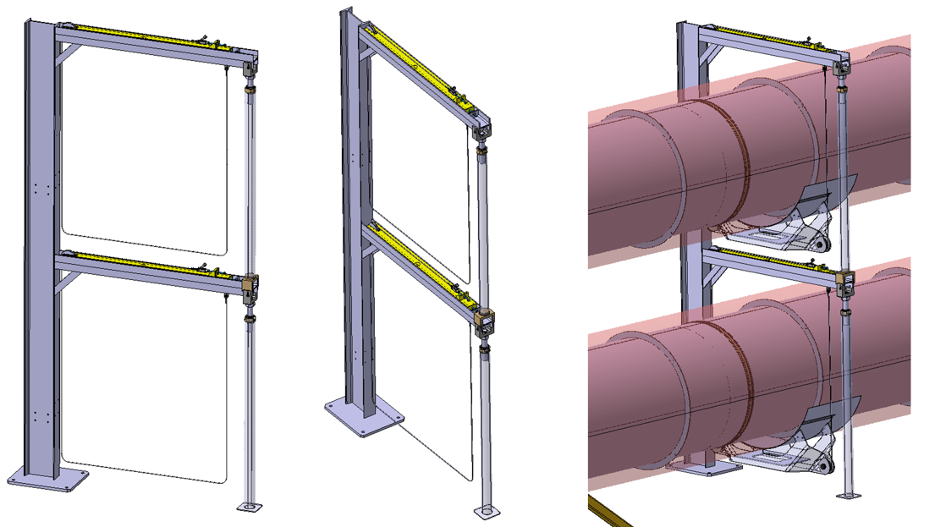
ET pilot sector – Procurement and manufacturing
ET Pilot sectors parts
AISI 441 Materials
Beampipe sections
Endcaps, Pumping modules
Support system
Bellows (AISI 316L)
Valves, pumps, instrumentation
Thermal insulation and Bakeout systems
Monitoring and control system
Courtesy of C. Garion, L. Gentini

Slide 10
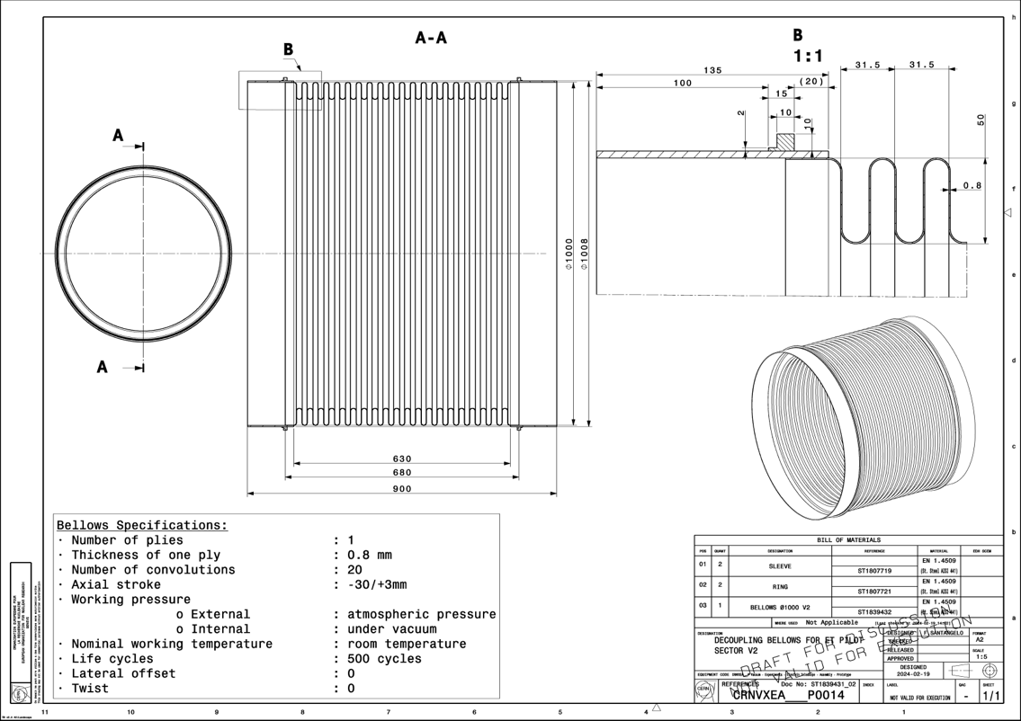
ET pilot sector – Procurement and manufacturing
ET Pilot sectors parts
AISI 441 Materials
Beampipe sections
Endcaps, Pumping modules
Support system
Bellows (AISI 316L)
Valves, pumps, instrumentation
Thermal insulation and Bakeout systems
Monitoring and control system
Courtesy of C. Garion

Slide 11
ET pilot sector – Logistics
Courtesy of J. Hansen

Slide 12
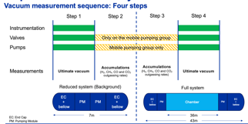
ET pilot sector – Logistics for step 1
ET Pilot sectors parts
(Dimensions not to scale)
AISI 441 Materials
Beampipe sections
Endcaps, Pumping modules
Materials and compontents procurement
Manufacturing/Procurement
Cleaning
EC
Bellow
PM
PM
Bellow
EC
Measurements
STEP 1
BAKEOUT
Installation
Installation
Leak tests
Support system
Welding
Installation
Installation
Alignment
Bellows (AISI 316L)
Cleaning
Vacuum
firing
1
Valves, pumps, instrumentation
Thermal insulation and Bakeout systems
Monitoring and control system
Time

Slide 13
ET pilot sector – Logistics for STEP 2
ET Pilot sectors parts
(Dimensions not to scale)
AISI 441 Materials
Beampipe sections
Endcaps, Pumping modules
Materials and compontents procurement
Manufacturing/Procurement
EC
Bellow
PM
PM
Bellow
EC
De-install instrumentation, valves and pumps
Measurements
STEP 2
Support system
Bellows (AISI 316L)
2
Valves, pumps, instrumentation
Thermal insulation and Bakeout systems
Monitoring and control system
Time

Slide 14
ET pilot sector – Logistics for STEP 3/4
ET Pilot sectors parts
(Dimensions not to scale)
(Dimensions not to scale)
AISI 441 Materials
Beampipe sections
Endcaps, Pumping modules
Materials and compontents procurement
Manufacturing/Procurement
EC
Bellow
PM
PM
Bellow
Bellow
EC
EC
PM
PM
Bellow
EC
Support system
CUT
SPLIT
Bellows (AISI 316L)
Valves, pumps, instrumentation
Thermal insulation and Bakeout systems
Monitoring and control system
Time

Slide 15
ET pilot sector – Logistics for STEP 3&4
ET Pilot sectors parts
(Dimensions not to scale)
AISI 441 Materials
Beampipe sections
Cleaning
Endcaps, Pumping modules
Materials and compontents procurement
Manufacturing/Procurement
EC
Bellow
PM
BS
BS
BS
BS
BS
BS
PM
Bellow
EC
Re-install instrumentation, valves and pumps
Welding
Measurements
STEP 3
Measurements
STEP 4
Alignment
Installation
Installation
Leak tests
Support system
BAKEOUT
Bellows (AISI 316L)
3
4
Valves, pumps, instrumentation
Thermal insulation and Bakeout systems
Monitoring and control system
Time

Slide 16
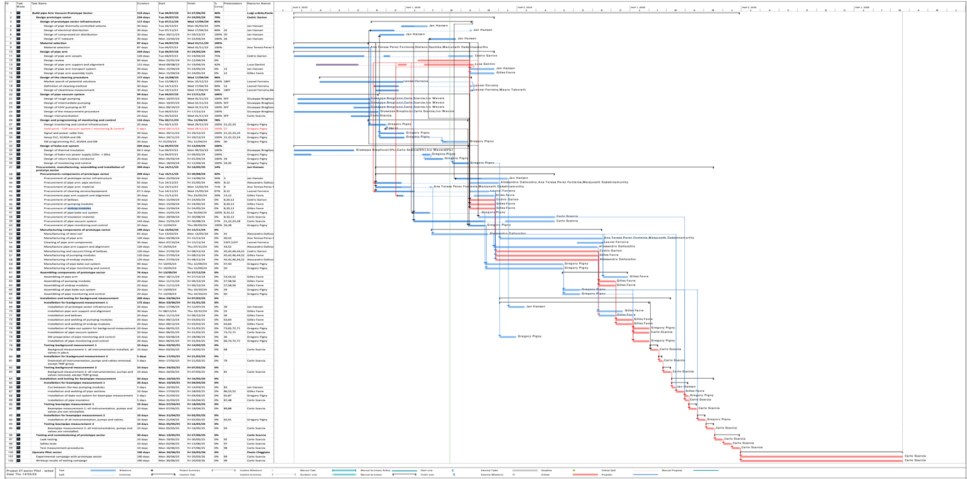
ET pilot sector – Main milestones
Q1, 2023
Q4, 2023
Q1, 2024
Q2, 2024
Q3, 2024
Q4, 2024
Q1, 2025
Q2, 2025
Q3, 2025
Q4, 2025
Q1, 2026
29/02/2024 – Start the procurement process
OK for the Material – (see next slide)
Mid Q2 – Start manufacturing
On the critical path!!!
Q3, 2024 – Start installation of infrastructure
TT4 new location – to be prepared before installation.
Q3/Q4 – Preliminary vacuum pipe TDR [ET-PP]
Data available.
Mid/End Q4 – All procured parts @ CERN
Some parts on the critical path!!!
Except Pipe sectors ~ 2 months slac.
End Q4 – Tunnel ready for installation
On the critical path!!!
Mid Q1 2025 – Start vacuum measurement sequence
Planning for success!
Courtesy of Carlo Scarcia

Slide 17
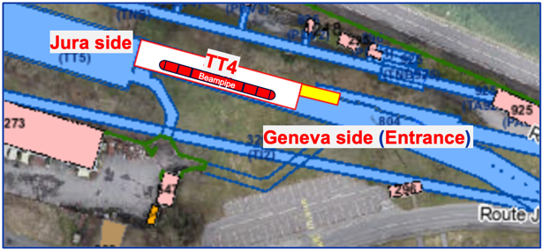
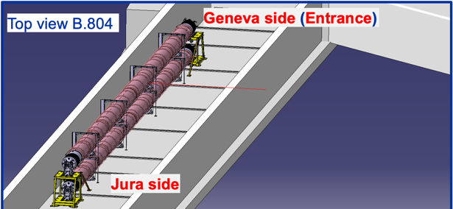
ET pilot sector – Alignment
Contact established with CERN alignment and survey services.
Request for support during the installation sequence in TT4 (see also next slide):
Trace the floor plan before installation of the supports
Help with the alignment of the vacuum supports during installation
Help with the alignment of vacuum chambers with respect to the end supports before welding.
Check the position of the chambers when the system is under vacuum.
Started discussions for the alignment techniques for the 10km installation.

Slide 18
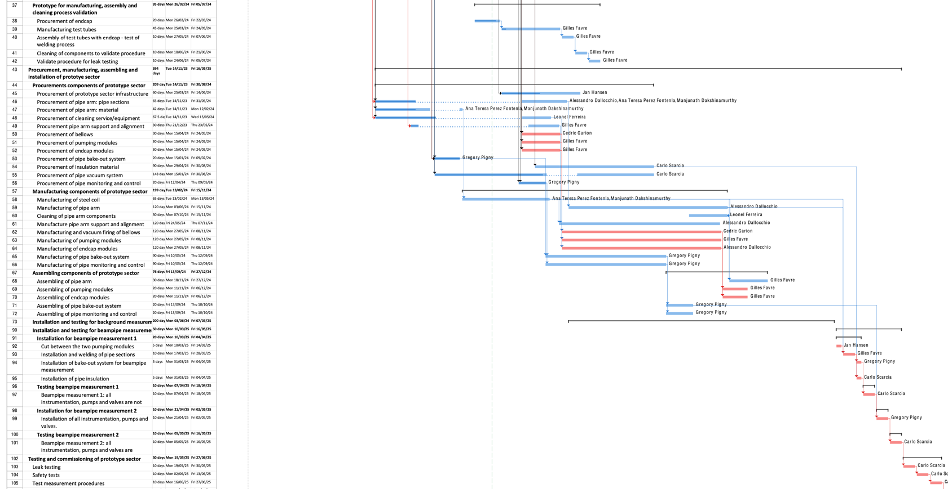
ET pilot sector – Alignment planning
October/November 2024 - Trace the floor plan based on an integration drawings
November 2024 - Help with the alignment of the vacuum supports during installation
December 2024 - Geometrical verification of the chambers and baffles after fabrication and before installation.
January 2024 + June 2025 - Align vacuum chambers with respect to a drawing before welding and after welding.
Second pipe non shown yet on the schedule
April/May 2025 - Check the position of the chambers when the system is under vacuum and baked.

Slide 19
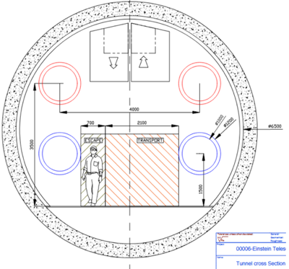
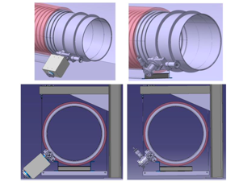
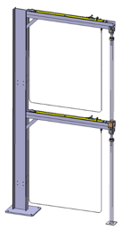
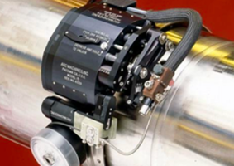
Interfaces/Interferences between the beampipe and the tunnel: cross section
Space required for the supporting structure, for welding and future inspections (min 500mm), for gate valves, for pumping modules and related control units (depending on design installation).
500
500
800
800
800
2720
2720
1100
1100
1100
2180
Fire fighting equipment (water - DN200 pipe?)
Cable trays for communication equipment?
Ventilation and smoke extraction?
Presence of alcoves/enlargements?
Minimum safety distance between tubes and wall?

Slide 20
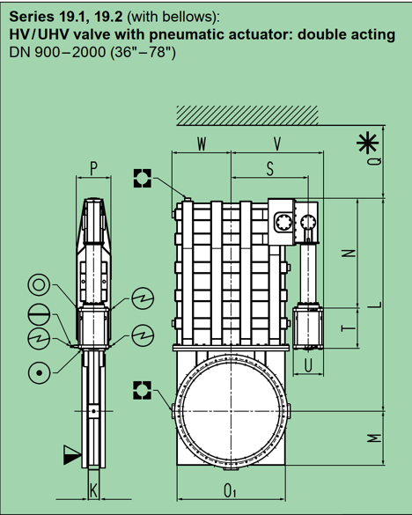
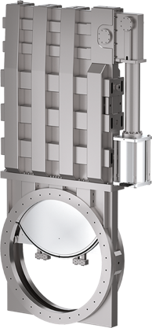
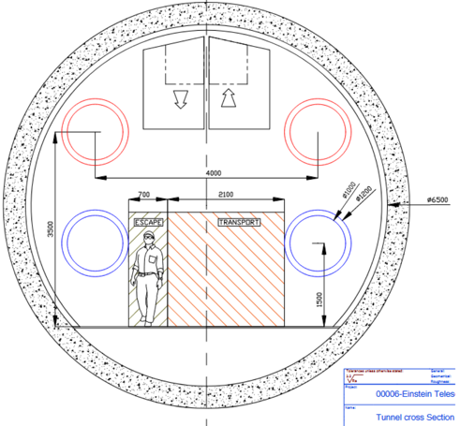
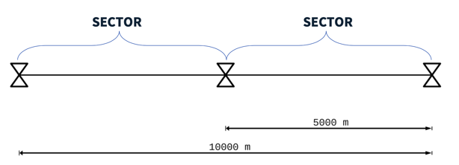
Interfaces/Interferences between the beampipe and the tunnel: cross section
Space required for sectional gate valves (DN1000)
1565 (W+V) x 2751 (L +M) x 356 (P) mm
+ 140 mm (Q)
800
1100

Slide 21
ET – CERN to be proposed future scope extension
Test of beampipe other than AISI 441 4mm VIRGO-like.
Prepare the framework for other beampipe solutions to be tested in the same environment.
Purchase a gate valve and carry out the mechanical integration studies, the UHV caracterization inclusing the conditioning and outgassing rate measurements.
Workout the detailed integration with the civil engineering.
Study alignment techniques for the 10km assembly and installation and eventual optimisations of the support system.
Design of leak detection systems for the manufacturing, installation and final system.
Design the detailed procedures for the installation and commissioning in the final ET tunnel design.
Study for the control of dust during all assembly and installation processes.
Carry out the baffle material outgassing studies and its integration and alignment in the ET final tubes.
Open to discuss, via ETO, the possibility to carry out other type of tests.
Update the TDR and costing in line with general ET timeline.

Slide 22
ET pilot sector: peer review recommendations
Recommendation | Action
Investigation on corrosion resistance of ferritic stainless steels (tunnel environmental conditions) | Contract with UGhent to be launched for comparative corrosion studies
Use pilot sector as testbed for extrapolation of ET leak detection | Methodologies and tooling under investigation
ET pilot sector to be used to test different insulation materials and solutions (installation, removal) | Contact with companies started
Implementation of large gate valves (DN1000+) to test thermal cycling, stroke cycling, treatments etc. | Planned in the extension of ET-CERN scope
Implementation of temperature control systems in selected building | ET pilot sector moved to TT4 tunnel – stable temperature.
Consider launching a parallel test on a corrugated chamber (perhaps through external contribution) | Planned in the extension of ET-CERN scope
See Carlo’s Presentation

