Slide 1
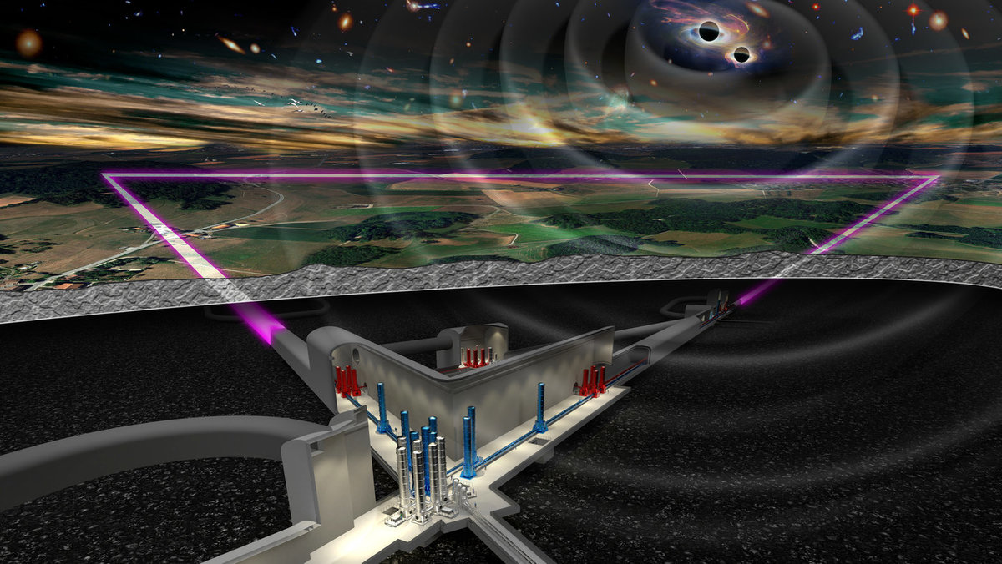
XIV ET Symposium: Systems Engineering and Requirements Management for ET
Complexity
Traceability
Revision: V03
Date: May 3rd 2024
Author: Romano Meijer
Assignment: ETO – Project Office
Role: Systems Engineer
Institute: Nikhef
Contact: r.meijer@nikhef.nl
Timeline

Slide 2
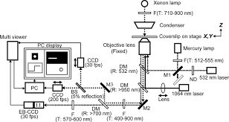
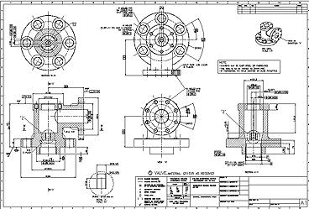
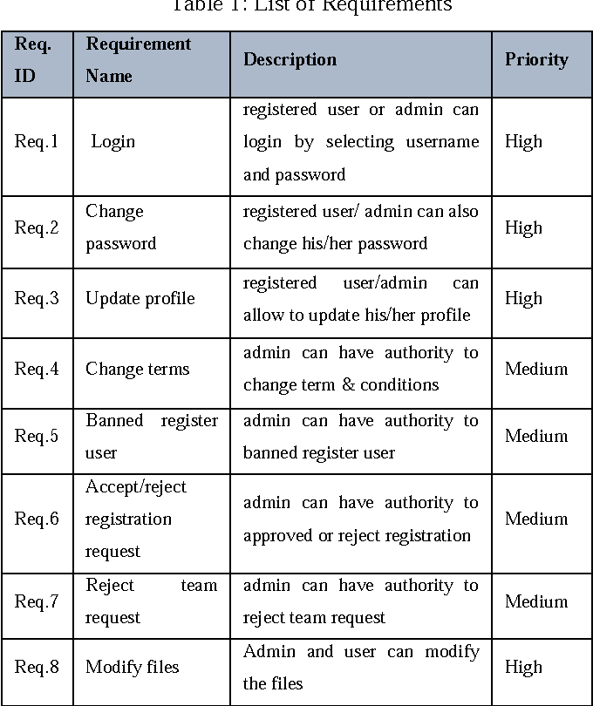
Managing time: SE development timeline
Interface Management
Identifying dependencies between systems
Requirements Management
Synthesizing system capabilities from objectives
Design Synthesis
Translating the system architecture to design parameters
Integration Management
Verifying that specs, requirements and objectives are met
Systems Engineering
Managing system complexity
M1: Science & Project Objectives
M2: System Requirements
M3: System Architecture
M4: Preliminary Design
M5: Critical Design
Construction & Manufacturing
M6: System Acceptance
M7: Operational Assessment
Why?
What?
How?
Correct?

Slide 3
Managing complexity: Product Breakdown Structure (PBS)
Progressing in the PBS tree increases the number of system elements
and interfaces, building the System Architecture (e.g. the collection of “layouts”)
PBS lv.1: ET
Civil Infrastructure
Noise (fundamental & technical)
Technical Infrastructure
Computing Infrastructure
Computing Infrastructure
Service & Support
Data
Electronics
Environmental (clean air, HVAC)
Site - Surface
Site - Underground
HFI
LFI
Data Processing
z
Water ingress
Fluids
x
Note: the PBS system decomposition in this presentation serves as an example and does not directly correspond to the latest PBS release (found here)

Slide 4
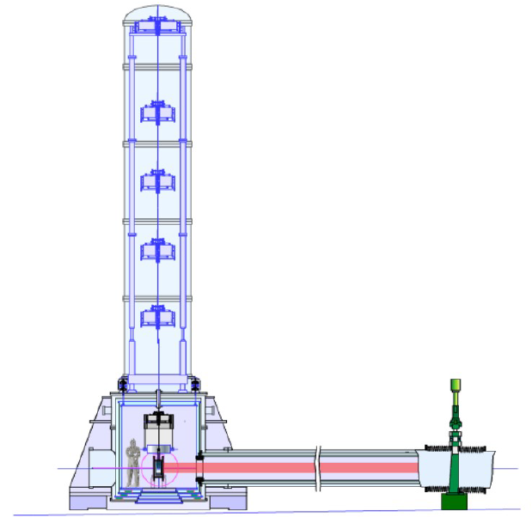
Managing complexity: Product Breakdown Structure (PBS)
PBS lv. 3: ITM Tower
PBS lv. 4: Core Optics
(Example: AdVirgo+ phase II Payload)
Note: the PBS system decomposition in this presentation serves as an example and does not directly correspond to the latest PBS release (found here)

Slide 5
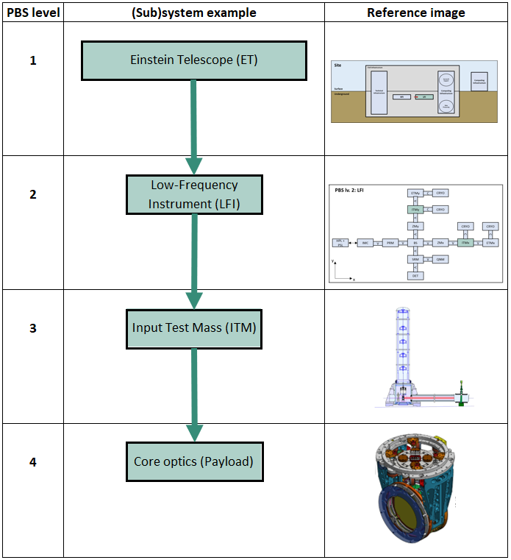
Managing traceability: Requirements framework
Each PBS element has Configuration Items (CI) attached
Requirements
Layouts (cross-cutting views)
Design Parameters (specifications)
Verification Plans
Risks
(from the Objectives)
(Functional, physical, optical, data, electronics, …)
Science Objectives
Project Objectives
PBS lv. 1
ET Requirements (R) + Layouts (L)
ET Design Parameters
ET Verification and Validation
~
PBS lv. 2
Other system R+L
LFI R+L
LFI Design Parameters
LFI Verification and Validation
PBS lv. 3
Other subsystem R+L
ITM R+L
ITM Tower Design Parameters
ITM Tower Verification and Validation
PBS lv. 4
Other subsubsystem R+L
Payload R+L
Payload Design Parameters
Payload Verification and Validation
…
PBS lv. n
…
PBS lv. n
…

Slide 6
What does a requirement look like?
Traceable: each requirement is traceable in the directions:
→ Up: to S&P objectives or higher-PBS level system requirements
→ Down: to lower-PBS level requirements – the trace ends at the integration specifications
→ In-plane (interfaces and dependencies): to related systems on the same PBS level
Verifiable: each requirement is structured and worded such that its realization can be proven – immediately or in the future
Implementation-free: a requirement is an expression of a need, it does not define a design solution to satisfy a problem
Singular: each requirement states a single capability, characteristic, constraint or quality factor
→ ‘How’ to solve for the requirement should be described in the design parameters
Conforming: each requirement must conform to an approved standard template (characteristics and attributes) and writing style
Consistent: the requirements set contains individual requirements that are unique, do not conflict with or overlap with other requirements in the set
R1
R1a
R1b
R1c
R1b-a
R1b-b
Contents
Traceable
Verifiable
Contents

Slide 7
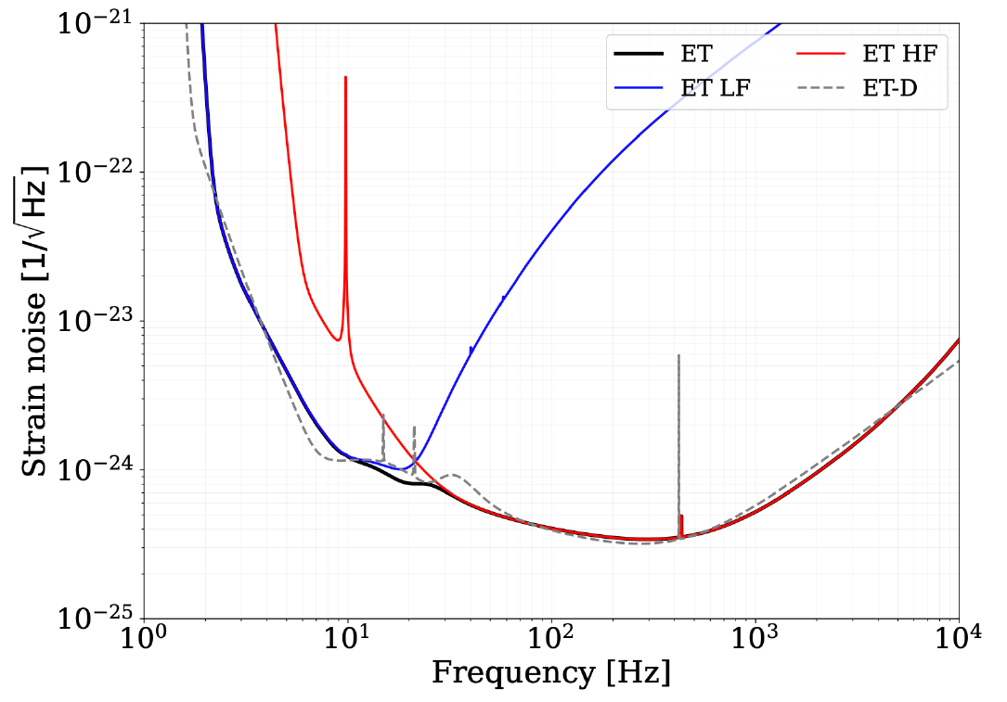
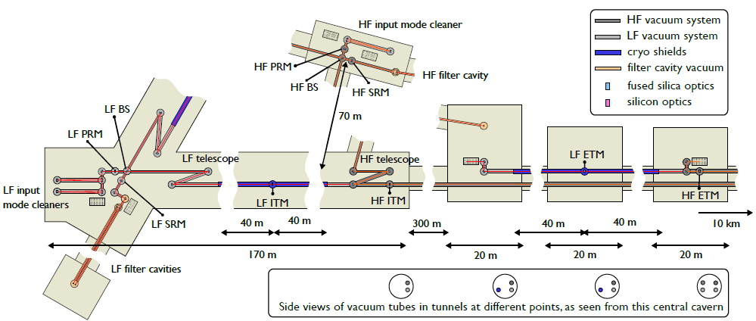
Traceability example 1: flowdown
Traceability from Science Objective to PBS lv. 2 Design Parameter
BBH
PBS lv. 1
PBS lv. 2

Slide 8
Traceability example 2: Cross-cutting dependency
PBS lv. 1
Civil Infrastructure
HFI
PBS lv. 2
Cross-cutting dependency (spatial)
PBS lv. 3
PBS lv. 4

Slide 9
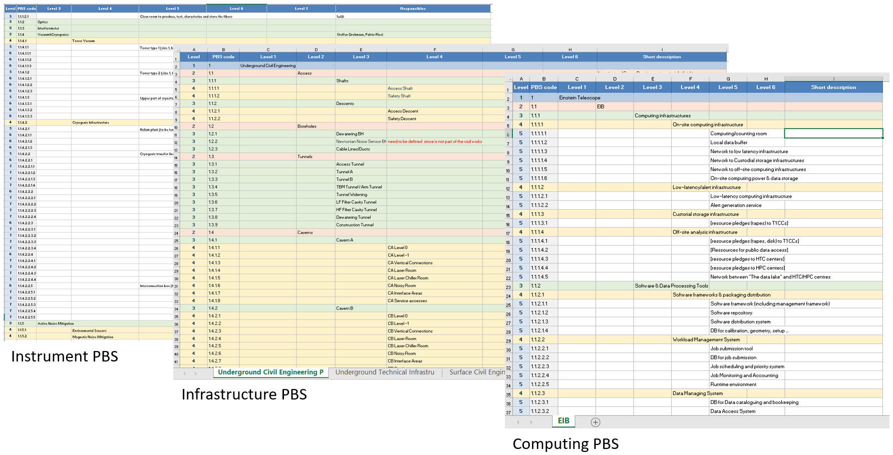
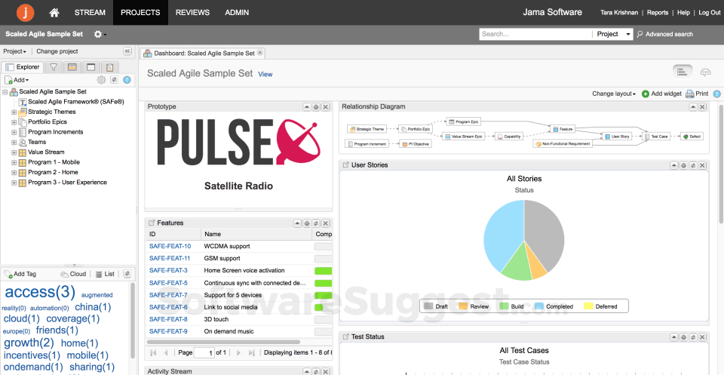
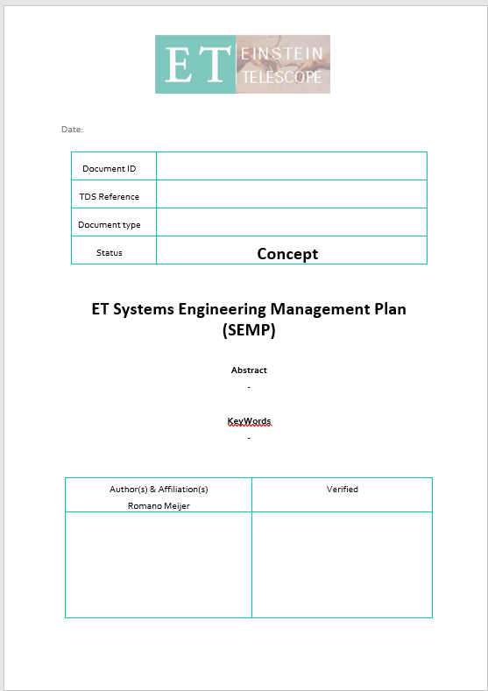
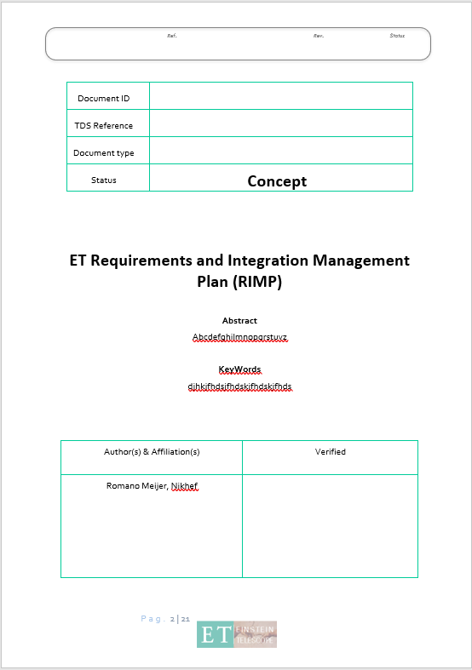
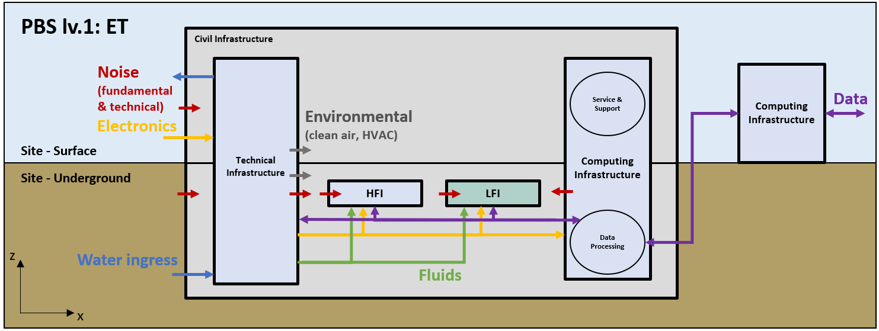
ET-SE: how to proceed
Top-down
Science objectives campaign
High-level system requirements campaign
Development of common RM tools to professionalize and centralize
Bottom-up
System requirements campaign
Step 1: functional & performance requirements (parameter files – functional (integration))
Step 2: interface requirements (parameter files – integration)
PBS reviews
High-level system requirements
Requirements Management tools
Science objectives
Interface requirements
Functional & performance requirements
SE&RM process drafts

Slide 10
Reference literature
International standards
ISO/IEC 15288:2023 – “Systems engineering – System life cycle processes”
ISO/IEEE/IEC 29148:2018 – “Systems and software engineering – Requirements engineering”
Books
“Applied Space Systems Engineering” by Larson, Kirkpatrick, Sellers, Thomas and Verma (2009)
“Systems Engineering – Fundamentals and Applications” by Haberfellner, de Weck, Fricke and Vössner (2019)
INCOSE Systems Engineering Handbook (2006)
NASA Systems Engineering Handbook Vol. 1 (2016)
Other examples
Fermilab (PIP-II): Systems Engineering Management Plan (2020)
Fermilab (PIP-II): Requirements Management Plan (2020)
ESO E-ELT: Systems engineering plan for the construction phase of the E-ELT (2014)
ESO E-ELT: Requirements Management Plan (2014)
ESO E-ELT: Requirements flow down (2016)
Literature selection on wiki page: https://wiki.et-gw.eu/Main/PBSWorkingGroup/PBSReview
Contact: r.meijer@nikhef.nl

Slide 11
Requirements synthesis guidelines

Slide 12
Requirement set characteristics
Traceable: each requirement is traceable in the directions:
→ Up: to S&P objectives or higher-PBS level system requirements
→ Down: to lower-PBS level requirements – the trace ends at the integration specifications
→ In-plane (interfaces and dependencies): to related systems on the same PBS level
Verifiable: each requirement is structured and worded such that its realization can be proven – immediately or in the future
Implementation-free: each requirement states what is necessary, not how this need should be met
Singular: each requirement states a single capability, characteristic, constraint or quality factor
→ ‘How’ to solve for the requirement should be described in the design parameters
Conforming: each requirement must conform to an approved standard template (characteristics and attributes) and writing style
Consistent: the requirements set contains individual requirements that are unique, do not conflict with or overlap with other requirements in the set
R1
R1a
R1b
R1c
R1b-a
R1b-b
Contents

Slide 13
Single requirement attributes
Traceability
Verifiability
and Contents
PBS ID: to mark the PBS element to which the requirement is attached
Configuration Item (CI) ID: unique requirement identifier
Parent ID: parent requirement ID to satisfy the traceability characteristic
Owner: the person who has authority and responsibility to change the requirement
Validation status: current level of requirement validation (Assumption (A), Simulation/ Modelling or Analysis (M), Inspection (I), Demonstration (D) or Formal Test (T))
Validation target: desired level of requirement validation (A, M, I, D or T)
Name: auto-generated, recognizable abbreviation in the form of: [PBS ID_Requirement class_Requirement ID]
Requirement: a description of the requirement conforming to the standardized requirement characteristics and writing guidelines
Rationale: a complete explanation of the reasoning behind the requirement. If relevant, include references, sources, (links to) calculations/simulations, etc.
PO preparation, assist & future exercise
Priority: an indication of importance to define Key Performance Parameters (KPPs) and allow for filtering (KPP – Essential – Conditional – Optional)
Type: to cluster the requirements into manageable categories
Expert inputs
Format: [PBS ID] – [CI_Class] – [CI_ID] – [Parent ID] – [Owner]
– [Priority] – [Type] – [Val. status] – [Val. target]
– [NAME: TMSU_REQ_00005] – [Requirement] – [Rationale]

Slide 14
Requirements type – examples
Functional
System capabilities and characteristics
Behavioral sequences
Operating modes
Performance
High-level PBS: ASD strain sensitivity
Low-level PBS: mechanical tolerances, electrical interference levels, optical power stability, …
Interface
System inputs, outputs and connections, including:
Desired: (mechanical connection, electrical, data, fluid in/out, …)
Undesired: (acoustic, thermal, electrical, magnetic noise, …)
System Usability
Reliability: failure rate, component and system lifetime, probability of failure, …
Maintainability: mean time to repair, maintenance accessibility, ease of maintenance, identification of field replaceable units (FRUs), …
Operability: ease of everyday use, ergonomics, human-machine interactions, automated monitoring, …
Availability: % of operational availability, length of continuous duty cycle, …
Design Constraints
Caused by design parameters in other (sub)systems
Mass properties
Maximum/minimum dimensions
Standardization (off-the-shelf product interaction)
Safety and Security
Instrument ‘design-for-failure’ considerations
Data safety and security standards
Human safety and security standards
Operational Constraints
Material supply and shipping
Underground space for logistics
On-site construction and assembly facilities
Cleanliness
Local legislative constraints
Cost
Schedule
Type | Requirement
Functional | “The Infrastructure shall provide underground space for the HFI and LFI instruments”
Performance | “The High-Frequency Interferometer (HFI) ASD strain sensitivity shall remain < 3*10^-25 between frequencies 0,8-2 Hz”
Interface (Noise) | “Infrastructure Newtonian Noise propagation to the HFI shall remain below an ASD strain sensitivity of 2*10^-25”
Availability | “The LFI shall have a minimum time between recalibration sequences of at least 72 hrs”
Design constraint | “The LFI-ITM and LFI-ETM cryostats shall be dimensioned within a design volume of 5x5x6 (lxwxh) [m]”

Slide 15
ET requirements writing guidelines
Category
Subjective language
Vague pronouns
Ambiguous terms
Open-ended statements
Comparative and superlative phrases
Negative statements
Loopholes
Language to be avoided
‘user friendly’, ‘easy to use’, ‘cost-effective’, ‘adequate’, ‘sufficient’, …
‘it’, ‘this’, ‘that’, …
‘minimize’, ‘et cetera’, ‘robust’, ‘high speed’, ‘’, …
‘provide support’, ‘but not limited to’, ‘as a minimum’
‘better than’, ‘higher quality’, ‘best’, ‘most’
‘not provide’, ‘not exceed’, ‘not be able to’
‘if possible’, ‘as appropriate’, ‘as applicable’
Practical examples (Incorrect (I) / Correct (C))
I: “The design of the ET-HF manual operation user interface shall be user friendly.”
C: “The design of the ET-HF manual operation user interface shall follow the ISO 9241-161:2016 – ‘Ergonomics of human-system interaction’ standard.”
I: “This system shall supply liquid helium to the ITM cryostat.”
C: “The cryogenic plant shall supply liquid helium to the ITM cryostat.”
I: “The ET-LF maintenance downtime shall be kept to a minimum.”
C: “The ET-LF maintenance downtime shall remain between 0-3% of total ET-LF runtime.”
I: “Underground cavern A will provide support for the laser source, PRM, SRM, BS, ITM and TELE towers.”
C: “The laser source, PRM, SRM, BS, ITM and TELE towers will be placed within underground cavern A.”
I: “The laser source cleanroom air cleanliness shall be of higher quality compared to the surrounding cavern”
C: “The laser source cleanroom air cleanliness shall correspond to the 2024 ISO 3 classification”
I: “The cavern A laser room doors shall not provide access to operators while the laser system is active”
C: “The cavern A laser room doors shall remain closed to operators while the laser system is active”
I: “If possible, the instrument local data storage buffer shall be placed in an underground cavern”
C: “The local instrument local data storage buffer shall be placed in an underground cavern” [Prio: optional]
Following the INCOSE and EARS requirements language standards

Slide 16
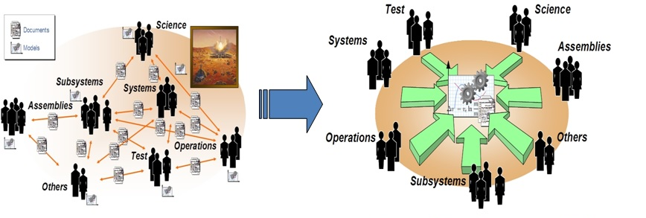
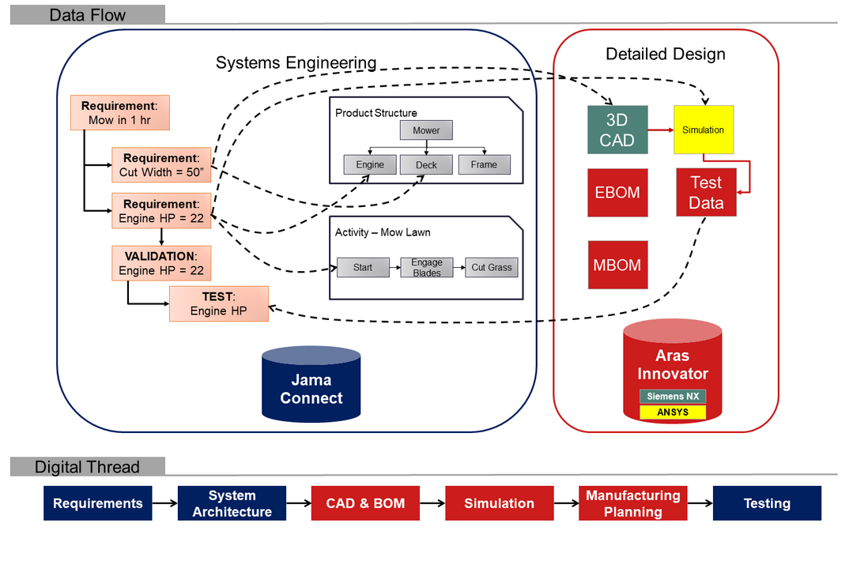
Spare: Model-Based Systems Engineering (MBSE)
Document-based
Decentralized, no single baseline source
Configuration items (Requirements, design parameters, test plans, risks) in separate documents
Traceability: documents point to other documents
ET short-term: good way to start
ET long-term: not sustainable
Model-based
Central relational database as single baseline source
Configuration items in single database
Traceability: configuration items point to each other in database
Documents are compiled from the database
ET short-term: not yet available, trials done, must be developed
ET long-term: necessary for traceability
Digital thread
Use a Requirements Management tool (ex. Jama) for requirements, system architecture and testing specification
Use specialized tools (PLM, CAD, simulation, Matlab/Simulink) for detailed design
Synchronize the SE and detailed design tools for continuity

Slide 17
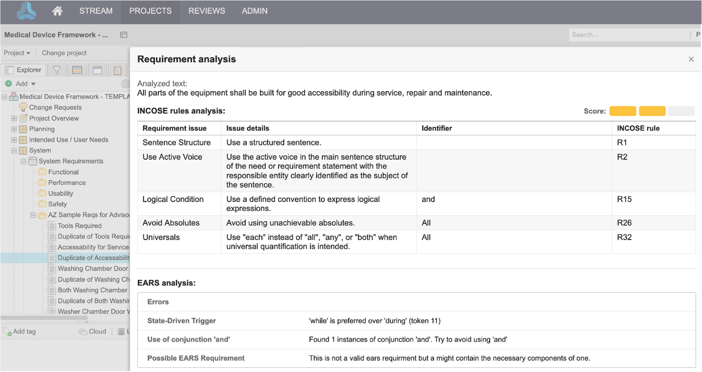
Spare: MBSE and modern Requirements Management tools
Requirements framework
Requirements writing check
PBS decomposition

