Slide 1
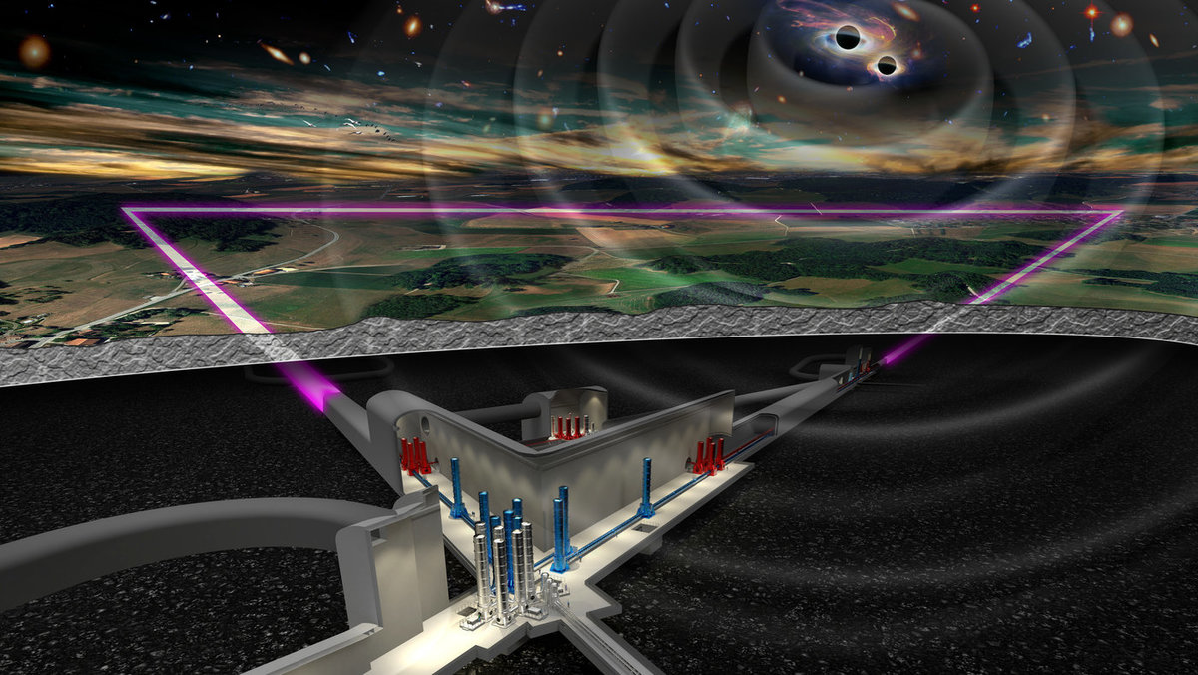
Risk Management
XIV ET Symposium | Maastricht
Ghada MAHMOUD – ET Project Office
mahmoud@apc.in2p3.fr

Slide 2
Context
A well functioning Product (detector)
Ideas
A full procedure
Project Managers : deliver tools – techniques – skills – knowledge to make sure the scope of a project is met on time and doesn’t exceed its budget. (Managing Tasks )
Systems Engineers: Making sure The goal of Project Management (scope-cost-time) is delivered to Project Members.
( Bridge )
Example : assessing project requirements , overseeing risk management activities …
Scientists : Responsible of the good functioning of the detector
Engineers : Responsible of building a safe frame for the detector to protect it from the external environment and help scientists achieving their goal in a good environment.

Slide 3
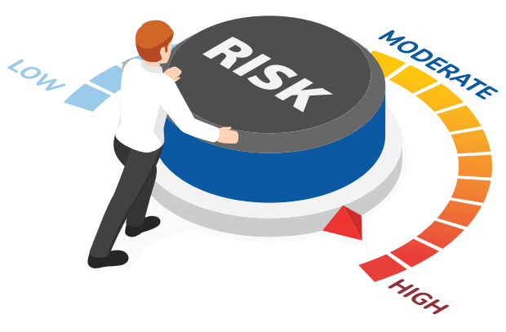
What is a Risk
Risk arises from the potential occurrence of specific hazard during a project's lifecycle.
This Hazard can affect the project, leading to impacts on cost, schedule, technical performance, safety, and other critical areas….
Risks are defined by their Criticality = Likelihood * Severity
- Likelihood Represents the chance this particular hazard will occur
- Severity quantify the impact of this hazard occurrence on a project ….

Slide 4
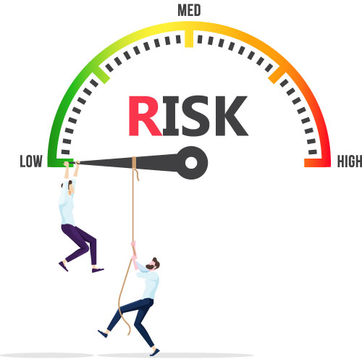
What to do ?
1- Develop Strategies:
Where we define all the different parties that contribute to Risk studies,
Also we define on what to study, when and how often,
2- Establish Processes :
In order to define the steps necessary for effective risk management.
3- Formulate a Risk Management Plan:
which is the final document that provides processes to be followed, responsibilities for each activity and policies and deliver Tools and Templates to aid in Risk Management.
- Conventions: Clear policies (Likelihood Scale, Severity Scale, Criticality Matrix … ) and processes for risk management.
- Templates & Tools
4- Conduct Risk Analysis :
identifying + assessing + responding to + controlling + reviewing risks throughout the project's lifecycle.

Slide 5
ET Risk Domains
Risk Domain
Technical
Financial
Schedule
Environmental
Political
Communication
Super-attenuator Operational Failures
Sudden increase in some materials prices affecting the cost
Some design Approval Delays
High energy use by the cryogenic systems raising concerns about carbon footprint
Organizational
Safety
Scope
A change in government leading to shifts in science funding priorities.

Slide 6
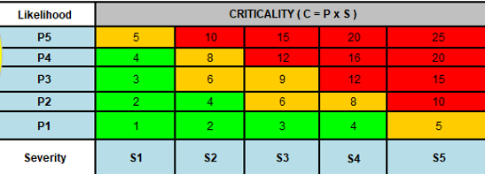
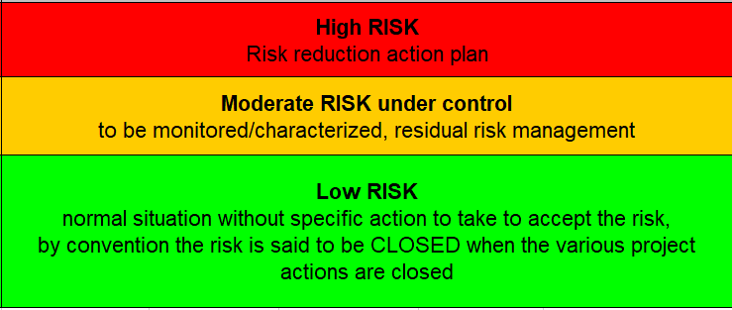
Risk Analysis
Risk Analysis :
Common convention that is adopted within a collaboration to study the risks and know how to deal with them .
It must be carried out at all the different phases of the project.
Risk Planning
Risk Identification
Risk Assessment
Plan Risk Responses: Accept/ Close / Avoid / Transfer / Mitigate
Implement Risk Responses
Monitor and control
Risk Planning
Monitor and control
Risk Identification
Implement Risk Responses
Risk Assessment
Plan Risk Responses: Accept/ Close / Transfer / Mitigate

Slide 7
Our Procedure in a minute:
We identify Risks + Causes ( Responsible of the Risk ) + Impacts ( The person to whom we transfer the Risk )
Cause : we know better the origin of the problem and what are the actions that we should take
Impact : We define better the person in charge to help with taking the action to respond to the Risk
Risk identification
Risk Assessment
2 steps :
You assess your Risks to accelerate the second campaign (Subsystems Groups )
we reassess together the Risks ( Risk board)

Slide 8
Conclusion:
A Comparative Risk Analysis is necessary for a design / Site Trade off as ETRAC is doing .
Risk Analysis is a very important for all the phases of the project that’s why we should keep building strategies, processes, policies and tools to aid with Risk Management, Then we should deliver a final Risk Management Plan (for all the phases of the project).
We’re initiating a Risk Campaign to study and analyze together Risks of your Groups / Systems, We will arrange together sessions for this aim.

