Slide 1
July 2024
EuroHPC JU
Supercomputing Infrastructure state-of-play

Slide 2





The EuroHPC Supercomputer Ecosystem
Operational
Lumi (FI)
Arrhenius (SE)
Preparing for RFP
EXASCALE
Under Construction
Operational
Operational
PRE-EXASCALE
JUPITER (DE)
Karolina (CZ)
MeluXina (LU)
Alice Recoque (FR)
Operational
PETASCALE
Preparing for RFP
Vega (SI)
Operational
Discoverer (BG)
MID-RANGE
Operational
Leonardo (IT)
Operational
Deucalion (PT)
Operational
MareNostrum 5 (ES)
RFP launched
Pre-production
Pre-production
Daedalus (GR)

Slide 3
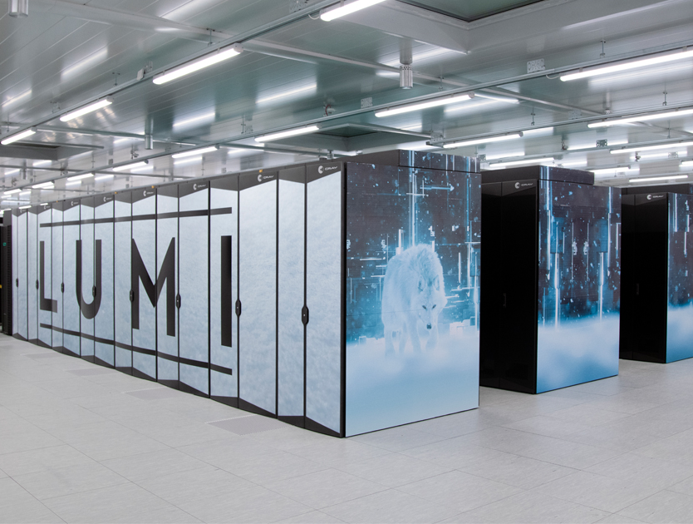
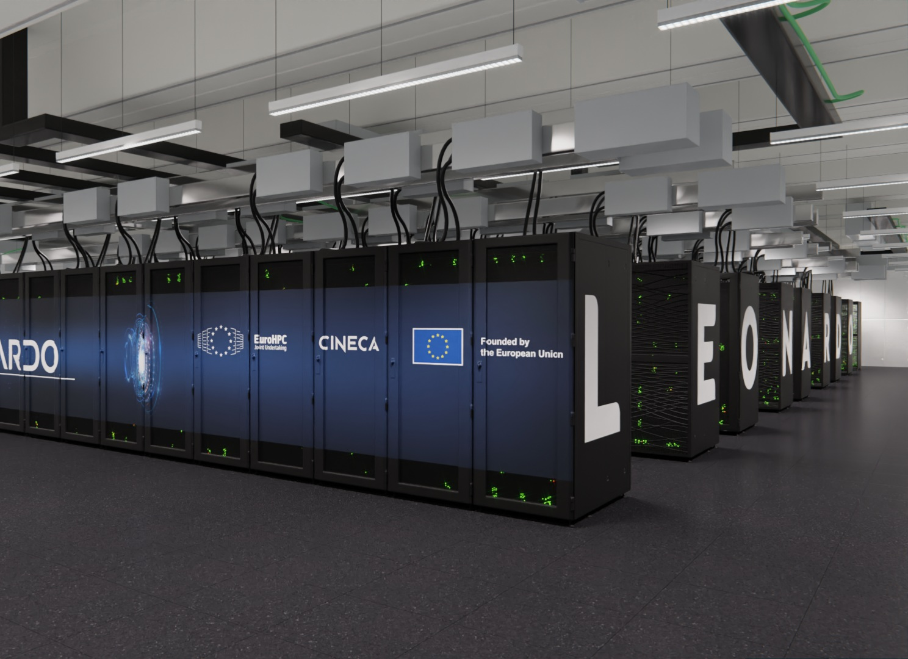
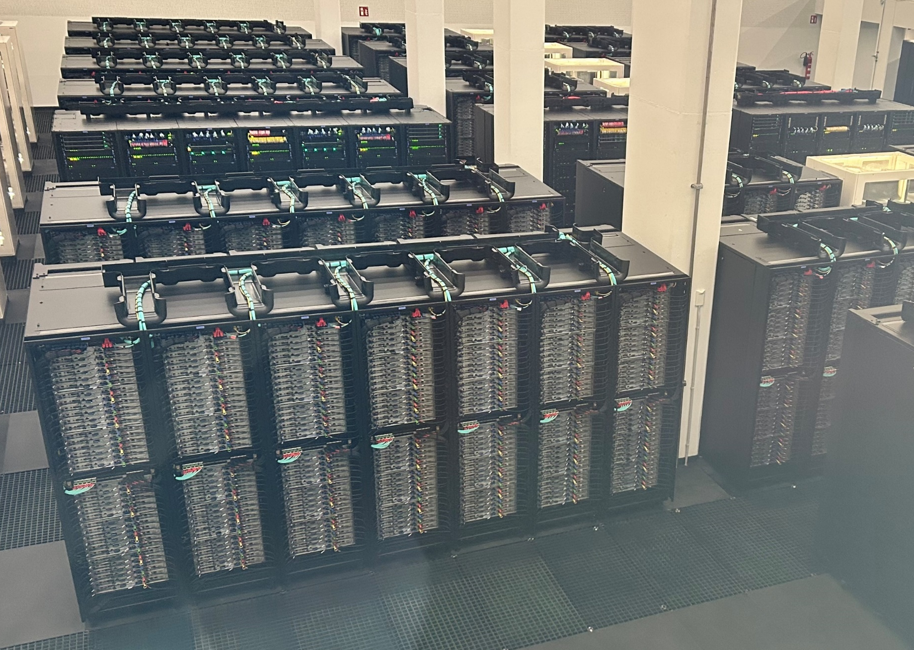
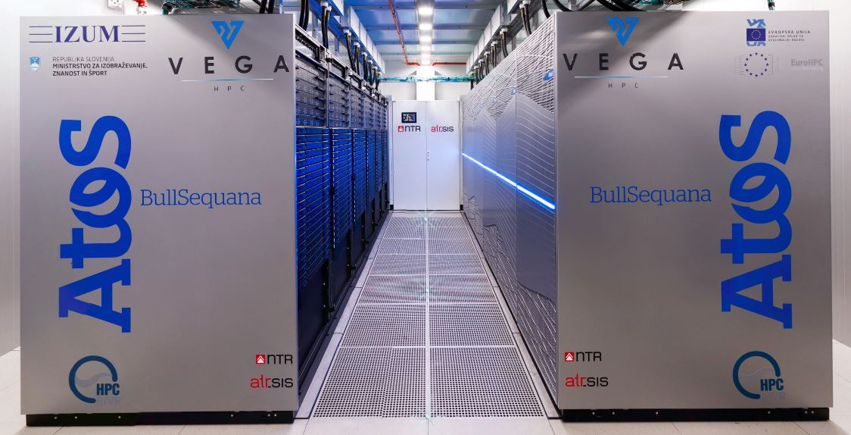
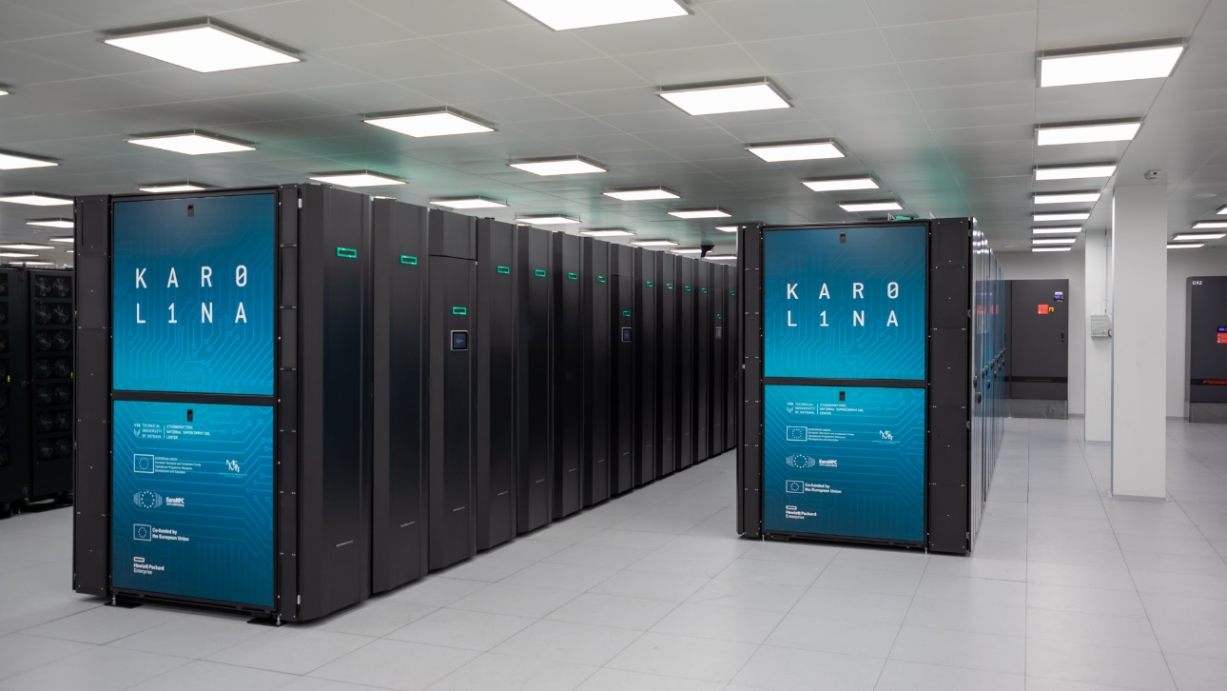
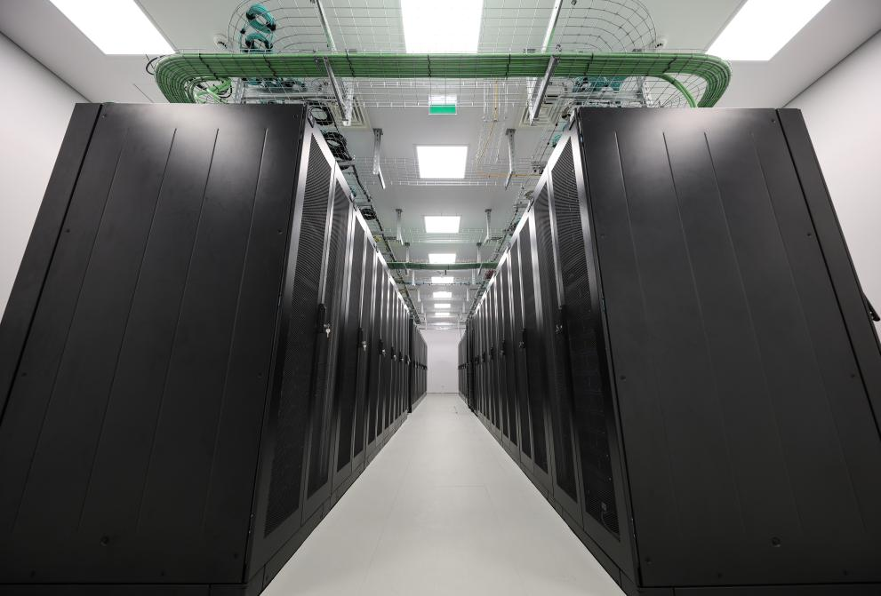
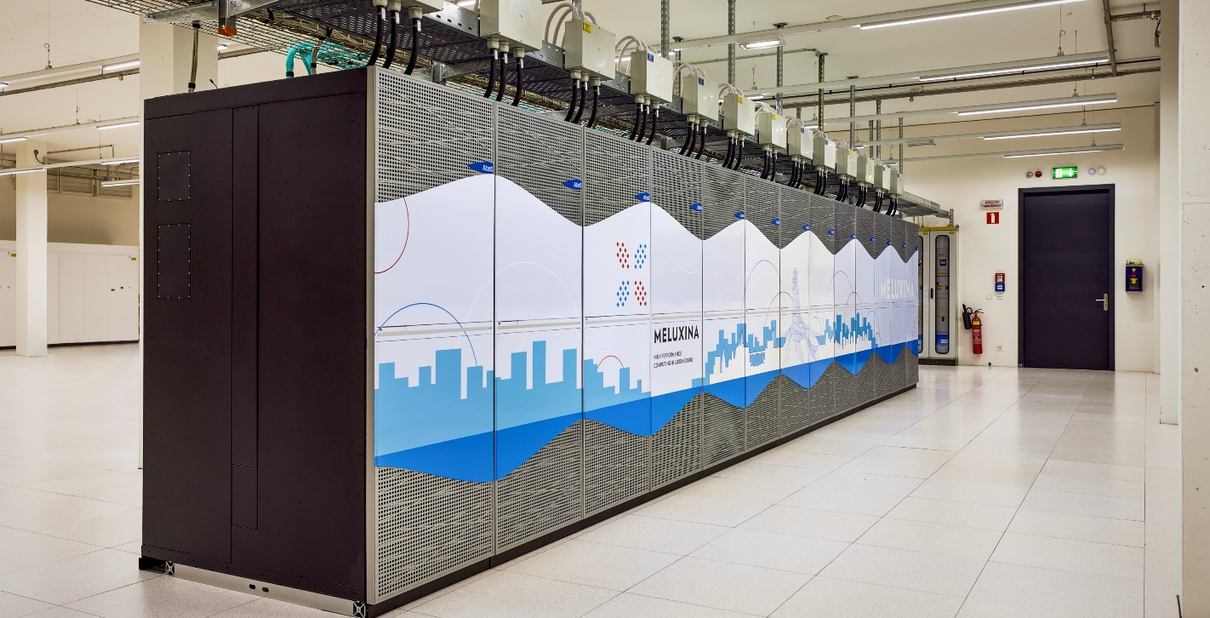
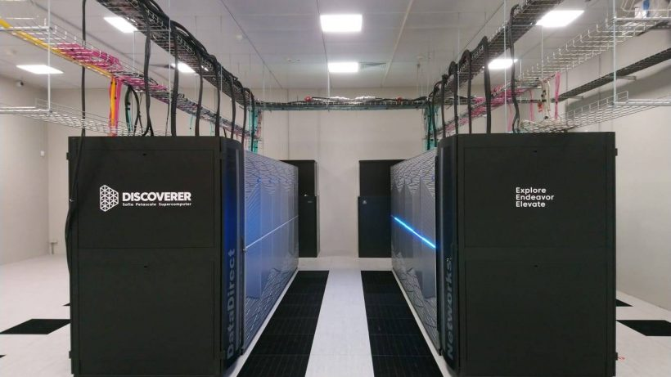
Available EuroHPC supercomputers
EuroHPC systems in numbers
893 PFlops
Aggregated sustained Linpack performance
20 partitions
15597 CPU Nodes (AMD/Intel x86 and Fujitsu ARM)
7869 GPU Nodes
43476 GPUs (NVidia A100/H100, AMD MI250X)
Other: FPGA, Visualisation and Cloud capabilities
LUMI (CSC)
Kayaani, Finland
Leonardo (CINECA)
Bologna, Italy
MareNostrum 5 (BSC)
Barcelona, Spain
Cray EX, Hewlett Packard Enterprise
#5 Top500 (May 2024): 379.7 PFlops (LUMI-G)
Atos BullSequana XH2000
#7 Top500 (May 2024): 241.2 PFlops (BOOSTER)
Atos BullSequana XH3000 / Lenovo ThinkSystems
#8 Top500 (May 2024): 175.3 PFlops (GPU Partition)
#22 Top500 (May 2024): 40.1 PFlops (CPU Partition)
Vega
Karolina
Deucalion
Fujitsu FX700 (Arm) / Atos (x86)
MeluXina
Discoverer
Atos BullSequana XH2000
HPE Apollo
Atos BullSequana XH2000
Atos BullSequana XH2000

Slide 4
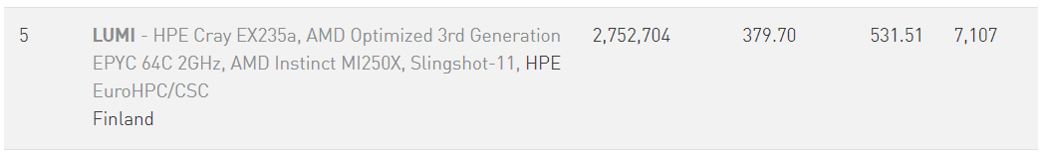

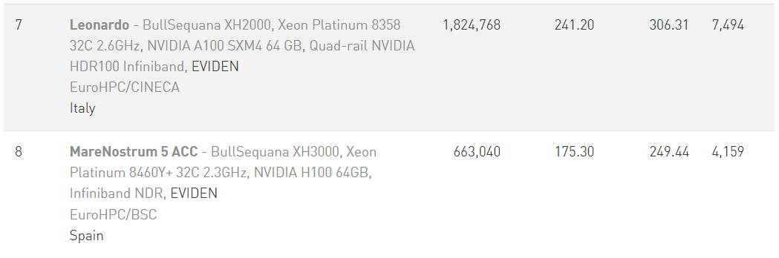
Latest Top500 results (EuroHPC Systems in Top10)

Slide 5


The EuroHPC Ecosystem
Lumi (FI)
Arrhenius (SE)
EXASCALE
CASPIr (IE)
EHPCPL (PL)
PRE-EXASCALE
MeluXina (LU)
JUPITER (DE)
Karolina (CZ)
Alice Recoque (FR)
LEVENTE (HU)
PETASCALE
Vega (SI)
Discoverer (BG)
MID-RANGE
Leonardo (IT)
Deucalion (PT)
MareNostrum 5 (ES)
Daedalus (GR)

Slide 6
Hyperconnected …
Lumi (FI)
EuroHyPerCon study
Analysis of current state-of-the art
Stakeholder consultation
Needs analysis
Blueprint of the next decade connectivity
https://eurohypercon.eu/
Results of the study will guide a connectivity services procurement
Arrhenius (SE)
EXASCALE
CASPIr (IE)
EHPCPL (PL)
PRE-EXASCALE
MeluXina (LU)
JUPITER (DE)
Karolina (CZ)
Alice Recoque (FR)
LEVENTE (HU)
PETASCALE
Vega (SI)
Discoverer (BG)
MID-RANGE
Leonardo (IT)
Deucalion (PT)
MareNostrum 5 (ES)
Daedalus (GR)

Slide 7
… and Federated
Lumi (FI)
Resource Federation one of the key pillars of EuroHPC activities
Authentication, Authorization and Identification services (AAI)
Computing services
        Interactive Computing
        Cloud access – Virtual Machines - Containers
Data services
Archival Services and Data repositories
Data mover / transport services
User and Resource management
Arrhenius (SE)
Federation services
Procurement process ongoing
Competitive Dialogue: Preparing Final RFP
Tendering phase to start: July 2024
Start of implementation: End-2024
EHPCPL (PL)
Meluxina (LU)
JUPITER (DE)
Karolina (CZ)
JULES VERNE (FR)
LEVENTE (HU)
Vega (SI)
Discoverer (BG)
Leonardo (IT)
Deucalion (PT)
MareNostrum 5 (ES)
Daedalus (GR)
Daedalus (GR)

Slide 8
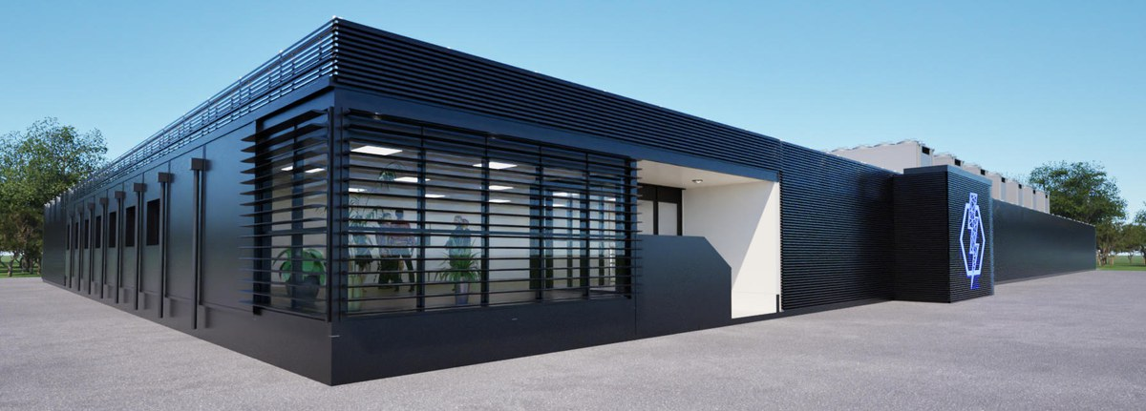
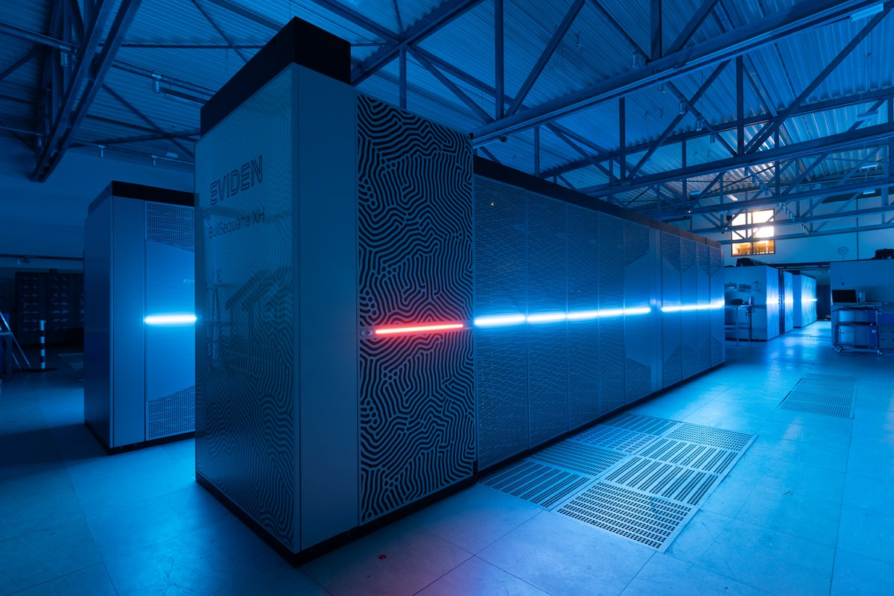
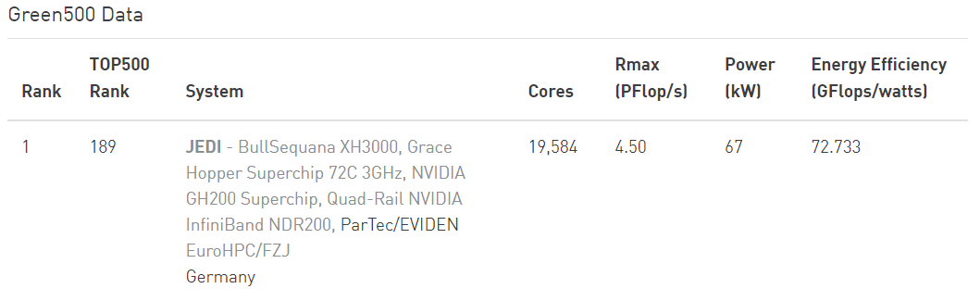
JUPITER
1st Exascale system in Europe
ARM system based on NVidia GH200 and SiPearl Rhea1
JUPITER Research and Early Access Program (JUREAP) ongoing
  Will enable users to test the new architecture the earliest possible. https://www.fz-juelich.de/en/ias/jsc/jupiter/jureap/call-for-participation/
  EuroHPC is collaborating with JSC to enable early access to European Users on the JU’s time share
JEDI (JUPITER Exascale Development Instrument) installed benchmarked in May - #1 in Green500 - Offers 24 nodes identical to JUPITER
A low-rise building consisting of around 50 containers will house the JUPITER exascale computer on the Jülich campus (computer animation). Image: Eviden
The JUPITER Exascale Development Instrument (left, orange) at the the Jülich Supercomputing Centre. Copyright: Forschungszentrum Jülich / Ralf-Uwe Limbach

Slide 9




Jules Verne : The French led Exascale project
A French/NL consortium
GENCI (FR) Hosting Entity
CEA (FR) Hosting Site
SURF (NL) as member of consortium
Full TCO over 5 years: 542 M€
(50% EuroHPC, 50% consortium)
Goal: Deploy a world-class Exascale supercomputer, based on European hardware and software technologies, addressing European major societal and scientific challenges via the convergence at scale of numerical simulations, massive data analysis and artificial intelligence.
Procurement expected to launch July 2024 (Competitive Dialogue)
Start of installation Q4 2025
Operational by Q2 2026
9

Slide 10
EuroHPC System Access
Offering 90 Million node hours per year across the 8 EuroHPC supercomputers in Europe
Research/Innovation/Industry/SMEs/Public Sector
EU Strategic Initiatives
Special AI access mode (New!)
Various opportunities for access (Production, Benchmark, Development)
7 access modes (3 peer-reviewed)
Rigorous peer-review selection process based on scientific/innovation excellence
More info: https://eurohpc-ju.europa.eu/access-our-supercomputers_en

Slide 11
ACCESS TO EUROHPC SUPERCOMPUTERS
  WHO IS ELIGIBLE?
Academic and research institutions (public and private)
Public sector organisations
Industrial enterprises and SMEs
Established in the EU or H2020 affiliated country
            Open to all fields of research
    WHICH TYPES OF ACCESS EXIST?
    Multiple access modes to serve different demands and application areas
    Defined in the EuroHPC Access Policy approved by the JU Governing Board.
    https://eurohpc-ju.europa.eu/access-our-supercomputers/access-policy-and-faq_en
WHAT ARE THE CONDITIONS FOR ACCESS?
Access is free of charge. Participation conditions depend on the specific access call that a research group has applied to.
In general users of EuroHPC systems commit to:
use computing resources primarily for research and innovation
acknowledge the use of the resources in their related publications
contribute to dissemination events
produce and submit a report after completion of a resource allocation

Slide 12
EuroHPC Access opportunities
Calls for preparatory activities
BENCHMARK ACCESS CALL
- For scaling tests & benchmarks
- Fixed amount of allocation for 2 or 3 months
- Continuously open with monthly cut-offs
- Results and access to system: 2 weeks from cut-off date
DEVELOPMENT ACCESS CALL
- For code and algorithm development
- Fixed amount of allocation for 6 or 12 months
- Continuously open with monthly cut-offs
- Results and access to system: 2 weeks from cut-off date
Calls for production activities
REGULAR ACCESS CALL
- For projects that require large-scale HPC resources
- Allocation duration: for 12 months
- Continuously open with 2 cut-offs per year
- Peer-review process duration: 4 months
EXTREME SCALE ACCESS CALL
- For high-impact, high-gain projects that require extremely large-scale HPC resources
- Allocation duration: for 12 months
- Continuously open with 2 cut-offs per year
- Peer review process duration: 6 months
AI AND DATA INTENSIVE APPLICATIONS ACCESS CALL
- For projects intending to perform artificial intelligence and data-intensive activities
- Fixed allocation for 12 months on first-arrived-first basis
- Bimonthly cut-offs
- Peer-review process duration: 1 month

Slide 13
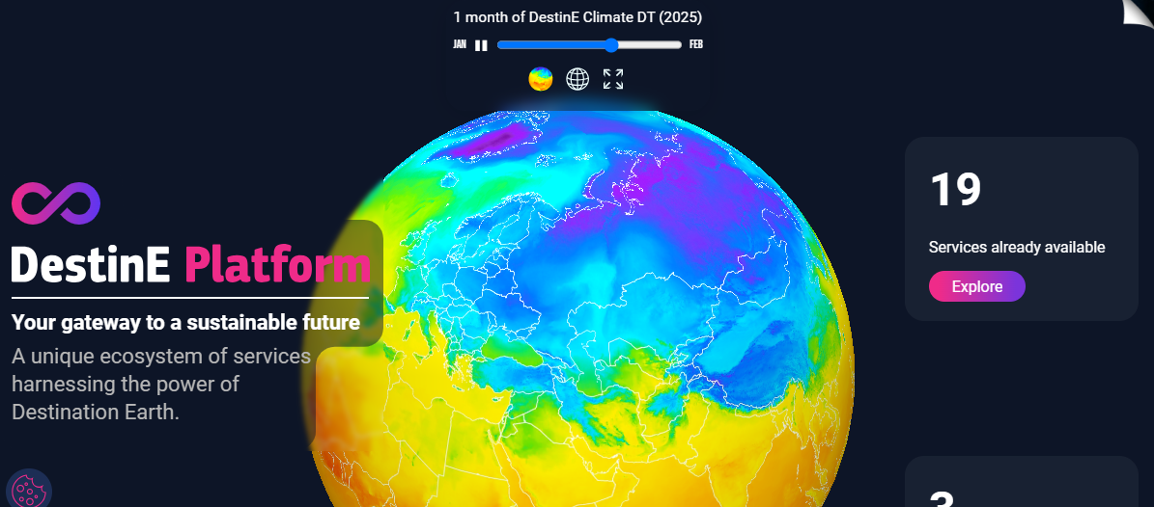

Strategic Applications
Governing Board decision - Allocating 10% of EuroHPC resources.
Currently 2 strategic initiatives selected:
  Destination Earth (LUMI, Leonardo, MN5, MeluXina)
    - Officially launched on 10 June.
  AI Grand Challenge
    - 5 Applications awarded access to LUMI-G (2x2M GPU hours), Leonardo BOOSTER (2x2M GPU hours each), MN5 ACC(1x800k)

Slide 14

Access Calls cut-offs – Regular, Extreme Scale and AI Access
UPCOMING CUT-OFFS IN 2024:
EXTREME SCALE ACCESS – 03 October 2024
REGULAR ACCESS – 06 September 2024
AI AND DATA INTENSIVE APPLICATIONS ACCESS – 13 September 2024
REGULAR ACCESS:
December 2021
March 2022
July 2022
November 2022
March 2023
July 2023
November 2023
March 2024 (completed evaluation)
EXTREME SCALE ACCESS:
December 2022
May 2023
October 2023
April 2024 (under evaluation)
AI AND DATA INTENSIVE APPLICATIONS ACCESS :
April 2024
June 2024 (under evaluation)
April 2024
December 2022
May 2023
April 2024
December 2021
July 2022
March 2023
November 2023
March 2022
November 2022
July 2023
March 2024
October 2023
June 2024

Slide 15
Extreme Scale Access statistics – proposal numbers
Total 55 proposals awarded

Slide 16
Extreme Scale Access statistics – overall resources distribution
AWARDED RESOURCES ACROSS ALL CUT-OFFS IN CORE AND NODE HOURS
Cut-offs | CORE HOURS |  |  |  |  |  | NODE HOURS
Cut-offs | Leonardo DCGP | Leonardo Booster | LUMI-C | LUMI-G | MareNostrum5 GPP | MareNostrum5 ACC | Leonardo DCGP | Leonardo Booster | LUMI-C | LUMI-G | MareNostrum5 GPP | MareNostrum5 ACC
Dec 2022 | 0 | 200,000,000 | 826,700,000 | 689,000,000 | 0 | 0 | 0 | 6,250,000 | 6,458,594 | 10,765,625 | 0 | 0
May 2023 | 0 | 144,659,008 | 436,667,904 | 505,024,000 | 0 | 83,740,000 | 0 | 4,520,594 | 3,411,468 | 7,891,000 | 0 | 2,616,875
Oct 2023 | 0 | 112,400,224 | 249,973,376 | 273,881,600 | 44,800,000 | 121,982,848 |  | 3,512,507 | 1,952,917 | 4,279,400 | 400,000 | 3,811,964
Total | 0 | 457,059,232 | 1,513,341,280 | 1,467,905,600 | 44,800,000 | 205,722,848 | 0 | 14,283,101 | 11,822,979 | 22,936,025 | 400,000 | 6,428,839
HPC Centre | Core hours awarded | Node hours awarded
CSC (FI) | 2,981,246,880 | 34,759,004
CINECA (IT) | 457,059,232 | 14,283,101
BSC (ES) | 250,522,848 | 6,828,839
TOTAL | 3,688,828,960 | 55,870,944
55.8 million node hours awarded via the Extreme Scale Access call

Slide 17
Regular Access statistics – proposal numbers
Total 160 proposals awarded

Slide 18
Regular Access statistics – awarded resources
AWARDED RESOURCES (NODE HOURS) ACROSS ALL CUT-OFFS
Cut-offs | Vega CPU | Vega GPU | MeluXina CPU | MeluXina GPU | Karolina CPU | Karolina GPU | Discoverer CPU | LUMI-C | LUMI-G | Leonardo Booster | Leonardo DCGP | MareNostrum5 GPP | MareNostrum5 ACC
Dec-21 | 328,125 | 31,923 | 0 | 173,325 | 177,344 | 0 | 156,250 | 1,865,234 | 0 | 0 | 0 | 0 | 0
Mar-22 | 882,160 | 7,813 | 0 | 147,344 | 151,563 | 0 | 135,240 | 281,142 | 0 | 0 | 0 | 0 | 0
Jul-22 | 1,102,710 | 104,688 | 122,200 | 227,600 | 273,438 | 56,250 | 0 | 1,343,281 | 0 | 0 | 0 | 0 | 0
Nov-22 | 508,049 | 29,688 | 468,750 | 163,705 | 392,896 | 49,297 | 890,625 | 2,488,506 | 0 | 0 | 0 | 0 | 0
Mar-23 | 763,573 | 0 | 493,753 | 125,781 | 468,750 | 46,875 | 990,005 | 0 | 0 | 0 | 0 | 0 | 0
Jul-23 | 451,650 | 15,866 | 110,000 | 174,650 | 86,240 | 21,828 | 325,000 | 177,000 | 288,807 | 296,810 | 53,177 | 36,938 | 0
Nov-23 | 604,400 | 50,000 | 511,719 | 190,320 | 493,900 | 48,000 | 1,096,000 | 386,500 | 547,520 | 300,563 | 140,000 | 38,724 | 286,404
Total | 4,640,667 | 239,978 | 1,706,422 | 1,202,725 | 2,044,131 | 222,250 | 3,593,120 | 6,541,663 | 836,327 | 597,373 | 193,177 | 75,662 | 286,404
HPC Centre | Node hours awarded | Core hours awarded
IZUM (SI) | 4,880,645 | 624,722,335
IT4I (CZ) | 2,266,381 | 290,096,571
SofiaTech (BG) | 3,593,120 | 459,919,306
LuxProvide (LU) | 2,909,147 | 338,622,963
CSC (FI) | 7,377,990 | 873,396,976
CINECA (IT) | 790,550 | 40,751,760
BSC (ES) | 362,066 | 17,639,000
TOTAL | 22,179,899 | 2,601,922,356
22 million node hours awarded via the Regular Access call

Slide 19
AI and Data Intensive Applications Access call – proposal numbers – April 2024 cut-off
SUBMITTED PROPOSALS – USED AI TECHNOLOGY – APRIL 2024 CUT-OFF
AI technology field | No of submitted proposals using the specific AI technology | % of submitted proposals that use the specific AI technology
Machine Learning | 9 | 45%
Natural Language Processing | 11 | 55%
Generative Language Modeling | 8 | 40%
Deep Learning | 12 | 60%
Vision (image recognition, image generation, text recognition OCR, etc.) | 12 | 60%
Audio (speech recognition, speech synthesis, etc.) | 4 | 20%
Robotic process automation | 1 | 5%
Virtual agents | 0 | 0%
Decision management: Classified and statistical learning methods | 2 | 10%
TOTAL SUBMITTED PROPOSALS | 20

Slide 20
AI and Data Intensive Applications Access call
1st cut-off, April 2024 – Awarded Resources
Cut-off |  | Vega GPU | MeluXina GPU | Karolina GPU | LUMI-G | Leonardo Booster | MareNostrum5 ACC | TOTAL
Apr 2024 | Offer (node hours) | 7 100 | 25 000 | 7 500 | 351 455 | 545 865 | 129 377 | 1 065 918
 | Awarded (node hours) | 0 | 0 | 7 500 | 35 000 | 400 000 | 128 000 | 570 500
 | Subscription | 0% | 0% | 100% | 10% | 73% | 99% | 53%

Slide 21






Thank you!
Keep up with EuroHPC news:
https://eurohpc-ju.europa.eu
@EuroHPC_JU
EuroHPC Joint Undertaking

