Slide 1
SPECTRUM
Tommaso Boccali – INFN Pisa
For the SPECTRUM Team
Einstein Telescope Computing Workshop
Naples - 09/07/2024

Slide 2
Outline
What is SPECTRUM?
Why we think we need ”a” SPECTRUM
The expected outputs
The Community of Practice
Community of Practice → the design
Community of Practice in action

Slide 3
SPECTRUM is …
… our answer to the EU call:
Our idea: data intensive sciences are striving to expand their access to computing resources beyond the “standard” in-house resources
The main obstacles are “mutual understanding” and “ahead planning”
Let’s fix it!
We had to “select” 2 domains for the bid: HEP and RA
But as a matter of fact, no other projects were assigned: we can “expand” to close-by domains (GW!)
The SPECTRUM project aims to deliver a Strategic Research, Innovation and Deployment Agenda (SRIDA) and a Technical Blueprint for a European compute and data continuum. With a consortium composed of leading European science organisations in High Energy Physics and Radio Astronomy, and leading e-Infrastructure providers covering HTC, HPC, Cloud and Quantum technologies, the project will work with a Community of Practice composed of external experts. The ultimate goal is to pave the way towards data-intensive scientific collaborations with access to a federated European Exabyte-scale research data federation and compute continuum.

Slide 4
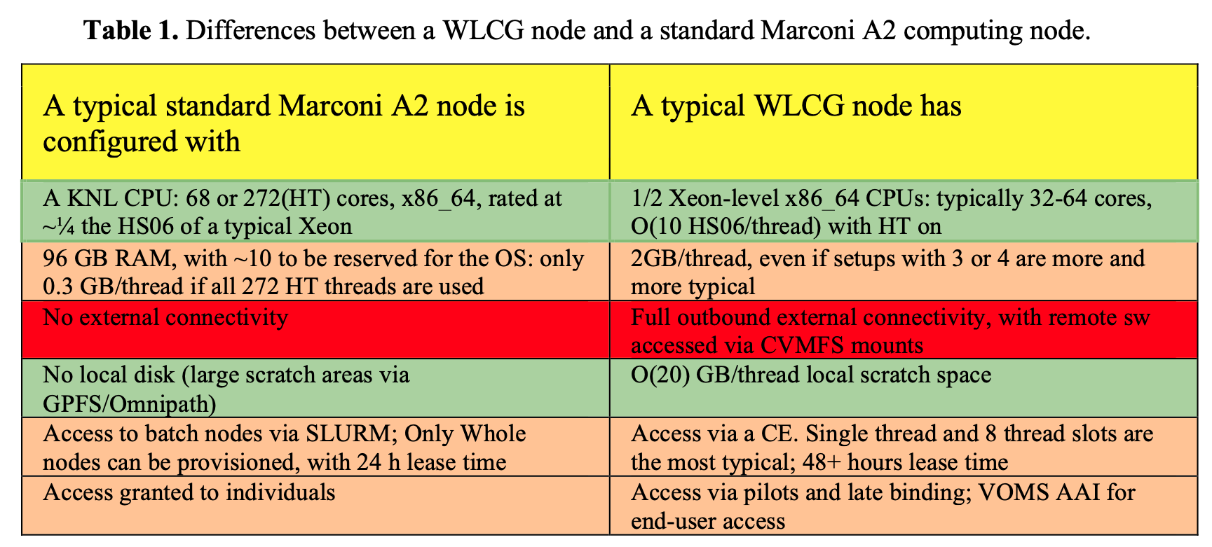
How was it working in the past?
Someone (for example an HPC center, a Cloud Provider, an institution, …) plans and deploys a system
Later on, you (HEP/RA/GW/…) are given some resources (core hours, storage, …) and … they do not match your standard needs
You try and find tricks / workarounds; maybe you succeed, but you are able to use the resource at low efficiency
From: Extension of the INFN Tier-1 on a HPC system, CHEP 2019

Slide 6
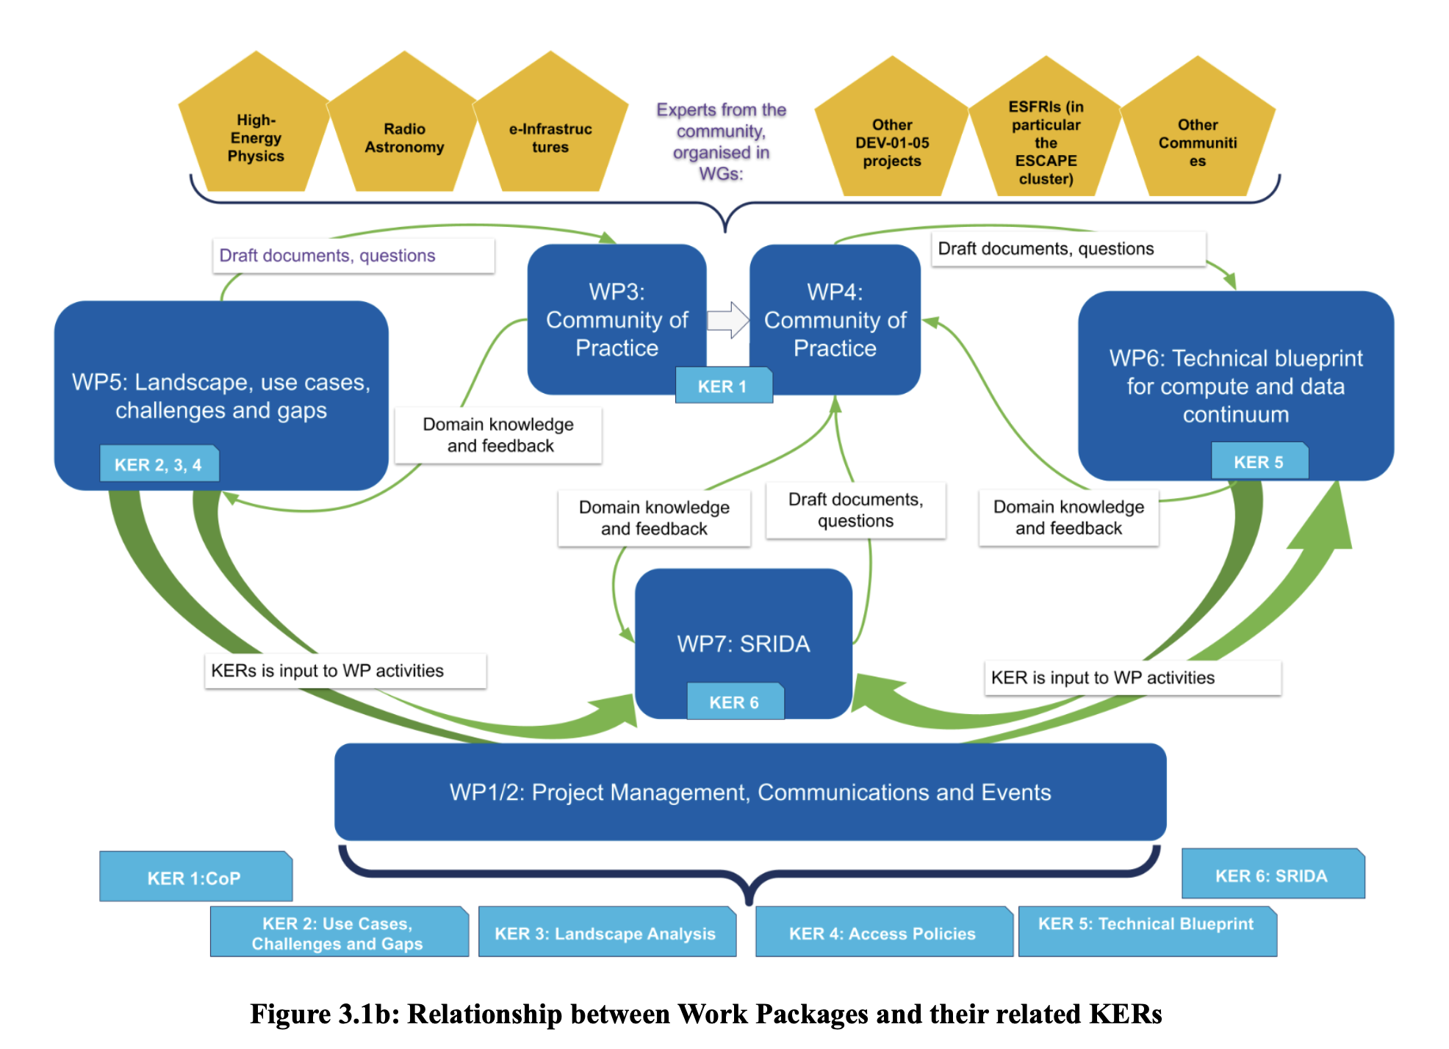
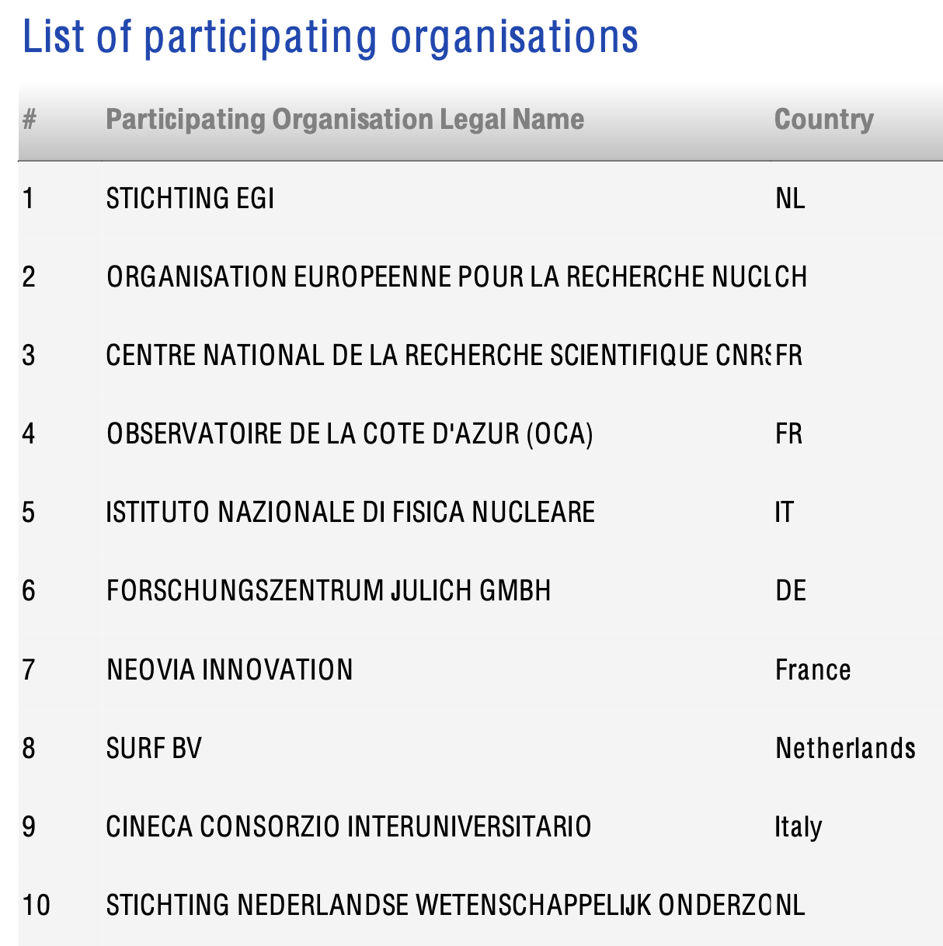
SPECTRUM: Plan of Work
Project length: 30 Months (Jan 24-Jun 26)
First period: Jan 24 - Mar 25
Second period: Apr 25 - Jun 26
6 Work Packages identified
WP1: Project Management and Communications (first period)
WP2: Project Management and Communications (second period)
WP3: Community of Practice Creation and 1st Consultation
WP4: Community of Practice 2nd Consultation and long-term sustainability
WP5: Landscape, use cases, challenges and gaps
WP6: Strategy Research, Innovation and Deployment Agenda

Slide 7
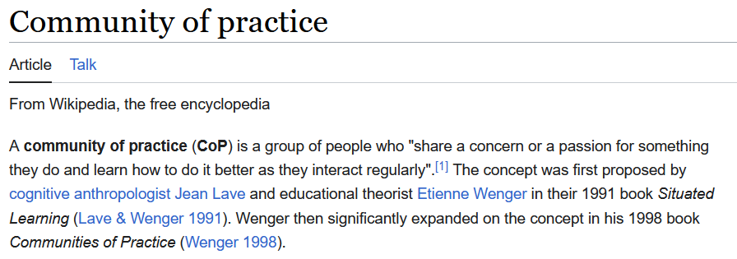
The SPECTRUM Community of Practice
EC published a 120 pages book on «What is a CoP»
Insights from the Communities of Practice playbook (EC, 2021)
« …the proactive pull roles of communities (of practice) are rated as needing improvements …
investing and providing–offering a means to give members the resources they need;
community building–promoting and sustaining values/standards among relevant stakeholders;
learning and facilitation–helping communities to work more efficiently and effectively.
…»
In practice:
- Find people with knowledge AND interest in solving a (future) problem …
- .. And while doing this, willing to confront with a (slightly) different community
- … And able to speak a common language with infrastructure, to be able and describe which are the technical needs

Slide 8
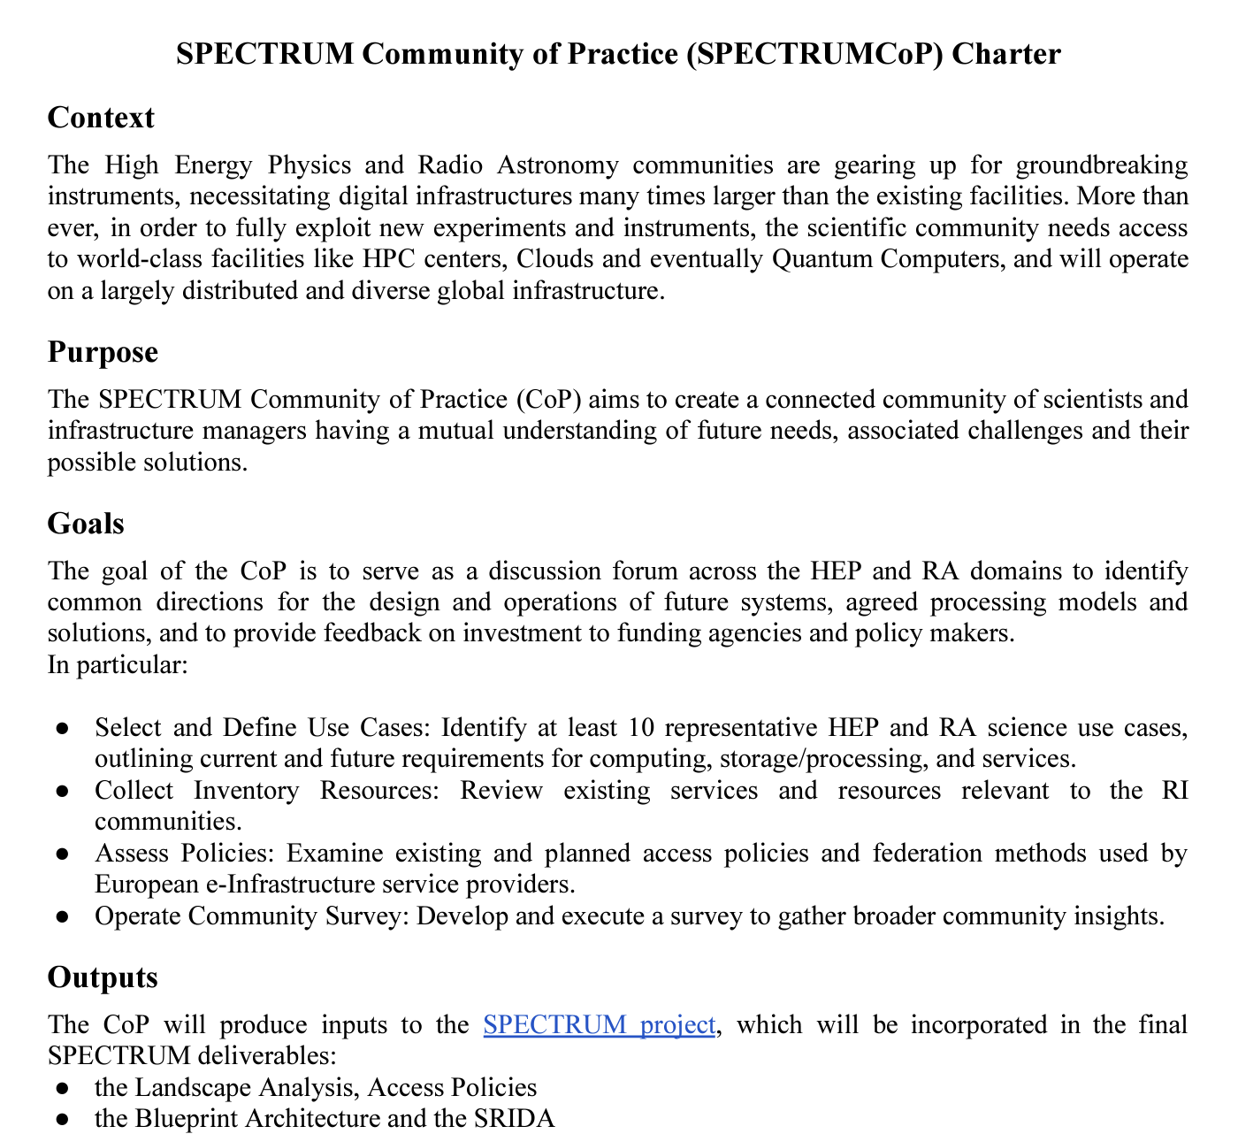
How to implement a CoP for SPECTRUM?
A community charter was prepared and distributed while calling for participation
https://cdn.spectrumproject.eu/app/uploads/2024/03/SPECTRUMCoP-final.pdf
We defined 6 Working Groups
The goal of the CoP is to serve as a discussion forum across the HEP, RA domains and infrastructures to identify common directions for the design and operations of future systems, agreed processing models and solutions, and to provide feedback on investment to funding agencies and policy makers.
List of WGs chairs:
WG1 (Data Management and Access): BAGNASCO Stefano (INFN, ET, Virgo) - bagnasco@to.infn.it
WG2 (Workflow management and organization): DELL'AGNELLO Luca (INFN CNAF-T1) - luca.dellagnello@cnaf.infn.it
WG3 (Compute Environment): BOZZI Concezio (INFN, LHCb, JENA-HPC) - bozzi@fe.infn.it
WG4 (SW tools):
SWINBANK John (Astron) - swinbank@astron.nl
VILOTTE Jean-Pierre (CNRS) - jean-pierre.vilotte@cnrs-dir.fr
WG5 (Scientific Use cases):
FERRARI Chiara (CNRS, OCA) - chiara.ferrari@oca.eu
GIRONE Maria (CERN) - maria.girone@cern.ch
WP5 as co-chair
WG6 (Facilities) : HOPPE Hans-Christian (Jülich) - h.hoppe@fz-juelich.de
If you want to join: here

Slide 9
The survey
The main task for the first SPECTRUM/CoP period is the preparation of a survey to be distributed to:
The HEP and RA communities (for SPECTRUM)
All the communities behind JENA (see next talk)
In general, every close by scientific community (we “claim” that the solutions we want to propose are general for “data intensive sciences”)
We want to accept views from researchers and from the management of experiments / instruments / …
We aim to distribute the survey by mid July, with a first result assessment by the end of September

Slide 10
The survey
Preparation in advances status, ETA ~ 1 week
Many sections, no one is expected to fill all of them but we wanted a single survey!
Are you a researcher manager of a scientific initiative using computing resources?
Do you have technical knowledge? (YES/NO per 6 areas)
Are you a manager of an e-Infrastructure?
Via the granularity, one is expected to answer < 50% of the questions
You are asked for use cases needing computing
You are asked for technical input
You are asked about your center

Slide 11
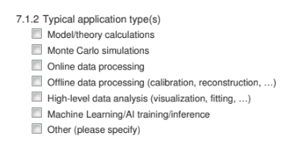
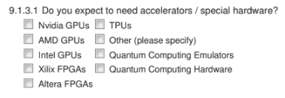
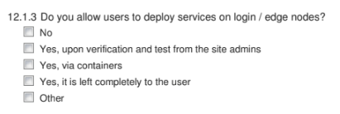
Questions
You can test the survey today here
Some examples follow

Slide 12
SPECTRUM longer term plans
July 15th 2024: distribute the survey; submissions open till September 15th
End-of-October 2024: first draft of the survey
End-of-March 2025: deliverable from the CoP
April 2025: second phase starts: new CoP WGs, document writing ...
… Jun 2026; End of SPECTRUM
Documents to the EU and entities such as EuroHPC, EOSC, for the inclusion in future policies / decisions / fundignallocations

Slide 13
Conclusions
SPECTRUM initiative aims to provide technical and policy guidance for data intensive sciences in the landscape of (future) European Computing
It is a piece of common bottom-up efforts we should do as a community to make sure the “future” computing is tailored / usable for our sciences

