Slide 1
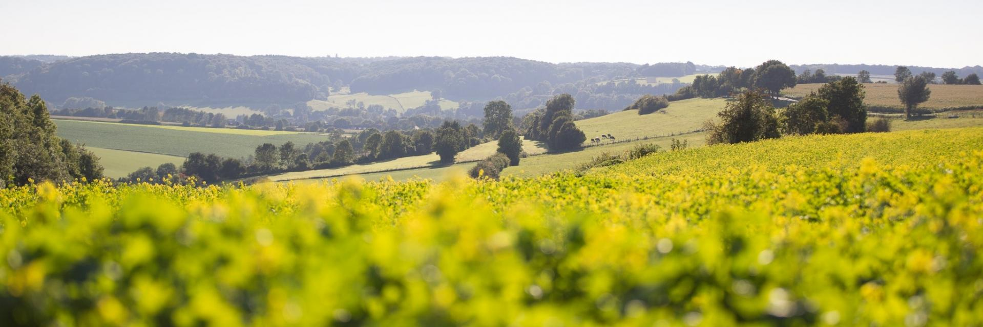
Discussion on Sustainability
economic / ecological / social
© Dreiländerpark

Slide 2
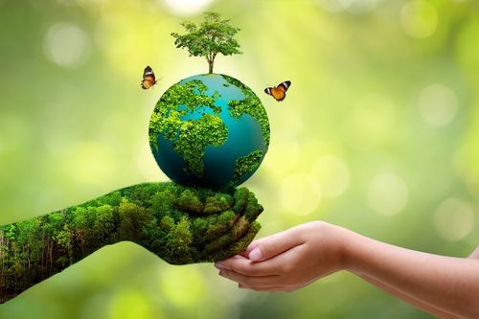
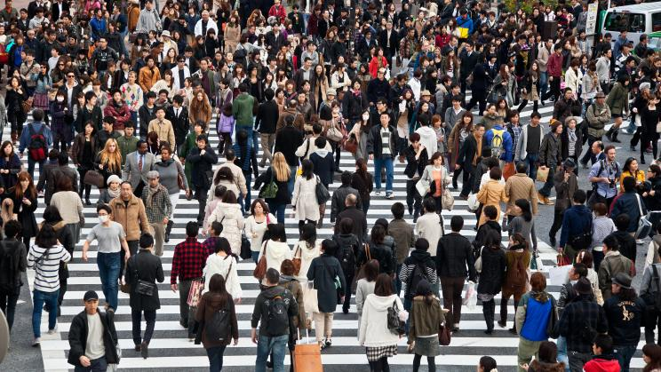
Sustainability
economic ecological social
Goal
Develop structures
which ensure a long-term
return to the economy
Goal
Minimize the impact on the environment and mediate the unavoidable impact on all time-scales
Goal
Assure the support of the project by the local and interregional society

Slide 3
Ecological Sustainability
Operation
CO2 footprint (power consumption)
Waste heat (cooling water)
Heating the building
Commute of personnel
…
More widely:
Business travel
Power for the telescope?
Installation
CO2 footprint building
Computer hardeware
Other hardware
Land consumption
…

Slide 4
Ecological Sustainability: Ideas
CO2 footprint (power consumption)
Own green energy? (wind turbines + solar power) Adapt computing power to available green energy (average x2? Run hardware longer?) H-storage for basic services
Your ideas ….

