Slide 1
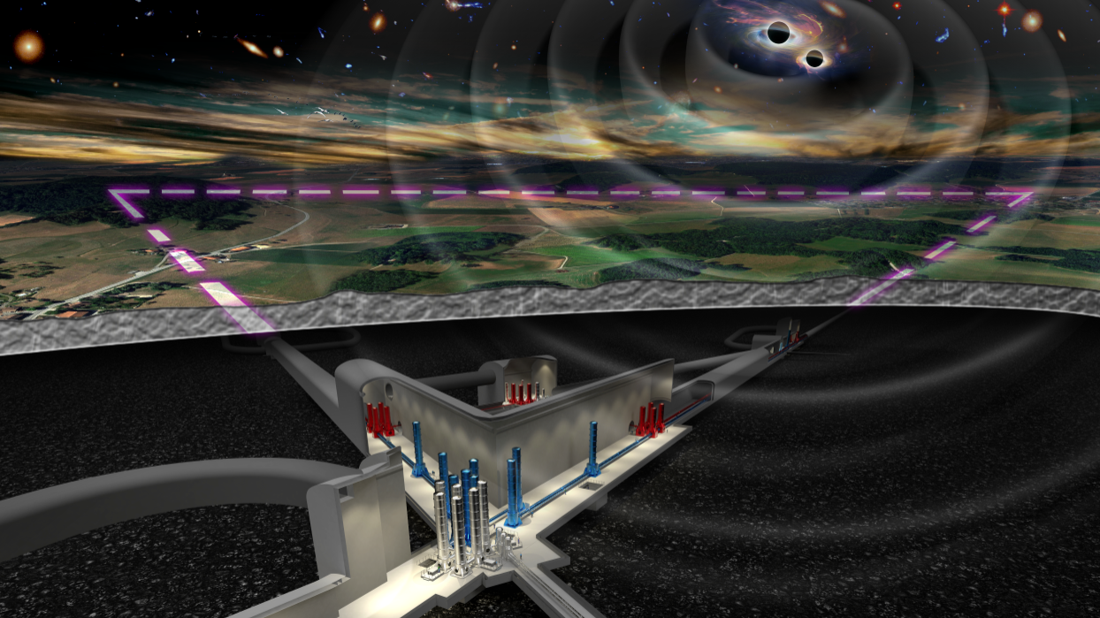

MM
04.06.2024
Eugenio Coccia

Slide 2
Agenda CB Meeting 13.05.2024
Presentation of the candidature of the Berlin Research Unit (Robert Menzel)
Presentation of the candidature of the INFN-Ferrara Research Unit (Guido Zavattini)
Report from the Executive Board (Michele Punturo)
ISB presentation to get endorsement on the new WP chairs (Jan Harms)
On the formation of the SSB Committees (Michele, Eugenio, all)
AOB

Slide 3
Presentation of the candidature of the Ferrara Research Unit (Guido Zavattini)
Slides:.
The collaboration board approved the new research units proposed by Robert Menzel (IKZ Berlin) and Guido Zavattini (Ferrara). The IKZ unit will focus on providing crystalline silicon materials and growth processes for the Einstein Telescope's mirror suspensions. The Ferrara unit will specialize in high-precision birefringence measurements of substrates and coatings, as well as developing techniques to mitigate birefringence noise.
Report from the EB Chair
Michele Punturo provided an overview of the recent ET Symposium, noting that it highlighted the immense challenges and tight timelines facing the collaboration. Key takeaways include the need to improve participation and contributions from Research Units in critical activities like the detector design report and observational science book. The collaboration is also working to better monitor and utilize human resources across the project.

Slide 4
ISB presentation to get endorsement on the new WP chairs (Jan Harm)
Slides:
Jan Harms presented a list of new work package chairs within the Instrument Science Board that require endorsement from the Collaboration Board. The changes involve substitutions and additions to chairs responsible for areas like Newtonian noise cancellation, magnetic noise coupling, and low frequency control noise.
On the formation of the SSB Committees.
Eugenio Coccia and Michele Punturo discussed the plan to establish various services and standards committees for the Einstein Telescope project. The chairs will propose initial committee compositions, which will then be reviewed by the Executive Board within a couple of weeks and finally presented to the Collaboration Board of June 10 for endorsement. Diversity and relevant expertise are key considerations in the committee makeup.

Slide 5
Agenda CB Meeting 10.06.2024
Introduction by the CB Chair
Report from the Executive Board by the Spokesperson
Composition of the SSB Committees, discussion and final endorsement
Procedure to improve the activity monitoring, discussion.
AOB

Slide 6
SSB Chairs list:
Project Program Committee (PPC) - Ettore Majorana (Roma)
Early Career Scientists Support Committee (ECSS) - Anna Green (Amsterdam)
Member Conduct and Ethics Committee (EMCC) - Monique Bossi (Perugia)
Speakers and Awards Committee (SAC) - Luca Naticchioni (Roma)
Editorial Committee (EC) - Paola Leaci (Roma)
Election, Voting, and Membership Committee (EVMC) - Mariafelicia De Laurentis (Napoli)
Meetings and Symposia Committee (MSC) - Jessica Steinlechner (Maastricht)
Communications and Education Committee (CEC) - Susanne Milde (Hannover)
Bylaws Updating Committee (BUC) - Harald Lück (Hannover)

Slide 7
Proposal to improve the activity accounting in the ET collaboration
Abstract
The ET collaboration is in a transition phase. We started as very inclusive scientific collaboration and we have to point toward a project oriented scientific collaboration. To perform this transition we need the definition by the SSB-PC of the core programme of the collaboration, the setting up of the MOA mechanism, the completion of the PBS and the definition of the key elements of the WBS. But we cannot wait to improve the involvement of the ET members.
The main existing technical tool to account the activities of the ET members is the ETMD. We need to improve NOW its use in order to have a better monitoring of the available, used and missed human resources.
The ETMD probably contains all the categories of activity we need (see Figure 1) down to the WP level, when present. The clear indicator of the misuse and poor accounting of the ET collaboration human resources is the plethoric participation to the ET General category; our first target is to move the FrTEs of the ET members toward the clearly identified categories.

