Slide 1


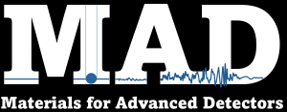

Birefringence noise of the suspended masses
Paola Puppo
INFN – Roma
15/11/2024

Slide 2

Birefringence noise from thermal motion of the masses
Thermal noise produces a deformation on the bulk that could modify the beam path through it. This change can be dependent on the directions and can give a birefringence effect due to the deformation and stress occurring in the test mass.
All those modes deforming the bulk can give a birefringence effect, however thermal noise is an incoherent sum of all the modal frequencies quadratic amplitudes having energy k_{b}T thanks to the equipartition theorem, so the displacement at a given frequency outside the resonances results in uncoherent phase noise.
D_{bulk} thickness
n refraction index

Slide 3


TN computation with the FEM and phase noise extraction
b
f
The ligth power is the probe of the
masses motion

Slide 4

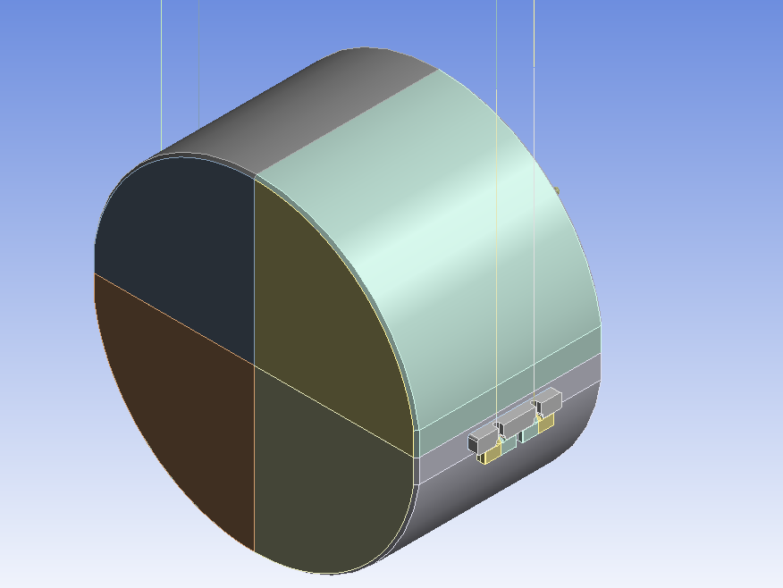
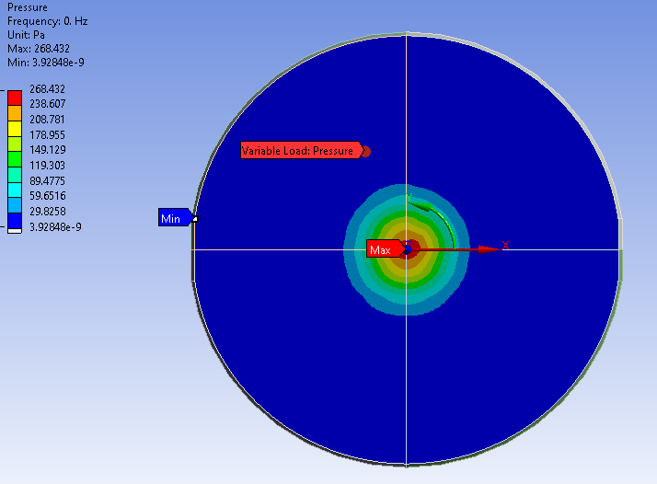

Calculation of the Mirror Thermal Noise (TN) with Levin Method
Dissipation Sources φ_{i}: Coating, HCBs …
Apply a force
F_{o} = 1
E_{strain} from FEM → Mirror TN via the Levin method

Slide 5
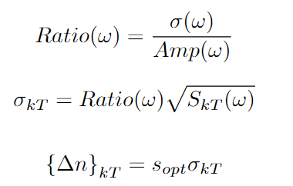

Birefringence noise
When we apply a force we extract the face amplitude
Amp(ω) and the bulk σ(ω) stress
Ratio(ω) coefficient is then extracted
Refraction index fluctuations
Thickness Fluctuactions
S_{opt}=3.2 10⁻¹² (1/Pa)
Stress-Optic Coefficient in glasses: Barlow & Payne, ‘The stress-optic effect in optical fibers’, IEEE QE-19,5,May 1983

Slide 6
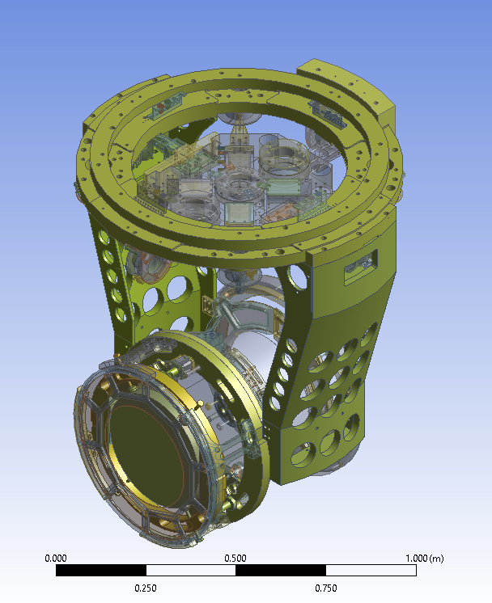
Compensation plate (CP)
Fused Silica
Diam 350mm
Th 35mm
Test Mass
Arms
CP

Slide 7
Example for the Compensation Plate (CP) in Virgo
CP is in fused silica
In the recycling cavity and misaligned
Considering the couplings at the ITF
Output The noise is negligible for CP
FOR other SUSPENDED bulks can be higher.
The material can be important

Slide 8
Conclusions
The phase noise of a suspended optic due to thermal
fluctuations can give a non negligible effect on the sensitivity
FOR SUSPENDED bulks depend on their material and the calculation must be included in the sensitivities computation
Next step: evaluate for test silicon and sapphire masses

