Slide 1
Towards Reliable Bonding of
Sapphire and Silicon
Available Methods:
Soldering/Brazing
Sintering
Welding
Gluing, etc.
Requirements:
High thermal conductivity
High tensile strength
High Q-factor
Constrains:
Specific material properties
Uneven geometry, roughness
Wide temperature working range (10 K – 293 K)
Sapphire: Most Promising Technique is Welding
Diffusion Welding
Laser Welding

Slide 2
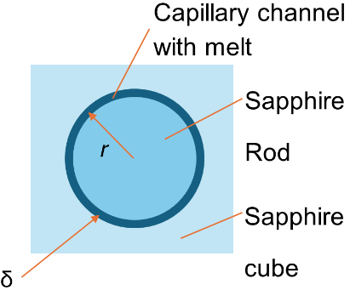
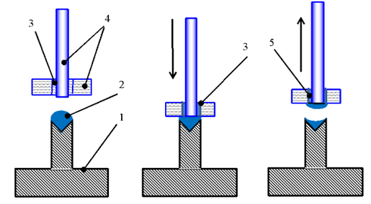
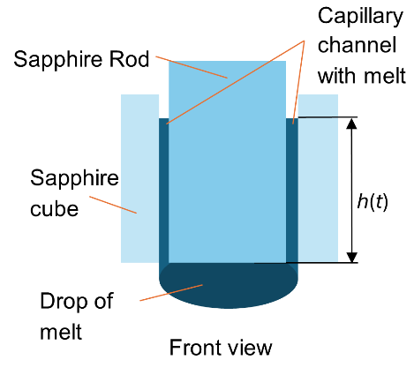
Diffusion Welding:
Sapphire Bonding by Its Own Melt
Quasi-stationary solution to the capillary rise
(acceleration neglection):
Taking solidification into account
Heat released during crystallization exceeds the heat released during cooling:
Linear thermal gradient
$$h\left(t\right)=\sqrt{\frac{σδ}{3μ}t}$$
$Q_{\text{cryst}}=λΔm≫$ $Q_{\text{freeze}}=cΔm\left(T_{0}−T_{\text{mel}}\right)$
$T\left(x\right)=T_{0}$- $θx$
Resulting equation for the melt height:
$$\frac{θ}{2}H^{3}+\frac{4}{3}\left(T_{\text{mel}}−T_{0}\right)H^{2}−\frac{λρσδ^{2}}{3μα}=0$$
$$H=\sqrt{\frac{λρσδ^{2}}{4μα\left(T_{\text{mel}}−T_{0}\right)}}$$
Processing schema: 1 – melt droplet holder, 2 – melt droplet,
3 – capillary gap, 4 – sapphire parts, 5 – weld seam
$$χ$$
, - thermal conductivity
$$α\sim χ/δ$$

Slide 3
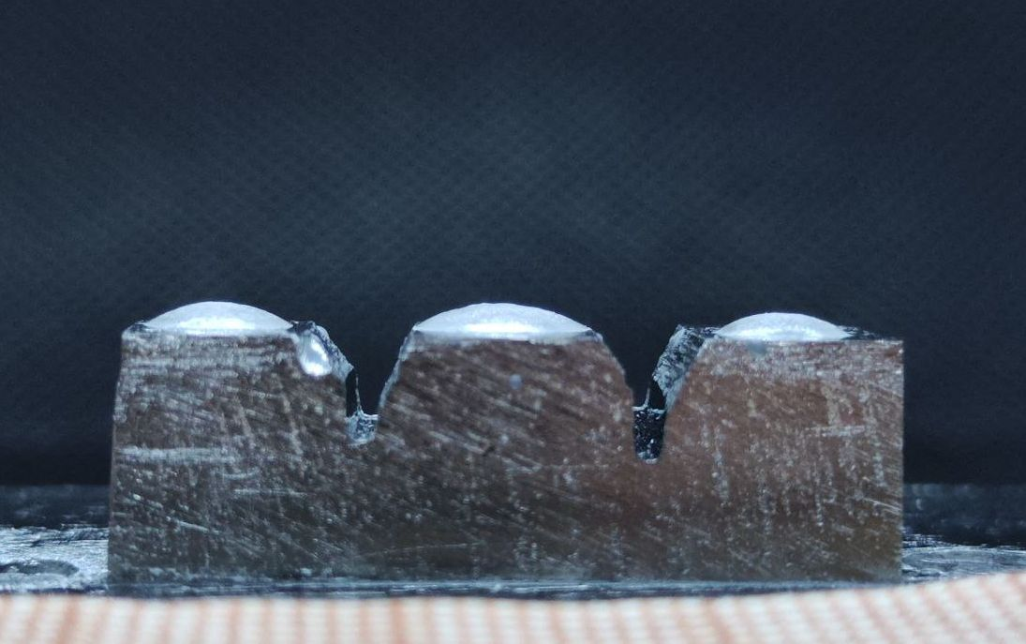
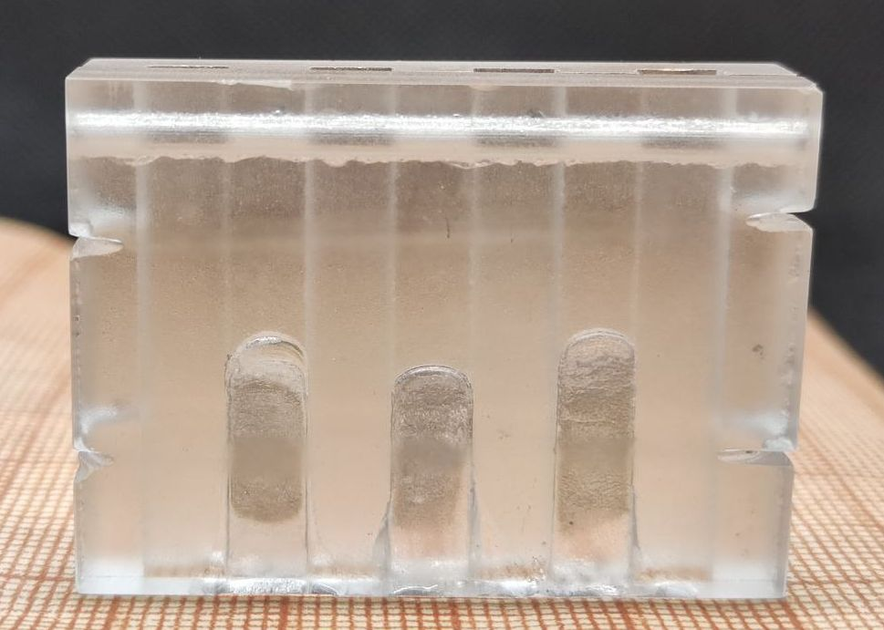
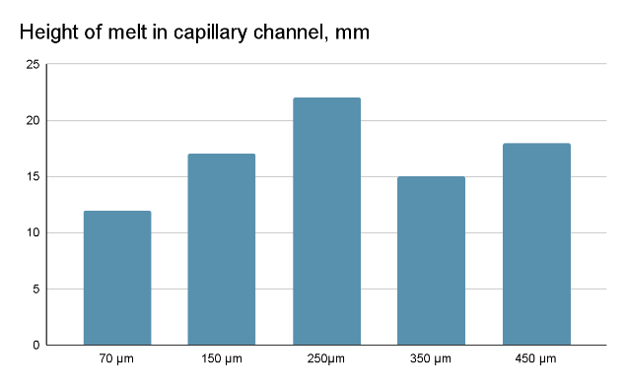
Sapphire Bonding by Its Own Melt:
Technique Improvements
By variation of
Channel Width
Thermal Gradient
The molybdenum holder for filling capillary channels
The row with capillaries of different width W=0.07..0.450 mm. LxH=5x50 mm.
Bonding optimization by variation of the channel width
Sapphire seeds on the holder before melting

Slide 4
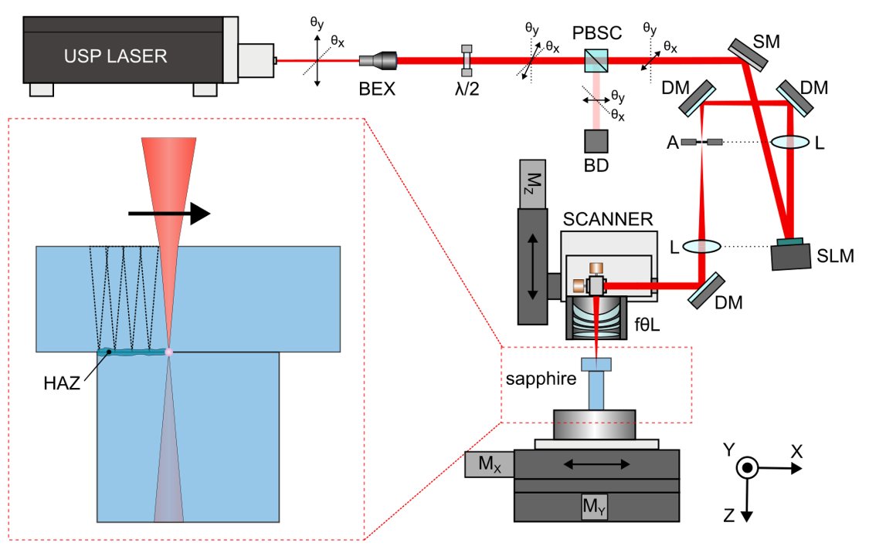
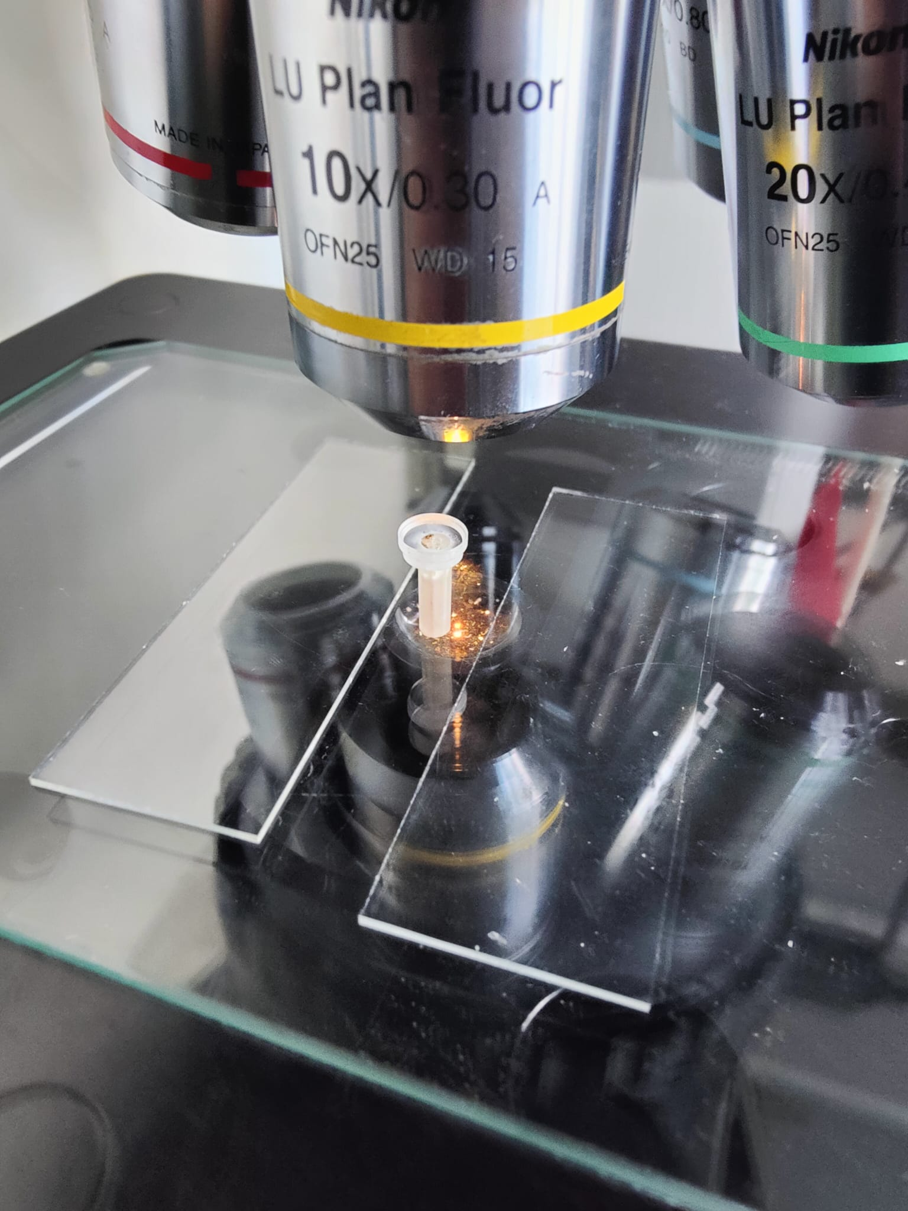
Sapphire-to-Sapphire Ultrashort Pulsed Laser Bonding: Technical Setup
1030 nm near-infrared wavelength
500 fs pulse length, 100 kHz repetition rate
20 – 40 W average power
< 15 µm focal spot size
Multiphoton absorption of USP-Laser gradually heat up the sapphire within a defined volume.
SLM is used for even heat distribution. Adjacent regions remain unaffected.

Slide 5
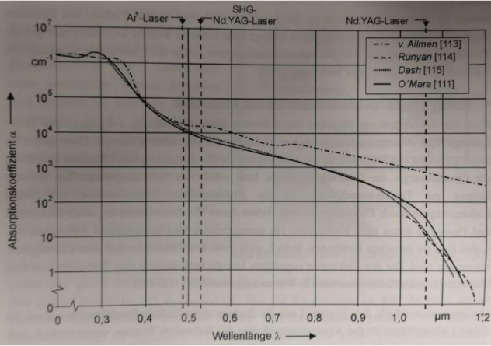
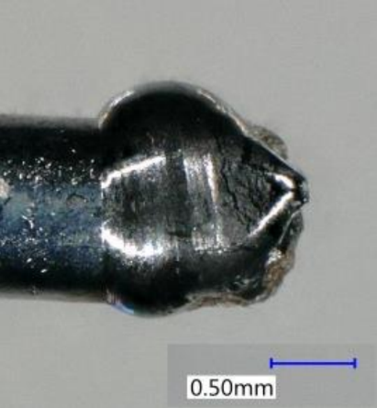
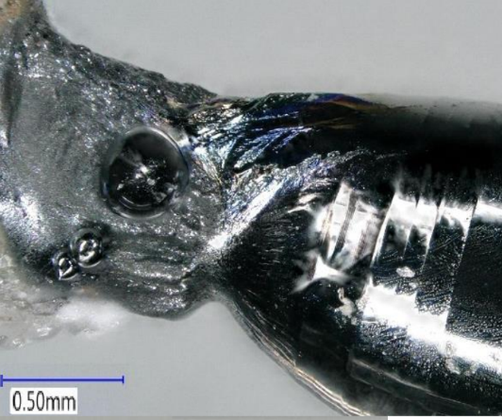
Silicon Welding:
Preliminary attempts (2019)
Attenuation coefficient of silicon in dependence on wavelength
Fragments of the trial to weld a cylindrical rod Ø 0.9, 1.1 mm to a round disk Ø25 x 10 mm. Nd:YAG-laser, wavelength
$λ$=1064 nm
Silicon Welding Outlook: Changing wavelength to $λ$=2100 nm

Slide 6
The above results were achieved with the support of Central Innovation Programme for small and medium-sized enterprises. Funding Nr. EP201456
Sergii Nizhankovskyi, Dr.
Pavlo Konevskyi, Dr.
Igor Pritula, Prof. Dr. Sci.
Institute for Single Crystals,
Kharkov, NASU
Alexey Kuzmichev, Dipl.-Chem.
Alexander Weber, Dipl.-Phys.
Helene Dyck, Dr.
Impex HighTech GmbH
Philipp L. Maack, M.Sc.
Jonas Wehner, B.Sc.
Marvin Schuleit, Dr.-Ing.
Aleksander Kostka, Dr.-Ing.
Andreas Ostendorf, Prof. Dr.-Ing. habil
Ruhr Uni Bochum, LAT
Thank you for attention!

Slide 7
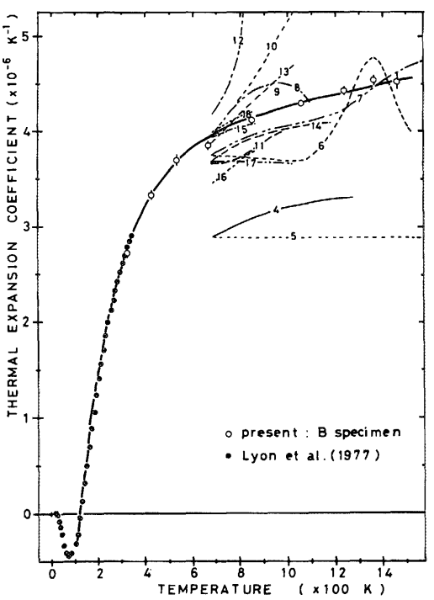
Silicon Welding:
Specific material properties
Thermal Expansion Coefficient Of Silicon:
Strong non-linearities in the welding operating range leading to thermal and mechanical instabilities:
Thermal shocks
Crack propagation
Possible explanation of the material failure in the welding trials?
Yasumasa Okada Y.,Tokumaru Y.
J. Appl. Phys. 56, 314–320 (1984)

Slide 8
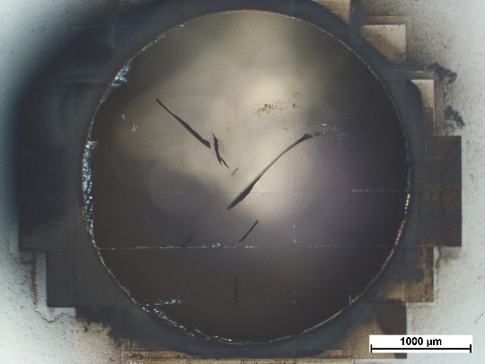
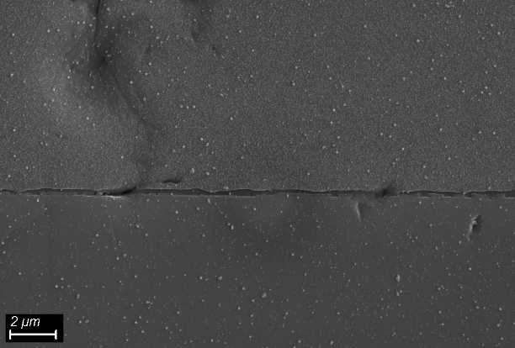
Sapphire-to-Sapphire Ultrashort
Pulsed Laser Bonding: Optimization, Characterization
Pressure mount
Optimization of Laser Parameters (Power, Pulse Duration)
Optical welding verification
SEM-image of the weld seam

