Slide 1
Laser welding of crystalline sapphire
ET Annual meeting 2024
Jennifer Docherty*, Alan Cumming, Jack Callaghan, Giles Hammond
Victoria Graham, Karen Haughian, James Hough, Russell Jones, Gregoire Lacaille, Iain Martin, Mariela Masso Reid, Peter Murray, Sheila Rowan, Andrew Spencer, Claire Wilson, Sarah Dugmore​
*j.docherty.2@research.gla.ac.uk
​
Institute for Gravitational Research​
University of Glasgow

Slide 2
Overview
This presentation will cover:
The advantages of fused silica in aLIGO
A recap of the sapphire fibre production in Glasgow
The development of a sapphire laser welding process
Characterisation of crystallography, strength testing, thermal conductivity, and mechanical loss
Modelling of single-test mass suspension thermal noise in ET for sapphire of different diameters

Slide 3
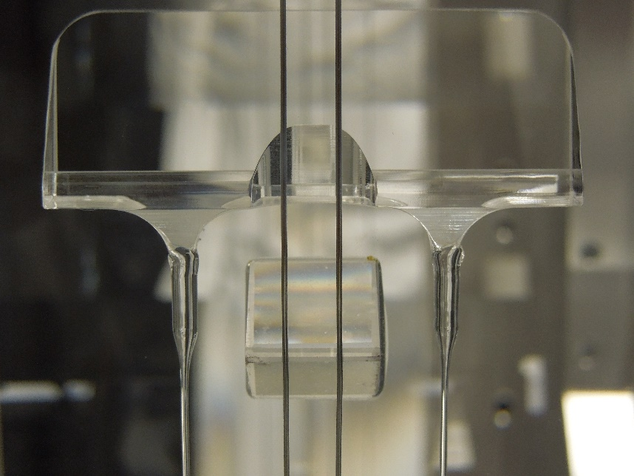
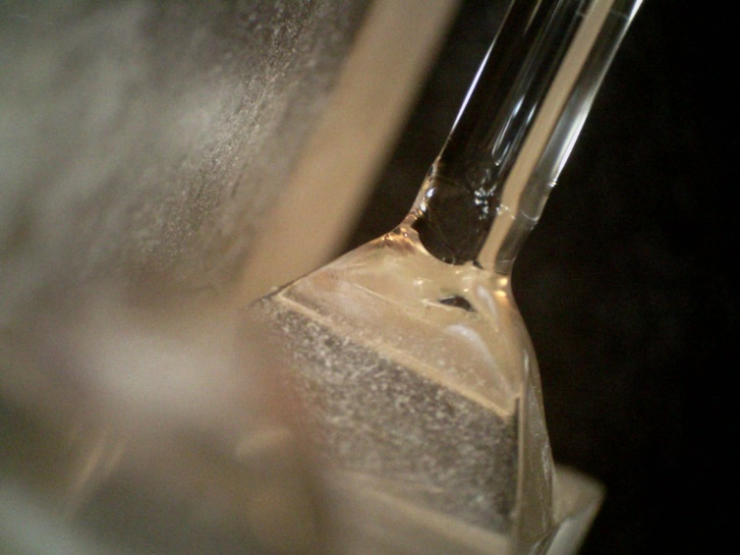
Recap: Laser welding of fused silica in aLIGO
Advantages:
Demonstrated use in aLIGO
Low thermal noise
Allows for violin mode tuning and pitch correction [2]
No need for bond at high stress area, near the bending region of the fibre
Can replace broken fibres without damaging ear
[1]
Highest measured Q in aLIGO: up to 2 billion [2]
1
[1] A.V. Cumming et al. “Design and development of the advanced LIGO monolithic fused silica suspension”. Classical and Quantum Gravity 29.3 (2012)
[2] A.V. Cumming et al. “Lowest observed surface and weld losses in fused silica fibres for gravitational wave detectors”. Classical and Quantum Gravity 37.19 (2020)
Notes:
Made possible by high quality fibre production and robust welding, so we are looking to investigate a process for this in cryogenic systems

Slide 4
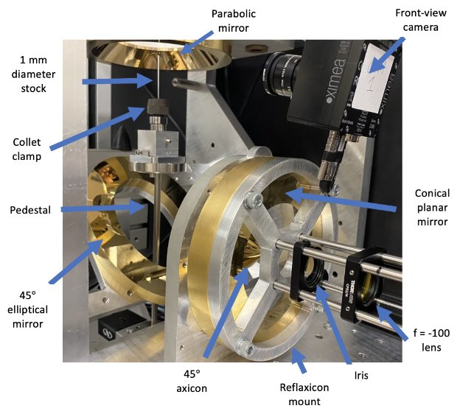
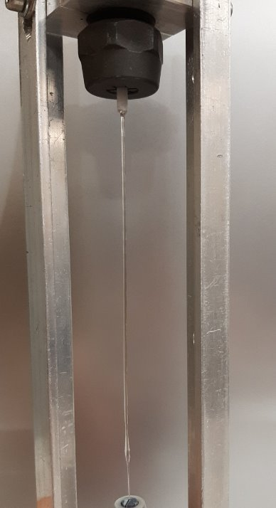
Previous work on sapphire fibre growth
Research conducted by Dr. Jack Callaghan [3]
Laser heated pedestal growth method used to produce sapphire fibres
1 mm in diameter, 350 mm long
Peak strength of 792 MPa (unbroken)
Low diameter variation and good surface quality
Further research to continue
2
[3] J. Callaghan. “Development of crystalline suspension fibres for next generation gravitational wave detectors.” PhD thesis. University of Glasgow. Aug 2024
Notes:
Previously the Glasgow group has reported the production of high quality sapphire fibres using LHPG, we used the same setup to achieve the welding results.

Slide 5
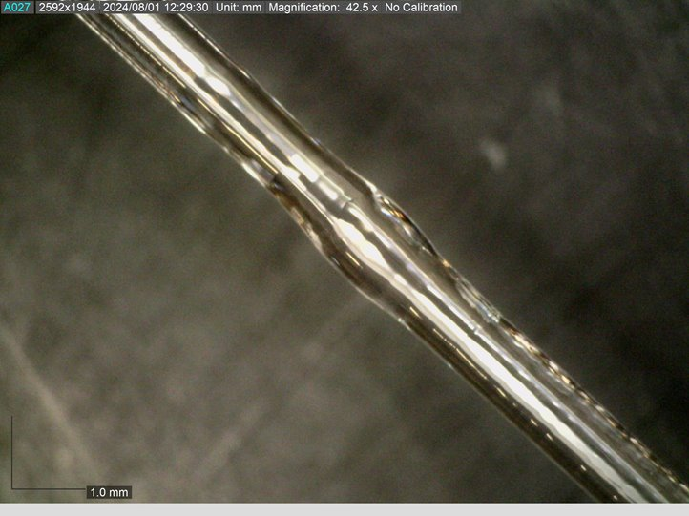
Sapphire welding
Weld region
The end product of the developed sapphire laser welding and polishing process: a laser polished 1 mm diameter welded sapphire sample
3

Slide 6
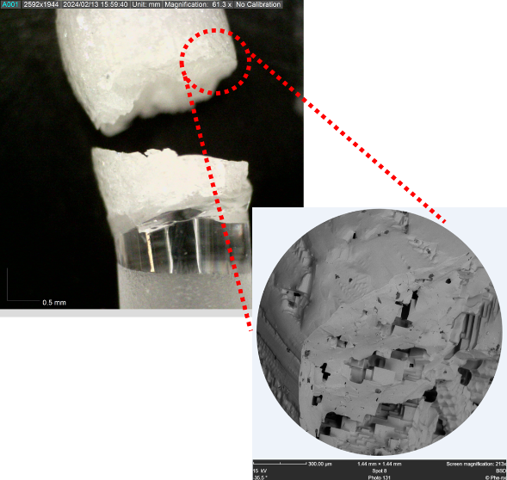
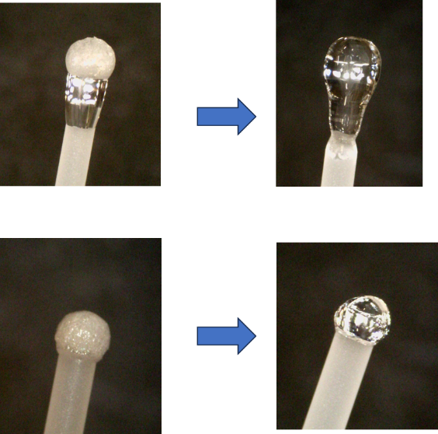
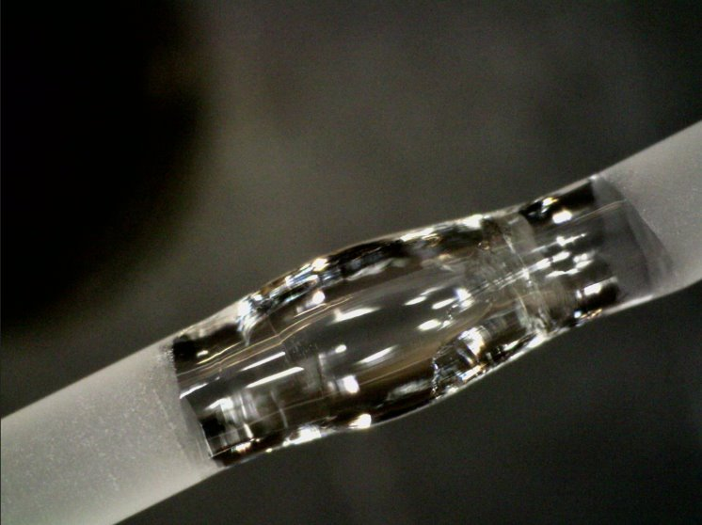
Sapphire welding
75 welds in total completed in the last year
Smallest diameter: 425 µm
Largest diameter: 1.6 mm
Three data sets of 12 welds to investigate surface quality
Ability to repair/reweld repeatedly
425 µm – 1mm
Managing cool down rate is essential
1.6 mm
1 mm
Laser polished
4
Notes:
Work of one year

Slide 7
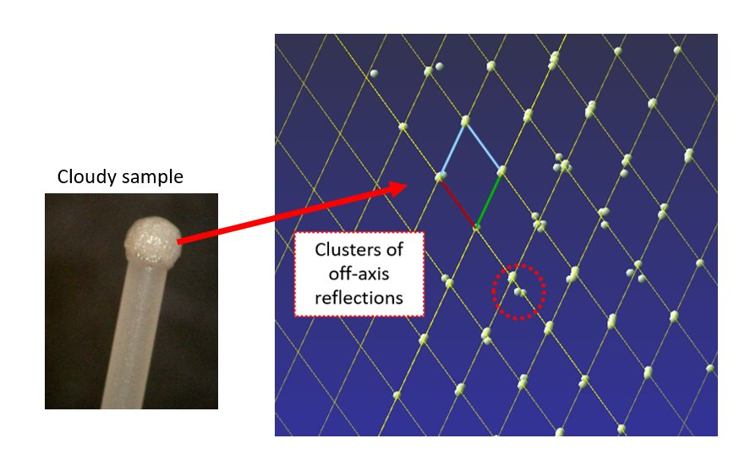
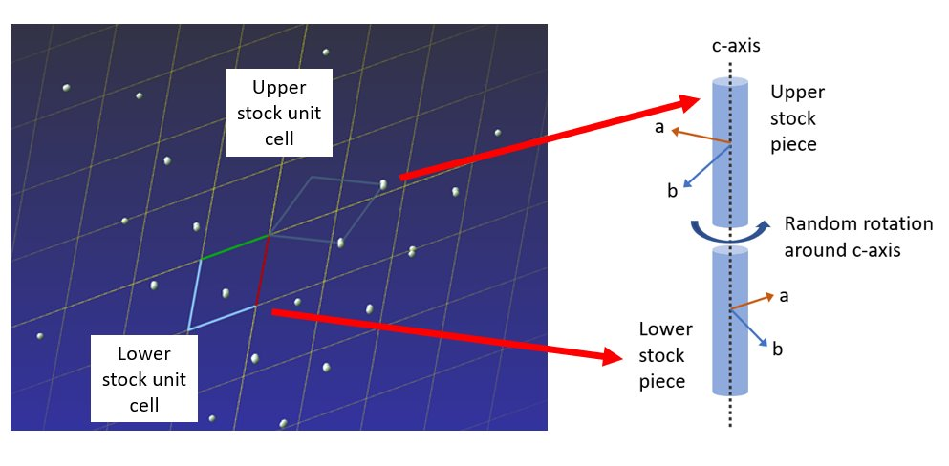
Crystallography
Research supported by Dr. Claire Wilson and Dr. Sarah Dugmore (Department of Chemistry)
Cloudy material shown to be single crystalline with off-axis domains
Weld region $≤$ 200 µm, ≈10 x smaller than in aLIGO [2]; promising for weld loss contribution
5
[2] A.V. Cumming et al. “Lowest observed surface and weld losses in fused silica fibres for gravitational wave detectors”. In: Classical and Quantum Gravity 37.19 (2020)

Slide 8
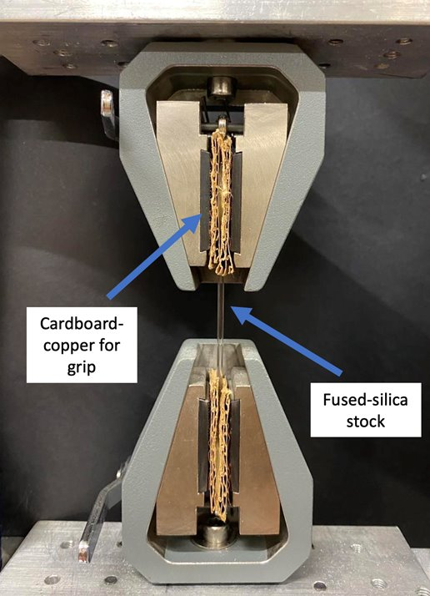
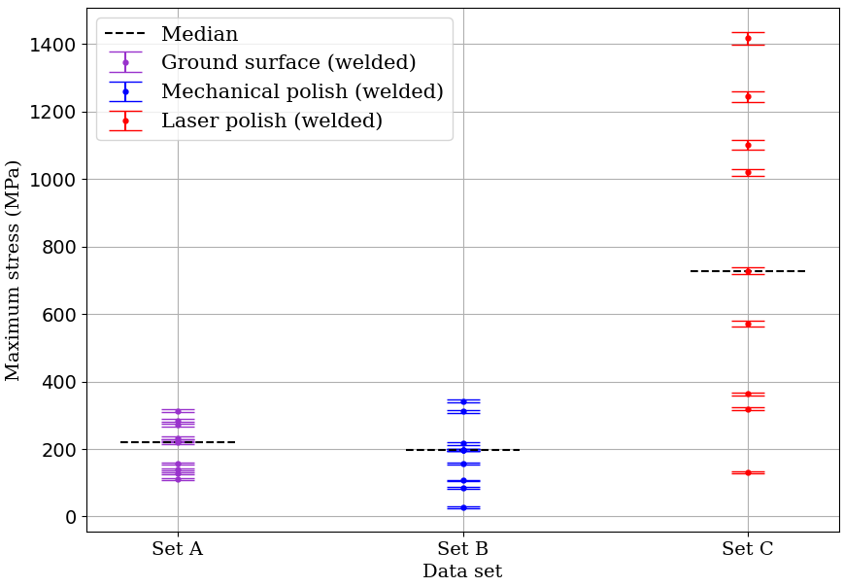
Strength testing
Tensile strength tests of 3 surface finishes were carried out
Highest maximum stress observed: 1.4 GPa (unbroken)
Literature value of ultimate tensile stress is 400 MPa [4]
Laser polished samples significantly stronger than ground and mechanically polished samples
No welds were broken
Laser polish
Max: 1418 MPa
Sample
Ground
Max: 314 MPa
Mech polish
Max: 342 MPa
400 MPa
6
[4] E.R Dobrovinskaya, L.A. Lytvynov, and V. Pishchik. “Properties of sapphire”. 2009
Notes:
Surface quality affects tensile strength

Slide 9
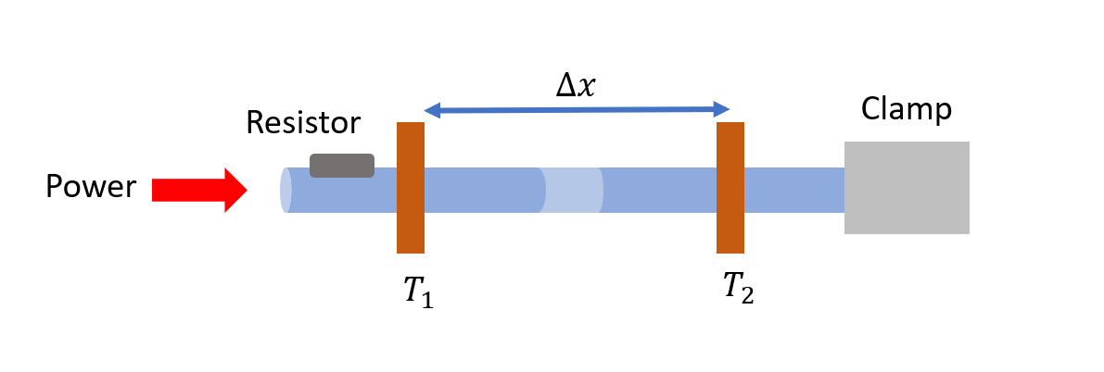
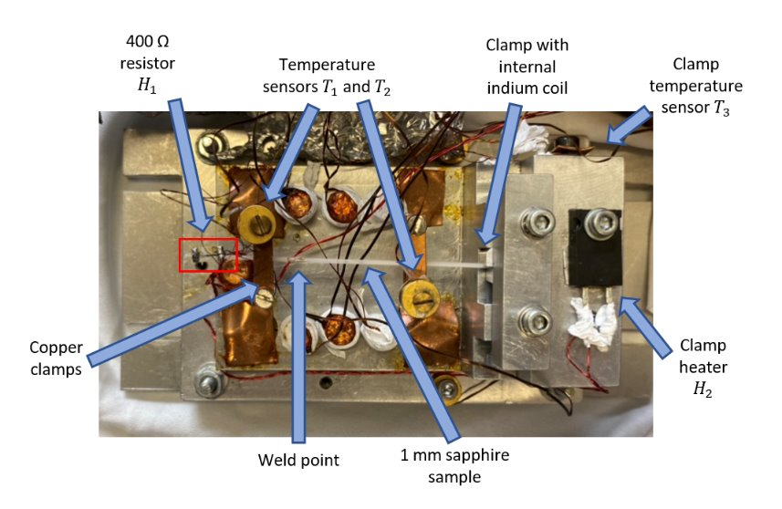
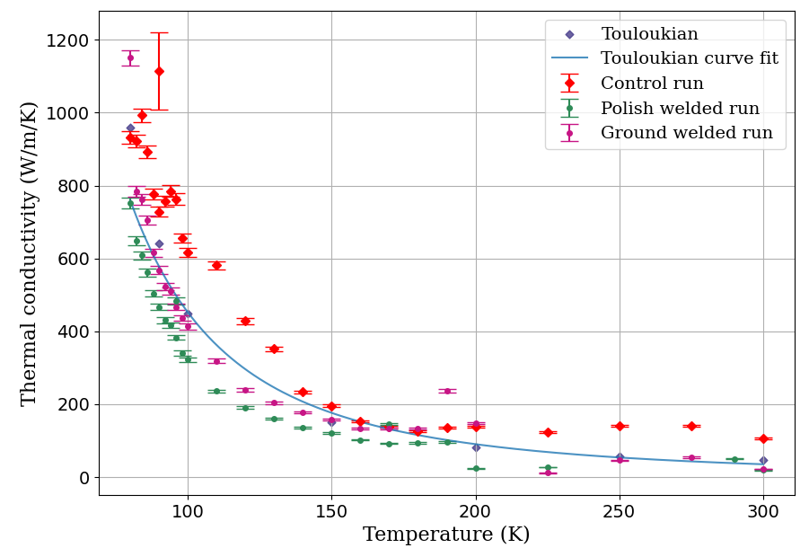
Thermal conductivity
Research undertaken with Dr. Karen Haughian and Dr. Mariela Masso Reid
Measurements down to 80 K using steady state method [5]
Further measurements down to 11 K are ongoing
No large difference between welded and recommended curve
7
[5] M.M Reid. “Properties of silicon for future generation gravitational wave observatories.” PhD thesis. University of Glasgow. Aug 2024
Notes:
Preliminary results, requiring deeper error analysis, measurements to 4 K, and at a better temperature stabilisation

Slide 10
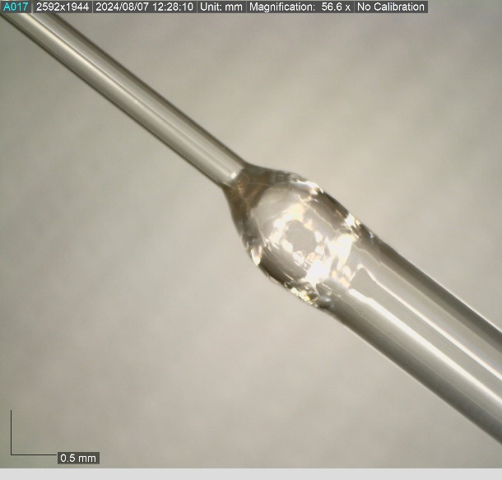
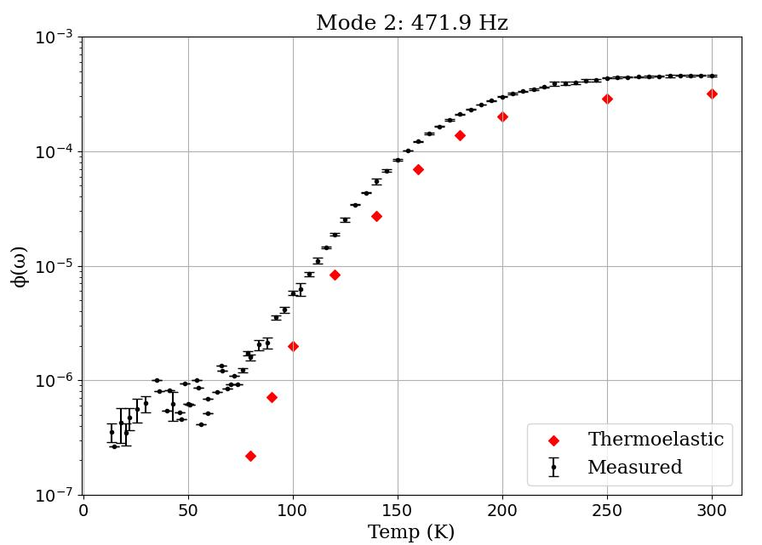
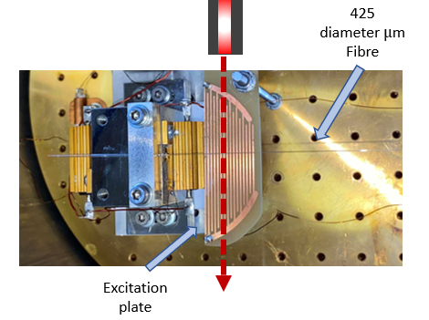
Mechanical loss
Research undertaken with Dr. Peter Murray, Dr. Iain Martin and Dr. Alan Cumming
Measured down to 13 K for six resonant modes
Ringdowns measured at ~5 K intervals
Using welded 425 µm fibre to 1 mm rod
Lowest measured loss 2.45$×{10}^{−7}$
425 µm – 1mm
425 µm fibre
Excitation plate
8

Slide 11
Calculating a $h∅_{s}$ estimate
The lowest measured loss is assumed to be a combination of surface and weld loss (with possible clamp loss contributions requiring FEA to determine)
To assume a worst-case scenario for surface loss, we say this value is entirely surface loss dominated
Then use the lowest measured loss of 2.45$×{10}^{−7}$in the following equation:
$∅_{surface}= \frac{8h∅_{s}}{d}$
we obtain a $h∅_{s}$ of $1.3×{10}^{−11},$ a previously unmeasured parameter for sapphire fibres
Currently we cannot decouple surface and weld loss, but both seem to be promisingly low
9

Slide 12
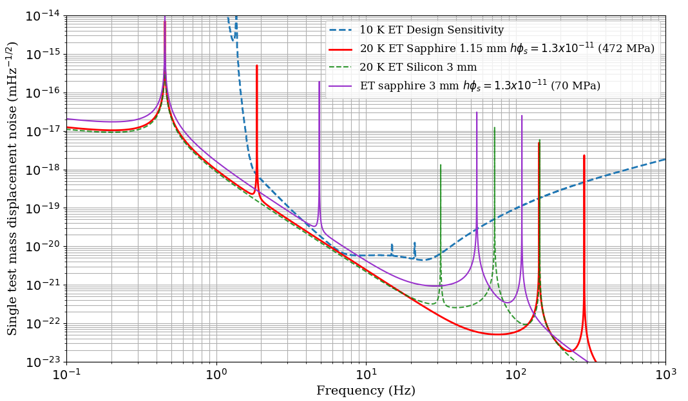
Suspension thermal noise modelling
This model included measured tensile strength (to obtain minimum fibre diameter), and measured $h∅_{s}$
1.15 mm does not account for heat extraction requirement
Does not directly include weld loss
Bonding loss not considered
Next steps: include heat limited case with measured thermal conductivity
10
Notes:
Most realistic modelling of an ET-LF sapphire suspension as based on measured values, is worst-case
Minimum fibre diameter was calculated using 200 kg test mass and 1.4 GPa stress, with a safety factor of three

Slide 13
Conclusion
Feature | Silica | Sapphire
Demonstrated | In aLIGO | In lab repeatedly
Thermal noise | Ultra-low demonstrated by violin mode measured Qs | Weld loss to be investigated further Weld size at most 200 µm Surface loss promising
HC bonding | Eliminates need for extra bond region | Eliminates need for extra bond region
Repairability | Ability to repair | Ability to repair
Violin mode/pitch tuning | Proven in aLIGO | Believed to be possible
Parameter updates:
Maximum tensile strength of 1.4 GPa, median value of 728 MPa (laser polished)
$h∅_{s}$ of 1.3$×{10}^{−11}$
Weld loss contribution promising
Development of laser welding + laser polishing
Future work:
Further conductivity measurements
Fibre growth and geometry optimisation
Welding to larger masses
Demonstration in 4 sapphire fibre hanging mass in Glasgow 10 m cryogenic interferometer prototype [Previously presented in ET-0275A24 https://apps.etgw.eu/tds/?r=18908]
We are working towards a publication on this
Promising results for sapphire suspensions!
11

Slide 14
Thank you for your attention
#UofGWorldChangers
j.docherty.2@research.gla.ac.uk
@UofGlasgow

Slide 15
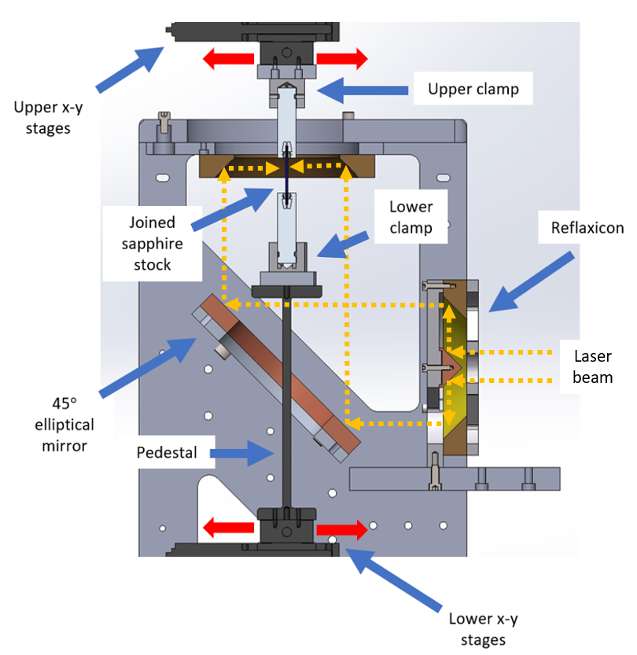
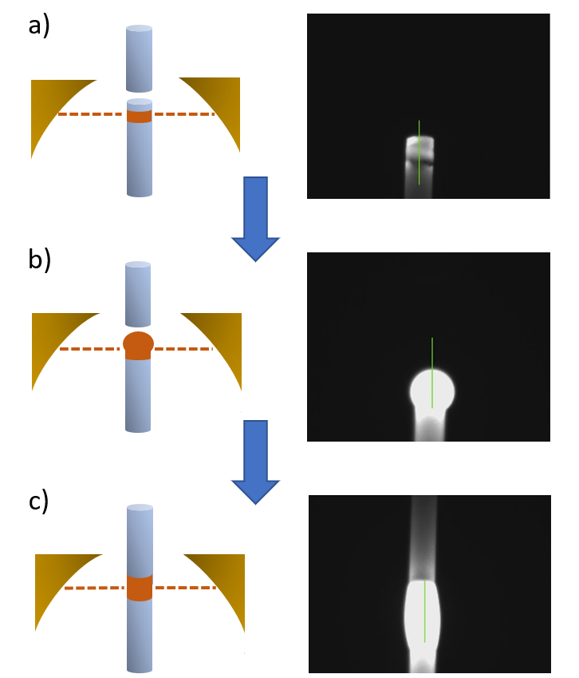
Extra slides: weld process

Slide 16
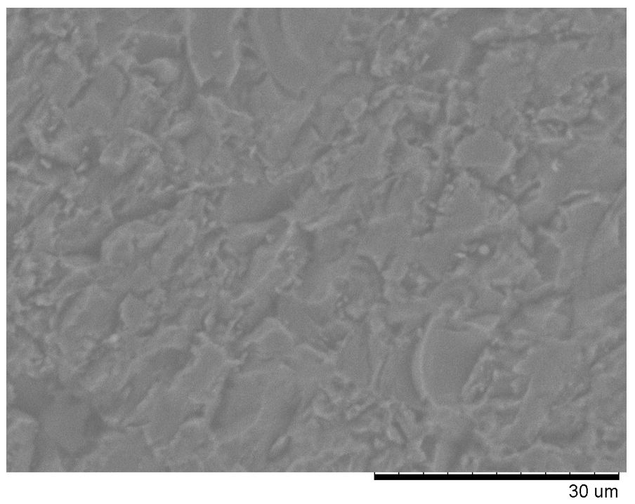
Extra slides: surface quality SEM images
Ground surface
Mechanical polish
Laser polish

Slide 17
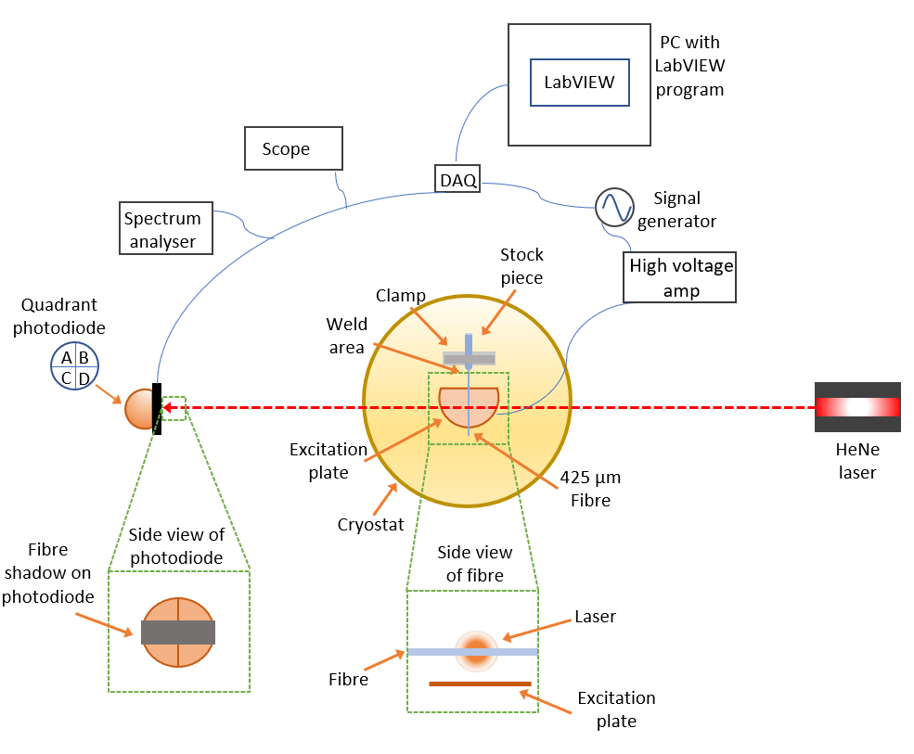
Measurements

Slide 18
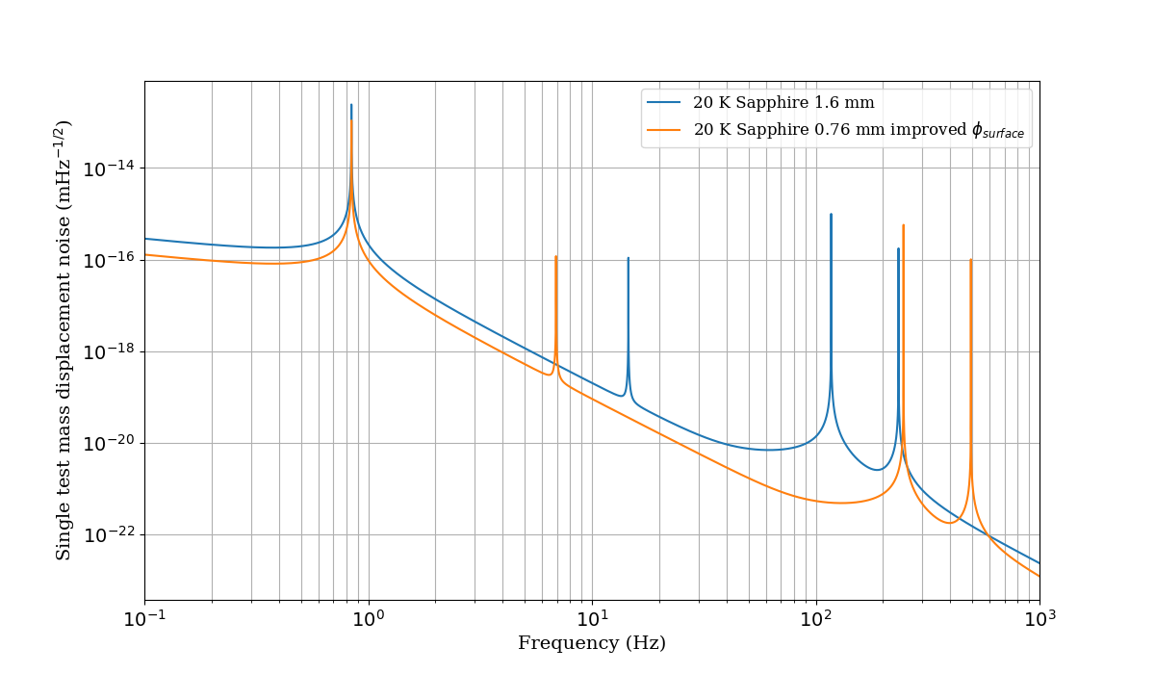
KAGRA suspension noise

Slide 19
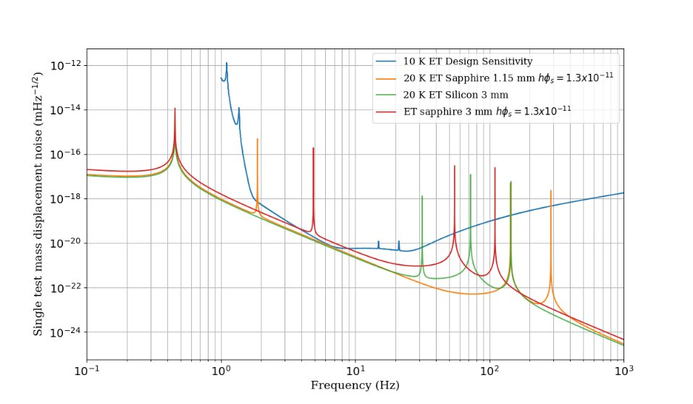
Full plot of ET suspension noise

Slide 22
Touloukian recommended curve

