Slide 1
Study of silicon vertical spring blades
For a cryogenic test-mass suspension system
Leonardo González
Nelson Leon
Fabián Peña
Riccardo DeSalvo
Harry Themann
Gerardo Iannone
Guerino Avallone
University of Guadalajara
California State University
University of Salerno

Slide 2
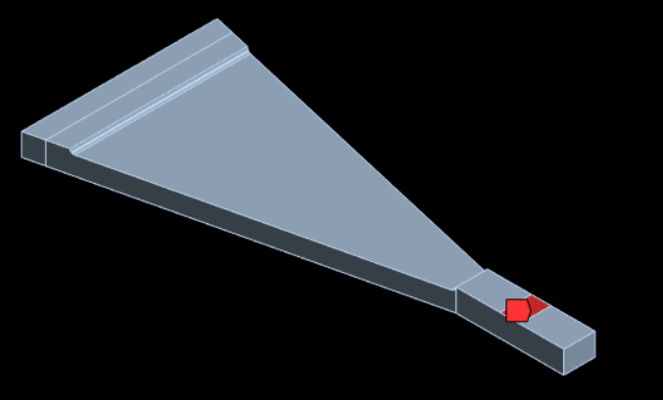
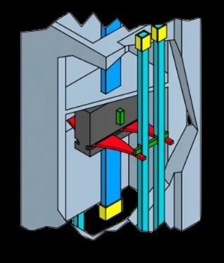
Necessity of the spring blades
While holding the mirror.
Incorporate vertical compliance
Provide a platform for mechanical noise attenuation
Part of the path for heat extraction

Slide 3
Design requirements and methodology
■ The tip of the suspension blades must be horizontal when mounting the load.
■ The stress on the parts under tension must not exceed 55 MPa, considering a minumum safety factor of 3. Considering an elastic limit of 165 MPa
The finite element method is used through Ansys to perform the simulations, iterating the process as we increasing the thickness.
[AZoM. A background to silicon and its applications Retrieved November 14, 2024, from https://www.azom.com/properties.aspx?ArticleID=599]

Slide 4
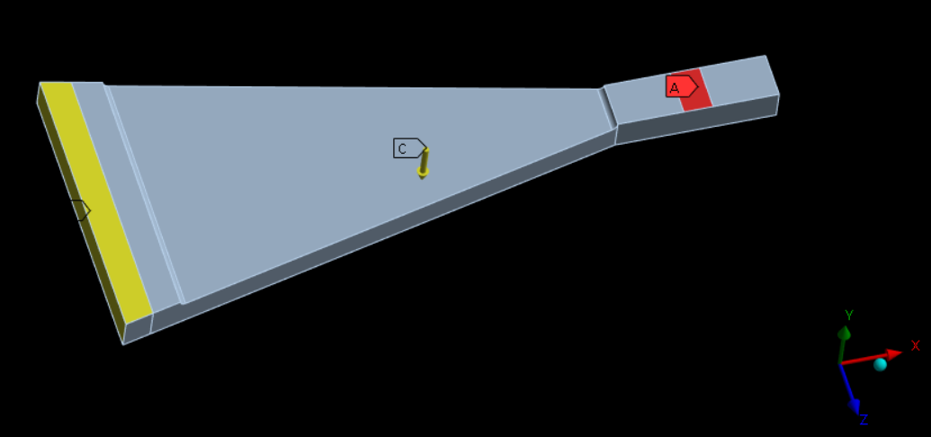
Simulation conditions
50 Kg
Gravity
Movement restriction
Explain the considerations taken when simulating the model, describe the material assignment and Ansys’s procedure verbally

Slide 5
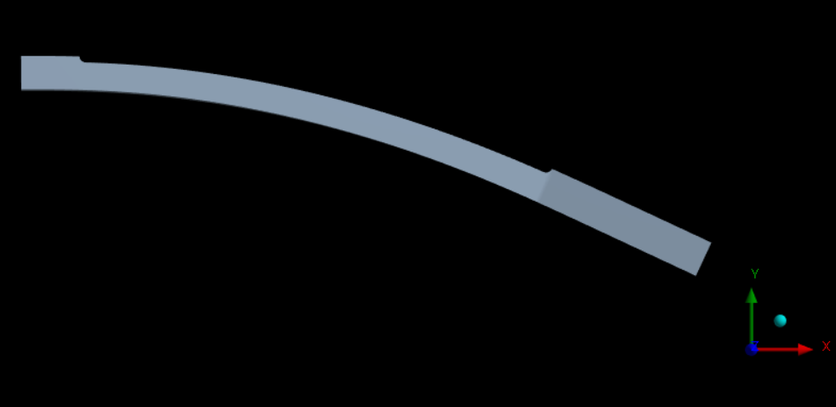
Deformation is exaggerated
50 Kg

Slide 6
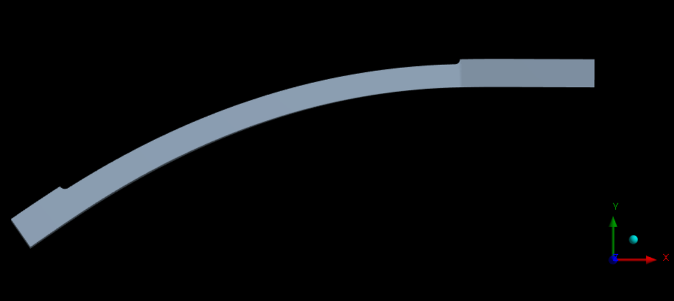
Deformation is exaggerated
$$θ$$
$$θ$$

Slide 7
Results for the different cases

Slide 8
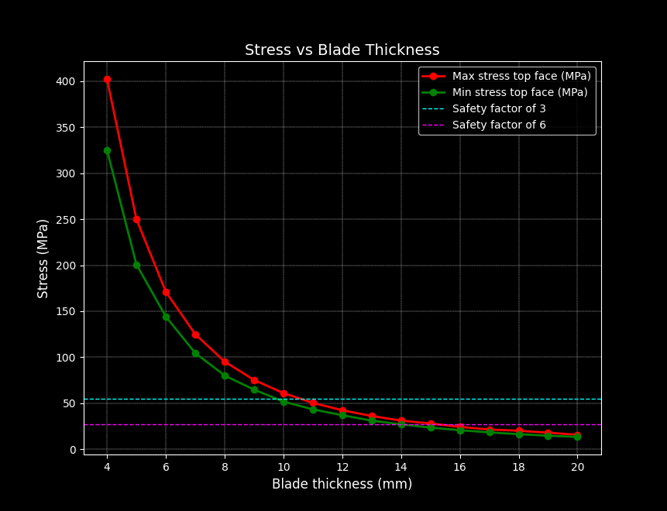
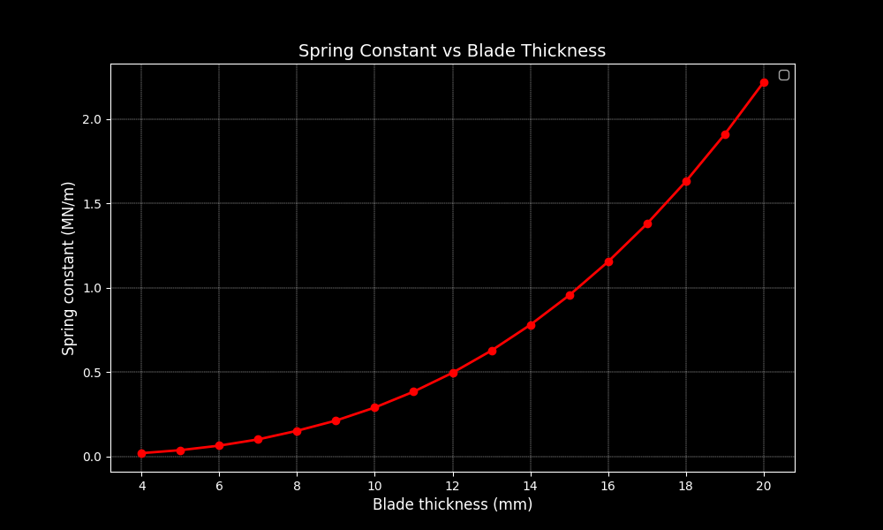
Explain that this is a compromise between the betterment of the stress distribution and the spring constant as we increase the thickness of the blade

Slide 9
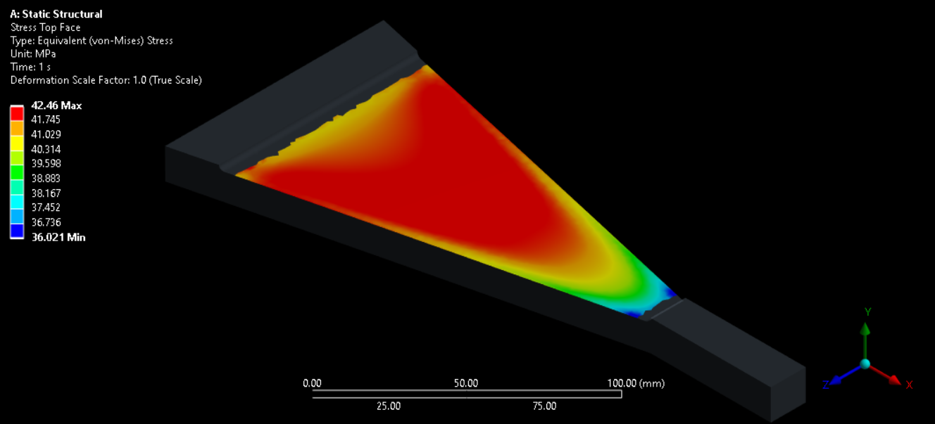
Max stress 42.46 MPa
12 mm
First mode at 15.4 Hz
Safety factor of 3.8

Slide 10
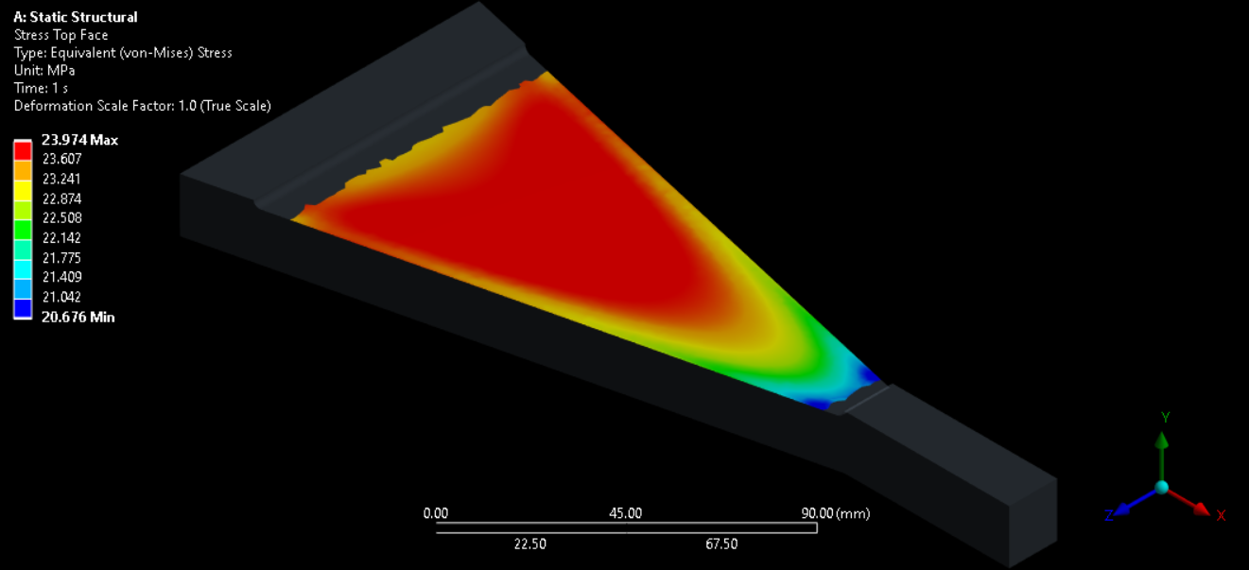
Max stress 23.974 MPa
16 mm
First mode at 23.51 Hz
Safety factor of 6.8
Change picture

Slide 11
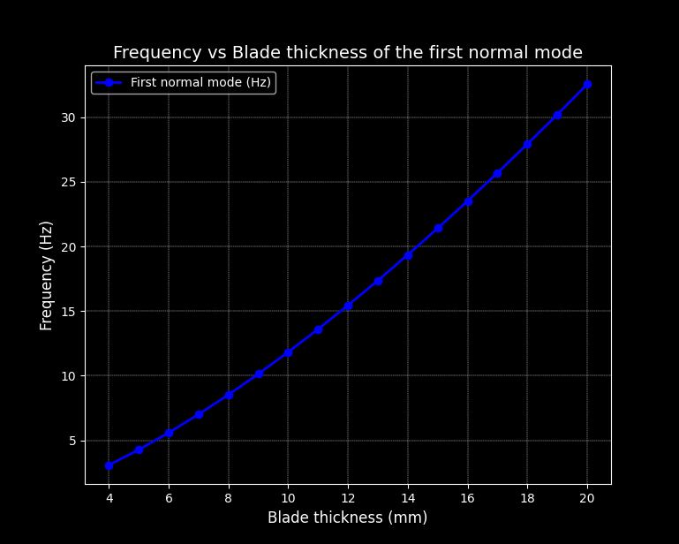

Slide 12
Output displacement
Input displacement
Not a lot of explanation, no need
Not very useful at the moment
1/f^2

Slide 13
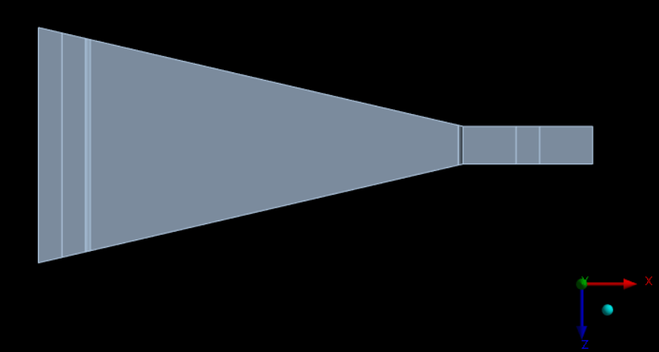
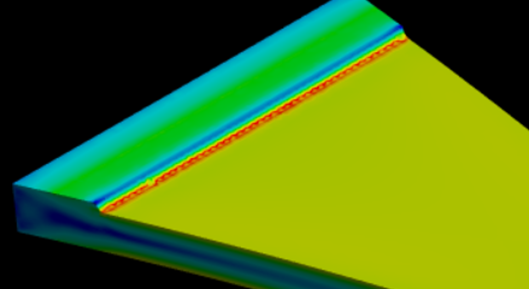
Planned optimization studies
Active anti-spring
Curved lateral profile
Fillet region

Slide 14
Conclusions
The four spring blades compensate for uneven suspension beam length.
We present some initial results for stress, normal modes and the displacement transfer function.
We present the design considerations for a safety factor 3 and 6.
We aim to lower the first resonance frequency with an active anti-spring.

Slide 15
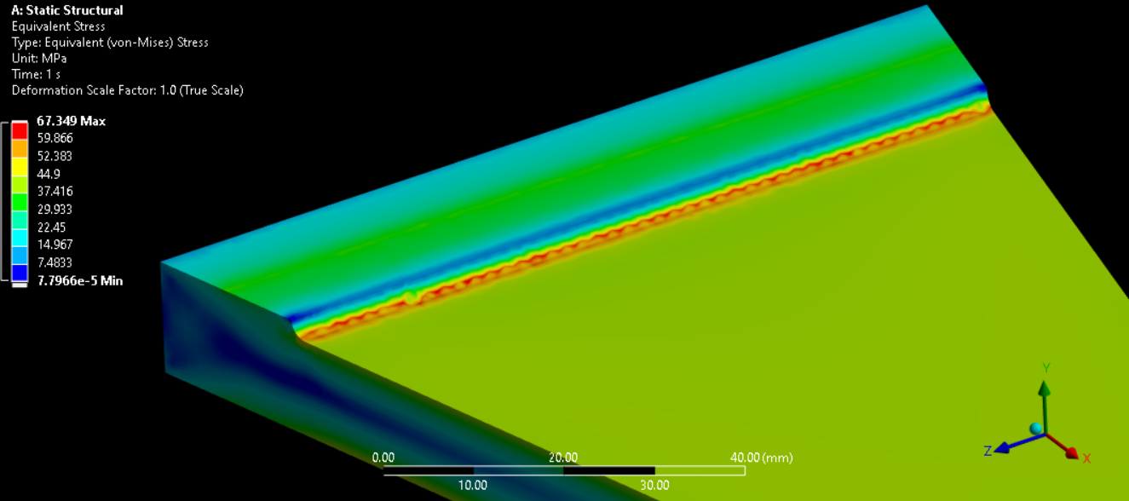
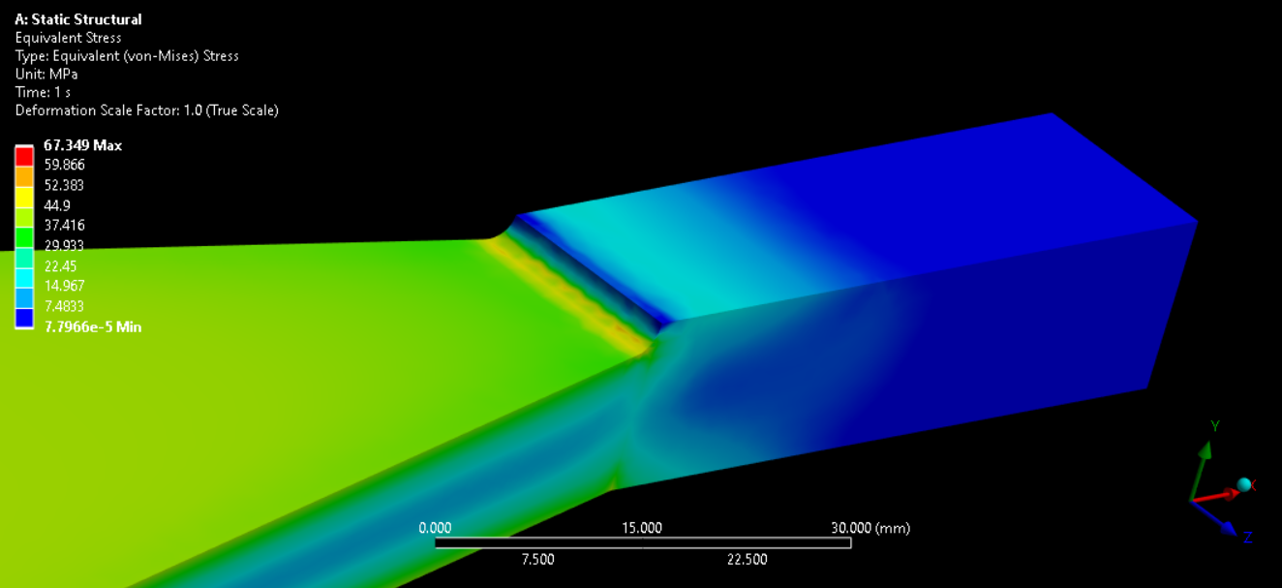
Backup slides
Fillet picture

Slide 16
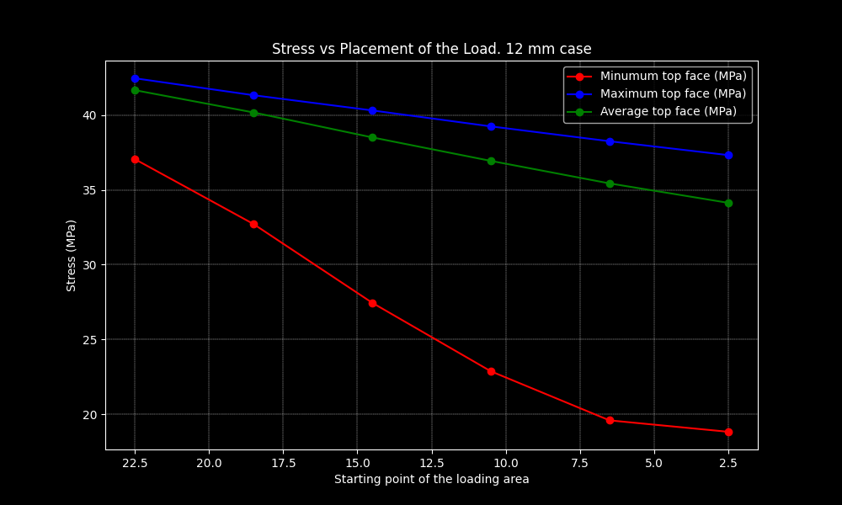
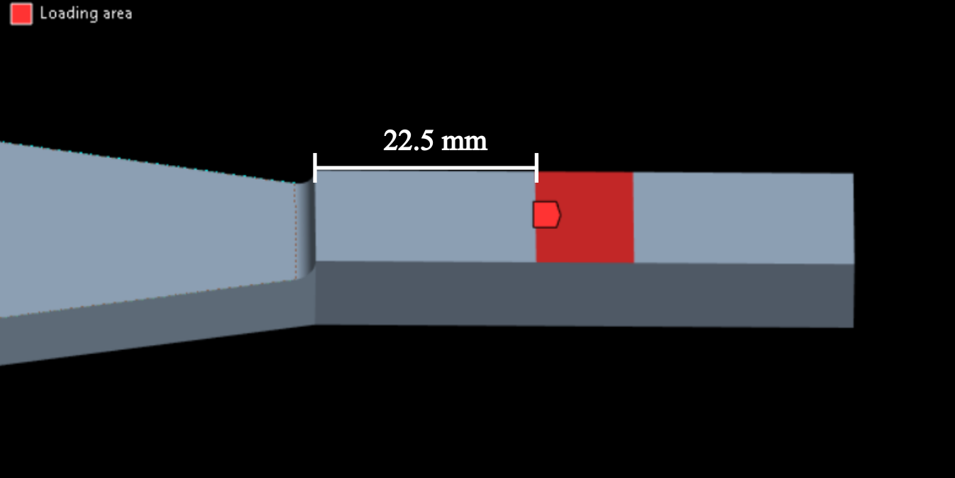
Further optimizations: Loading area
16

Slide 17
