Slide 1
Agenda

Slide 2
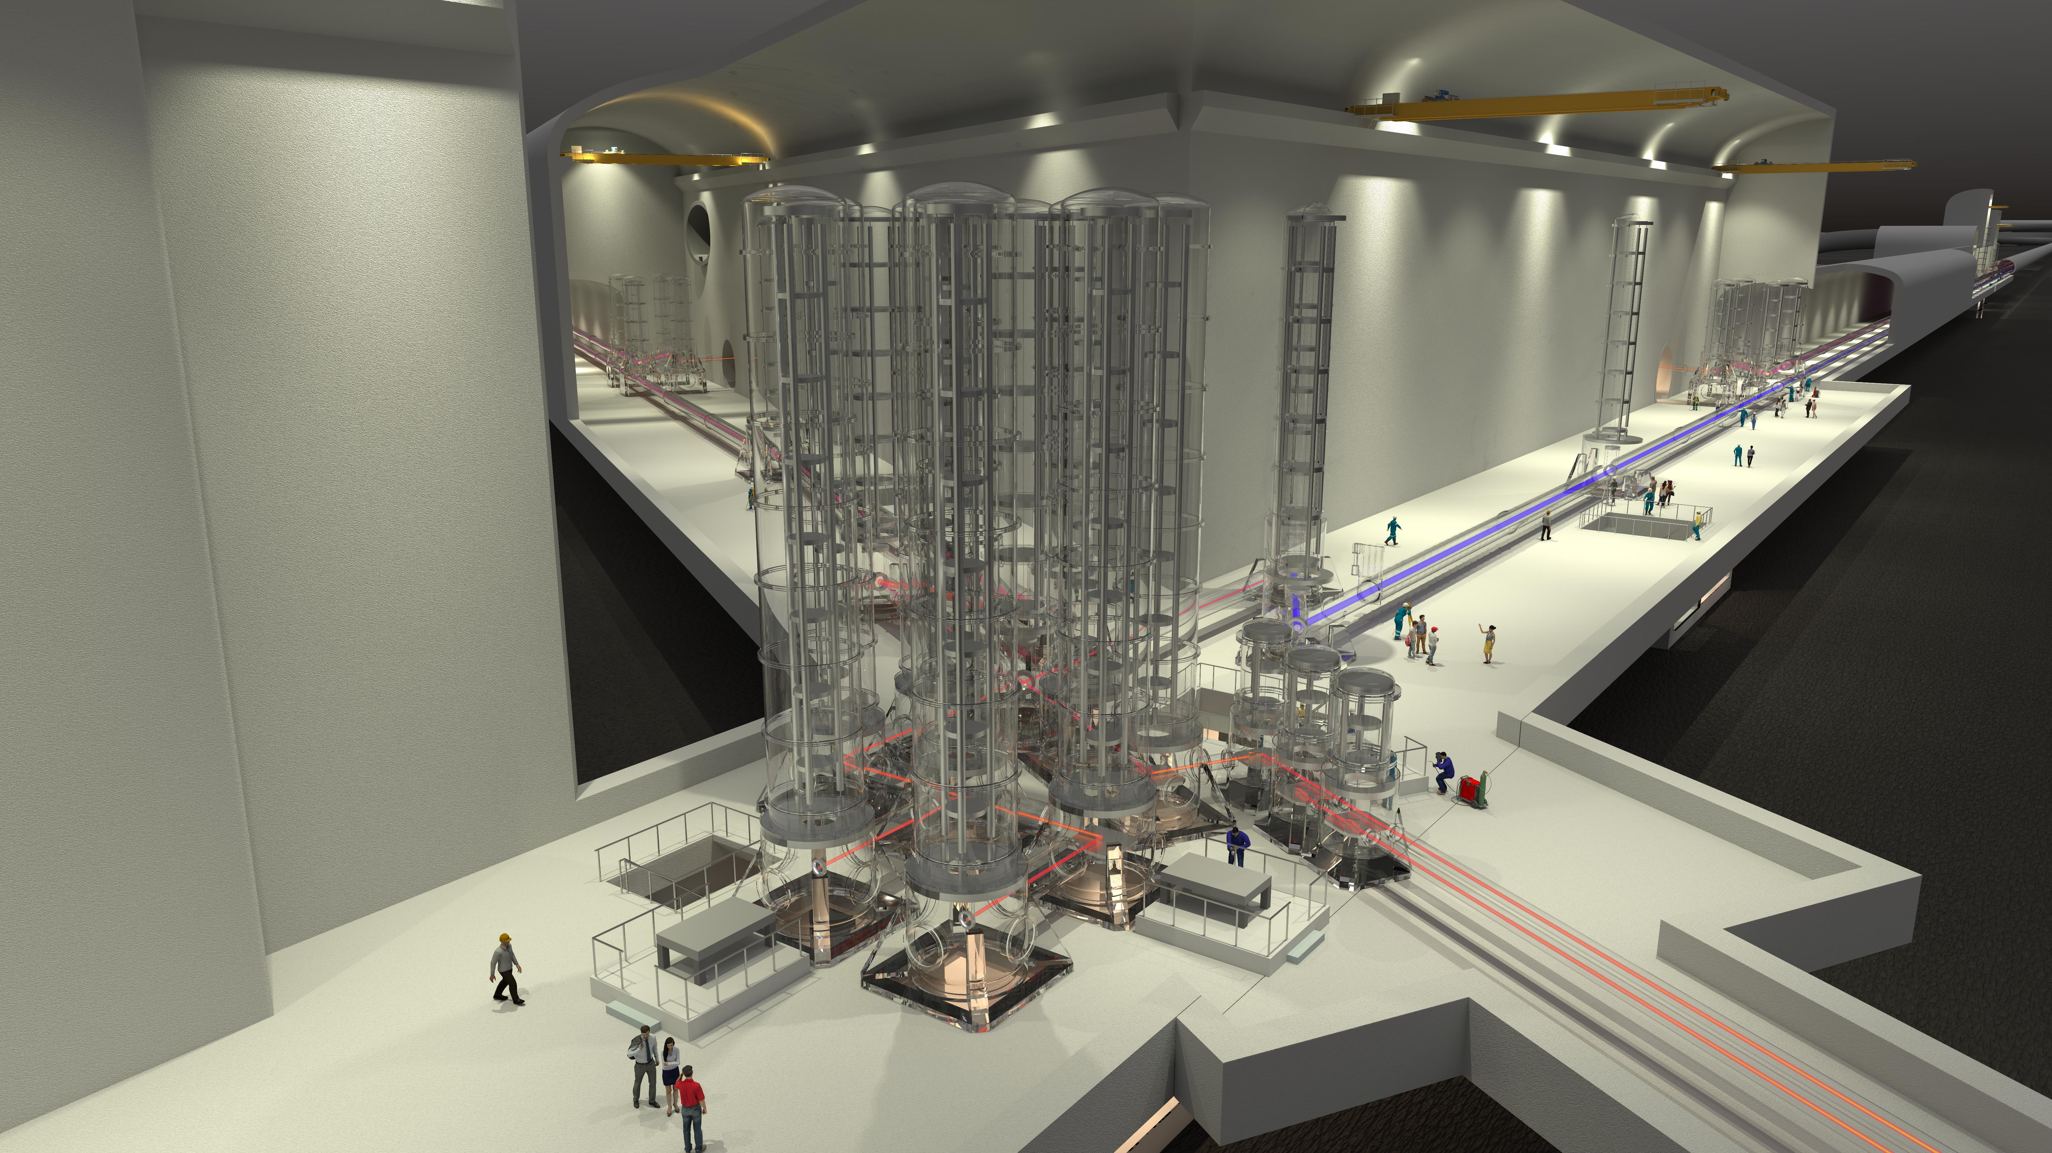
ET Monthly Meeting
October 2024
Collaboration Status
Harald Lueck

Slide 3
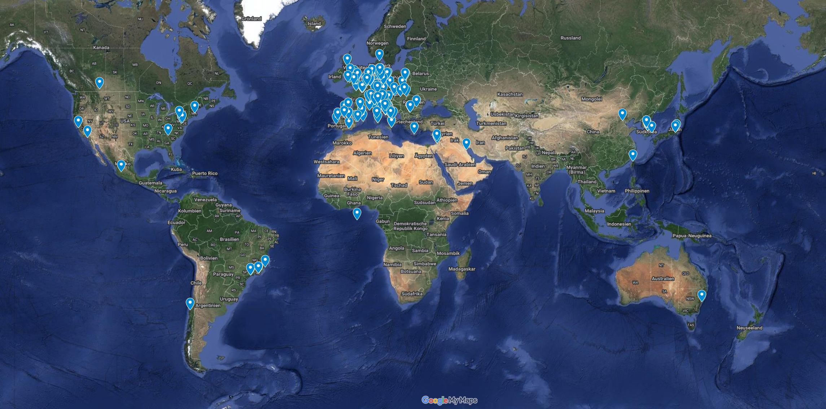
ET Member‘s Affiliation Map
1725 members (1.10.2024)
91 Research Units
Total: 253 Institutions
in 30 Countries
Notes:
https://www.google.com/maps/d/u/0/edit?mid=1GZXaOjNPYvHeVi_1EKBrwX9kkploa8M&ll=3.7269142217833036%2C0&z=3

Slide 4
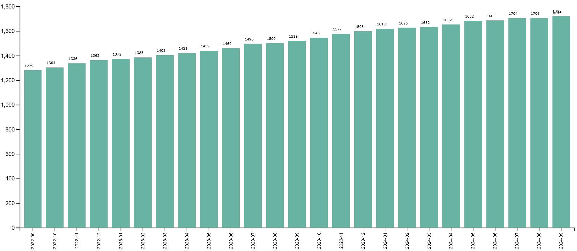
Evolution of # of members
Levelling off a little

Slide 5
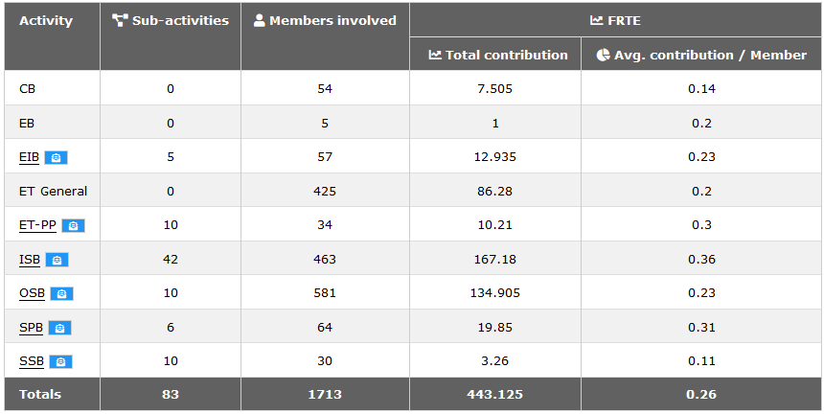
Registered activities in the Collaboration
What is all this ET General work, being done?
Why, when we have 91 RUs, are there only 54 RU leaders in the CB?

Slide 6
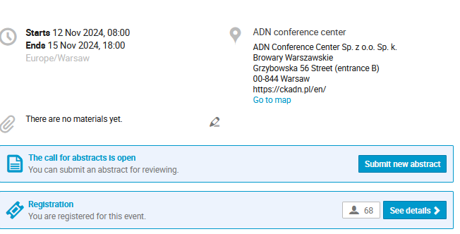
ET Annual Meeting 2024
Don‘t forget to register!
https://indico.ego-gw.it/event/764/

Slide 7
Proposal for ET Symposium 2025 in Bologna (Italy)
13th March 2024

Slide 8
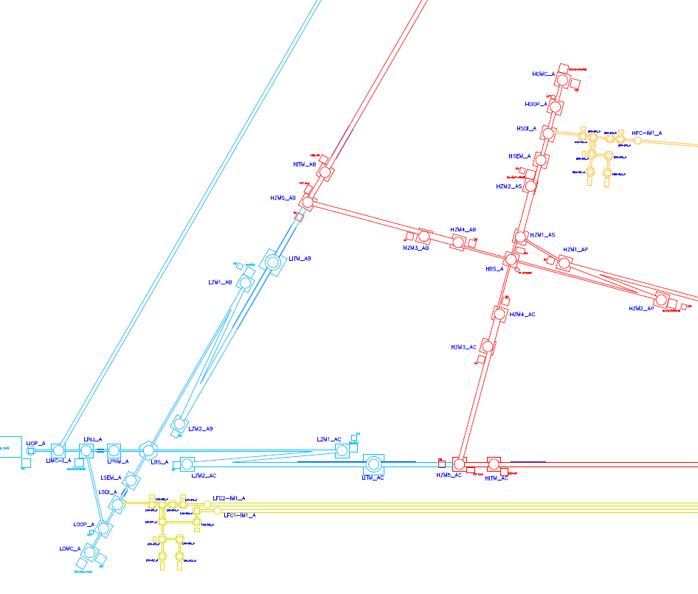
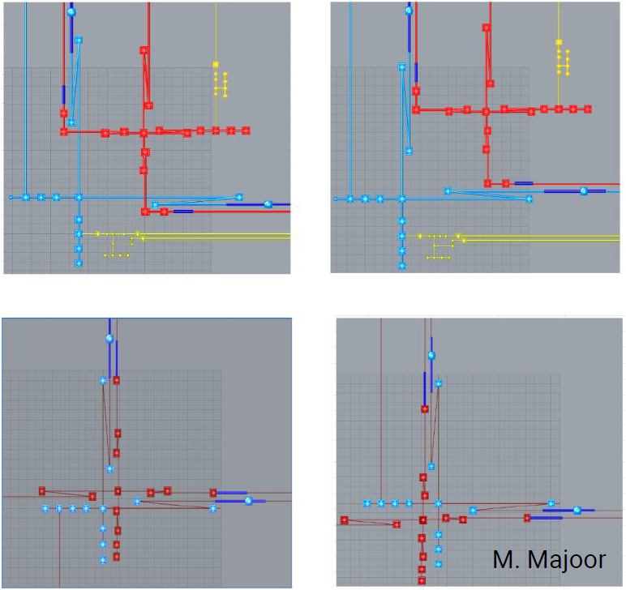
ET Optical layout → Infrastructure layout
Baseline 10km Triangle: ET-0443A-24, 90 page document; ET-0368A-24 (Graphics)
2L-Option 15km: ET-0482A-24, preliminary pptx,
document under development
Notes:
The interferometer division had been charged by ETO to deliver an optical layout for the triangle and the L option.

Slide 9
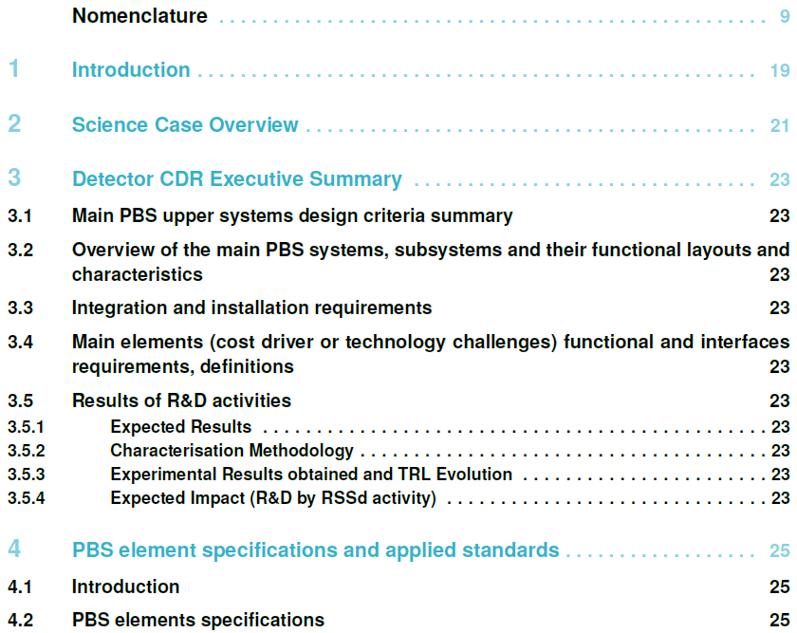
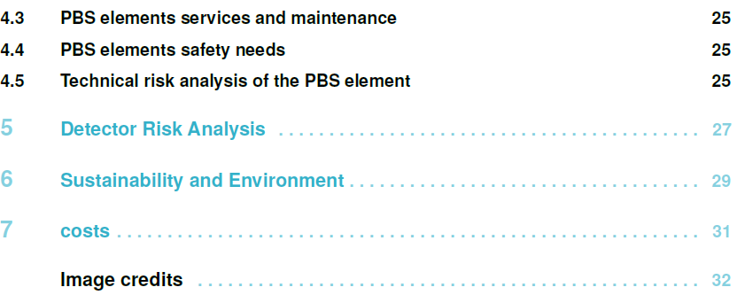
Detector TDR
The activities and the path of the TDR have been described by the ETC management at the last ET symposium and the ET-PP Barcelona meeting in June.
The template of the TDR has been suggested by the ETO Project Office and the structure agreed upon in the regular bilateral meeting between EB/ED/PO chairs («Wednesday meetings»)
ET-0307A-24

