Slide 1
Modelling low-frequency control noise for the Einstein Telescope and deriving a requirements matrix
ET Symposium, ISB/ANM session
Artem Basalaev (AEI Hannover, 10 m Prototype)
on behalf of ET LF Control Noise WP
ET-0264A-25, ET-0327A-25
27 May 2025

Slide 2
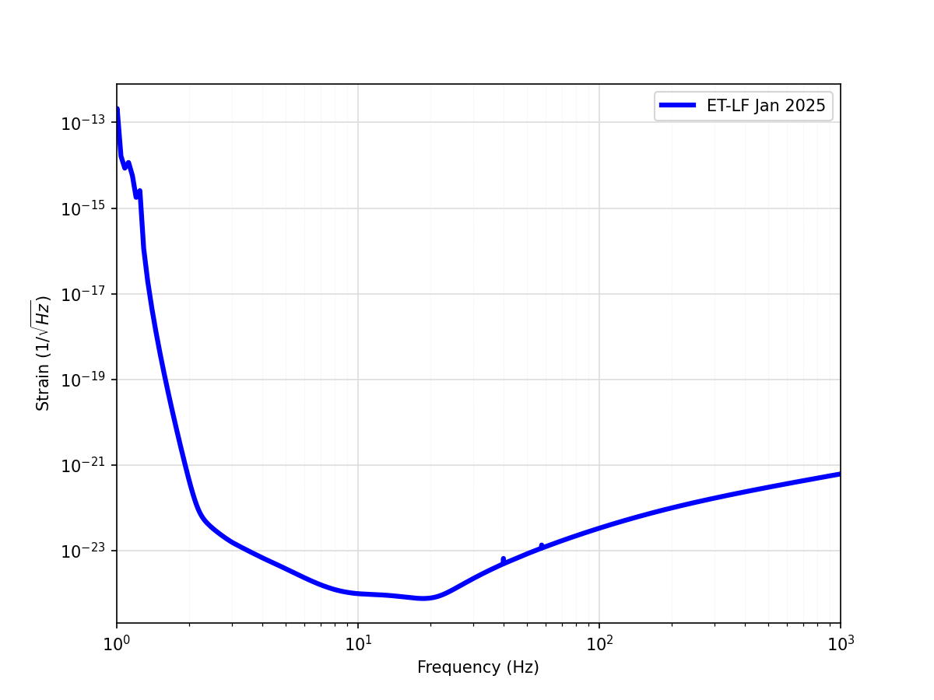
Low-frequency noise wall
Very steep here!
Can we actually achieve this?
We don’t know: complex interplay of requirements
et-sensitivity-curves in git

Slide 3
Controls (especially LF) are uniquely affected by interplay of noises in two realms: optics and mechanics
IFO controls
Suspension
controls
* not actual ET optical layout
??
* not actual ET suspension

Slide 4
How to tackle this interface without “simulating everything”?
If we can make simulation modular, we can also better integrate with other groups and work in parallel
Requirements flow between modules and in some cases loop in several iterations
Suspension model:
State Space
Transfer functions
Our Box:
Susp/Finesse interface
Finesse model for control effects
IFO model:
(huge) Finesse model

Slide 5
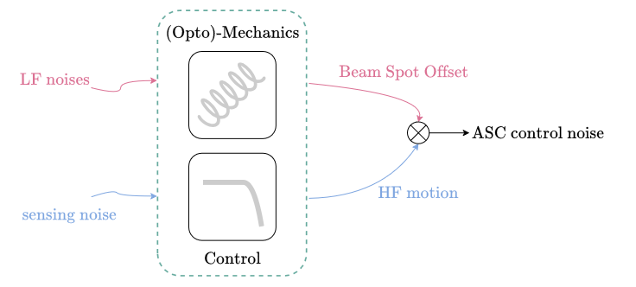
Where to start
Tackle potentially the worst offender: angular sensing and control (ASC)
Build up one cavity model with realistic last stage suspension
Assume some value for beam spot RMS and sensing noise, see how they interact
Do this for pitch
Do this for yaw
Include effects of longitudinal sensing noise (LSC)
Build up more realistic IFO model/take “official” model – this is a big one!
Is Finesse the right tool? Check results esp. for pitch
we are here
Credit: Riccardo Maggiore
L
d
L’
|L-L’| ≈ d*α
α

Slide 6
Our Current Model
Our model is accessible in ET gitlab
MAR→MIR TF (pitch, yaw)
← RP effects →
Realistic marionette → mirror TF extracted from state space suspension model and ported to Finesse
Mirrors response to tilts is calculated with radiation pressure effects
Two variables: static beam offset and tilt sensing noise
Fix one, vary the other to get max allowed: get requirements matrix

Slide 7
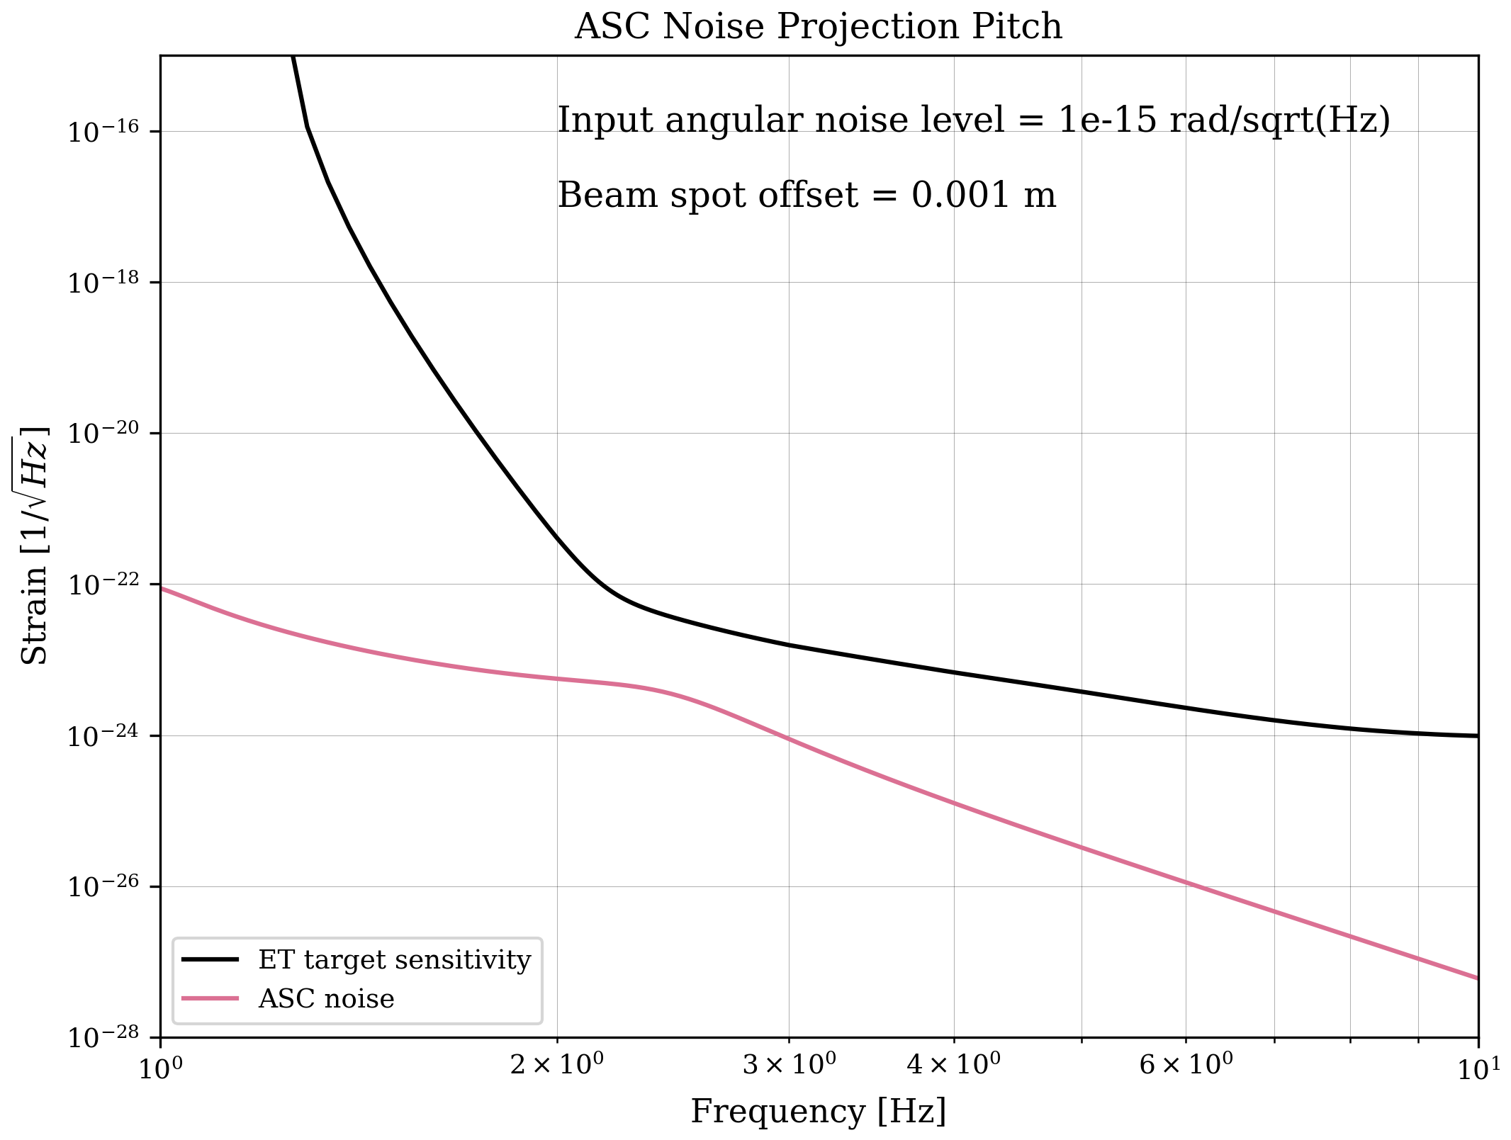
Preliminary results
Tilt sensing noise and beam spot offset are at ~low levels

Slide 8
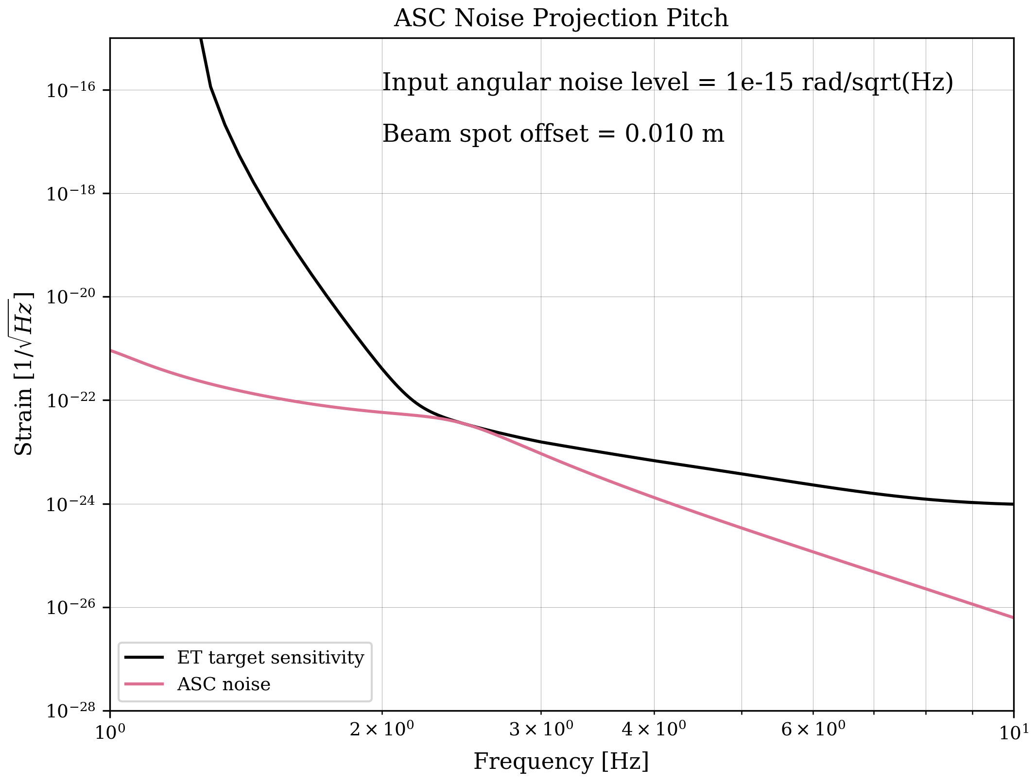
Preliminary results
Tilt sensing noise is fixed at low level, find maximum tolerable beam spot offset before exceeding ET sensitivity

Slide 9
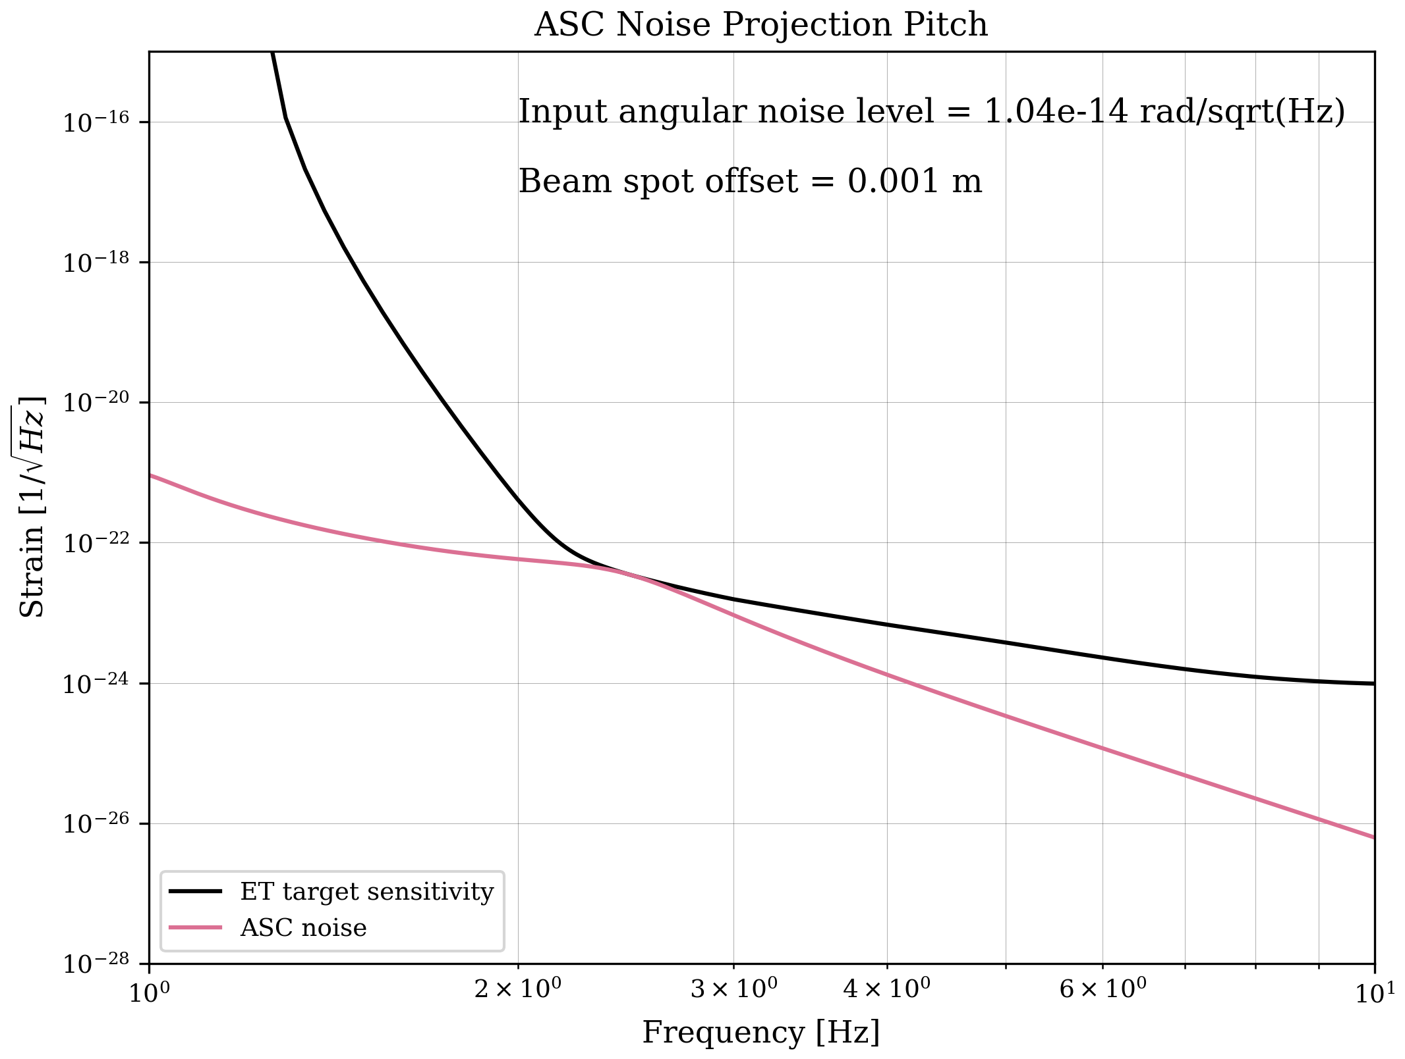
Preliminary results
Beam spot offset is fixed at low level, find maximum tolerable tilt noise input at marionette before exceeding ET sensitivity

Slide 10
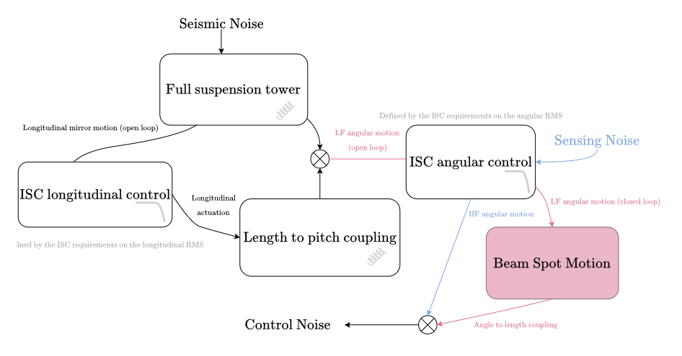
Where next? LSC noise
Credit: Riccardo Maggiore, Jonathan Perry

Slide 11
Where next? IFO, Suspensions models
Previously studied case of Virgo [Maggiore et al 2024]
Angular noise is not simply multiplied by static offsets beam offsets – they act as mirror tilts in actual model
Interaction with IFO Division:
Virgo work made possible by available official model finesse.virgo – we need finesse.et!
Sensing matrix: use good guess from them, provide feedback, iterate
Interaction with Suspensions Division:
Marionette → mirror TF – is it enough??
Angular RMS guess

Slide 12
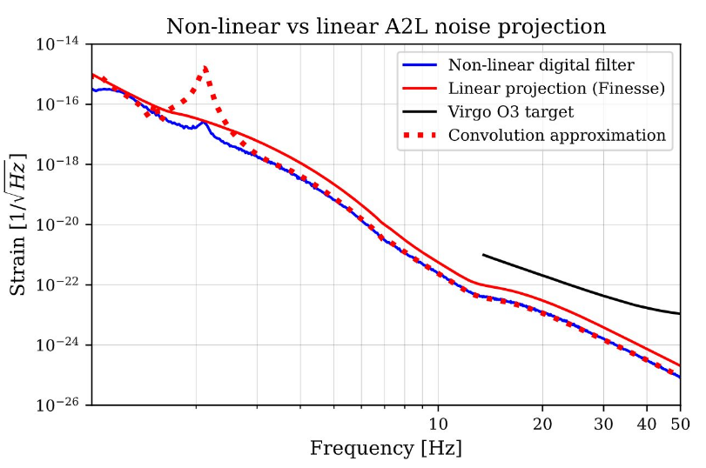
Finesse modelling – is it enough for us?
Does Finesse underestimate ASC noise, however complex the model?
Perhaps yes! Because ASC is nonlinear. Looking into time-domain simulation and “in-between”
The case of Virgo. Credit: Jonathan Perry, GWADW presentation [ET-0234A-25]

Slide 13
Conclusions
Note with more information: ET-0327A-25
Low-frequency control noise of ET is a hard problem
We can only solve it by working together and adopting modular approach with clearly defined responsibilities of WPs
LF Control Noise WP is at the interface between Suspension and Optics
First step: tackle ASC noise with Finesse model with realistic suspension, produce requirements matrix (first result shown)
Next: further develop the model in cooperation with Suspension and IFO Divisions, iterate on requirements
In parallel explore limits of our tools: e.g. is Finesse sufficient for, generally, non-linear problem of LF controls?

Slide 14
Conclusions
Note with more information: ET-0327A-25
Low-frequency control noise of ET is a hard problem
We can only solve it by working together and adopting modular approach with clearly defined responsibilities of WPs
LF Control Noise WP is at the interface between Suspension and Optics
First step: tackle ASC noise with Finesse model with realistic suspension, produce requirements matrix (first result shown)
Next: further develop the model in cooperation with Suspension and IFO Divisions, iterate on requirements
In parallel explore limits of our tools: e.g. is Finesse sufficient for, generally, non-linear problem of LF controls?
…
PROFIT! ET TDR

Slide 15
Thank you!
image ref

Slide 16
Backup

Slide 17
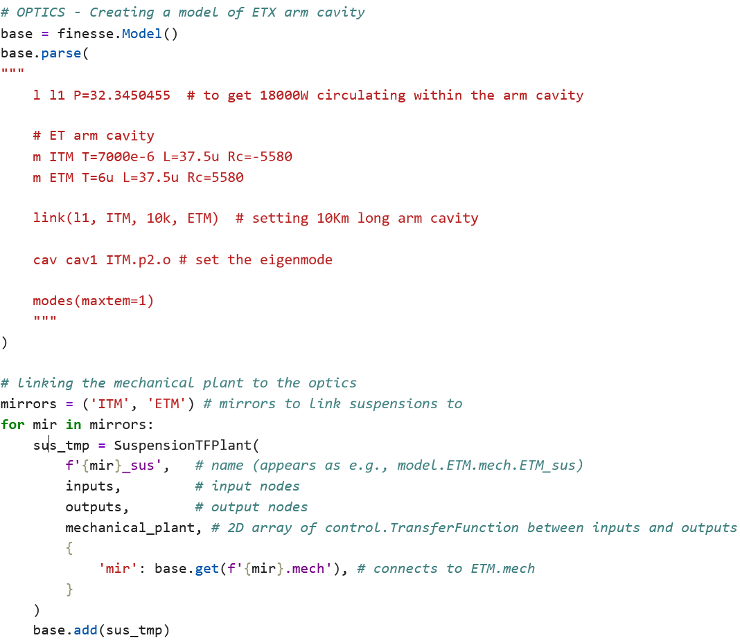
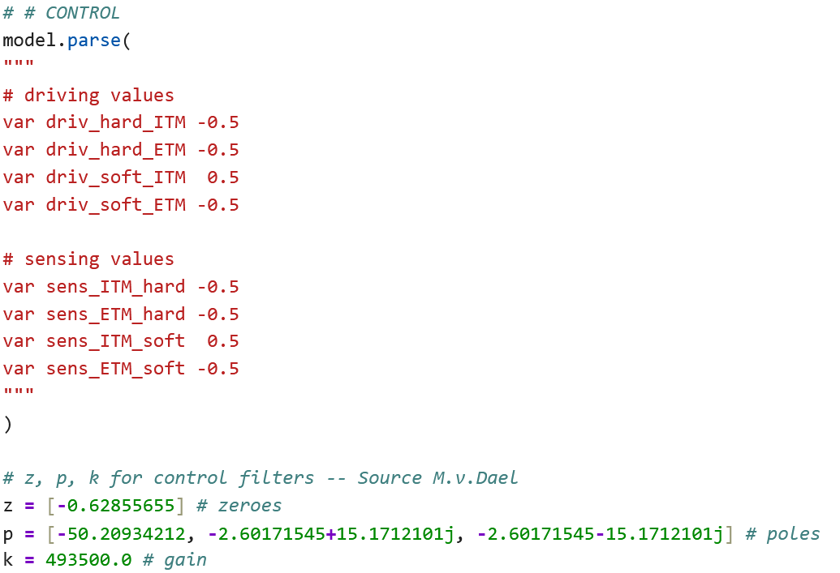
Optics model & Control

Slide 18
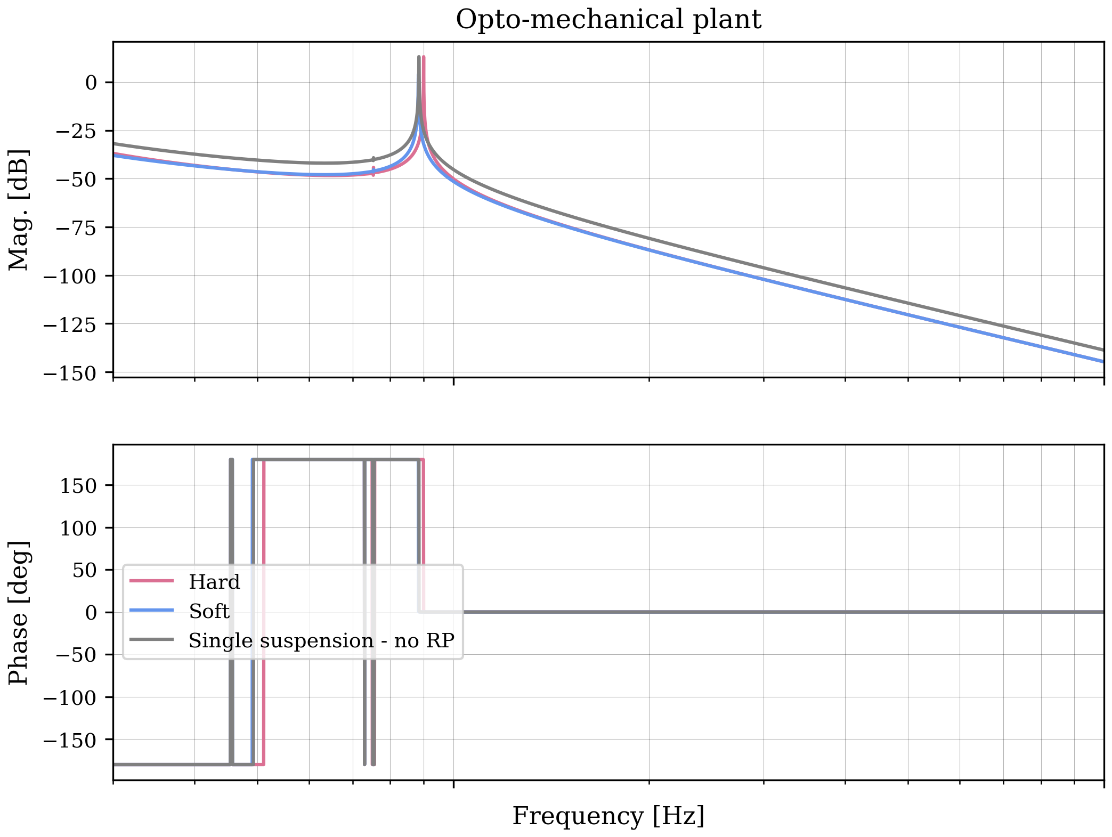
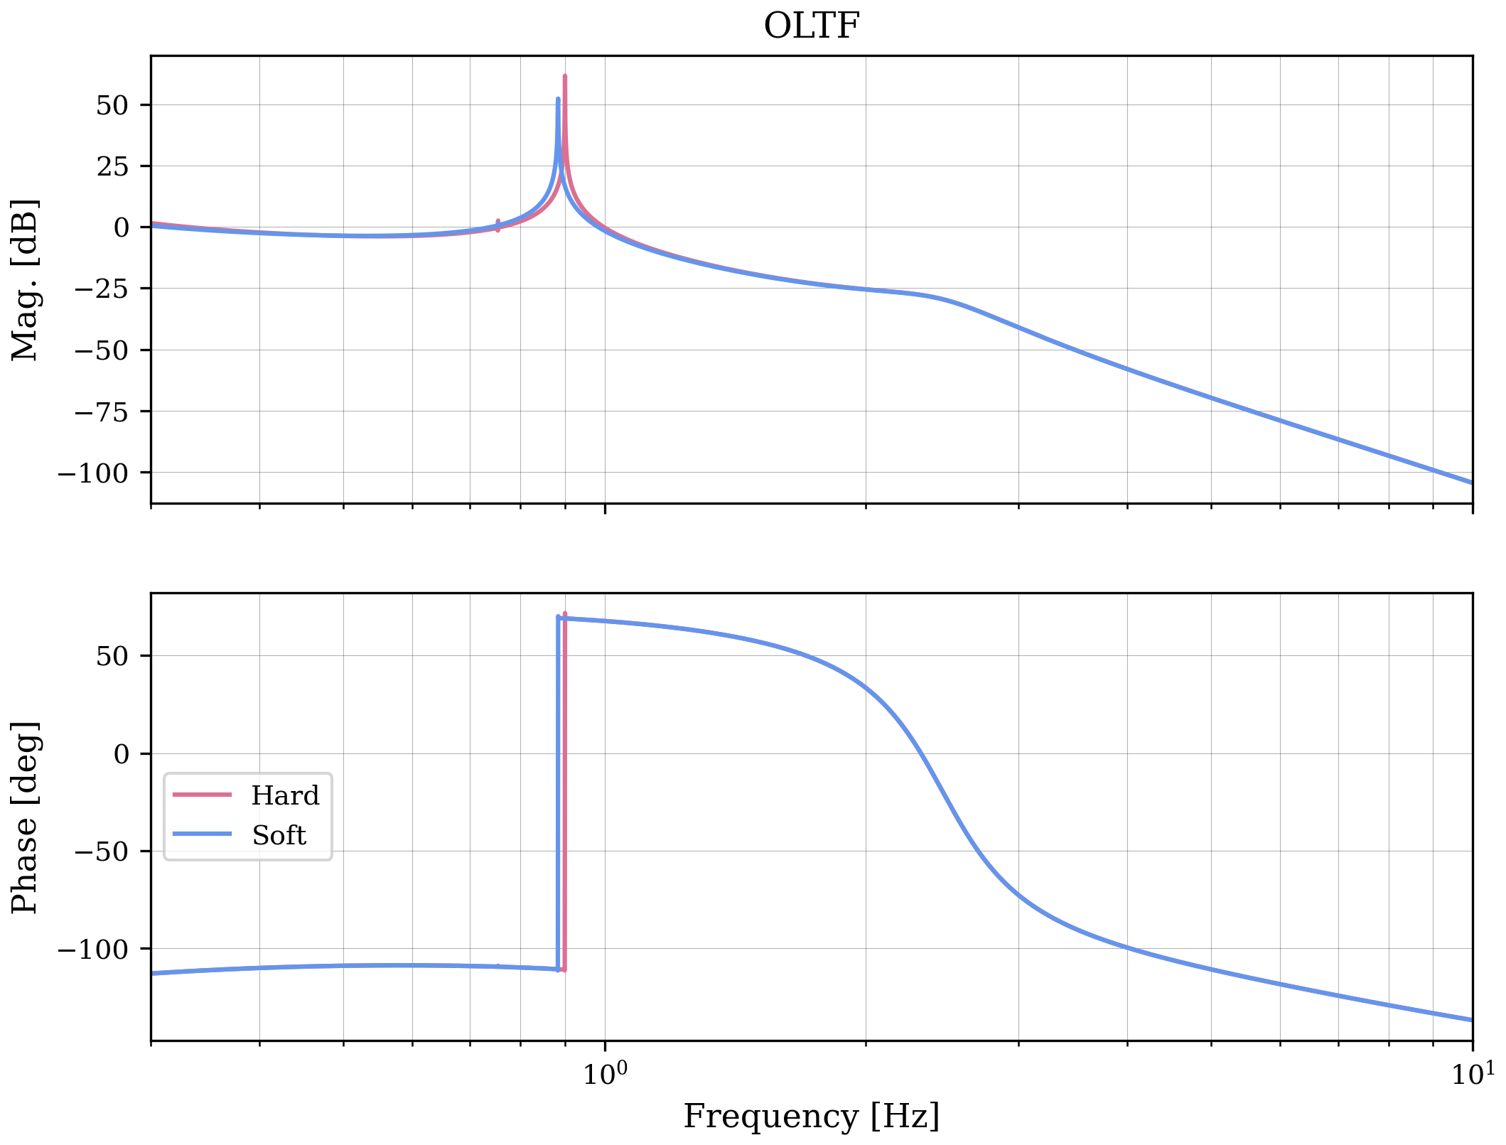
opto-mechanical plant

Slide 19
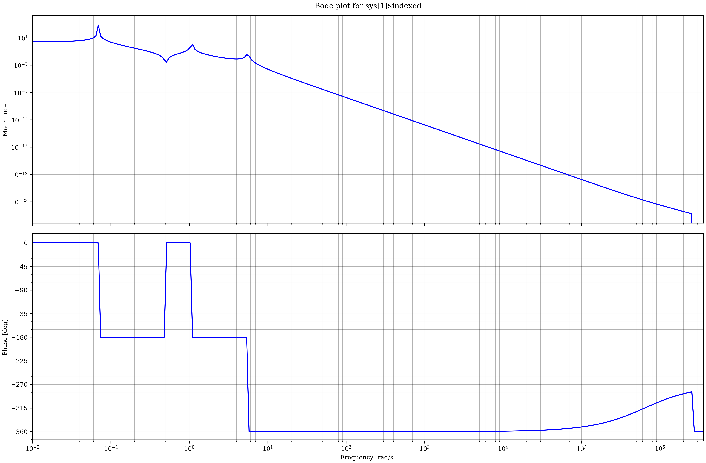
Suspension model
Marionette torque in pitch → mirror pitch transfer function
Notes about this model:
Author: Robin Cornelissen
Ref: ET-0592A-24, live doc: https://www.overleaf.com/read/bgcyqqrtrdmc#03d933
Produced with Femto
The model, especially the parameters, are not final.
E.g. mirror mass went through several iterations; a value of 211 kg was used here
Model is converted to SuspensionTFPlant for Finesse

