Slide 1
DESIGN AND ANALYSIS OF A CRYSTALLINE SILICON TRIANGULAR VERTICAL SPRING BLADES
ESRA ZERINA APPAVURAVTHER
GEO 600-MAX PLANCK INSITUTE FOR GRAVITATIONAL WAVE PHYSICS (AEI)- POST-DOC

Slide 2
Motivation
For the ET-LF (low frequency) cryogenics suspension, achieving sensitivity at 10K requires crystalline materials. While both sapphire and silicon are candidate materials, we aim to work with crystalline silicon, using a new manufacturing method (WEDM-Wire Electrical Discharge Machining) to enhance surface stress and lower the resonance frequency (10 Hz) of the vertical spring blades, meeting the required sensitivity.
Artist's impression of the underground Einstein Telescope, a planned third-generation gravitational-wave detector.
© NIKHEF

Slide 3
Why Crystalline Silicon for ET?
ET requires cryogenic components to reduce thermal noise in the interferometer.
Silicon stands out for its:
High thermal conductivity (esp. at 10–20 K).
High mechanical (breaking) strength (suitable for suspensions).
Low thermal noise.
Low optical absorption (suitable for substrate applications).

Slide 4
SINGLE CRYSTAL Silicon database:
Website: https://wiki.et- gw.eu/ISB/MaterialsDatabase/DatabaseSuspensions

Slide 5
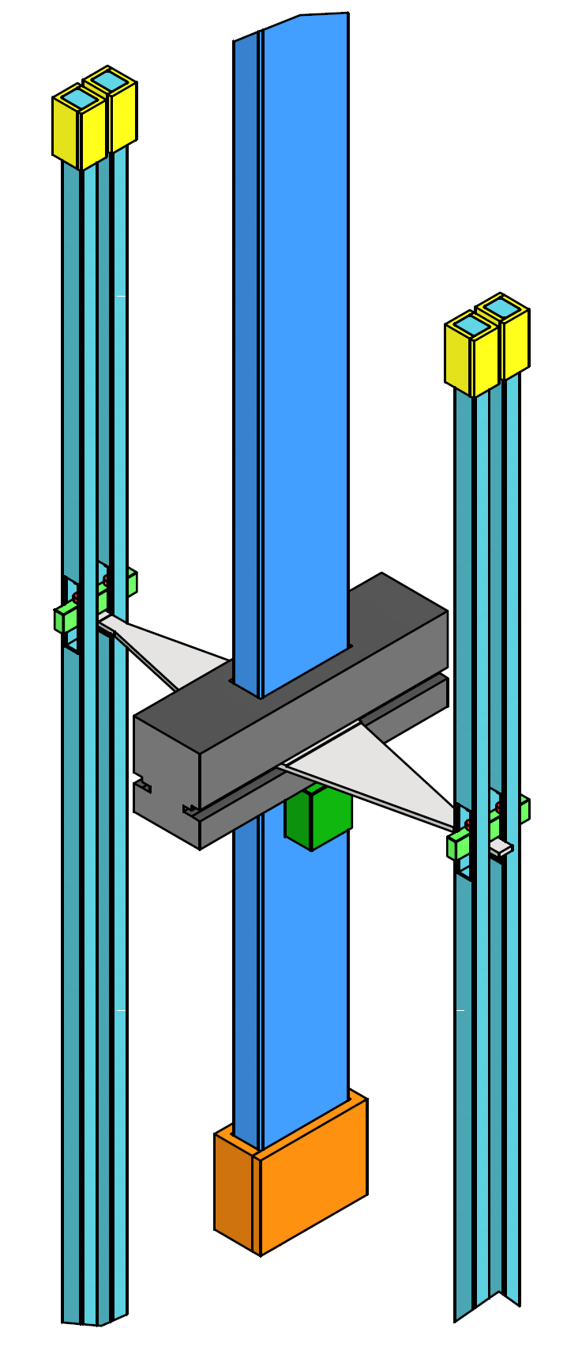
Why are crystalline vertical blades needed ?
Our concept of the ET-LF test masses involves employing a cryogenics suspension system that utilizes flexural joints combined with rectangular cross section rods.
The silicon blades lower resonance frequency and provide compliance for load distribution compensate for beam length tolerances.
My initial goal is to optimize the blade geometry in ANSYS to reduce mechanical stress and enhance natural frequencies, incorporating a new manufacturing method to further improve surface stress on the blade (Figure 1).
Figure 1. Isometric view with detail of test and intermediate mass (Scheme made by CSULA team of the suspension solution).

Slide 6
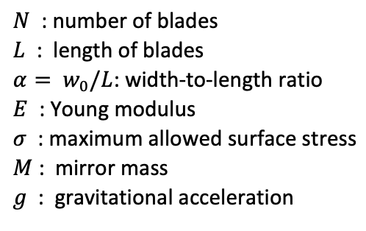
Mathematics of ideal triangular blade springs with small deformation
As a starting point for blade design purposes, we choose the following fixed “input” parameters:
We can solve all other “output” parameters, including:
(1) Clamping angle (θ)
(2) Blade thickness (t)
(3) Natural frequency (f)
(4) Tip stiffness (k)

Slide 7
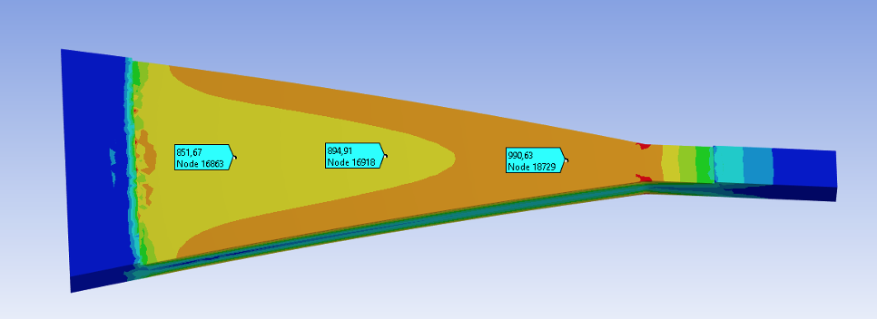
Parameter optimization
Our initial investigation focuses on blade dimensions:
Length (150mm, 175mm, 200mm, 225mm),
Width (50mm, 75mm, 100mm),
Thickness (5mm-20mm).
Simulations involve loads:
100kg-1000N,
50kg-500N.
Figure 2. Von-Misses Stress Distribution (MPa) upper view of the intermediate mass crystalline silicon triangular blade spring.

Slide 8
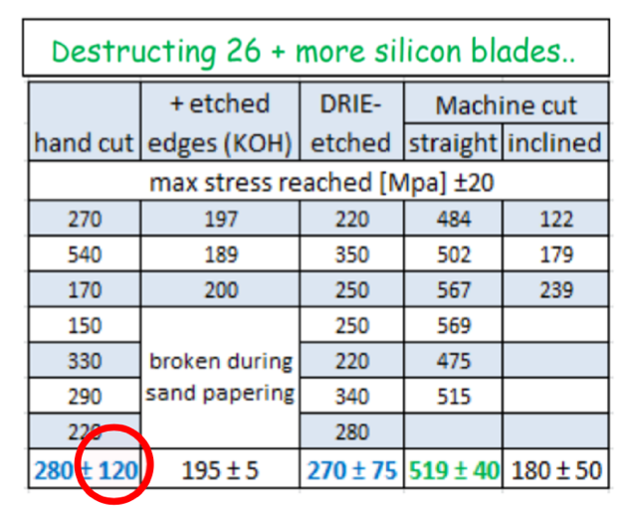
SILICON’s BREAKING STRENGTH
The blade's design aims to maintain stress well below the silicon's yield tensile stress.
The tensile stress causing silicon cantilever blade breakage was measured at approximately 270±75 MPa (Table 1).
To ensure safety, a maximum allowable tensile stress of 90 MPa is applied, considering a safety factor of 3.
Table 1. Results of breaking stress measurements on rectangular samples (10<L<20cm, thickness>2mm) done at Nikhef (2013).

Slide 9
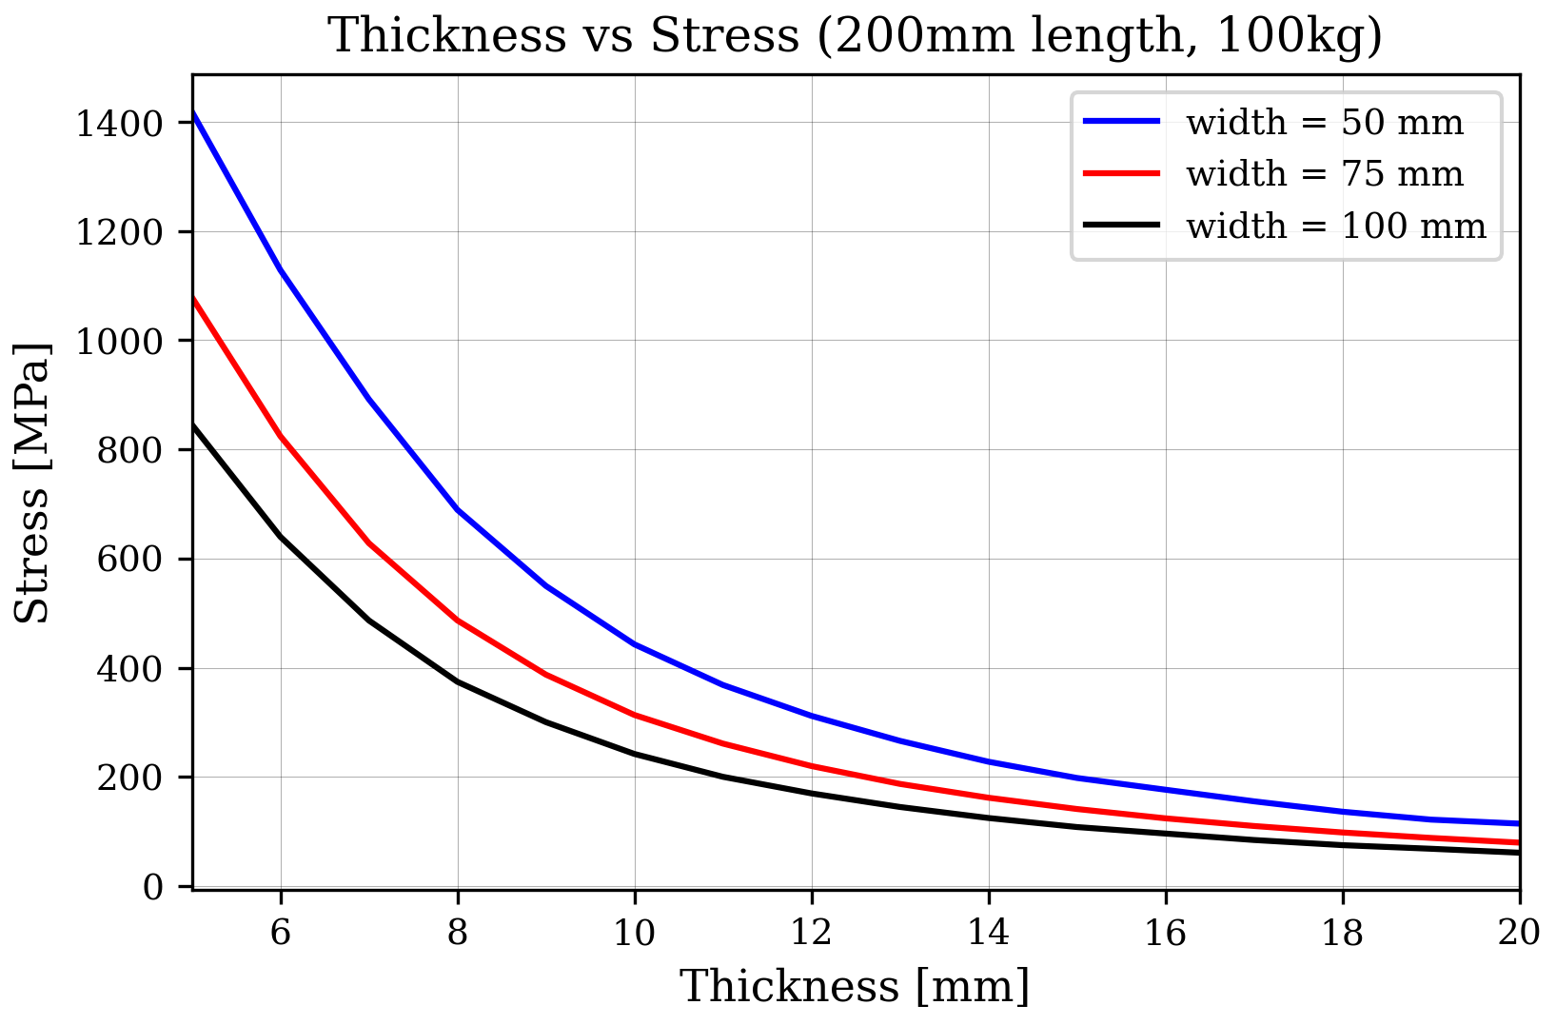
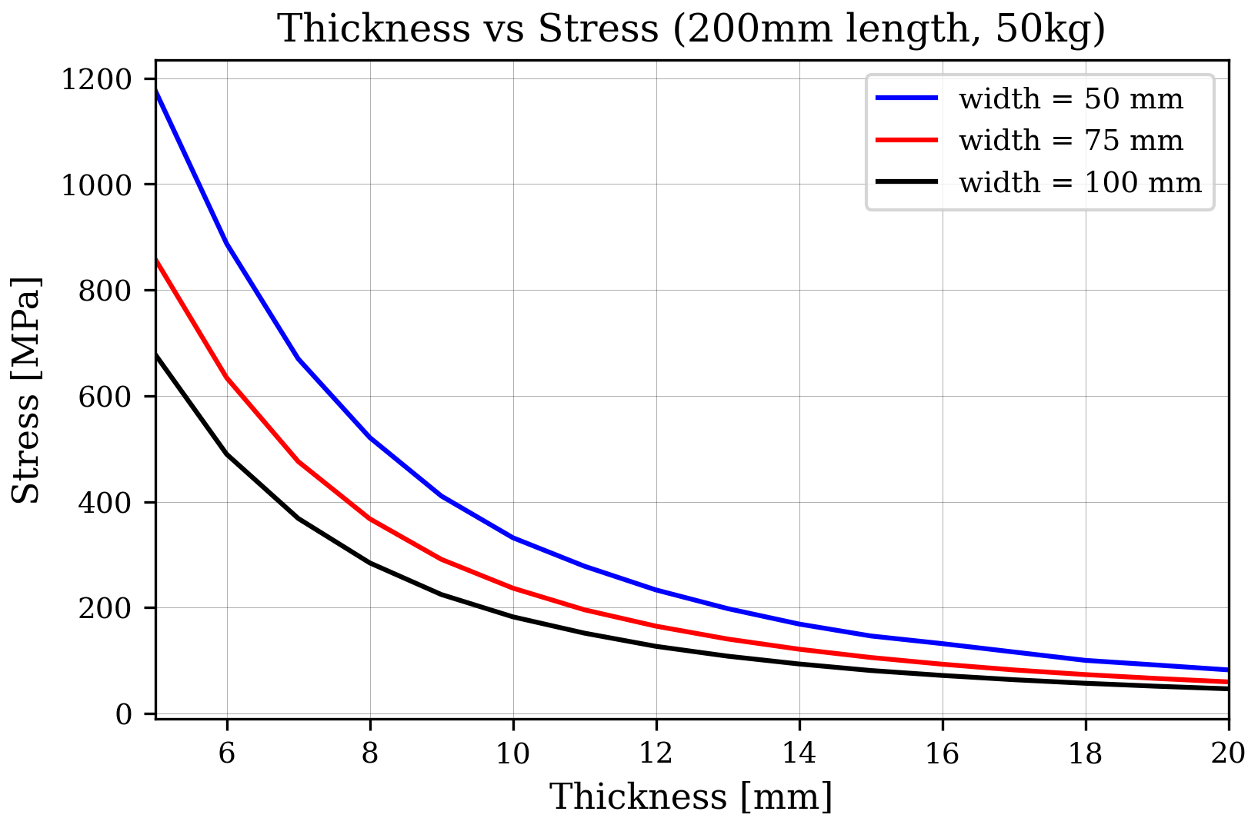
Surface stress
The tensile stress of 90 MPa is applied, considering a safety factor of 3.
Thicker blades show lower stress.
3x safety factor

Slide 10
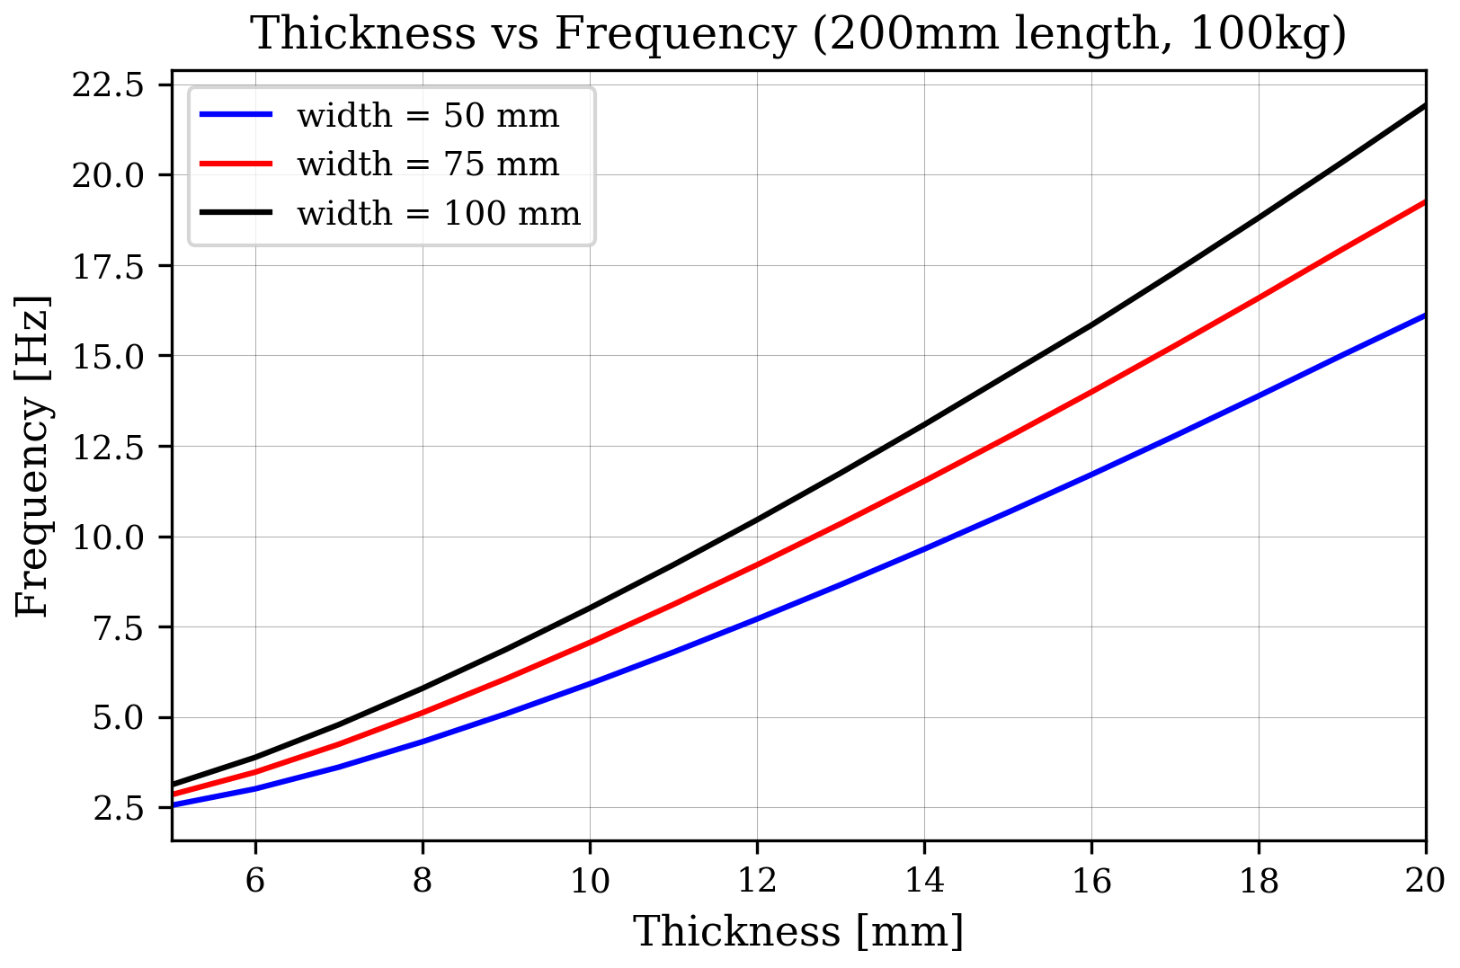
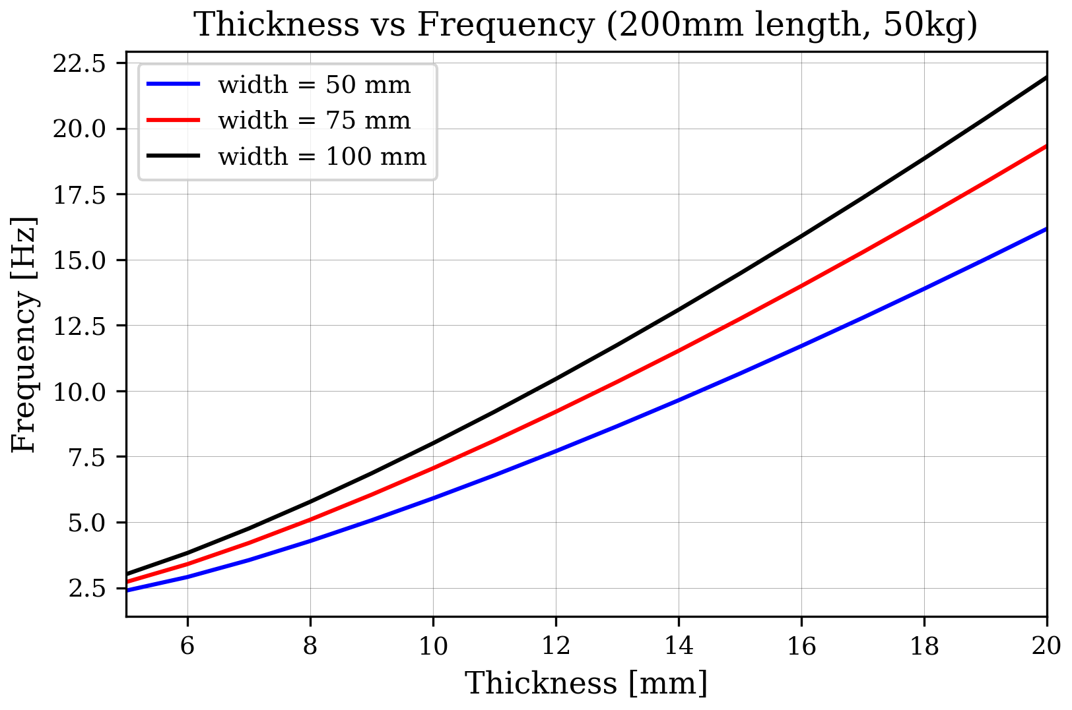
Natural frequency
Thicker blades have higher natural frequencies.
Design with less than 10Hz natural frequency.

Slide 11
Experimental setup
The research aims to identify conditions that result in the maximum feasible stress for crystalline silicon flexures.

Slide 13
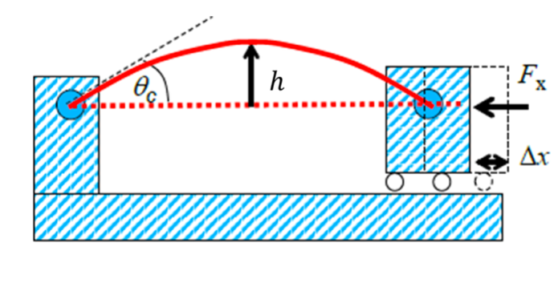
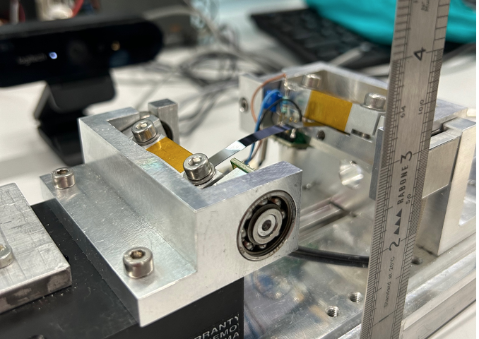
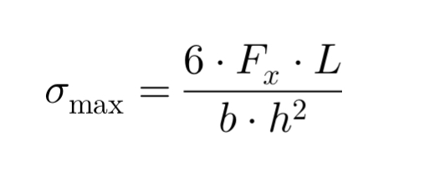
How to calculate the bending stress of the flexures
An experimental setup has been prepared at Nikhef to measure stress (Figure 3).
This setup measures compression distance, compression force, height of the flexure, and the rotation angle at the end of the flexure, as shown in Figure 4.
Figure 4. Drawing of the experimental setup.
Figure 3. Photograph shows the height measurement process.

Slide 14
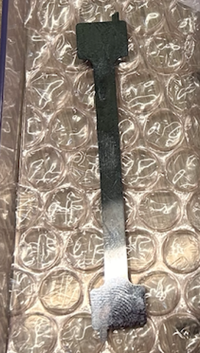
WEDM cut strategy
The electrical sparks between the wire and the material can only occur if the material allows current to flow.
Strategy:
Half of the samples will be cut along the <110> axis, with a breaking stress of 270 MPa (Table 1).
Due to the triangular design, cuts solely along <110> are impractical, so we will also test samples at a 13-degree angle to simulate tapering (Figure 5).
Wafers are 100 mm diameter, 300 µm thick, double-side polished, N-type (Sb) doped, with resistivity 0.008 to 0.02 ohm-cm, oriented <100>. Electrically conductive
WEDM: thin wire and electrical sparks to cut hard materials like metals or crystals without touching them (complex shapes with high accuracy).
Figure 5: Cutting Strategies: <110> and 13-Degree Inclined Sections

Slide 15
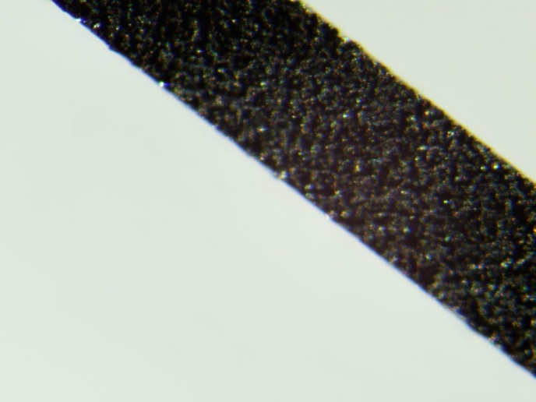
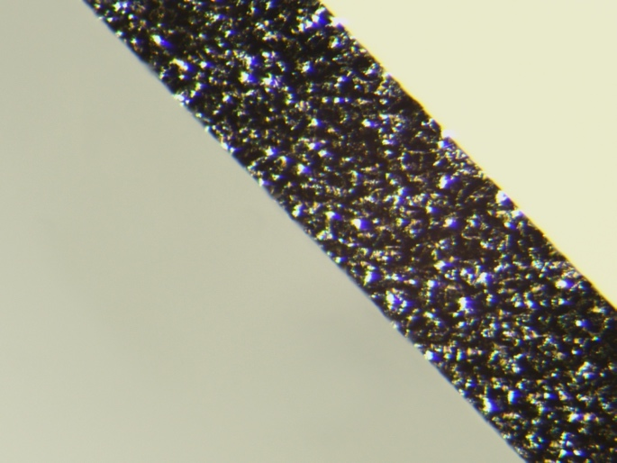
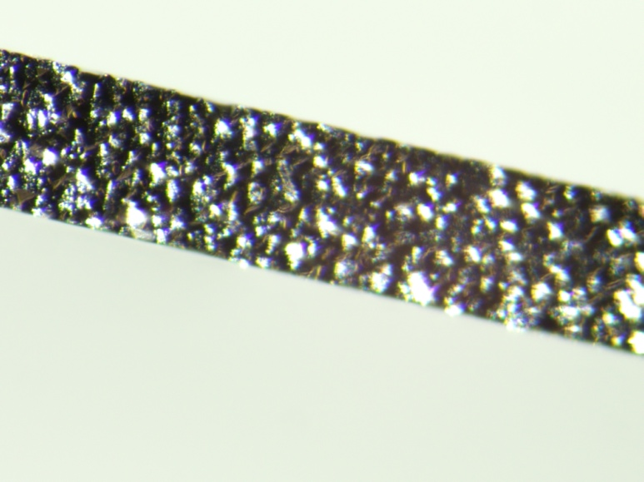
WEDM chemical etching
45% weight potassium hydroxide (KOH) solution at 60°C is used for chemical etching, following the indications of Reynaerts et al.
a-)
b-)
Figure 6: Optical microscope images of silicon samples:
a-) Sample with no chemical etching (non-crystalline surface),
b-) Chemically etched at 60°C for 20 minutes,
c-) Chemically etched at 60°C for 40 minutes.
c-)

Slide 16
Results of the breaking strength measurements
Fracture strength: the maximum stress a material can withstand before breaking.
Toughness: the ability to resist fracture by absorbing energy.
Sample | Mean (MPa) | Standard Deviation (MPa)
SSP-90 (1.group) | 438.07 | 35.75
DSP-90 (2.group) | 348.76 | 49.38
DSP-13 (3.group) | 346.14 | 90.66
DSP-13 shows the lowest fracture strength and the widest spread in failure stress, indicating the least predictable mechanical performance.
DSP-90 has slightly higher strength and less scatter than DSP-13, but still underperforms compared to SSP-90 in both strength and consistency.

Slide 17
Weibull Distribution Analysis of Silicon Samples Breaking Strength
(higher shape = less variability), and the scale parameter indicates the material's characteristic strength.
SSP-90 has the highest fracture strength (453.86 MPa) and most uniform mechanical behaviour (shape 16.71).
DSP-90 has moderate strength (351.30 MPa) and shows more scatter in strength values (shape 6.68).
DSP-13 has the lowest strength and the widest spread in failure stress (shape 5.57), making its performance less predictable.
Figure 3. The Weibull distribution parameters for the breaking strength (MPa) of crystalline silicon samples.

Slide 18
SUMMARY
Silicon blades capable of carrying 100-kg and 50-kg have been designed and optimized by FEA.
Designs with a natural frequency of less than 10 Hz and a peak stress of 90 MPa have been proven feasible.
The study is complemented with experimental tests on (smaller and thinner) WEDM samples measuring the breaking strength.
SSP-90 has the highest breaking strength, DSP-13 has the lowest breaking strength and highest variability, while DSP-90 is slightly stronger.

Slide 19
Backup slights

Slide 20
Weibull distribution
The Weibull distribution models material failure and reliability using:
Shape parameter (β):
β < 1 → early failures
β = 1 → constant failure rate
β > 1 → failure rate increases with time (e.g., wear-out)
Scale parameter (λ):
Larger λ → higher strength or longer life
Smaller λ → earlier failure or lower strength

Slide 21
What we need for Design?
Size-Thickness
Aspect ratio (length/width)
Edge design (base of the blade)
Material properties (crystal orientation)
Support and fixturing
Load distribution (tip stiffness)
Environmental factors (cryogenics)
Testing and simulation

Slide 22
But we need more for the design..
Material Selection
Crystal Orientation
Geometry
Blade Profile: blade's cross-section
Cryogenic Constraints
Stress Distribution
Natural Frequency
Thermal Analysis
Mounting and Attachment (assembling)
Material Properties
Load Conditions
Analysis Methods: FEA
Safety and Reliability
Manufacturability
Cost Constraints

Slide 23
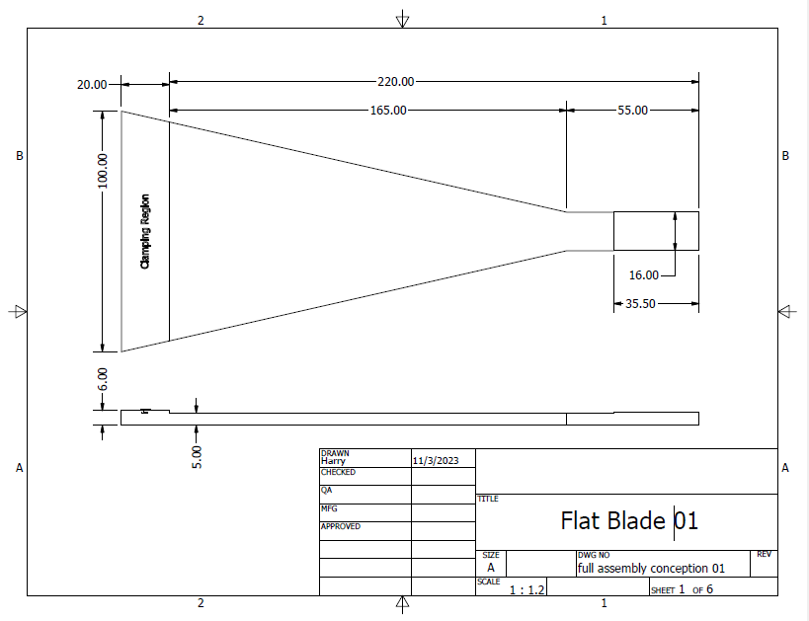
New blade design- Calstate senior design team

Slide 24
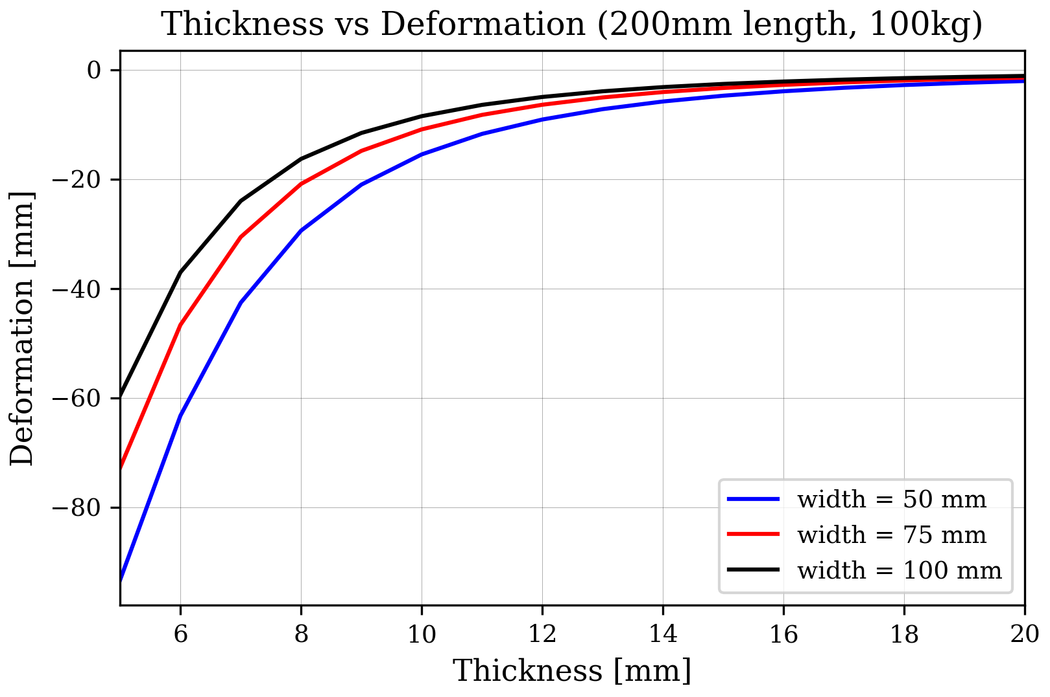
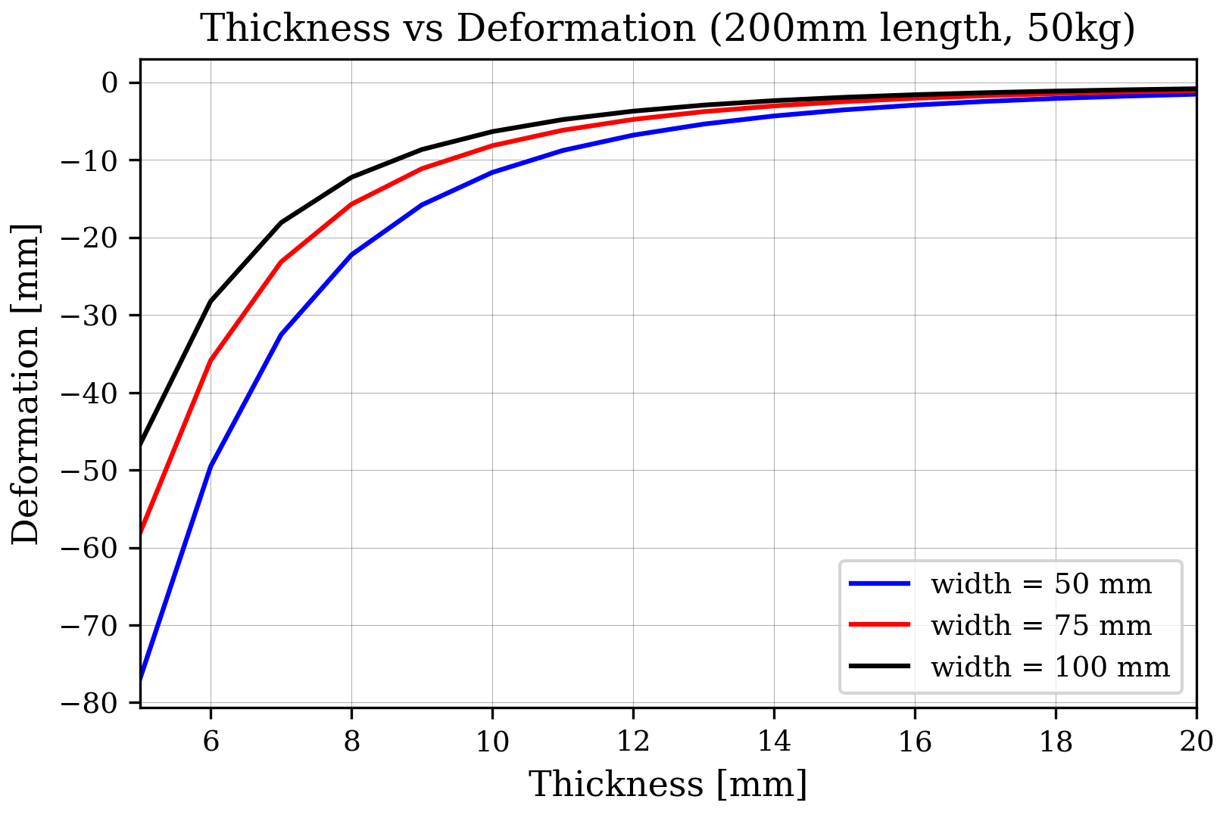
Vertical directional deformation
Thicker blades has lower displacement under applied loads.

Slide 25
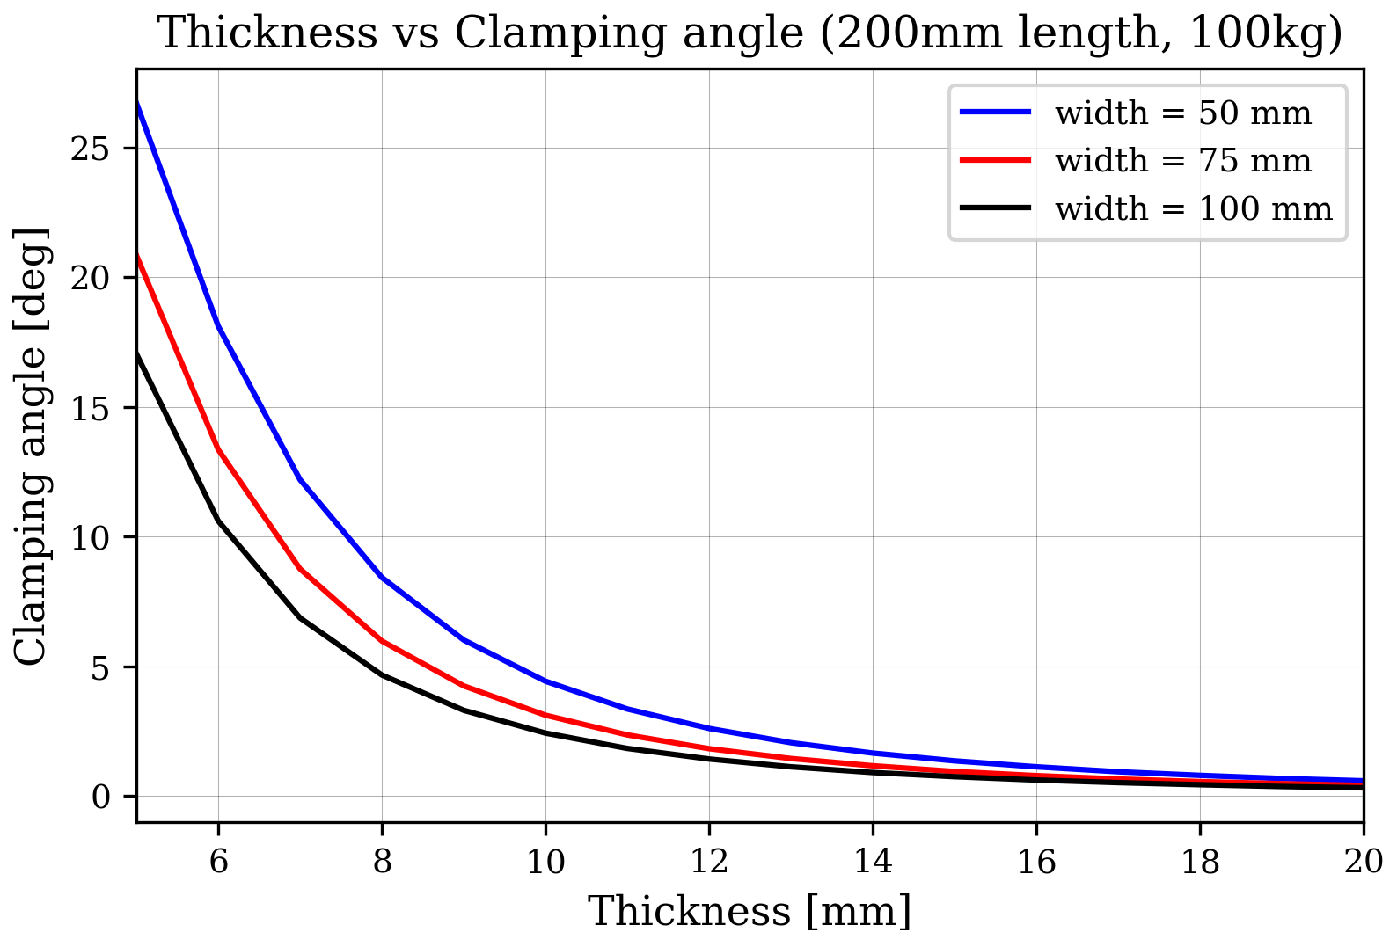
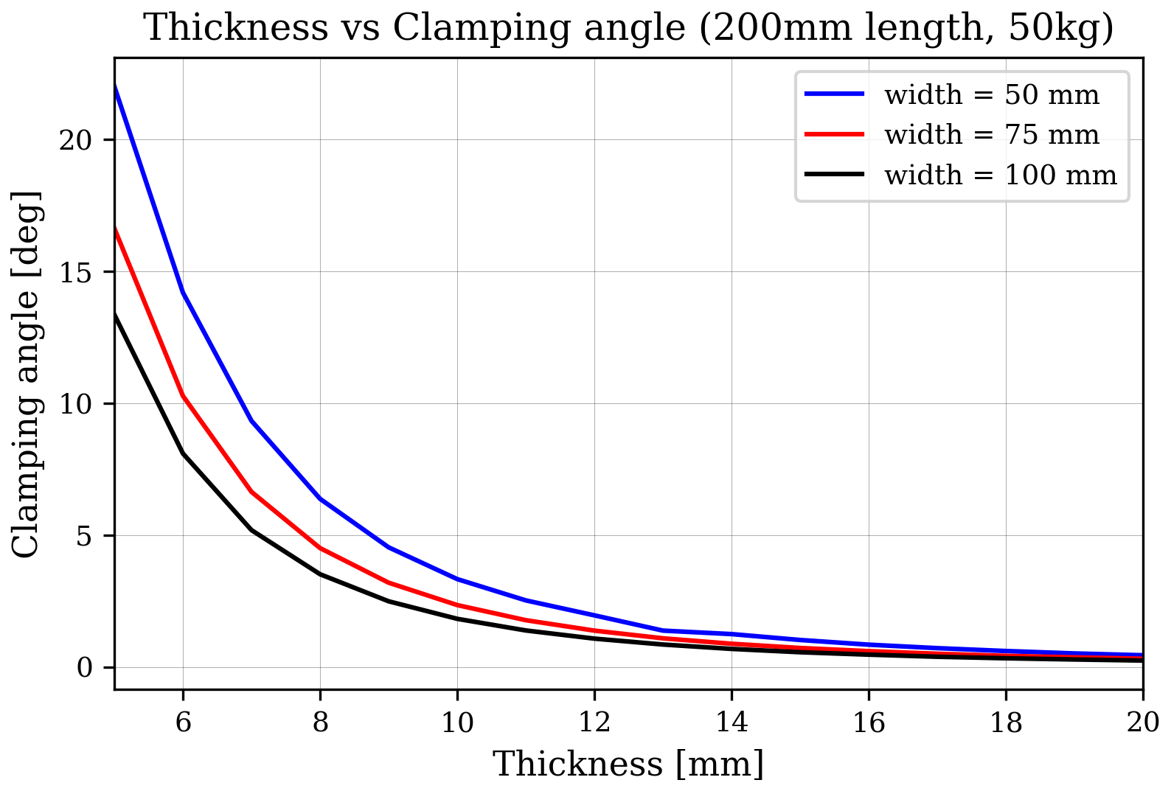
Clamping angle
A higher clamping angle and increased applied load generally enhance stability and improve stress distribution.

Slide 26
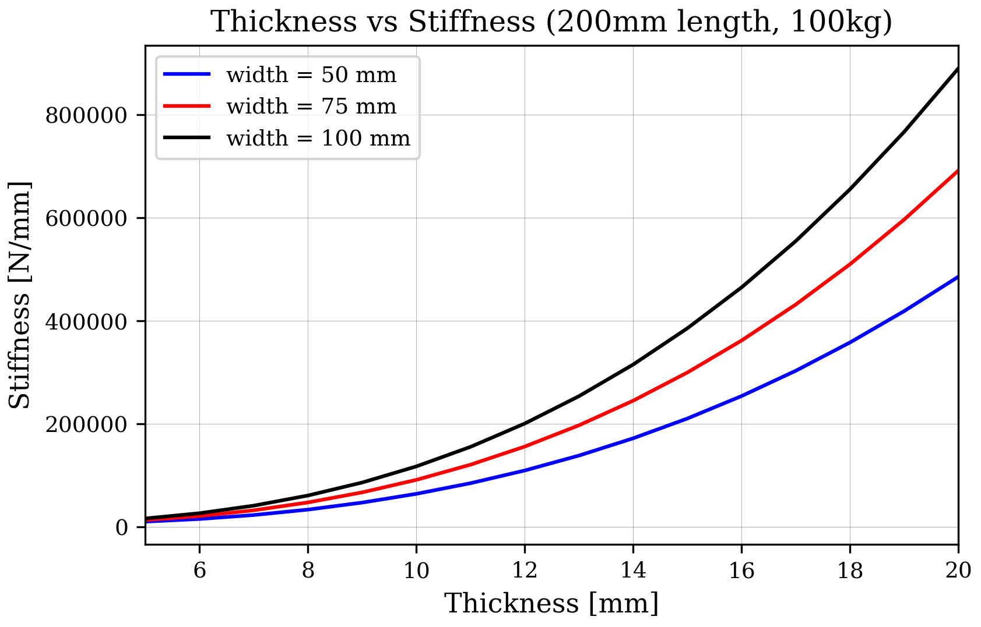
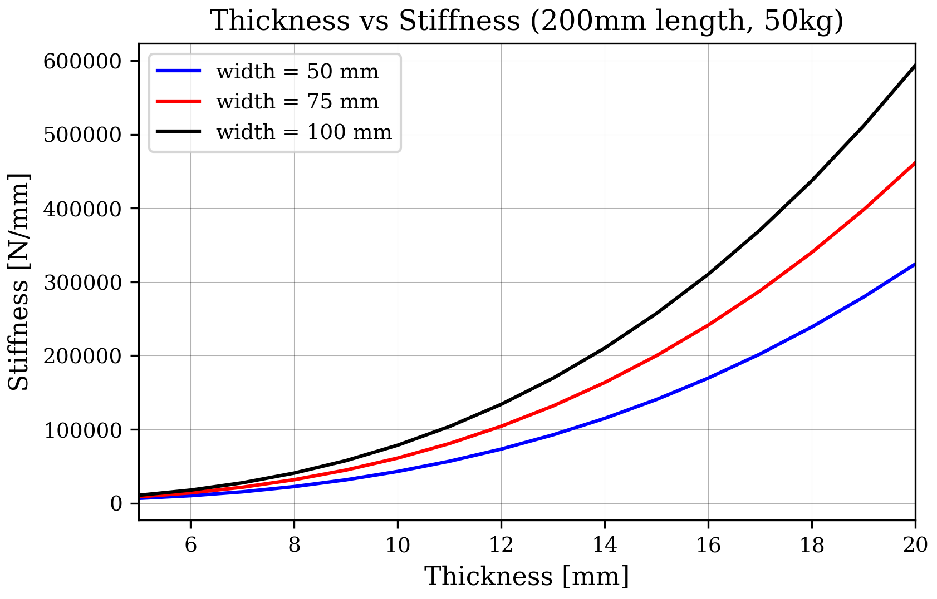
Stiffness
Stiffness is a measure of how much a material resists deformation when a force is applied (k = F/Δx).
In simple terms: High stiffness = bends or stretches very little under load Low stiffness = bends or stretches more easily
Stiffness increases with thicker blades.

Slide 27
Why Crystalline Silicon for Cryogenic Suspension?
Seismic & thermal noise → limit GW detector sensitivity (<10 Hz) (Seismic: ground vibrations | Thermal: atomic motion)
Cryogenic operation → reduces thermal noise (Cryogenic: low temperature ~10 K)
Silicon → high thermal conductivity (efficient heat removal), low thermal expansion (dimensional stability)
→ high Q-factor (low mechanical loss = less thermal noise) [Q-factor: energy storage efficiency]
→ suitable for vertical spring design for ET-LF (Einstein Telescope Low Frequency)

Slide 28
What makes triangular blade geometry effective?
Triangular shape → distributes stress evenly (Stress: internal force per area)
→ high rigidity near clamp, flexible at tip (Rigidity: resistance to bending)
→ tunes vertical resonance frequency < 10 Hz (Resonance frequency: natural vibration point)
→ compatible with compression-mode design, reduces stress peaks (Compression: force inward)

Slide 29
How do mechanical losses affect thermal noise?
Thermal noise ∝ Temperature × Loss Angle / Frequency (Loss Angle φ: internal friction)
High mechanical loss → higher thermal noise → less sensitivity
Silicon at 10 K → very low φ → less thermal vibration (10^8 Q-factor)
Fluctuation-Dissipation Theorem → connects φ to thermal noise (FDT: noise-loss relationship)

Slide 30
What challenges arise in fabricating silicon blades?
Silicon = brittle → machining introduces cracks (Brittle: breaks without bending)
WEDM (Wire Electrical Discharge Machining) → enables precision cutting
→ but causes micro-cracks → solved with chemical etching (Etching: removes damaged layer)
Surface quality critical → influences fracture strength and Weibull distribution (Weibull: failure probability model)

Slide 31
How does anisotropy affect blade behavior?
Silicon = anisotropic → properties vary with orientation (Anisotropic: direction-dependent)
Crack propagation and toughness vary by crystal plane (e.g., <100>, <110>)
<100> chosen → higher toughness, balanced stiffness (Toughness: resistance to crack growth)
Orientation affects stress concentration and failure risk
Different crystal orientations (like <100> and <110>), have different resistance to crack growth (called fracture toughness).
Cracks may propagate more easily along one direction than another because of how atoms are arranged in the crystal, so the toughness isn't the same in all directions.
In short: Fracture toughness depends on crystal orientation. Some directions resist cracking better than others.

Slide 32
How do your simulations and experiments match?
FEA (ANSYS) → simulates stress, deformation, resonance (FEA: Finite Element Analysis)
Boundary conditions = fixed clamp + tip load (Load: applied force)
Validated with bending tests → 3-point method, optical crack inspection
Surface stress < Breaking strength → confirms design feasibility

Slide 33
What’s the broader impact on gravitational-wave detection?
Improved vertical isolation → better sensitivity below 10 Hz
Reduced thermal noise → clearer mid-frequency signals (10–100 Hz)
Supports ET’s goal → observe earlier-universe events & low-mass binaries
Silicon blade system = scalable, cryogenically optimized, experimentally validated

Slide 34
Why are silicon's thermal properties important for cryogenics?
High thermal conductivity → essential for extracting heat from the payload (conductivity: heat flow ability)
Low thermal expansion → maintains dimensional stability when cooling (expansion: size change with temperature)
Zero-crossing near 18K and 123K → minimizes stress buildup during cool-down
→ Enables safe integration with other components at cryogenic temperatures

Slide 35
How do you ensure blades don't fracture in real operation?
Weibull distribution → models statistical fracture probability (Weibull: failure likelihood)
Design ensures surface stress << breaking strength (Safety margin: stress limit buffer)
Fracture toughness orientation-dependent → <100> chosen for better resistance
Post-processing (etching) reduces surface flaws → enhances mechanical integrity

Slide 36
What affects crack growth in single crystal silicon?
Crack follows cleavage planes → different for each orientation (Cleavage: natural break path)
Silicon is brittle → no plastic deformation → cracks propagate easily under tension
<111> prone to cleavage → <100> preferred for better toughness
Crack initiation sites often caused by machining defects → removed by etching

Slide 37
How reliable are your FEA results in predicting real behavior?
Used nonlinear static + modal analysis in ANSYS (FEA: simulation method)
Input cryogenic material properties manually (e.g., Young's modulus at 10K)
Validated with experiments: bending tests, crack inspection, displacement tracking
Convergence study → ensured mesh independence of results

Slide 38
What are the challenges in scaling your design for ET?
Larger mass → higher blade load → higher stress (Scaling: design adaptation)
Thermal contraction mismatch with other materials → needs compliant joints
Suspension dynamics more complex → needs active damping or feedback loops
Full system tests needed (ET-Pathfinder) → verify integration and performance

