Slide 1
Groundwater modelling : new results and future works
Quentin Guillemoto, Philippe Orban, Frédéric Nguyen
27/05/2025

Slide 2
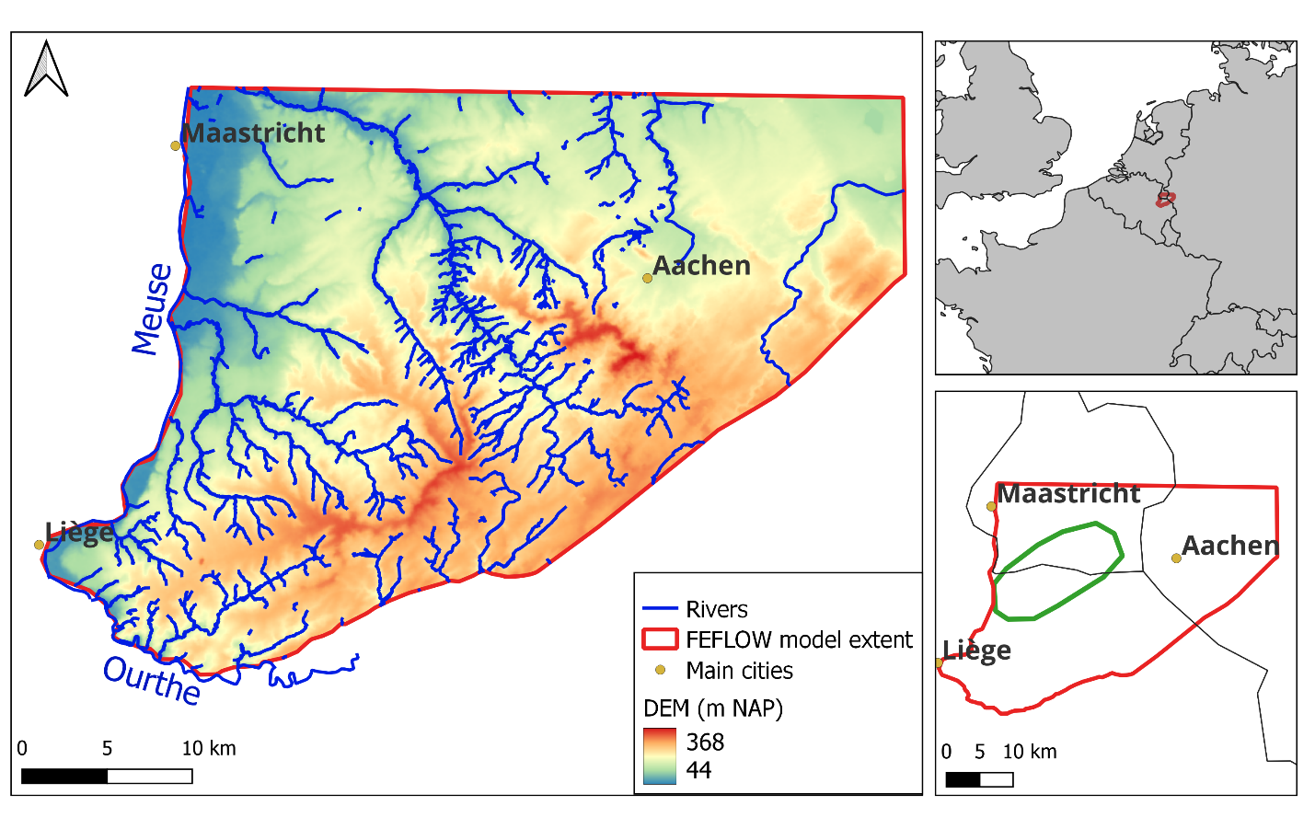
Objectives of the model
Regional hydrogeological model extent
Open cross-border groundwater model for ecosystem service:
quantify quantitative impacts of ET tunnels implantations on groundwater
estimate groundwater inflows in tunnels

Slide 3
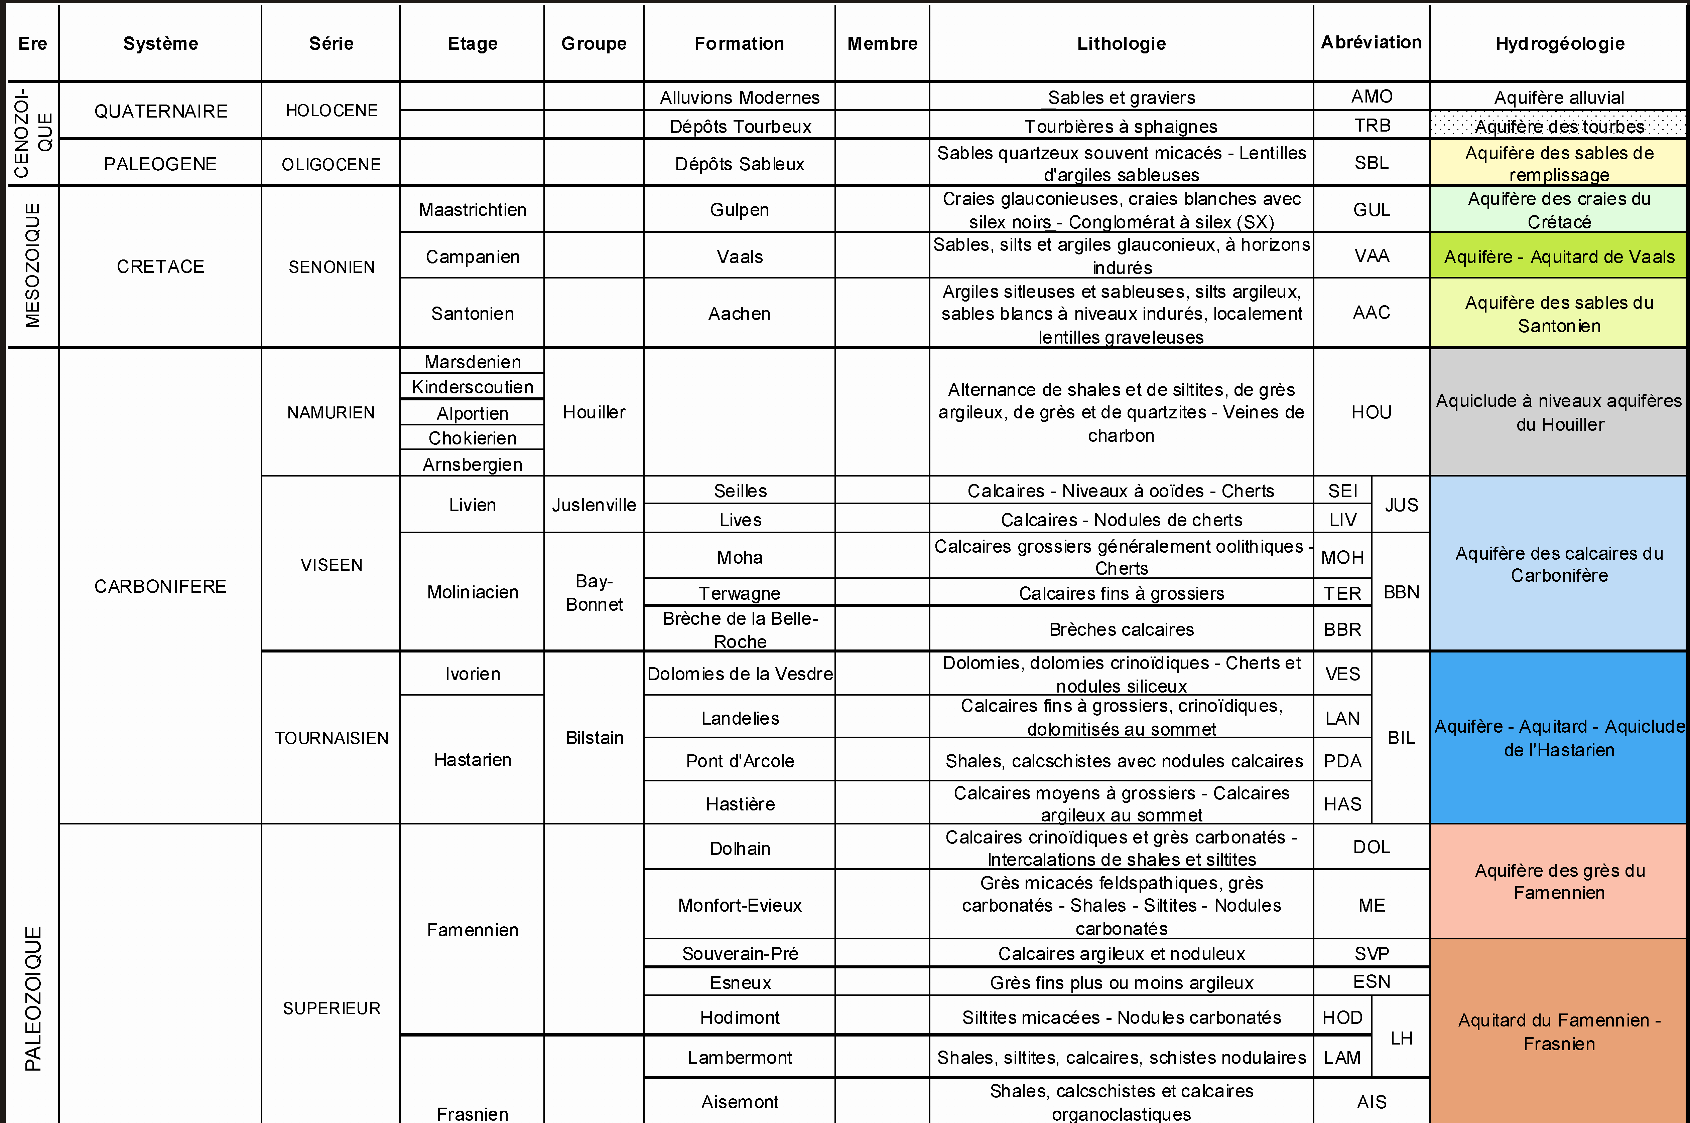
Aquifer simulated
all the aquifers are simulated until lower Famennian
aquifers considered as connected
with different hydrogeological properties
Cretaceous aquifers (sands, chalk)
Houiller (Namurian)
(shales, siltstones, sandstones)
Famennian (limestones-sandstones)
Lower Famennian aquitard (siltstones)
Table of hydrogeological units
Hydrogeological map. RUTHY and DASSARGUES, 2009.

Slide 4
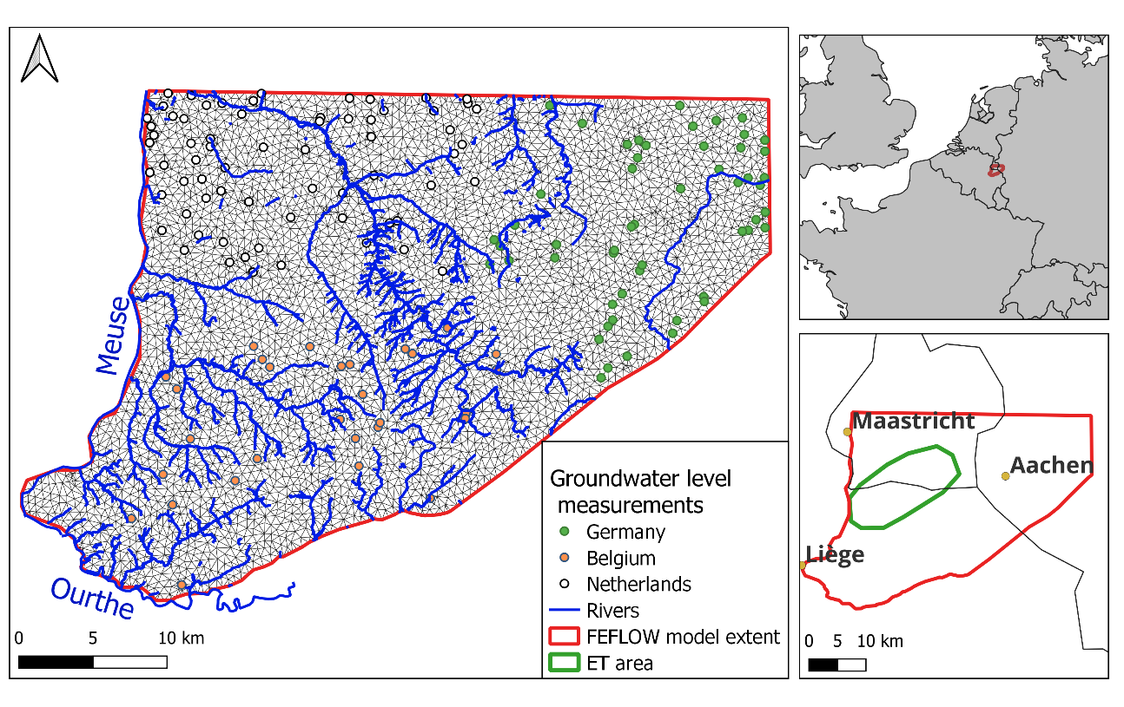
Numerical model
Feflow® hydrogeological flow model construction:
finite element mesh
steady flow model
based on 2018 data
Regional database used in the model:
groundwater water level observations, groundwater abstractions (Wallonia, Germany, The Netherlands)
hydraulic conductivities
topography
geology
River network, groundwater level measurements and mesh of the finite elements model
Mesh sizes about 500 meters length
Hydrogeological model according to regional geological model

Slide 5
Recent improvements of the model
New position of the ET triangle
Quantifying tunnels inflows using boundary conditions (3rd type)
Better discretization of the tunnel surfaces in the regional model.
finer mesh near tunnels
3D geometry imported into the regional model
New position of the ET tunnels

Slide 6
Tunnel design simulated
Consideration of the grouting area
E
Tunnel surrounded by ≈ 5 m of grouting area
The hydraulic conductivity of the grouting area is adapted considering an acceptable inflow rate
H=Patm
5m
K ?
Expected volumes are of the order of 10 L / 100 m /min
(0.144 m³ / d / m)
(i.e. 4320 m³/d over 30 km of tunnel)

Slide 7
Tunnel design simulated
3rd type boudary condition
The 3D tunnel in the model
The inflow is simulated as:
Q = Ar(h_{ref}-h)
A = relevant area (tunnel surface)
r = conductance (calculated from k_{g} and d)
h_{ref} = reference water level (atmospheric pressure)
h = current hydraulic head in groundwater
k_{g}
d
k_{g}
5.1 m
≈ 6.5m diameter tunnel surface
The inflow rates are linked to the conductance:
r = kg/d
K_{g} = grouting conductivity, d = grouting thickness

Slide 8
Numerical model calibration
Ranges of hydraulic conductivity values estimations from expert knowledge and previous studies in the considered main geological unit allowed for the Pest estimation.
Optimization of the objective function
Geological unit | Lower Limit | Preferred values | Upper Limit
Cretaceous | 1.0⋅10⁻⁷ | 1.0⋅10⁻⁶ | 1.0⋅10⁻³
Namurian (Houiller) | 1.0⋅10⁻⁸ | 1.0⋅10⁻⁷ | 1.0⋅10⁻⁵
Visean and Tournaisian | 1.0⋅10⁻⁷ | 1.0⋅10⁻⁵ | 5.0⋅10⁻³
Famennian | 1.0⋅10⁻⁷ | 1.0⋅10⁻⁷ | 1.0⋅10⁻⁵
$$Φ=\sum_{i}{w_{i}({h_{i}}^{obs}−{h_{i}}^{sim})²}$$
Calibration with Pest software 50 pilot points/geological layers, considering prior hydraulic conductivities.

Slide 9
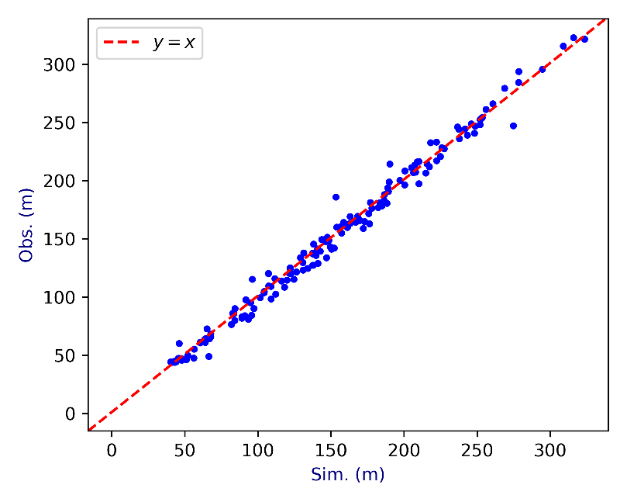
Calibrated numerical model
Observed and simulated natural hydraulic heads
Plot of groundwater level observations and groundwater level simulations.
$Φ=\text{15,887}$ m

Slide 10
Tunnel inflow estimations
Results of calculated inflow
Calculations of ET impacts considering variations of the grouting area hydraulic conductivity.
Using the optimized model (one set of calibrated hydraulic conductivity)
k_{g} (m/s) | Q m³/d
1.00×10⁻⁸ | 45500
5.00×10⁻⁹ | 29000
1.00×10⁻⁹ | 7400
5.00×10⁻¹⁰ | 3800
1.00×10⁻¹⁰ | 776
Expected inflows

Slide 11
Drawdown and tunnels inflows
k_{g} (m/s) | Q m³/d
1.00×10⁻⁸ | 45500
5.00×10⁻⁹ | 29000
1.00×10⁻⁹ | 7400
5.00×10⁻¹⁰ | 3800
1.00×10⁻¹⁰ | 776
With a grouting conductivity of K= 1.00×10⁻⁹ and Q= 7400 m³/d (mean total value of 17L/100m/min)
Inflow values (L/100m/min) at tunnel sections
Baseflow river decreases:
Berwinne/Voer = 4.4 %
Berwinne at Val-Dieu = 8.5 %
Gueul = 3.7 %
12.6
15.8
18.1
15.7
18.6
20.8

Slide 12
Drawdown and tunnels inflows
k_{g} (m/s) | Q m³/d
1.00×10⁻⁸ | 45500
5.00×10⁻⁹ | 29000
1.00×10⁻⁹ | 7400
5.00×10⁻¹⁰ | 3800
1.00×10⁻¹⁰ | 776
With a grouting conductivity of K= 5.00×10⁻¹⁰ and Q= 3800 m³/d (mean total value of 8.8L/100m/min)
Inflow values (L/100m/min) at tunnel sections
Baseflow river decreases:
Berwinne/Voer = 2.2%
Berwinne at Val-Dieu =4.3%
Gueul = 1.9 %
6.4
8.0
8.1
9.2
9.5
10.8

Slide 13
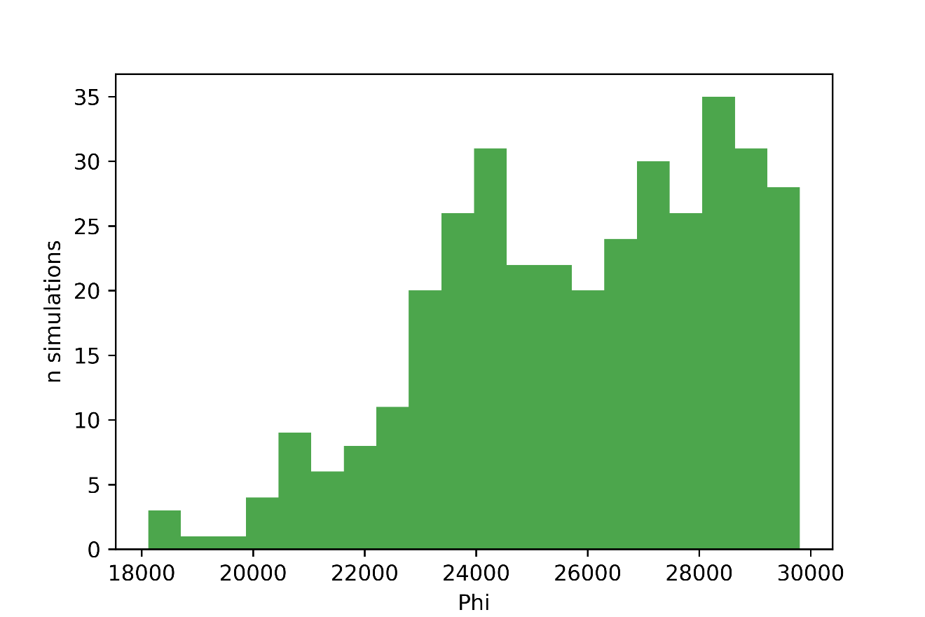
Null-Space Monte-Carlo analysis
Sensitivity analysis of the impact of groundwater levels taking into account different ranges of hydraulic conductivities
400 sets of hydraulic conductivities that cannot be estimated on the basis of the calibration dataset (Doherty et al., 2010)
Hydraulic conductivity sets with acceptable $Φ$
Measurement objective function of the 400 NS-MC simulations

Slide 14
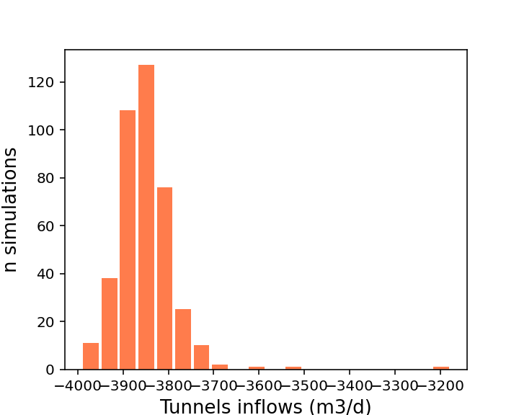
Null-space Monte-Carlo
Range of hydraulic conductivities simulated in the 400 NS-MC simulations
Scenarios of varying grouting hydraulic conductivity
Geological zone | Mean K values (all elements) m/s | Mean variation factor [min – max] (all elements) (-) | Mean K values (around tunnels) m/s | Mean variation factor [min – max] (around tunnels) (-)
Cretace | 1.0x10⁻⁵ | 160 [5.7 – 7,499] | - | -
Houiller | 2.2x10⁻⁷ | 43 [11.2– 897] | 1.1x10⁻⁷ | 21 [14 .6 – 57.8]
Visean | 6.8x10⁻⁶ | 292 [9.1– 42889] | 3.8x10⁻⁶ | 59 [14.3 – 600]
Upper Fammenian | 4.8x10⁻⁷ | 47[5.6 – 920] | 3.9x10⁻⁷ | 42 [10.3 – 379]
k_{g} (m/s)
1.00×10⁻⁸
5.00×10⁻⁹
1.00×10⁻⁹
5.00×10⁻¹⁰
1.00×10⁻¹⁰
Computation of the 400 simulations considering the different scenarios
Scenario with k_{g}= 5 x 10⁻¹⁰ m/s

Slide 15
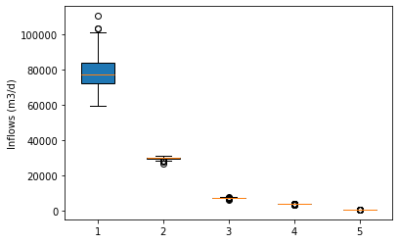
Null-Space Monte-Carlo analysis
Calculated inflow values for the 400 NS-MC simulations
Scenario | k_{g} (m/s) | Mean inflows (m3/d)
¹ | 1.00×10⁻⁸ | 78100
² | 5.00×10⁻⁹ | 29700
³ | 1.00×10⁻⁹ | 7396
⁴ | 5.00×10⁻¹⁰ | 3841
⁵ | 1.00×10⁻¹⁰ | 857
Ranges of inflows considering the different scenarios (grouting area conductivity)
Mean inflows calculated from the different scenarios

Slide 16
Null-Space Monte-Carlo analysis
Sensitivity analysis of the hydraulic heads through the 400 NS-MC scenarios
Mean drawdown
With an hydraulic conductivity of the liner of 5.00×10⁻¹⁰

Slide 17
Null-Space Monte-Carlo analysis
Sensitivity analysis of the hydraulic heads through the 400 NS-MC scenarios
Minimum drawdown
With an hydraulic conductivity of the liner of 5.00×10⁻¹⁰

Slide 18
Conclusions & perspectives
Results showed large impacts (>10m of drawdown) near the tunnels if hydraulic conductivity of the liner > 5×10⁻¹⁰ m/s. For all the scenarios, possible drawdown impacts are > 2m.
Hydraulic conductivity (and thickness, water pressure in the drainage system) of the grouting area are important to mitigate the impact on groundwater ressources.
Hydraulic conductivity (and thickness, water pressure in the drainage system) of the grouting area are important to mitigate the impact on groundwater ressources.
Local model developments (VUB and Uliège) are being developed to consider more precise geological configuration around the tunnels and caverns.

Slide 19
Quentin Guillemoto
University of Liège
q.guillemoto@uliege.be
Thank you for your attention

