Slide 1
ET-EMR: stable course, adaptive power
Towards robust and sustainable feasibility of ET hosting
XV ET Symposium Bologna –30 May 2025
Theo Reinders

Slide 2
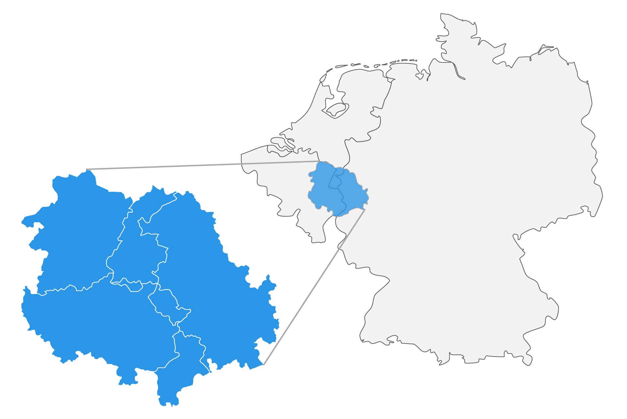
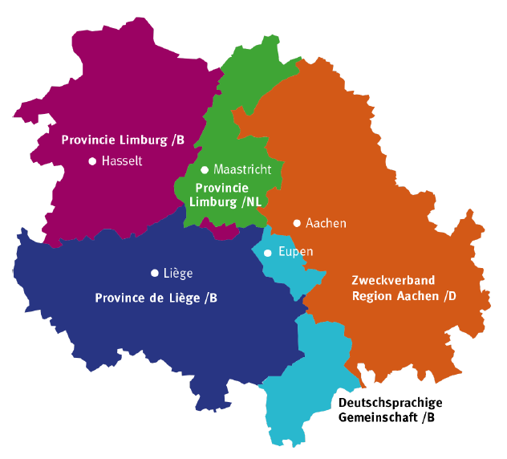
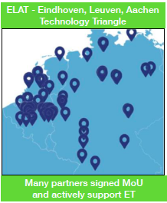
EMR Region

Slide 3
EMR Region assets
Subsurface:
  Dampening of vibrations and building in a quiet landscape
  Sufficient and suitable rock masses
Location:
  Ecosystem of renowned research institutes and high-tech industry
  Attractive international living & business climate
  Good connectivity, excellent education, multilingual area
International cooperation:
  Existing strong cooperation internationally
  New elected governments support ET-EMR
  Solid preparation of feasibility studies

Slide 4
ET-EMR Starting points
1: scientific community is customer
    Adaptive power, to absorb the scientific wishes and requirements
2: public management
    public money, public responsibility, public accountability
    account for choices, costs, and added value; broad socio-economic impact requirement
    sustainability, circularity, nature, landscape and livability also part of responsibility
3: synergy as the definition of success
    integral approach: science, geology, civil engineering, environment and involving society, active R&D network, valorisation, financial commitment
These starting points determine strategies and the design of processes!

Slide 5
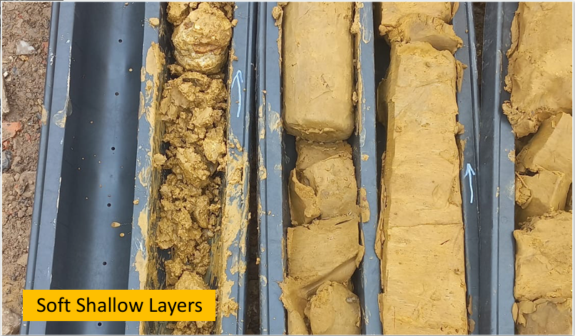
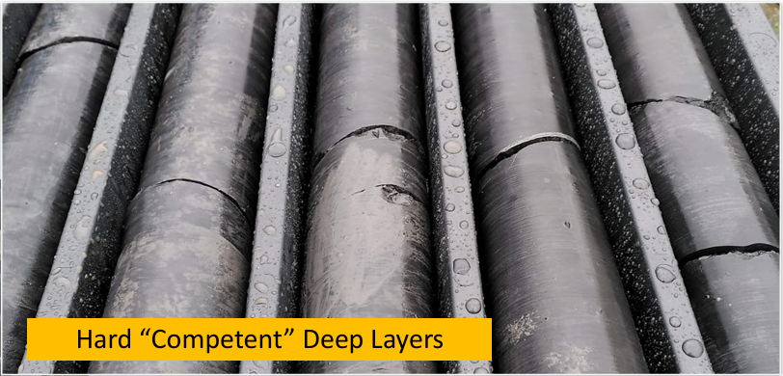
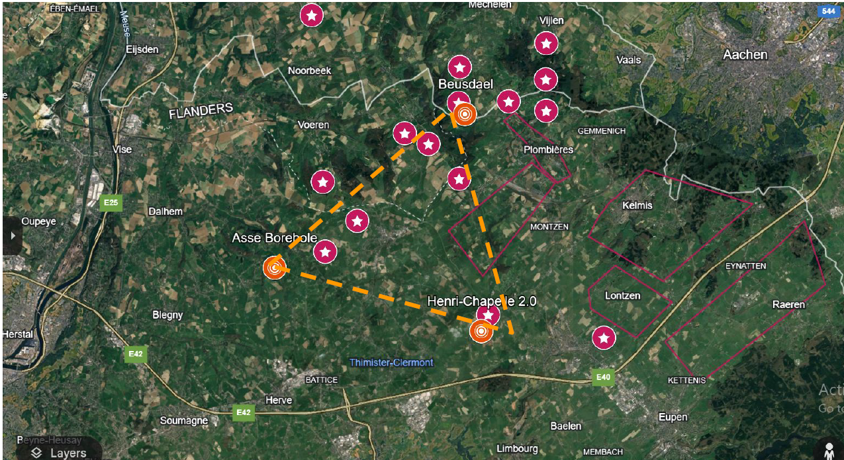
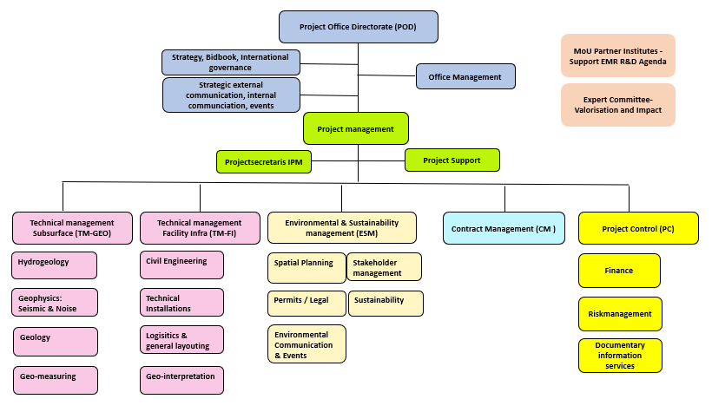
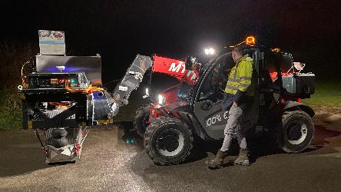

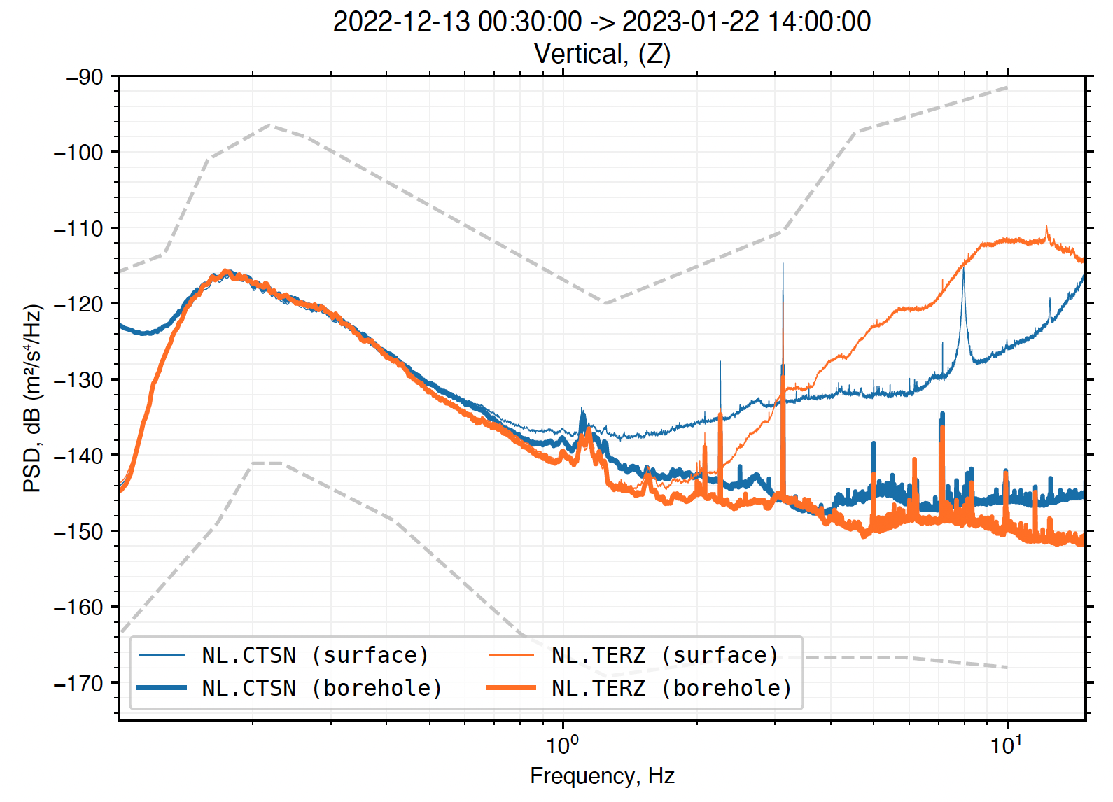
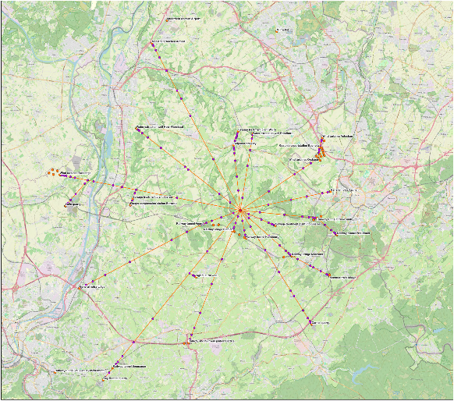
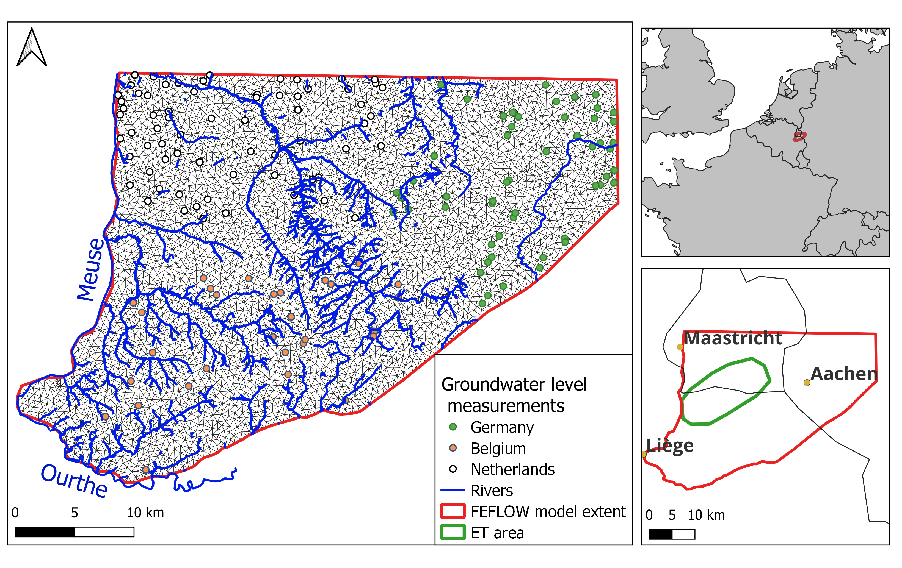

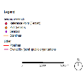
Status May 2025
300-400 m
Drilling campaign
Seismic surveys
Hydrogeology
Noise
Project Management Team
New elected governments: commitment € 1,1 B
16
400
1,1 B
90 km
10
6

Slide 6
2L-layout: status feasibility study
Desk study finished: no showstoppers!
First step now: focus on triangle to collect data of the area.
Next step (TBD): interpretation of available data for L-layout.
After that (TBD): formulating remaining dedicated research questions about the L layout; establishing timeline.
Finally (TBD): specific supplementary drillings and noise investigations L layout.

Slide 7
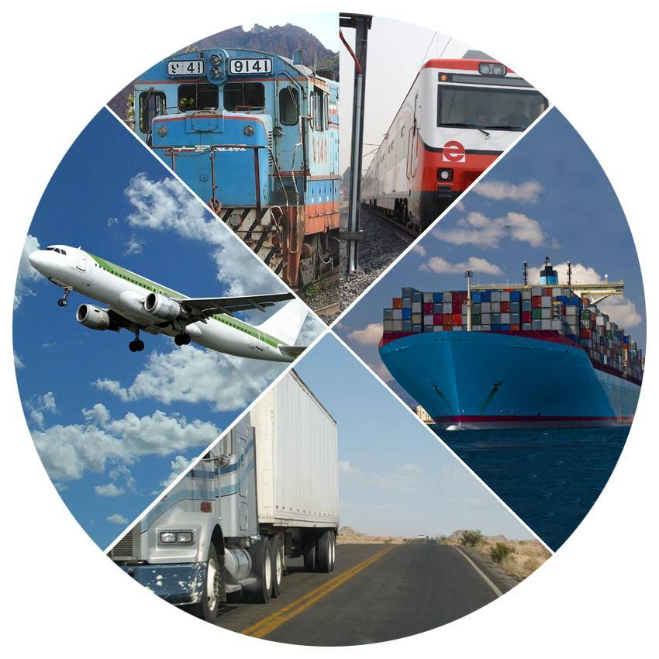
Facility Infrastructure - CE
Assessment phase ongoing:
Modular approach: identifying technical and societal aspects having potential impact and design concept scenarios
Converging design criteria together with ETO/ETC (task force ETO) and other stakeholders (local)
Concept design phase: fixation main starting points (ETO & stakeholders) and finalize concept design
Surface impact: urban planning, landscape
Logistics: opportunities optimal modal shift

Slide 8
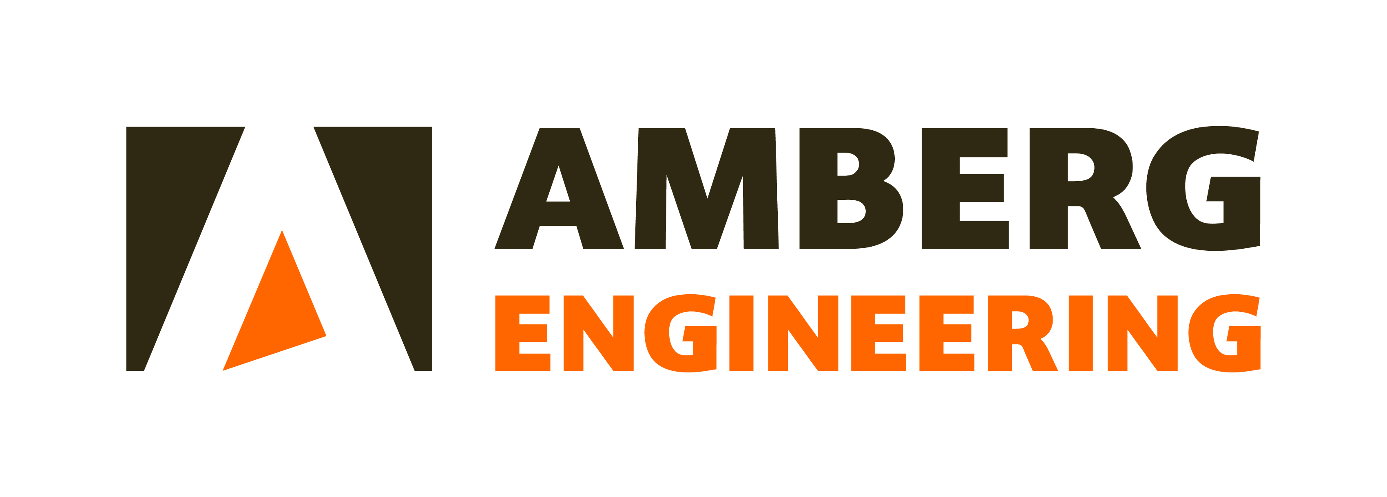
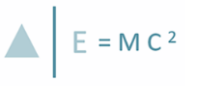

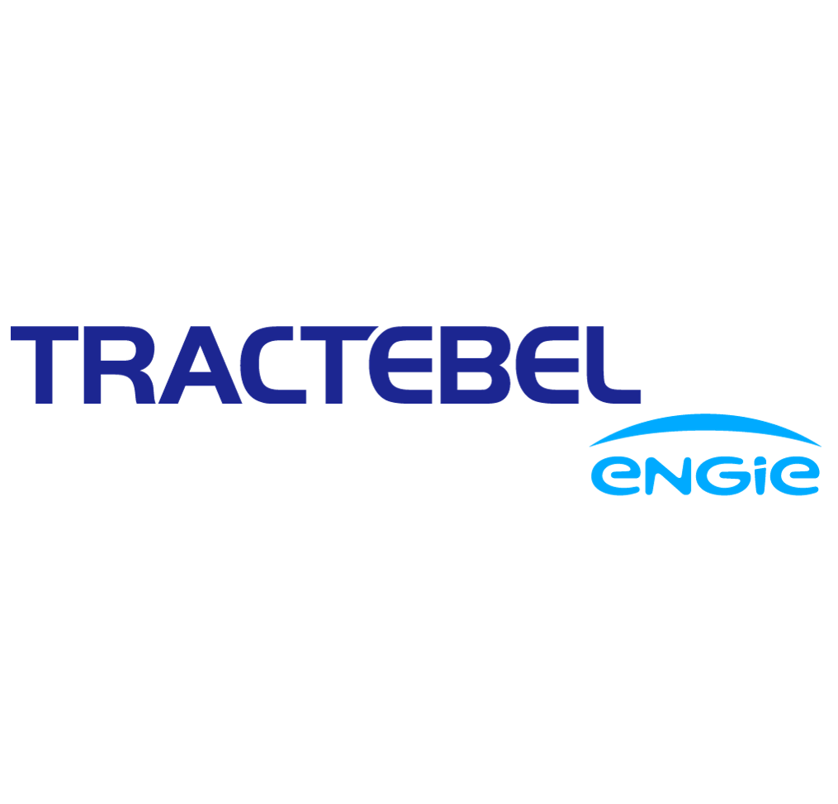



Facility Infrastructure

Slide 9
Facility Infrastructure - CE
Assessment phase ongoing:
Modular approach: identifying technical and societal aspects having potential impact and design concept scenarios
Converging design criteria together with ETO/ETC (task force ETO) and other stakeholders (local)
Concept design phase: fixation main starting points (ETO & stakeholders) and finalize concept design
Surface impact: urban planning, landscape
Logistics: opportunities optimal modal shift

Slide 10

Environment management
Groundwater protection, extraction and discharge: an issue!
Nature and landscape: we make it even better!
Sustainability: frameworks for circularity, resource recovery, sustainable energy, reducing nitrogen-CO2-dust, reducing carbon footprint.
Logistics: modal shift from sustainable and nuisance perspective
Machine noise and vibration: harmful for human, disturbing habitats
Participatory Design: robust support !

Slide 11
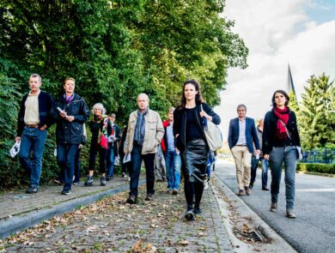
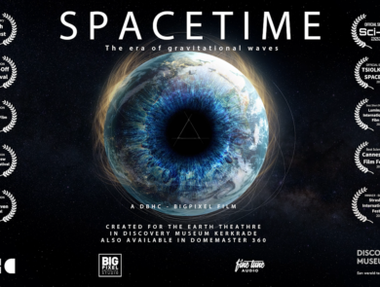
Involving society
Stakeholder management
11 information meetings - 1000 people
150 education and outreach activities
1800 news stories - 100 million people.
Because it is more than science and engineering!
Create science to people!

Slide 12
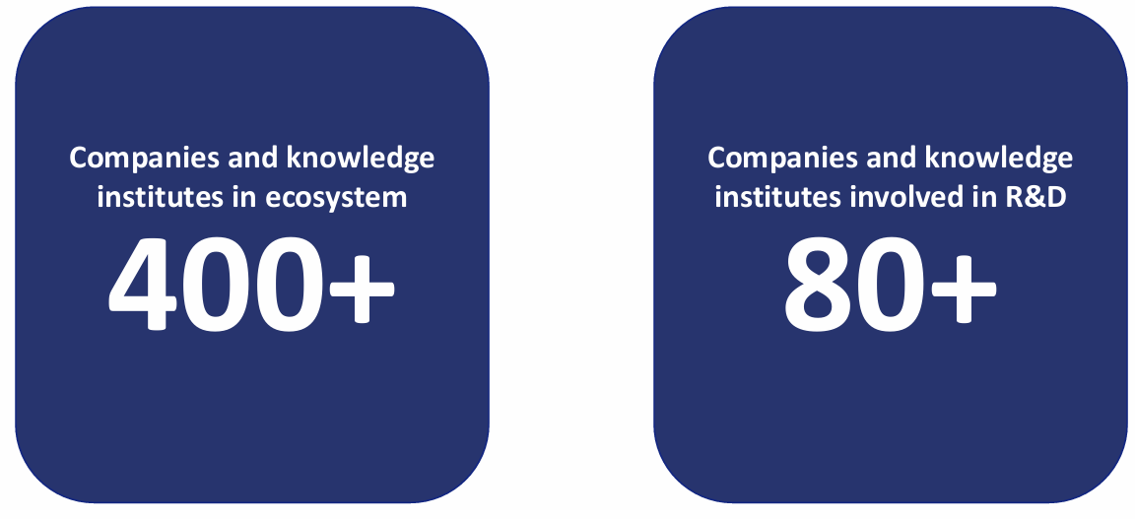
Ready for ET future
ET-Pathfinder R&D Field Lab
ET-CRISTAL instrumentation
Six consortia with a total of 26 Dutch high-tech companies and knowledge institutions develop crucial technology for ET/ET Pathfinder
ET-Pathfinder Smart Skills Lab, ET Education Centre, Einstein Academy, Maastricht University –FSE, Leuven Gravity Institute: ET-EMR has the future in its hands!
INVESTMENT OVER € 100 MLN

Slide 13
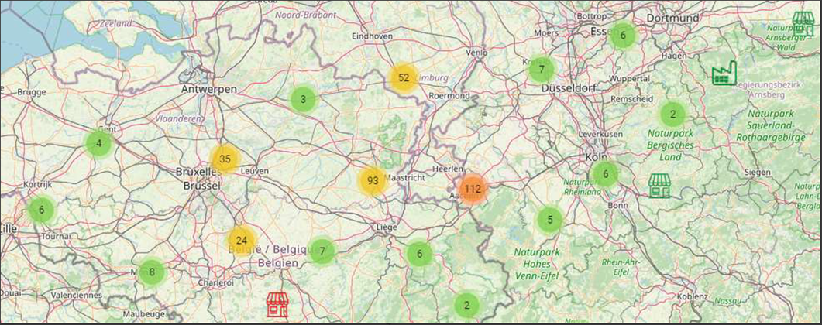
400+ actors (84% companies, 70% SME

Slide 14
Ready for ET future
ET-Pathfinder R&D Field Lab
ET-CRISTAL instrumentation
Six consortia with a total of 26 Dutch high-tech companies and knowledge institutions develop crucial technology for ET/ET Pathfinder
ET-Pathfinder Smart Skills Lab, ET Education Centre, Einstein Academy, Maastricht University –FSE, Leuven Gravity Institute: ET-EMR has the future in its hands!
INVESTMENT OVER € 100 MLN

Slide 15
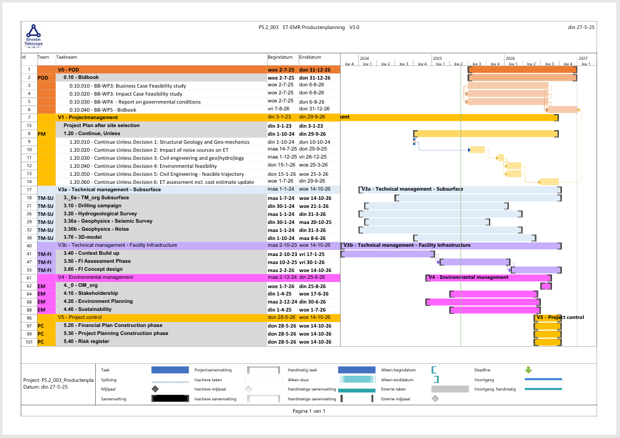
Timeline

Slide 16

ET-EMR is heading to an Integral Feasibility
Low seismic noise
Sufficient and suitable rock masses
Large rural area with dampening top layer
Populated areas with amenities on neighborhood livability without breaking the 'silence'
A lot of opportunities for sustainability (e.g. modal shift, market for resource recovery nearby)
A future-proof and ET-relevant R&D network (S2B-B2S-B2B-S2S) > science to impact and science to people!
Robust support from society!

Slide 17

Thank you for your attention !

