Slide 1
Task Force: System Decomposition and Traceable Output Tables XV Einstein Telescope Symposium | Bologna
R. Meijer
26-05-2025

Slide 2
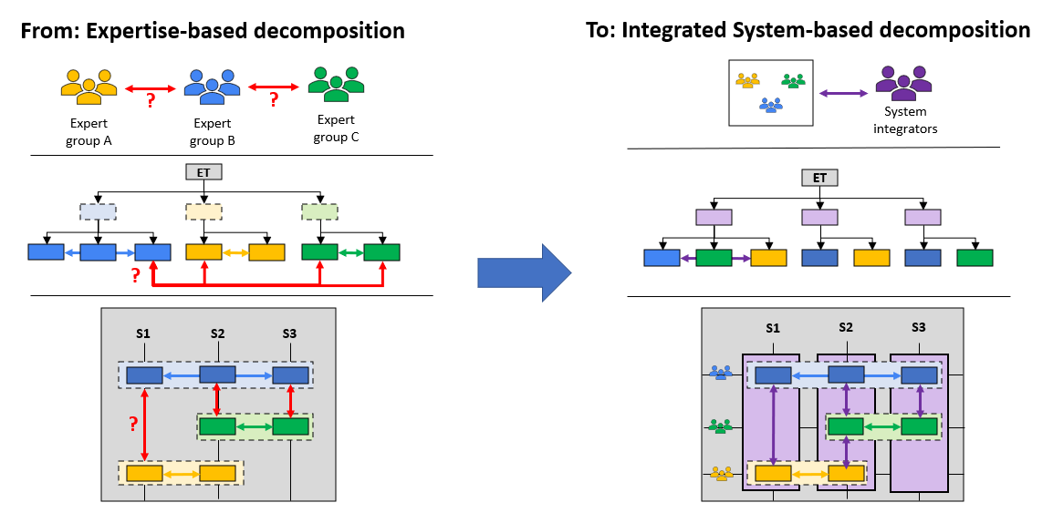
Taskforce construct allowed for subsystem integration
Taking advantage of the Task Force organizational construct, where we worked with:
A multidisciplinary design team with both scientists and engineers
A “core team” that could take responsibility to coordinate integration work
A large group of subject matter experts to advise and support
Some light project management support
Existing construct
Task Force construct
People
System Decomposition
System Architecture

Slide 3
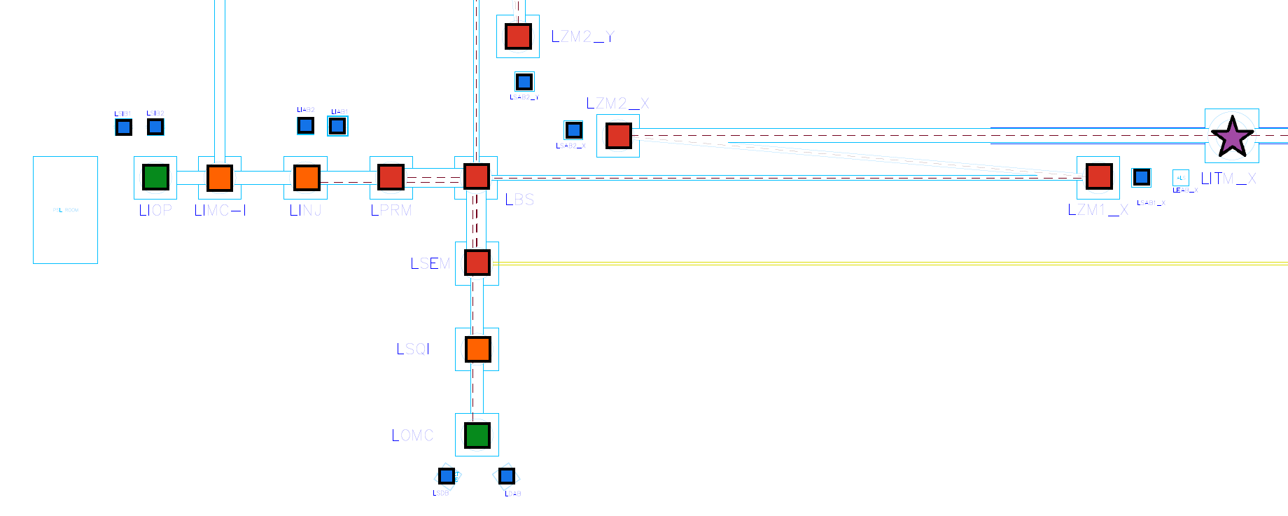
An Integrated-System based Decomposition to capture the Task Force work
As presented by F. Sorrentino and R. Meijer at the 2024 ET Annual Event, Warsaw
Discipline-based → Integrated-system based decomposition
Lv. 1: ET → {Grouping of expert systems} → Lv. 2: All ET Suspensions → …
Lv. 1: ET → {Functional & physical partitioning} → Lv. 2: Low-Frequency Interferometer (LFI) → …
(Detail view)
Sys. level 2: LF-Interferometer
SYS_004 (LFI)
Sys. level 3: LF-Test Mass tower
SYS_129 (LITM_Y)

Slide 4
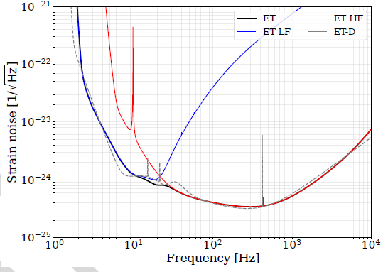
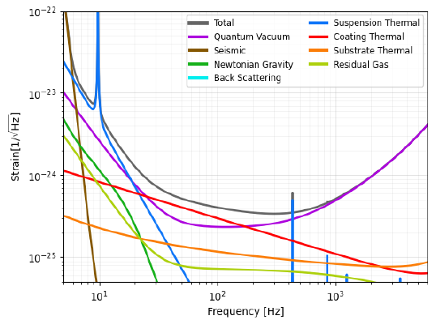
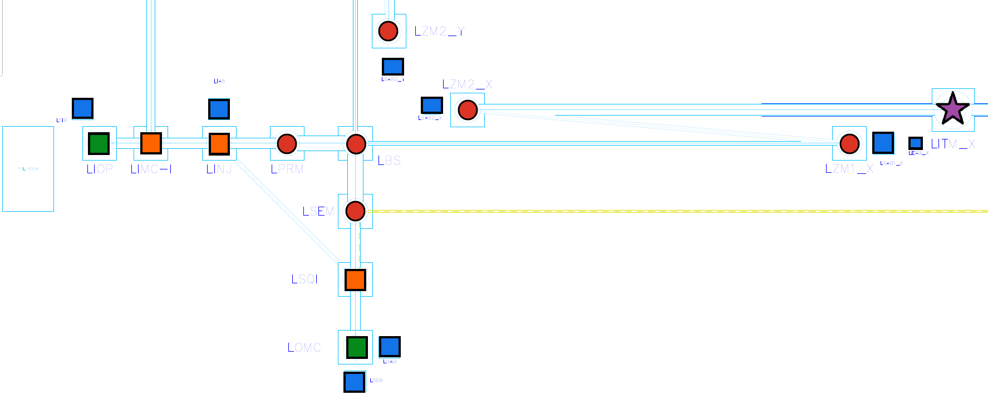
System decomposition – Instrument branch example
Lowest level of detail at the Integrated Tower (‘node’) level
→ Total # of nodes considered per HF-LF pair: ~160
→ Two decompositions: Triangle and 2L
REQ0001 - Einstein Telescope sensitivity budget
Science case
REQ0002 – HFI sensitivity budget
SYS_001: ET
SYS_002: Subsurface Civil Infra.
SYS_005: Technical Infra.
SYS_004: LFI
SYS_003: HFI
SYS_026: LITM_X
SYS_033: LBS
SYS_xxx: …

Slide 5
Capturing traceable requirements
Traceable requirements and specs are stored in 12 Output Tables
→ One set for Triangle (TABs 1-6) and one for 2L (TABs 7-12) configuration
→ Traceability from sensitivity curve to Civil Functional volumes
1. Specification line root
1c. Seismic Isolation subsystem requirements
1a. Optical Payload subsystem requirements
1b. Vacuum vessel subsystem requirements
1. SYS_129 (LITM_Y)

Slide 6
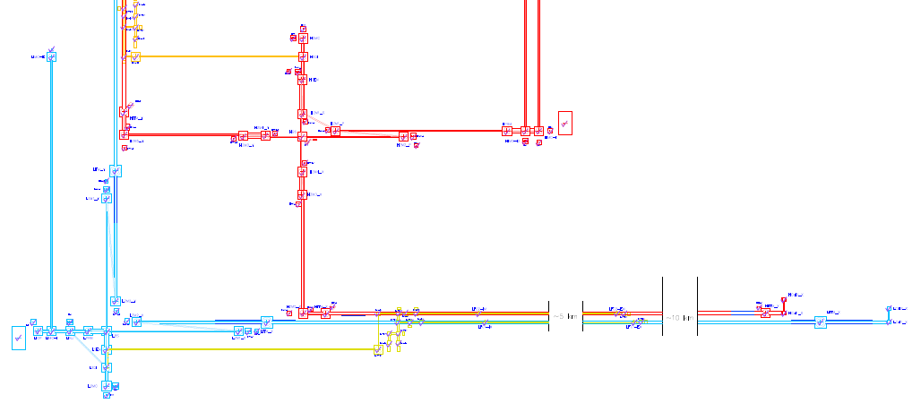
Task Force output tables overview
TABs 1&7 (System Decomposition):
Numbered system node decomposition table –
‘Coat rack’ used by Tower Integration, Optical/Detector layout, Civil Infrastructure and ET Sensitivity Budget exercises
TABs 2&8 (Integrated Towers):
Captures categorization, design flexibility and boundary conditions of integrated tower nodes
→ Suspension architecture
→ Optical payload boundary conditions
→ Vessel architecture and special features
→ Detector layout boundary conditions
TABs 3&9 (Optical Layout):
Convert ‘old’ optical layout output tables to Taskforce context
→ Subtable A: Captures high-level optical requirements at ET/LFI/HFI system level - connection to sensitivity curves
→ Subtable B: Optical element and subassembly functions, positions, orientations
→ Subtable C: Named optical elements and subassemblies system allocation and ‘spec-sheet’
→ Subtable D: Optical flexibility demands

Slide 7
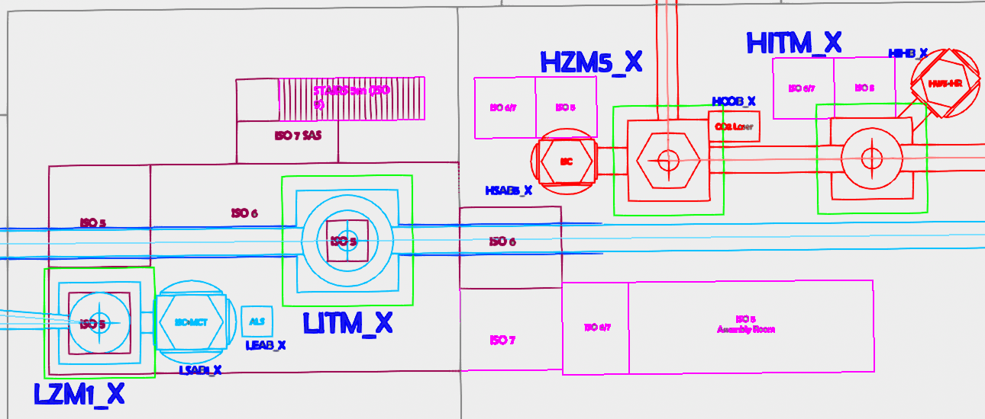
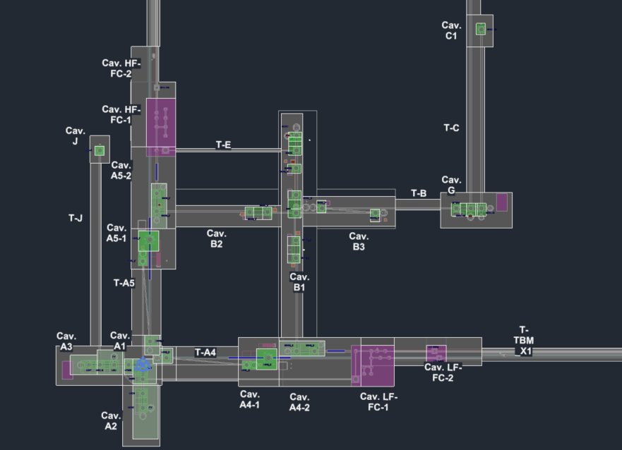
Task Force output tables overview
TABs 4&10 (Detector Layout / Technical Infrastructure):
As high-level REQs/SPCs: Detector space claims
(tower scaffolding, logistics space, …)
As named Subsystems: Noisy rooms, cleanrooms,
select beampipe segments, Cryogenic infrastructure
TABs 5&11 (Civil Eng. Layout / Civil Functional Volumes):
High-level engineering requirements on civil systems
Functional contents and Excavated volume per cavern
Functional contents and Excavated volume per tunnel
TABs 6&12 (ET Sensitivity/Noise budget):
- Sensitivity curves as requirement lines
- Noise components as specification lines

Slide 8
Summary
Three-level system decomposition constructed for Task Force work
→ Integrated-system based
→ Approx. 250 nodes per ITF pair
→ For both Triangle and 2L configurations
Requirements and specifications made traceable in Technical Annexes: Output Table sets
TAB1: System Decomposition
Optical element positioning
Beam characteristics
Space claims:
Cleanrooms
Noisy rooms
Tech Infra
Logistics
Safety
Functions
& volumes:
Caverns
Tunnels
Attach
TAB3:
Optical Layout
TAB4:
Detector Layout
TAB6:
Sensitivity Budget
TAB2: Tower Integration
TAB5:
Civil Functional Volumes
Science Case
Sensitivity curves
Optical element:
Type
Size
Co-location
Tower info: Footprint
Height
Access
ISO lvl

Slide 9
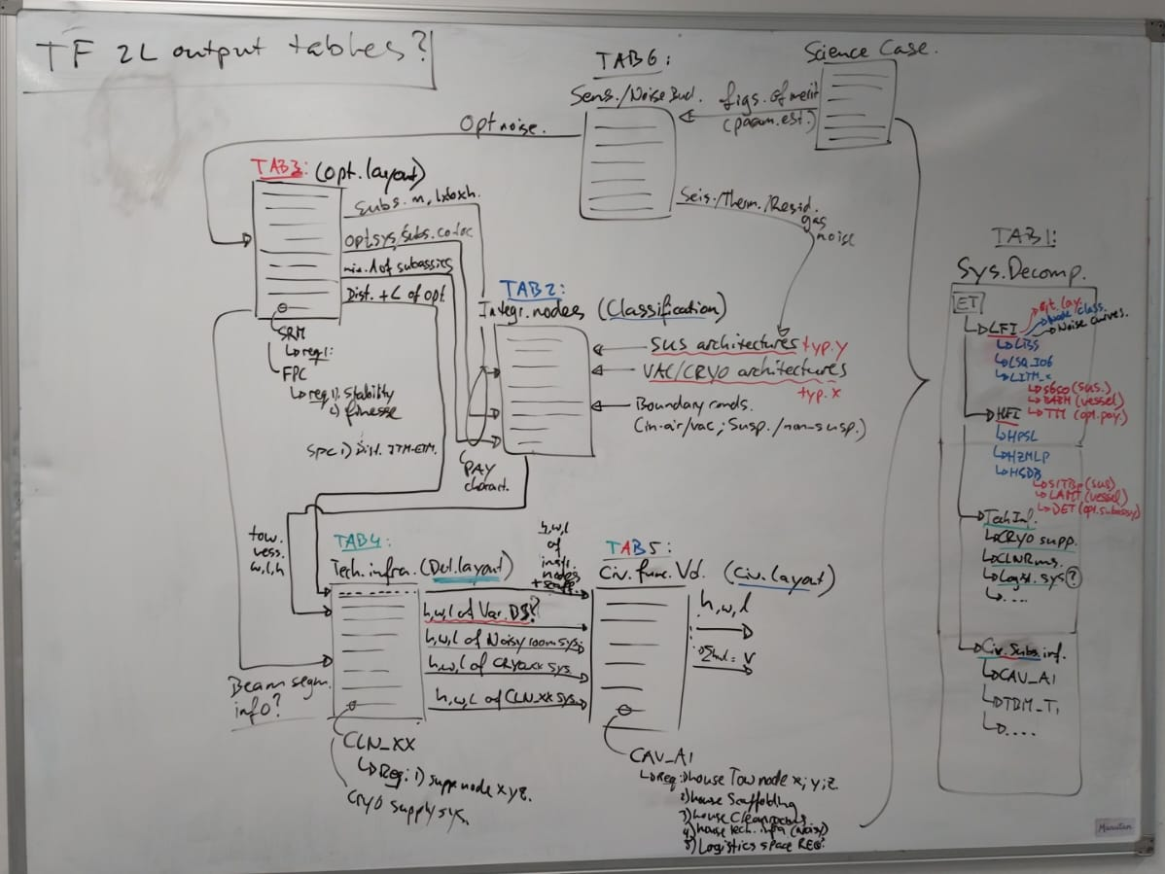
Spare – logical connections between tables

