Slide 1
Task Force: Tower Integration and Categorization XV Einstein Telescope Symposium | Bologna
R. Meijer
26-05-2025

Slide 2
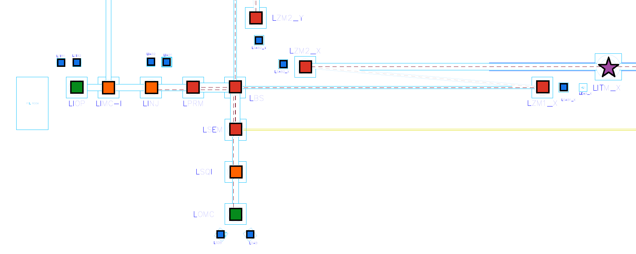
Context of Tower nodes
Tower nodes are subsystems of ET’s Low-Frequency and High-Frequency Interferometers (LFI, HFI)
Interfaces with Optical Layout: Residual Motion level and Payload boundary conditions (size, type, co-location)
Interfaces with Detector Layout: Accessibility constraints, allowable space claim
Considered are three subsystems: Optical payload, Seismic Isolation System, Vacuum Vessel
b. Vacuum Vessel
c. Seismic Isolation System
(Detail view)
a. Optical payload
Sys. level 2: LF-Interferometer
SYS_004 (LFI)
Sys. level 3: LF-Test Mass tower
SYS_129 (LITM_Y)

Slide 3
Capturing tower specifications
Tower specifications are stored in Output Tables TAB2 (Triangle) and TAB7 (2L)
1. Specification line root
1c. Seismic Isolation subsystem specifications
1a. Optical Payload subsystem specifications
1b. Vacuum vessel subsystem specifications
1. SYS_129 (LITM_Y)

Slide 4
Scope of tower categorization exercise
Tower categorization proceeds on previous work:
ET-0577A-24 – MEMO: Einstein Telescope Preliminary Suspension System Classification
ET-0676A-24 – Preliminary Detector Layout - 10km Triangle
Notable scope extensions compared to previous work:
Introduction of 6th SUS Residual Motion (RM) category
Preliminary estimate of quantified RM levels for select nodes
Increased maturity with Optical and Detector layout for tower boundary conditions (e.g. required bench footprint, co-location, accessibility constraints, …)
Recategorization of Triangle and extension to 2L configuration
Inclusion of Auxiliary optical benches – both In-vacuum/Suspended and In-air/Non-suspended
Some general remarks:
Wherever available, flexibilities on boundary conditions are retained and highlighted alongside the baseline categorization
Categorization is performed subsystem design-agnostic → tower subsystem design space is retained as much as possible
High-level conceptual design considerations conceived within the Task Force work are recorded in the Supporting Document
Categorization almost equivalent between Triangle and 2L configurations – exceptions in nodes HZM5_X/Y +1 additional node per corner for Triangle LF SQZ steering mirror (LSQ-ZM_A/B/C)
Highly recommended to proceed future work with increased Tower subsystem integration activity

Slide 5
Main considerations for configuration changes
Expected major impact on excavation volume
1) Reduction in height of the LF Test Mass Seismic Isolation System
→ Large effect due to size of LF Cornerpoint Cavern
2) Reduction in height of HF non-Test mass nodes
→ Long, tall caverns with many nodes
3) Reduction in footprint of Auxiliary benches
→ AUX benches are many and widespread, premature footprint estimation from legacy work
4) Consistent application of lateral or bottom tower access
→ Avoiding scattered bottom-access basements, avoiding lateral access wherever inconvenient
5) Accommodating a shift towards optical element co-location
→ Co-locating optical elements in an increased # of nodes to reduce excavation cost resulting from optical layout
Expected medium/small impact on excavation volume
6) Reduction of ET-LF Cryostat footprint
→ Impact larger for Triangle configuration than 2L
→ Dependent on LF Test Mass tower subsystem design maturity
7) Reduction of LF non-Test Mass tower height
→ Proximity to taller LF-Test Mass tower in the same cavern
8) Reduction of HF Test Mass tower height
→ Proximity to taller towers in the same cavern

Slide 6
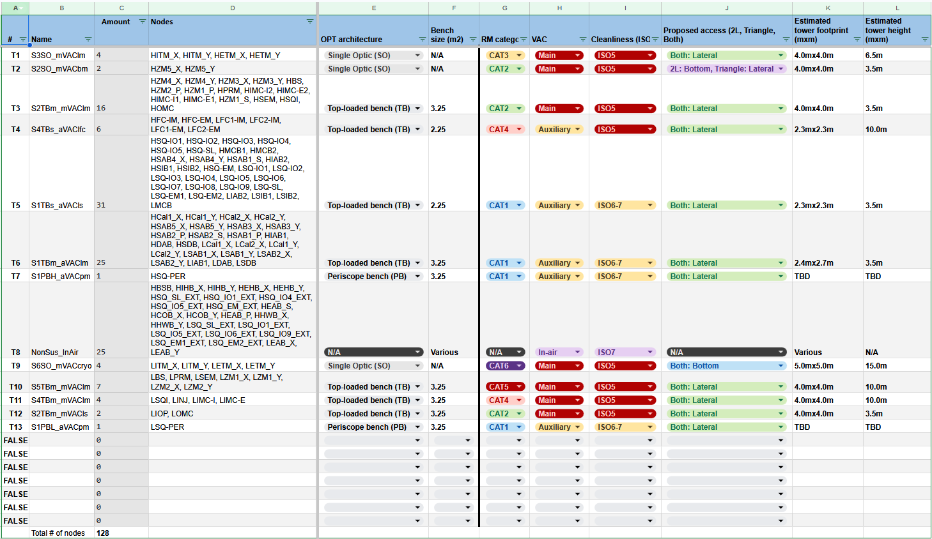
Categorization output table summary (2L example)

Slide 7
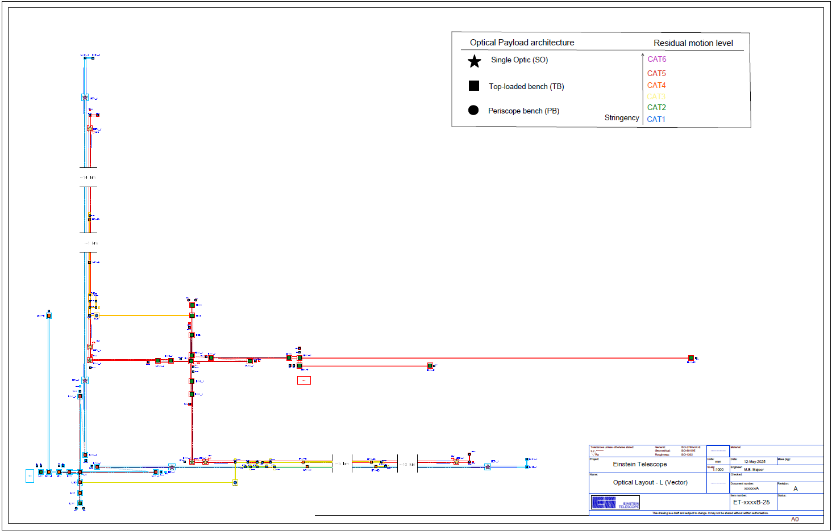
Categorization update 1/5 – large impacts
Reduction in height of the LF Test Mass Seismic Isolation System
→ Reduction adopted from ongoing LF-TM integration and SUS LF-TM tower conceptual design exercises

Slide 8
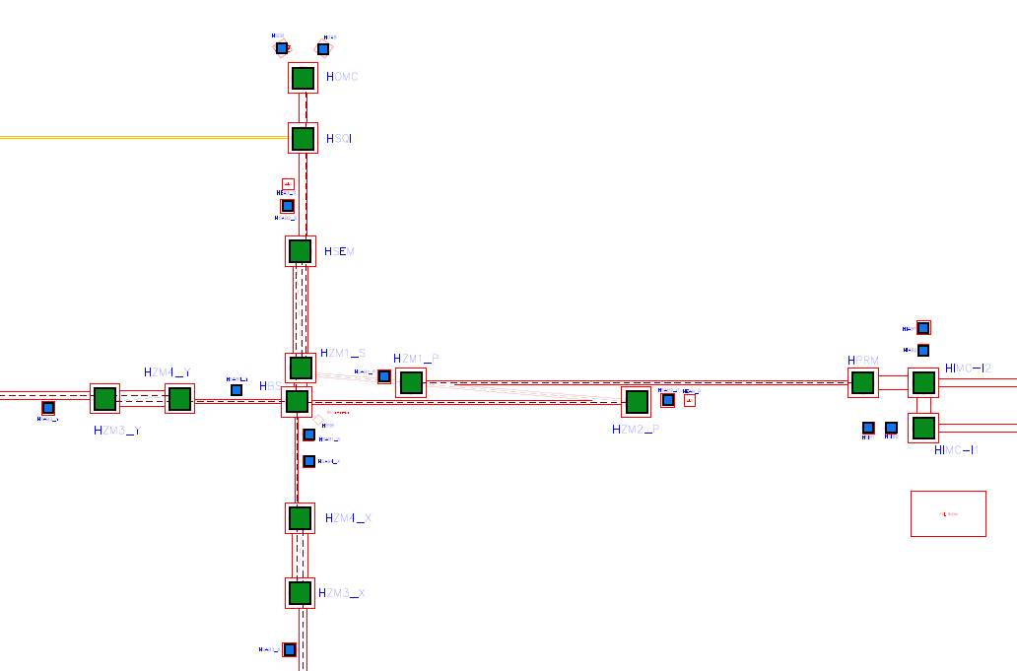
Categorization update 2/5 – large impacts
2) Reduction in height of HF non-Test mass nodes
→ HF’s more relaxed residual motion requirements can likely be satisfied by low (modular) SUS systems

Slide 9
Categorization update 3/5 – large impacts
3) Reduction in footprint of Auxiliary benches
→ Increased maturity of Optical AUX subsystem bench space requirements estimation
→ Strategic grouping of AUX systems

Slide 10
Categorization update 4/5 – large impacts
4) Consistent application of lateral or bottom tower access
→ Default access: lateral
→ Exceptions for LF-TM towers and HZM5_X/Y in 2L configuration
→ Flexibility retained wherever possible (e.g. not possible in SQZ lab → only lateral access option)
5) Accommodating a shift towards optical element co-location
→ Emphasis on top-loaded bench Suspension architectures
→ Design flexibility on conceptual suspension system solution retained
5)
4)

Slide 11
Categorization update 5/5 – new introductions
6) 2x: Periscope tower (HF and LF)
→ Introduced need by Optical layout: plane difference between SQZ lab and main ITF
→ Maximum flexibility retained, new design effort required
7) 25x: Bookkeeping of In-air Non-suspended benches
→ Previously uncategorized, but also require footprint
→ No dedicated design effort envisaged for now

Slide 12
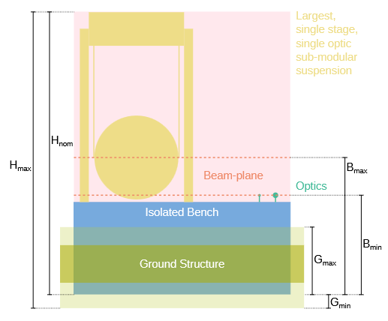
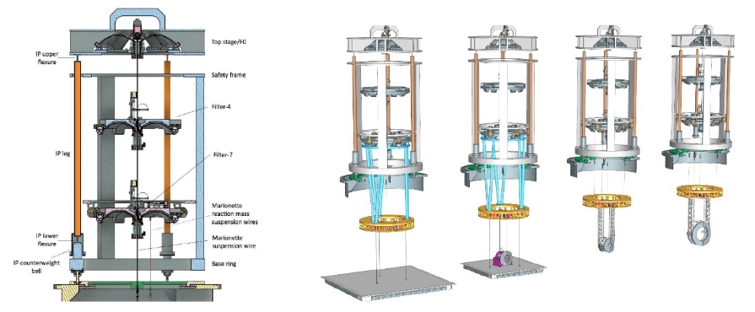
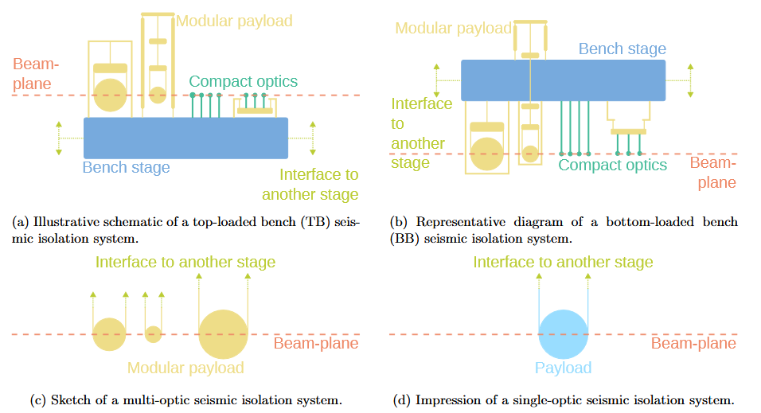
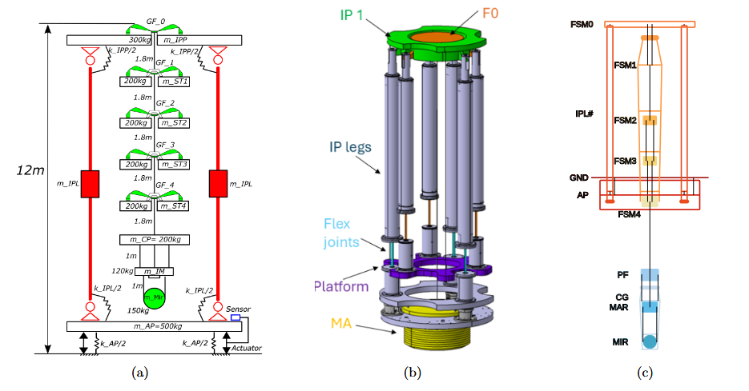
Tower subsystem design flexibility retained
High-level Suspension System design considerations summarized per Residual Motion category in Supporting document

Slide 13
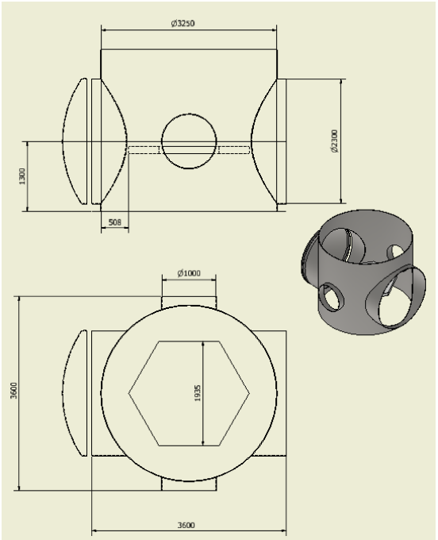
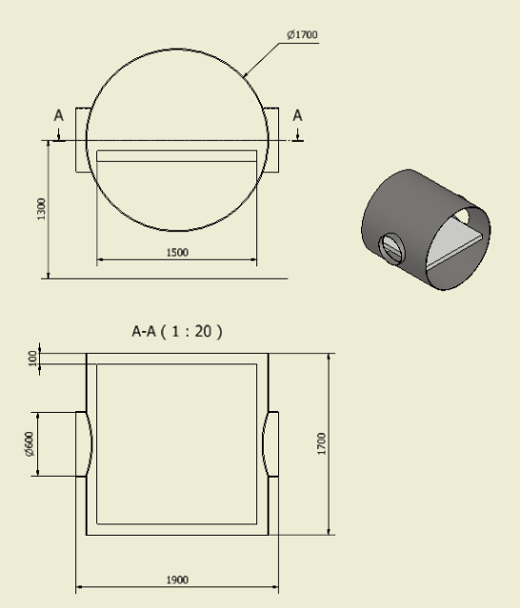
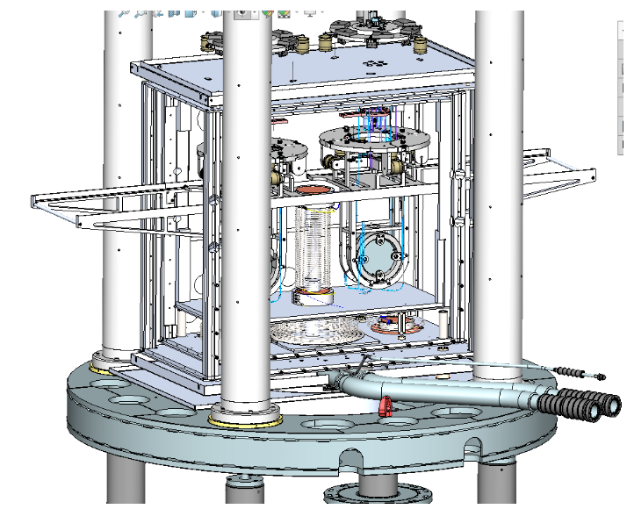
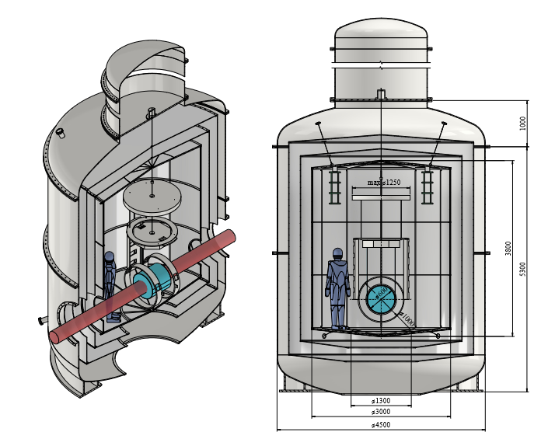
Tower subsystem design flexibility retained
High-level Cryostat and Vacuum Vessel considerations also summarized in Supporting document

Slide 14
Summary
Scope of exercise extended significantly over previous efforts
Increased maturity for integration between tower nodes and external dependencies
Updated tower categorization per ITF pair: 128 (129 Triangle) nodes spread over 13 types
Configuration changes adopted that are expected to have major impacts on excavation volume
New tower types introduced: HF and LF Periscopes and In-air Non-suspended AUX benches
Approx. 100 out of 128 nodes captured as either In-air, CAT1 or CAT2 bench towers
Boundary condition flexibility retained alongside baseline configuration
Tower subsystem design flexibility retained, conceptual considerations documented

