Slide 1
Requirements to Civil Infrastructure:
Criteria and Tools used for the ETO Design Task Force
Jonathan Bratanata / NIKHEF
Maria Marsella / INFN
Wissam Wahbeh / FHNW

Slide 2
Outline
Civil engineering criteria/principles used
Civil functional volumes – estimated excavated volumes
Cost estimation methodology
Engineering requirements that influence design and subsequently cost
Parametric tool for quick volume & cost estimation
Changes when comparing the 2024 design and 2025 Baseline Task Force update
  Key drivers and breakdown of volumes (and %change in vol./cost)

Slide 3
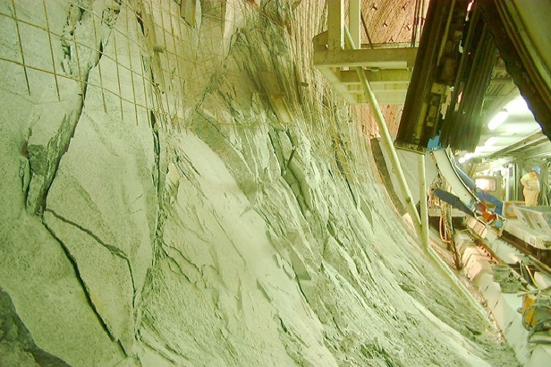
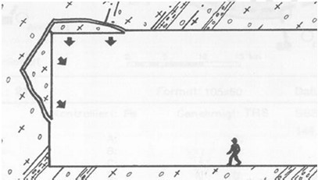
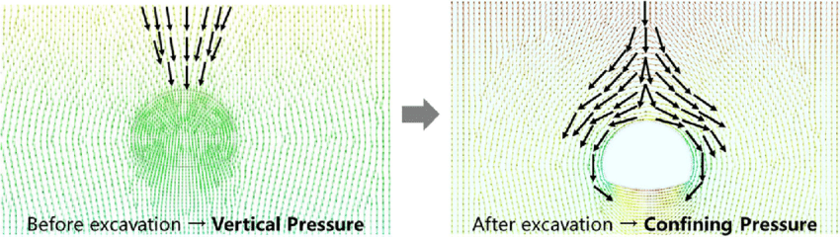
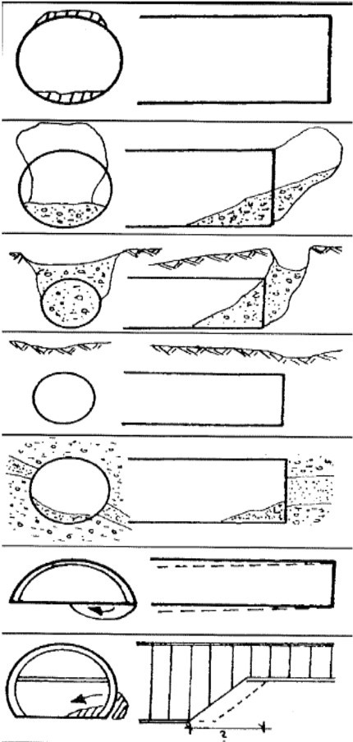
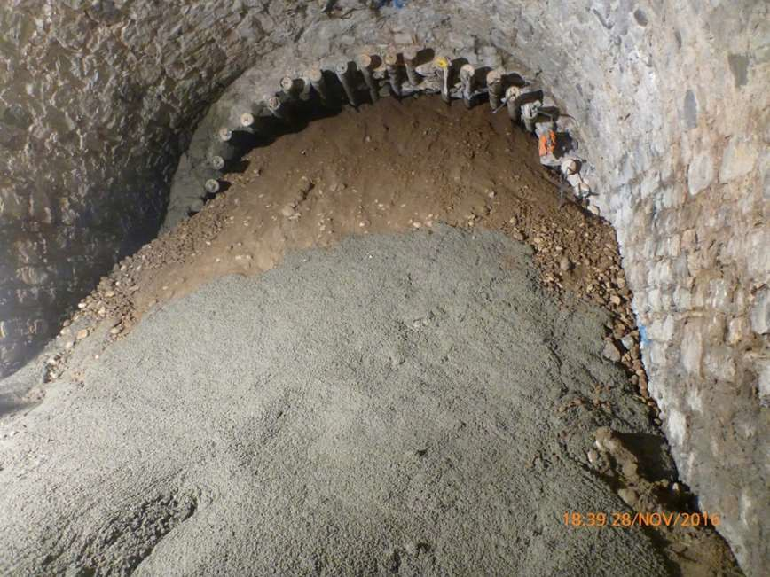
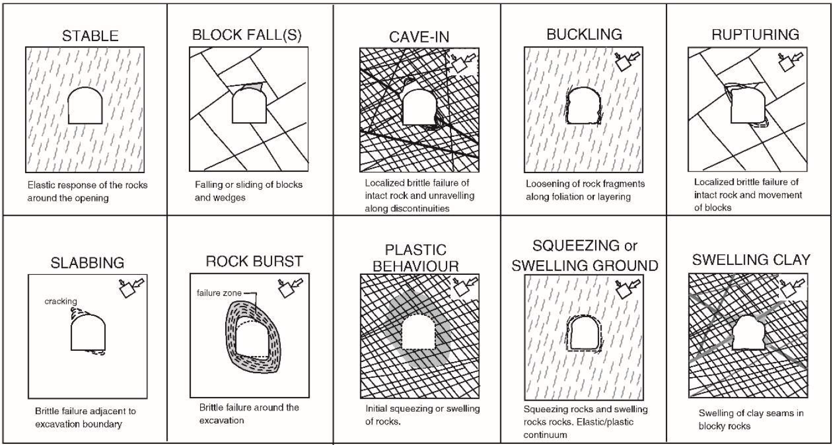
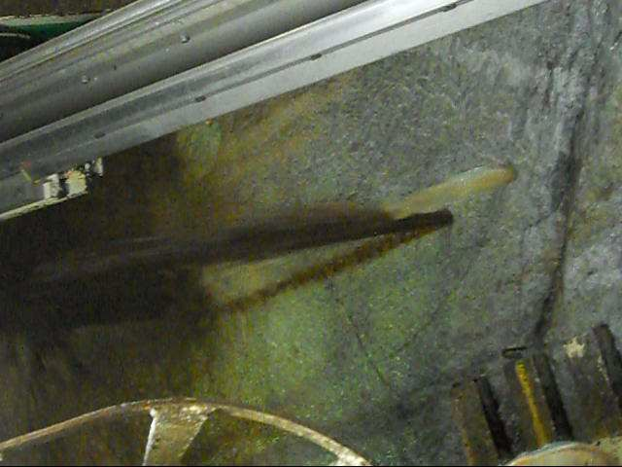
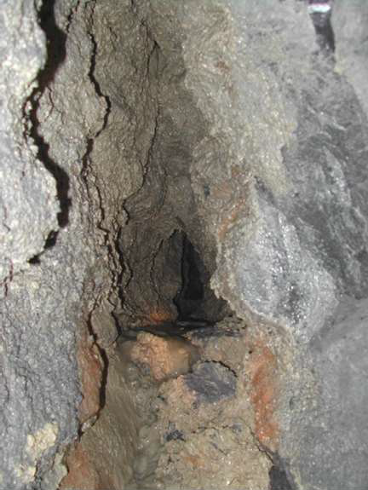
Potential underground issues
3

Slide 4
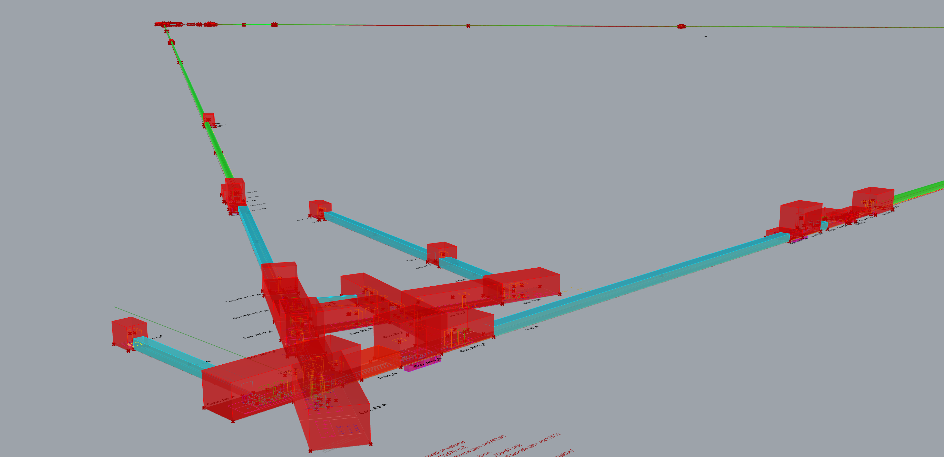
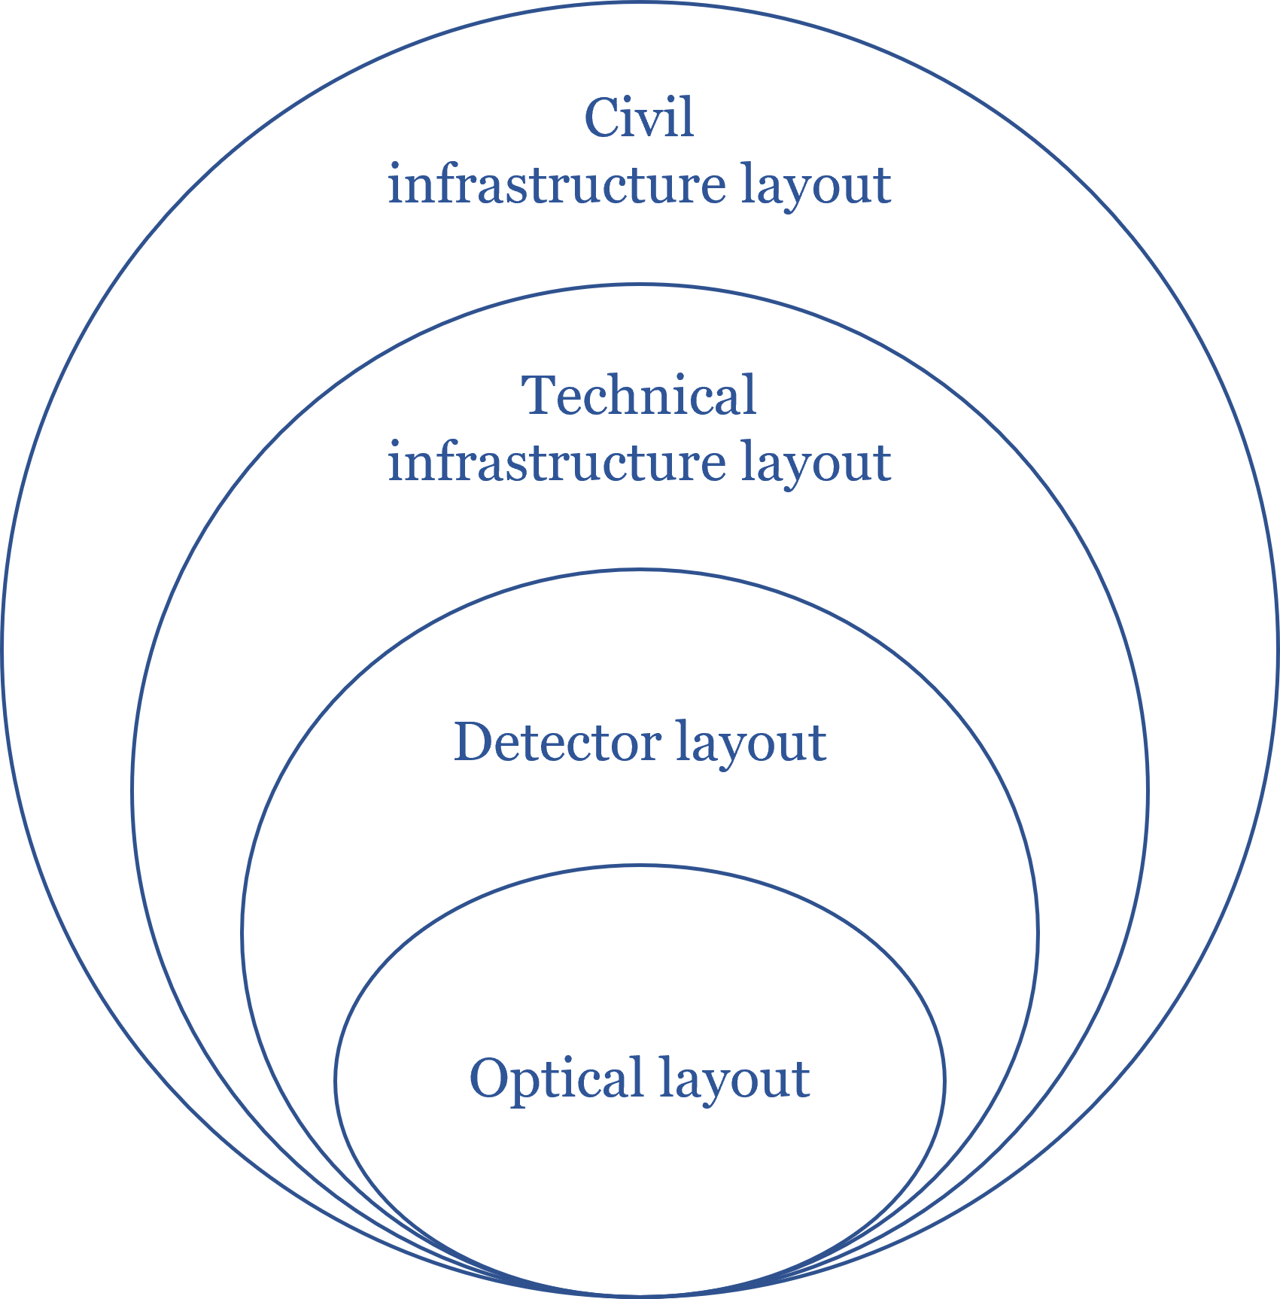
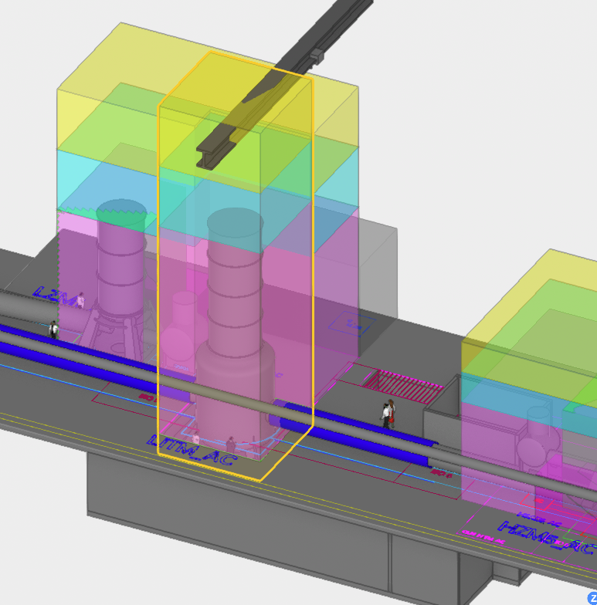
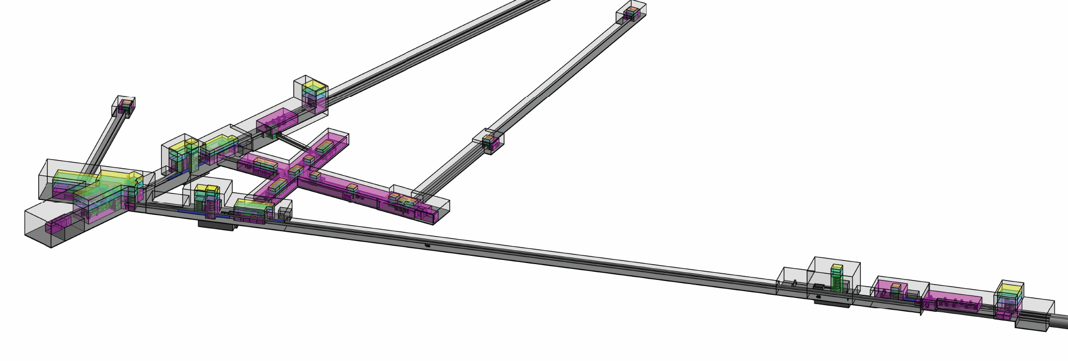
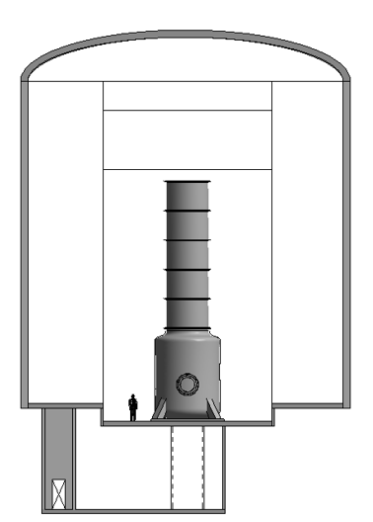
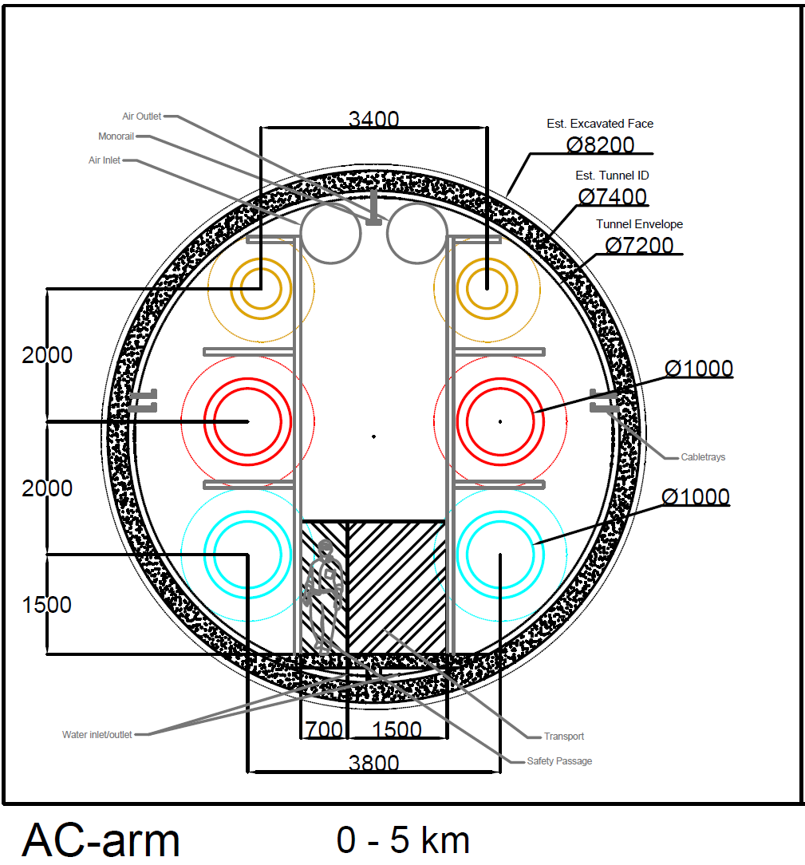
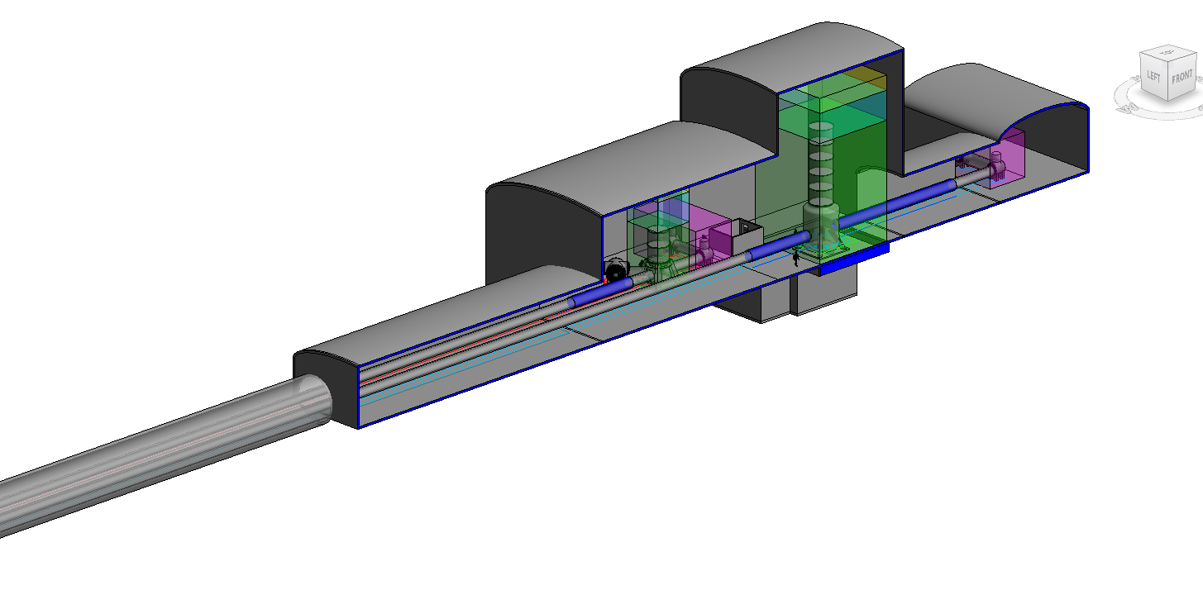
Functional Volumes and Geometrical Criteria
Infrastructure consists of:
  Caverns
  Tunnels (short access)
  TBM tunnels (main arms)
Volumes estimated using simplified civil engineering criteria.
Tunnel,
Caverns,
Access shafts/tunnels
Emergency exits, etc.
Mechanical systems
Cooling & ventilation,
Electrical systems,
Safety systems,
Logistics
Tower base, suspensions, tower envelopes,
Scaffolding,
Clean rooms,
Auxiliary benches,
Beampipes
Logistics
Arm cavities + recycling cavities
Laser, injection, detection, squeezing
Web viewable 3D Detector Layout(s): https://wiki.et-gw.eu/ED/WebHome

Slide 5
Cavern Design Assumptions
Aspect ratio 1:2 (max width 25 m).
Arched ceiling assumed for volume calc only.
1xHeight spacing between caverns/tunnels.
Future refinements depend on geotechnical studies.

Slide 6
Mechanized/TBM Tunnel Assumptions
Straight 10 km (Triangle) or 15 km (L) TBM tunnels.
Beamline straightness critical (laser requirement).
Assumes:
  Radius enlargement of 0.1m to account for TBM deviation/construction tolerance.
  Radius enlargement of 0.1m–0.3m for tunnel lining.
  Radius enlargement of 0.1m–0.15m for the annulus gap

Slide 7
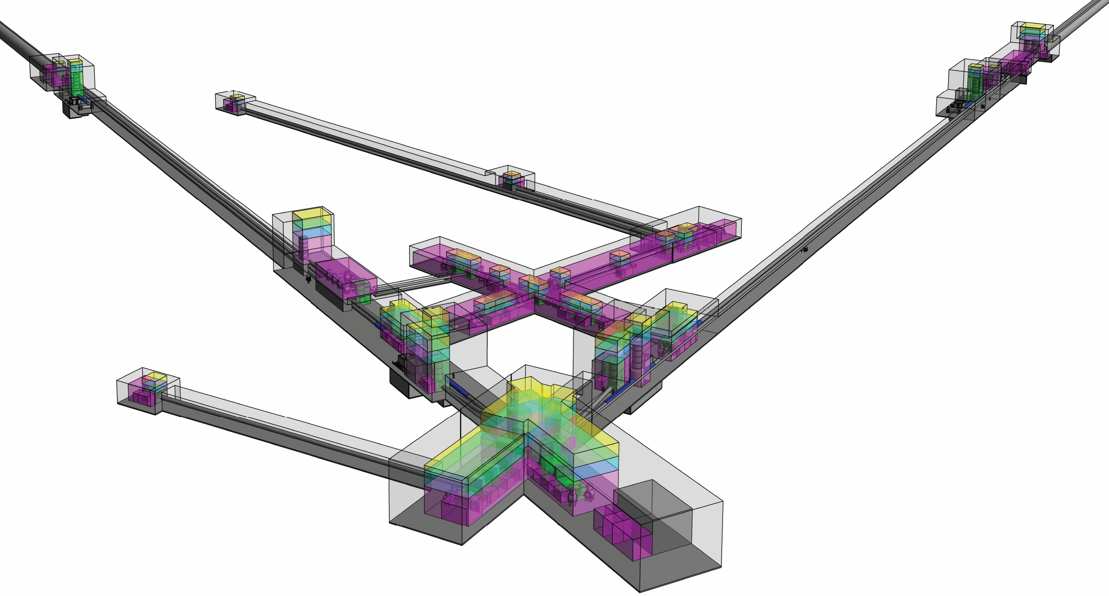
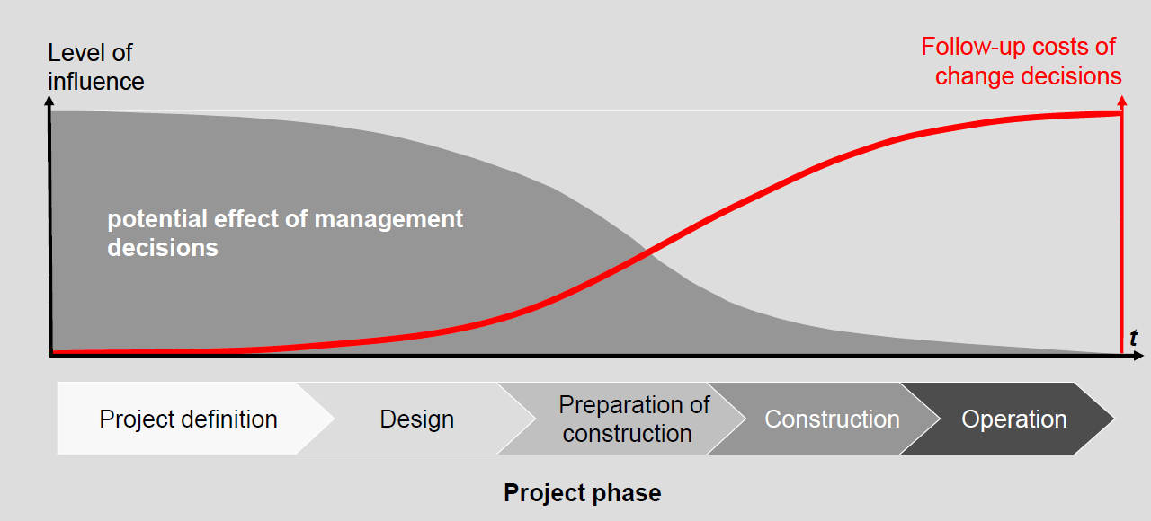
Limitations of Taskforce comparative analysis
Tunnel,
Caverns,
Access shafts/tunnels
Emergency exits, etc.
Limitations of Taskforce comparative analysis:
Not tied to certain geographical and geological conditions
  Can only assume geological/hydrological conditions to a certain level
Excavation method is assumed
Construction planning scheme(s) not considered
Not considering optimal cavern/tunnel shape
  Assuming support system (primary and/or secondary lining, rockbolts, etc.)
Not considering access (shaft/tunnel), nor depth/position underground
Not considering additional tunnels needed for construction (e.g. connection/service tunnels for excavation of caverns)
Surface works not considered
Not fully considering safety (no personnel yet).
Mechanical systems
Cooling & ventilation,
Electrical systems,
Safety systems,
Logistics
Tower base, suspensions, tower envelopes,
Scaffolding,
Clean rooms,
Auxiliary benches,
Beampipes
Logistics
Arm cavities + recycling cavities
Laser, injection, detection, squeezing

Slide 8
Other Technical/Engineering requirements
Beyond Geometry
Projects must consider non-geometrical engineering criteria that impact:
  Cost
  Feasibility
  Long-term performance
Examples of non-geometrical requirements (discussion still on-going):
  Water tightness of caverns/tunnels
  Allowable water inflow levels
  Inclination limits for tunnels
  Cleanliness standards (for sensitive equipment)
  Environmental constraints (e.g., humidity, temperature, also fluxuations)
  Electrical and utility needs
  Safety and emergency access requirements
  Future-proofing (space or systems reserved for future upgrades)
Feasibility Implications:
  These factors may necessitate design changes→ Can lead to higher costs than early concept designs assumed
  To be assessed further in the local host site(s) feasibility studies

Slide 9
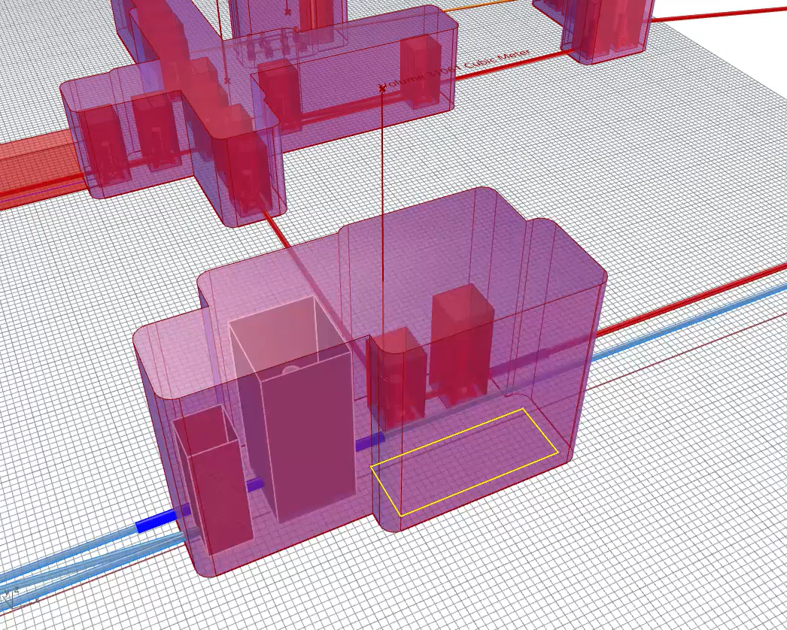
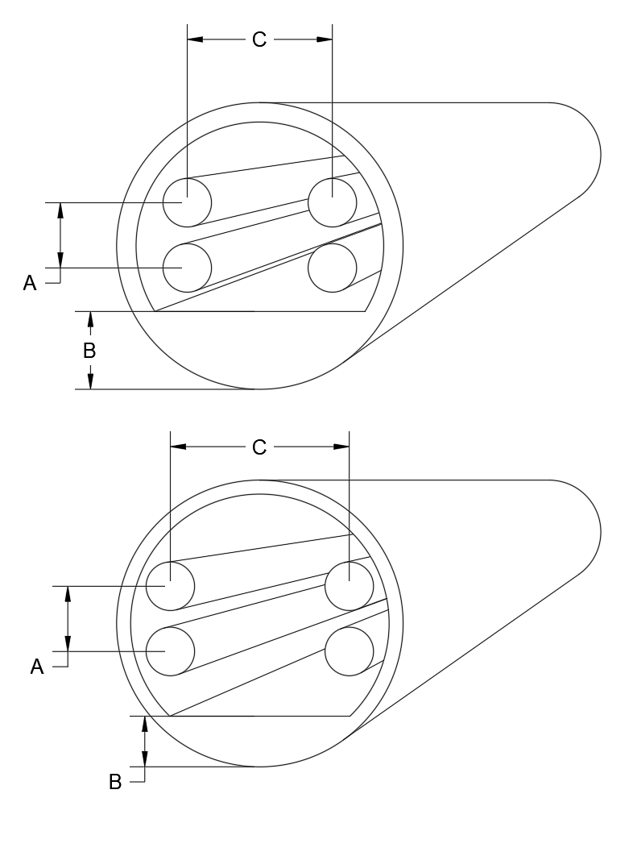





Model-based parametric design and analysis
Adoption of parametric design methodology leveraging 3D models of the infrastructure not merely as a means of geometrical representation but as a versatile tool to:
Compare alternative scenarios and situations.
Perform real-time analyses (e.g., costs, quantities).
Automate solution generation where feasible.
This approach enhances efficiency, adaptability, and decision-making throughout the design process.
Parametric modelling
Option A
Real time Calculation: (Cavern Volumes, Tunnel Volumes & Lengths, Quantity of materials,.. )
Cost
Parameters set 1
Comparison
Option X
Validation
Parameters set 2
Parametric model (Flexible with constraints) Which include the layout variants
Multi objective optimization
Decision making
Automatic layout and sections proposals
Criteria to be considered
Generative design based on criteria to optimise

Slide 10
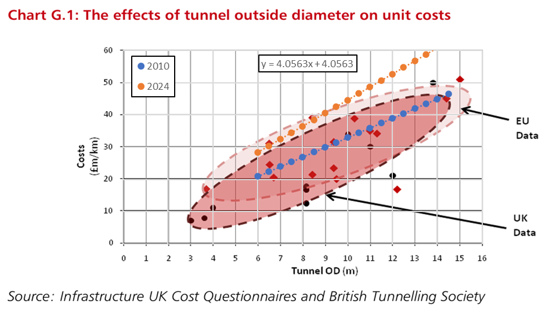
Strategy for evaluating various layouts
Propose an initial layout and unit cost values
Calculate the corresponding estimated volume and cost
Deliver a feedback
New proposals
Changes to the unit costs
Evaluation from Experts (Local Teams & CERN).
New criteria to be considered
Confirm
the solution
Layout changes
More detailed drawings
Instrument science; other ideas
Cost estimation methodology:
Simplified approach based on excavation volume only.
  Not the exact geometrical/structural form for caverns (simplified extrusions)
Relative—not absolute—cost comparison.
Useful to screen layout options at early stage.
NOT a cost estimation of the project,
It does not represent an accurate estimate of the final costs.
The real cost variations could deviate significantly from the volume variations due to the neglected factors.
It is essential to proceed with more detailed and methodologically advanced analyses to obtain reliable estimates.

Slide 11
Estimated Excavation Volumes – 2025 Layout
Triangle Configuration
TBM tunnels: ~54.4% of total excavation volume→ Large component, but proportionally smaller than in L configuration
Caverns: ~36.6% of total→ ~3× larger than L layout due to 6 interferometers (vs. 2)
Non-TBM tunnels: ~9.0%→ Reflects additional connection complexity in triangle layout
L Configuration
TBM tunnels: ~75.9% of total volume→ Indicates a tunnel-dominant layout, focused on 15 km arms (x2 for 2 sites)
Caverns: ~22.1%→ Suggests simpler/compact central infrastructure→ But requires 3 feasible geological sites for corner station & end stations
Non-TBM tunnels: ~2.0%→ Minimal auxiliary connections; simpler layout

Slide 12
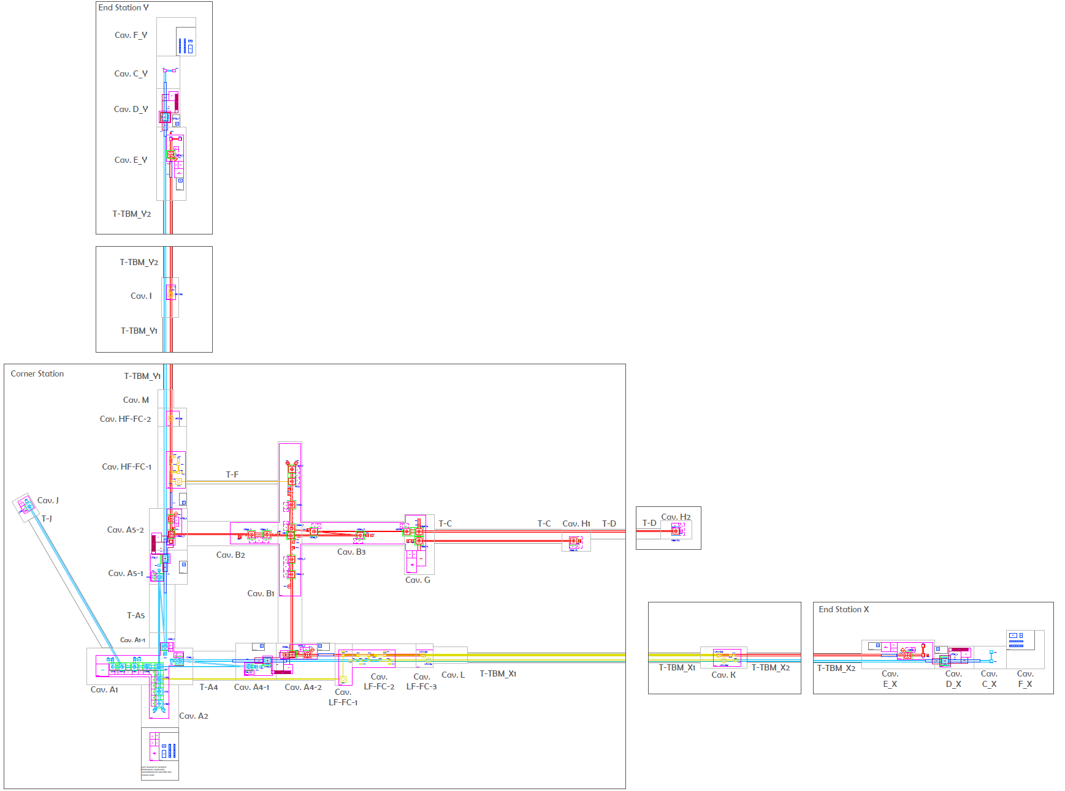

Slide 13
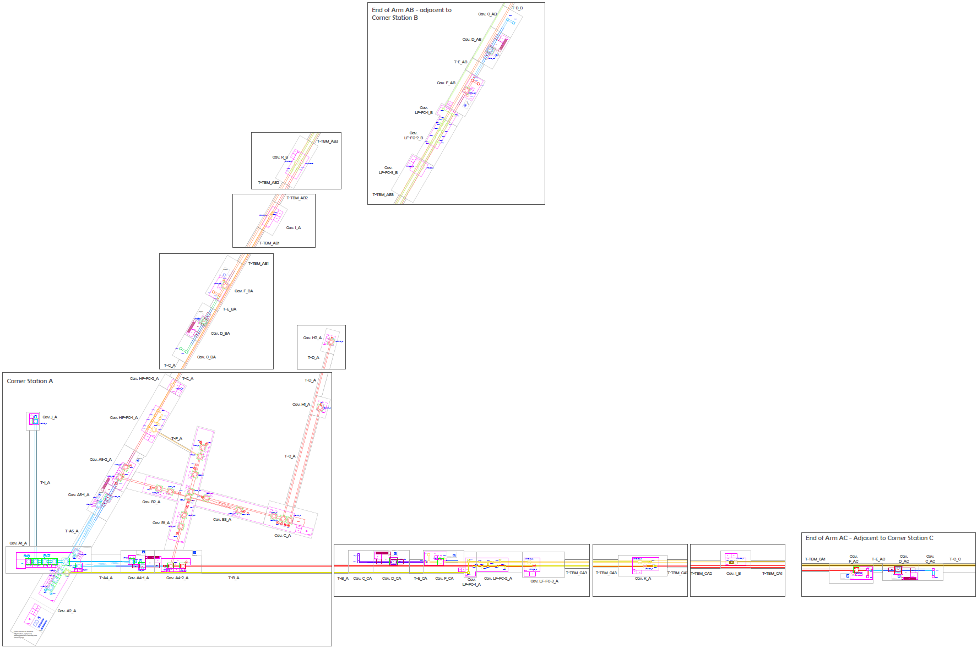

Slide 14
2025 Baseline Layout vs 2024 Reference Layout - Triangle
Total excavation volume: → Reduced by 24.9% (~0.9mil m³ !!)
Total excavation cost:→ Reduced by 29%
TBM Tunnels:
  Volume reduction: 20.9%→ Main driver: Integration of LF and HF filter cavity tunnels with main arms; TBM tunnels still major cost component of excavation
Caverns
  Volume reduction: 9.7%→ Smaller volumes in many key areas (e.g. HFI tower, LF-corner station, splitting of caverns); Offset by increased cavern needs elsewhere due to configuration reshuffling (i.e. FCs)
  Smaller (even if longer) caverns often offer greater manageability → improved overall project feasibility.
Non-TBM Tunnels:
  Largest relative reduction: 62.5%→ Contributes ~11% to volume & cost savings
-0.401 mil. m³;
-10.8%
-20.9%
-0.418 mil. m³;
-11.2%
-24.9%
-0.110 mil. m³; -2.9%
-62.5%
-9.7%

Slide 15
2025 Baseline Layout vs 2024 Reference Layout – L (numbers per instance)
Total excavation volume:→ Reduced by 27.6%
Total excavation cost:→ Reduced by 23%
TBM Tunnels
  Volume reduction: 24.0%→ Driven by integration of LF & HF filter cavities with main arms; Follows same optimization principle as Triangle configuration
Caverns
  Volume & cost reduction: Over 29%→ Indicates major improvements in central infrastructure. Result of mature design refinements (in optical layout and tower volumes),
Non-TBM Tunnels
  Reduction: Over 71%→ Contributes ~3.5% to volume & cost savings; Reflects significant layout simplification, similar to Triangle case
-0.360 mil. m³;
-17.4%
-24.0%
-27.6%
-0.073 mil. m³; -3.5%
-0.138 mil. m³; -6.7%
-71.4%
-29.4%

Slide 16
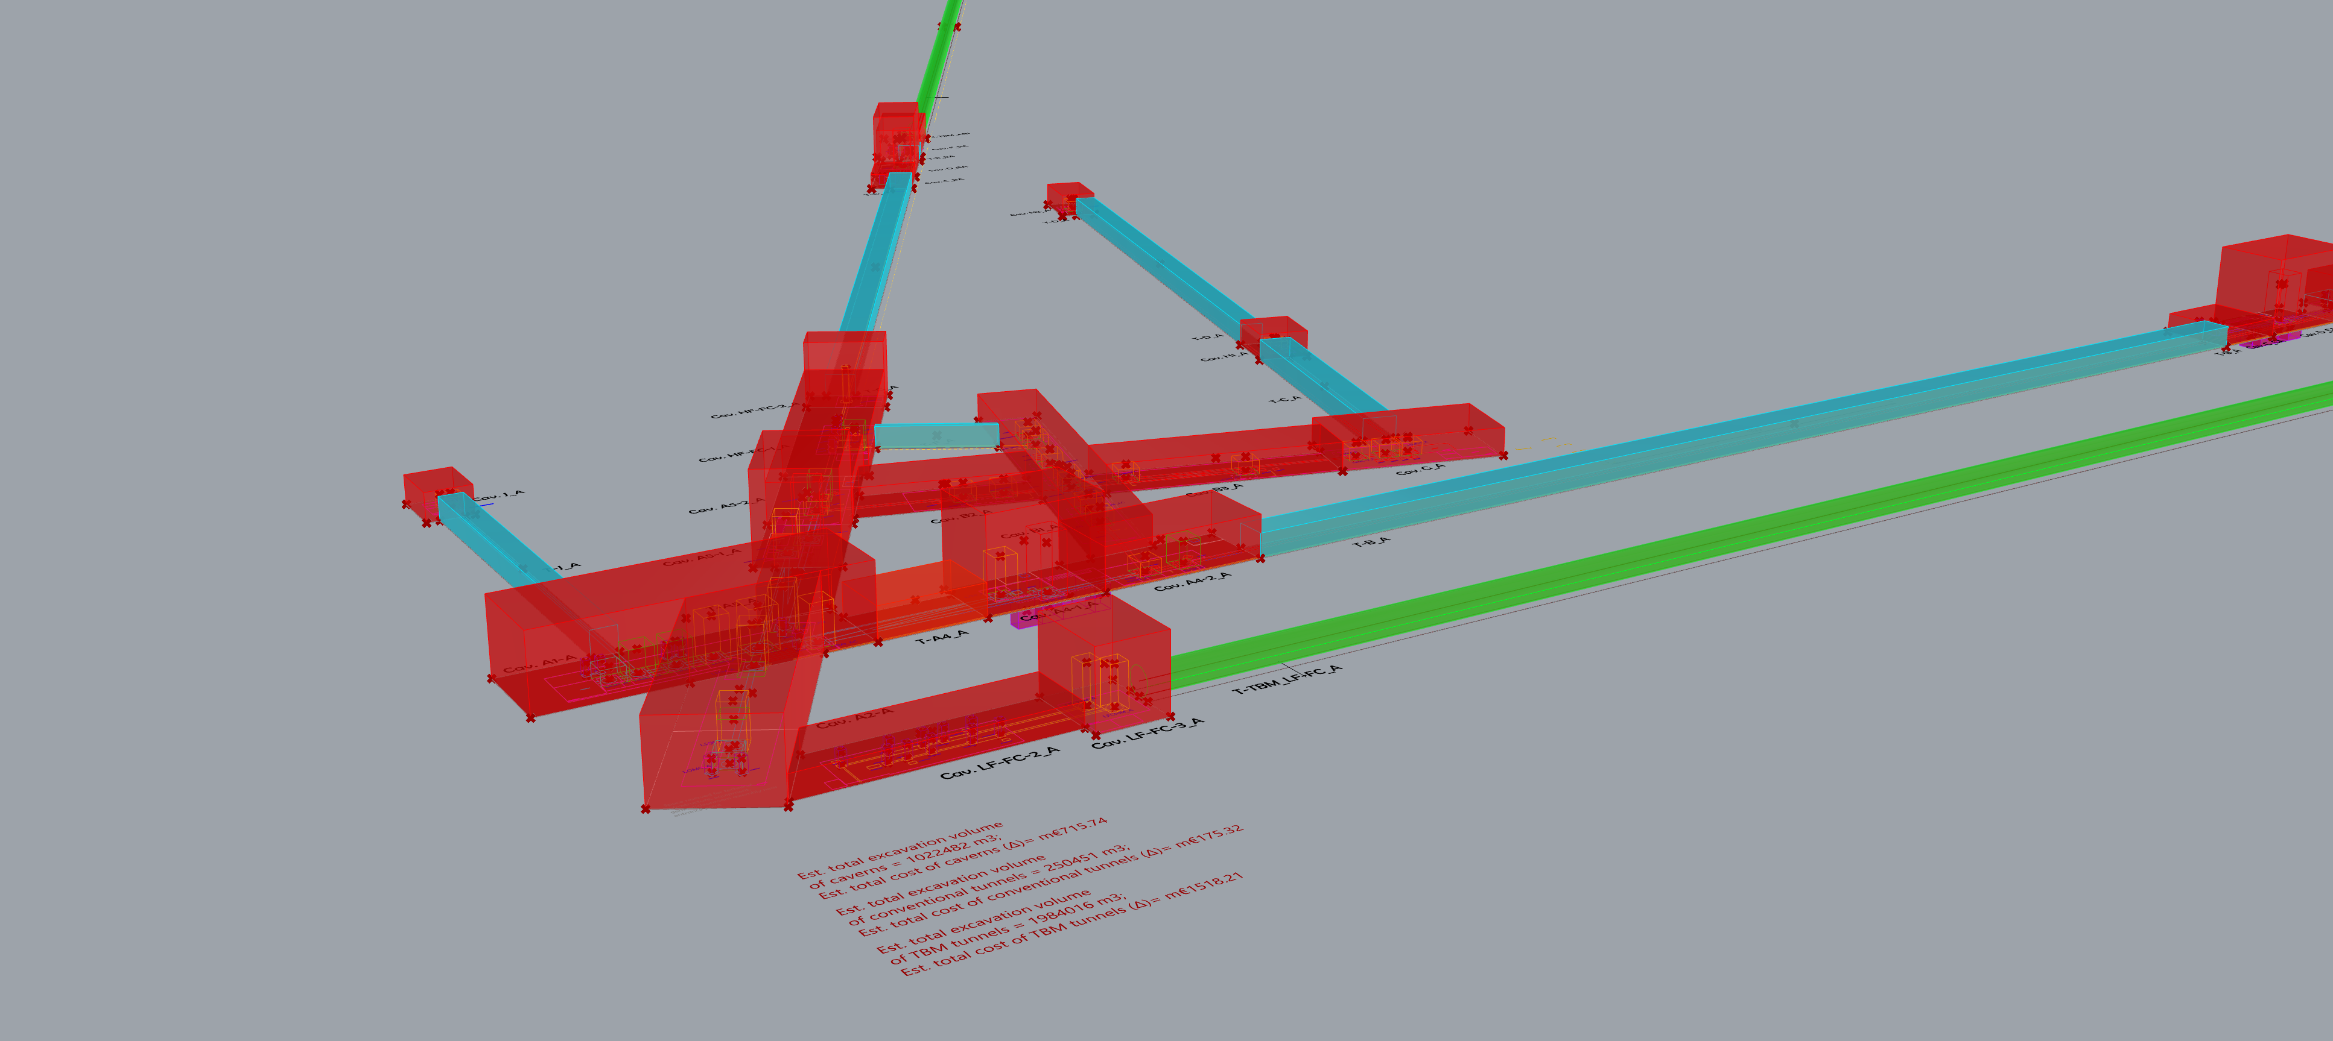
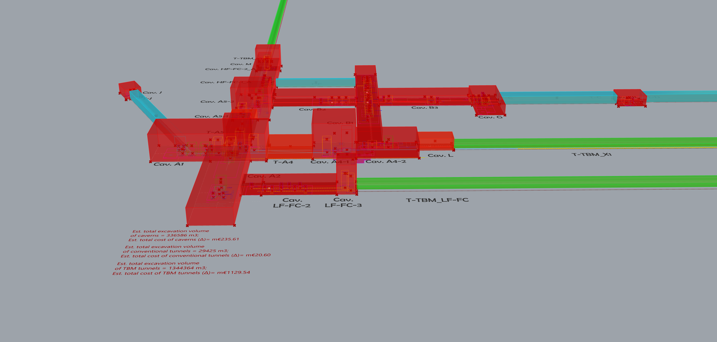
Key Cost Drivers
Isolated Design Change Impact Analysis:
  Analyzed individual design changes on excavation volume and cost
  using the parametric tool.
  Applied changes one at a time to the 2025 baseline layout
1. Use of Periscopes for LF Filter Cavities
L: LF filter cavity in X arm uses 2m periscope
Triangle: LF filter cavity in X arm uses 4m periscope
High-risk technology, but major contributor to cost & volume reduction
Eliminating periscopes in LF adds:
  Triangle layout:: +0.454 mil. m³ (+16.3%)
  L layout (per instance): +0.210 mil. m³ (+14%)
2. Tower Footprint Reductions
Reverting to 2024 tower sizes leads to modest increases in excavation volume & cost
But larger caverns come with increased stability risks and construction challenges
Limitations of Volume-Based Cost Comparisons
  Construction feasibility (e.g., smaller caverns = easier, safer, more flexible) not fully captured
  Multiple smaller caverns can be better than a single large one, despite similar volume
  Design simplifications from optical layout, integrated towers, detector layout—but not fully reflected in these isolated changes

Slide 17
Thanks!

