Slide 1
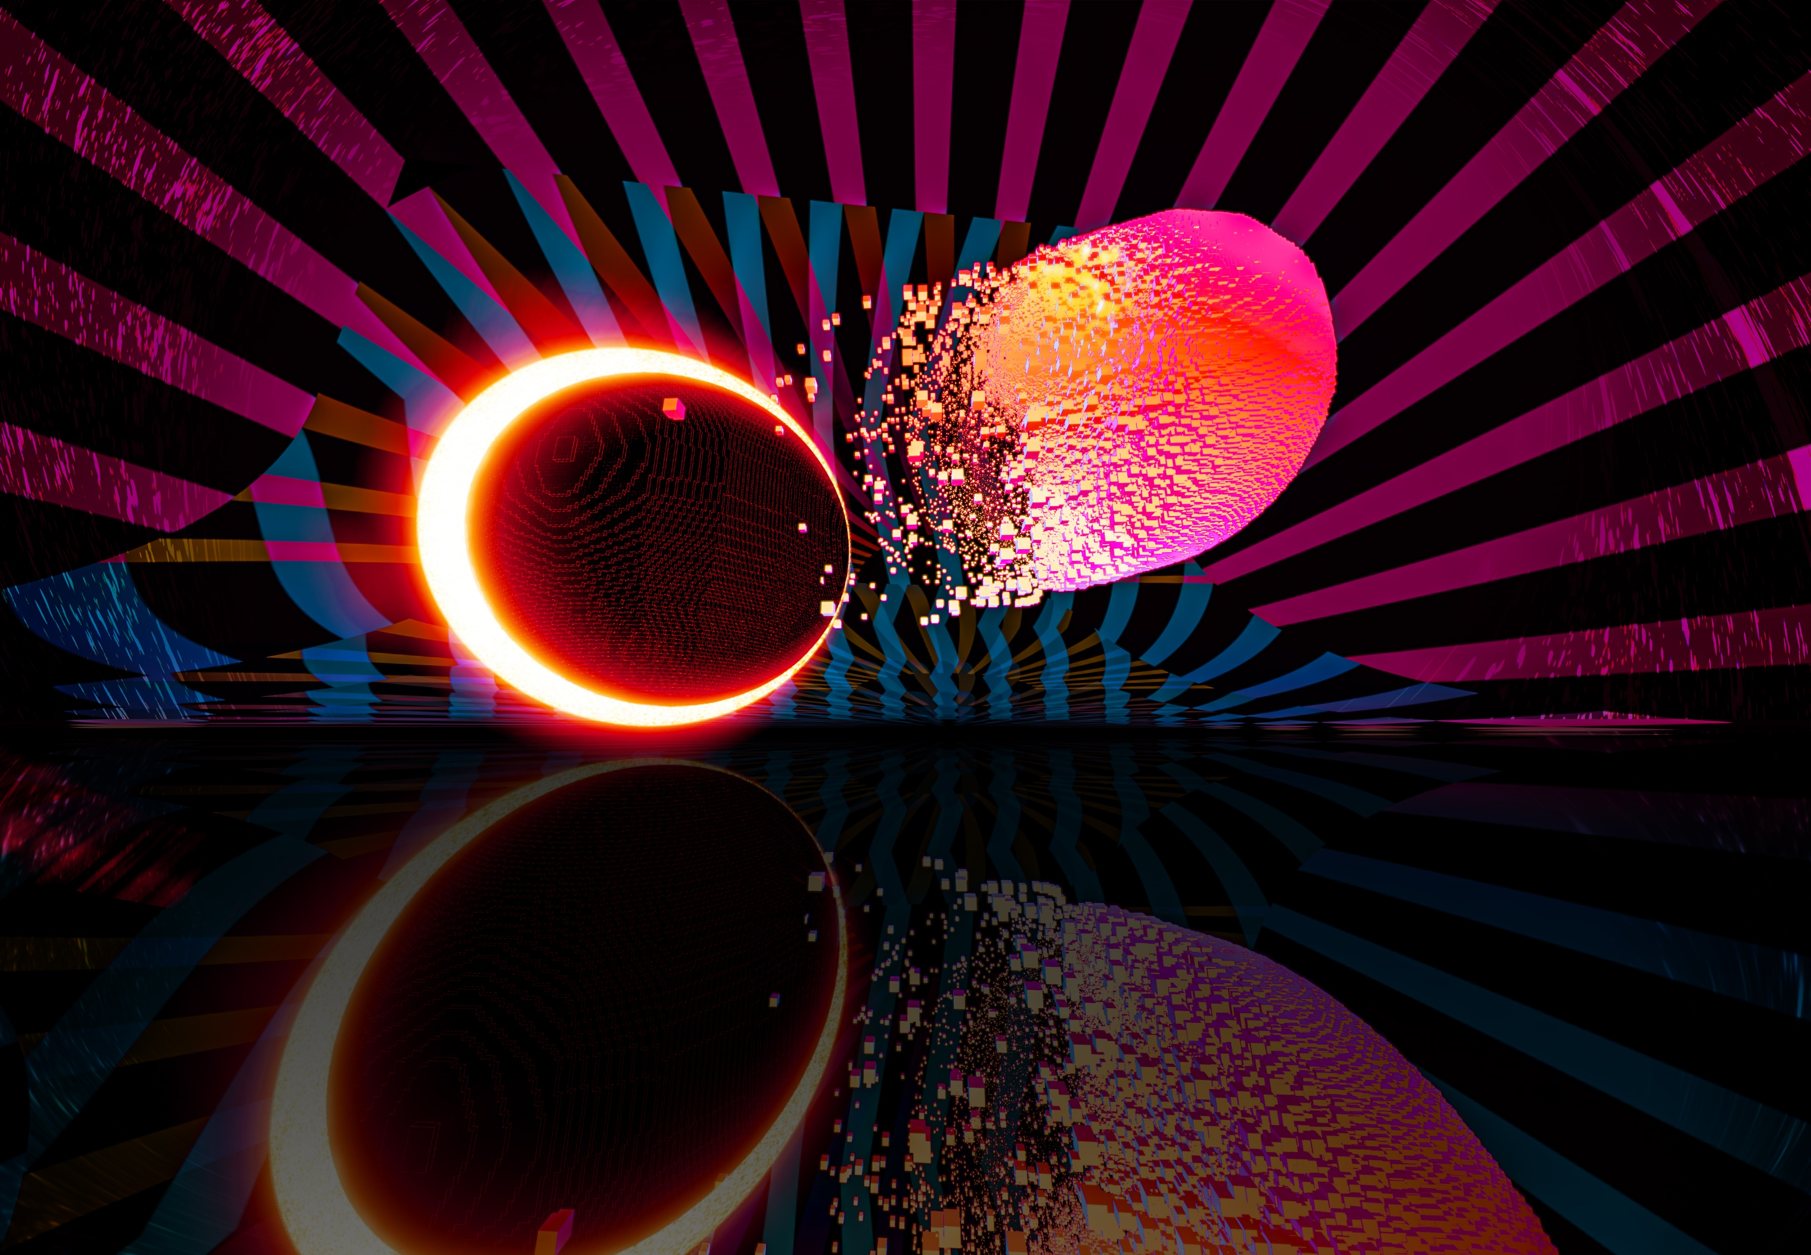

Einstein Telescope
XV Einstein Telescope Symposium Bologna – 27.05.2025
XV Einstein Telescope Symposium, Bologna
ET’s Model-Based Systems Engineering Update: Towards a Unified Systems Architecture

Slide 2
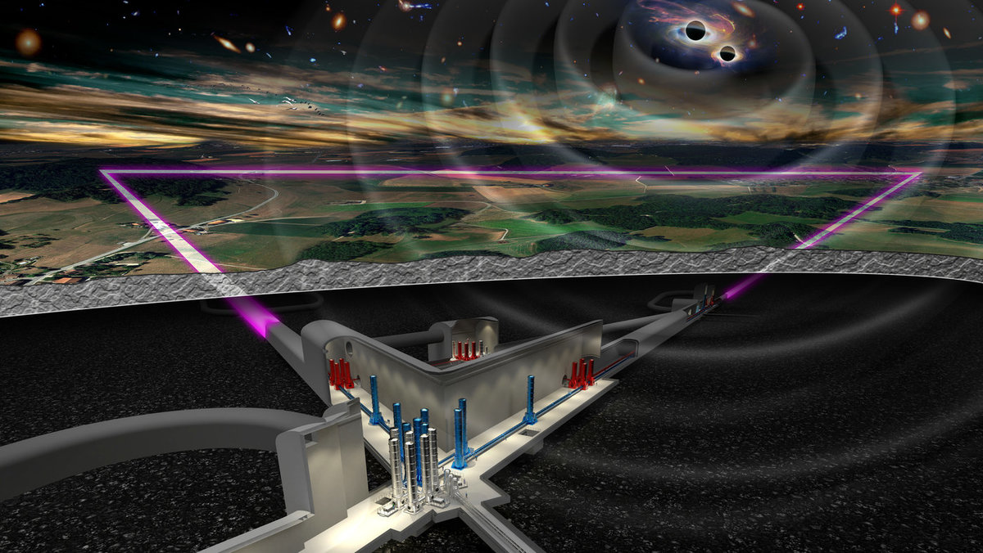













Distributed development of a complex system: The Einstein Telescope
Detection accuracy: 10⁻¹⁹ m
Large underground infrastructure complex
ET-LF operating at cryogenic temperatures
100’000 m³ of UHV
Marco Kraan/ NIKHEF
Over 1800 researchers of different disciplines all over Europe are involved
2

Slide 3
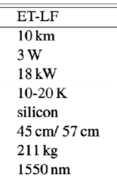
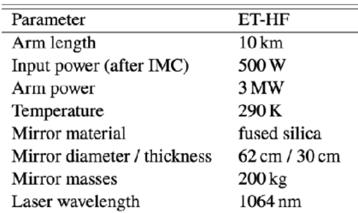
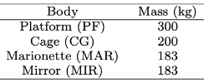
Model-Based Systems Engineering tackles the challenges in the development of complex systems
Future
Current challenges
Beam
Tower
Beam
Beam pipe
Seismic
noise
_{Heat}
Beam
Heat
Model-Based Systems Engineering (MBSE)
Document based development
The subsystem interactions are unclear, and parameter influences cannot be traced
Data consistency across the Collaboration
Requirement interdependencies and relations
are not traced
Single Point of Truth for data and parameter
Development results are stored in interconnected models
Requirements traceability from science case to component requirement
3

Slide 4
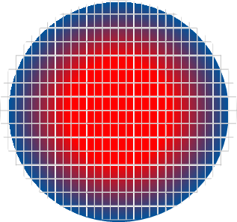
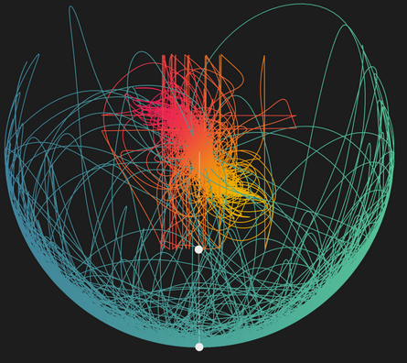
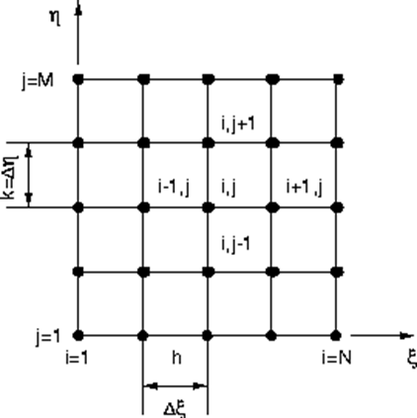


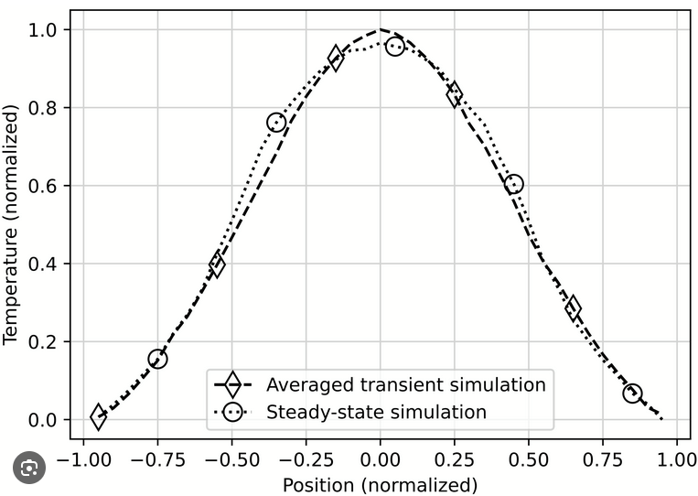
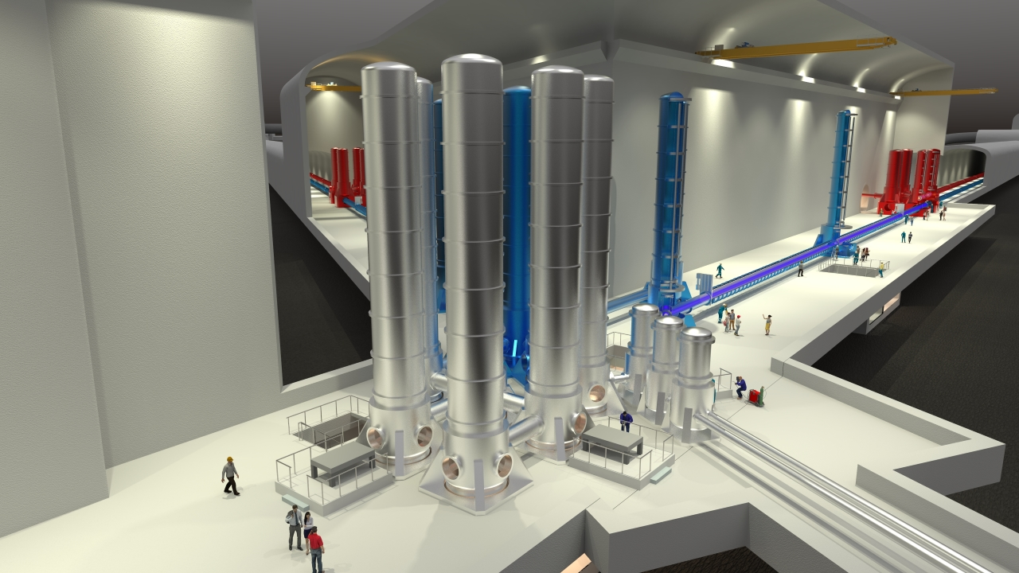
MBSE structures the product and connects requirements with behavior models
Finite Element Method
Detection accuracy
Requirements
Behavior Models
Multi-Body-Simulation
Finite Difference Method
LCA
Vacuum pressure
Model-Based
Systems Engineering
Cost model
Lifetime
Heat
Surrogate
Architecture
Product break down structure
System
System architecture
Subsystem 1
Subsystem 3
Subsystem 2
Subsystem 1
Subsystem 2
Subsystem 3
Marco Kraan/ NIKHEF
4

Slide 5
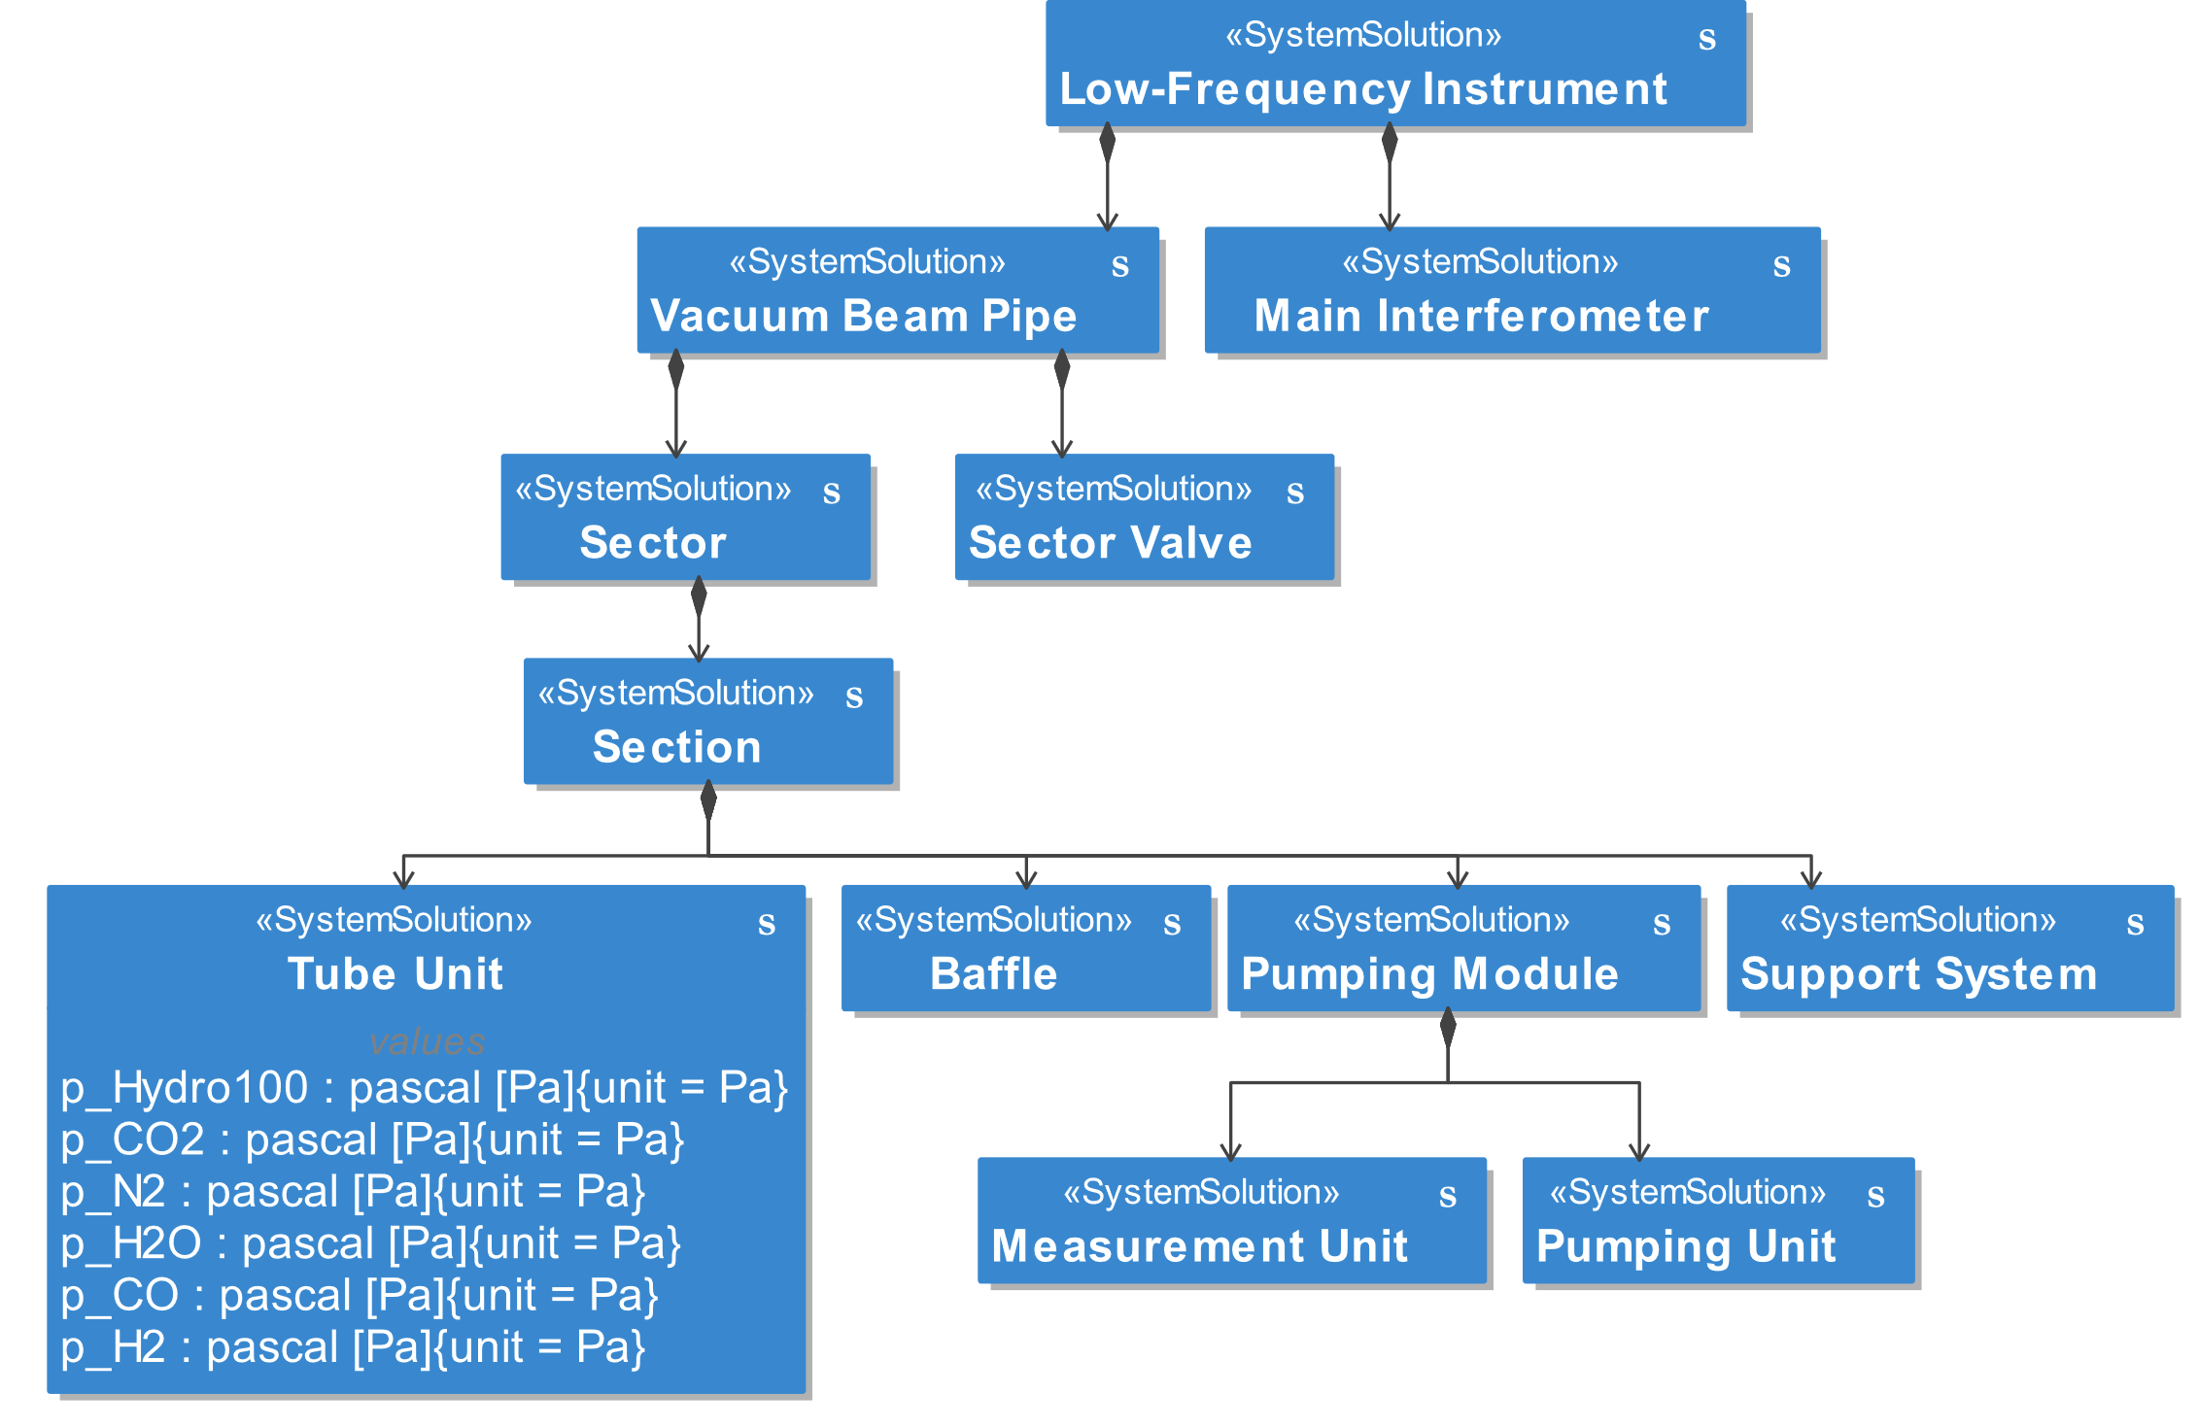
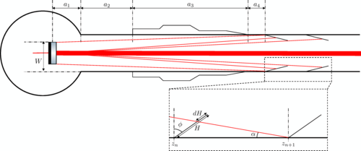
Vacuum Beam Pipe Decomposition
[3]
[3]
[2]
[3]
[3]
The initial Use-Case for the MBSE exercise is the Vacuum Beam Pipe as designed by CERN
5

Slide 6
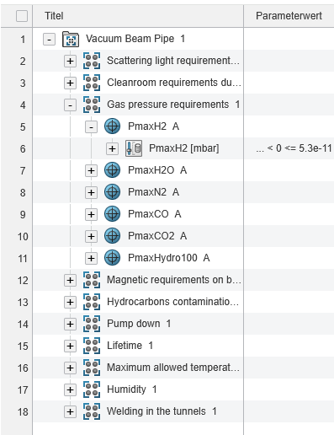
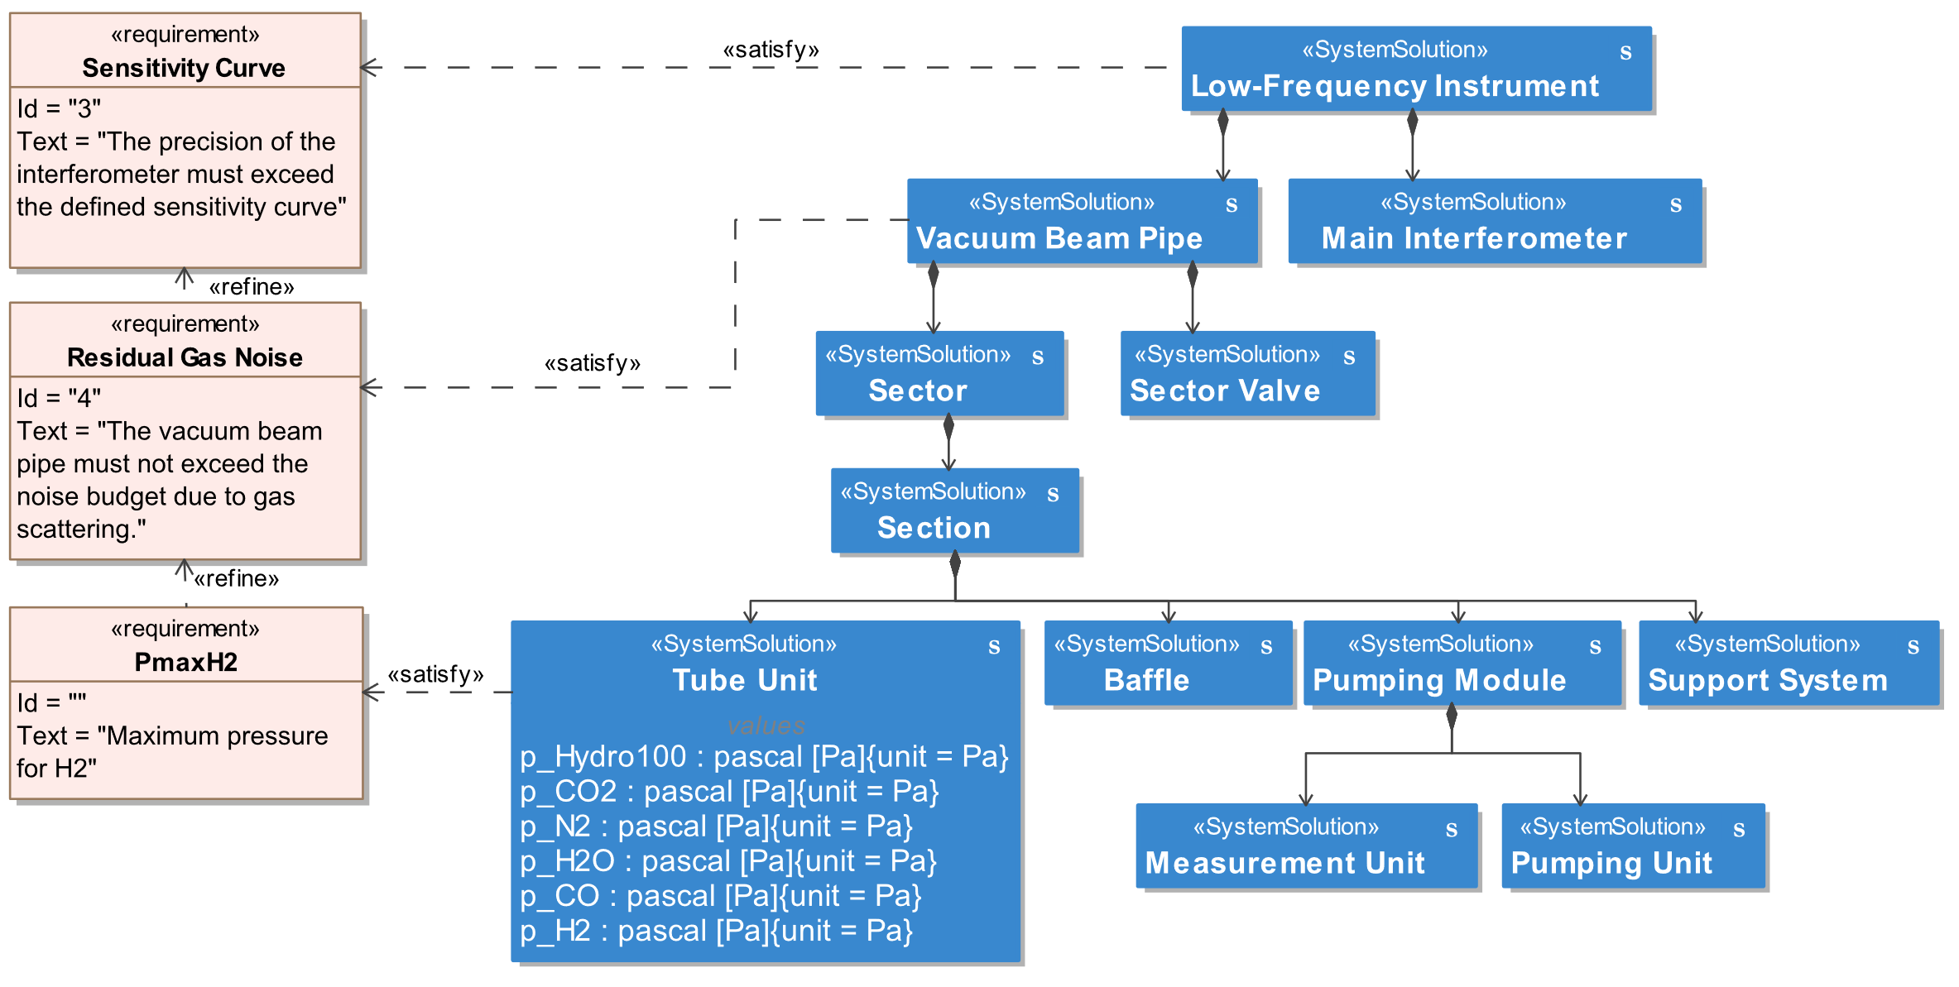
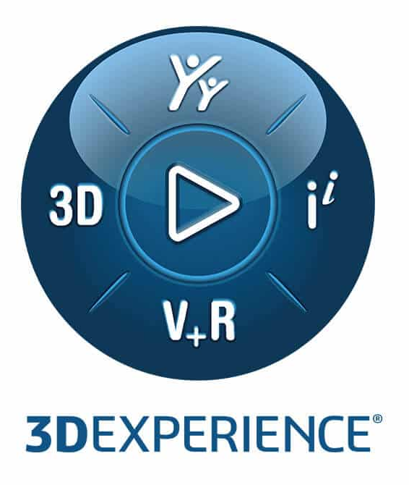
Linking Requirements and Architecture
Requirements are managed on the 3DExperience Platform (near future: Jama Connect)
Synchronized to architecture tool
Linking requirements to the architecture enables requirements traceability
6

Slide 7
Subsystem decomposition and architecture generation
conditions
Beam
Beam
Molecules
Functions and functional interactions are derived from Components and Requirements
Technical Solutions that implement functions are connected and assigned with parameters
Usable by all, implemented by few
7

Slide 8
Subsystem decomposition and architecture generation
Beam
Beam
conditions
Molecules
conditions
Beam
Beam
Molecules
Functions and functional interactions are derived from Components and Requirements
Technical Solutions that implement functions are connected and assigned with parameters
Usable by all, implemented by few
8

Slide 9
Subsystem decomposition and architecture generation
Beam
Beam
conditions
Molecules
conditions
Beam
Beam
Molecules
Functions and functional interactions are derived from Components and Requirements
Technical Solutions that implement functions are connected and assigned with parameters
Usable by all, implemented by few
9

Slide 10
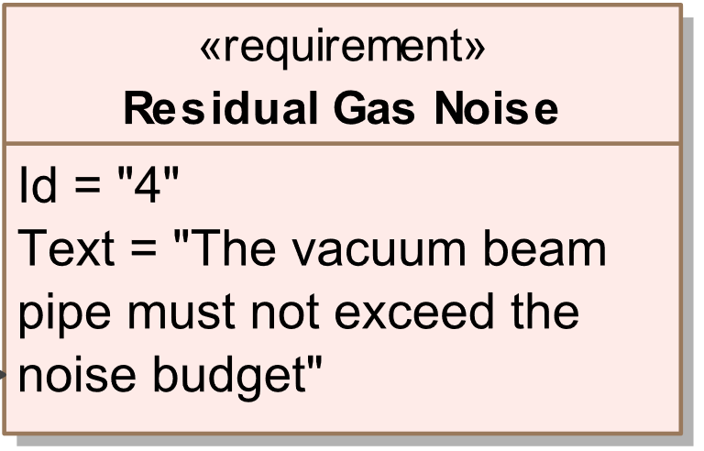
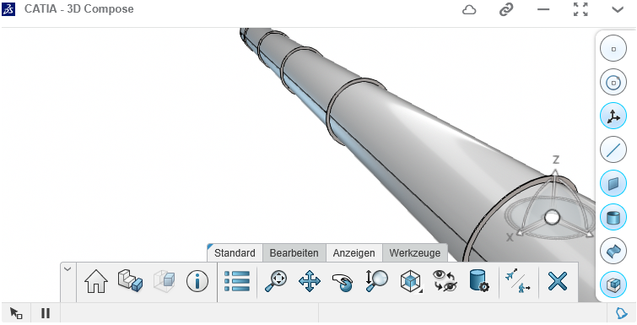
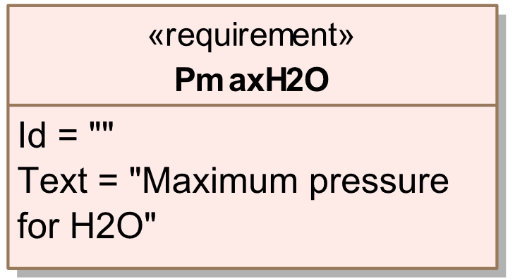
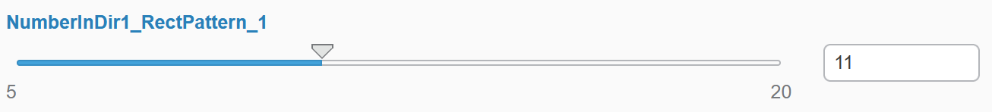
Using functional and logical architectures for requirements traceability
Requirements
Functional architecture
Logical architecture
Product
What do we want?
What does the system need to do?
How does the system do it?
What does the system look like?
Residual Gas Noise
Beam
Beam
Beam
Beam
Conditions
Conditions
Molecules
Molecules
Number of pumping stations
Parameter changes can be pushed from developers to the logical architecture
CAD model automatically updates when parameters change
10

Slide 11
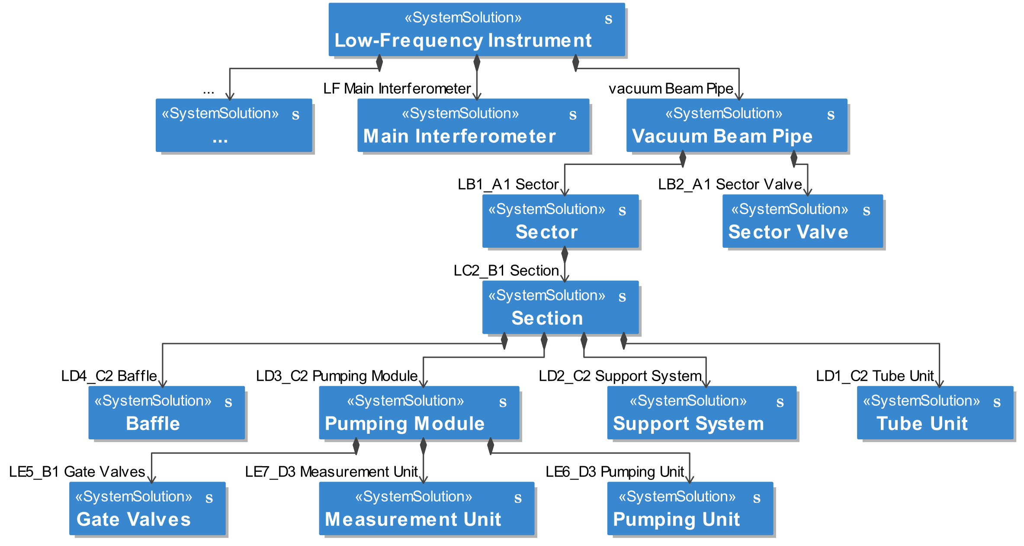

Verification requires integration of classified expert models into the architecture
[4]
Scope: Vacuum Beam Pipe
Purpose: Calculate VBP noise
Model
Parameters
In: Partial pressures, pipe dimensions, temperature, …
Out: Noise
Scope: Tube Unit
[3]
Purpose: Partial Pressures
Model
Parameters
In: Number of pumps, dimensions, …
Out: partial pressures (pH₂O, p_{H2}, p_{CO},…)
11

Slide 12
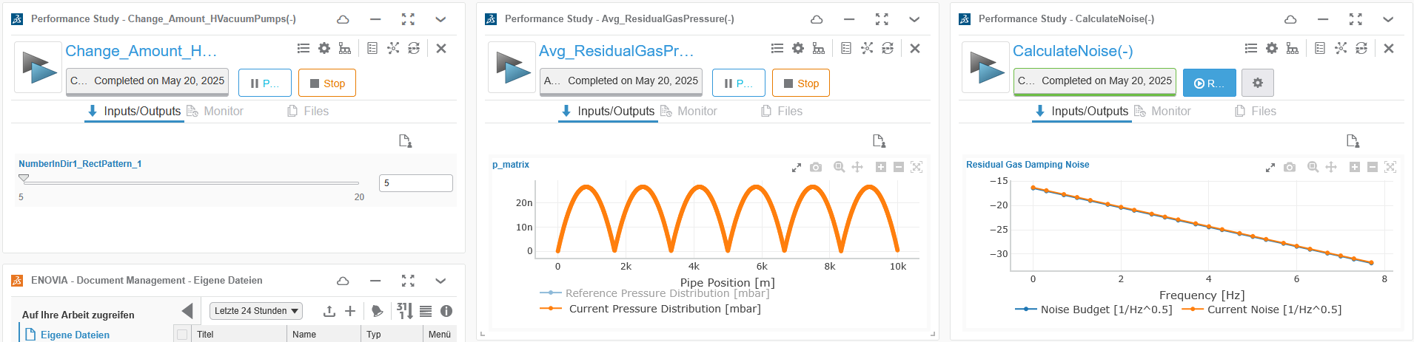
Connecting integrated models within the architecture allows automated verification of requirements
Requirements
Functional architecture
Logical architecture
Product
Residual Gas Noise
Beam
Beam
Beam
Beam
Conditions
Conditions
Molecules
[4]
Molecules
[3]
Purpose: Calculate VBP noise
5
Purpose: Partial Pressures
12

Slide 13
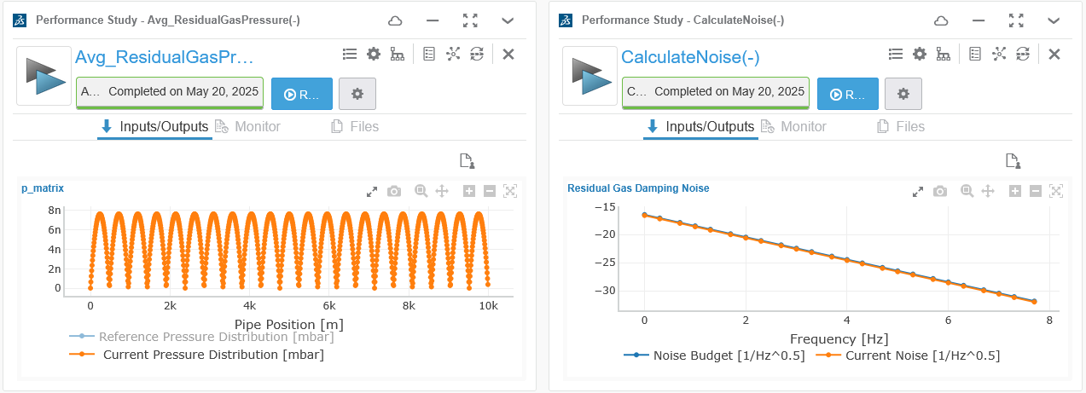
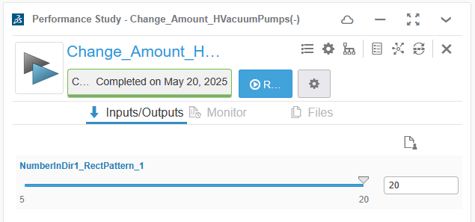
Connecting integrated models within the architecture allows automated verification of requirements
Requirements
Functional architecture
Logical architecture
Product
Residual Gas Noise
Beam
Beam
Beam
Beam
Conditions
Conditions
Molecules
[4]
Molecules
[3]
Purpose: Calculate VBP noise
20
Purpose: Partial Pressures
13

Slide 14
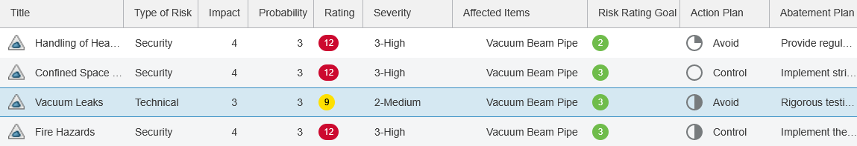
Connecting Risk Management and Systems Architecture
Requirements
Functional architecture
Logical architecture
Product
Residual Gas Noise
Beam
Beam
Beam
Beam
Conditions
Conditions
Molecules
Molecules
Risks are connected to items of the architecture
Interconnection of items through the system architecture enables reaction chain analysis
Vacuum Leaks
14

Slide 15
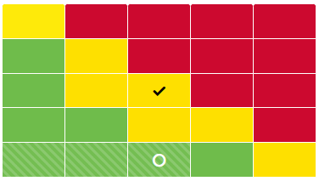
Risk Management – Analysis and Mitigation
Vacuum Leaks
Risk Cause:
Manufacturing defects
Leaky joints and valves
Failure in seals
Thermal expansion
Risk Impact:
Reduced vacuum quality
System contamination
Abatement Plan:
E.g. Rigorous testing and quality assurance during assembly
Risk Assessment: Medium
Mitigation-Management with Rating-Goals and Abatement Plans
15

Slide 16

Seamless application of MBSE requires a robust toolchain integration
Parallel exercise to prepare for the future: towards a scalable, professional toolchain for ET’s technical configuration
Working interfaces
Breakdown + Interfaces
Architecture
Jama
3DX
Interface 1 under development
Configuration Items
Requirements
Risk management
Verification
Interface 2 under development
Synchronize
To populate the toolchain a database is necessary. There are two scenarios that need to be considered:
Existing architectures or high-level layouts, that present a top-down approach.
Existing detailed expert models that present a bottom-up approach.
The combination of both approaches yields a seamless traceability from science case to detailed components
CATIA MAGIC
Geometry Models
Documentation
System Architecture Tool
Parameter space
CAD, Layout
(BIM)?
Expert + Engineers
Existing Architectures
Data exchange
Process Composer
Model integration
Data exchange
Already developed architectures such as PBS or high-level subsystem decompositions
Transfer
Model integration tool
Model integration
Data exchange
“Play button”
Model execution is possible from both Process Composer and CATIA MAGIC. However, currently only the execution in CATIA MAGIC allows the use of the parameter space. The use of the parameter space via Process Composer is planned.
Satellite Models
Expert + Engineers
Expert models (e.g. Matlab)
16

Slide 17
ET’s MBSE exercise progress overview
Preparatory work
(<Feb 2025)
Basic Toolchain
(< Jun 2025)
Expanded toolchain
(<Dec 2025)
Future work
(<Jun 2026)
Scope definition
Licensing
Method development using a mature system (Vacuum beam pipe):
  Architecture
  Risk management
  CAD models
  Expert models
Expand scope
  Integrated tower
  LF optical layout
Interconnect all modeled subsystems to one seamless data space
Expand toolchain to include Jama Connect
Expand scope
  Cryopumps
  Civil tunnel
  Technical infrastructure
Advanced toolchain features
  Dashboarding
  Approval cycles
  Further Risk mitigation
  Design optimization methods
17

Slide 18


Summary and Outlook
Summary:
Vacuum Beam Pipe implemented in MBSE exercise
System architectures enable:
  Parameter management
  Traceability analysis
  Requirements management
Anticipating for the IV ET Annual Meeting:
Increased toolchain maturity
Expansion of MBSE approach to other subsystems:
  Integrated tower
  High-level interferometer
MBSE workshop for ET-all in autumn 2025
Potentials of MBSE approach:
Support alignment between ET subsystem developments
Ensure requirement fulfillment across the system
Support risk mitigation
Frederik Moers
MSE, RWTH Aachen
SE: Connected Systems
frederik.moers@imse.rwth-aachen.de
Romano Meijer
NIKHEF
ETO-PO Systems Engineer
r.meijer@nikhef.nl
18

Slide 19
Einstein Telescope
XV Einstein Telescope Symposium Bologna – 27.05.2025
XV Einstein Telescope Symposium, Bologna
Thank you!

Slide 20
Sources
[1] 3D printed concept of the Einstein Telescope created by Marco Kraan located at Nikhef, taken from ET-0385A-24
[2] Study of scattered light in the main arms of the Einstein Telescope gravitational wave detector
[3] ET-0005A-25: Deliverable 6.2 The Vacuum Pipe of ET
[4] ET-0007C-23: Conceptual design and noise budget of Einstein Telescope
20
From now on demonstration of Use-Case content in tool:
System decomposition of the Vacuum Beam Pipe
Notes:
Cad bilder,
Requirements bebildern
Animationen über folienzahl steuern
Hier nur architecture/decomposition
Wie decomposition?

