Slide 1
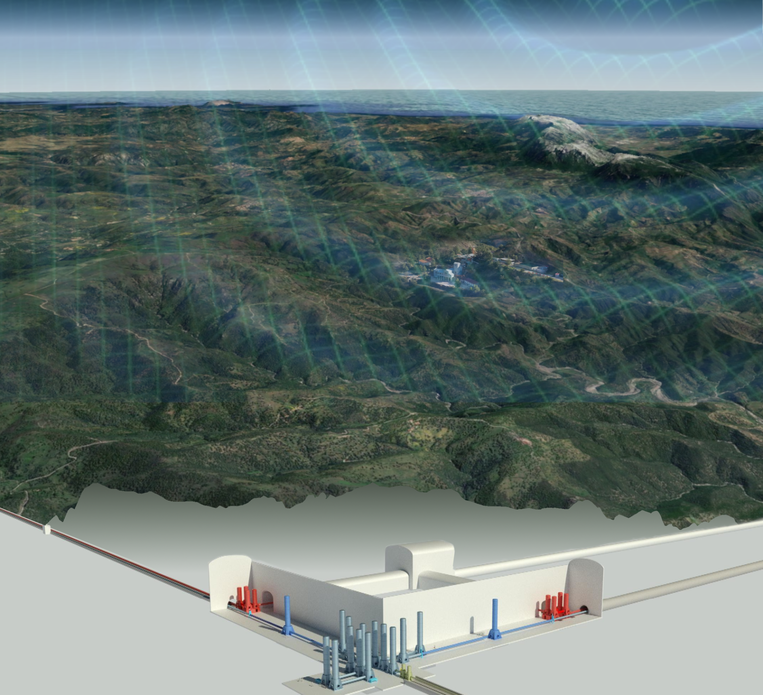
XV ET Symposium SCB Issues

Slide 2
SPB Documents already produced
M1.1: physical variables: ET-0012A-23, discussed and finalized at the II SPB Workshop (Jan 2023) https://apps.et-gw.eu/tds/?content=3&r=18113
M1.2: measurements recommendations and standards: ET-0013A-23, discussed and finalized at the II SPB Workshop (Jan 2023) https://apps.et-gw.eu/tds/?content=3&r=18114
M1.3: data format standards and analysis tools ET-0270A-23, https://apps.et-gw.eu/tds/?content=3&r=18398
ET-PP M04.01: “Site-specific Characteristics impacting ET sensitivity and duty cycle” (manly based on previous documents) ET-0252B-23, https://apps.et-gw.eu/tds/?call_file=ET-0252B-23_SitespecificCharacteristicsImp.pdf

Slide 3
What next?

Slide 4
The New SCB Structure
Site Characterization Board (SCB)
Chairs: D. D’Urso & W. Walk, A. Rietbrock
WD1: Noise Measurements
WD2: Noise Evaluation & Validation
WD3: Geological and Geotechnical Evaluation
Luca Naticchioni
Mike Linder
Michael Kiehn
Domenico D'Urso
Andreas Rietbrock
Stan Bentvelsen
Fred Nguyen
Marco Olivieri
Peter Achtziger
WP1: Seismic Noise
WP1: Noise Impact Evaluation
WP1: Structural Geology
WP2: Gravimetrics
WP2: Noise Impact Validation
WP2: Hydrogeology
WP3: Magnetic Noise
WP3: Geophysics
WP4: Other Environ- mental Noise
WP4:Geotechnology

Slide 5
Expected Deliverables for Site Selection (see ET-PP)
Report on 3D geology, hydrology, etc. model with localisation of the ET infrastructure (Exp. in Feb26)
Complete quantification of all the aspects impacting the ET performance for each site (Exp. in July26)
Updated cost and schedule estimates of the excavations, including, if necessary: instrumentation for Newtonian Noise cancellation; costs of debris removal; costs of land acquisition, permitting, etc. (Exp. in July26)

Slide 6
SCB Duties
Set a common framework
Risks
Activities already on going
Managed directly by site Host Teams
different organizational strategies, constrained by the national and regional fundings conditions
different timelines
Site selection criteria and the optimal geometrical configuration still to be set

Slide 7
Contingency plans
Common table ETO – Local Teams already existing
ask to invite chairs of Geophysical and Geotechnical Division
Inventory of already existing models
are we using different platforms ? different codes ?
are they public ?
have the same accuracy ?

Slide 8
SCB Duties
Steer the process to evaluate the detector performance
Risks
ET Collaboration is still working on the definition of detector specification
Still on going the standard modelling and interpretation

Slide 9
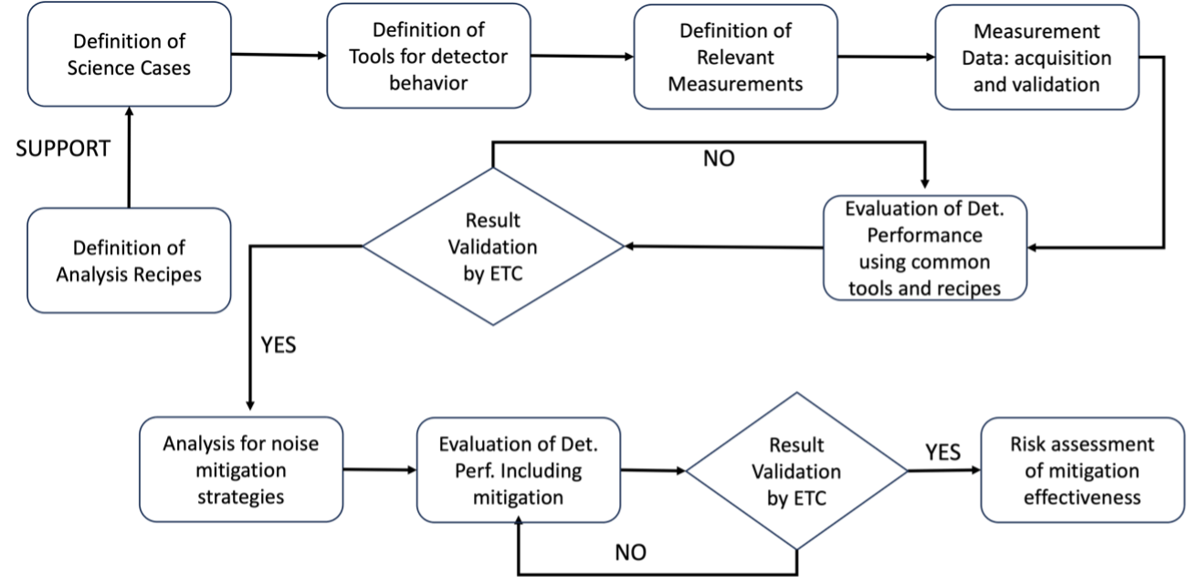
Common Methodology

Slide 10
Definition of Science Cases and of Analysis Recipes
Huge effort in the ETC to define the science case for the Einstein Telescope.
A. Abac et al., ”The Science of Einstein Telescope”, ET-PP D6.1, 2025, https://arxiv.org/pdf/2503.12263.

Slide 11
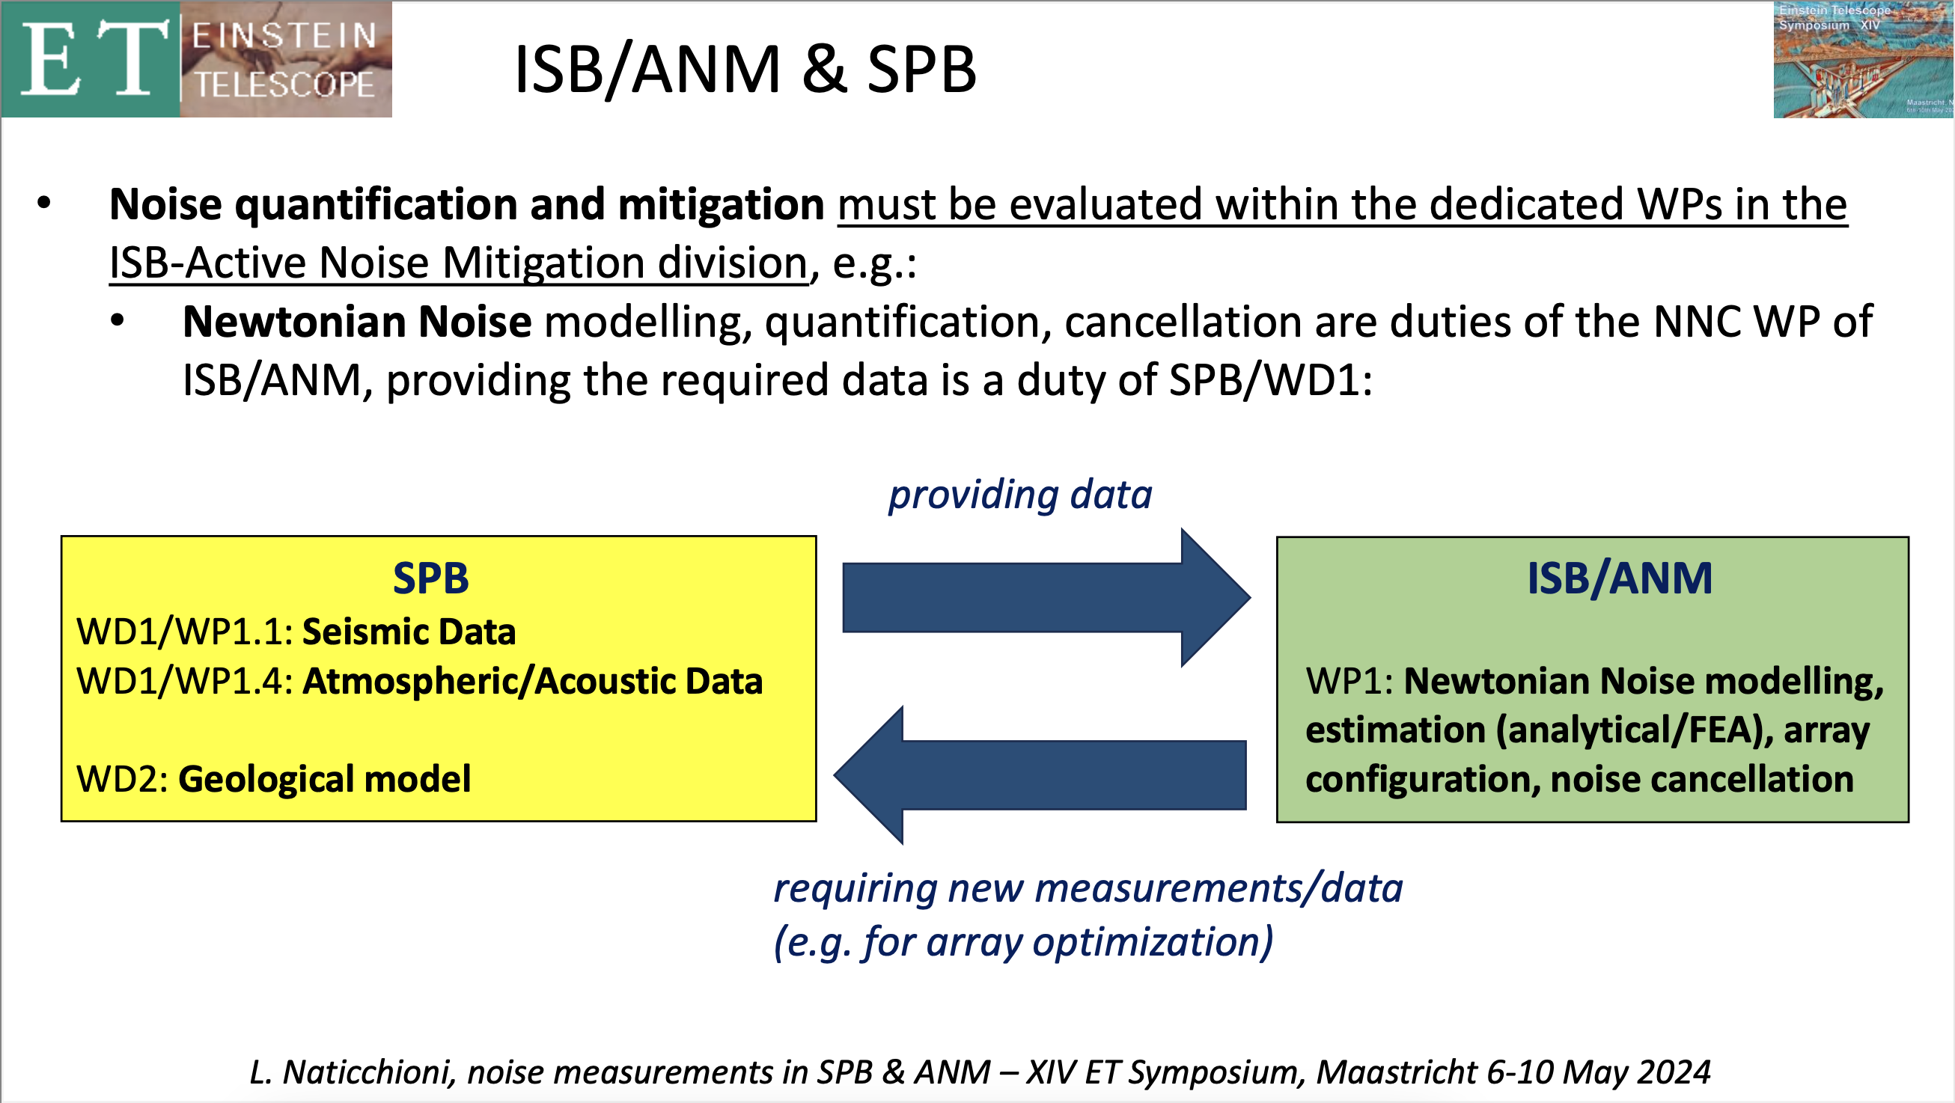
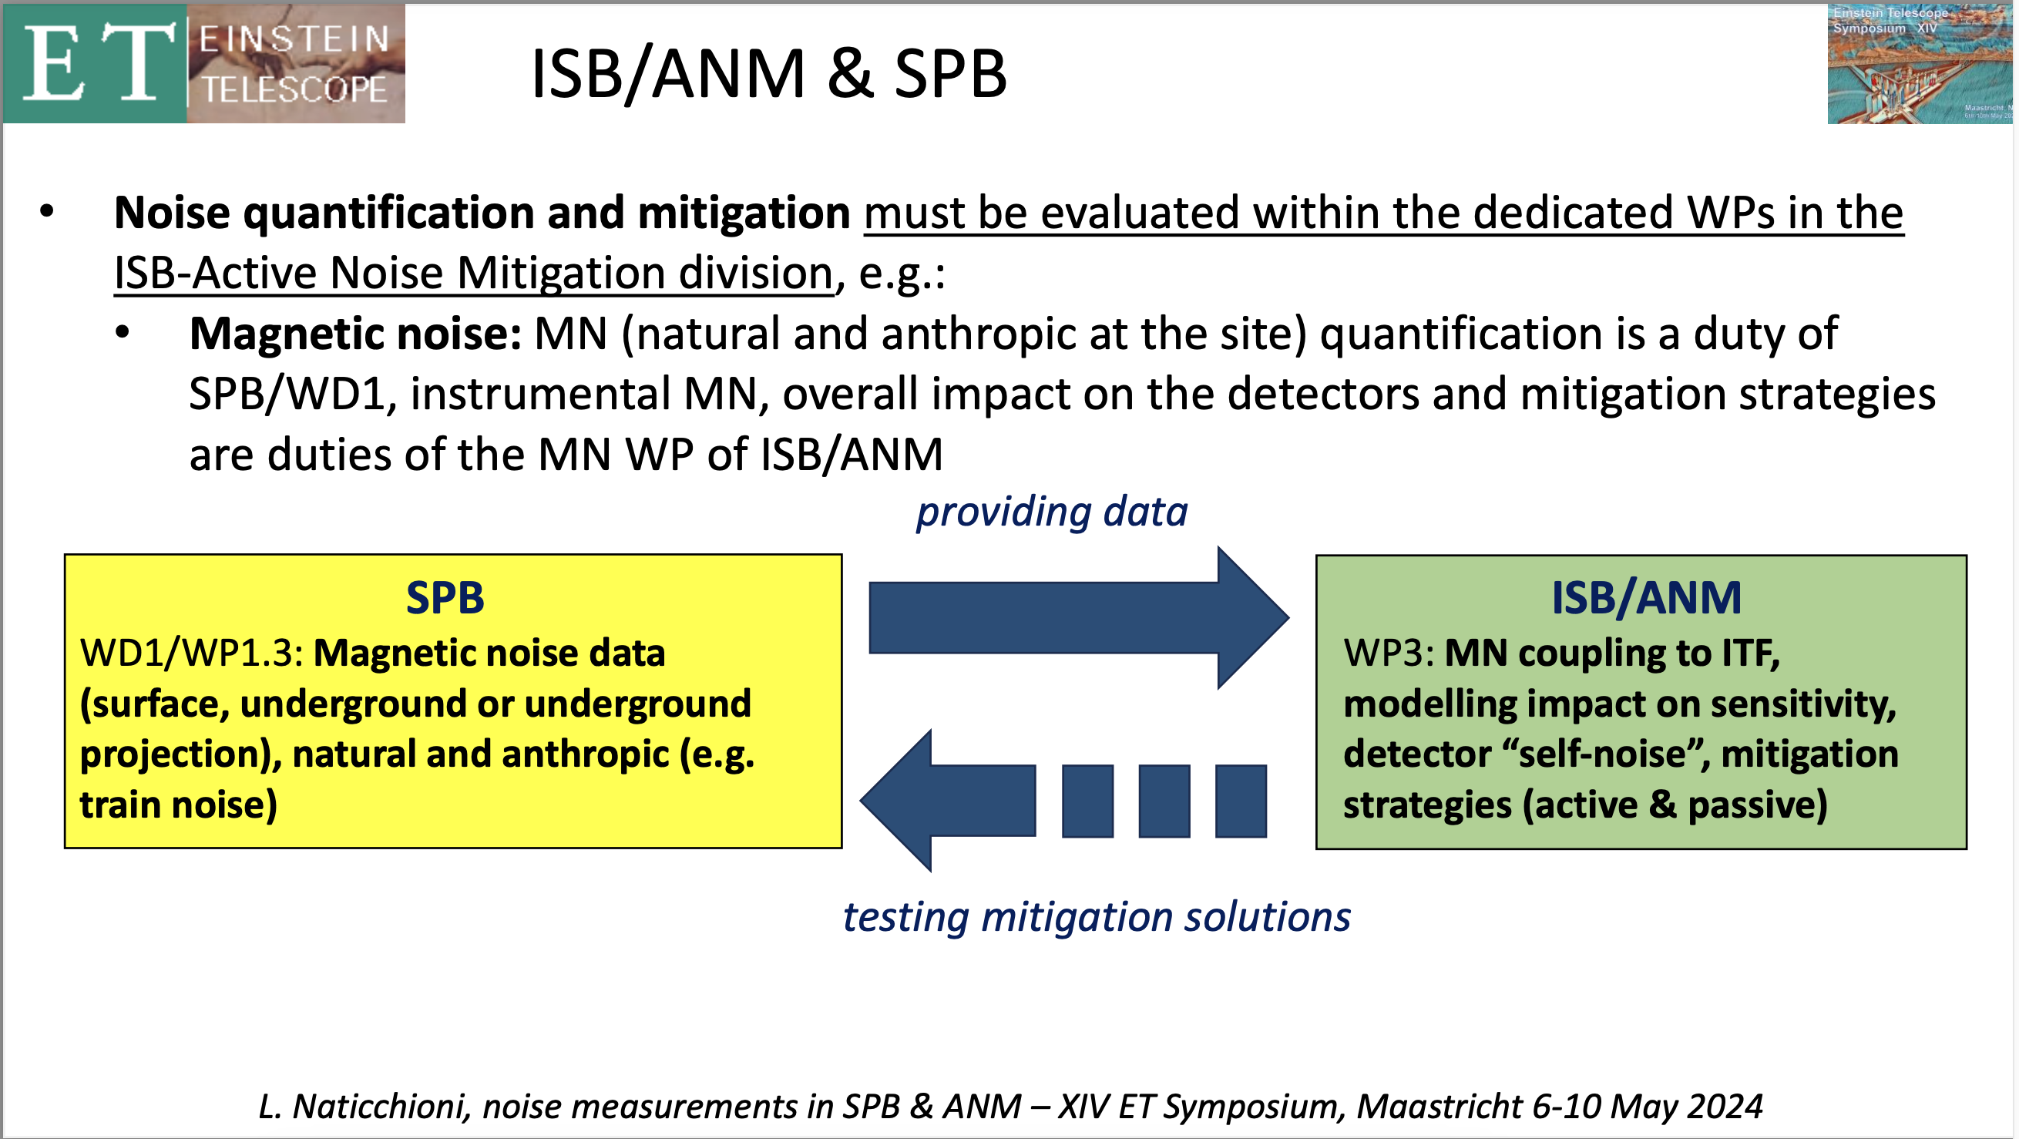
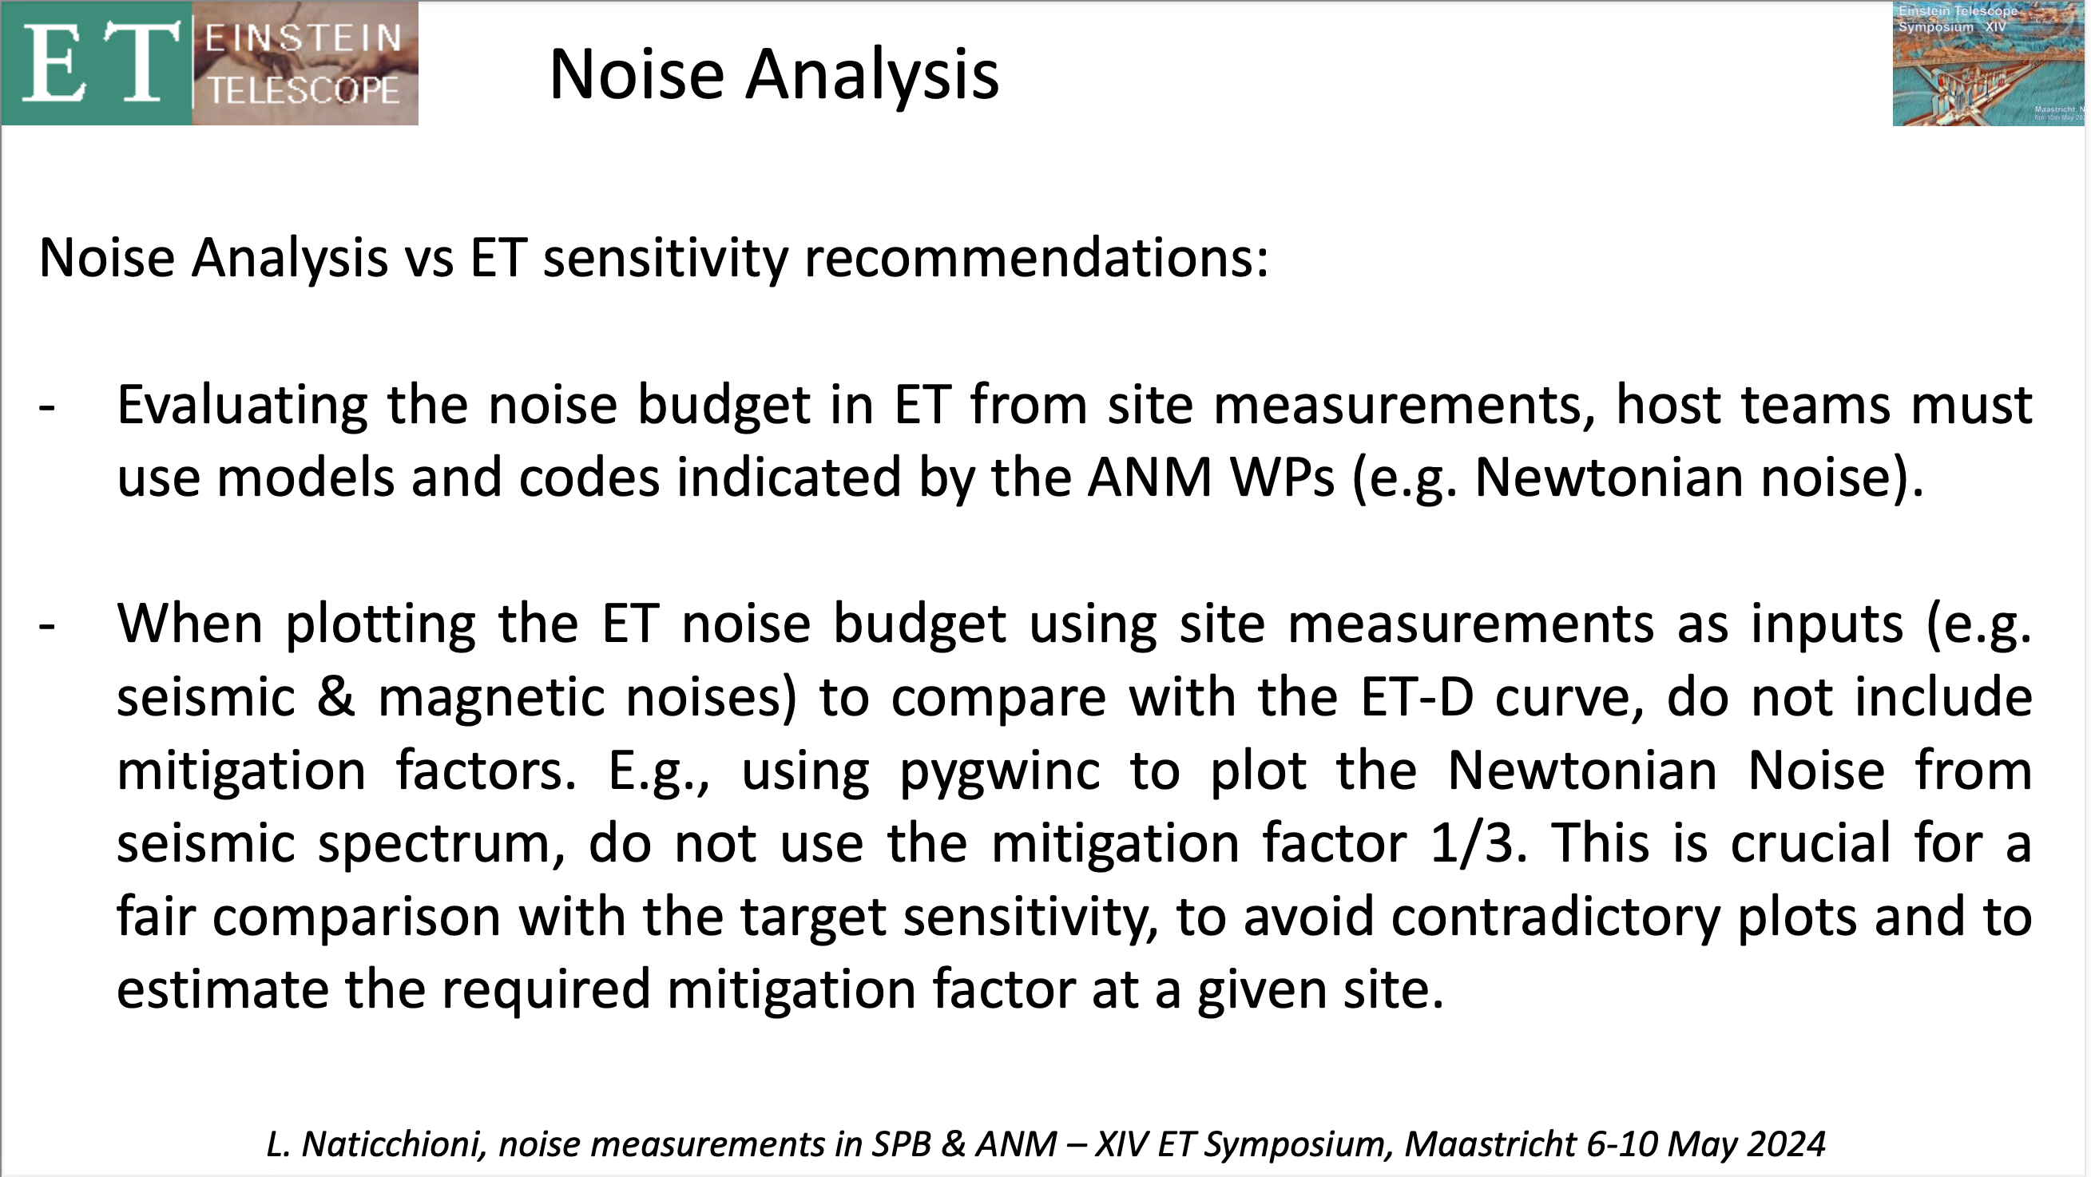
Detector Effect and Mitigation
Credits to L. Naticchioni
SCB
SCB

Slide 12
How to proceed?
ETC task force involving OSB-ISB-SCB-Local Teams
SCB has the duty to coordinate the effort
share code and recipes
Optimization of existing tools or development of new ones should be approved by relevant ETC bodies (i.e. NN code should be approved by NN WP of ISB-ANM division)

