Slide 1
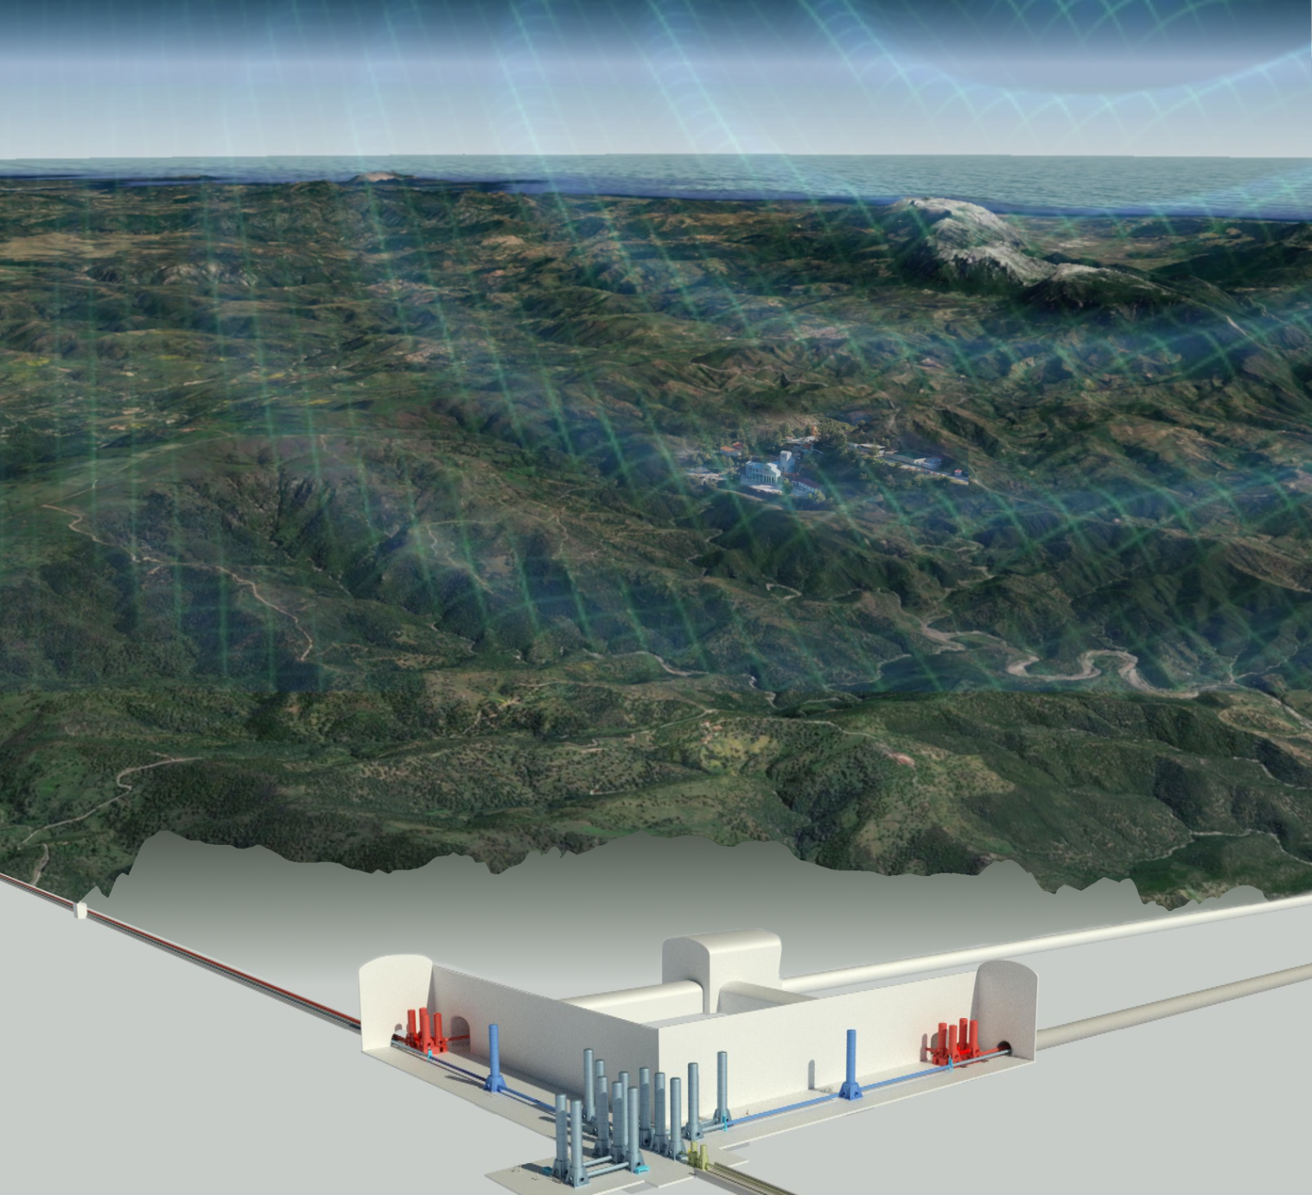
XV ET Symposium SCB Parallel Session

Slide 2
The SCB Structure
Site Characterization Board (SCB)
Chairs: D. D’Urso & W. Walk, A. Rietbrock
WD1: Noise Measurements
WD2: Noise Evaluation & Validation
WD3: Geological and Geotechnical Evaluation
Luca Naticchioni
Mike Linder
Michael Kiehn
Domenico D'Urso
Andreas Rietbrock
Stan Bentvelsen
Fred Nguyen
Marco Olivieri
Peter Achtziger
WP1: Seismic Noise
WP1: Noise Impact Evaluation
WP1: Structural Geology
WP2: Gravimetrics
WP2: Noise Impact Validation
WP2: Hydrogeology
WP3: Magnetic Noise
WP3: Geophysics
WP4: Other Environ- mental Noise
WP4:Geotechnology

Slide 3
SCB Session
22 talks divided in 3 sessions:
general updates from sites
geology and geophysics investigations
modelling
noise measurements
noise estimation and mitigation
detector performance

Slide 4
SCB/WP4 Open Issues
3D geological model
Detector Performance estimation
Update on cost and time schedule
Wed. Morning 11:50-13:00: discussion on SCB issues

