Slide 1
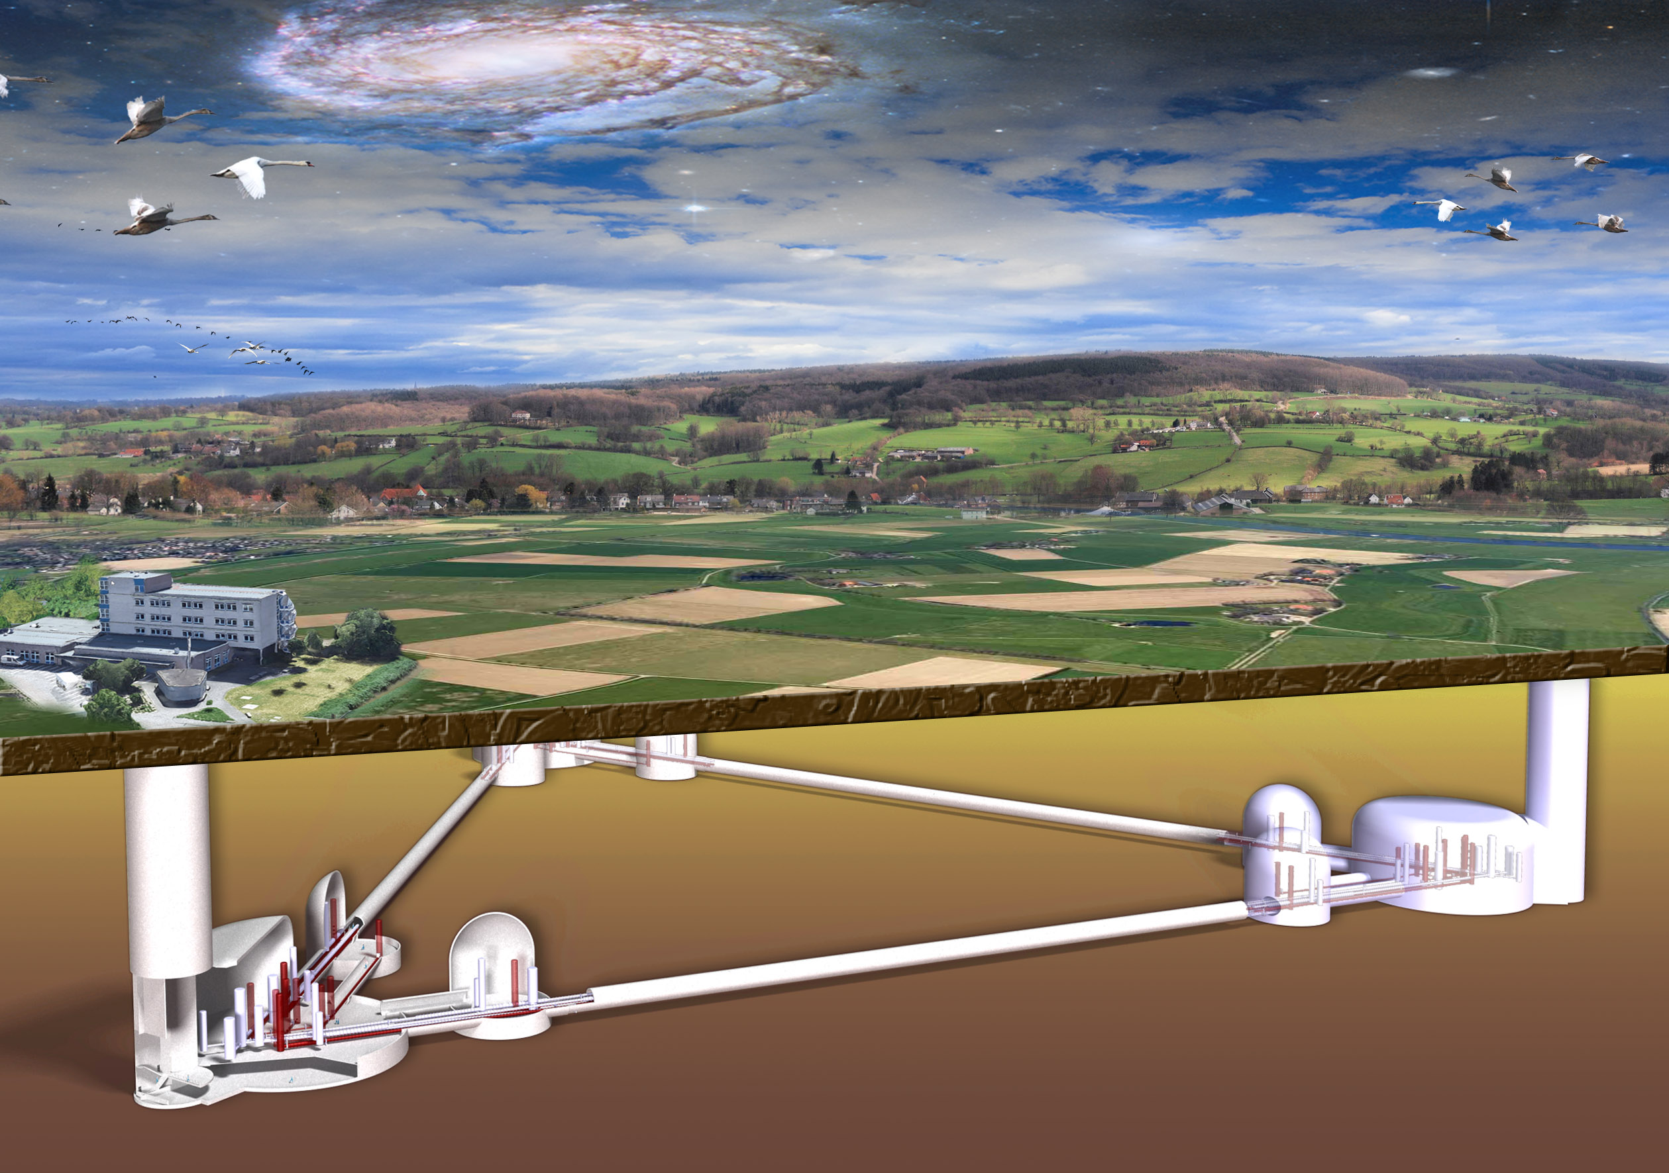
© Marco Kraan
ET Computing Centre
Achim Stahl, June, 30st 2025
RWTH Aachen University

Slide 2
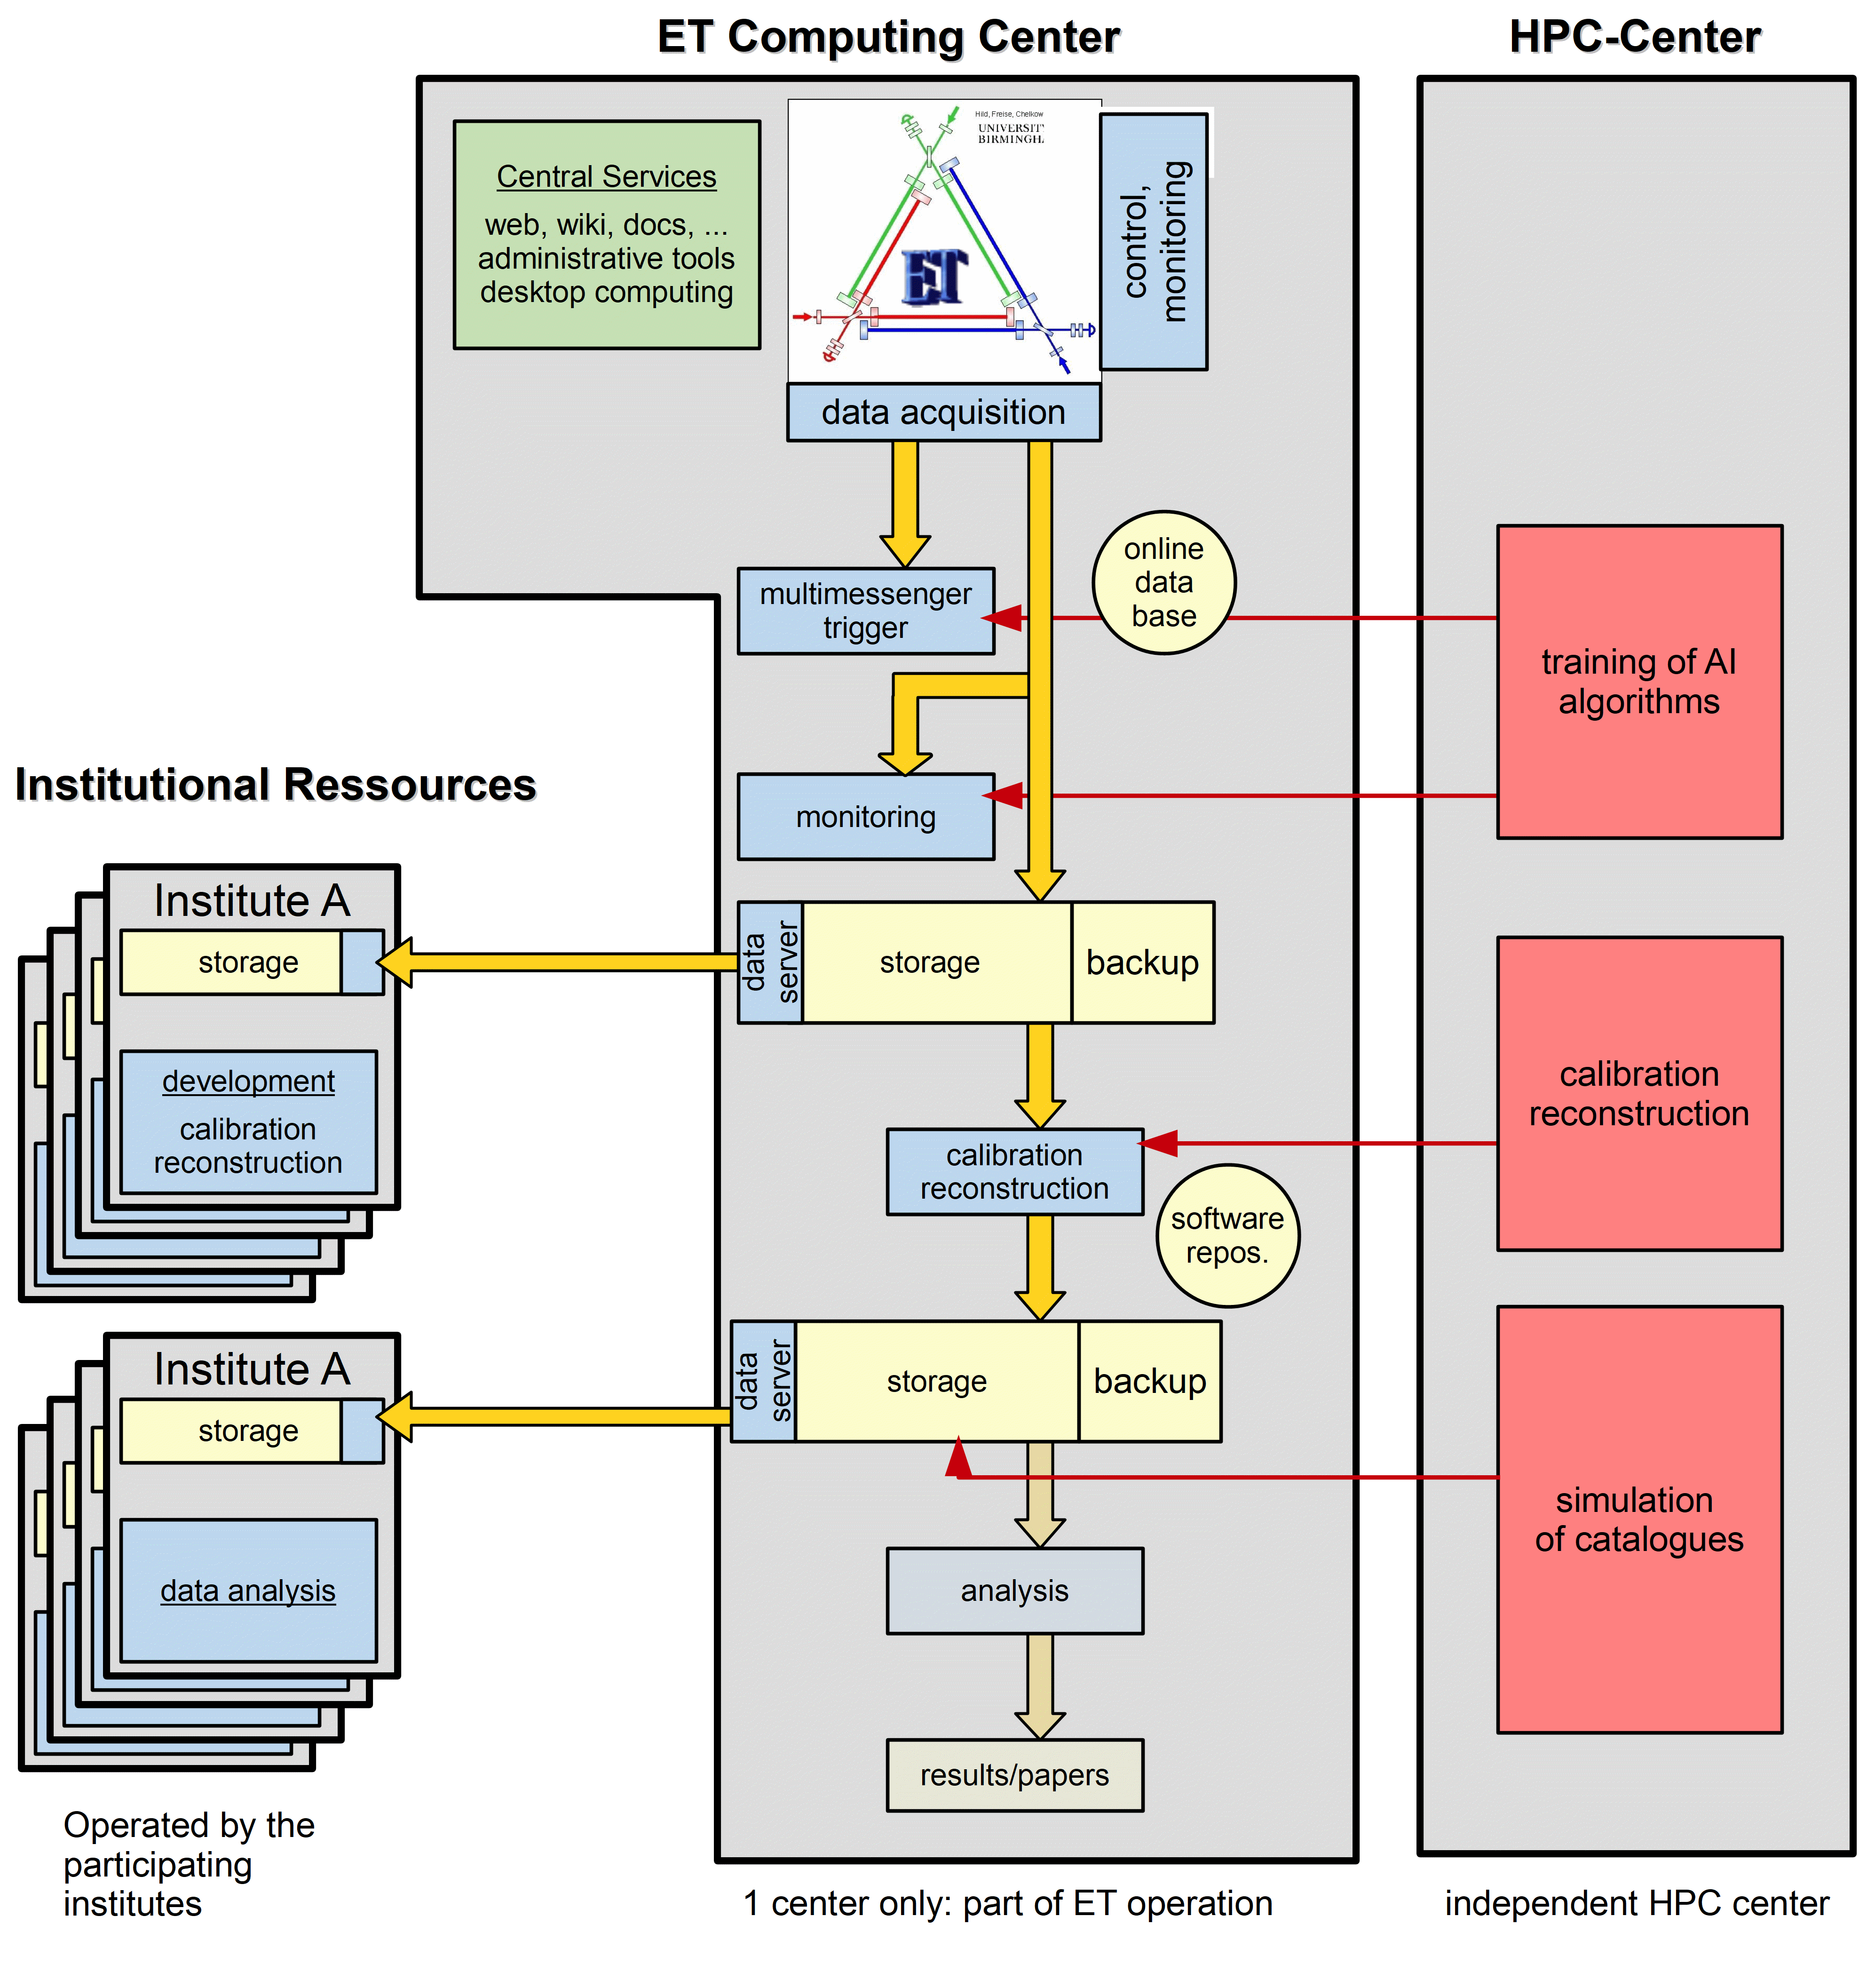

Slide 3
List of Tasks
The ET computing centre must provide services for the operation of ET, data acquisition, and the generation of low-latency multimessenger alarms. It ensures the long-term storage of the data, calibration, and accessibility of the data for further analysis. (from the German roadmap application)
Control of the telescope
Δατα Αχθυισιτιον
Λow-latency alarms (local or distributed?)
Calibration of the data
Δατα ηυβ φορ τηε διστριβυτιον οφ τηε δατα φορ φυρτηερ αναλψσισ
Λονγ−τερμ στοραγε οφ τηε δατα
Σοφτωαρε μαιντενανχε, ρεποσιτορψ, ετχ.
ΙΤ σερϖιχεσ φορ τηε ΕΤ χολλαβορατιον (ΖΟΟΜ, χλουδ, μεμβερσ δαταβασε, ….)
Υνδερ δισχυσσιον: ΙΤ σερϖιχεσ φορ τηε ΕΤ οργανισατιον
Συππορτ οφ λοχαλ ΙΤ χοορδινατορσ ατ τηε ινδιϖιδυαλ ινστιτυτιονσ
Σομε γλοβαλ υσερ συππορτ.

Slide 4
5 km to Aachen
Location
State of NRW:
Committed to provide
a building for the
ET Computing Centre

Slide 5
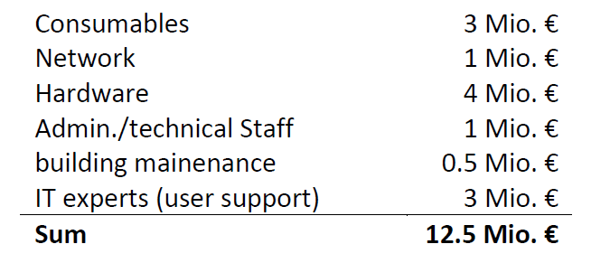
Cost Estimate
ESFRI: Estimate of 10 Mio. € annually for computing (2020)
→ Scaled to 12.5 Mio. € for the German roadmap application (2024)
German in-kind contribution? (25% of the operational cost of ET)

Slide 6
Status: Operation
If in Germany ….
Operational cost will be covered by BMFTR (former BMBF)
Usually administered through an HGF centre
We are discussing with potential partners:
  FZ Jülich (preferred solution by NRW, close-by, within NRW)
  KIT (more experience with computing in our communities)

Slide 7
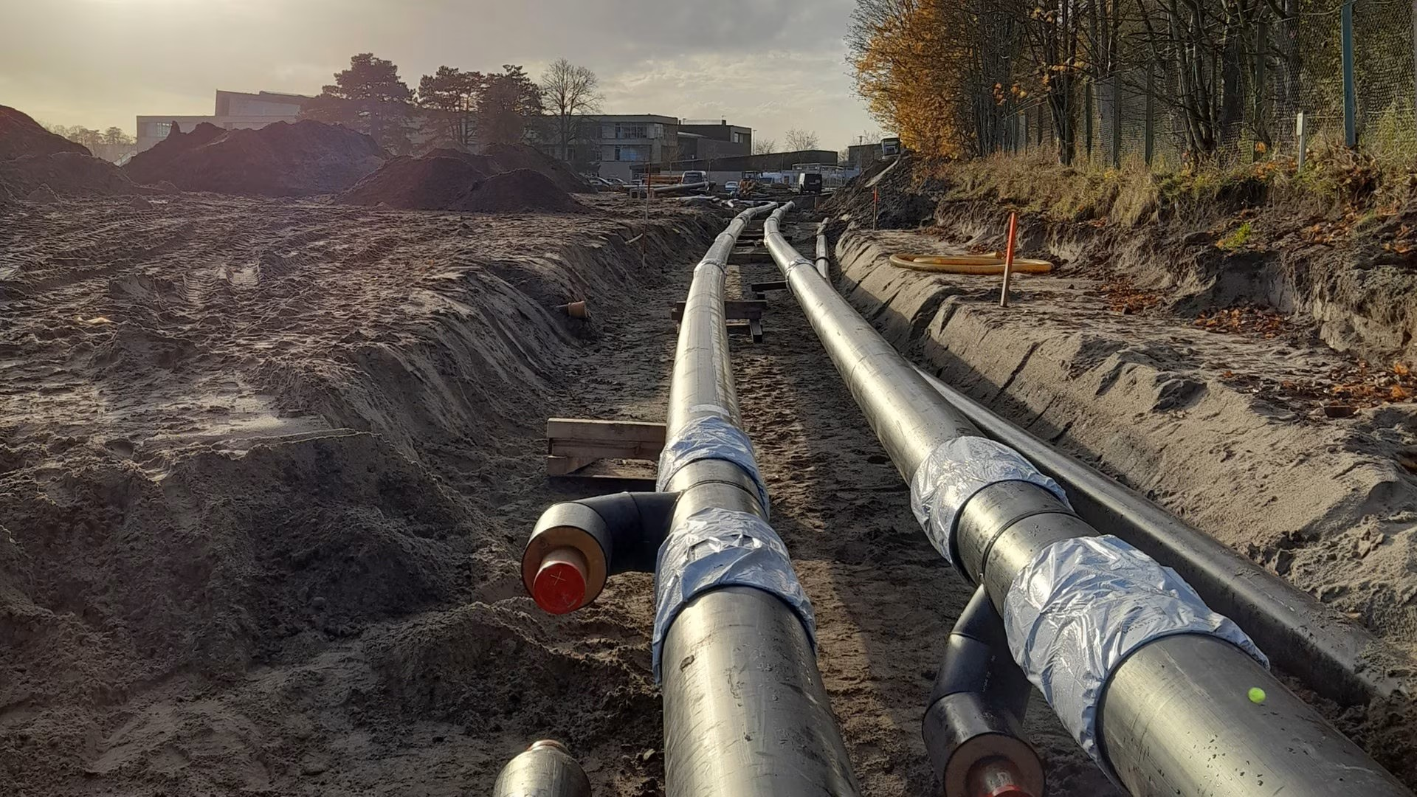
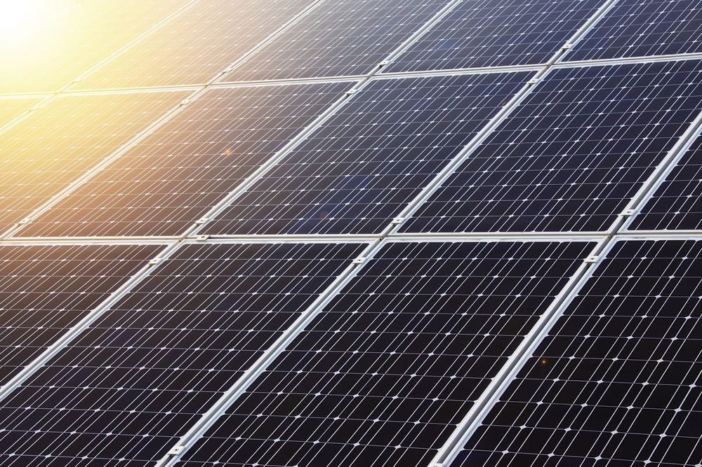
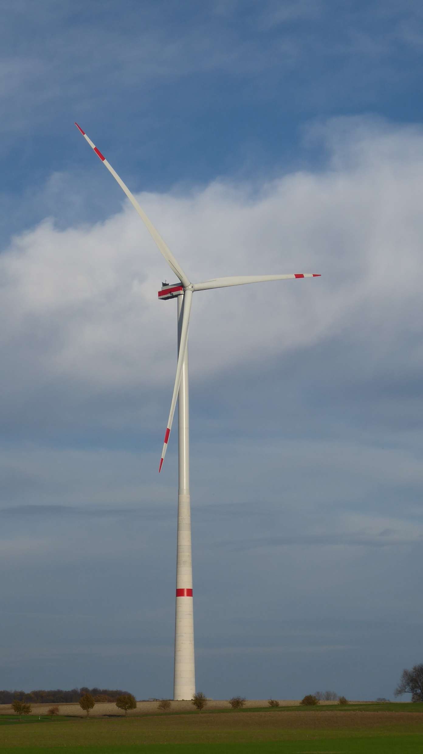
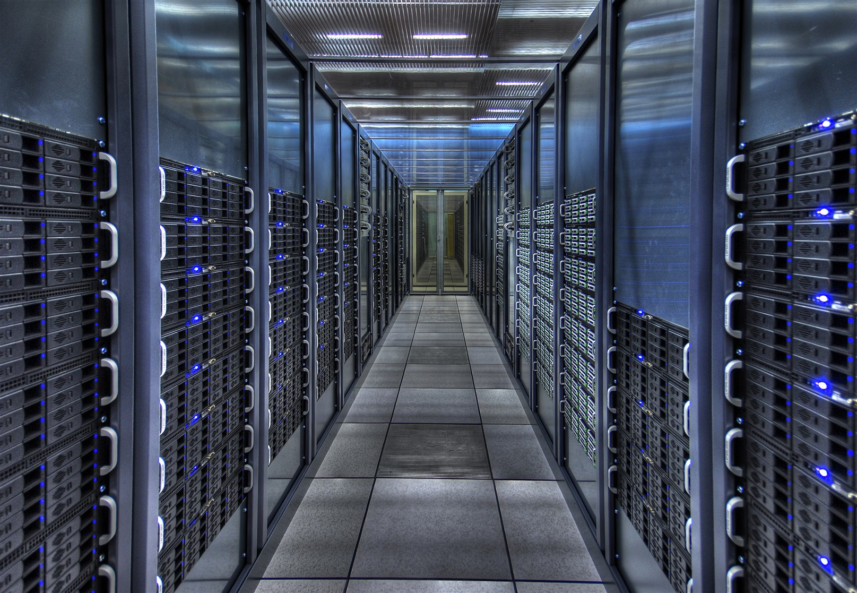
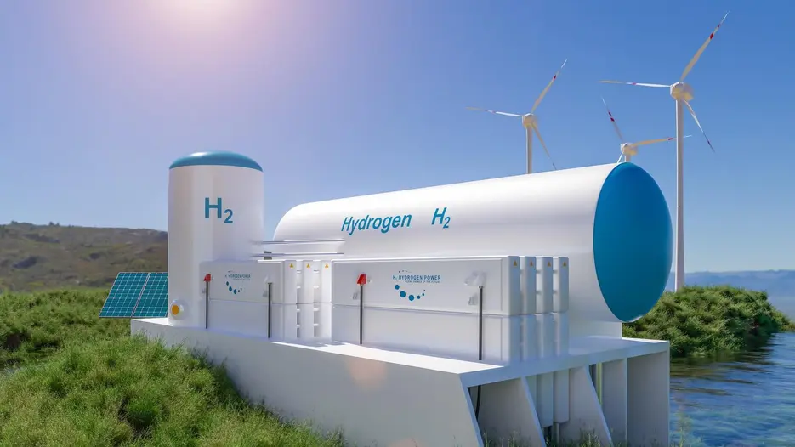
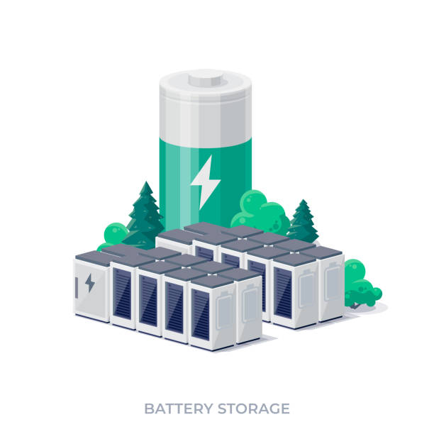
A sustainable ET computing center
wind power
solar power
adapt compute power to available green energy
Include:
Sustainable building.
Passive heating,
supported by waste heat.
Reduced traffic of personnel,
connected to public transportation,
some home office.
Accounting of CO2-emission of jobs,
prioritize users on prior CO2 budget?
…
power storage
(for basic load)
Sustainable hardware production?
district heating

Slide 8

© Marco Kraan
ET Computing Centre
Thanks

