Slide 1
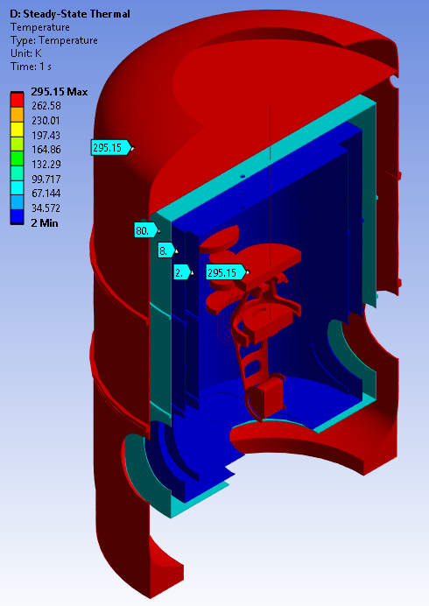


Thermo-Mechanical Simulations of ET-LF Payload
Marco Ricci
III Workshop on ET-LF TM Tower Integration
29 September 2025
La Biodola Bay, Isola d'Elba, Italy

Slide 2
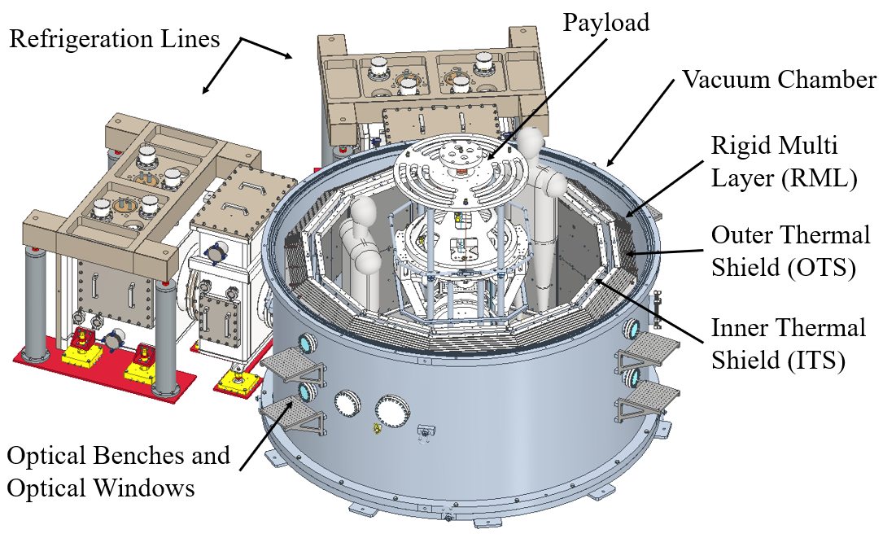
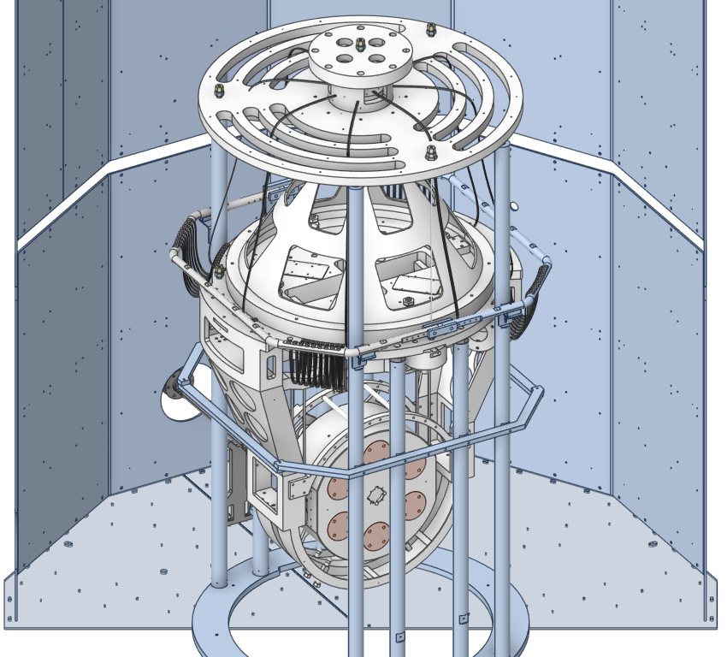
ARC - ETCRYO
Thermo-Mechanical Simulations of ET-LF Payload
III Workshop on ET-LF TM Tower Integration 29/9/25 – Marco Ricci

Slide 3
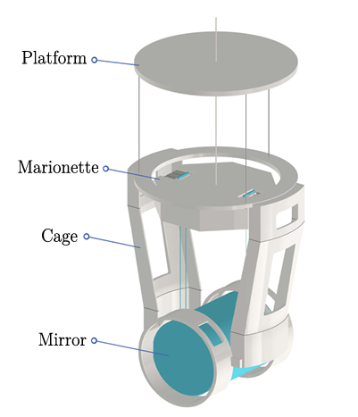
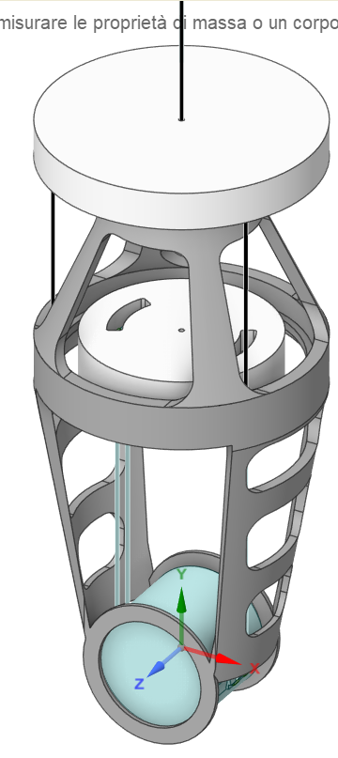
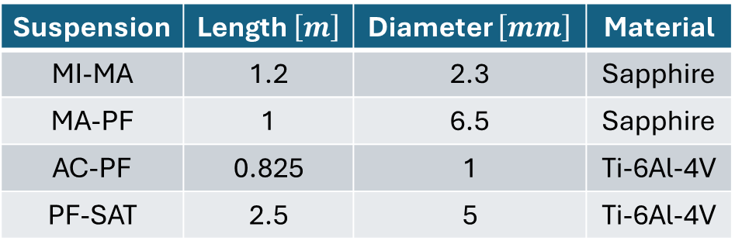
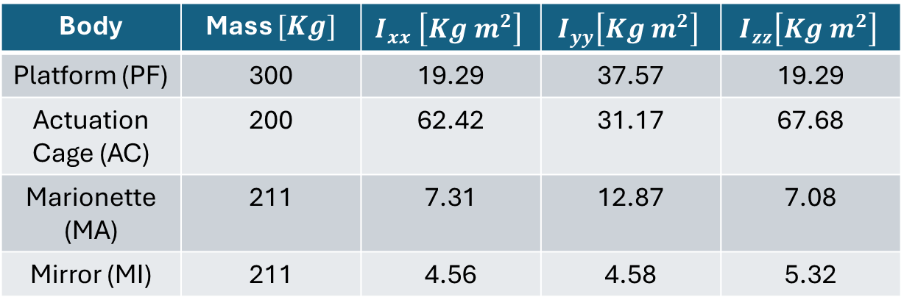
Cryogenic Payload Thermal Simulation Design
Suspension | Length $\left[m\right]$ | Diameter $\left[mm\right]$ | Material
MI-MA | 1.2 | 2.3 | Sapphire
MA-PF | 1 | 6.5 | Sapphire
AC-PF | 0.825 | 1 | Ti-6Al-4V
PF-SAT | 2.5 | 5 | Ti-6Al-4V
Body | Mass $[Kg]$ | $$I_{xx} \left[Kg m^{2}\right]$$ | $$I_{yy}\left[Kg m^{2}\right]$$ | $$I_{zz}\left[Kg m^{2}\right]$$
Platform (PF) | 300 | 19.29 | 37.57 | 19.29
Actuation Cage (AC) | 200 | 62.42 | 31.17 | 67.68
Marionette (MA) | 211 | 7.31 | 12.87 | 7.08
Mirror (MI) | 211 | 4.56 | 4.58 | 5.32
Thermo-Mechanical Simulations of ET-LF Payload
III Workshop on ET-LF TM Tower Integration 29/9/25 – Marco Ricci

Slide 4
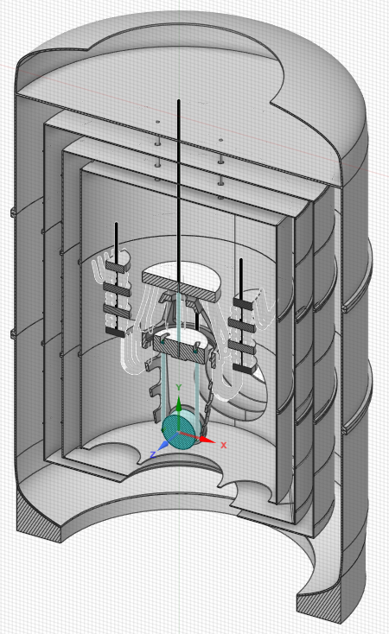
Hybrid Cooling Concept
Main Features:
3 Radiation Shields:
OTS @ 50-80K (with the RML)
ITS @ 5K
IITS @ 2K (superfluid Helium)
Payload cooled through Al6N
soft Heat Links connected to IITS
2 Heat Link Vibration Isolation
Systems (HLVIS) employed to
reduce vibrations
Thermo-Mechanical Simulations of ET-LF Payload
III Workshop on ET-LF TM Tower Integration 29/9/25 – Marco Ricci

Slide 5
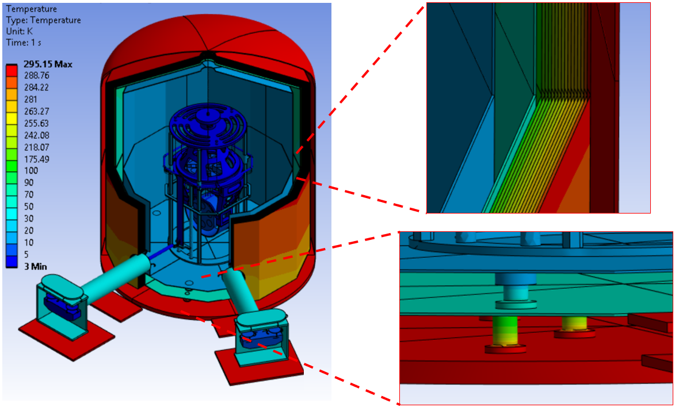

ARC-ETCRYO: Rigid Multi Layer (RML)
Additional shielding on the OTS:
Rigid Multi-Layer (RML) solution @ Rome
Expected Heat Flux $<2W/m^{2}$
Thermo-Mechanical Simulations of ET-LF Payload
III Workshop on ET-LF TM Tower Integration 29/9/25 – Marco Ricci

Slide 6
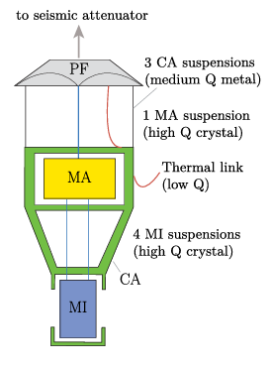
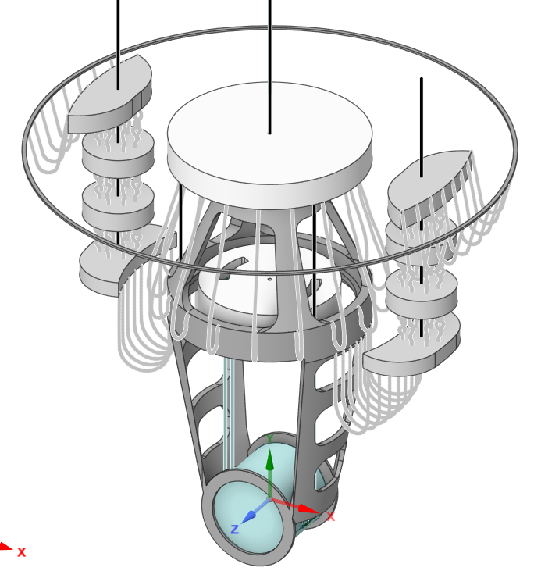
Cryogenic Payload Baseline Design
IITS @2K
Thermo-Mechanical Simulations of ET-LF Payload
III Workshop on ET-LF TM Tower Integration 29/9/25 – Marco Ricci

Slide 7
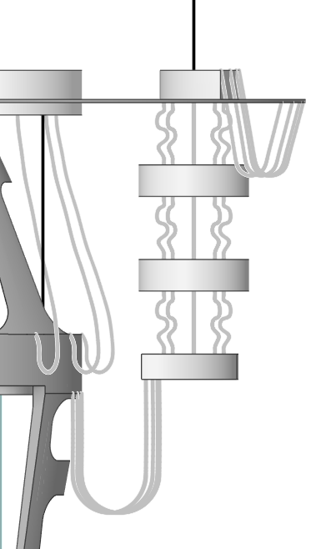
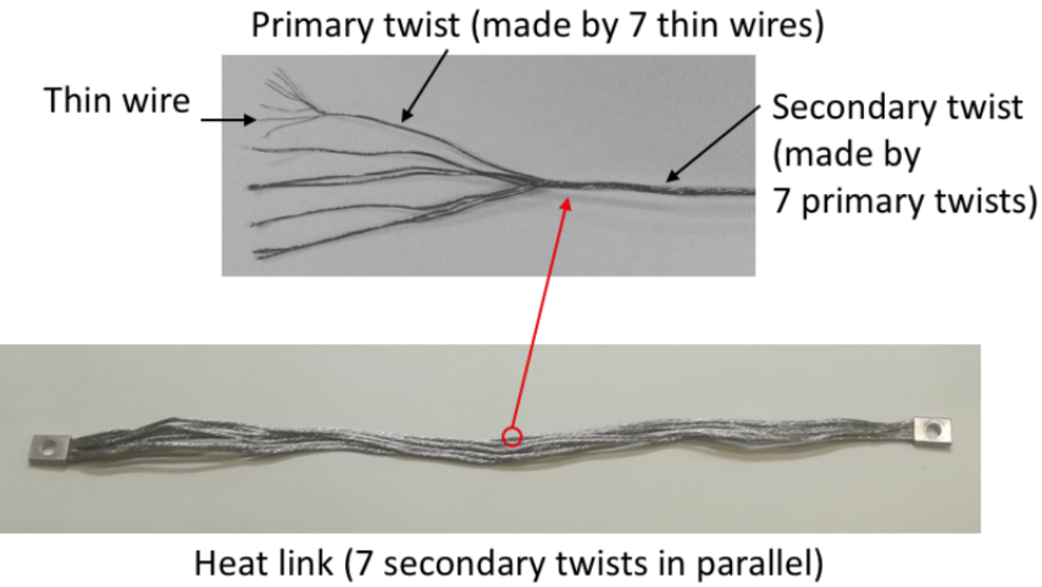
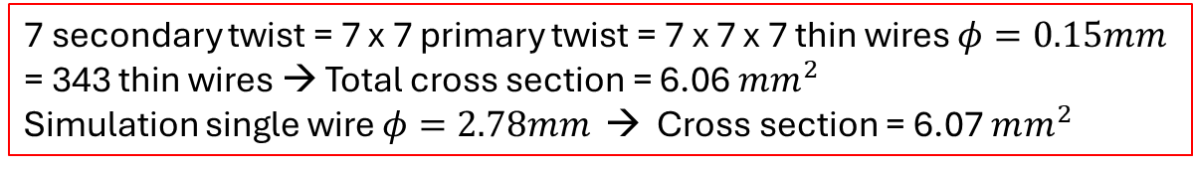
Cryogenic Payload Thermal Simulation Design
8 Heat Links
Placeholder !
Heat
Link
Vibration
Isolation
System
X 2
16 Heat Links
7 secondary twist = 7 x 7 primary twist = 7 x 7 x 7 thin wires $φ=0.15mm$
= 343 thin wires → Total cross section = 6.06 $mm^{2}$
Simulation single wire $φ=2.78mm$ → Cross section = 6.07 $mm^{2}$
Thermo-Mechanical Simulations of ET-LF Payload
III Workshop on ET-LF TM Tower Integration 29/9/25 – Marco Ricci

Slide 8

Cryogenic Payload Thermal Simulation Design
34.87 Kg
8 Heat Links
635.19 mm
Total mass HLVIS = 116.83 Kg
16 Heat Links
1005.45 mm
Total length (w.o. HLVIS bulks)
Ring → AC = 2308.3 mm
25.98 Kg
8 Heat Links
243.45 mm
Heat
Link
Vibration
Isolation
System
Total mass Pay = 921.8 Kg
200mm
30 Kg
HLVIS $∼$ 1/8 Pay
8 Heat Links
942.76 mm
KAGRA design requirement = 1/10 Pay
Thermo-Mechanical Simulations of ET-LF Payload
III Workshop on ET-LF TM Tower Integration 29/9/25 – Marco Ricci

Slide 9
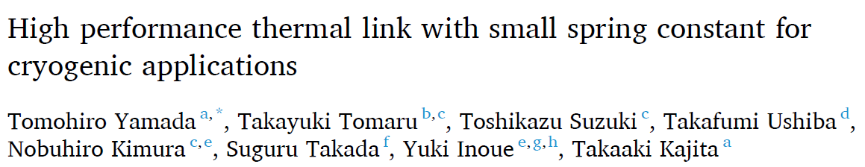

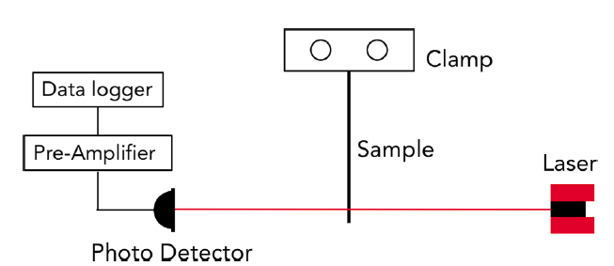
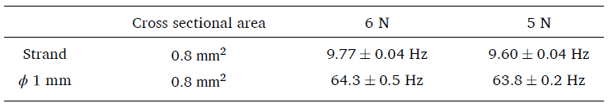

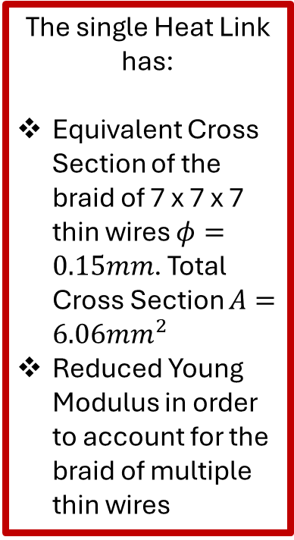
Heat Link Stiffness
The single Heat Link has:
Equivalent Cross Section of the braid of 7 x 7 x 7 thin wires $φ=0.15mm$. Total Cross Section $A=6.06mm^{2}$
Reduced Young Modulus in order to account for the braid of multiple thin wires
Thermo-Mechanical Simulations of ET-LF Payload
III Workshop on ET-LF TM Tower Integration 29/9/25 – Marco Ricci

Slide 10
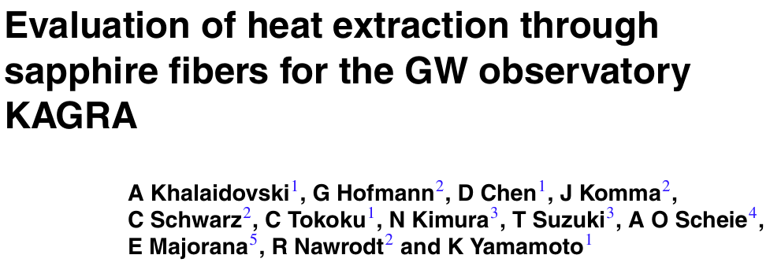
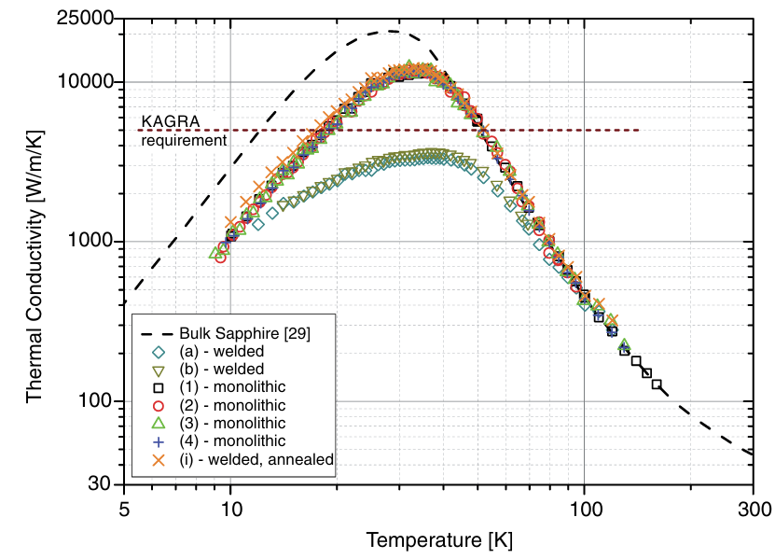

Cryogenic Payload Materials
Sapphire
Thermo-Mechanical Simulations of ET-LF Payload
III Workshop on ET-LF TM Tower Integration 29/9/25 – Marco Ricci

Slide 11
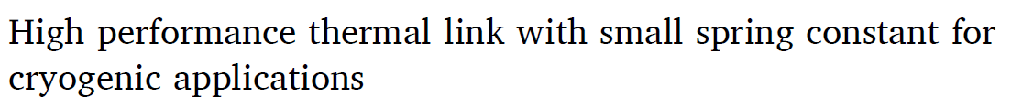
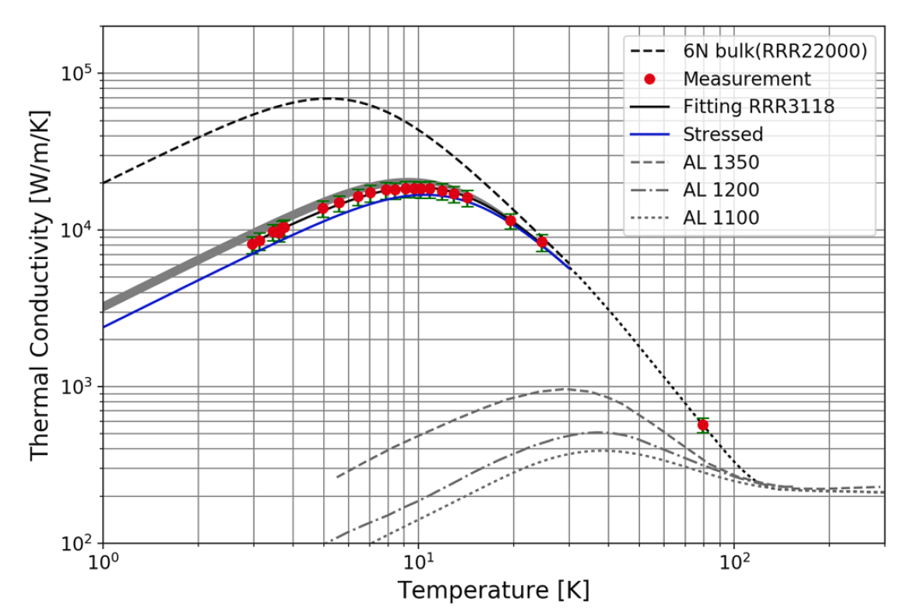
Cryogenic Payload Materials
Al 6N KAGRA Braids
Thermo-Mechanical Simulations of ET-LF Payload
III Workshop on ET-LF TM Tower Integration 29/9/25 – Marco Ricci

Slide 12

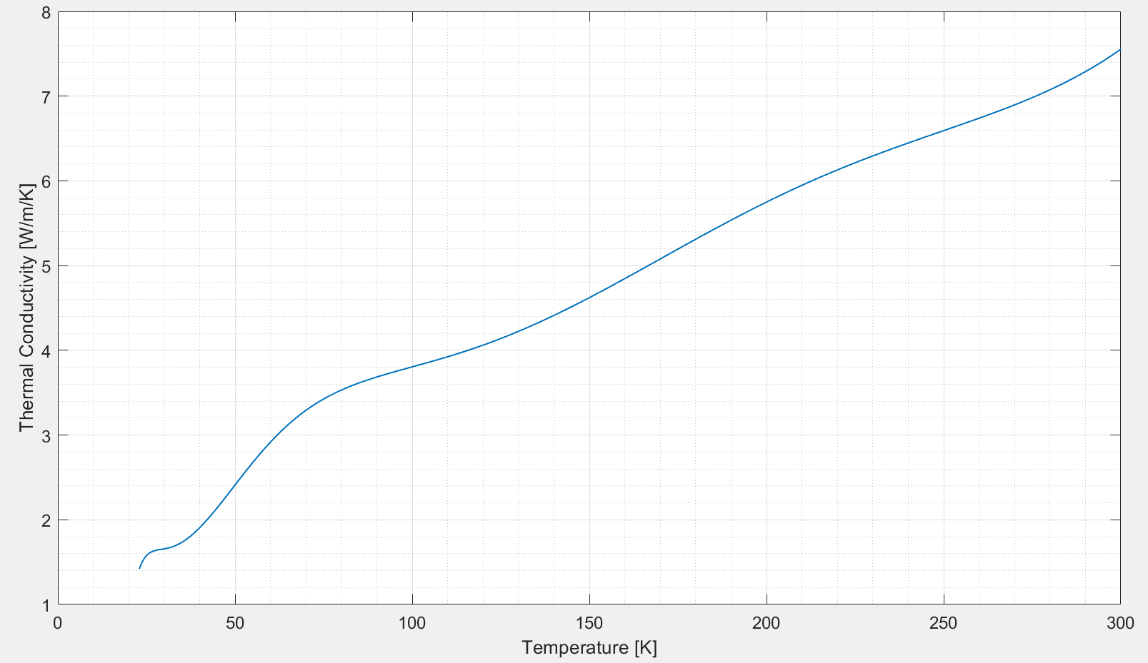
Cryogenic Payload Materials
Ti-6Al-4V
https://trc.nist.gov/cryogenics/materials/Ti6Al4V/Ti6Al4V_rev.htm
Thermo-Mechanical Simulations of ET-LF Payload
III Workshop on ET-LF TM Tower Integration 29/9/25 – Marco Ricci

Slide 13
Cryogenic Payload Electrical Wires Connections
Electrical wires are also connected (and thermalized) to the Actuation Cage
Electrical Wires
(low Q)
Thermo-Mechanical Simulations of ET-LF Payload
III Workshop on ET-LF TM Tower Integration 29/9/25 – Marco Ricci

Slide 14

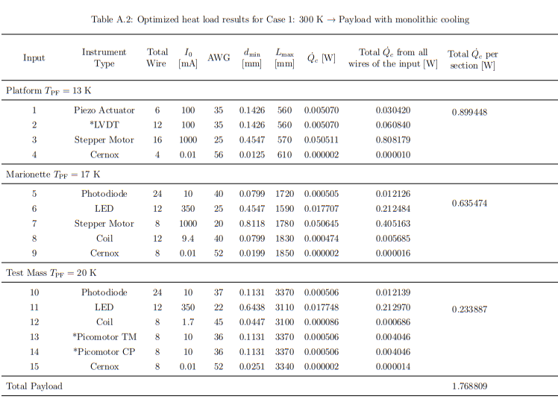



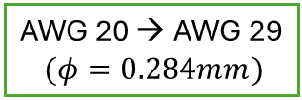


Cryogenic Payload Electrical Wires Connections
Worst Case scenario:
No Thermalization
${\dot{Q}}_{Stepper Motor}=$0.3649W
AWG 25 → AWG 29
$(φ=0.284mm)$
+
${\dot{Q}}_{Coil}=$0.0064W
=
AWG 20 → AWG 29
$(φ=0.284mm)$
AC
${\dot{Q}}_{TOT}^{AC}=$0.38W
AC
Thermo-Mechanical Simulations of ET-LF Payload
III Workshop on ET-LF TM Tower Integration 29/9/25 – Marco Ricci

Slide 15
Cryogenic Payload Initial Temperature
Thermal Simulations consider:
Cryostat completely cooled
OTS @ 80K
ITS @ 5K
IITS@ 2K
Payload @ Room Temperature
Thermo-Mechanical Simulations of ET-LF Payload
III Workshop on ET-LF TM Tower Integration 29/9/25 – Marco Ricci

Slide 16
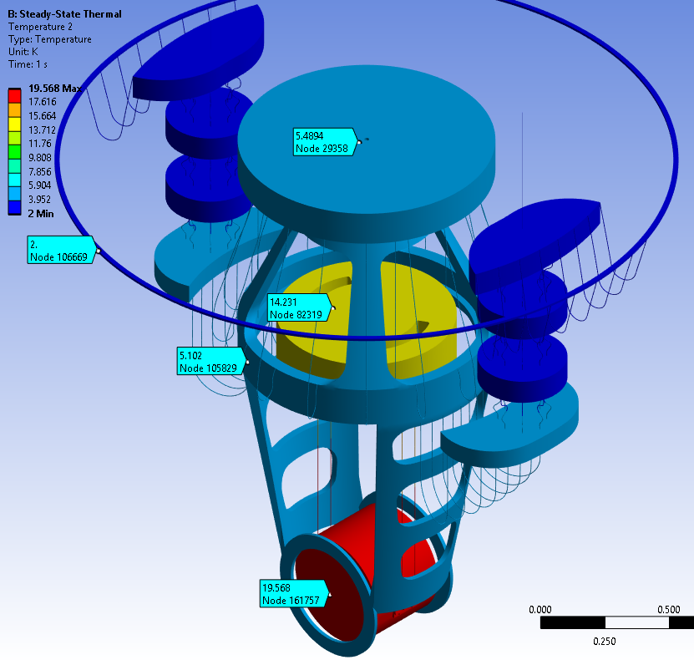
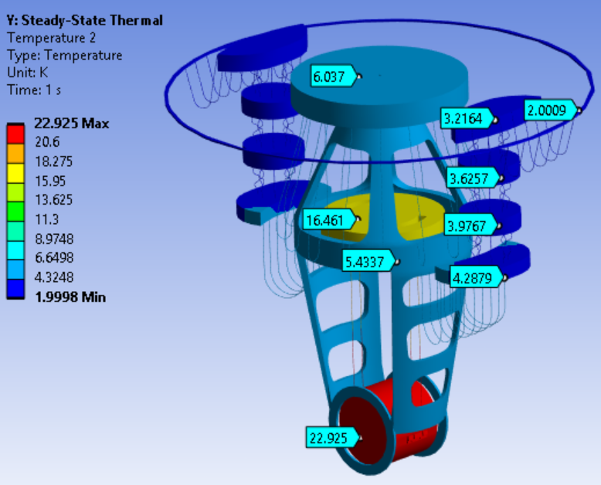
ET-LF Payload : Thermal Simulation
VS
0.3W Heat Input on the Mirror
+
0.38W on AC (electrical wires)
0.5W Heat Input on the Mirror
+
0.38W on AC (electrical wires)
Thermo-Mechanical Simulations of ET-LF Payload
III Workshop on ET-LF TM Tower Integration 29/9/25 – Marco Ricci

Slide 17
ET-LF Payload : Thermal Simulation
Worst Case Scenario Taken as a Reference
VS
0.3W Heat Input on the Mirror
+
0.38W on AC (electrical wires)
0.5W Heat Input on the Mirror
+
0.38W on AC (electrical wires)
Thermo-Mechanical Simulations of ET-LF Payload
III Workshop on ET-LF TM Tower Integration 29/9/25 – Marco Ricci

Slide 18
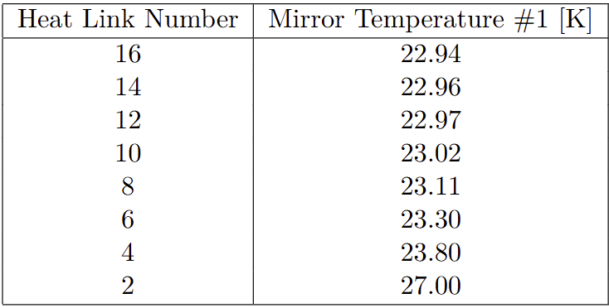
ET-LF Payload : Heat Link Number Dependance
8 Heat Links
7 Heat Links
6 Heat Links
1 Heat Link
16 Heat Links
14 Heat Links
12 Heat Links
2 Heat Link
…
…
Thermo-Mechanical Simulations of ET-LF Payload
III Workshop on ET-LF TM Tower Integration 29/9/25 – Marco Ricci

Slide 19
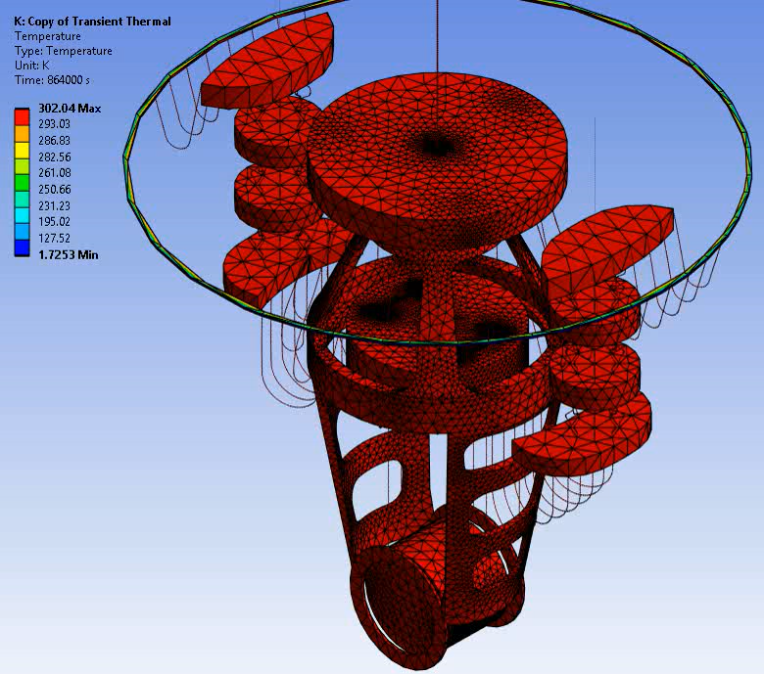
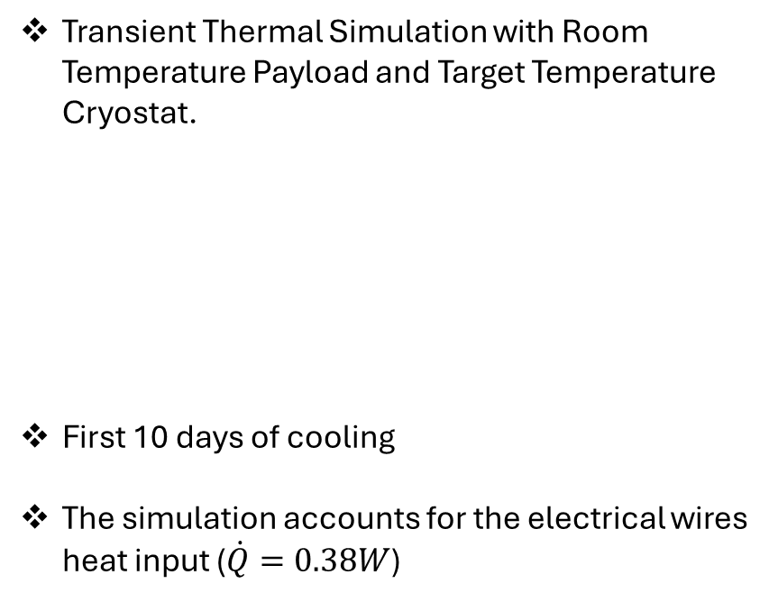
ET-LF Payload : Transient Thermal Simulation
Transient Thermal Simulation with Room Temperature Payload and Target Temperature Cryostat.
First 10 days of cooling
The simulation accounts for the electrical wires heat input ($\dot{Q}=0.38W$)
Integration with Cryostat cooling with Helium in progress (with Marco Orsini (Sapienza), Enes Turkic (KIT), Timo Weckerle (KIT), …)
Thermo-Mechanical Simulations of ET-LF Payload
III Workshop on ET-LF TM Tower Integration 29/9/25 – Marco Ricci

Slide 20
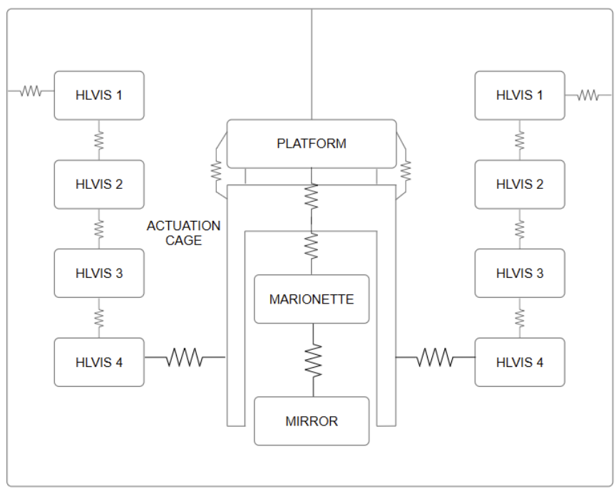
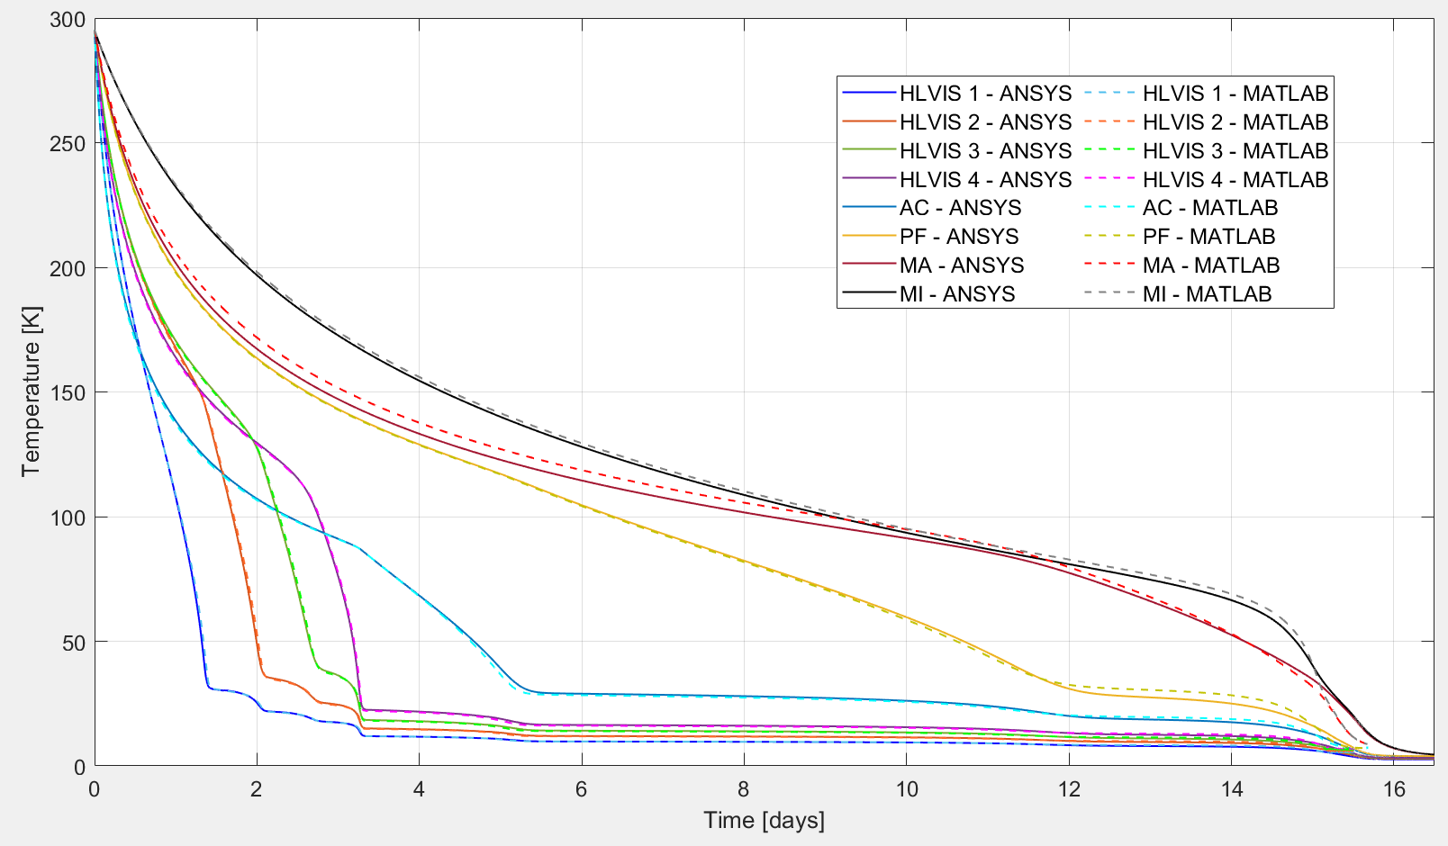
ET-LF Payload : Transient Thermal Simulation
ANSYS FEA Transient Thermal Simulation
Vs
MATLAB Code with lumped parameters
Cooling time with 16 Heat Links 16.2 days
Thermo-Mechanical Simulations of ET-LF Payload
III Workshop on ET-LF TM Tower Integration 29/9/25 – Marco Ricci

Slide 21
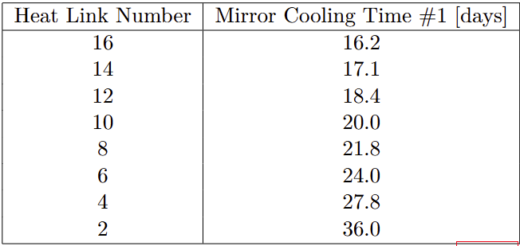

ET-LF Payload : Transient Thermal Simulation
8 Heat Links
7 Heat Links
6 Heat Links
1 Heat Link
16 Heat Links
14 Heat Links
12 Heat Links
2 Heat Link
…
…
Thermo-Mechanical Simulations of ET-LF Payload
III Workshop on ET-LF TM Tower Integration 29/9/25 – Marco Ricci

Slide 22
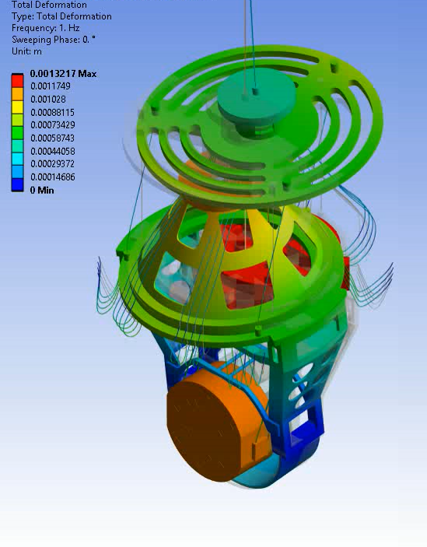
ET-LF Payload : Thermal Noise Budget
Preliminary Thermal Noise Budget Comparisons with ANSYS FEA and OCTOPUS for ARC-ETCRYO payload.
Planned
Thermal Noise Estimation for ET-LF Payload for various number of Heat Links.
Thermal Noise Estimation for ET-LF Payload with Thermal Gradient along the suspensions.
Harmonic Response @ 1Hz
Thermo-Mechanical Simulations of ET-LF Payload
III Workshop on ET-LF TM Tower Integration 29/9/25 – Marco Ricci

Slide 23
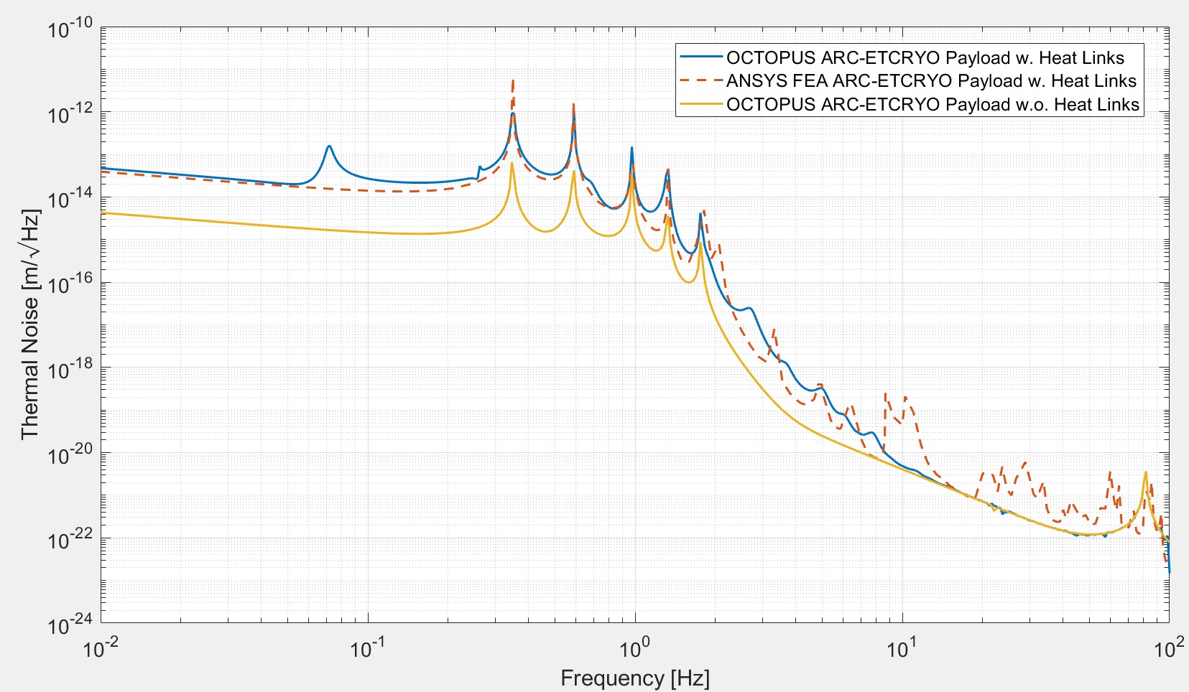
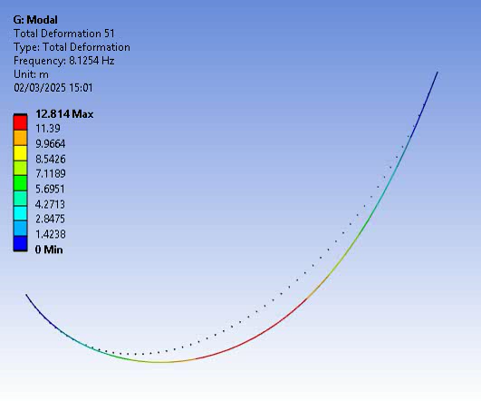
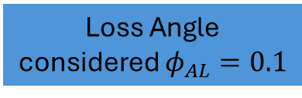
ARC-ETCRYO Payload : Thermal Noise Budget
DC contribution of the Heat Links
Highly dependent on Soft Heat Link Loss Angle!!
Contributions of the Heat Links resonances
Loss Angle considered $φ_{AL}=0.1$
Thermo-Mechanical Simulations of ET-LF Payload
III Workshop on ET-LF TM Tower Integration 29/9/25 – Marco Ricci

Slide 24
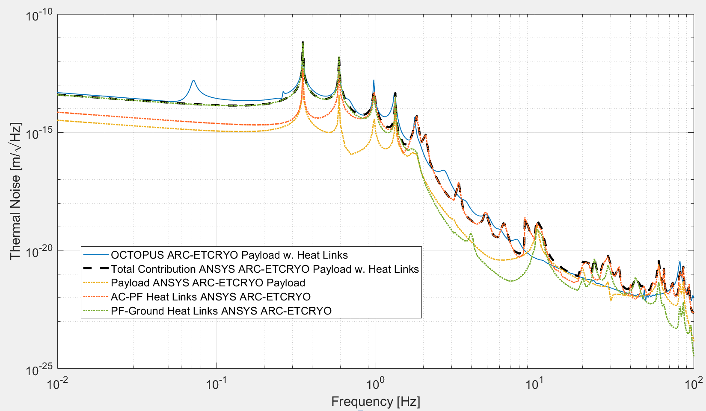

ARC-ETCRYO Payload : Thermal Noise Budget
Thermo-Mechanical Simulations of ET-LF Payload
III Workshop on ET-LF TM Tower Integration 29/9/25 – Marco Ricci

Slide 25
Conclusions
Thermal Simulations of the baseline ET-LF Payload:
Thermal Noise Budget of the baseline ET-LF Payload:
R&D Activities in ARC-ETCRYO
Steady-State Simulations vs Heat Links;
Transient Simulations vs Heat Links (Room Temperature Payload in cold environment);
Transient Simulations integrated with Cryostat cooling -> Ongoing (Sapienza + KIT)
Thermal Noise estimation with Heat Links for ARC-ETCRYO Payload;
Thermal Noise estimation with Heat Links for ET-LF Payload -> Ongoing
Soft Heat Links Thermo-Mechanical Validation;
Heat Link Vibration Transfer Characterization;
Quality Factor estimation of Al6N Heat Links at cryogenic temperatures;
Control Strategy implementation on reduced scale cryogenic Payload.
Thermo-Mechanical Simulations of ET-LF Payload
III Workshop on ET-LF TM Tower Integration 29/9/25 – Marco Ricci

