Slide 1
III Workshop on ET-LF TM Tower Integration LNF Activities
Elba
September 29th -30th, 2025
L. Spallino, M. Angelucci and R. Cimino
LNF-INFN

Slide 2
ET Activities @ LNF-INFN
GW detector Upgrade for High Sensitivity
Electrostatic charges mitigation
Frost mitigation on Cryogenic Mirrors
Passive
Active
WP1
M. Angelucci (MaSSLab)
Active
Passive
Identification and Control
of charge sources
(Electrostatic screen)
Characterization of
materials vacuum properties
(Outgassing)
Charge mitigation
(Electron irradiation)
Frost Removal
(Electron desorption)
WP3
M. Angelucci (MaSSLab & Vacuum Group @ LNF
& EGO/Virgo & IFAE)
Cryogenic Environment
WP2
A. Liedl (Vacuum Group – Latino @ LNF
& MaSSLab & EGO/Virgo)

Slide 3
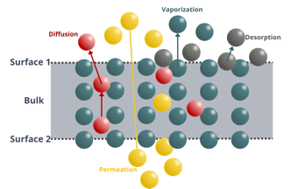
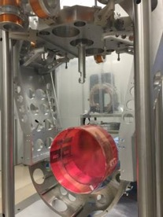
ET Activities @ LNF-INFN
WP1: Frost mitigation and Electrostatic Charging (MaSSLab)
The final goal of this WP is to validate the use of low energy electrons as a mitigation method for frost formation and as a neutralization method for mirrors’ electrostatic charging.
WP2: Material Properties (Vacuum Group @LNF in collaboration with MaSSLab and EGO/Virgo)
The aim of this WP is the characterization of the materials involved in the tower vacuum system containing the mirrors. The investigation of the outgassing properties will define the level and quality of vacuum surrounding the mirror surfaces.
WP3: Passive mitigation method for electrostatic charging
(MaSSLab in collaboration with the Vacuum Group @ LNF, EGO/Virgo)
The aim of this WP is to carry out a R&D activity to develop a passive mitigation strategy for the electrostatic charging generated by low energy electrons coming from ion pumps, propagating along the beampipes and finally impinging on the test masses.

Slide 4
ET Activities @ LNF-INFN
GW detector Upgrade for High Sensitivity
Electrostatic charges mitigation
Frost mitigation on Cryogenic Mirrors
Passive
Active
WP1
M. Angelucci (MaSSLab)
Active
Passive
Identification and Control
of charge sources
(Electrostatic screen)
Characterization of
materials vacuum properties
(Outgassing)
Charge mitigation
(Electron irradiation)
Frost Removal
(Electron desorption)
WP3
M. Angelucci (MaSSLab & Vacuum Group @ LNF
& EGO/Virgo & IFAE)
Cryogenic Environment
WP2
A. Liedl (Vacuum Group – Latino @ LNF
& MaSSLab & EGO/Virgo)

Slide 5
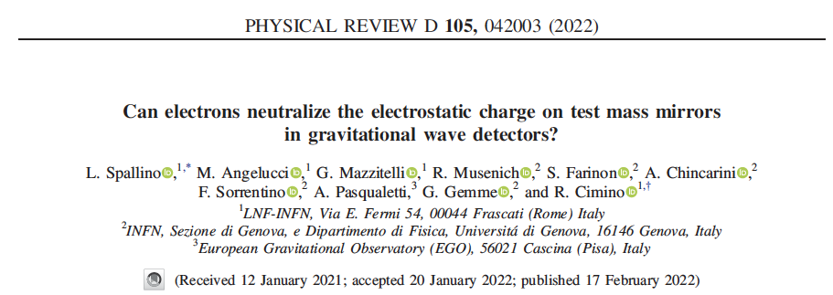
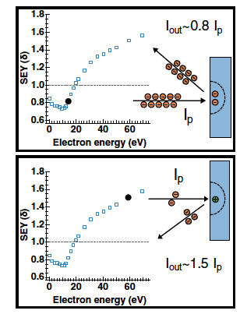
Activity at LNF-INFN

Slide 6
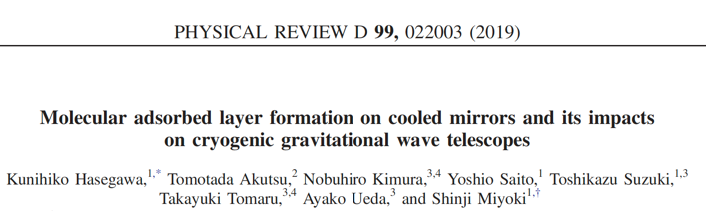
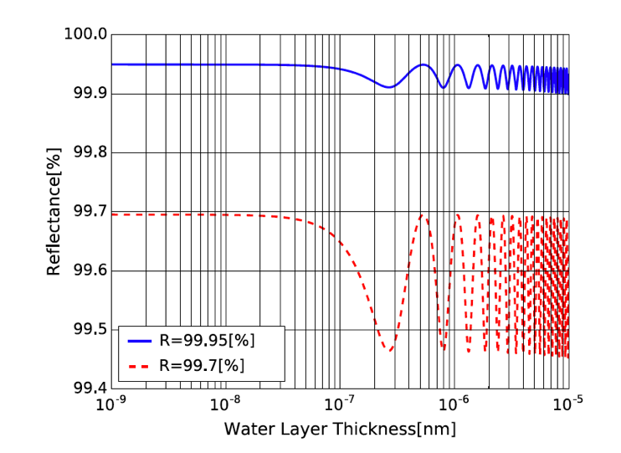
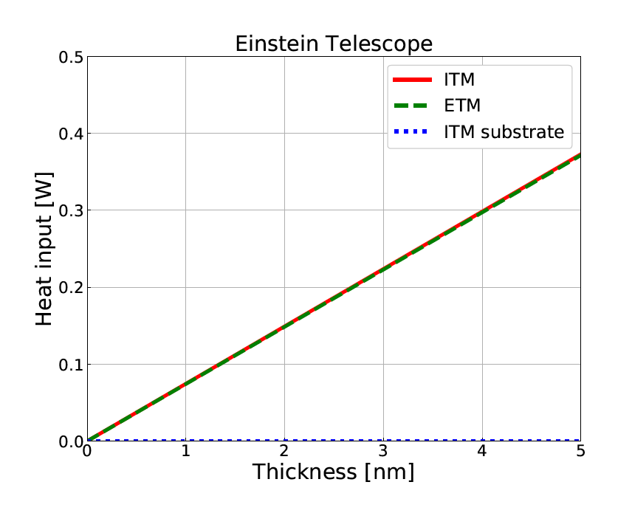
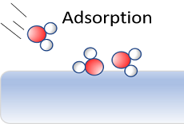
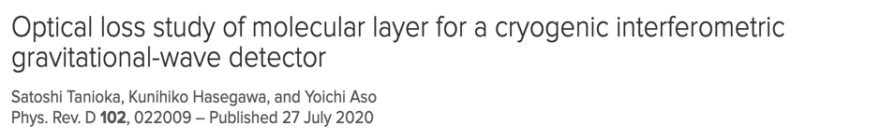
Cryogenic Vacuum Issues on GWD optics
From KAGRA experience, simulations indicate:
reflectivity gets affected, already after 100 nm of H₂O ice
ET maximum thermal budget (~100 mW/ 1 W) is expected to be exceeded already after ~1-10 nm of H₂O ice!!!
Water Layer Thickness [m]
→ Can we cure it?

Slide 7
Residual gas adsorption on cold surfaces
Saturated vapour pressure from Honig and Hook (1960)
Cryosorption depends on:
surface temperature
pressure
gas partial pressures
They have to be correctly evaluated, considering:
P_{RT}≠P_{LT} (thermal transpiration correction)
vacuum history
For T~10 K and p<10⁻¹⁰ mbar, the most common residual gas species in a UHV chamber (except H₂ and He) will be adsorbed, forming a molecular ice (“frost”) on the surface

Slide 8
Residual gas adsorption on cold surfaces
The right evaluation of gas pressure allows to give reliable estimates of ice thickness forming on the cold surface.
Langmuir (L) unit:
1 L = 1x 10⁻⁶ mbar x 1s
gas exposure of a surface (or dosage)
For sticking coefficient S_{c}= 1:
1 L ~ 1 Monolayer (ML) cryosorbed
for H₂O, 1 ML ~ 0.3 nm
→ In 1x 10⁻¹² mbar, it takes 1.000.000 s (~300 h / ~13 days) to build up a ML.

Slide 9

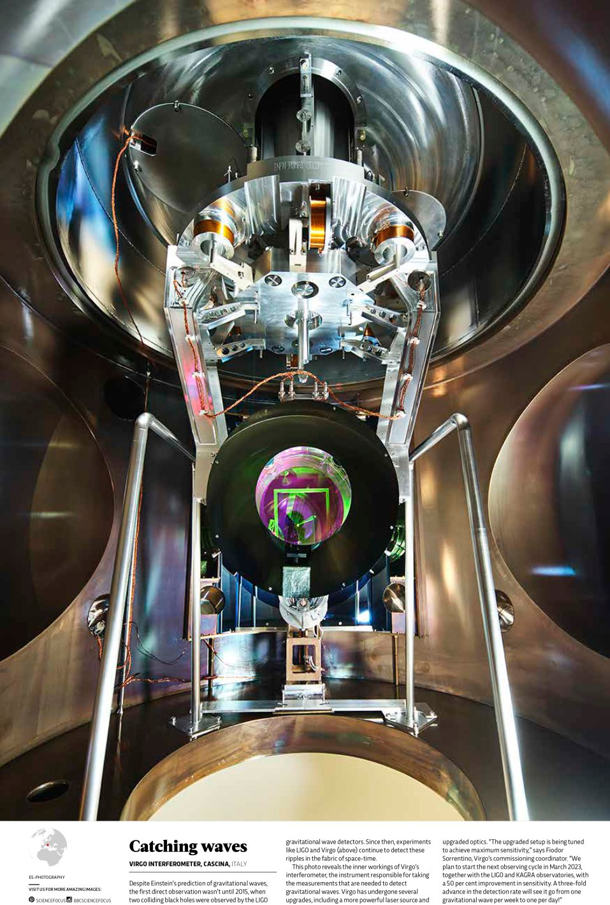
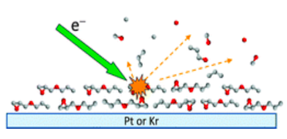
Low energy electrons irradiation
Electrons efficiently induce molecular ice nonthermal desorption!
R. Dupuy et al. J. Appl. Phys. 128, 175304 (2020)
L. Spallino et al., Phys. Rev. D, 062001, 104 (2021)
Mirror
Possible if a charging mitigation method compliant with cryogenics is proved!

Slide 10
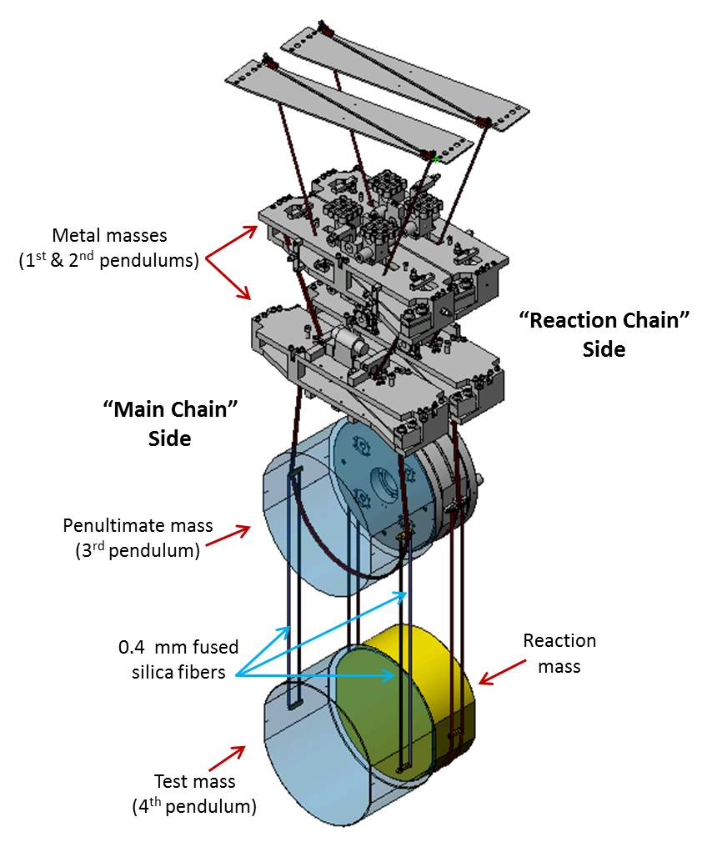
Electrostatic charging on test masses of GW detector
Unclear in origin, quantity and even sign
Effects of charging:
Interferers with optical position control
Accumulation and motion of charges can generate fluctuating electric fields that could move the test mass at frequencies in the interferometer's sensitive band
Attracts dust, reducing reflectance, increasing scattering and absorption
Electric field noise coupling to test mass motion
Potentially limiting noise source

Slide 11
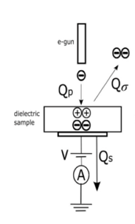
Status of Activities:
Frost mitigation and Electrostatic Charging
Electrostatic charging neutralization by low energy electron irradiation:
Proof of concept (Spallino et al., PRD 2021; Spallino et al., PRD 2022).
Experimental validation at RT and LT (T~10 K) by developing a capacitive method for small prototypical samples (10 x 10 mm²) of metals, semiconductors and thin insulator layers (~20 nm) (Spallino et al., Vacuum 2025).
Frost mitigation by Electron Stimulated Desorption (ESD):
Efficient process already known in literature (Spallino et al., PRD 2021).
Capacitive setup developed for experimental validation
Electrons can neutralize both positive and negative charges by properly tuning their energy → ESD feasible in principle.
There is a strict correlation between neutralization parameters and SEY: by studying SEY features of any coating, it is possible to extract operational parameters to discharge it.
It is possible to induce a stable and homogeneous surface potential.

Slide 12
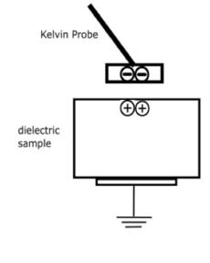

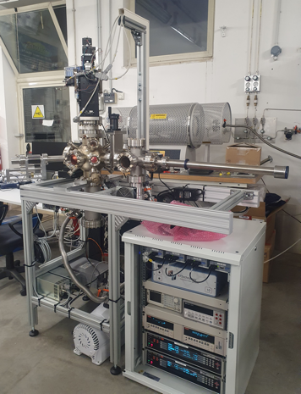
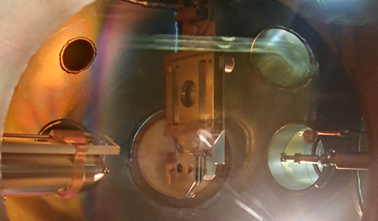
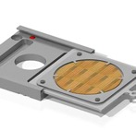
Status of Activities:
Frost mitigation and Electrostatic Charging
Electrostatic charging neutralization by low energy electron irradiation:
Experimental validation at RT and LT (T~10 K) on more realistic small samples by capacitive method (→ waiting for materials coming from collaboration)
Experimental studies on charge distribution and neutralization for big realistic samples (1-inch, thick insulators) → implementation of a dedicated setup equipped with a Kelvin probe (system currently under test).
Frost mitigation by Electron Stimulated Desorption (ESD):
First tests on H₂O/Si and Cu to combine ESD and neutralization
Kelvin probe scheme under test for charging neutralization
Setup overview
Chamber inner view
Kelvin probe
e- gun
Sample holder

Slide 13
Mid-term Perspective:
Frost mitigation and Electrostatic Charging
Preliminary XPS and Raman investigations carried out in our lab on prototypical small have shown that, within the detectability limit of these experimental techniques, electron irradiation below few hundreds’ eV does not induce observable structural defects on the substrate.
Laboratory based experiments
More investigation are needed, especially on realistic and specific materials.
→ WHAT is the effects induced by electron irradiation on optics?
→ WHAT is the best way to monitor the effects (studies on optical properties and/or noise induced effects: crystallization status, optical defects, scattering centers, scattering losses, mechanical losses,...)?
Work in progress within the ET-Italia collaboration (Core Optics and Coating group) but we are opened to inputs and suggestions!

Slide 14
Frost mitigation and Electrostatic Charging
Final goal → Integration
In principle, electron irradiation to mitigate charging is compatible with cryogenics and will work at RT as well.
→ At the present stage, can the method be integrated in design of the overall system? and HOW?
→ WHAT is the impact at cryogenic conditions?
Is there an available mock-up system where to plan test on:
frost/neutralization mitigation methods by using electrons;
effects on optics under realistic conditions;
If it is not, a mock-up system should be designed/realized.
Mandatory R&D plan
cold electron gun
a charging monitoring system

Slide 15
ET Activities @ LNF-INFN
GW detector Upgrade for High Sensitivity
Electrostatic charges mitigation
Frost mitigation on Cryogenic Mirrors
Passive
Active
WP1
M. Angelucci (MaSSLab)
Active
Passive
Identification and Control
of charge sources
(Electrostatic screen)
Characterization of
materials vacuum properties
(Outgassing)
Charge mitigation
(Electron irradiation)
Frost Removal
(Electron desorption)
WP3
M. Angelucci (MaSSLab & Vacuum Group @ LNF
& EGO/Virgo & IFAE)
Cryogenic Environment
WP2
A. Liedl (Vacuum Group – Latino @ LNF
& MaSSLab & EGO/Virgo)
WP5 (2026)
M. Angelucci (MaSSLab)
Development of a
“Cold” electron gun

Slide 16
ET Activities @ LNF-INFN
GW detector Upgrade for High Sensitivity
Electrostatic charges mitigation
Frost mitigation on Cryogenic Mirrors
Passive
Active
WP1
M. Angelucci (MaSSLab)
Active
Passive
Identification and Control
of charge sources
(Electrostatic screen)
Characterization of
materials vacuum properties
(Outgassing)
Charge mitigation
(Electron irradiation)
Frost Removal
(Electron desorption)
WP3
M. Angelucci (MaSSLab & Vacuum Group @ LNF
& EGO/Virgo & IFAE)
Cryogenic Environment
WP2
A. Liedl (Vacuum Group – Latino @ LNF
& MaSSLab & EGO/Virgo)
WP5 (2026)
M. Angelucci (MaSSLab)
Development of a
“Cold” electron gun

Slide 17
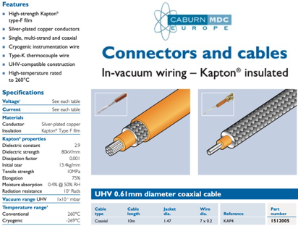
WP2: Material Properties
(Vacuum Group – Latino @ LNF in collaboration with MaSSLab & EGO/Virgo)
RGA
H₂O
CO/N₂
CO₂
Outgassing and RGA data for a commercial Kapton insulated coaxial cable, suitable for cryogenic applications. (data to be published)

Slide 18
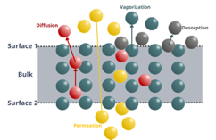

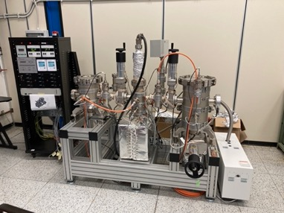
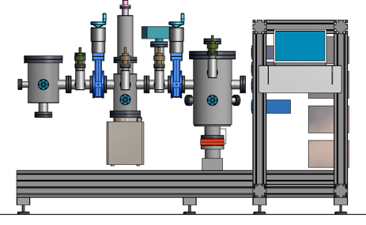
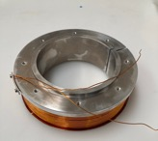
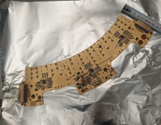

The aim of this WP is the characterization of the materials involved in the tower vacuum system containing the mirrors. The investigation of the outgassing properties will define the level and quality of vacuum surrounding the mirror surfaces.
Status of Activities:
Materials properties
LNF «LATINO» - Outgassing Facility - fully operating.
LNF-Virgo/EGO networking for materials’ characterization.
First tests on samples provided by Virgo/EGO to be in line with measurement methods and procedures
Two Chamber for samples (φ 200 x 260mm and φ 250 x 450mm)
Background ≈10⁻¹³ mbar/l s cm²; two RGA analyzer
Coil
We are ready to carry out measurements’ campaigns.
Material/devices proposed to be used in the tower vacuum system?
Networking with other outgassing facilities for database?
Baffle

Slide 19
ET Activities @ LNF-INFN
GW detector Upgrade for High Sensitivity
Electrostatic charges mitigation
Frost mitigation on Cryogenic Mirrors
Passive
Active
WP1
M. Angelucci (MaSSLab)
Active
Passive
Identification and Control
of charge sources
(Electrostatic screen)
Characterization of
materials vacuum properties
(Outgassing)
Charge mitigation
(Electron irradiation)
Frost Removal
(Electron desorption)
WP3
M. Angelucci (MaSSLab & Vacuum Group @ LNF
& EGO/Virgo & IFAE)
Cryogenic Environment
WP2
A. Liedl (Vacuum Group – Latino @ LNF
& MaSSLab & EGO/Virgo)
WP5 (2026)
M. Angelucci (MaSSLab)
Development of a
“Cold” electron gun

Slide 20
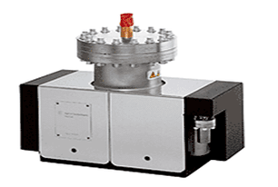
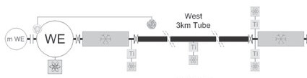
Status of Activities:
Passive mitigation method for electrostatic charging
Limit free electron imping on optics
From the Virgo experience: Electrons coming from Ion pumps
Studies on the emitted electrons from ion pumps
Mes. Of Number of emitted electrons
Emission configuration
…
Studies on the electron’s propagation along the beampipe
Numerical simulation of propagation
Mes. of Number of propagated electrons
SEY of beampipes material

Slide 21
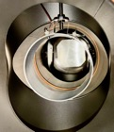
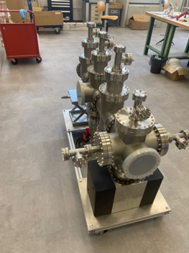
Studies on the emitted electrons from ion pumps
Currents vs Ion pump voltage
K1
(Collector)
Electrostatic screens
Specific configuration for installation
K2
(Applied
Voltage)
Ion pump
→ Mock-up system under construction

Slide 22
Studies on the emitted electrons from ion pumps
Final goal → Integration
→ At the present stage, can the method be integrated in design of the overall system? and HOW?
R&D activity LNF-EGO/Virgo to test the possibility of integrating an electrostatic ring on selected baffles to mitigate the charges’ flow.
R&D activity on final design of electrostatic screen considering pumping variation...

Slide 23
Summary
We are going on with our work program
We are at a critical point for activities related to frost and charging mitigation by electrons
→ we believe it could be the right time to move towards an advanced phase requiring a well-defined R&D program involving the GWD community.
Final goal → Integration
Strong interaction with the community is needed
Even if we are ready, characterizations on outgassing properties of specific materials of interest are in stand-by
→ a collective enterprise could be beneficial to push this activity in different laboratories (EU call?).
The work on passive strategy to mitigate electrostatic charging is promising and in line with time
→ Interaction for integration/R&D
Mandatory R&D plan

Slide 25
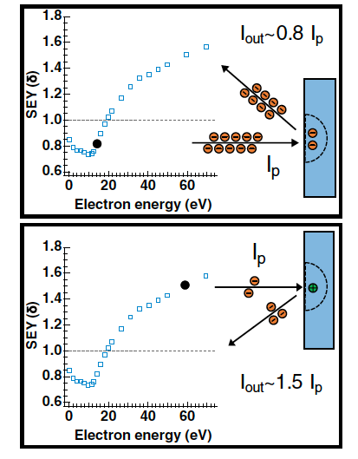
Charging mitigation by low energy electrons
Proof of concept
Electrons of variable but low energy (below few hundreds eV) can compensate charges of both polarity
Secondary Electron Yield
(SEY or δ)
SEY=I_{out}/I_{In}
L. Spallino, IL NUOVO CIMENTO C (2022)
L. Spallino et al., Phys. Rev. D. (2022)

Slide 26
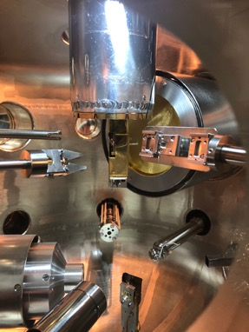
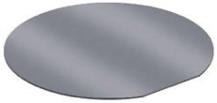
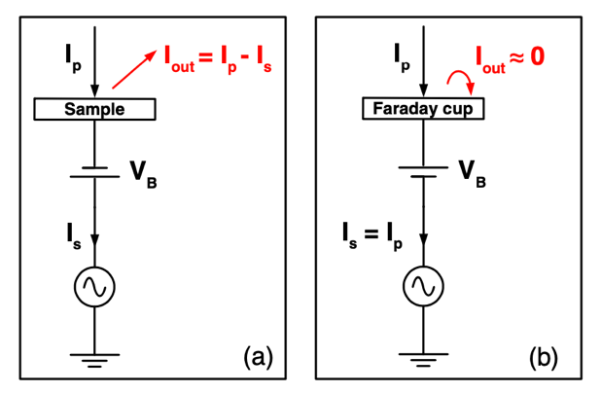
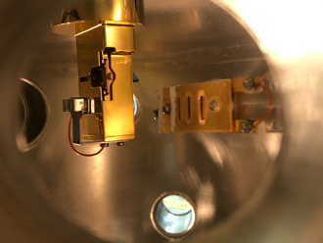
Electrostatic measurements
UHV systems for multi-technique surface studies
MaSSLab
Material Surface Science Laboratory @ LNF-INFN
preparation
chamber
Incident electrons current (I_{p})
Emitted electrons current (I_{out})
main chamber
fast-entry lock
Sample
Faraday cup
Capacitive setup developed for experimental validation

Slide 27
Ongoing electrostatic measurements
From a proof of concept to the experimental validation
L. Spallino et al., Vacuum (2025)
Electrons can neutralize both positive and negative charges by properly tuning their energy.
There is a strict correlation between neutralization parameters and SEY: by studying SEY features of any coating, it is possible to extract operational parameters to discharge it
L. Spallino et al., To be published

Slide 28

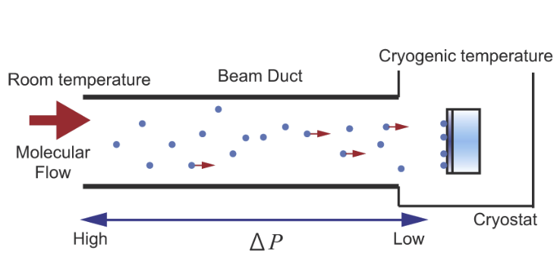
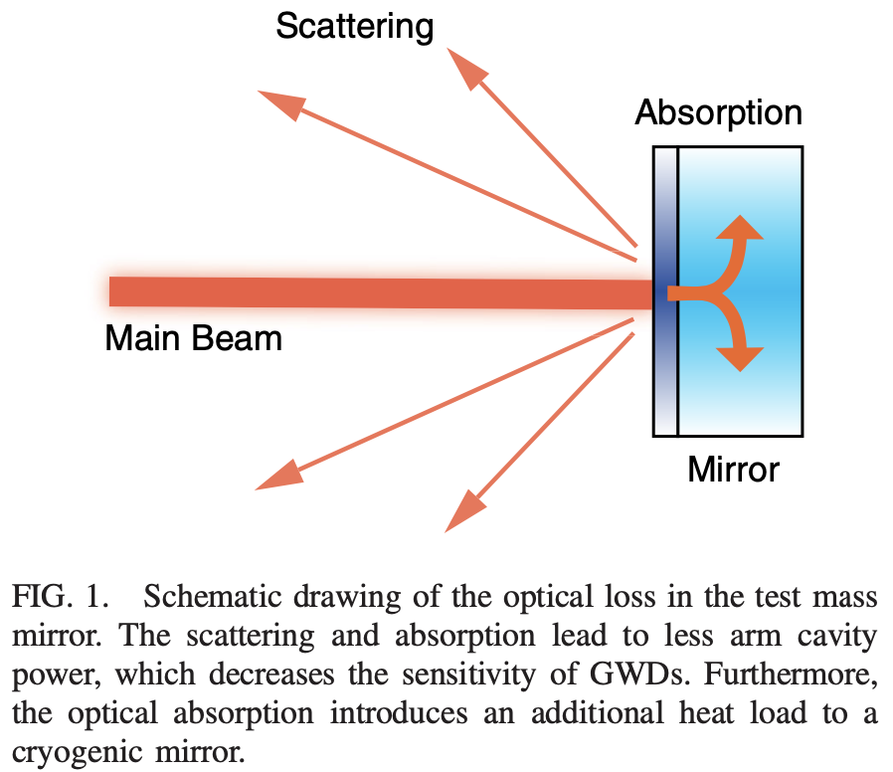
Cryosorption on cold optics (frost)
From KAGRA experience, simulations on ET indicate:
reflectivity gets affected, already after ~100 nm of H₂O ice
Dramatic effects on optical properties
K. Hasegawa et al., Phys Rev. D (2019)
S. Tanioka and Y. Aso, Optic Express (2021)
Water Layer Thickness [m]
S. Tanioka et al., Phys Rev. D (2020)

Slide 29
Low energy electrons irradiation
Electrons efficiently induce molecular ice nonthermal desorption!
R. Dupuy et al. J. Appl. Phys. 128, 175304 (2020)
L. Spallino et al., Phys. Rev. D, 062001, 104 (2021)
Mirror

Slide 30
Low energy electrons irradiation
Mirror
If P_{eff} ∼ 1x10⁻¹⁰ (H₂O,CO,CO₂, etc) mbar; sticking coefficient = 1
1 monolayer (∼ 10¹⁵ mol/cm² ∼ 0.3 nm) will be cryosorbed in 10.000 s.
(∼ 2.5nm/day ∼ 10 times less than in KAGRA)
If we assume a mean ESD η= 0.1 mol./electron (as for H₂O) @ 100eV.
(R. Dupuy et al. J. Appl. Phys. 128, 175304, 2020)
To remove 1 ML we need an el. current of: ~ 1 mAmps/cm² in one second
… depositing less than 100 mW/ML/cm² (not all el. energy goes in thermal heat!)
All in UHV, with marginal heating up of the mirrors and (possibly) reduced downtime.
Deserves further investigation!

Slide 31
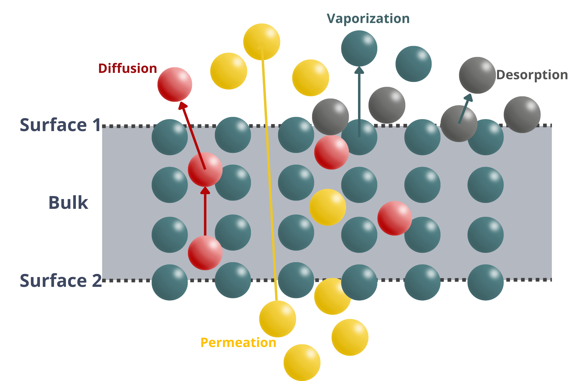
WP2: Material Properties
(Vacuum Group – Latino @ LNF in collaboration with MaSSLab & EGO/Virgo)
The main factor determining the vacuum level within the towers is the amount of gas released from the components installed inside the tower's chambers.
→ The choice of materials is critical to limit the traces of low-volatile organics, potentially cryosrobing onto optical surfaces and directly degrading ET performances.
Saturated vapour pressure from Honig and Hook (1960)
Test on materials and assemblies to assess their compatibility to the vacuum
Outgassing Measurements
Vacuum compatible Materials List (EGO-INFN-KIT MoA)

Slide 32
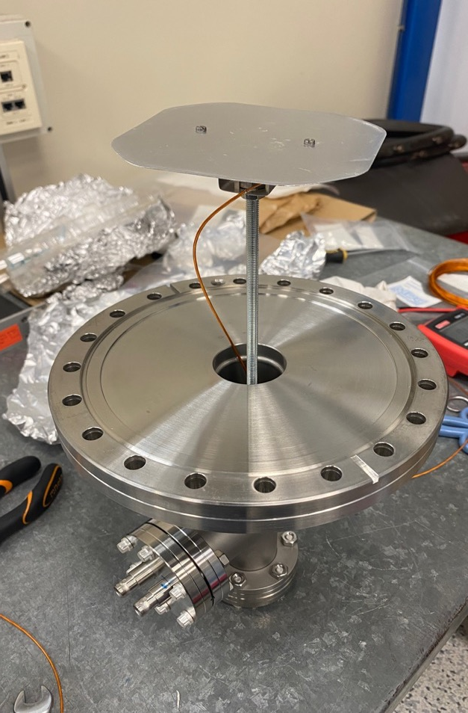
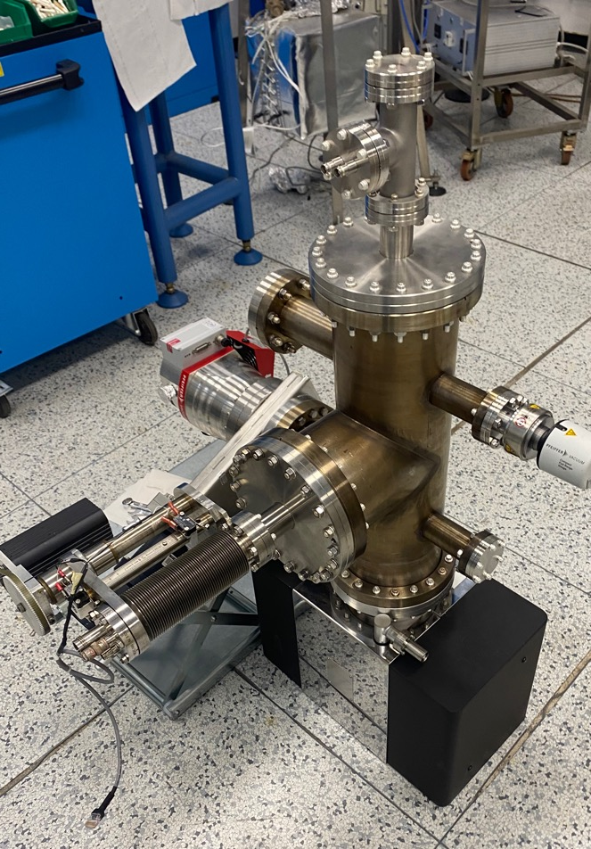
Studies on the emitted electrons from ion pumps
Collector 1
Collector
UHVacuum Chamber
Collector 2
Emitted
electrons
Ion Pump

