Slide 1




Evolution of Optical Coating Thin Films Following Thermal Annealing: Raman Investigation and IR Spectroscopic Ellipsometry
Shima Samandari
University of Genova

Slide 2
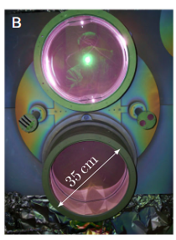
Optical Coating Films for GWD Mirrors
Material | Refractive Index @1064 nm | Reference
TiO₂:GeO₂ | 2.20 ± 0.02 | D Diksha et al CQG. 41(2024)
TiO₂:Ta₂O₅ | 2.05–2.27 | Amato, Alex, et al. ACS Appl. Opt. Mater. 1, 395−402(2023)
HfO₂:Ta₂O₅ | ~1.94 -2.07 | Milotti, Valeria, et al. Optical Materials 163(2025)
Si₃N₄ | 1.97–2.06 | Amato, A., et al. Phys. Rev. D 111, 042003(2025)
Amato, Alex, et al. Advanced Photonics Research 6.4 (2025).
TiO₂:GeO₂ on Si Substrate
By ion beam sputtering
At Laboratoire des Matériaux Avancés, Lyon, France (LMA)
Notes:
In the quest to enhance the sensitivity of gravitational wave detectors (GWD), it was proposed to change the composition of one of the amorphous mixed coatings in the GWD dielectric mirrors, switching from the current TiO2-Ta2O5 to TiO2-GeO2. These two mixtures, however, are quite dierent on a fundamental level: TiO2-Ta2O5 is only composed by transition metal oxides, whereas TiO2-GeO2 contains GeO2, a strong glass former with a glass transition temperature around 510-520 ◦C. As a consequence, the lessons learned during over two decades of research on amorphous TiO2-Ta2O5 coatings might not be straightforwardly applicable to the TiO2-GeO2 coatings. For this reason, new Studies dedicated to that mixture are required.
Material selection for high-reflectivity detectors directly impacts noise and sensitivity in GWDs, motivating the exploration of alternatives to TiO₂–Ta₂O₅.

Slide 3
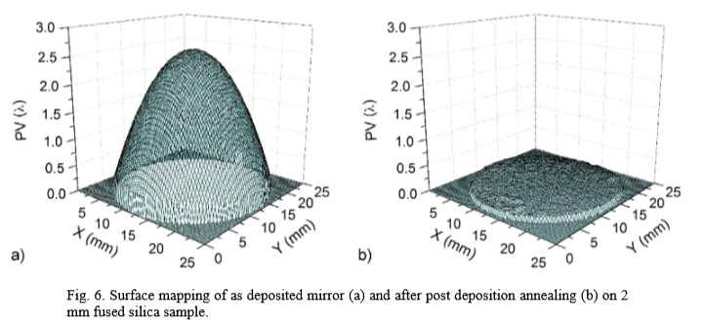
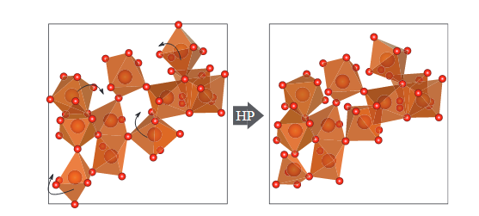
Why thermal annealing in IBS-produced coating?
The structure of the films produced by Ion Beam Sputtering (IBS) is not in a state of equilibrium, which means they suffer from High residual compressive stress.
Induced stress in thin films may lead to delamination and fracture.
Amorphous transition-metal oxides exhibit annealing-induced microscopic changes in their atomic structures, as well as macroscopic variations in properties such as density and refractive index.
\
Kičas, Simonas, et al., “Post-deposition annealing of IBS mixture coatings for compensation of film-induced stress." Optical Materials Express (2016)
Elodie Coillet, PhD thesis, 2017
Notes:
As a consequence, the performance of as-deposited IBS-produced coatings is not satisfactory. This means that mechanical losses and optical absorption are too high

Slide 4
Important requirement in thermal annealing :
coatings with optimal mechanical and optical properties should remain amorphous – (Formation of crystallization must be avoided)
As the crystallization occurs at high temperatures!
What is the optimum condition for obtaining the most stable amorphous phase?
Notes:
This is what motivates our investigation. We want to map the fine line between structural relaxation and the onset of crystallization.”

Slide 5
TiO₂:GeO₂ on silicon | In-Situ technique | Ex-Situ technique
AS_deposited |  | Raman Spectroscopy ATR (Attenuated Total Reflectance ) IRSE (Infrared Spectroscopic Ellipsometry) 400-6600cm⁻¹ (1600nm-25µm)
At 600 °C (20h plateau at 600 °C ) (previous work) | Spectroscopic Ellipsometry 250-1700nm (0.25–1.7 µm)
Up to 950 °C | Raman Spectroscopy
Notes:
to study these films comprehensively, we used a combination of in-situ and ex-situ techniques.
In-situ gives us real-time insights into the optical and structural changes. For this, we used Spectroscopy Ellipsometry in previous work, and for temperatures up to 700°C, we also employed Raman Spectroscopy.
Ex-situ measurements are taken after the sample has been heated and cooled. This allows for more detailed analysis with techniques like Raman Spectroscopy, Attenuated Total Reflectance (ATR), and Infrared Spectroscopic Ellipsometry (IRSE).
We're studying films as-deposited, and then after annealing at 600°C and 700°C to see how their properties evolve."

Slide 6
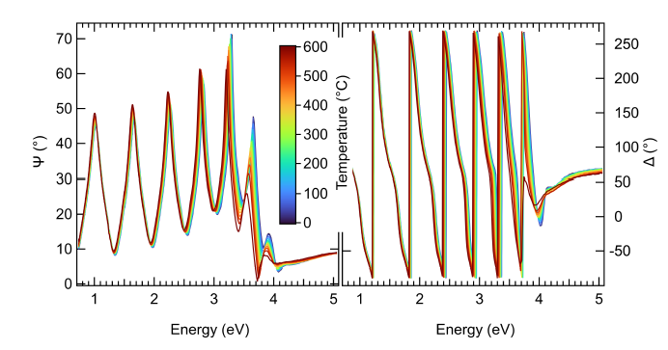
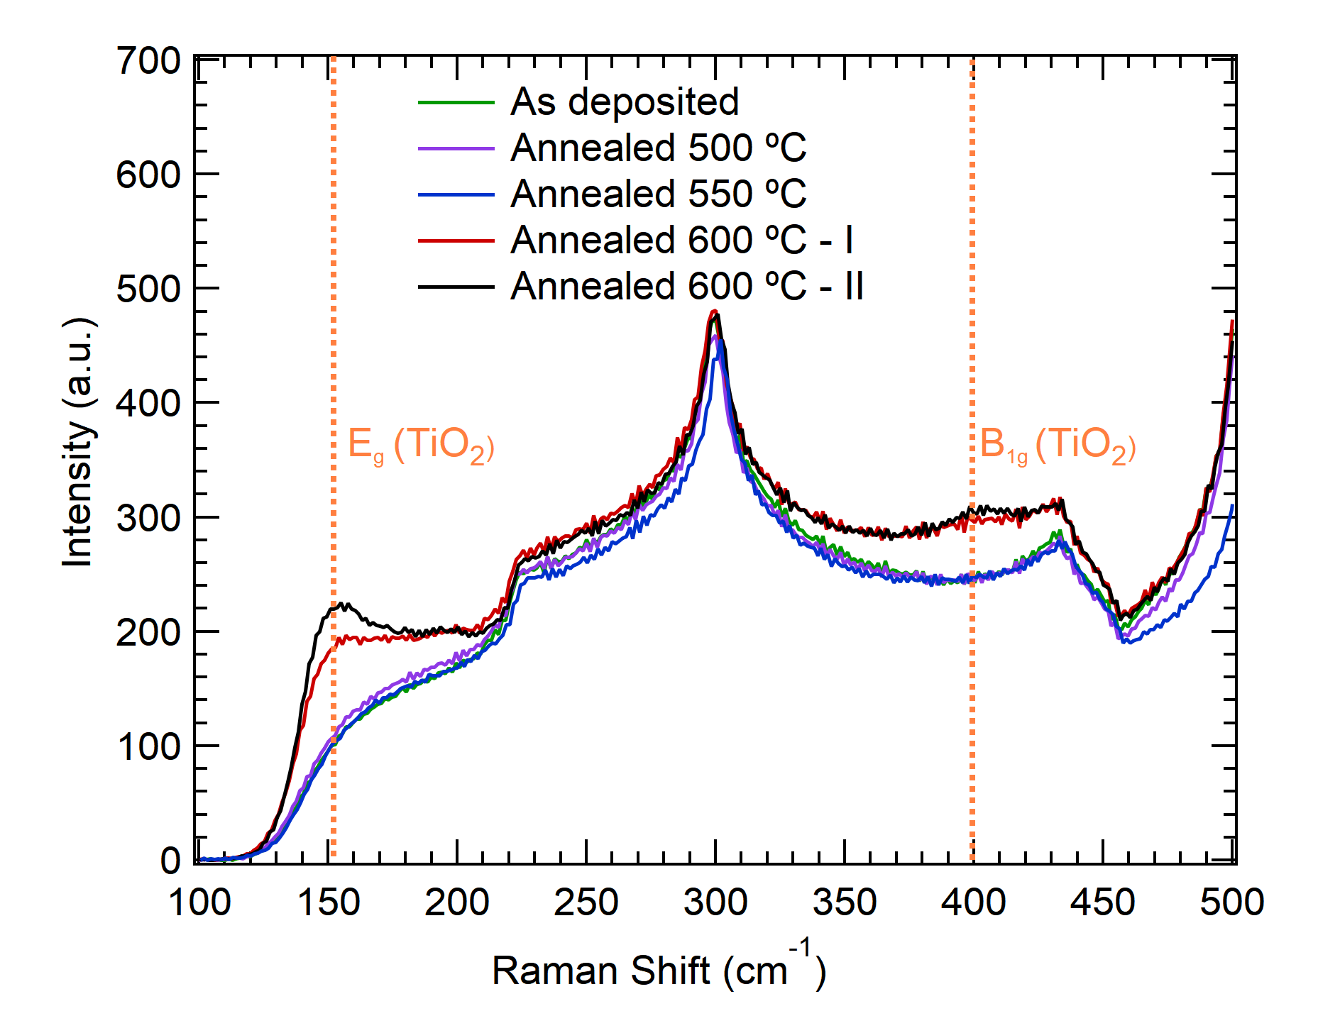
In-situ annealing treatment – previous work
Green Laser
The TiO₂–GeO₂ coatings show very small or nearly zero variations in thickness and refractive index after annealing at 600 °C (20h plateau), unlike other amorphous oxide coatings for GWD applications.
The atomic structure of the coatings has been significantly altered by the annealing, as evidenced by an irreversible shift of -180 meV in the optical gap.
Ex-situ Raman data show some small change in the atomic structure.
M. Magnozzi, S. Samandari, et al., "Exploring in situ the thermal annealing of amorphous TiO2-GeO2 coatings," Submitted
Notes:
The sensitivity of the surface layer thickness is obtained by fitting the photon energy range from 0.7 to 5.0 eV, where the sample is non-absorbing, and the thickness of the surface layer is subsequently fixed to ensure the structural model is consistent along the extended spectral range, thereby enabling a single optical model across the entire spectral range.

Slide 7
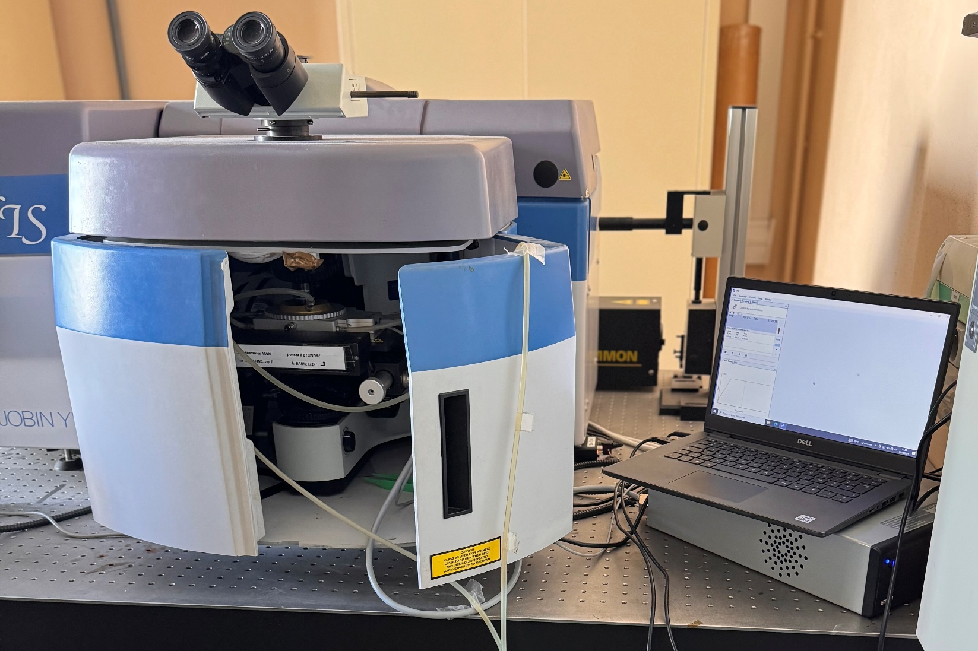
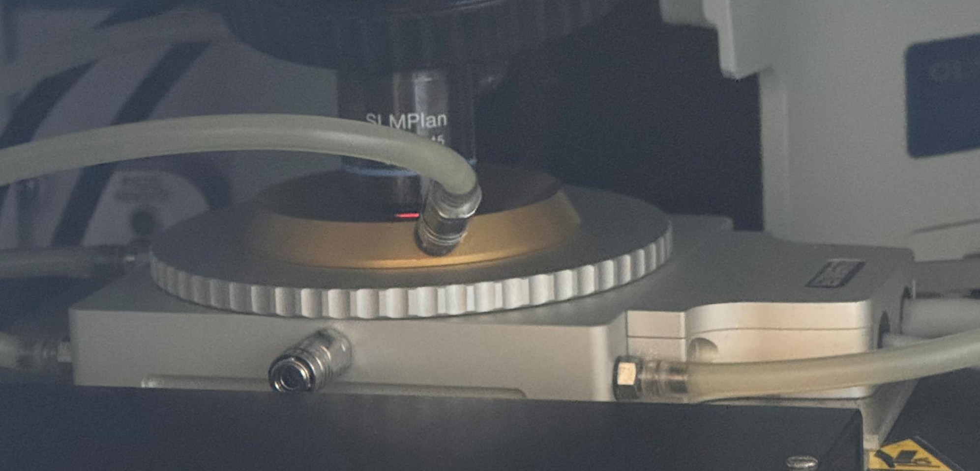
In-situ and Ex-situ Raman Spectroscopy
in situ Raman measurements with Dr. Valérie Martinez (iLM, Lyon, France)
Horiba ARAMIS spectrometer
473 nm laser excitation
50× objective lens (NA 0.45), 1800 lines/mm grating
Blue Laser
Data classification | max temp(◦C)
MRO/ The Onset of Crystallization and | 700
Dynamic of Crystallization | 950
Linkam Cell

Slide 8
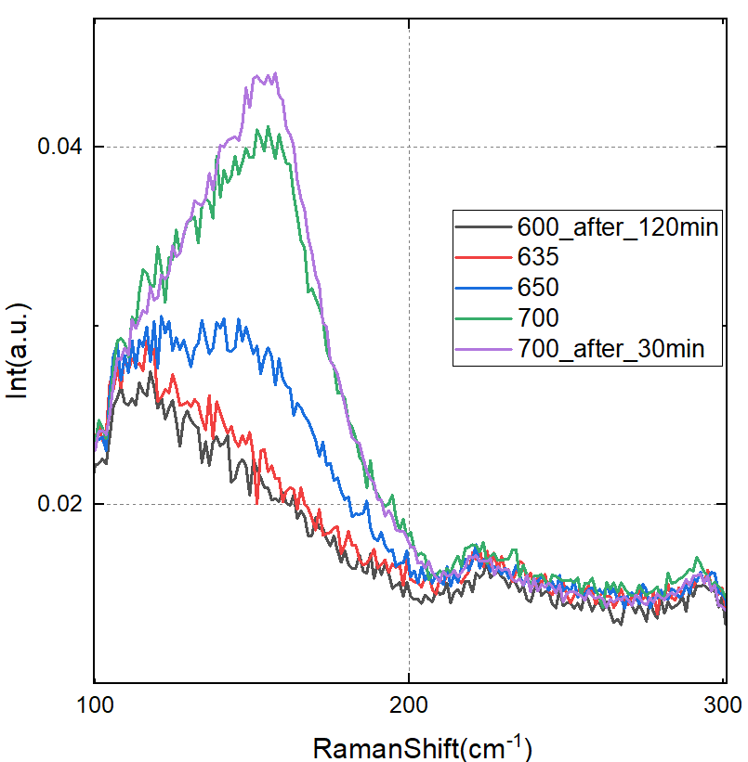
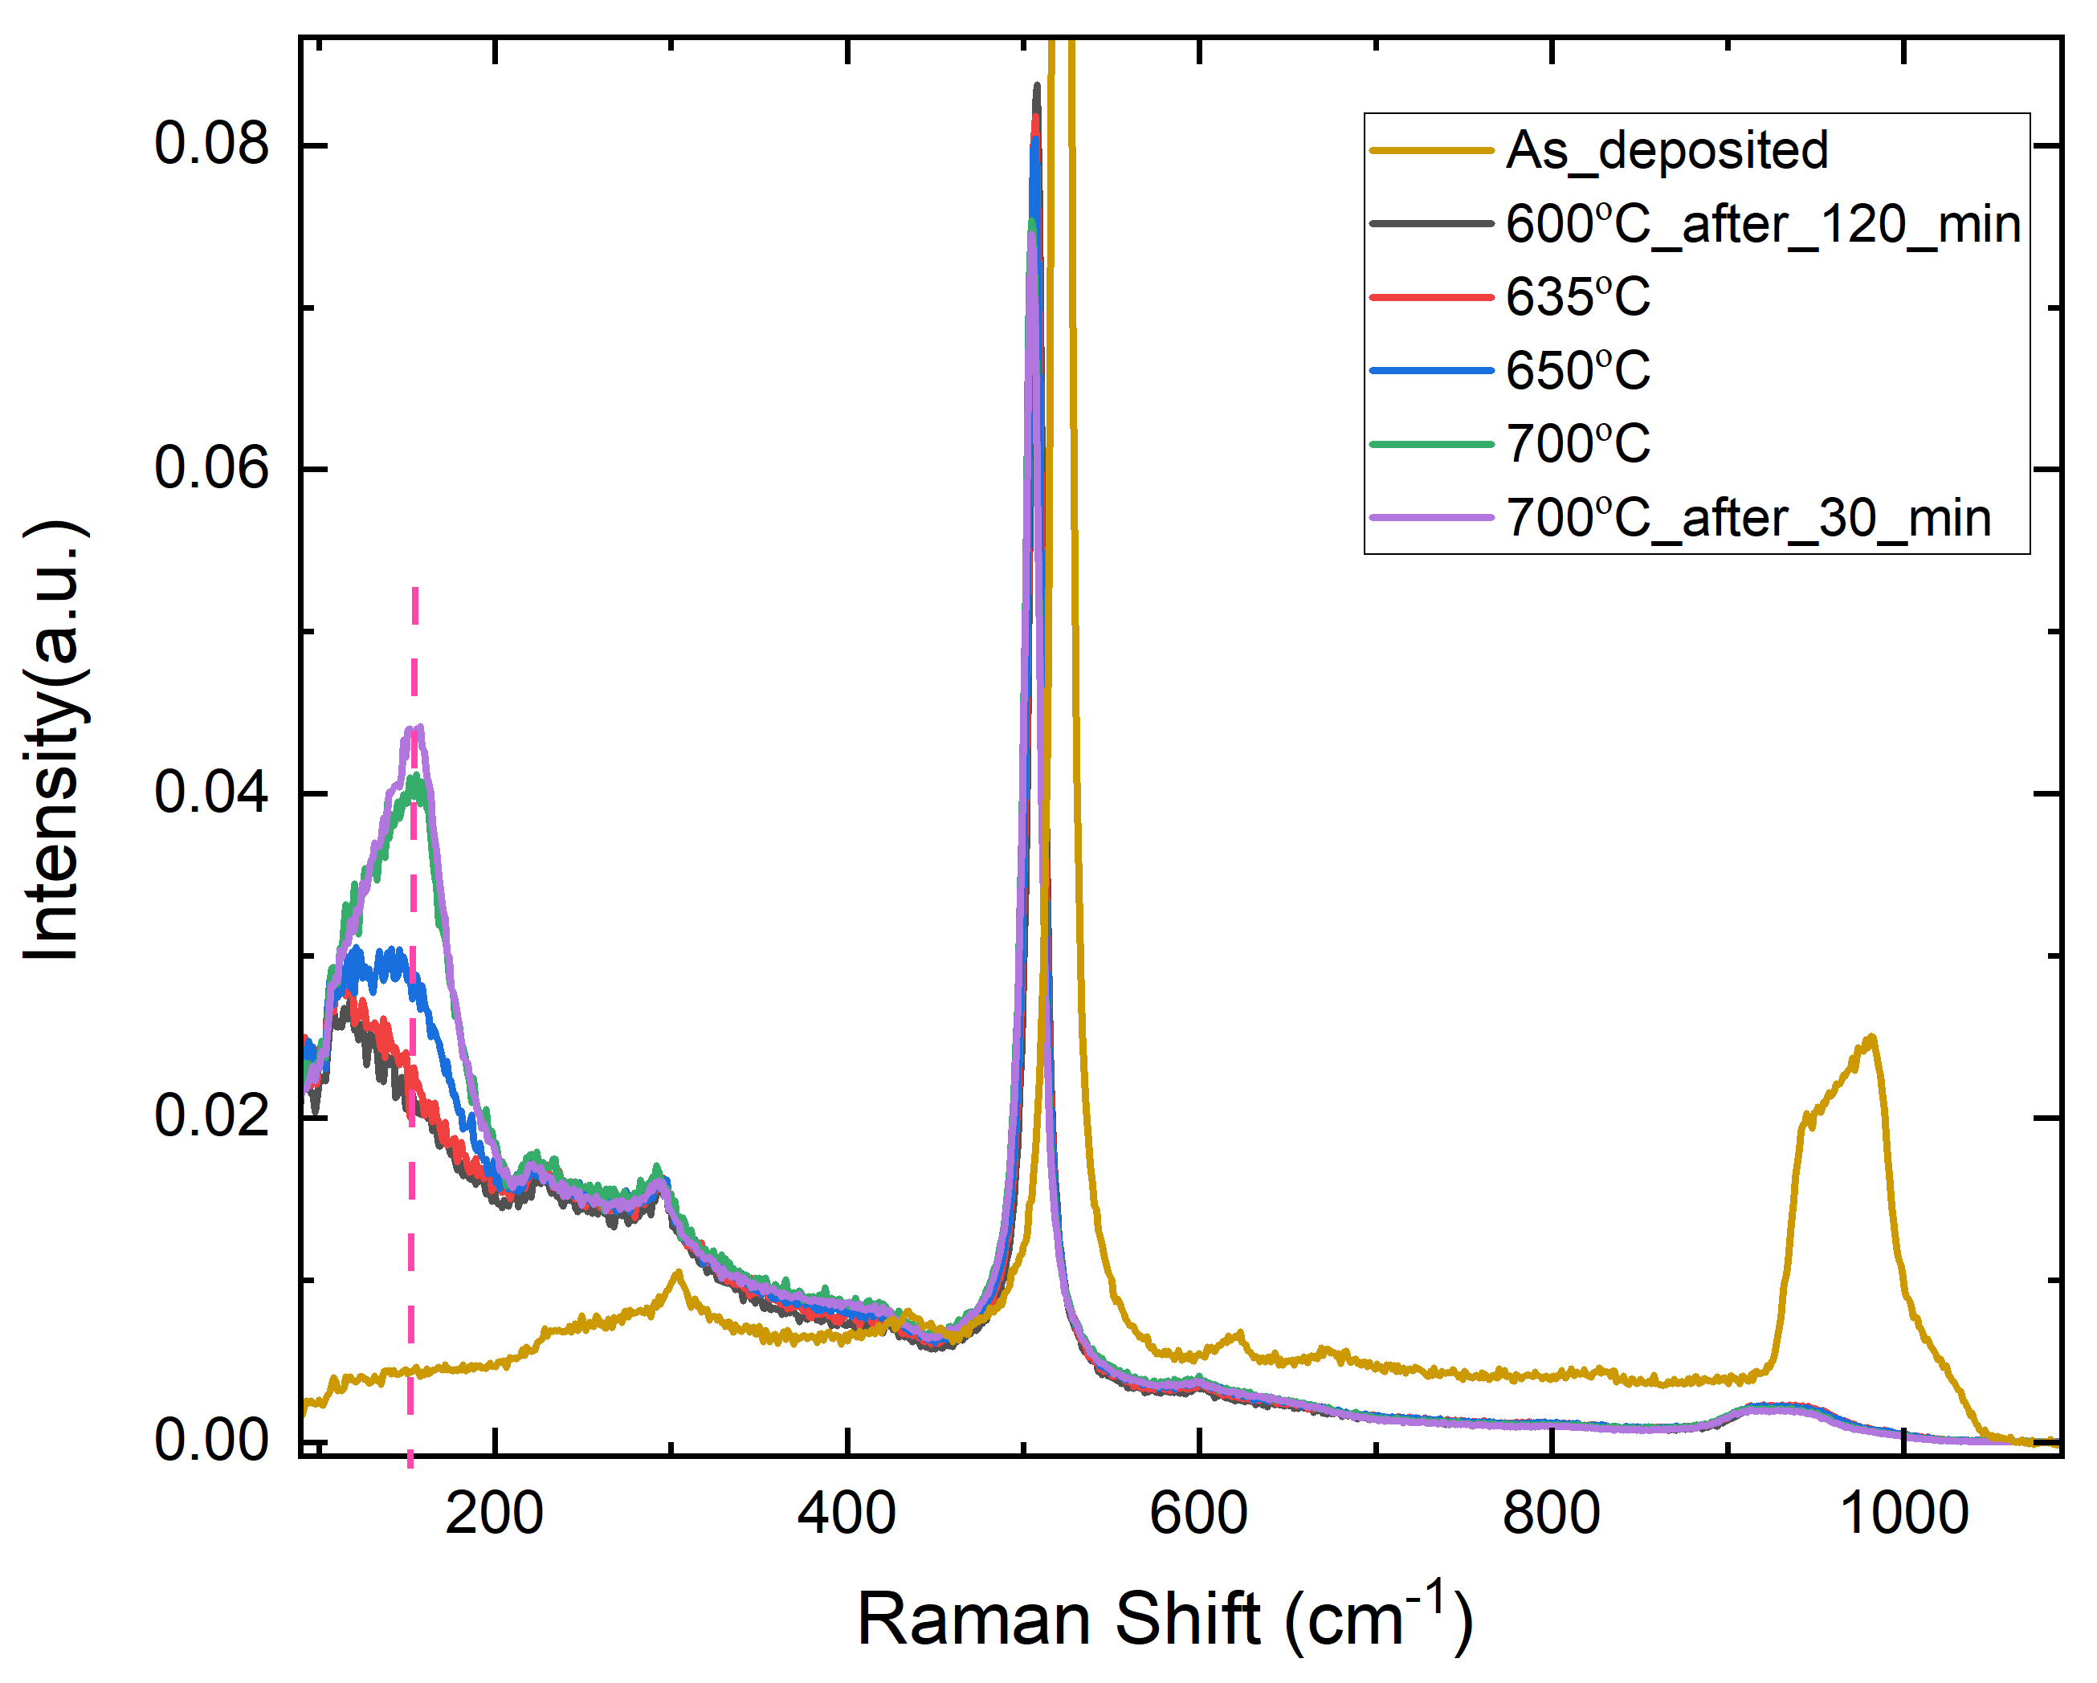

In-Situ Raman Spectroscopy: Structural Evolution During Annealing
Blue Laser
~635 °C
During the annealing, the silicon peak has shifted towards low frequency (Evolution of the peaks vs Temp)
Amorphous materials have a broader spectroscopic signature due to the lack of long-range order
Anatase-like peak at 154 cm⁻¹
Notes:
IT give us this idea that about 600 could be the optimum temperature that the material be well ordered

Slide 9
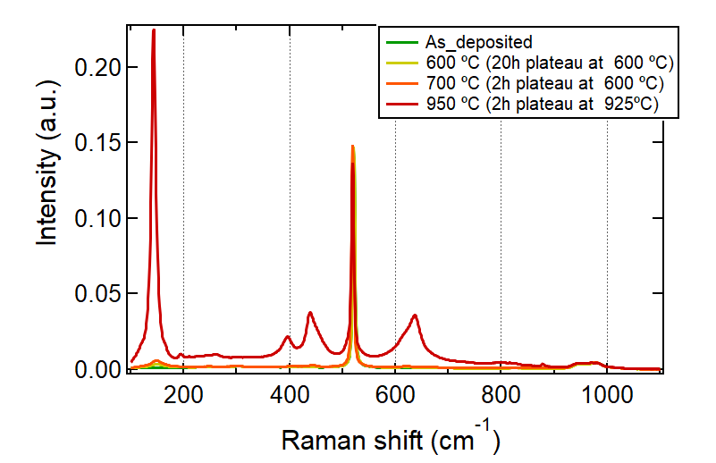
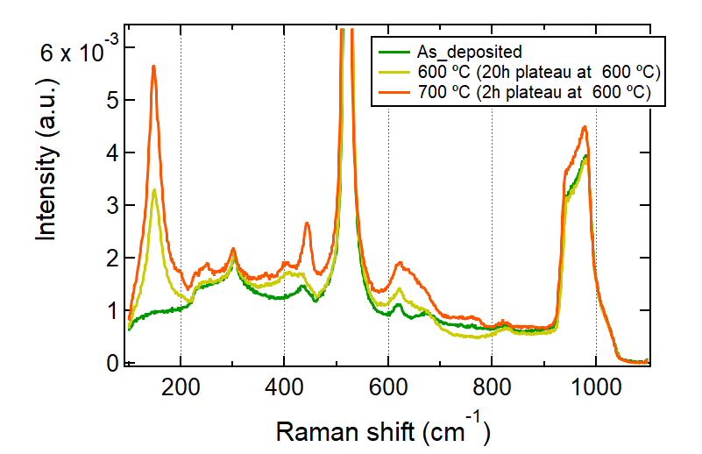
Ex-situ Raman spectroscopy
Blue Laser
148 | Anatase, Eg1 Ti – O (stretching )
390-415 | TiO₂, Anatase B1g? Or Symmetric stretching of bridging oxygens (BO) in 6-membered GeO4 rings: Ge–O–Ge?

Slide 10
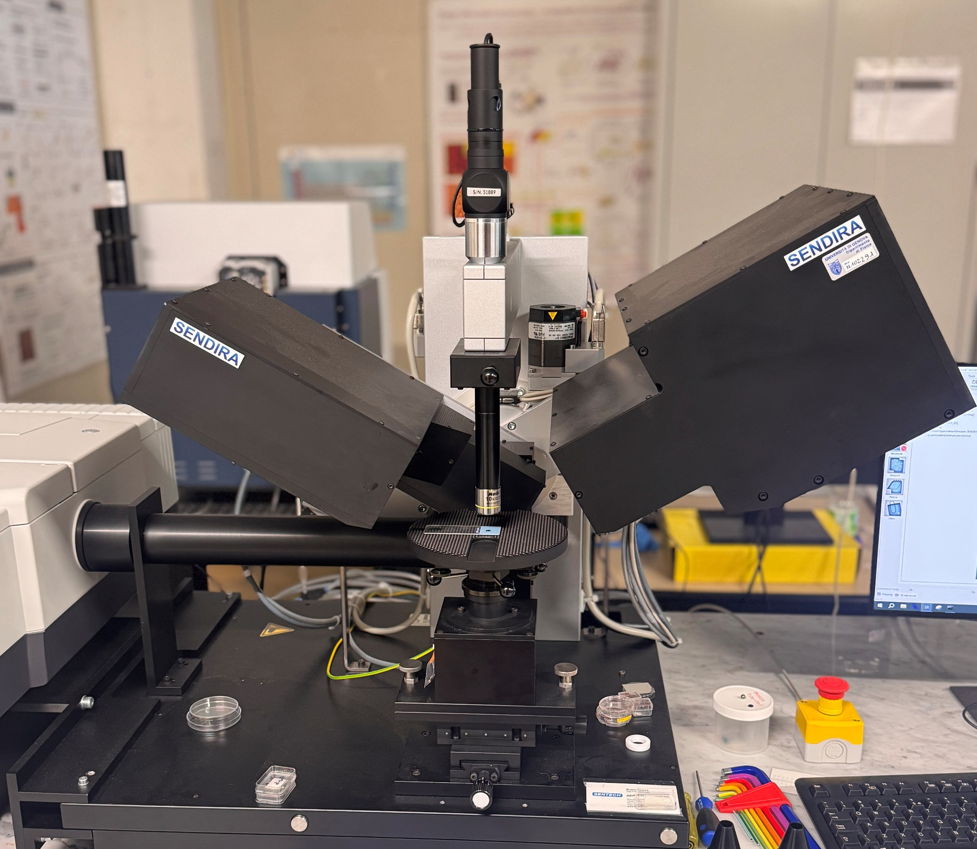
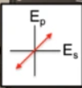
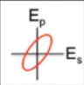
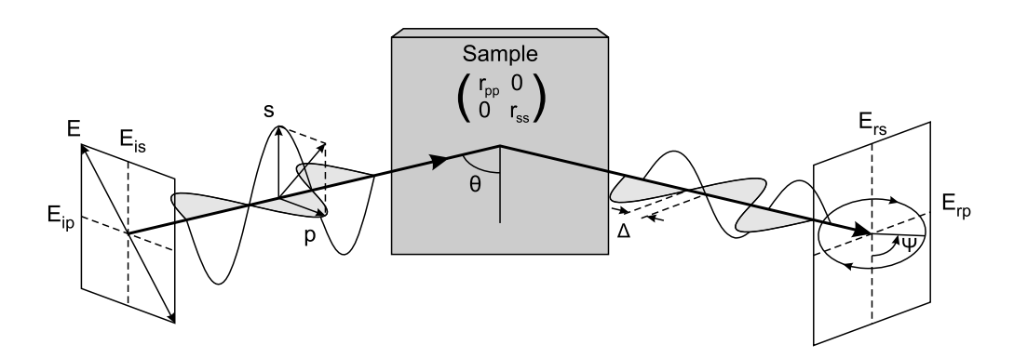
Ex-situ IRSE (Infrared Spectroscopic Ellipsometry)
IRSE Spectra range :
400-6600cm⁻¹
1600nm-25µm
air ambient
Surface layer
Substrate
Optical coating
Model-based approach to fit experimental data, for the extraction of material properties :
Phonon resonant frequency in the IR spectra region
Dielectric functions in the IR spectra region and Thickness
Contaminants (O-H, C-H,…groups)
SENTECH Sendira Infrared Ellipsometer (IRSE)

Slide 11
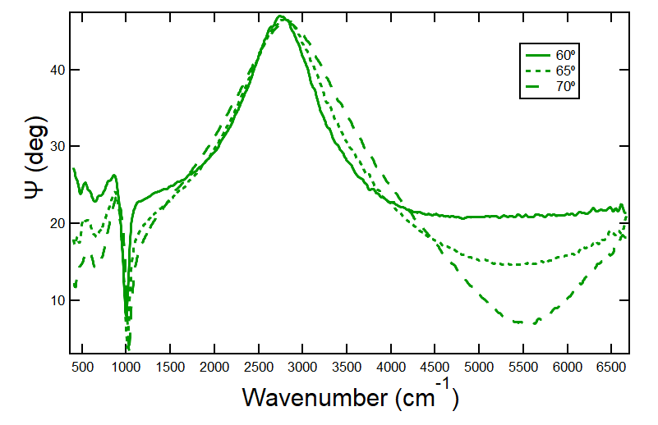
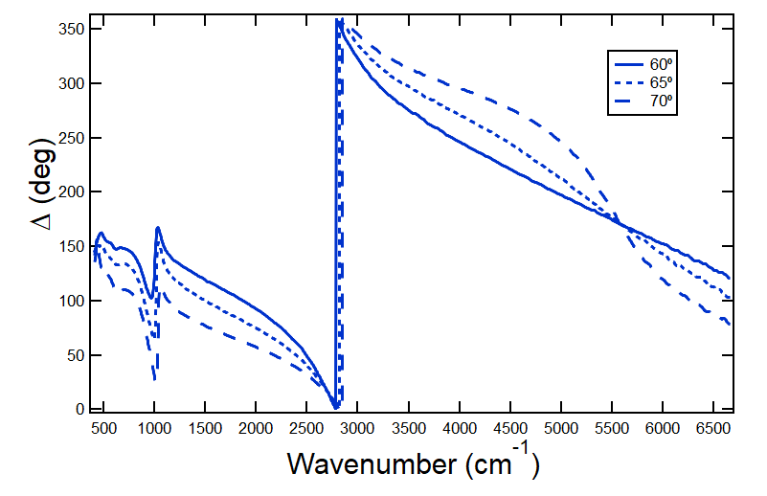
As-deposited (44%)TiO₂:GeO₂ on Si substrate
Wavelength(nm)
Vibrational information
(Lower frequency )
Thickness
Determination
(Higher frequency)

Slide 12
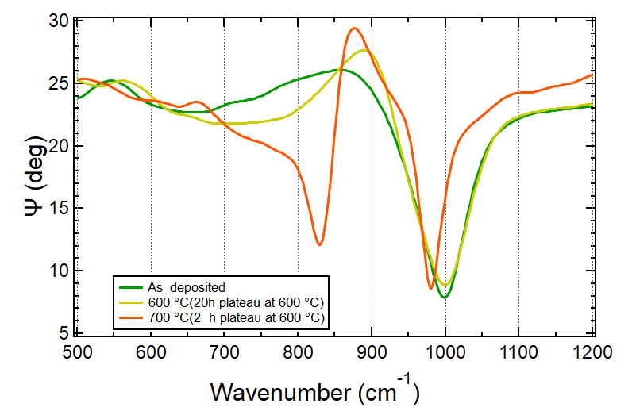
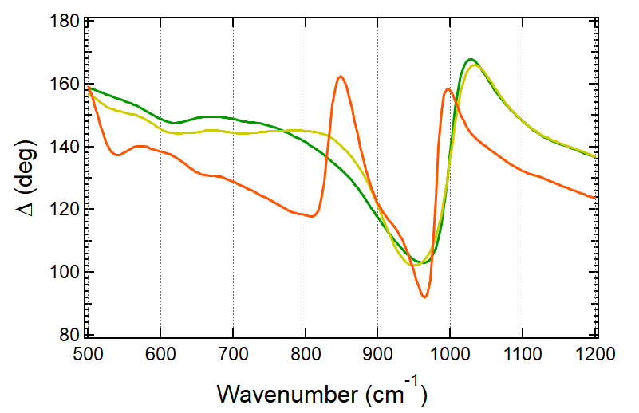
IRSE experimental data - Overview
IRSE reveals significant changes in the thin film's vibrational properties after annealing at temperatures up to 700 °C.
This makes it an excellent approach for studying the onset of crystallization in these films.
Notes:
IRSE reveals significant changes in the thin film's vibrational properties after annealing at temperatures up to 700 °C.
ATR shows that when the annealing temperature exceeds 700 °C, measurements further shift in vibrational frequencies. which provides valuable insight into the transition toward crystalline phases in comparison to the amorphous state. This makes it an excellent approach for studying the onset of crystallization in these films.

Slide 13
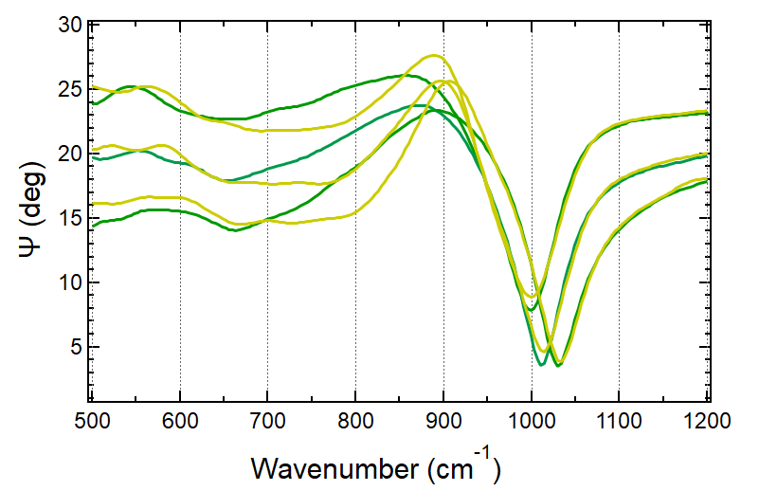
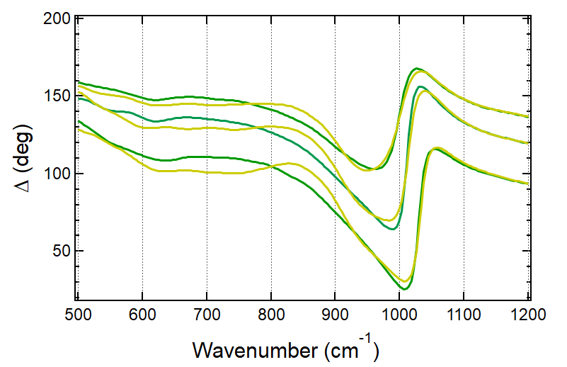
Experimental data - IRSE
As-deposited vs at 600 °C (20h plateau at 600 °C)
60°
65 °
70 °
The spectra show enhanced band intensity in the range of 500–750 cm⁻¹.
New vibrational features appear at around 850 cm⁻¹ and 1250 cm⁻¹.
A narrowing of spectral bands is observed within the 950–1000 cm⁻¹ region.
60°
65 °
70 °

Slide 14
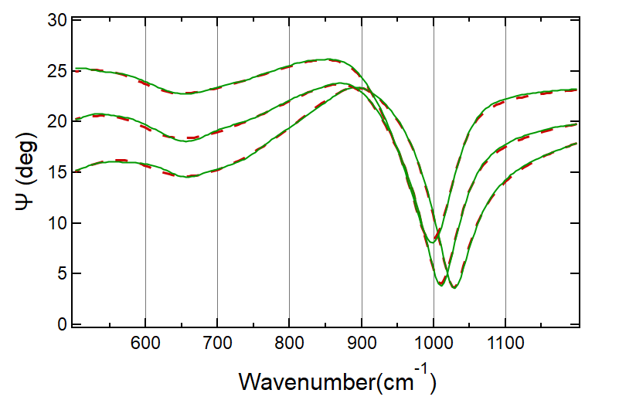
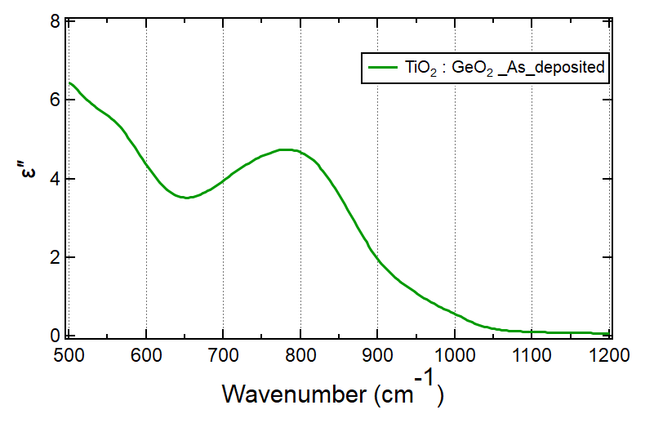
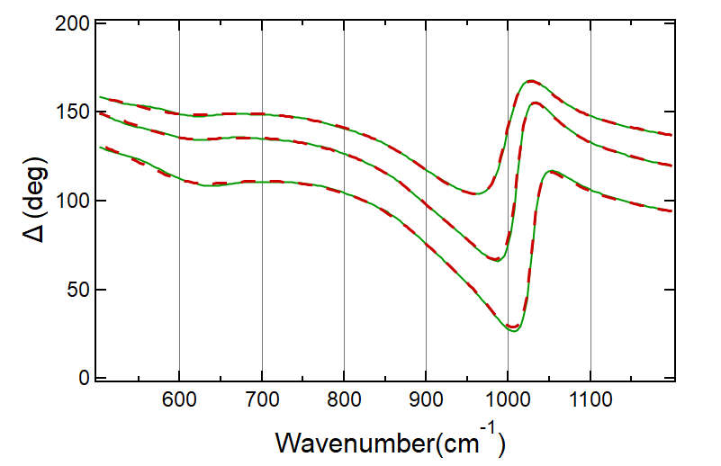
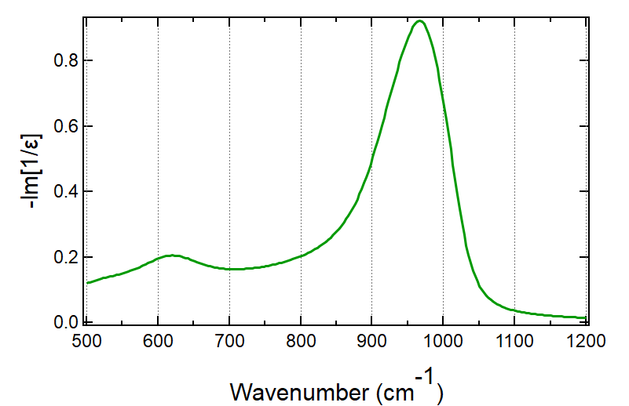
IRSE model and dielectric function
Experimental data
Dielectric Function (transverse) and
Energy Loss Function (longitudinal)
The thickness value is consistent with ‘standard ellipsometry’ results. ~ 560 nm (previous work)
Generated data
60°
TO
TO
65°
70°
Broad features → amorphous structure (lack of long-range order).
Weak peak at 560 and broad peak at (660 -990) cm⁻¹
60°
LO
The highly asymmetric profile of this band may reflect the broad distribution of intertetrahedral Ge-O-X (X= Ge or Ti) angles ¹
The main peak and (660 -990) cm⁻¹ could be related to Ge-O-Ti
65°
70°
LO

Slide 15
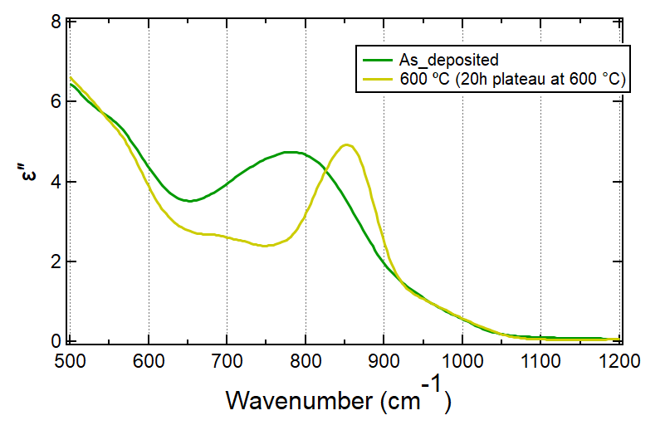
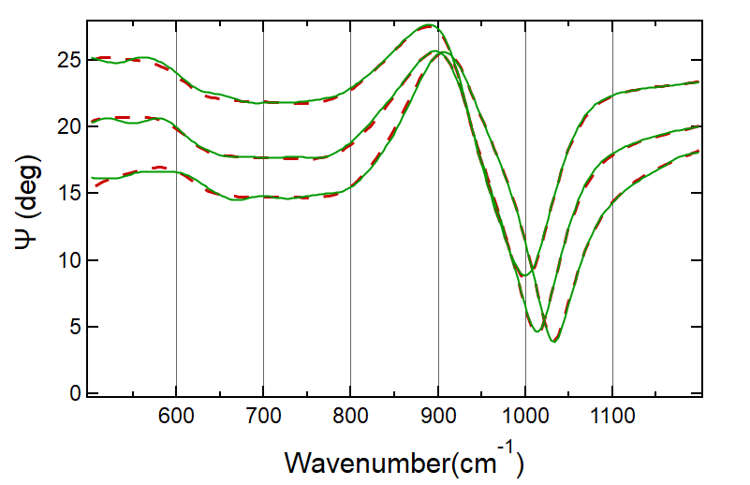
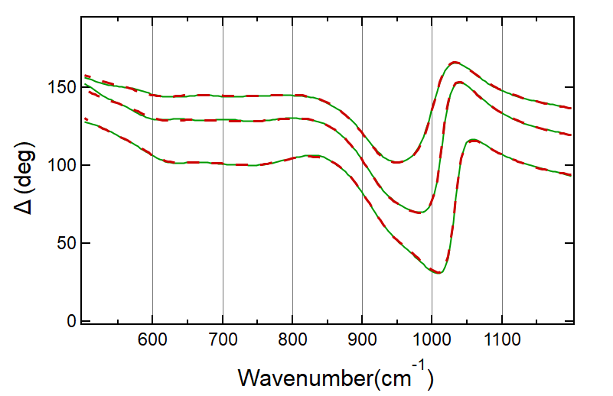
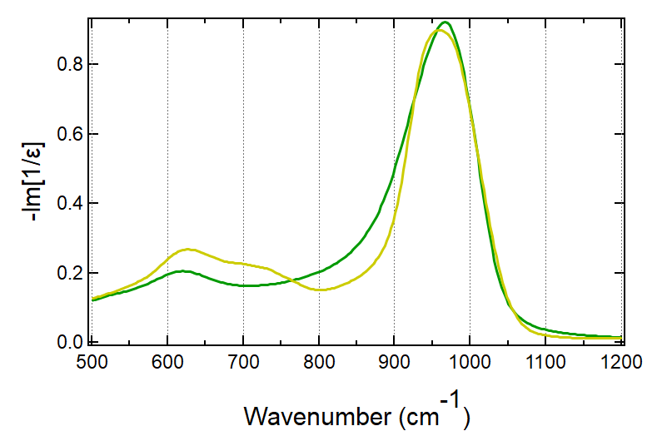
IRSE model and dielectric function
Experimental data
TO
TO
TO
LO
Generated data
60°
Dielectric Function (transverse) and
Energy Loss Function (longitudinal)
65 °
70 °
The main peak becomes narrower and shifts to higher frequency → Change in structural ordering.
\\\\
60°
65 °
70 °
15

Slide 16
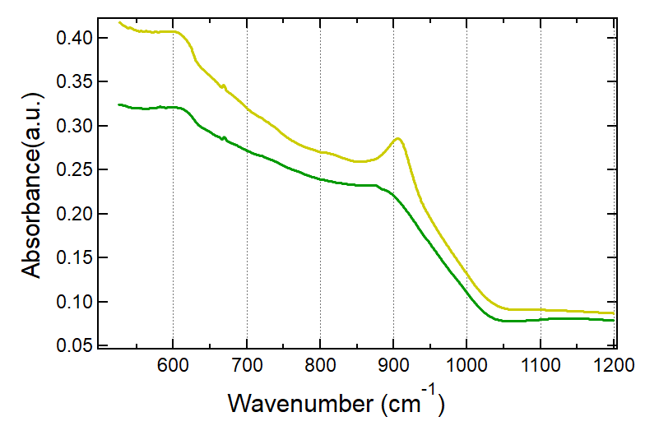
(44%)TiO₂:GeO₂ annealed at 600 °C (20h plateau at 600 °C )
IRSE
ATR
"Do these changes in structural ordering arise from medium-range ordering, or from the onset of crystallization?"

Slide 17
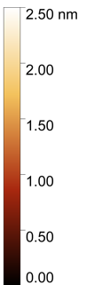
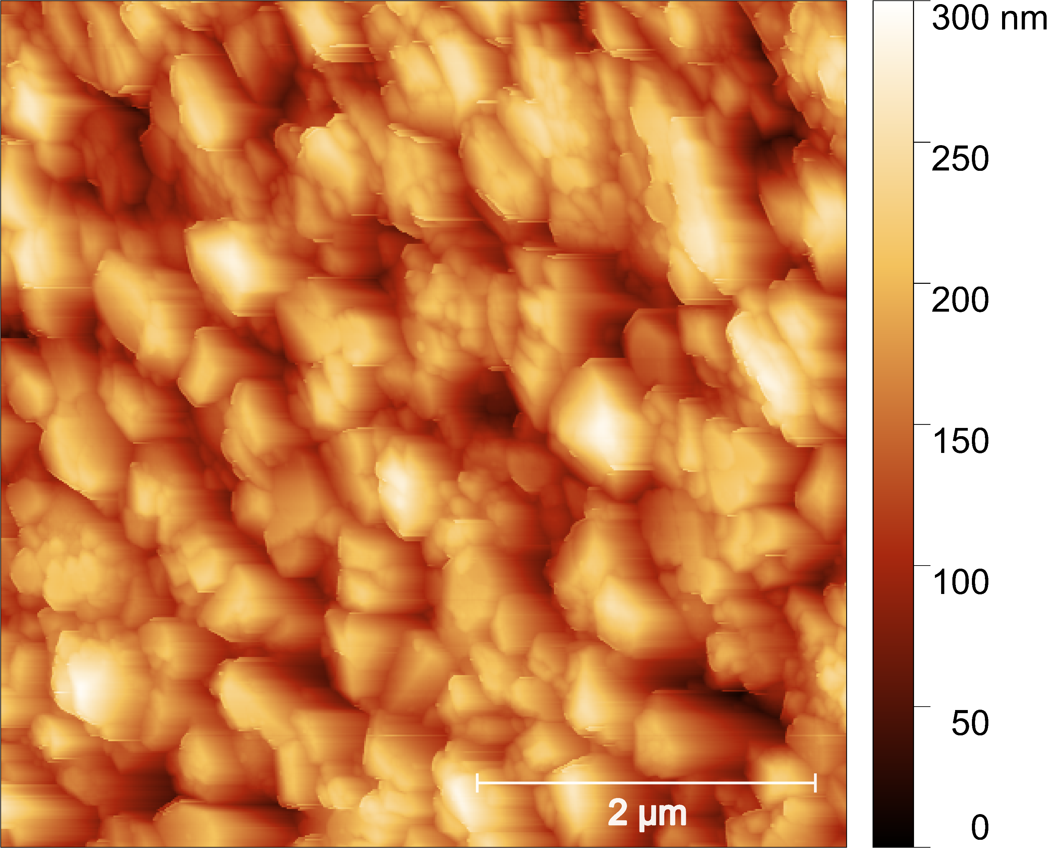
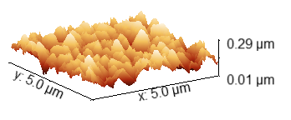
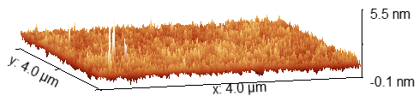
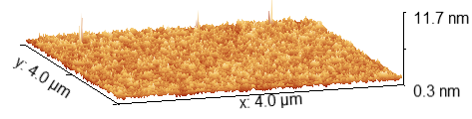
Morphology – AFM (ex-situ)
As-deposited
Annealed at 600 °C (20h plateau at 600 °C)
Annealed at 700 °C(2h plateau at 600 °C)
 | As-deposited | Annealed at 600 °C | Annealed at 700 °C
RMS roughness (nm) | <1 | <2 | ~ 44

Slide 18
Summary and perspectives
We studied thin films composed of TiO₂–GeO₂ using Infrared Spectroscopic Ellipsometry (IRSE), focusing on how their dielectric properties evolve with annealing.
Combination of results from different techniques — optical, structural, and morphological — suggest that, considering the annealing temperature at 600 °C and the plateau time up to 20hs , the film exhibits a neat improvement of structural ordering. The Raman measurements suggest that crystallization is still limited yet not ignorable at this stage. Higher annealing temperatures produce a larger crystallization effects.
Future Plans:
Improving the Model: We plan to refine our oscillator-based model for the data at 700°C and higher to better capture changes and signs of crystallin formation.
Using Additional Techniques:. We’ll employ other methods, such as EMs and X-ray diffraction, to obtain a more comprehensive picture
Combining Tools: We aim to better understand the vibrations seen in Raman images by combining them with Accurion imaging ellipsometry.
Exploring Other Materials: We may compare TiO₂–GeO₂ films with other oxide systems (like TiO₂–Ta₂O₅) to see if similar behaviors occur at high temperature.

Slide 19


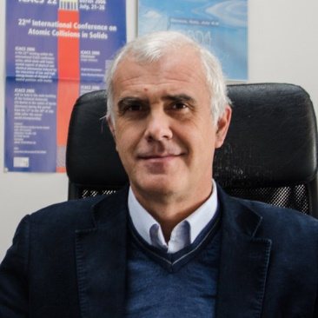

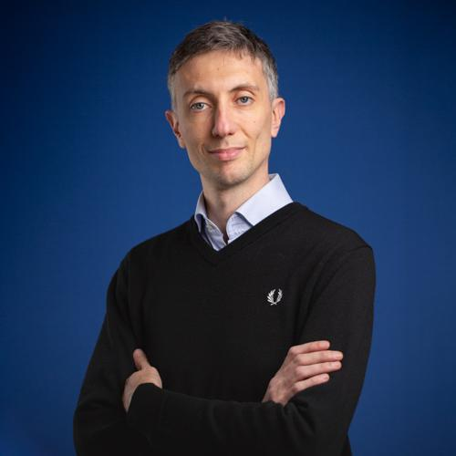



The research team on optical coatings for GWD @
Prof. Maurizio Canepa
Shima Samandari
Dr. Michele Magnozzi
Dr. Michael Caminale
Stefano Colace

Slide 20




Acknowledgments
Dr. Valérie Martinez (iLM)
Dr. Christophe Michel (LMA)
Dr. Francesco Bisio (CNR-SPIN)
Dr. Riccardo Galafassi

Slide 21
References
E. I. Kamitsos, et al. J. Phys. Chem, 100, 11755-11765. (1996)
Scarel, G., et al. "Far-infrared spectra of amorphous titanium dioxide films." Journal of Non-Crystalline Solids 303.1 (2002): 50-53.
Jokanović, Vukoman, et al. "Optical properties of titanium oxide films obtained by cathodic arc plasma deposition." Plasma Science and Technology 19.12 (2017): 125504.
Madon, M., et al. "A vibrational study of phase transitions among the GeO2 polymorphs." Physics and chemistry of minerals 18.1 (1991): 7-18.
Ardyanian, M., et al. "Structure and photoluminescence properties of evaporated GeOx thin films." Applied Physics Letters 89.1 (2006).
Roessler, D. M., and W. A. Albers Jr. "Infrared reflectance of single crystal tetragonal GeO2." Journal of Physics and Chemistry of Solids 33.2 (1972): 293-296.

Slide 23
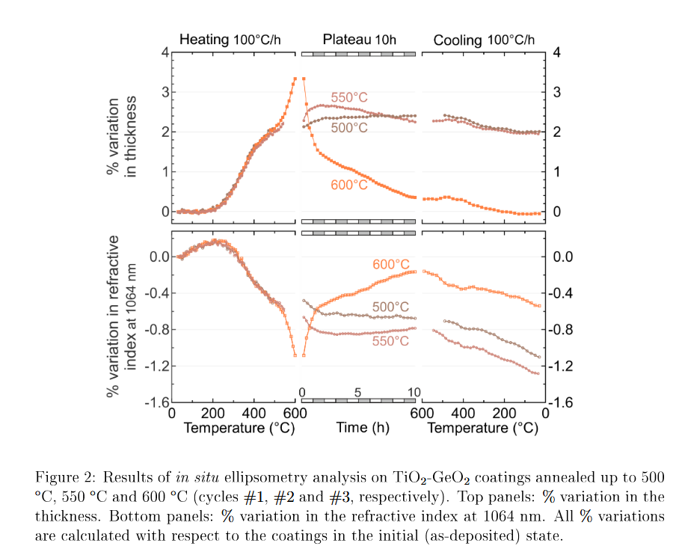
In-situ 600°C

Slide 24
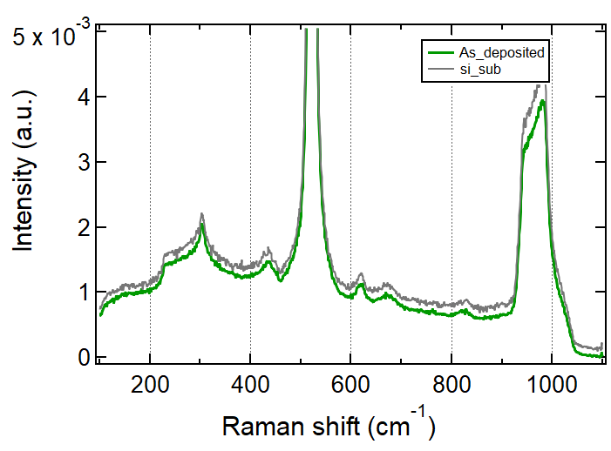
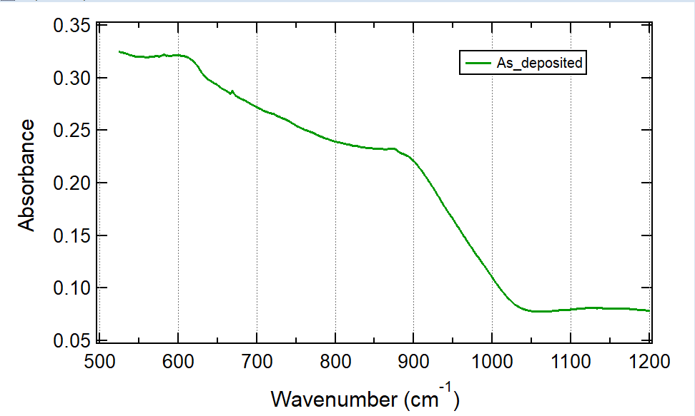
As-deposited (44%)TiO₂:GeO₂ on Si substrate
RAMAN
Blue laser
ATR
Both measurements were taken in collaboration with Dr. Valérie Martinez, iLM, Lyon, France
Raman: Blue ( 473) nm laser excitation, 100× objective lens (NA 0.45), 1800 lines/mm grating
There is no feature or assignment of crystallization.
Broad features → amorphous structure (lack of long-range order).

Slide 25
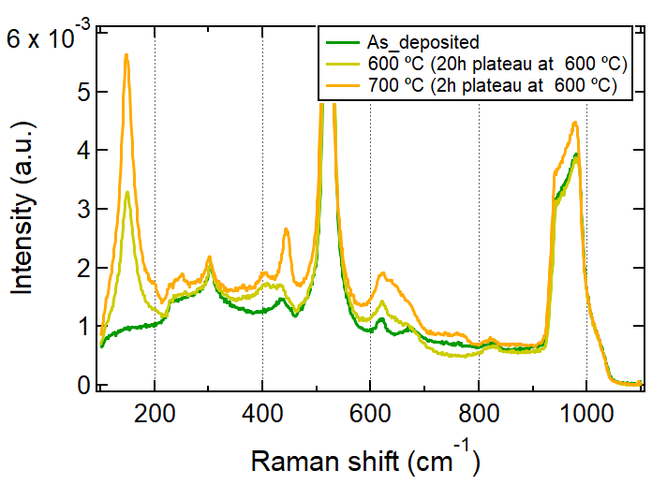
Ex-situ Raman Spectroscopy annealed at 700 °C (2h plateau at 600 °C)
wavenumber(cm⁻¹). This work | Description of the Crystalin counterpart Raman active mode
148 | TiO₂, Anatase, Eg1 Ti – O (stretching )
198 | TiO₂, Anatase, Eg Ti – O (stretching )
638 | TiO₂, Anatase, Eg symmetric stretching of Ti–O bonds,
240 | associated with second‐order Raman, in the rutile structure
390-415 | TiO₂, Anatase B1g? Or Symmetric stretching of bridging oxygens (BO) in 6-membered GeO4 rings: Ge–O–Ge?
444 | GeO₂ , trigonal Ge-O-Ge stretching
680-800 | Ti-O-Ge?
Blue Laser
J. Raman Spectrosc. 2015, 46, 231–235
Notes:
The crystallization has grown up
Nanomaterials 2023, 13,
The intense low-wavenumber band at 149 cm1 arises from the O – Ti – O bending vibrations and is a characteristic feature of the anatase phase of TiO2. All the four peaks correspond to the Raman active phonon modes of te- tragonal anatase phase of TiO2

Slide 26
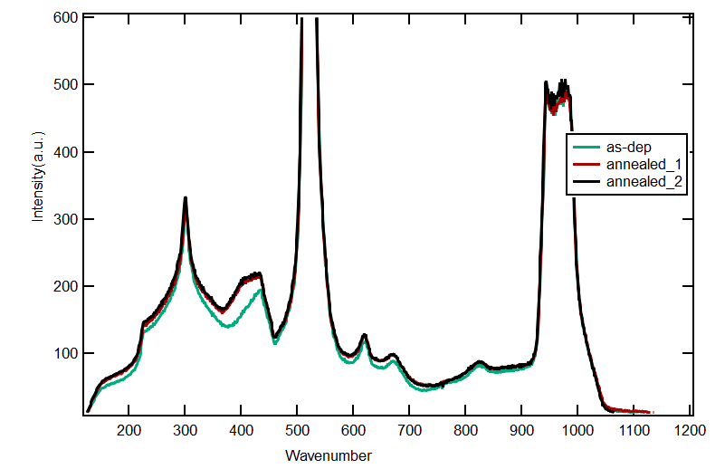
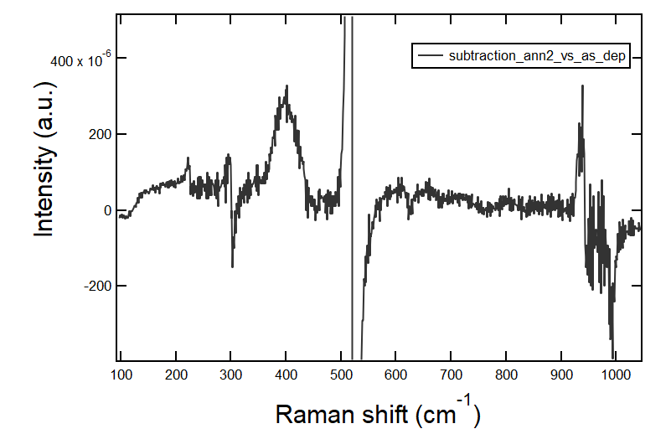
GeO₂ on Silicon

Slide 27
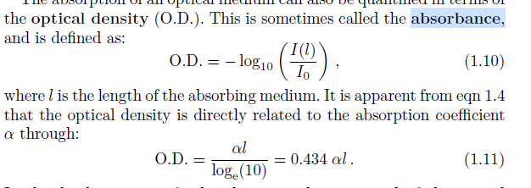
ATR VS IR

Slide 28
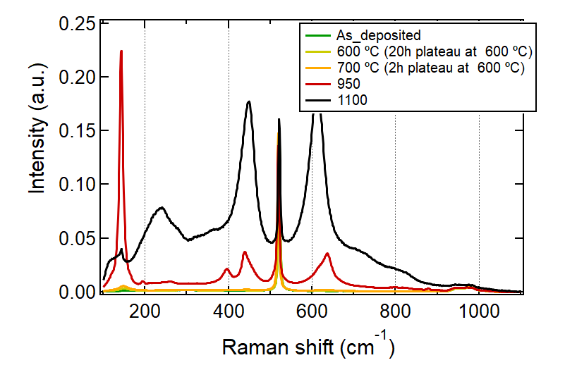
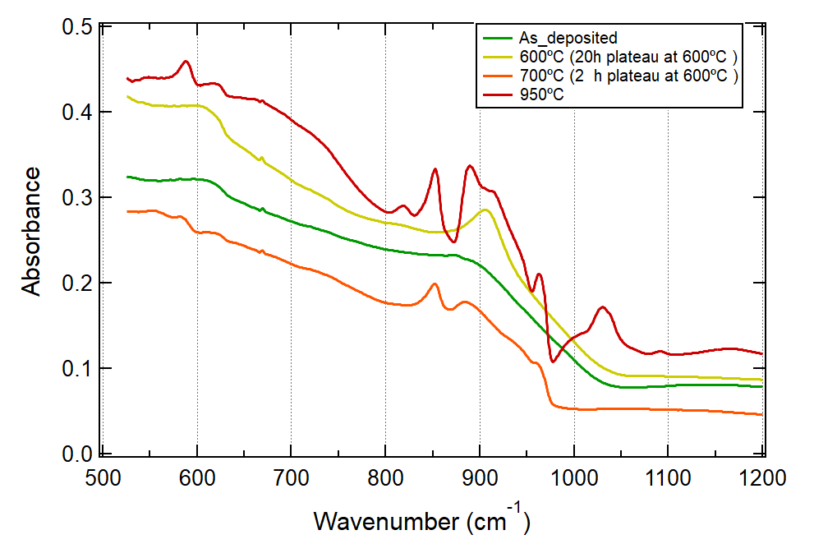
Study the dynamics of crystallization

Slide 29

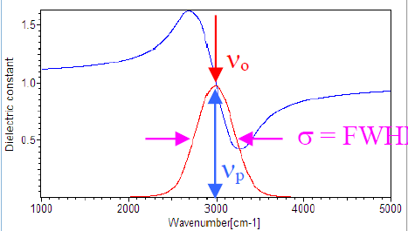
IRSE Generated model: Unveiling Material Properties with Dispersion Models
Voigt profile:
x Frequency offset from center / cm⁻¹
A Amplitude
d Guassian FWHM
g Lorentzian FWHM
x
FWHM
A
In this work, we use the Voigt oscillator, which is the convolution of a Lorentzian oscillator by a Gaussian distribution, to model materials with such non-Lorentzian bands.
wikipedia.org/wiki/Voigt_profile
Notes:
Real material spectra often show features that are neither purely Lorentzian nor purely Gaussian. The Voigt profile accounts for both types of broadening, providing a more realistic and flexible fit to experimental data when modeling absorption, reflection, or dielectric properties, especially in complex and disordered systems

Slide 30
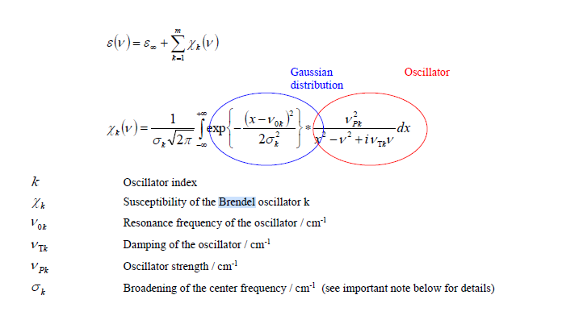
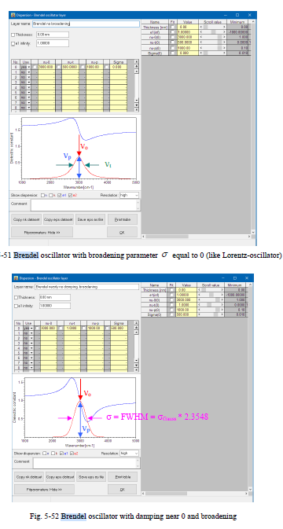
Modeling IRSE Data: Unveiling Material Properties with Dispersion Models
The Brendel oscillator model is designed to describe vibration absorption bands of molecules in the MIR spectral range. It is based on an oscillator model. Due to an inhomogeneous environment in amorphous materials the cen-ter frequency of each individual oscillator is influenced. This leads to a broadening of the center frequencies which can be described by a Gaussian distribution of the center frequency of the oscillator. The broadening of this distribution is a measure for the deviation from the ideal single frequency model.

Slide 31
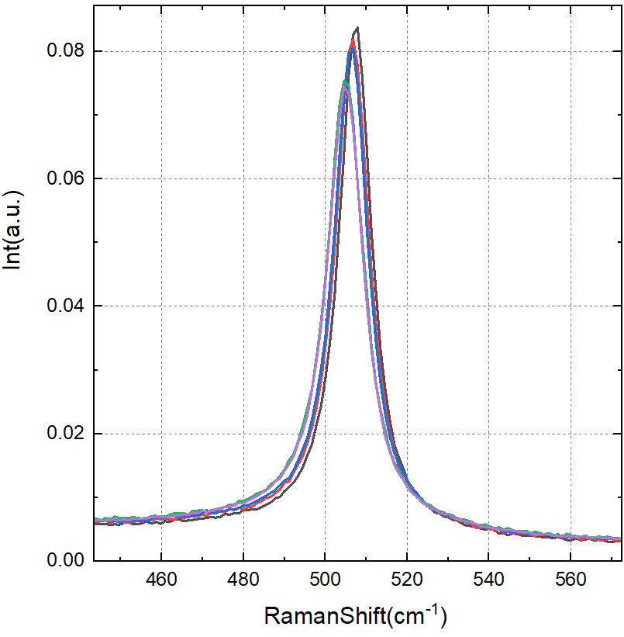
In-Situ Raman Spectroscopy: Structural Evolution During Annealing
During the annealing, the silicon peak has shifted towards low frequency (Evolution of the peaks vs Temp)
Amorphous materials have broader absorption features due to the lack of long-range order
Anatase peak at 154 cm⁻¹

Slide 32

Slide 14
With a temperature change, phonons are augmented in energy, lifetime, and population.
As the temperature increases, so too does the phonon population. Population changes lead to changes in the intensities of the Stokes and anti-Stokes signals. At the same time, the peak position shifts and the linewidth broadens due to anharmonic expansion31 and increased phonon-phonon scattering.
Saltonstallet al. REVIEW OF SCIENTIFIC INSTRUMENTS 84, 064903 (2013), Single element Raman thermometry
R. Loudon, Adv. Phys. 13, 423 (1964)
G. Lucazeau, J. Raman Spectrosc. 34, 478 (2003).

Slide 33


Red-shift and broadening indicate that GeO2is partially substituted by Ge-O-Ti bonds.

Slide 34



Slide 35




Infrared Vibrational frequency at higher temperatures till fully crystalline
IRSE_Experimental data
ATR

Slide 36





