Slide 1
Cautions for a correct evaluation of breaking strength measurements
M. A. Dicorato, A. Nela, A. Spencer, F. Travasso
Notes:
Good morning to everyone, today I’m going to present my thesis, about silicon suspensions for the Einstein Telescope mirrors.

Slide 2
Tensile strength measurement
Notes:
First I’m going to present the tensile strength measurements

Slide 3
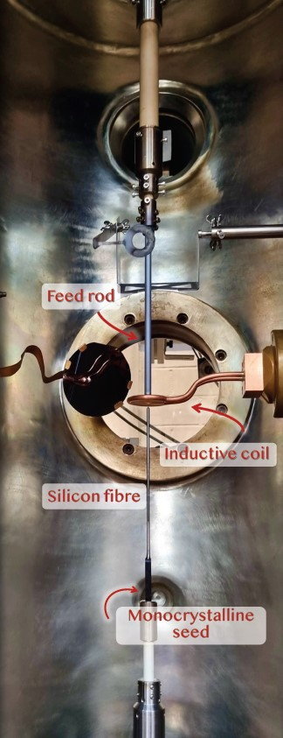
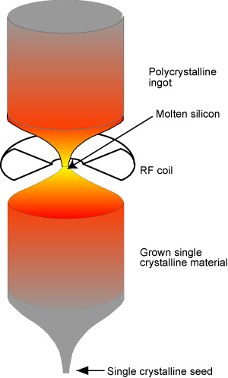
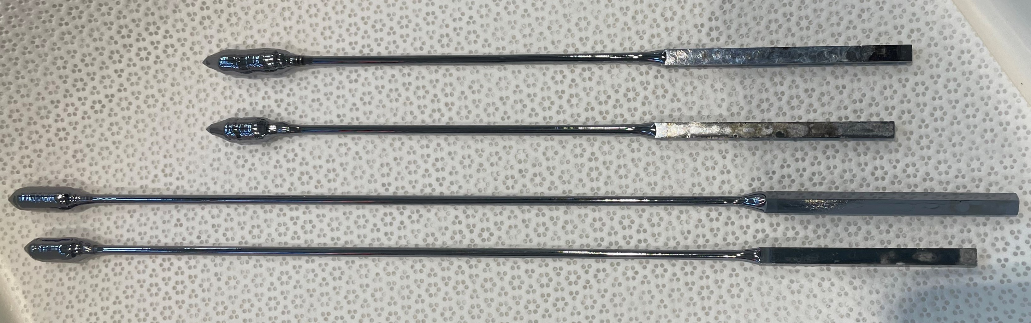
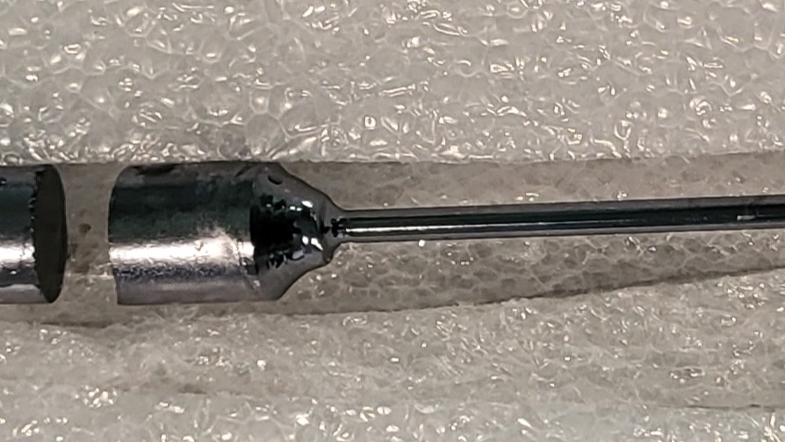
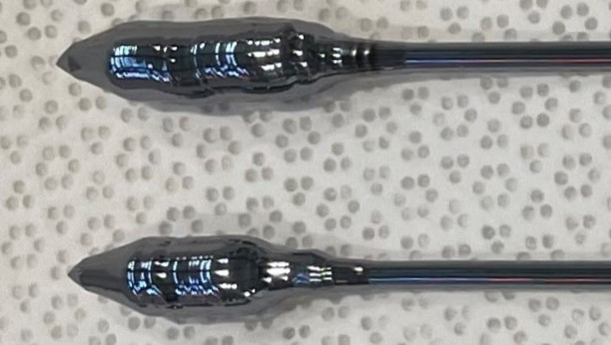
Samples
Production method: FLOAT-ZONE
SILICON FIBERS
Production center: Leibniz-Institut für Kristallzüchtung (IKZ), Berlin
Crystal orientation <100>
D = 3 mm
Grown or welded heads 8 mm thick
WELDED HEAD
GROWN HEADS
Credit: Ardiana Nela
Notes:
The measured samples are silicon fibers producted by IKZ with the Float Zone method. These fibers have a diameter of 3 mm and grown or welded head with thickness of 8 mm.

Slide 4
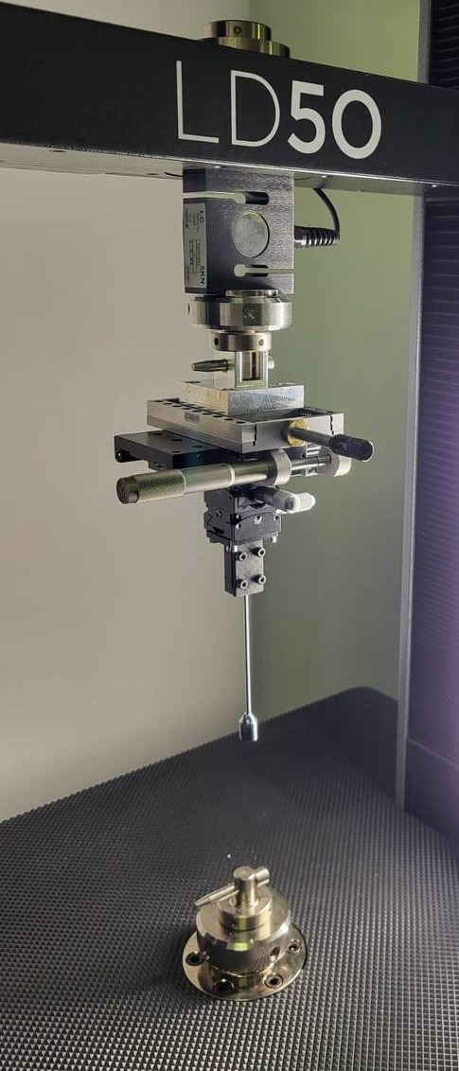
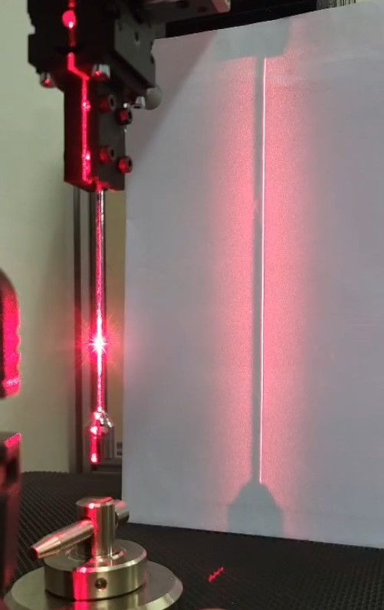
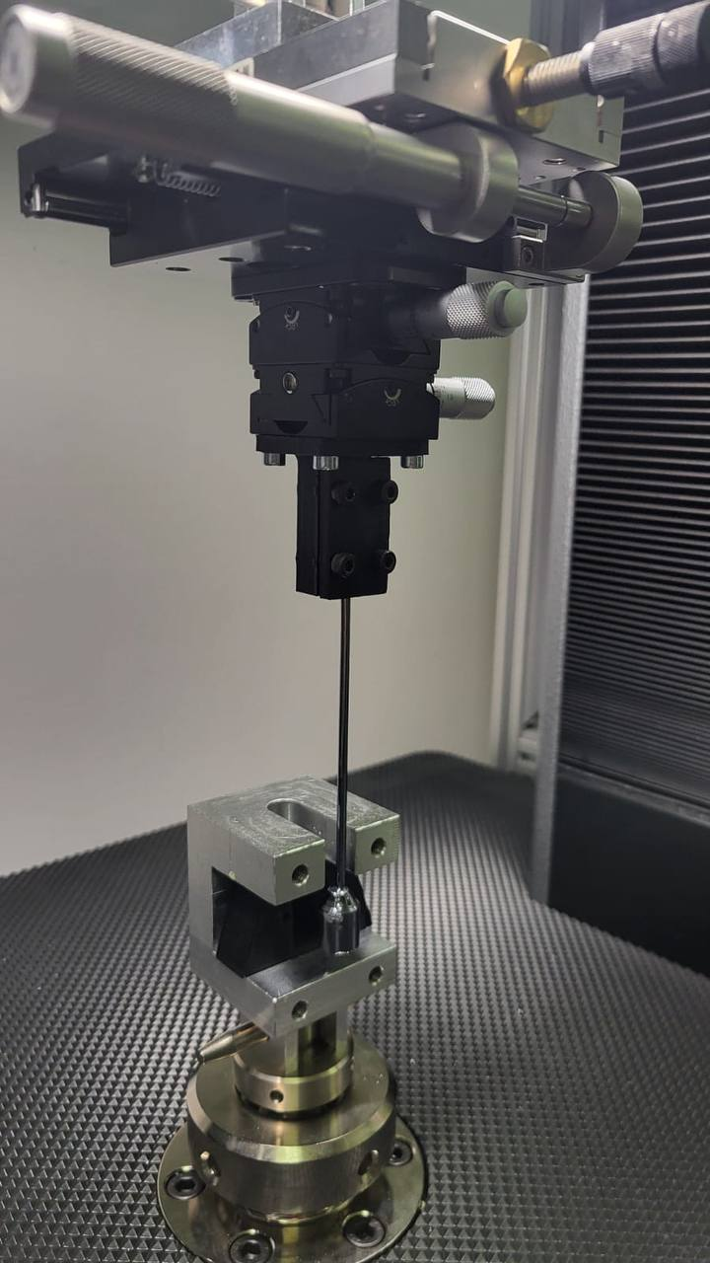
Clamping method
Temporary fixation of the seed to the micrometric alignment system
Vertical fiber alignment, checking fiber position with laser level
Positioning the lower clamp so that it embraces the fiber head, without touching the fiber body, and injecting the epoxy resin into the 3D-head housing
Notes:
One of the crucial things is that fibers are well aligned with the direction of the applied load, in order to minimize the shear stress component. Therefore, I developed a clamping method based on the following steps.
Firstly, the seed is fixed to a micrometric alignment system, then the fiber is aligned vertically checking the position with a laser lèvel. Then the fiber head is inserted in a 3D-printed head which is fitted into an alùminum suppòrt. In this way…

Slide 5
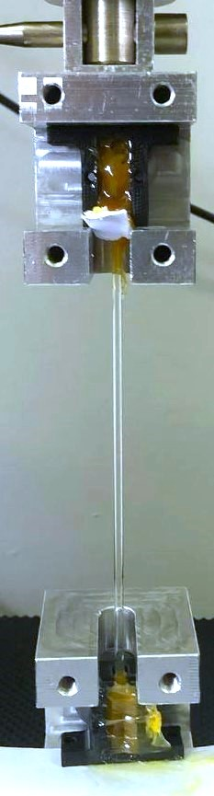
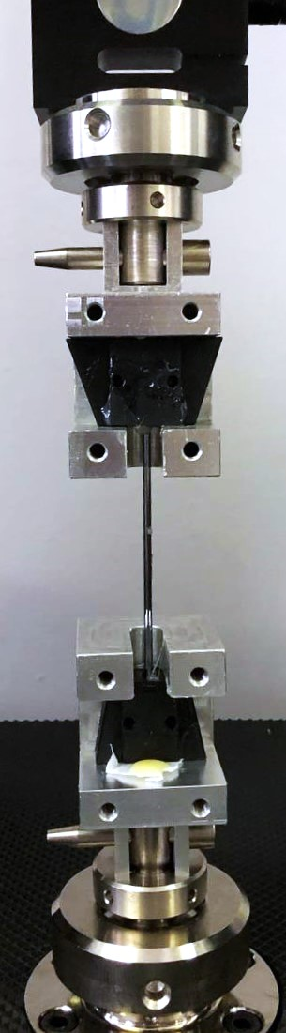
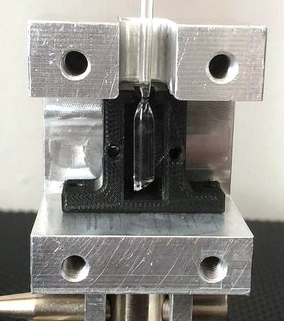
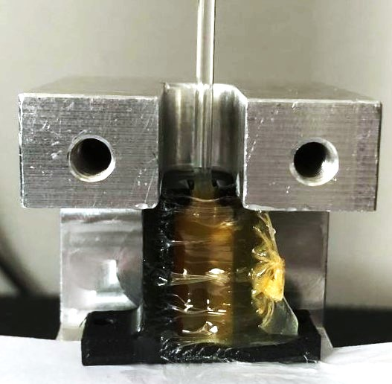
Clamping method
Positioning the lower clamp
Waiting for the resin to cure
Repeating the procedure to glue the seed
Notes:
The epoxy resin is then injected inside the cavity of the 3D printed head, and after waiting for the resin to cure the procedure is repeated to glue the seed.
These photos were made during the tests on fused silica, that were carried out to test the procedure.

Slide 6
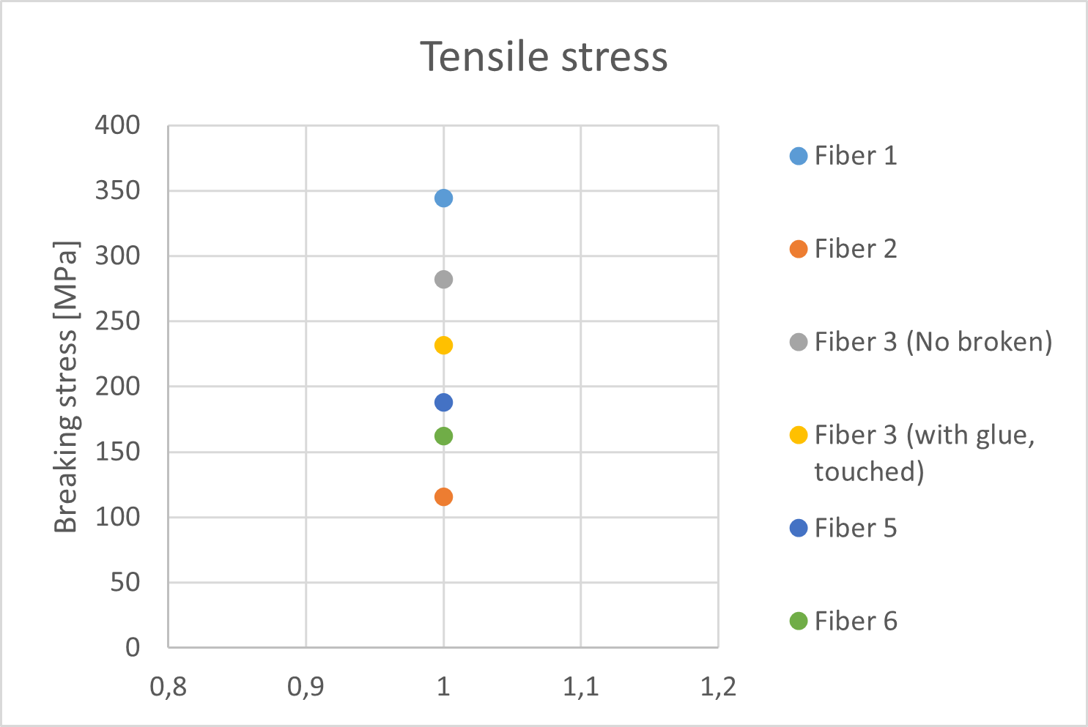
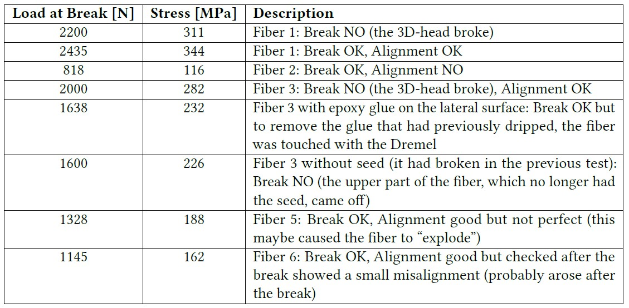
Results
> 220 MPa (safety factor of 3)
Considerations
Alignment is an important factor
Good results for fiber 1 and 3
Not possible to clamp headless fibers with epoxy glue
Too much variability in the results (measurement method + production process)
At the moment welding is not a limiting factor
Future work
Replace the plastic of 3D printed heads with a more resistant material
Use high-speed camera and laser level together to understand if the fiber becomes misaligned during the traction for the glue deformation
The number of measured samples should be increased to obtain better statistics
Improve the production process to achieve good reliability
Notes:
Watching the results it can be stated that the alignment is an important factor, indeed I’ve obtained good results for fiber 1 and fiber 3, for which the measured stress at break is relatively high compared to the required value for the strength in the case of a safety factor of 3.
Unfortunately, it was not possible to clamp headless fibers with epoxy glue because everytime the fiber slipped out of the clamp.
Moreover, there is still too much variability in the results, and this probably depends on the measurement method as well as on the fiber production process.
At the moment welding doesn’t seem to be a limiting factor
In future it could be replaced the plastic of the 3D head with a more resistant material; it could be used a high speed camera and laser level together to understand if the fiber becomes misaligned during the traction for the glue deformation; in addition the number of measured samples should be increased to obtain better statistics. In general there is the need to achieve a good reliability of fibers, collaborating with the production centers.
With this method it was not possible to evaluate the experimental error. Moreover, the statistical sample is too small and the variability too high to provide a statistical error

Slide 7
Bending strength measurement
Notes:
Secondly regarding the bending strength measurement

Slide 8
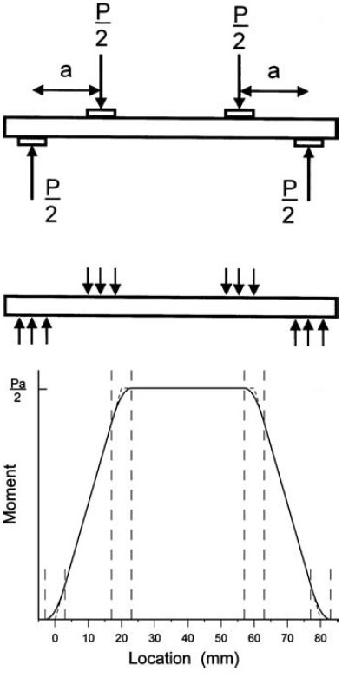
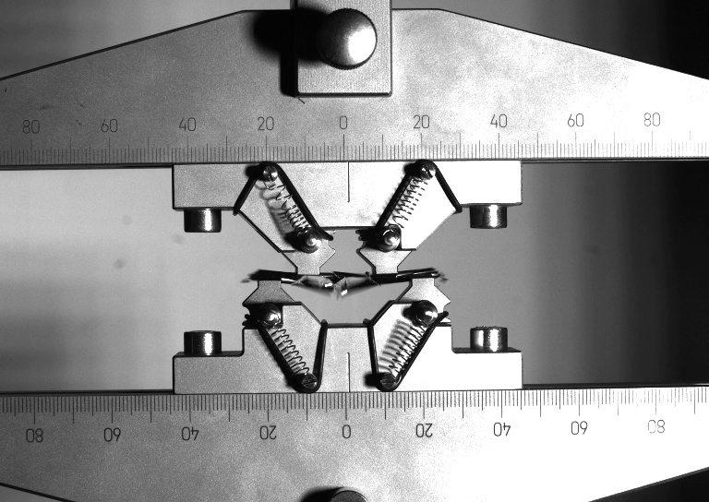

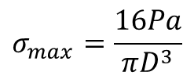
4-point bending method
2a
Maximum stress on a line at the bottom of the rod within the two inner loading points
4 contact points
$$σ_{max}=\frac{16Pa}{πD^{3}}$$
$$a=10 mm$$
$$D= 3 mm$$
Bending system designed and optimized for cylindrical rods 3 mm thick and 5 cm long, according to the American Society for Testing and Materials standard ASTM C1684-18 2023
Quinn et al., Journal of Testing and Evaluation, 2009
Notes:
I’ve used the 4-point bending method, characterized by 4 contact points with the sample, along which the load is applied. The maximum stress occurrs on a line on the bottom of the specimen within the inner two loading points.
The entire bending system was designed and optimized according to the ASTM standard.

Slide 9
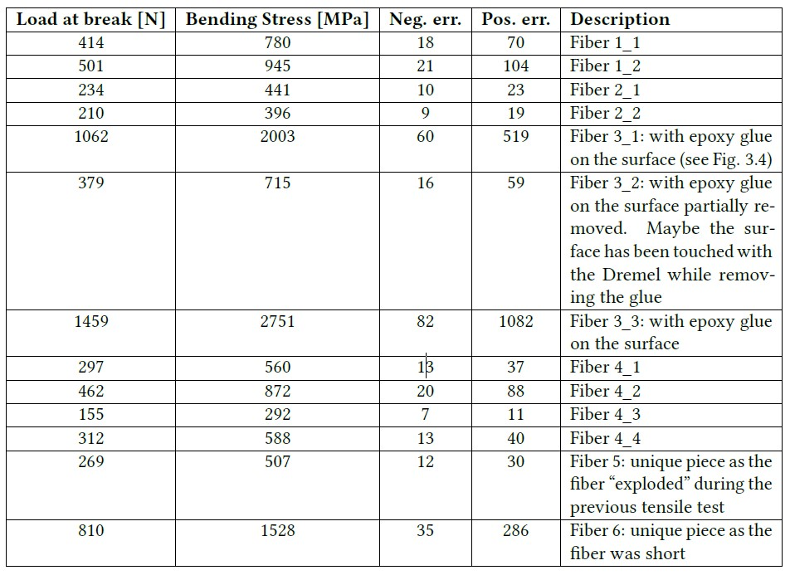
Bending results

Slide 10
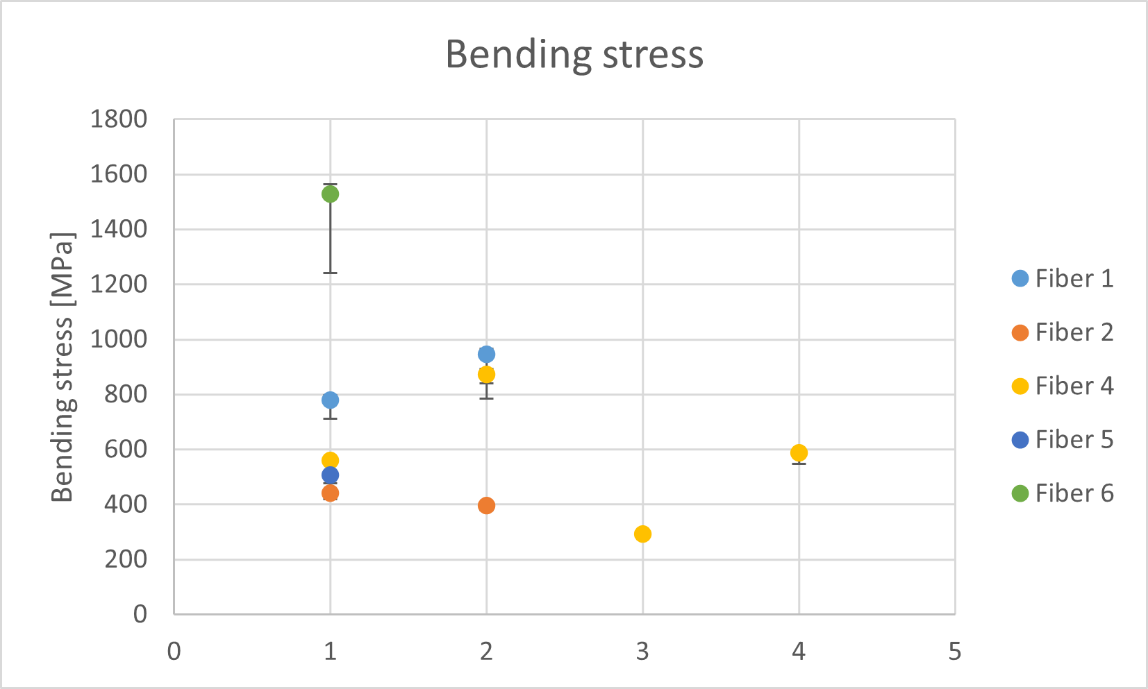
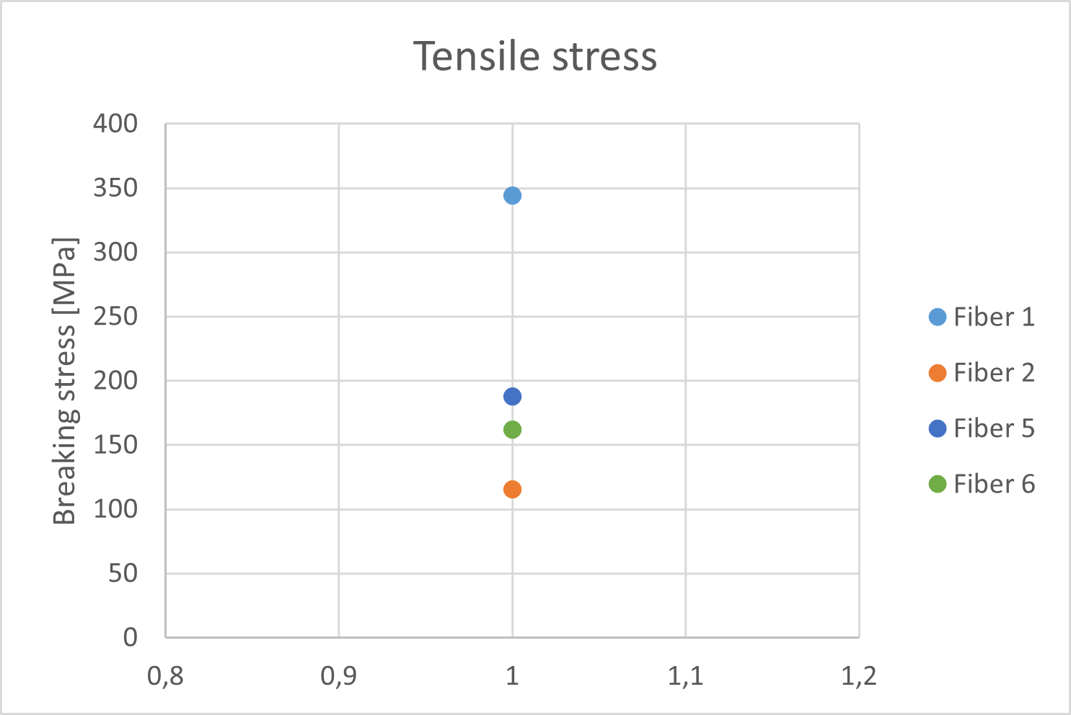
Bending vs tensile results
Considerations
Stresses in bending are higher than those in tensile
High variability in general
Fiber 4: very different values (maybe heterogeneity in the defects)
Dominant error at high strength: Contact point tangency shift
The bending and tensile data are consistent for fibers 2,5, and 1
Future work
Reduce the cradle size and the roller size to reduce the dominant error
Increase the number of tested samples to improve the statistics
Notes:
Here the bending results are compared with the tensile results. Measured strength in bending is generally higher than in tensile tests. This is because in bending the region subjected to maximum stress is confined to a line, so the probability of presence of large defects is lower.
Notice that there is a high variability, like in the tensile tests, but in 3 cases bending and tensile results are consistent, meaning that some fibers are in general more resistant than others. Moreover Fiber 4 exhibited very different values, maybe due to the heterogeneity in the defects. The dominant error is due to the contact point tangency shift, which is caused by the rotation of the upper contact points around the rollers during the deflection, resulting in a reduction of moment arm. I’m going to make new smaller cradles and rollers to reduce this error.
Finally, the number of measured samples should be increased to obtain better statistics.

Slide 11
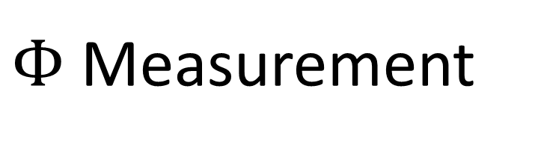
$Φ$ Measurement
Notes:
Thirdly the loss-angle measurements

Slide 12
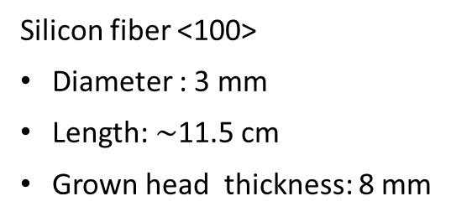
Sample
Produced by IKZ (Berlin)
with Float Zone method
Silicon fiber <100>
Diameter : 3 mm
Length: $\sim$11.5 cm
Grown head thickness: 8 mm
Notes:
The measured sample is a silicon fiber 3 mm thick and 11,5 cm long, with grown head 8 mm thick. The fiber was produced by IKZ with FZ method.

Slide 13
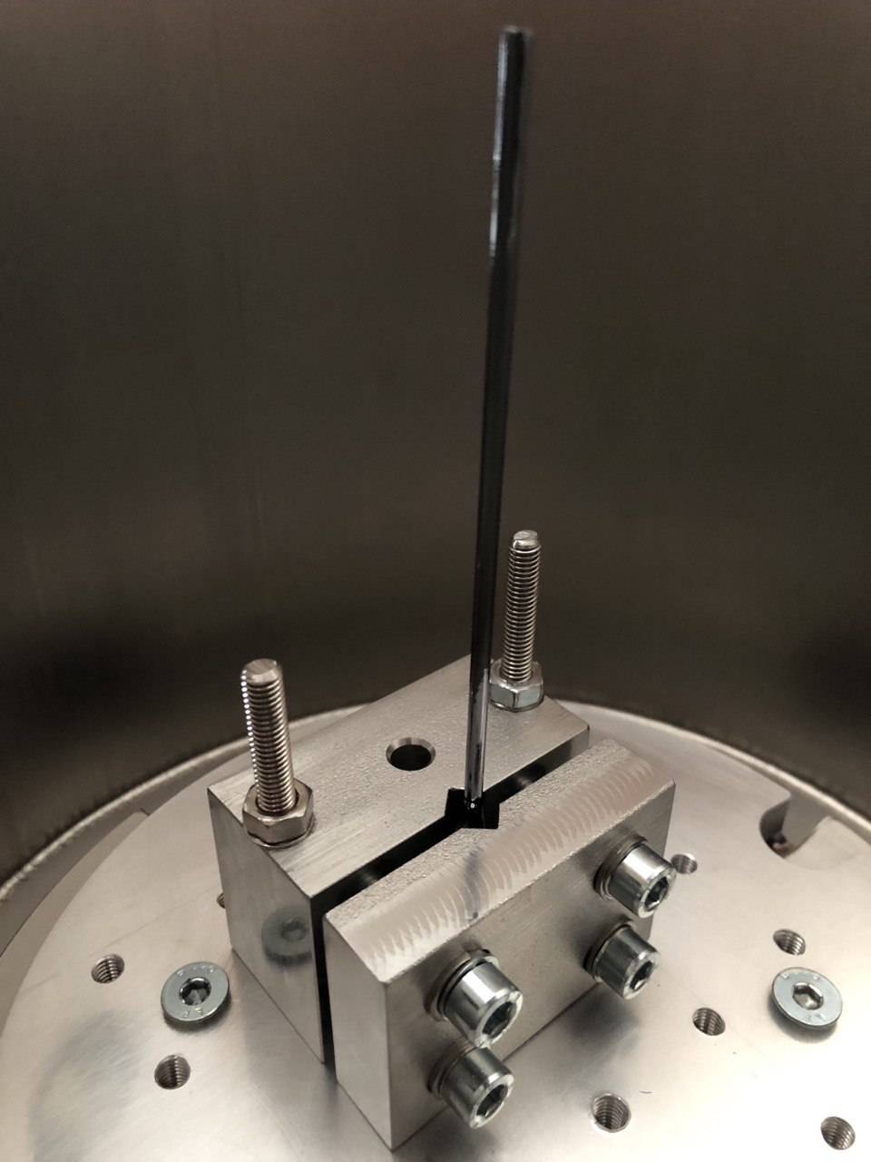
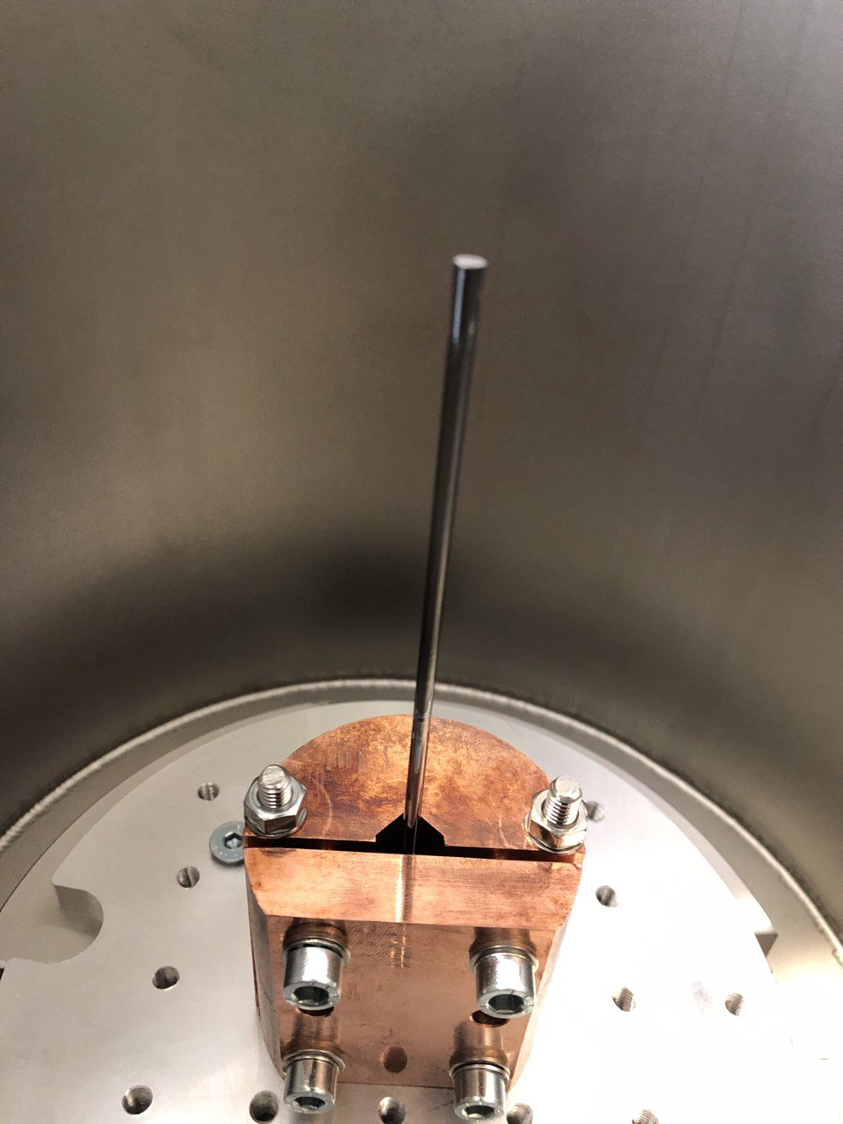
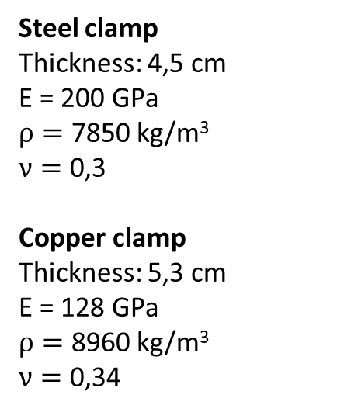
Clamps
Steel clamp
Thickness: 4,5 cm
E = 200 GPa
$ρ=$ 7850 kg/m³
$ν=$ 0,3
Copper clamp
Thickness: 5,3 cm
E = 128 GPa
$ρ=$ 8960 kg/m³
$ν=$ 0,34
Notes:
These are the two clamp used during the measurements, one in copper and one in steel. The clamp is important because probably it’s the dominant source of dissipation…

Slide 14
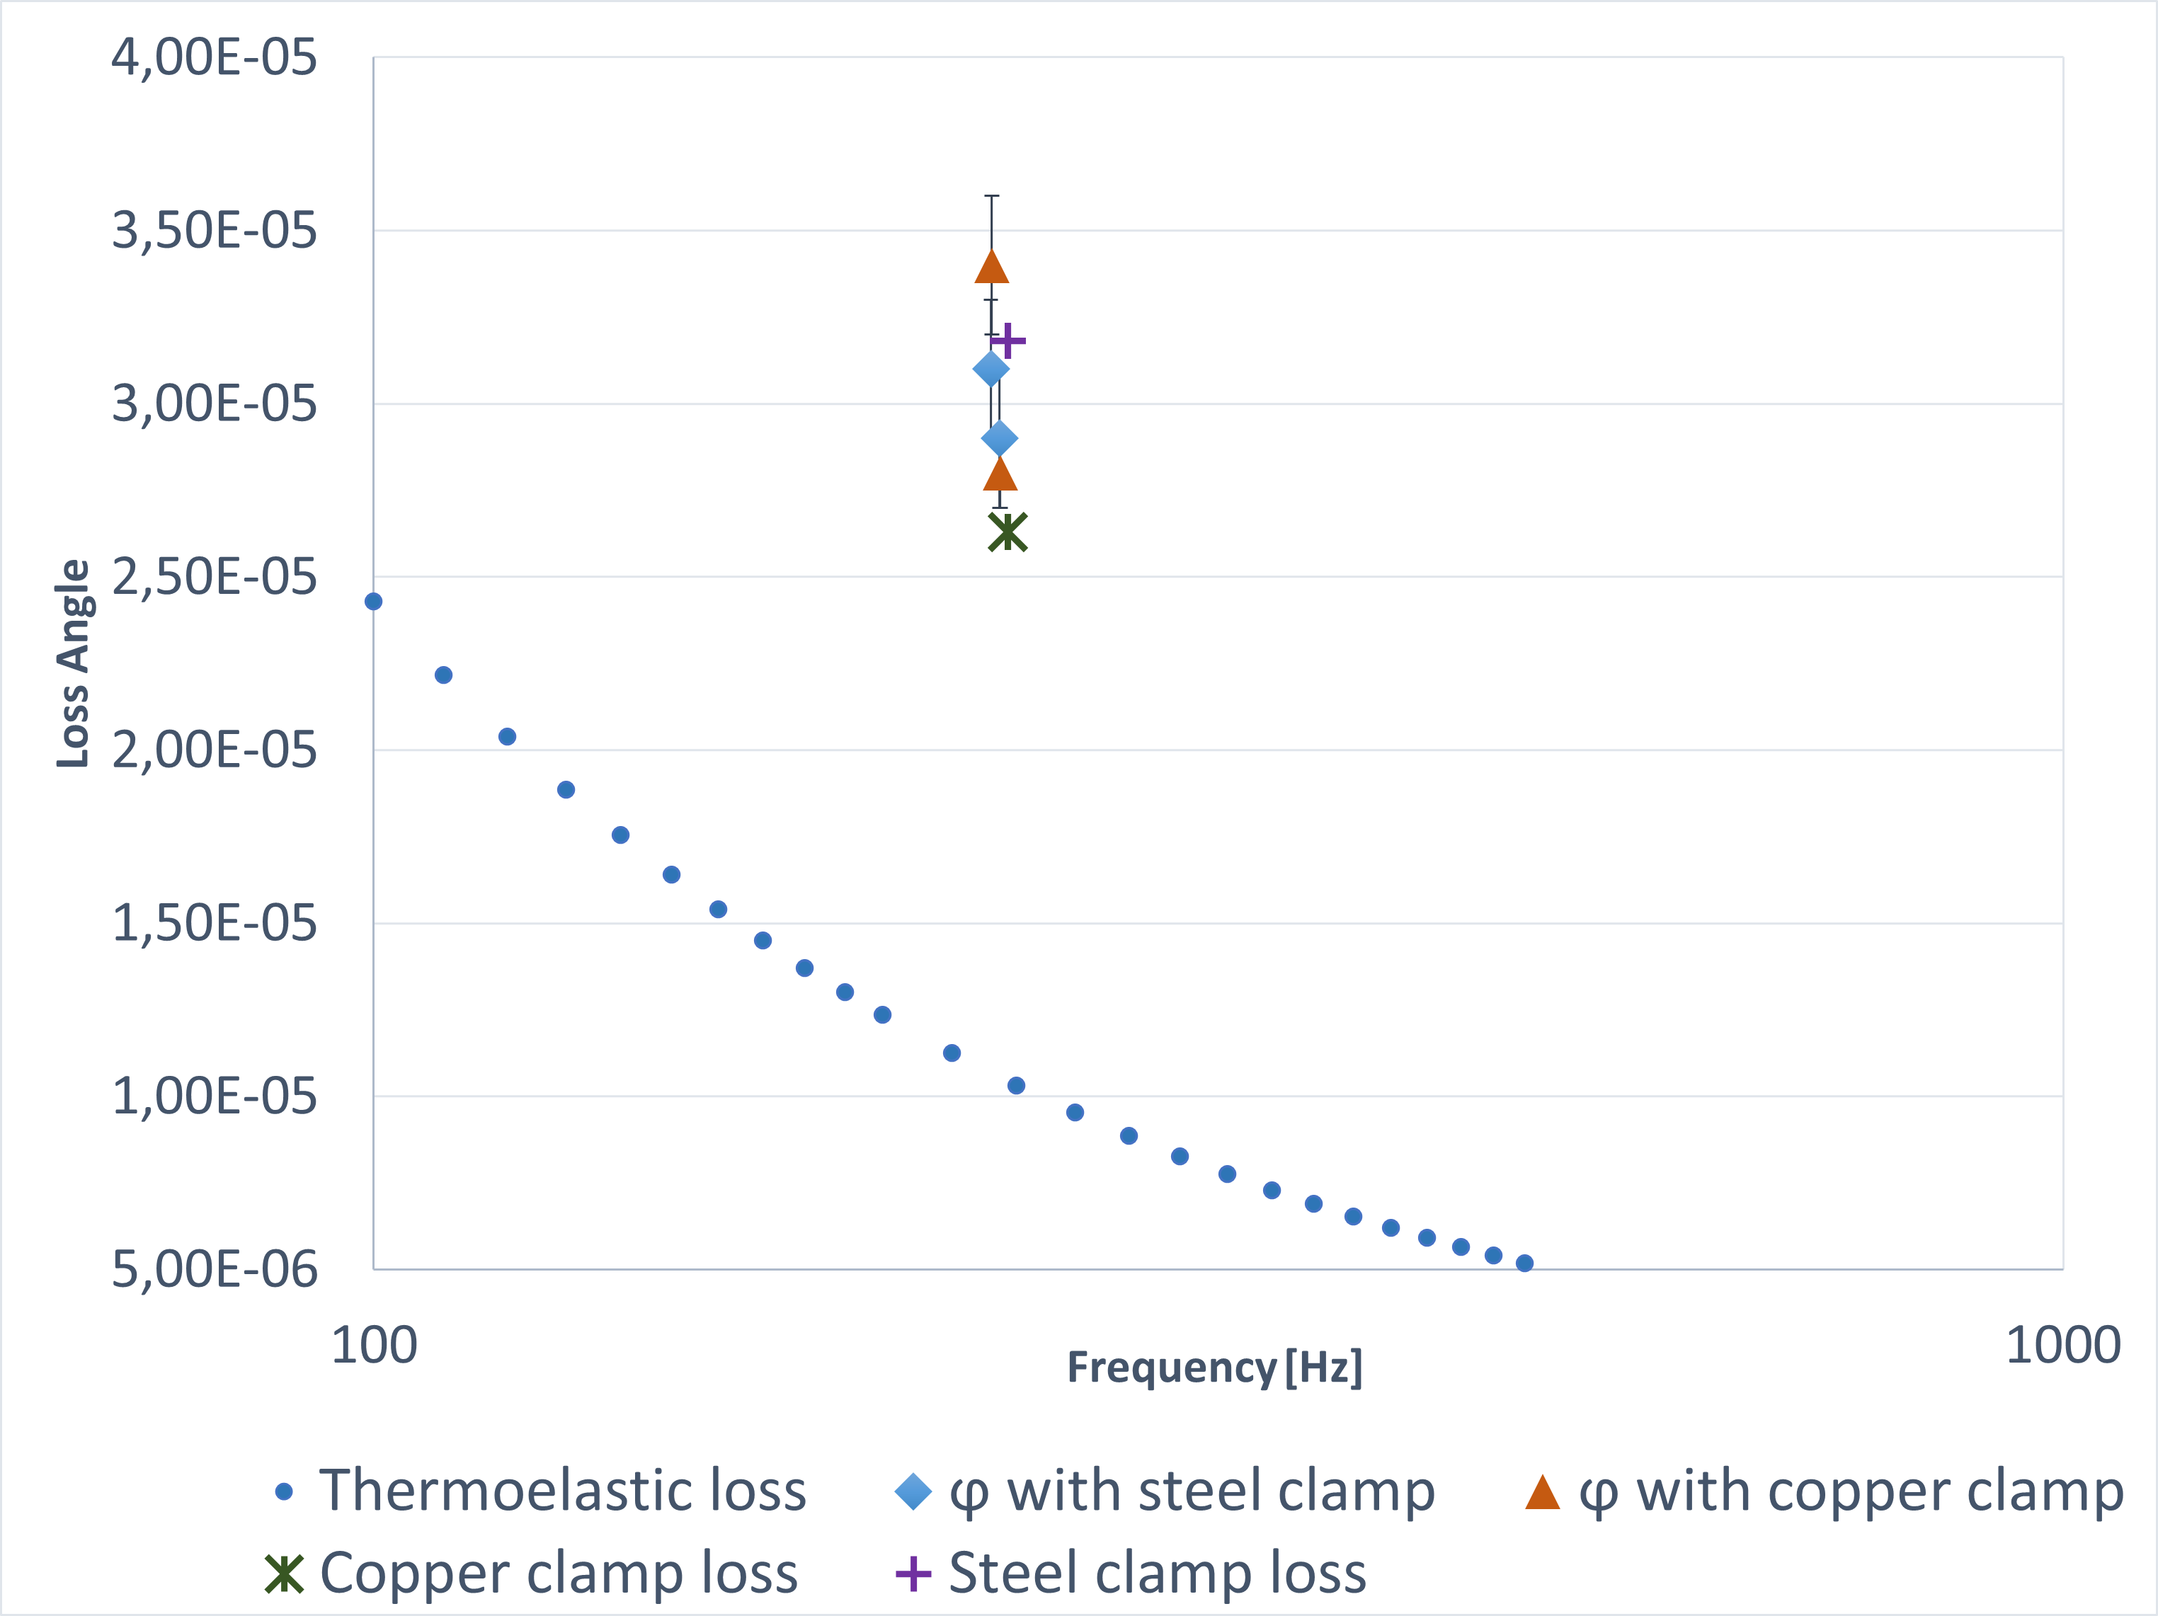
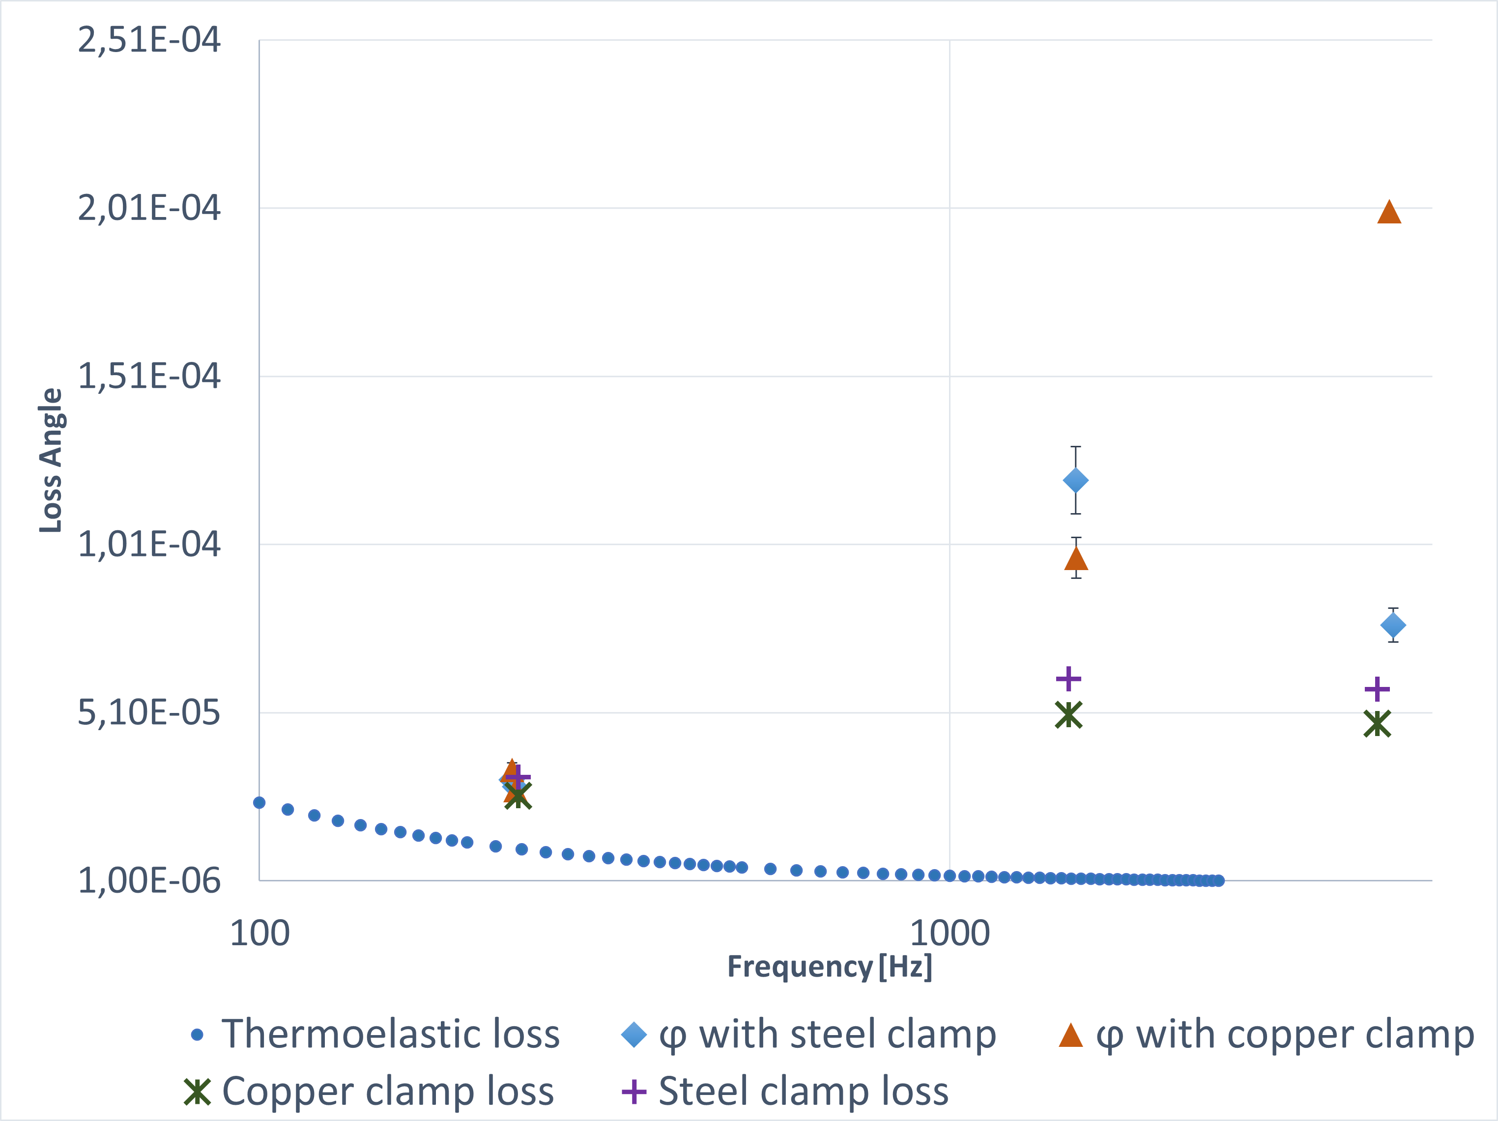
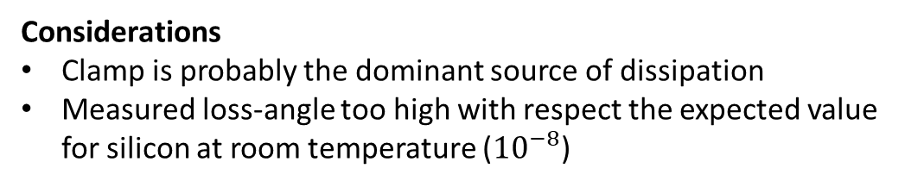
Results
Considerations
Clamp is probably the dominant source of dissipation
Measured loss-angle too high with respect the expected value for silicon at room temperature (${10}^{−8}$)
Future work
Increase clamp thickness
Cryogenic measurements
Copper clamp with inserts
Notes:
Watching the results it can be stated that the clamp is the dominant source of dissipation.
Thanks to these results I have understood how to improve the measurement system, indeed I’ve just designed a new copper clamp with greater thicknes with inserts, to avoid the deformation of the clamp body.
Moreover, in future cryogenic measuremens will be performed.

Slide 15
Thank you ☺
Notes:
Finally I proposed a new spring blade geometry to reduce the vertical suspension thermal noise.

Slide 16
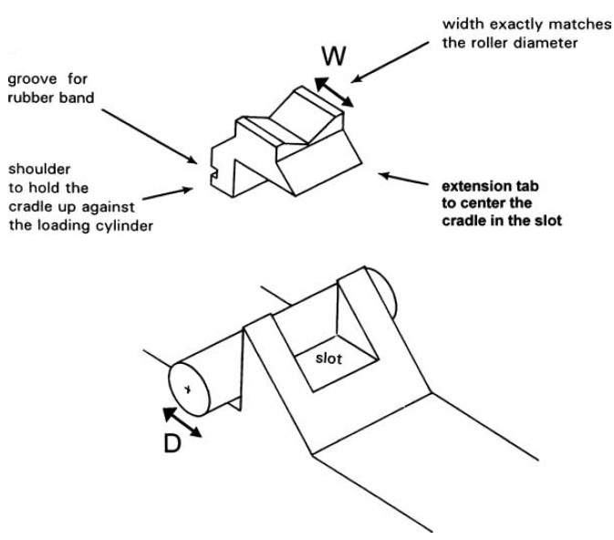
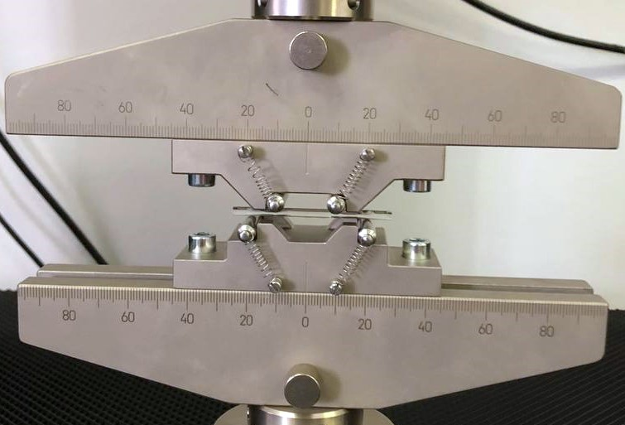
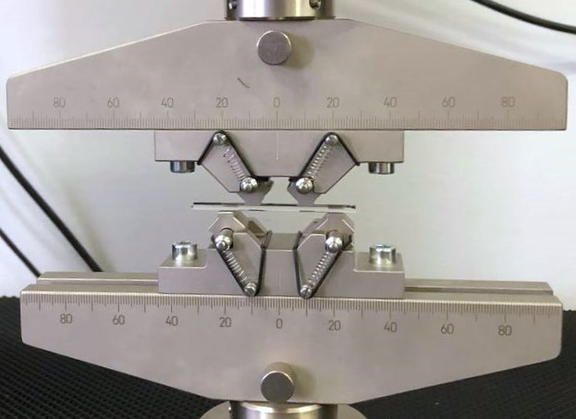
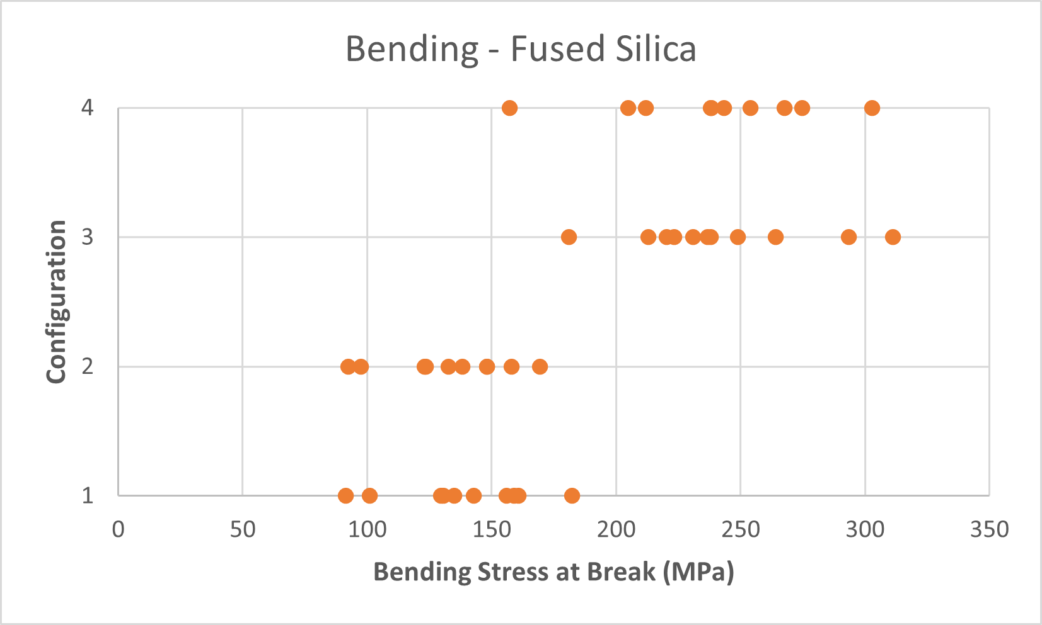
Fused silica preliminary tests
Cradle design
With cradles, top pair of contact points free to articulate.
With cradles, top pair of contact points fixed.
Without cradles, top pair of contact points free to articulate.
Without cradles, top pair of contact points fixed.
Notes:
Cradles are used to convert the concentrated load to a distributed load.
40 fused silica samples were tested in 4 differents configurations. It can be seen that with cradles the measured strength is almost twice the measured one without cradles. While the presence or not of the upper contacts point articulation doesn’t seem to have a significant effect.

Slide 17
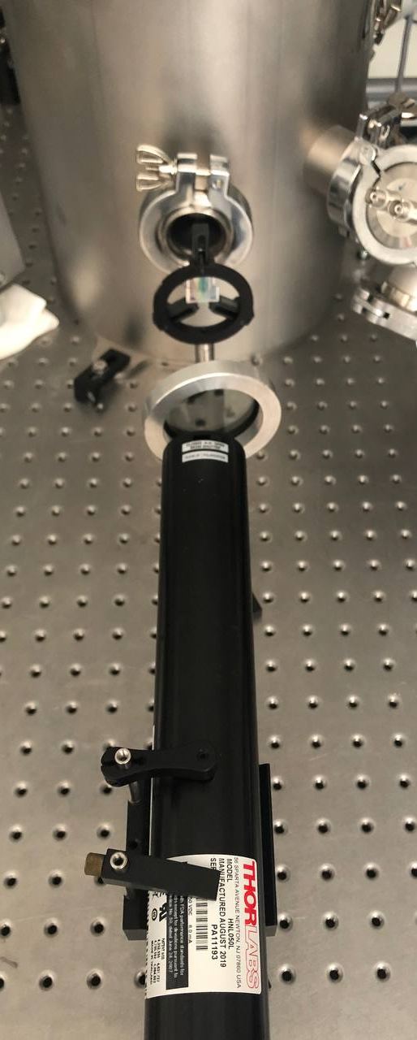
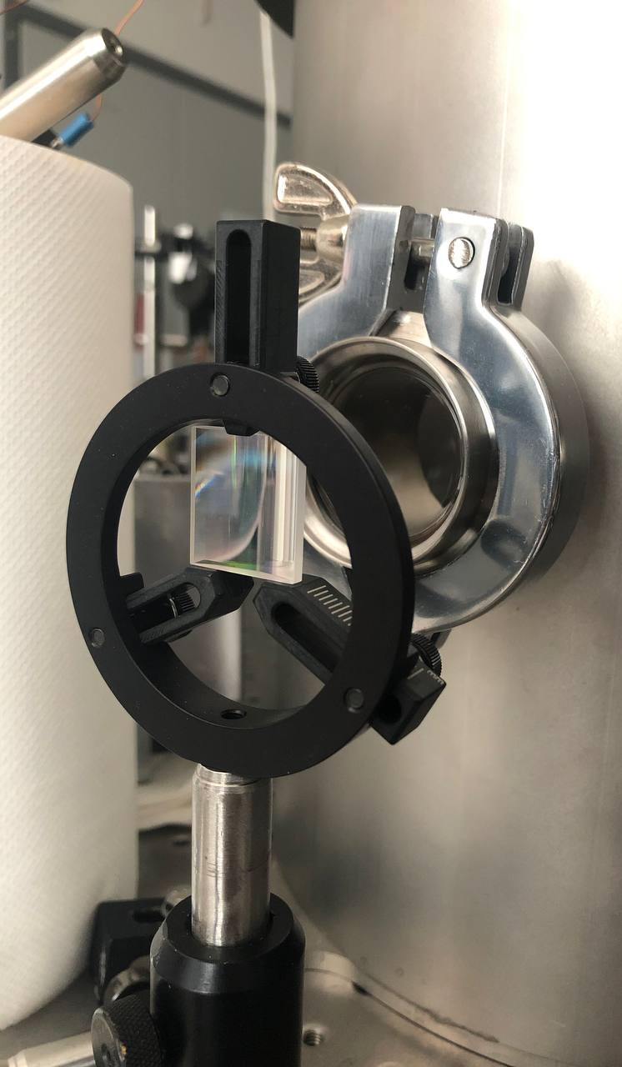
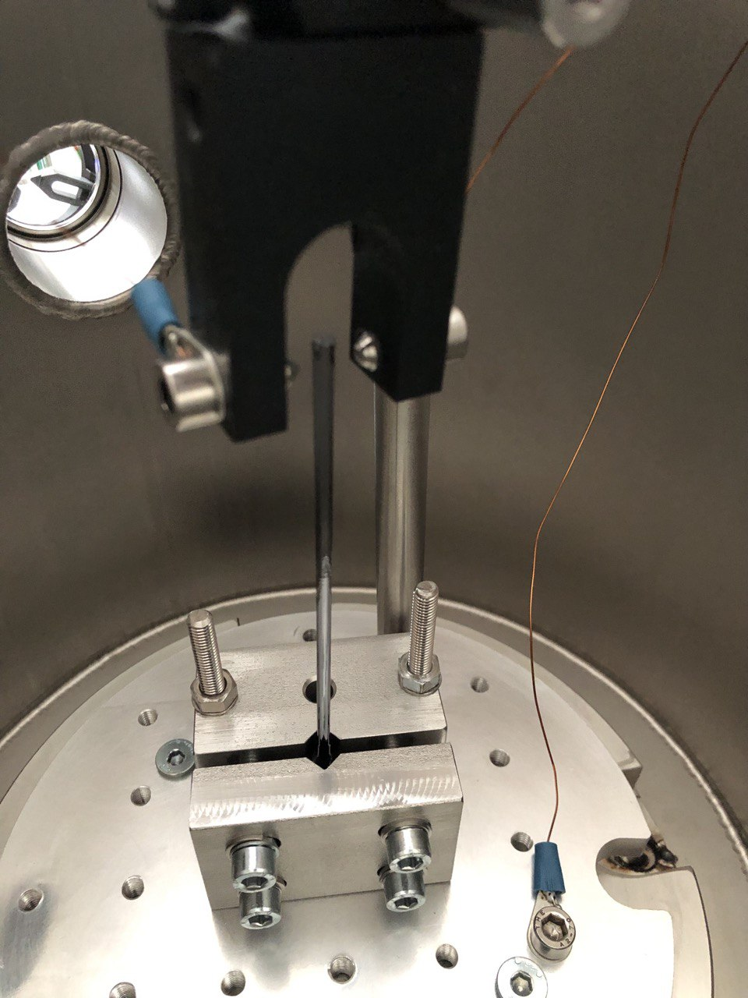
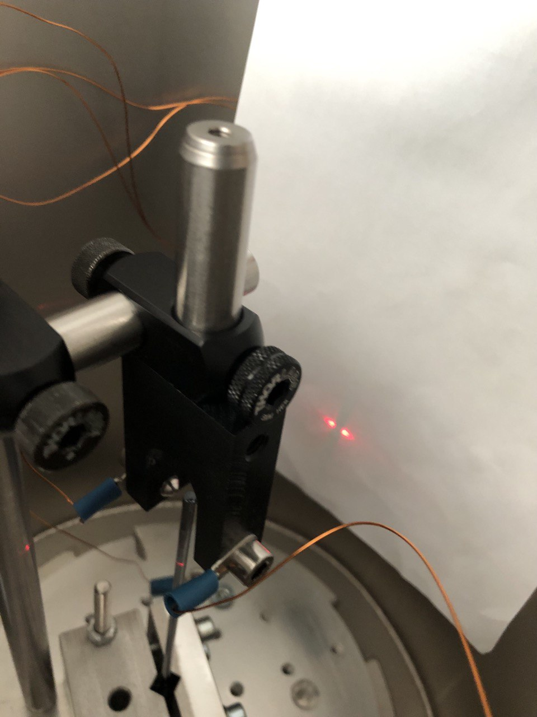
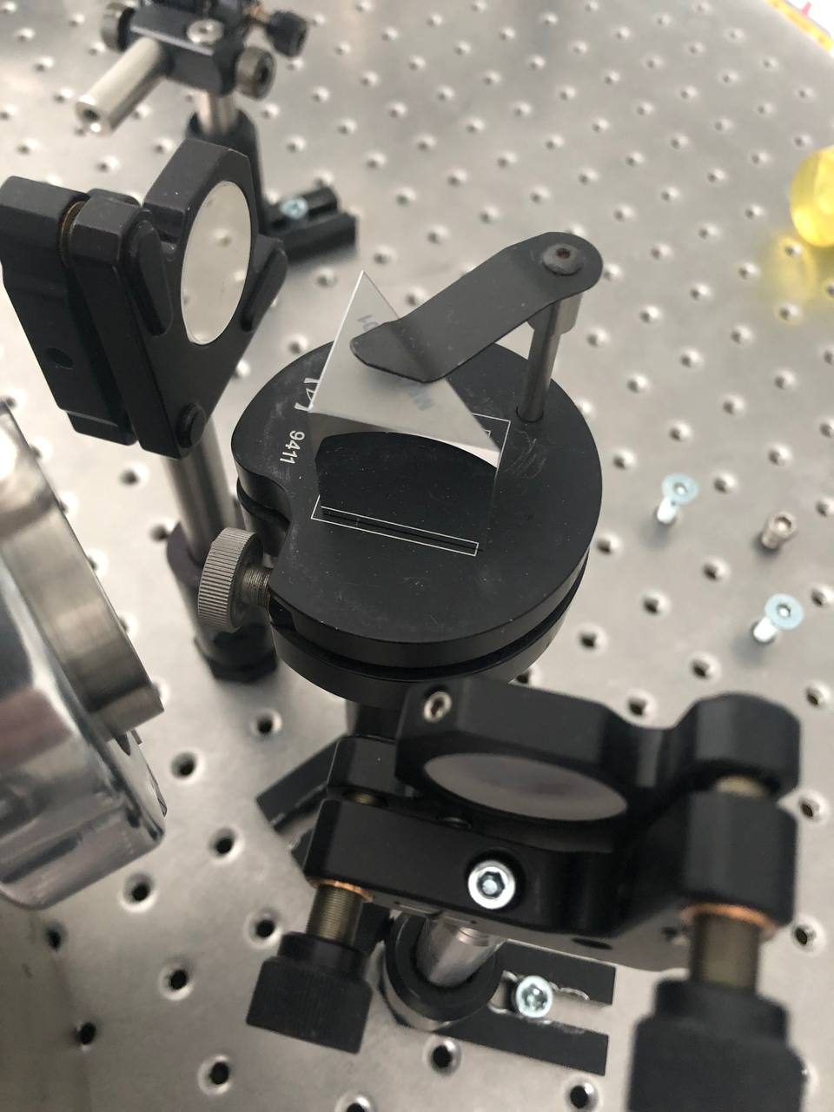
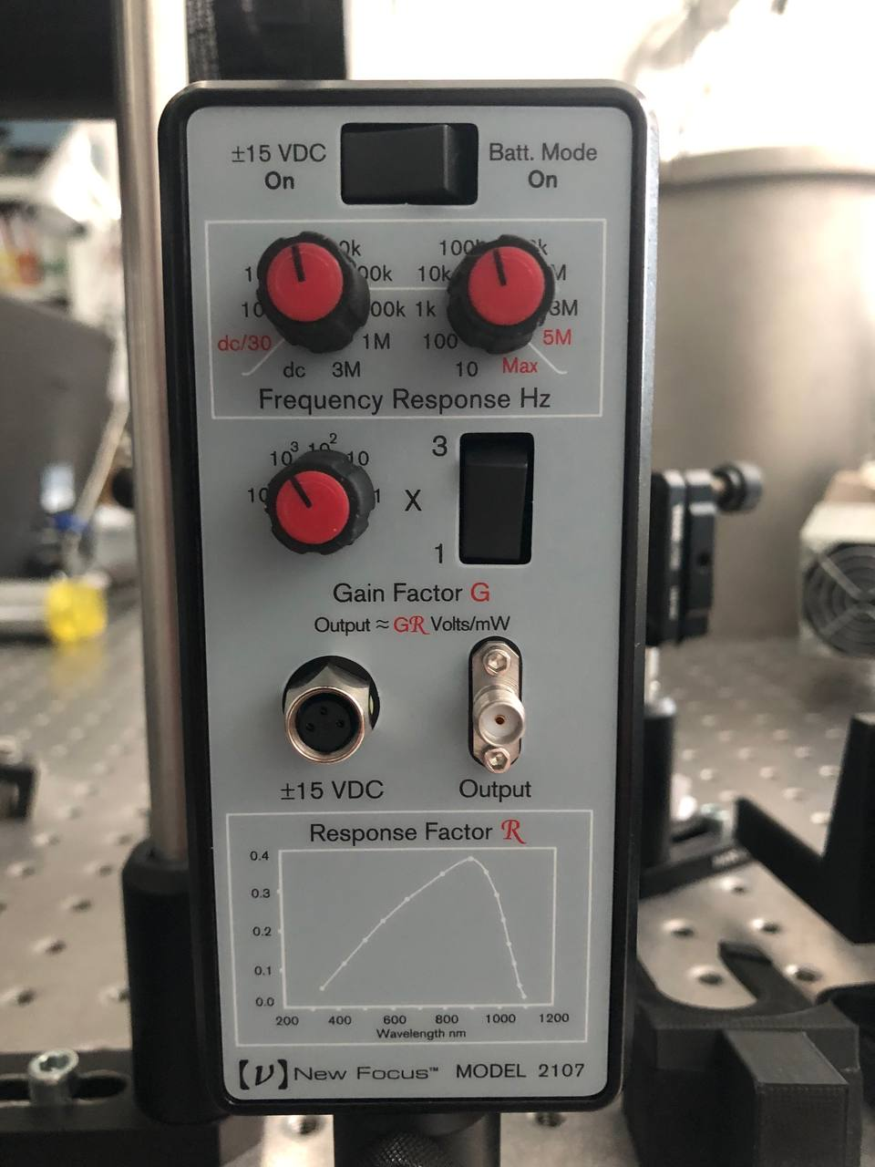
Setup
Laser
Cylindrical lens
Fiber
(clamped at the base of the vacuum chamber)
Mirrors
Photoreceiver
Labview VI
Spectrum
Band-pass filter around the resonant frequency
Resonant peak analysis
Exponential fit
Data acquisition card
Signal proportional to relative displacement of the fiber
Notes:
The head of the fiber is clamped to a massive support inside the vacuum chamber.
The fiber is illuminated with a red laser beam, and the two light beams that pass around the fiber on either side strike the two photodiodes of the photoreceiver, which outputs an electrical signal proportional to the relative displacement of the fiber.
The signal is then analyzed by a Labview VI.

Slide 18
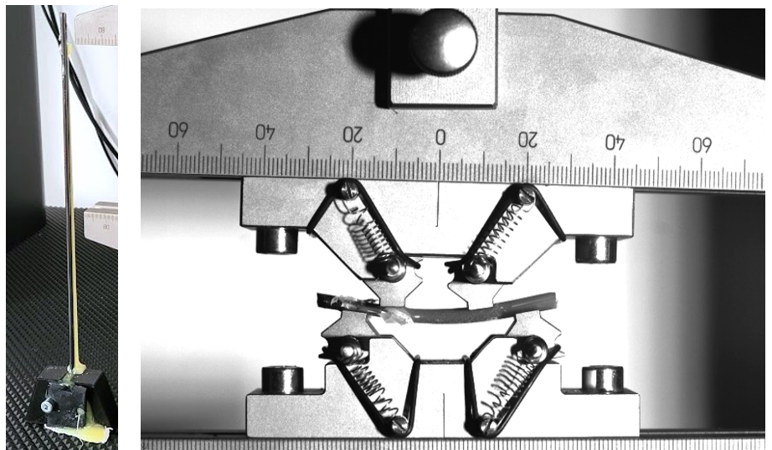
«The epoxy incident»
Stress at break: 2 GPa
Notes:
The fiber 3, which was contaminated by the epoxy glue during the tensile test, showed a particularly high strength and deflected a lot before the fracture.
The measured strength for this sample was greater than 2 GPa. From this incident, a useful information was obtained that could lead to a future development, that is the idea of covering a minimal part of the fiber with epoxy glue, in particular the bending points of the pendulum model, without increase too much thermal noise.

Slide 19
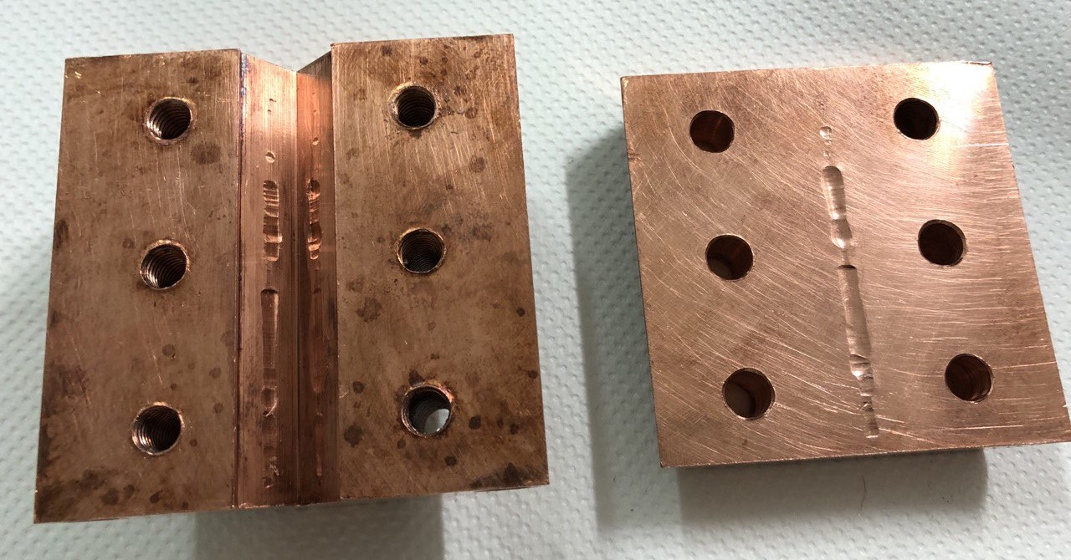
Copper clamp deformation
I replaced the copper clamp with the steel clamp, that deforms less, and I added the electrostatic exciter. With this clamp the maximum torque applied was 1 Nm.

