Slide 1

MAD25 : The ETFIBER Project
Gilles Magain
Notes:
The ET-FIBER project is a collaborative R&D initiative, focused on developing monocrystalline silicon fibres for suspending a 100 kg test mass in the E-TEST prototype. E-TEST serves as a critical cryogenic prototype for the Einstein Telescope , operates a large monocrystalline silicon mirror cooled radiatively to 20–25 K, while achieving low seismic noise below 10 Hz through advanced vibration isolation. In this context, ET-FIBER aims to design, manufacture, and characterise silicon fibres capable of supporting these large test masses under cryogenic conditions, while meeting the stringent mechanical and thermal noise requirements of next-generation detectors.
While second-generation detectors like Advanced LIGO and Virgo employ fused silica fibres for suspension, their mechanical and thermal properties degrade at cryogenic temperatures. Silicon, in contrast, offers low mechanical loss and excellent thermal conductivity at low temperatures, making it a strong candidate for third-generation cryogenic suspensions. However, working with crystalline materials presents unique challenges. The mechanical loss in such materials is anisotropic and depends on crystal orientation, defect density, and impurity levels. Furthermore, welding or bonding techniques required to attach fibres to the test mass can disrupt the crystal structure, introducing additional dissipation mechanisms and compromising performance. Unlike amorphous materials such as fused silica, monocrystalline silicon lacks isotropy, making it more sensitive to geometrical and fabrication-induced imperfections.
ET-FIBER addresses several unresolved questions critical to silicon fibre technology. These include determining the breaking strength and yield thresholds of monocrystalline silicon fibres under cryogenic conditions, identifying optimal manufacturing techniques for producing ultra-pure, defect-free fibres, and understanding the mechanical and thermal behaviour of different fibre geometries. Additionally, the project explores how internal friction and surface losses contribute to overall thermal noise, and how these losses scale with diameter, surface finish, and bonding interfaces. Thermal conductivity is a key parameter in fibre design, as fibre diameter directly influences heat extraction from the test mass. Therefore, careful optimisation of fibre geometry is necessary to balance thermal transport with mechanical stability. This includes a detailed examination of variations in mechanical loss with temperature and crystal orientation, further highlighting the influence of crystalline anisotropy.
Through a combination of theoretical modelling, material characterisation, and experimental testing, we aim to provide a comprehensive understanding of silicon fibre performance under cryogenic conditions. By enabling the systematic development and evaluation of monocrystalline silicon fibres, ET-FIBER supports the Einstein Telescope’s technical roadmap. The outcomes of this work will help define suspension design parameters, manufacturing protocols, and mechanical loss budgets for cryogenic test masses. By integrating fibre R&D into the E-TEST platform, ET-FIBER ensures that critical performance characteristics can be tested under realistic operational conditions, paving the way for reliable, low-noise silicon suspensions in future gravitational wave observatories

Slide 2
Outline
The ETEST Prototype
What is the ETFIBER project
The use of Silicon
The proposed designs
External companies
The production process
The surface treatment
Mechanical Characterisation

Slide 3
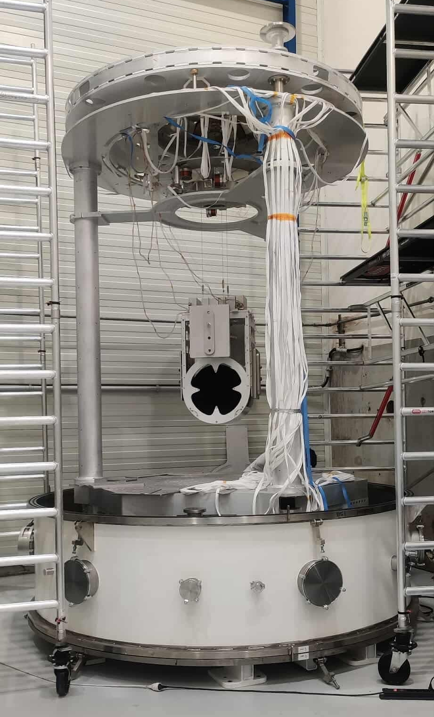
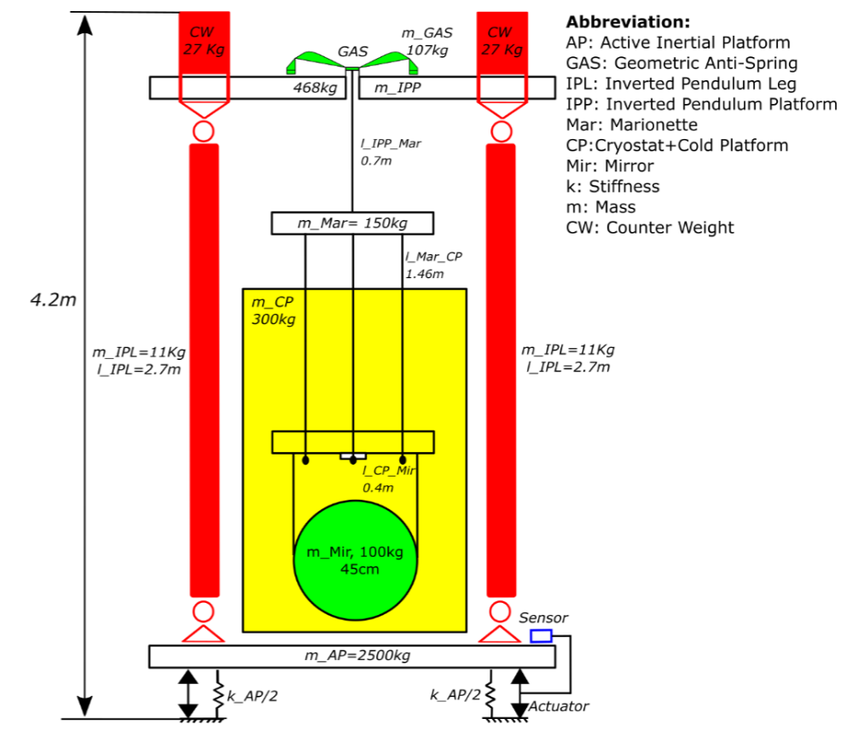
ETEST Prototype
Test of advanced seismic isolation
Low seismic noise below 10 Hz
The goal is to isolate the test mass
The isolated mass will ultimately be a 100 kg silicon mirror design to operate at cryogenic temperatures (20K)

Slide 4
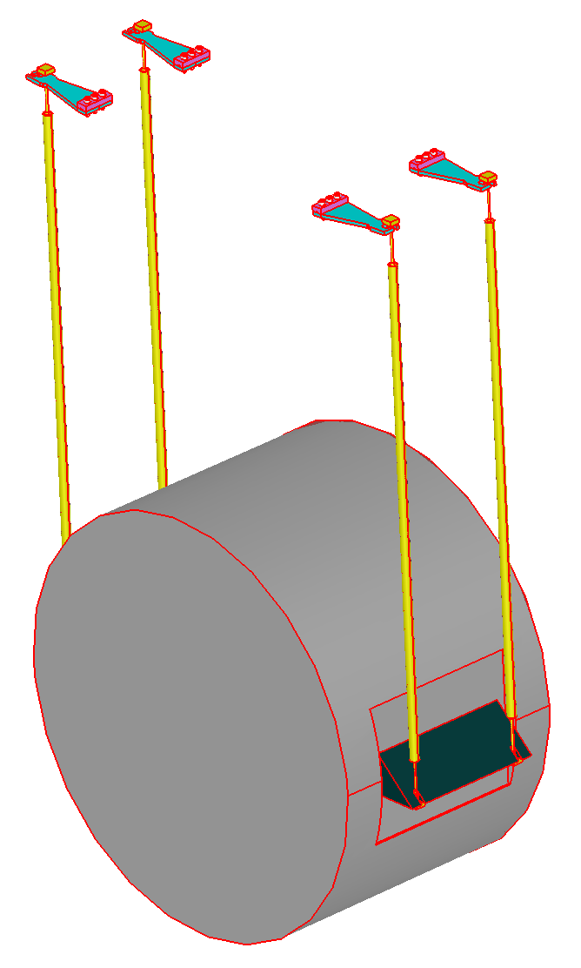

The ETFIBER Project
R&D Project : Design & production of suspensions for the ETEST prototype mirror compatible with cryogenic environment
Loses its properties at cryogenic temperature
Silica as for LIGO ?
Why Silicon ?
High quality factor (low mechanical dissipation)
Thermoelastic nulling at cryogenic
High thermal conductivity
Sufficient mechanical strength
Ref [2]
Perfect for isolation at cryogenic temperature

Slide 5
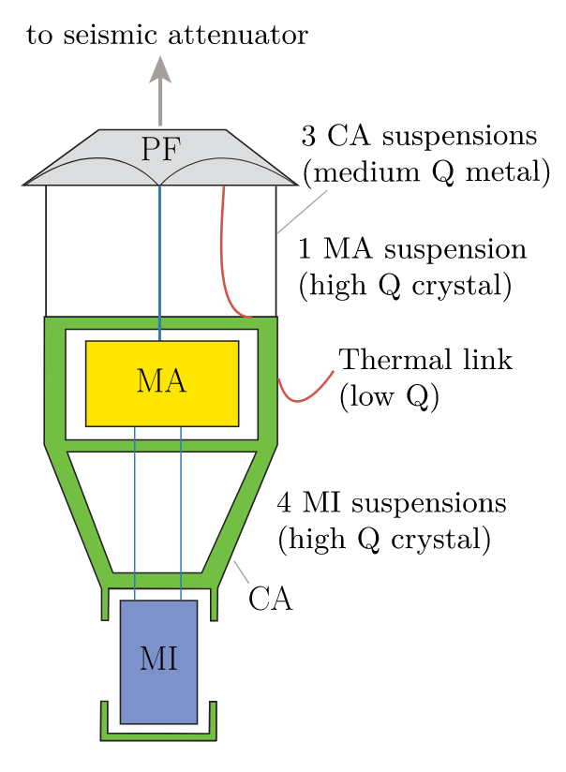
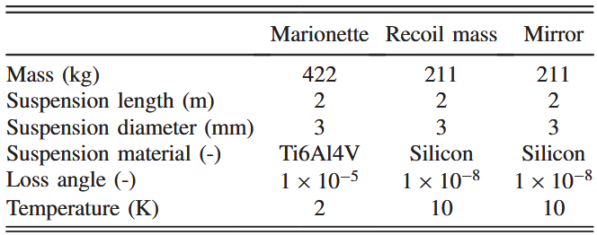
Tension design
SF = 3
Max Stress = 230 MPa
4 mm for :
SF = 3
Max stress = 120 MPa
5.6 mm for :
SF = 6
Max stress = 120 MPa
Ref [1]

Slide 6
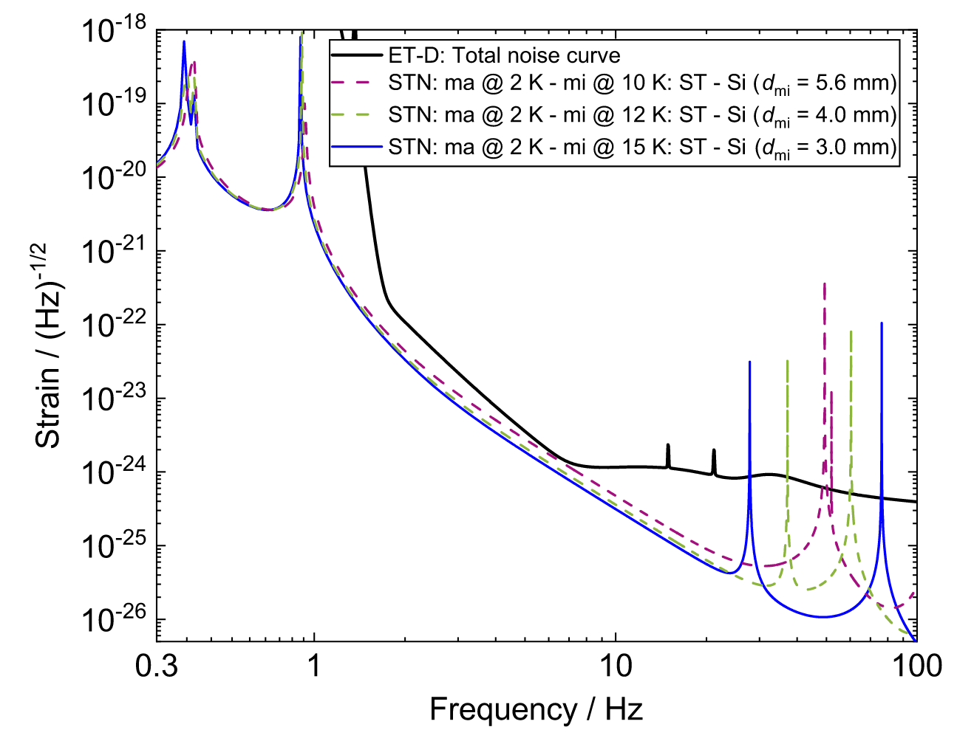
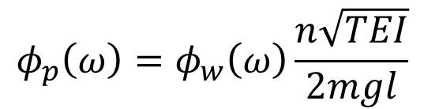
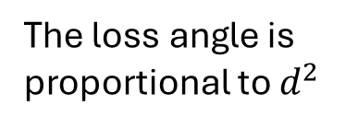
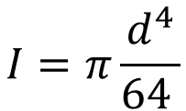
Thermal noise VS Sensitivity
$$φ_{p}\left(ω\right)=φ_{w}\left(ω\right)\frac{n\sqrt{TEI}}{2mgl}$$
Ref [4]
The loss angle is proportional to $d^{2}$
$$I=π\frac{d^{4}}{64 }$$
The thermal noise is just below the sensitivity.
Ref [1]

Slide 7
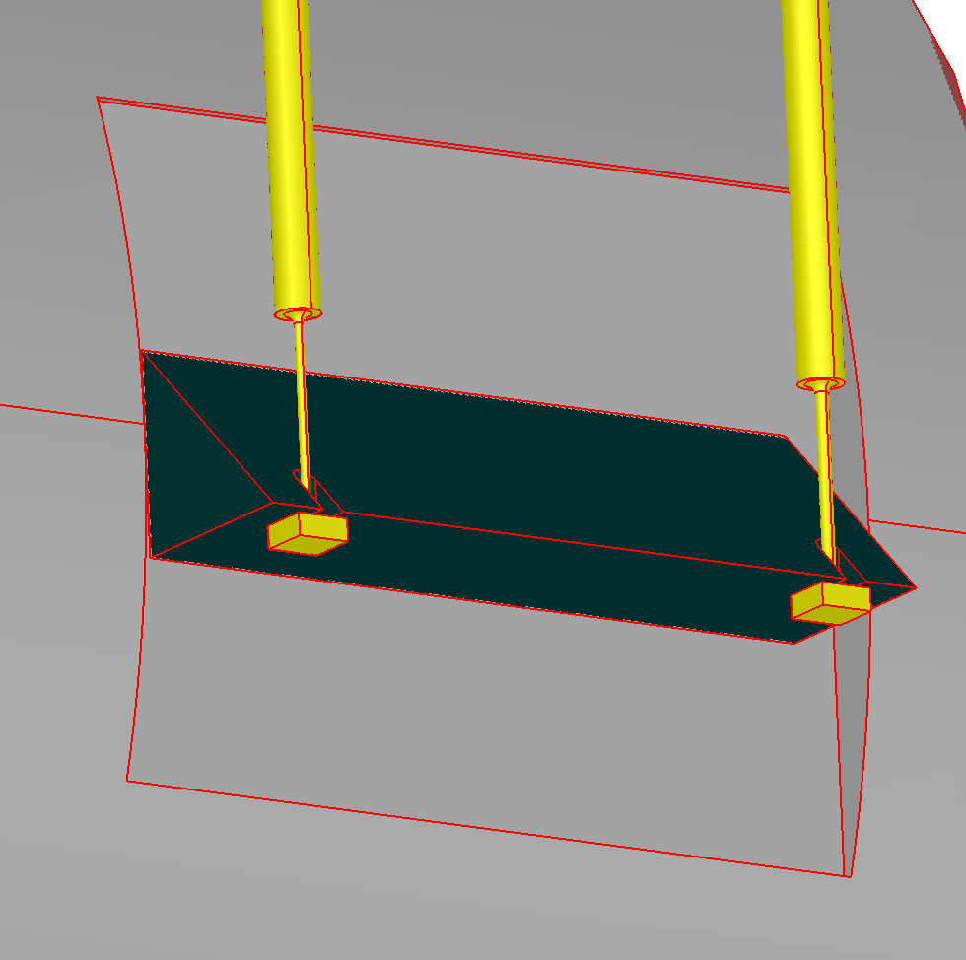
Tension design
Hydroxide catalysis bonding (HCB)
Thinning to gain flexibility :
Smaller diameter close to the yield point
Effective stiffness not as low as wanted.
Ref [2]

Slide 8
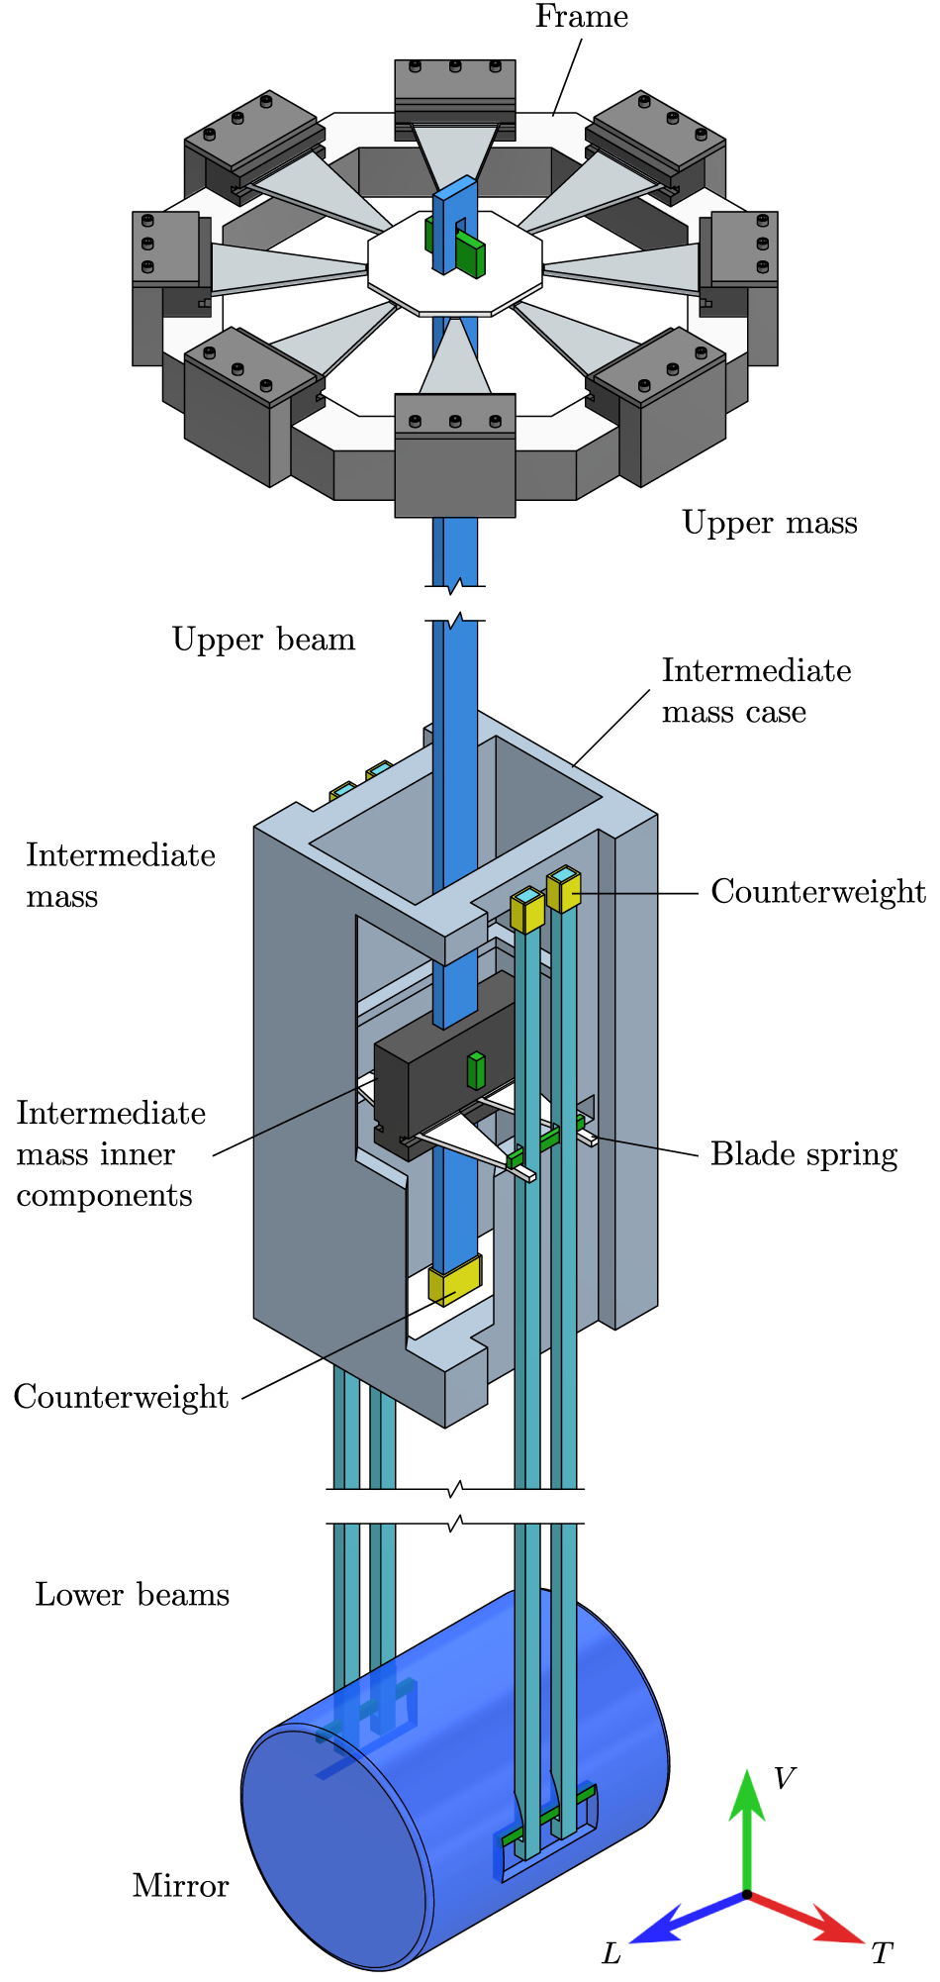
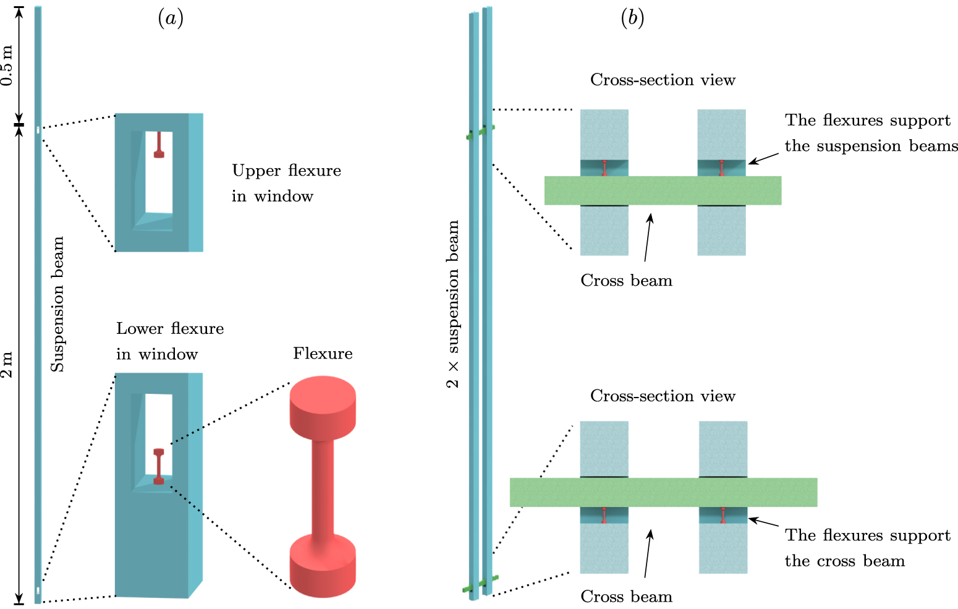
The compressive design
Ref [3]

Slide 9
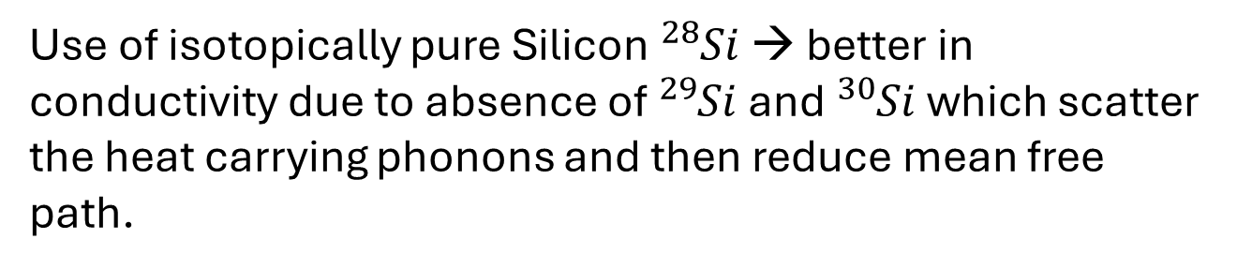
Use of Si Isotope
Flexures have short length, but they set the limit of suspension thermal conductivity due to their small diameter
Use of isotopically pure Silicon ${}_{ }^{28}{Si}$ → better in conductivity due to absence of ${}_{ }^{29}{Si}$ and ${}_{ }^{30}{Si}$ which scatter the heat carrying phonons and then reduce mean free path.
This isotope has a better conductivity below 100K with peaks of 10 orders of difference at 20K.
Ref [3]

Slide 10
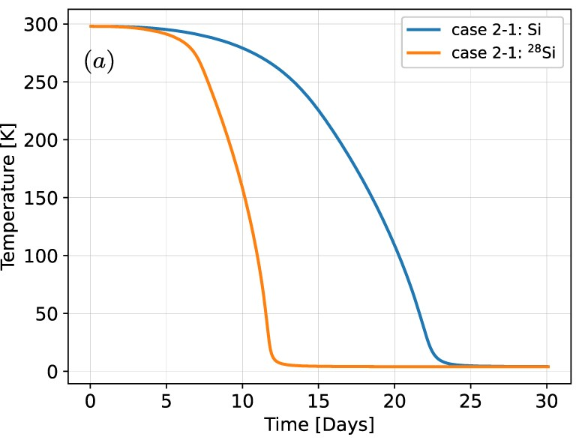
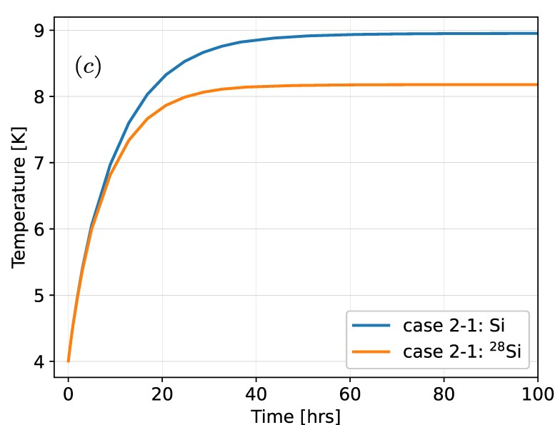
Use of Si Isotope
Hypothesis :
radiation negligible below 100K. The time can be expected to be shorter.
Evolution of Temperature depending on the time and the isotope used
Cooling of the suspension
Dissipation of 0.5 W
Ref [3]

Slide 11
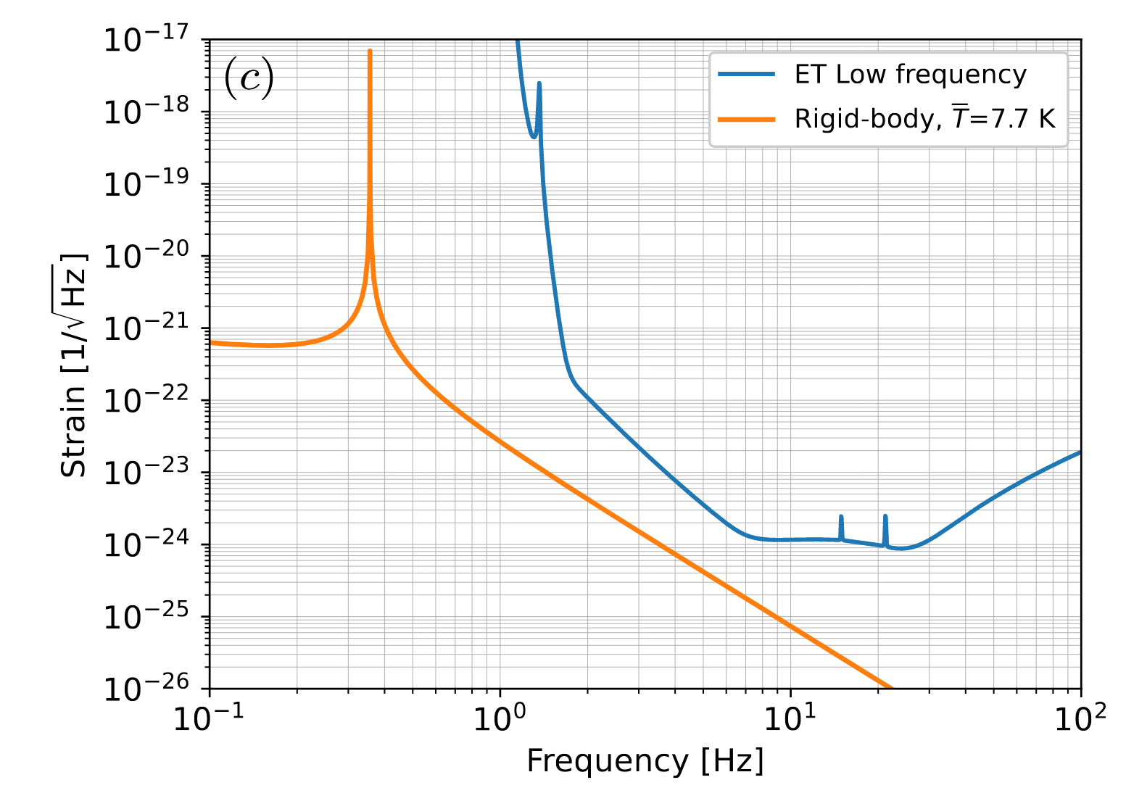
Performance and Comparison
The Compressive solution
Pro | Cons
Better performances | Centre of percussion effect and beam resonance
Easy mounting or disassembling | No recoil mass -> New control solutions must be developed
Good heat extraction thanks to large cross sections | We have to use isotope for flexure to obtain those results
Ref [3]

Slide 12

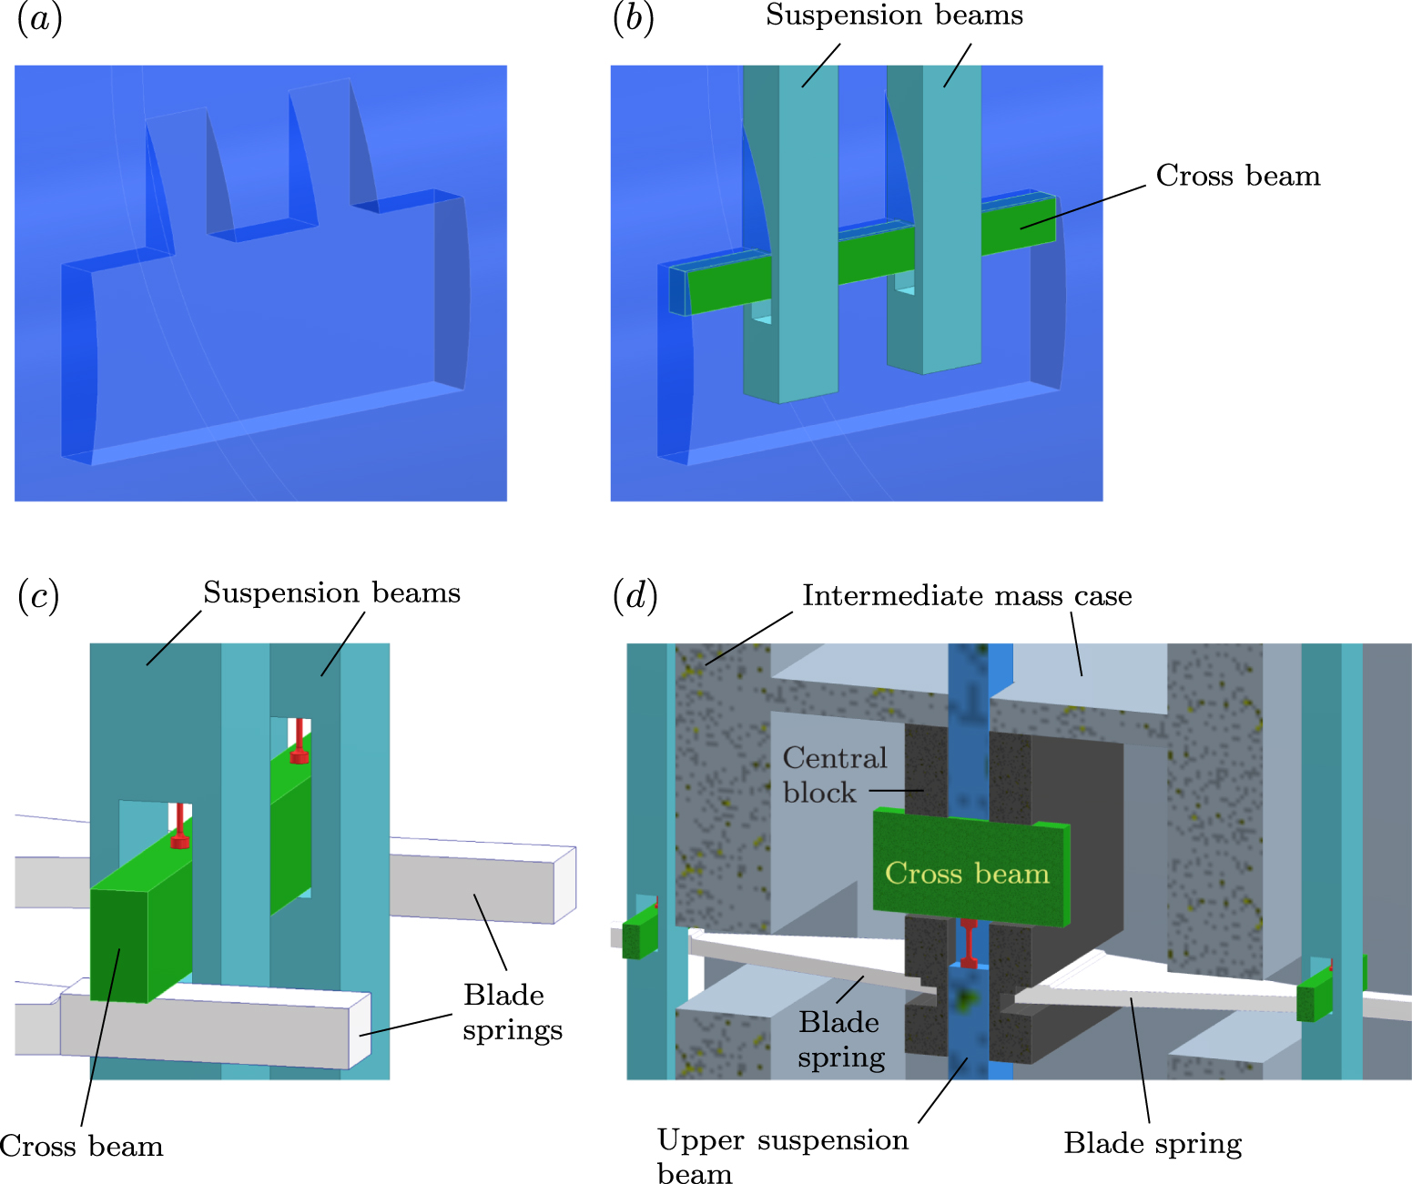
The Silicon production
Ultra precision optics
Mostly specialized in mirror or reflective surfaces
In charge of the manufacturing of the silicon parts

Slide 13


Surface & Mechanics
industrial laser integrator and custom laser machine manufacturer
In charge of
Mechanical test of the different produced fibre
Characterize the different fibre geometry
Scaling with geometry ?
In charge of
Surface laser treatment
Modelisation of the surface heat

Slide 14
To conclude
The ETEST prototype has been presented
Presentation and comparison of tensional and compressive design of suspension
Is the gain of performance realistic ? Is it necessary to do that much for this gain ?
The companies working on the project have also been presented.

Slide 15
References
[1]
[2]
[3]
[4]
KOROVESHI, Xhesika, BUSCH, Lennard, MAJORANA, Ettore, et al. Cryogenic payloads for the Einstein Telescope: Baseline design with heat extraction, suspension thermal noise modeling, and sensitivity analyses. Physical Review D, 2023, vol. 108, no 12, p. 123009.
A. Bertolini (Nikhef) : Silicon suspensions for the E-TEST mirror : status
ARELLANO, Fabián E. Peña, LEON, Nelson L., LÓPEZ, Leonardo González, et al. A cryogenic test-mass suspension with flexures operating in compression for third-generation gravitational-wave detectors. arXiv preprint arXiv:2503.19169, 2025.
SAULSON, Peter R. Thermal noise in mechanical experiments. Physical Review D, 1990, vol. 42, no 8, p. 2437.

Slide 16
Finally
Thank you for your attention !
Contact : gilles.magain@uliege.be

Slide 17
The compressive design
Ref [3]

Slide 18
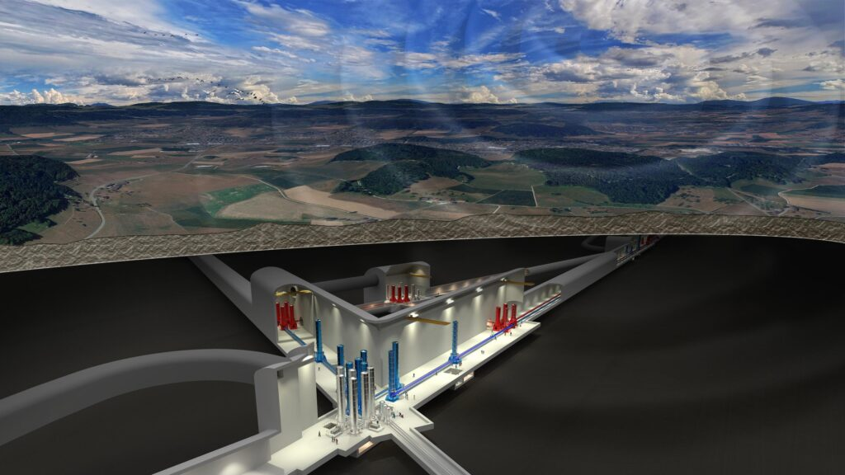
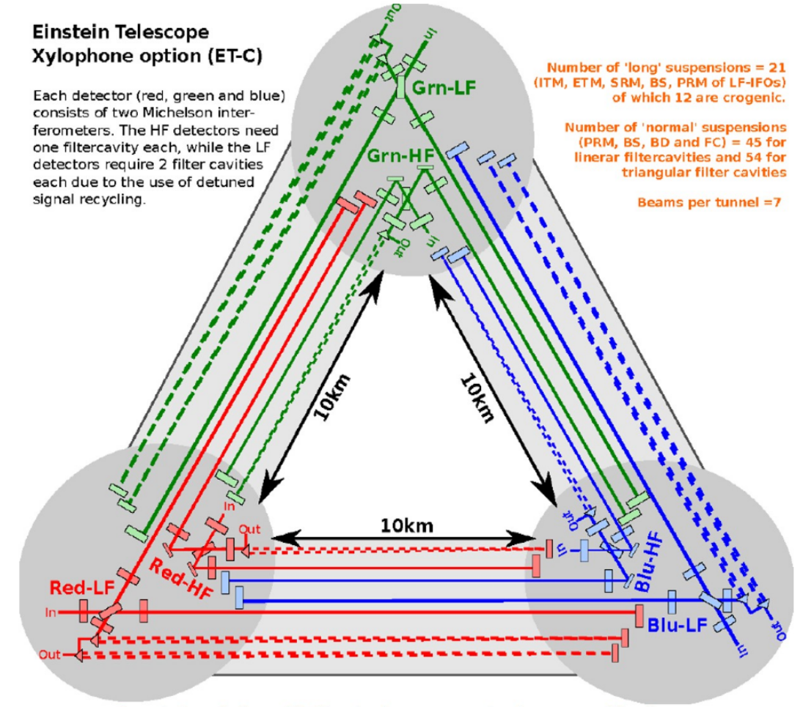
ETEST and ET

Slide 19



The ETFIBER Project
A multitude of involved participants
Doing :
Material production
Surface treatment
Material characterization
Funding

Slide 20
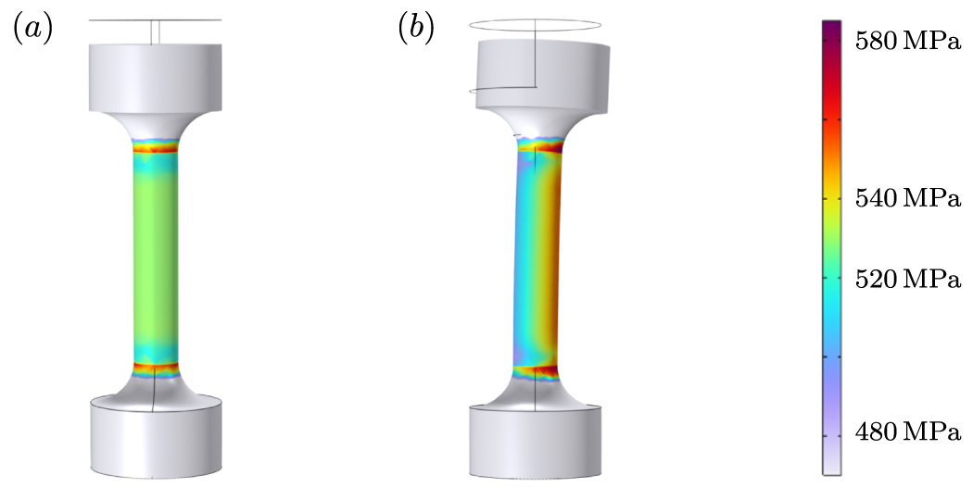
The ETFIBER Project
Ref [3]

Slide 21
Mechanical Characterisation
In charge of
Mechanical test of the different produced fibre
Characterize the different fibre geometry
Scaling with geometry ?

