Slide 1
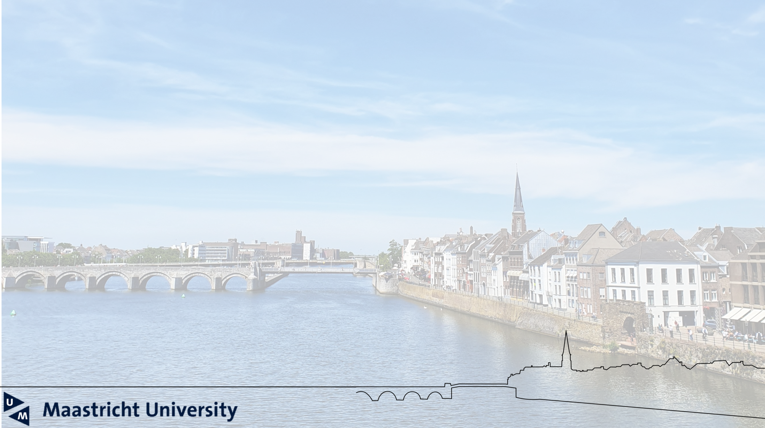



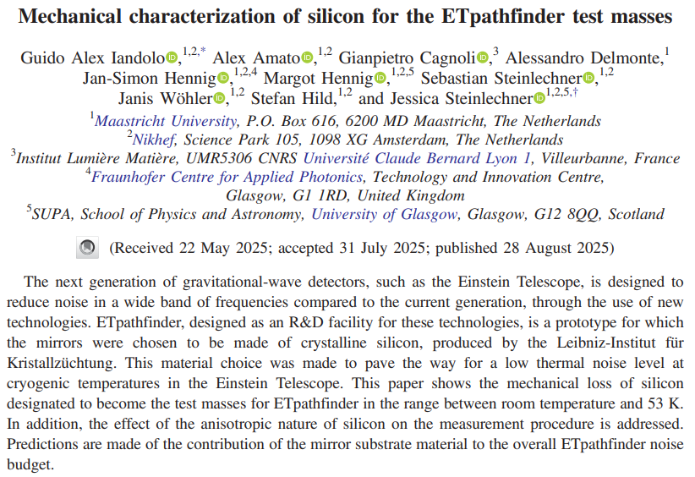
Guido Alex Iandolo

Slide 2
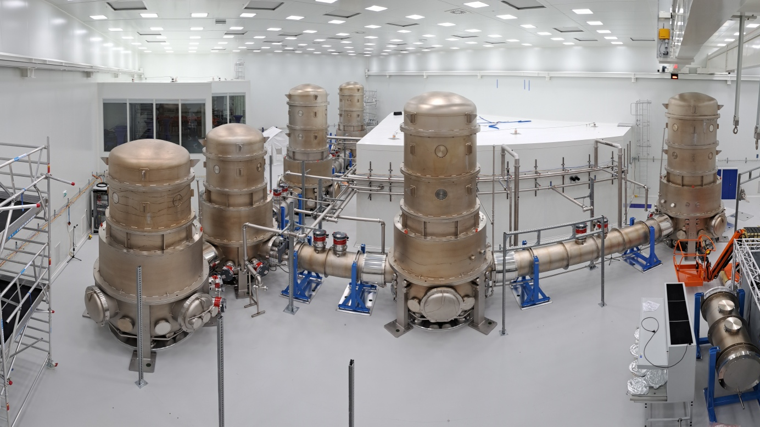

ETpathfinder Silicon Ingots
ETpathfinder is a R&D infrastructure for testing and prototyping innovative concepts and enabling technologies for the Einstein Telescope.
ETpathfinder will feature silicon test masses, obtained by <100>-oriented Float Zone silicon ingots, provided by the Leibniz-Institut für Kristallzüchtung.
Guido Alex Iandolo

Slide 3
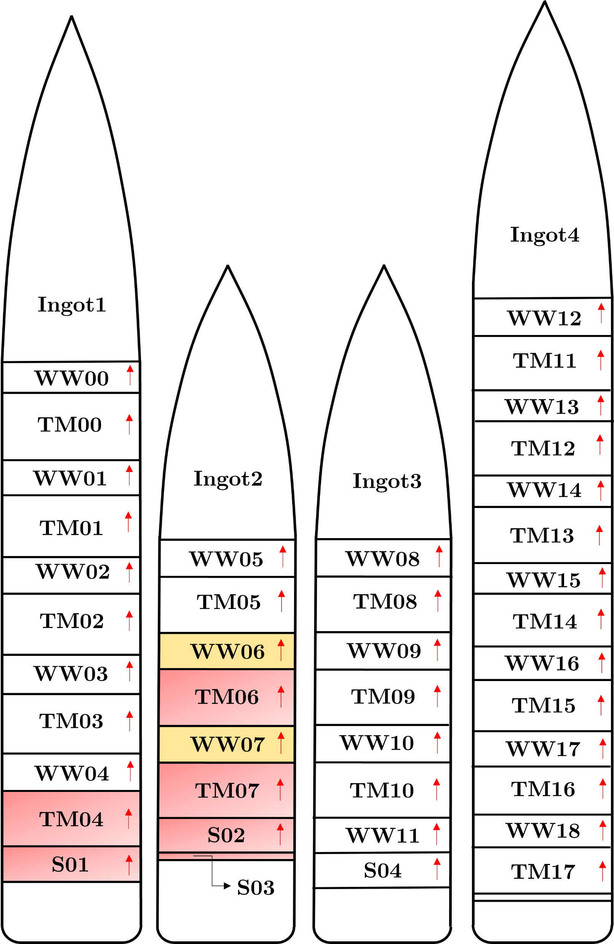
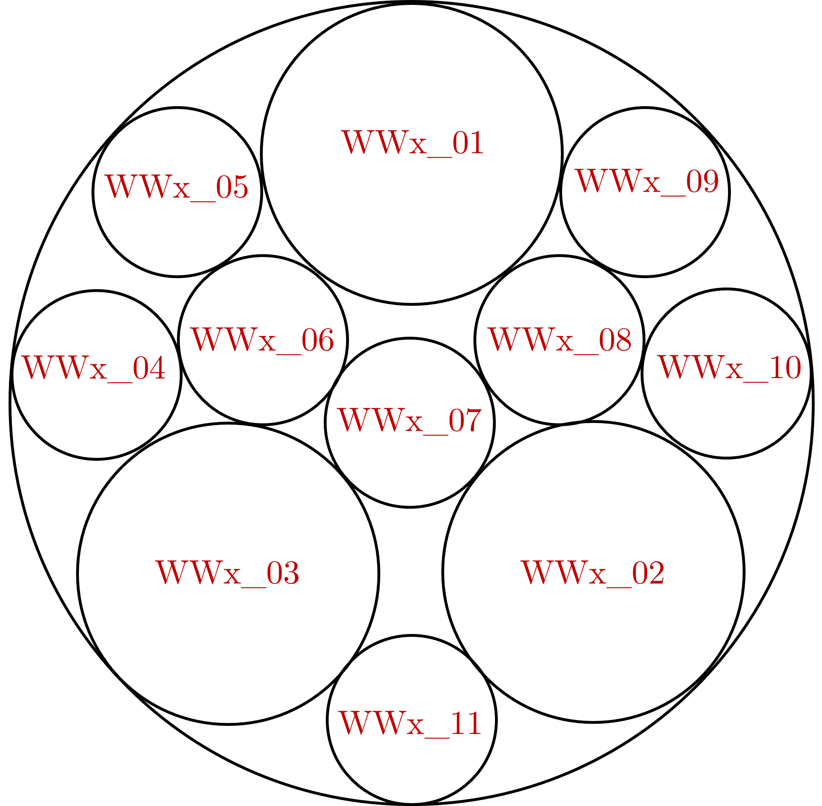
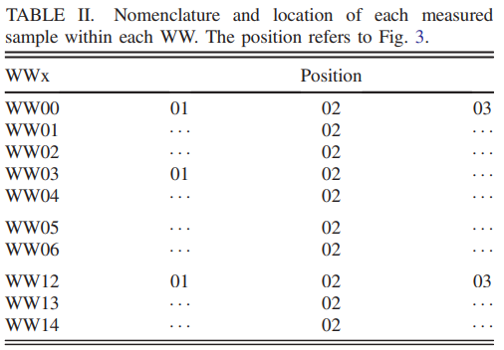
Nomenclature
4 ingots sliced into potential Test Masses, Witness Wafers and remaining Small Wafers.
Each WW was subdivided into three 2” diameter samples and eight 1” diameter samples.
Measured samples from Ingot1, Ingot2 and Ingot4.
Guido Alex Iandolo

Slide 4
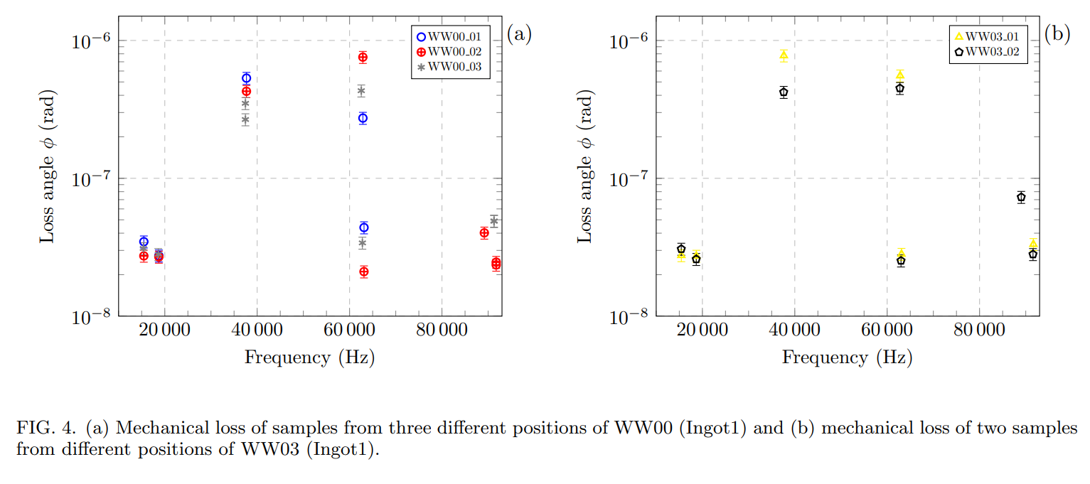
Radial differences Room Temperature
Guido Alex Iandolo

Slide 5
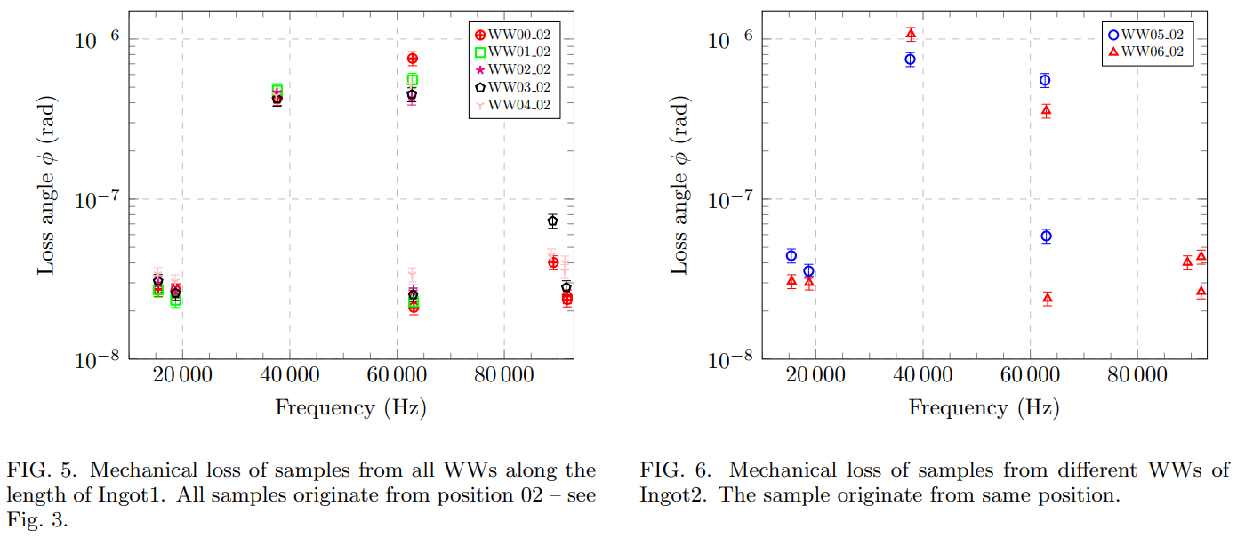
Length differences Room Temperature
Guido Alex Iandolo

Slide 6
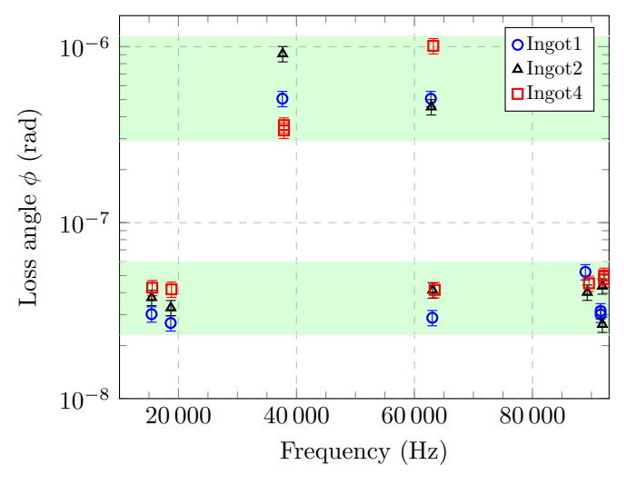
Comparison between ingots
Average mechanical loss measurements from all the
ingots.
The opaque green bands in the background are intended to highlight the difference in spread and level between the lowest loss angle modes and the highest loss angle modes.
Guido Alex Iandolo

Slide 7
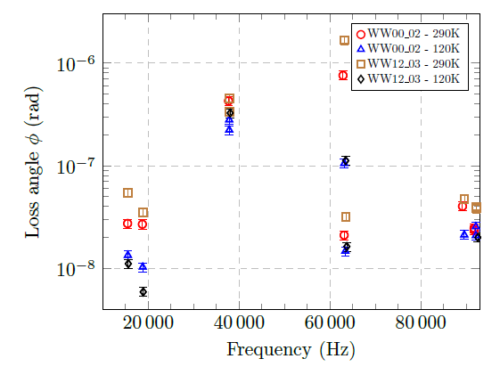
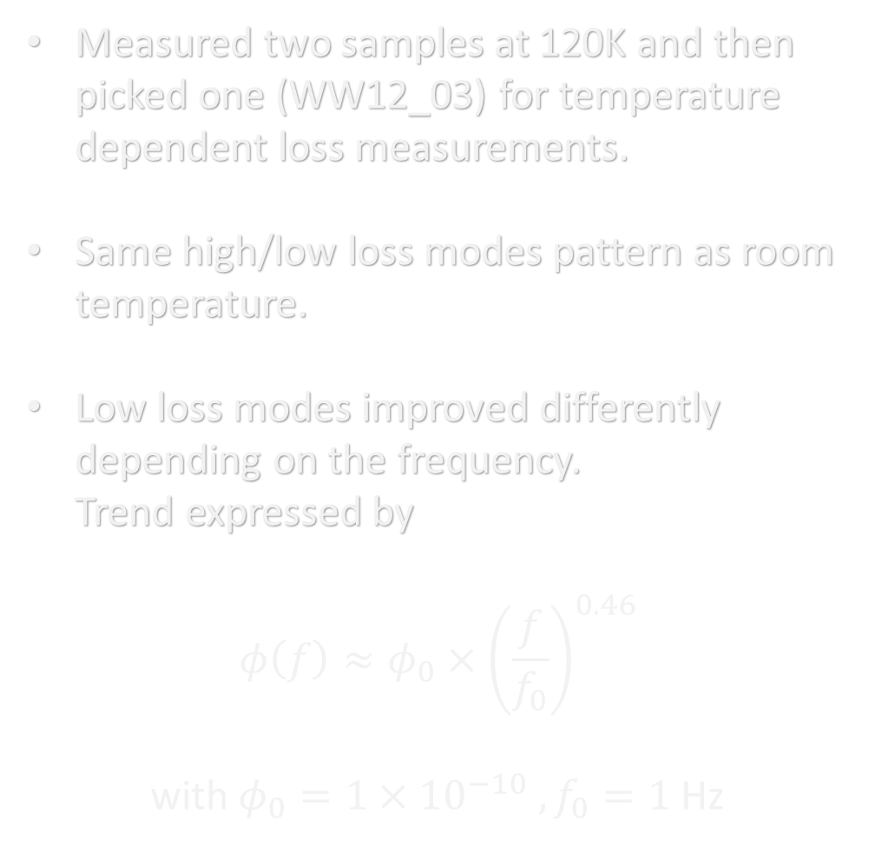
Cryogenic loss measurements
Measured two samples at 120K and then picked one (WW12_03) for temperature dependent loss measurements.
Same high/low loss modes pattern as room temperature.
Low loss modes improved differently depending on the frequency. Trend expressed by
$$φ\left(f\right)≈φ_{0}×{\left(\frac{f}{f_{0}}\right)}^{0.46}$$ with $φ_{0}=1×{10}^{−10} , f_{0}=1$Hz
Guido Alex Iandolo

Slide 8
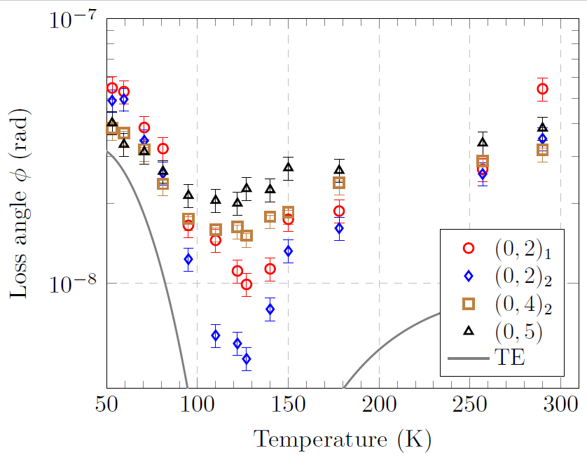
Cryogenic loss measurements
Temperature dependent loss measurements of WW12_03.
Lowest temperature of 53K due to setup limitations.
At 120K, where the thermal expansion coefficient cross the zero value, we see the loss increase over frequency.
Therefore, the constant loss versus frequency observed at room temperature may be due to an increasing thermo-elastic loss component at lower frequencies, which becomes negligible at 120 K.
Guido Alex Iandolo

Slide 9
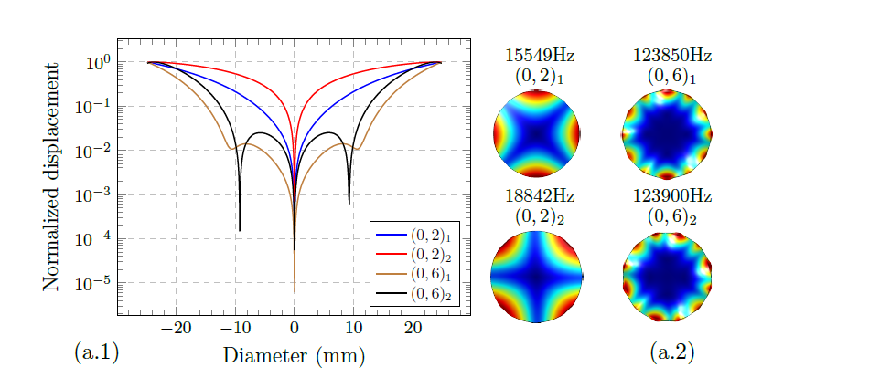
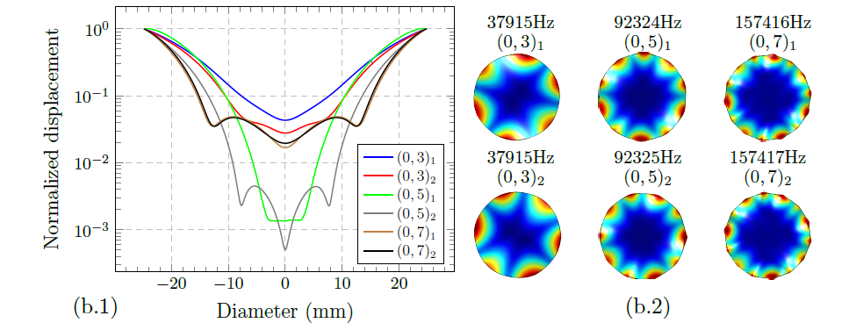
Surface oscillation profile
Modes with EVEN number of nodal lines do not oscillate;
Modes with ODD number of nodal lines oscillate;
Oscillation couples with the suspension causing additional source of dissipation.
Guido Alex Iandolo

Slide 10
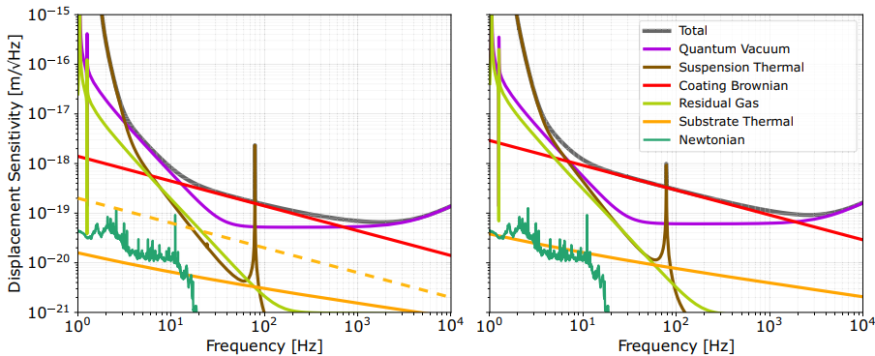
ETpathfinder sensitivity curve
Based on the low-loss modes we made an estimation of the substrate thermal noise expected for two scenarios in ETpathfinder. Dashed line represents the value at 53K.
Guido Alex Iandolo

Slide 11
Conclusions
No significant variation in mechanical loss was observed between the ingots or between the radial or longitudinal positions within individual ingots.
One of the findings of our study was the possible influence of the anisotropic crystalline structure of silicon on the mechanical loss results, particularly in modes with odd numbers of nodal lines.
We show that the expected substrate thermal noise level is at least a factor of 10 lower than coating thermal noise in the initial phase of ETpathfinder.
Guido Alex Iandolo

Slide 12
Thanks for your attention!
Guido Alex Iandolo

