Slide 1
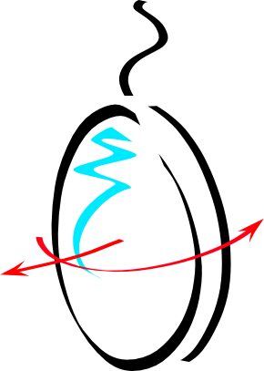


Longitudinal and angular control
Maddalena Mantovani
For the ISC team

Slide 2
longitudinal
For the longitudinal control the situation is quite simple
- All the sensing is computed in Acl
- The controls are stored in LSC_Acl
- The driving (some signals are sent to multiple suspension DSPs) is performed in Acl
- The correction signals are sent to the DSP

Slide 3
Angular control
The present status is that the sensing for the global alignment (except for few error signal blended with LCs) is computed in Acl and then the corrections and the driving is done in DSPs
The plan is to move the corrections and the driving in Acl keeping the common integrator in the DSP

Slide 4
What we need
We need:
Support from DSPs experts (for helping in the standard working and to create functions that we will find useful)
Documentation
Automatic archiving of configurations
the possibility to separate few process in order to be able to restart the part connected to LSC or ASC without affecting the suspension controls
Storing of all the settings (gain etc…) in the data

