Slide 1
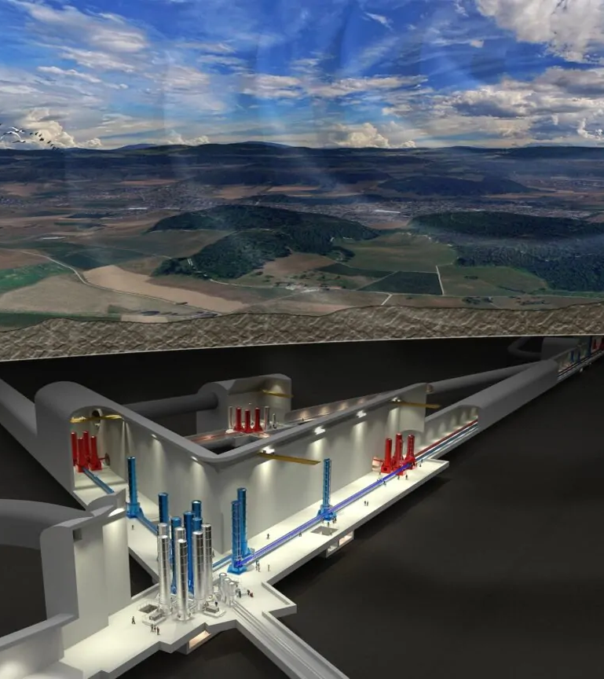






Status of crystalline monolithic suspension for ET-LF
Gravitational Waves and Detection Technologies - PAS Rome meeting 2026
Michele Arcangelo Dicorato, Nicolo’ Baldicchi, Flavio Travasso – University of Camerino, University of Perugia
Ardiana Nela (IGR) – University of Glasgow
Iryna Buchovska, Robert Menzel – Institut für Kristallzüchtung, Berlin

Slide 2















Outline
Why crystalline test-mass suspension
Production
Fibers characterization
Blade simulations
  Michele Arcangelo Dicorato and Nicolò Baldicchi, PAS Rome meeting 2026

Slide 3
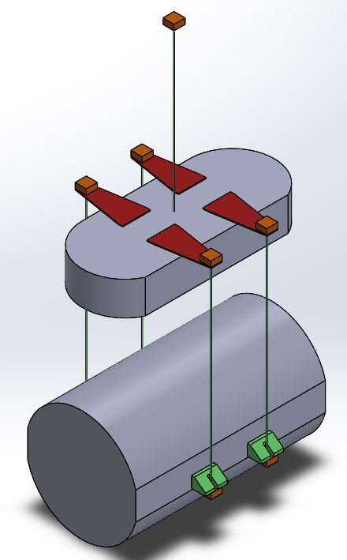
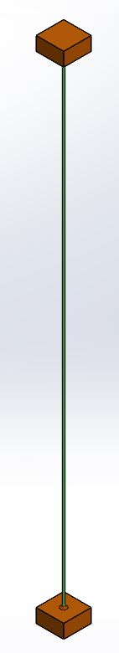
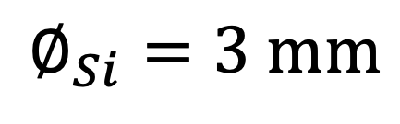
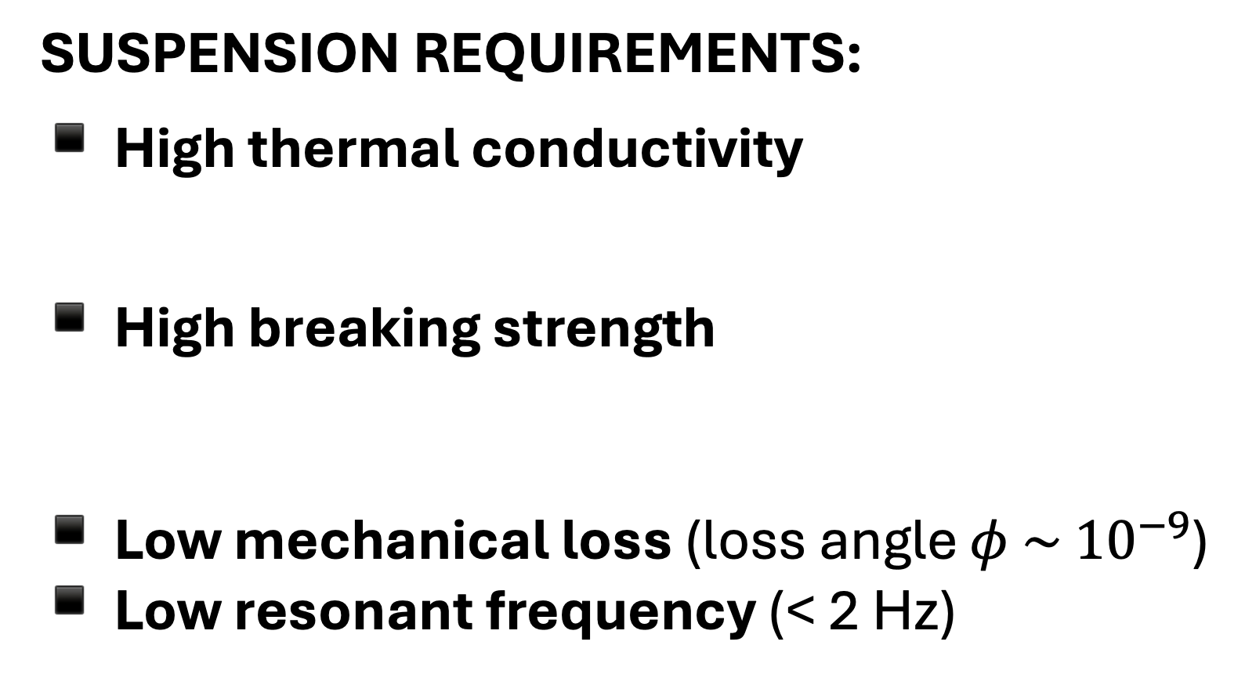
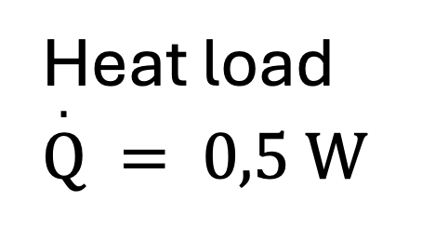
Towards the development of a silicon cryogenic suspension
Heat load $\overset{.}{Q} = 0,5 W$
SUSPENSION REQUIREMENTS:
High thermal conductivity
High breaking strength
Low mechanical loss (loss angle $φ \sim { 10}^{−9}$)
Low resonant frequency (< 2 Hz)
$$∅_{Si}=3 mm$$
Mirror mass 211 kg
Blade
Marionette
Excellent surface quality
Anchor
220 MPa with a safety factor of 3
Low thermal noise
Fiber
Cryogenic temperature (10 K -20 K )
Monocrystalline silicon is one of the most promising candidate materials.
This is due to its thermoelastic nulling regions (zero crossing of the thermal expansion coefficient at 18K and 123K) and low mechanical loss at cryogenic temperatures.
Ear
Substrate
  Michele Arcangelo Dicorato and Nicolò Baldicchi, PAS Rome meeting 2026

Slide 4

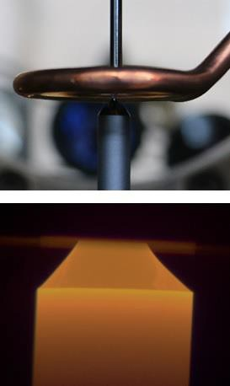
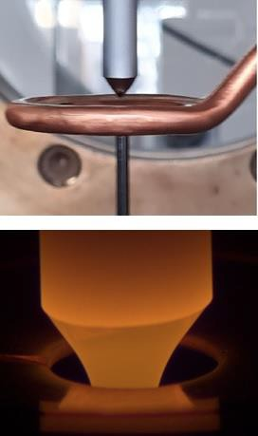
Fiber production
LEIBNIZ ⁻ INSTITUT FÜR KRISTALLZÜCHTUNG
Float-zone technique produces high purity, contaminant free, single crystal uniform silicon fibers with exceptionally good surface quality.
Pedestal growth
Float zone growth
Crystal
HF
Inductor
Feed
Melt
A silicon feed rod is melted at the bottom using an inductive coil
The molten zone contacts a monocrystalline seed
The seed is moved downwards, and crystallization begins
Molten silicon solidifies into a large single crystal silicon fiber without direct contact with seed rod, minimizing impurities
Pulling
Pulling
  Michele Arcangelo Dicorato and Nicolò Baldicchi, PAS Rome meeting 2026
Notes:
Si-fiber diameter: 3 mm
Diameter variation: +/- 0.1 mm
Length: up to 1.5 m
Reproducible process with low fiber-to-fiber variation

Slide 5
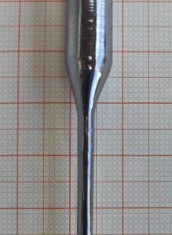

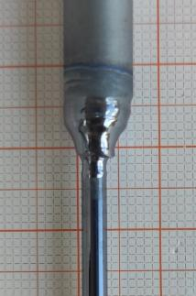

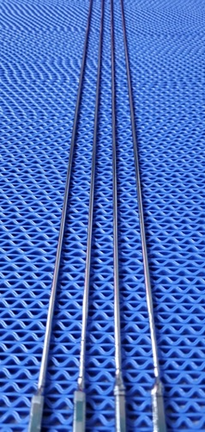
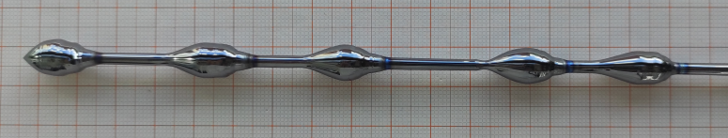
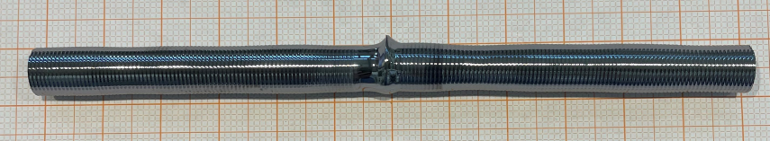
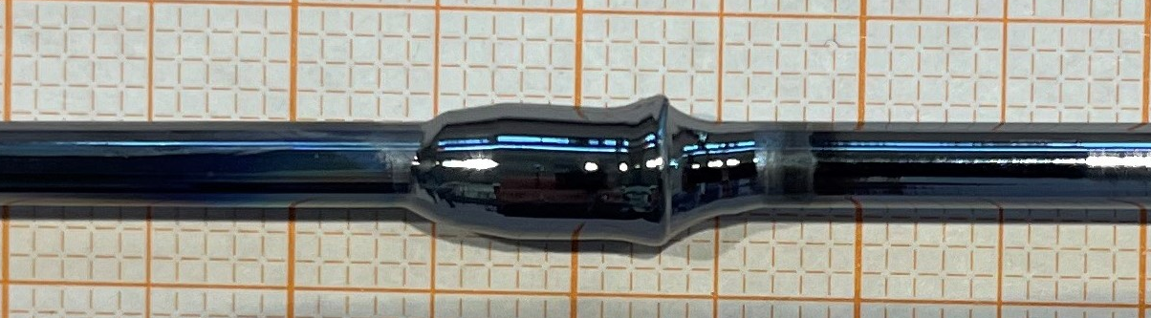
Fiber production
Welding of 8 mm rods
Welding of 3 mm rods
Long fibers with grown thicker ends
  Michele Arcangelo Dicorato and Nicolò Baldicchi, PAS Rome meeting 2026

Slide 6
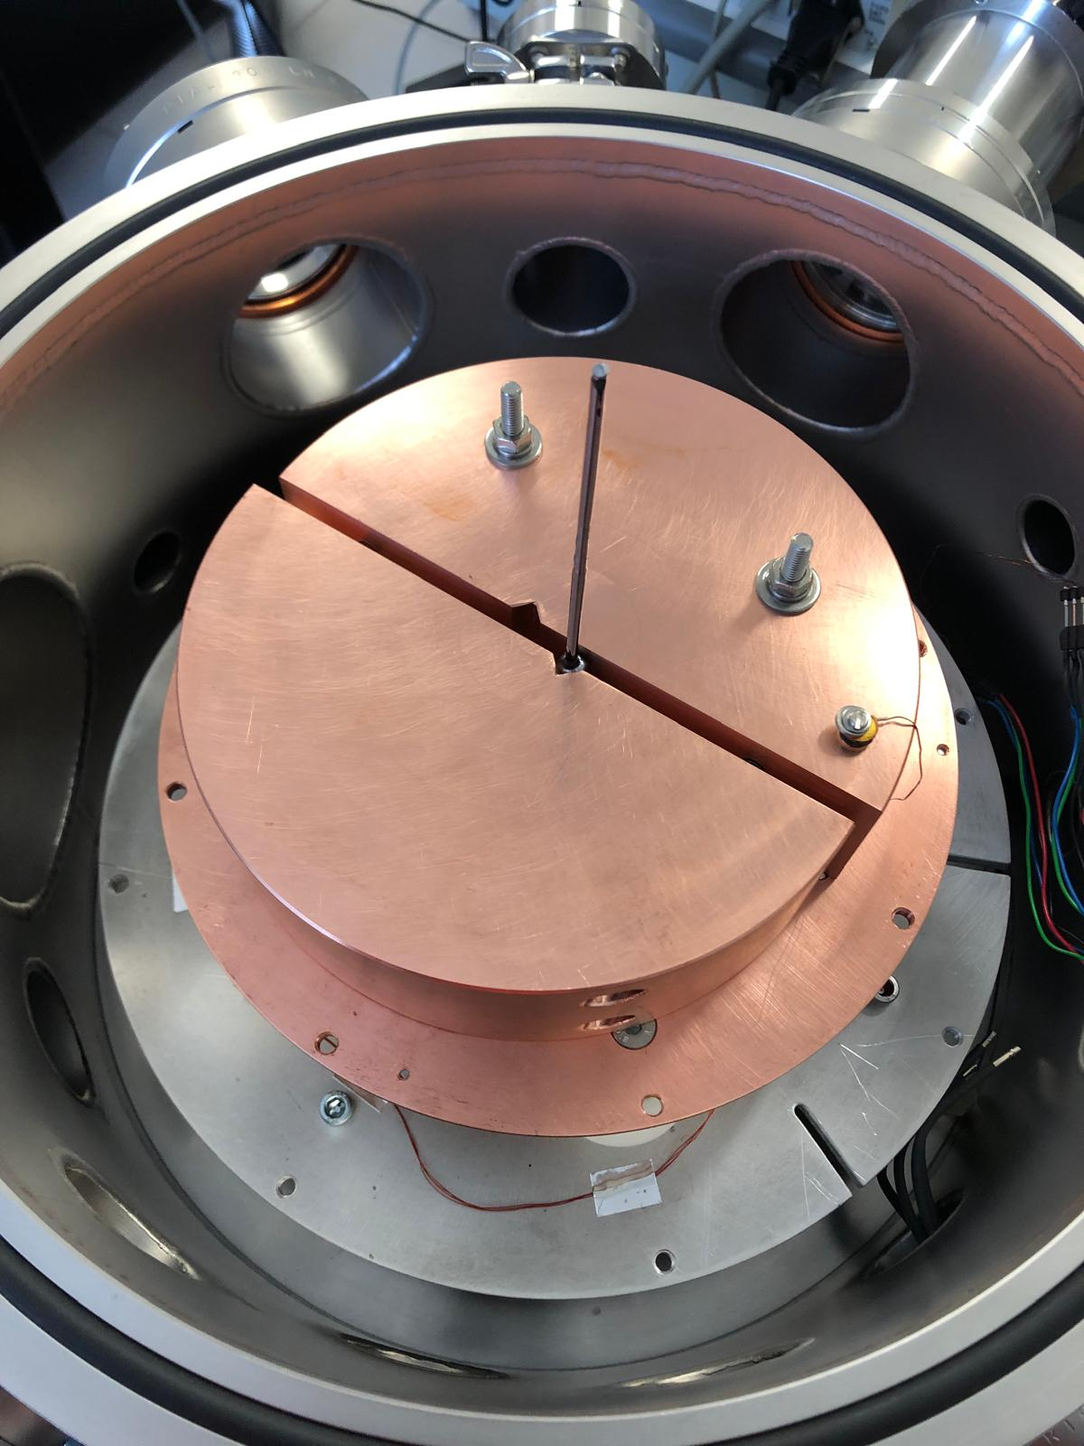
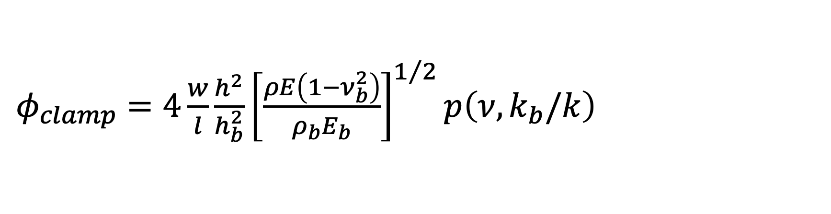

Fiber characterization
Mechanical loss measurements
Mechanical loss measurements at the University of Camerino to accurately measure the loss of fibers with the ring-down method
If the fiber has an excellent surface quality and a good crystallinity, the limiting factor for this measurement at cryogenic temperature is the clamp loss
Clamp material (rigidity, density)
Clamp dimensions
Fastening strength
$$h_{b}$$
$$φ\left(ω\right)=φ_{bulk}+φ_{surface}+φ_{thermoelastic}\left(ω\right)+φ_{clamp}\left(ω\right)+φ_{gas}\left(ω\right)+φ_{other}(ω)$$
[Douglas M. Photiadis and John A. Judge Attachment losses of high Q oscillators]
$φ_{clamp}=4\frac{w}{l}\frac{h^{2}}{h_{b}^{2}}{\left[\frac{ρE\left(1−ν_{b}^{2}\right)}{ρ_{b}E_{b}}\right]}^{1/2}p\left(ν,k_{b}/k\right)$
  Michele Arcangelo Dicorato and Nicolò Baldicchi, PAS Rome meeting 2026

Slide 7
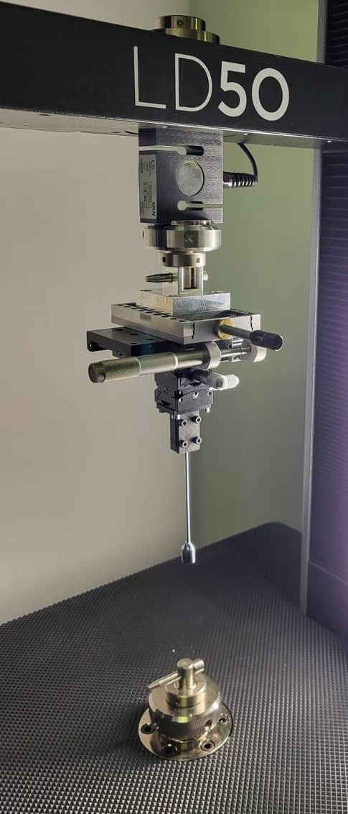
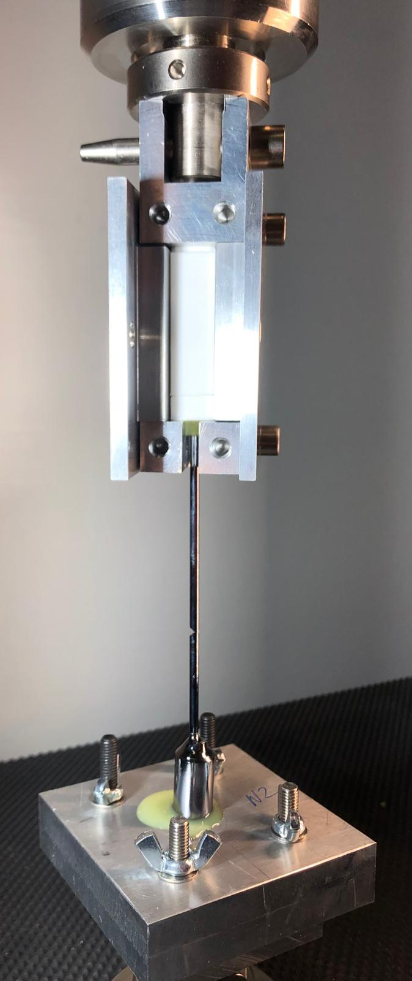
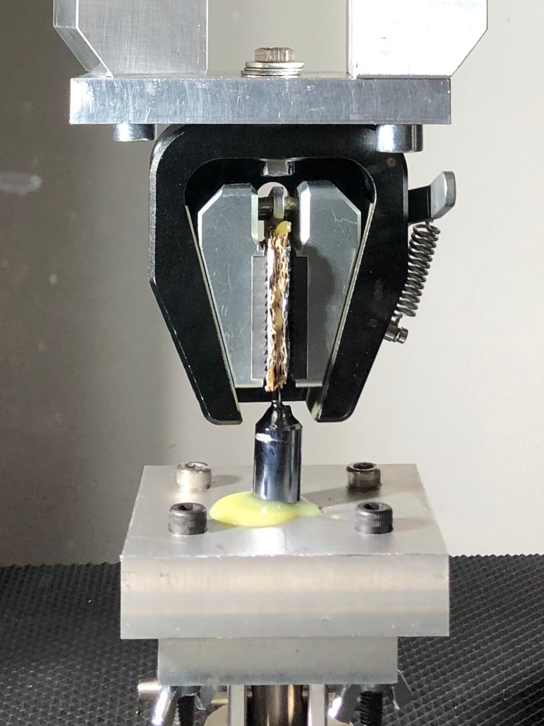
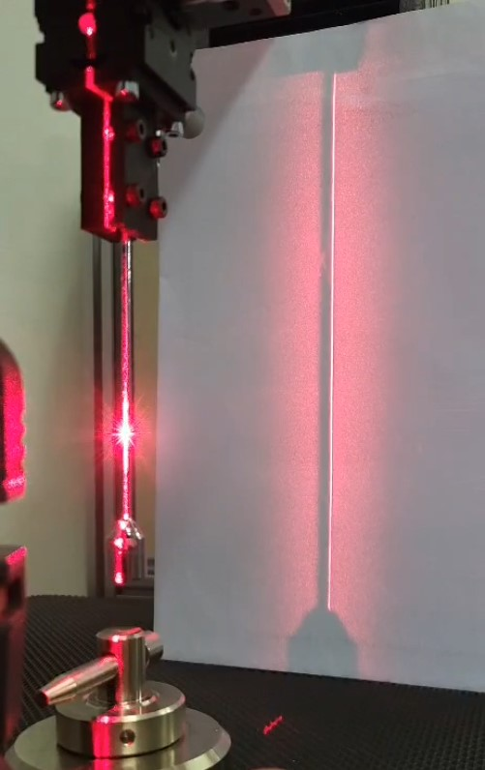
Fiber characterization
Tensile stress measurements
Fiber with seed
(Perugia method)
Fiber without seed
(Glasgow method)
Vertical Alignment with micrometric controls and laser level
Work done with Ardiana Nela and Dr Flavio Travasso at the University of Perugia
  Michele Arcangelo Dicorato and Nicolò Baldicchi, PAS Rome meeting 2026

Slide 8
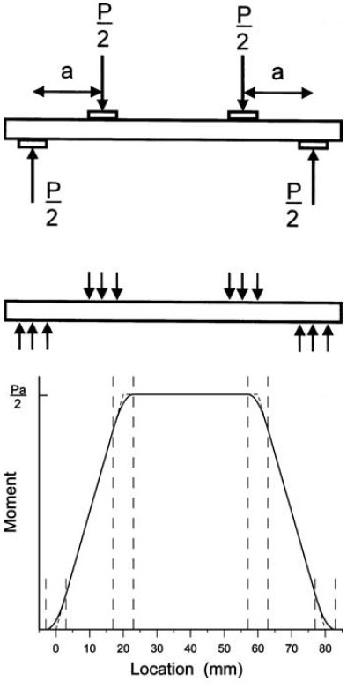
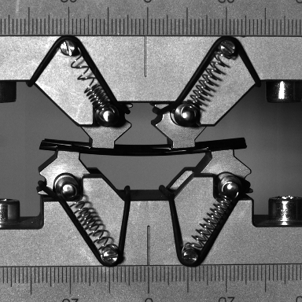
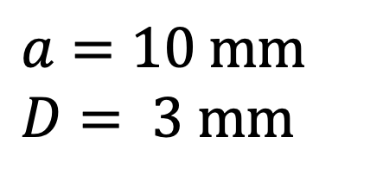
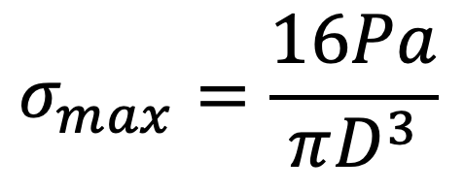
Fiber characterization
Bending stress measurements
2a
4-point bending method
Maximum tensile stress
$$σ_{max}=\frac{16Pa}{πD^{3}}$$
$$a=10 mm$$
$$D= 3 mm$$
Why bending test?
To determine the assembly precision (some misalignment in the assembly can cause the fiber to bend)
To determine the dynamic displacement range during the setup of the active controls
Bending system designed and optimized for cylindrical rods 3 mm thick and 5 cm long, according to the standard ASTM C1684-18 2023
Work done with Ardiana Nela and Dr Flavio Travasso at the University of Perugia
[Quinn et al., Journal of Testing and Evaluation, 2009]
  Michele Arcangelo Dicorato and Nicolò Baldicchi, PAS Rome meeting 2026

Slide 9
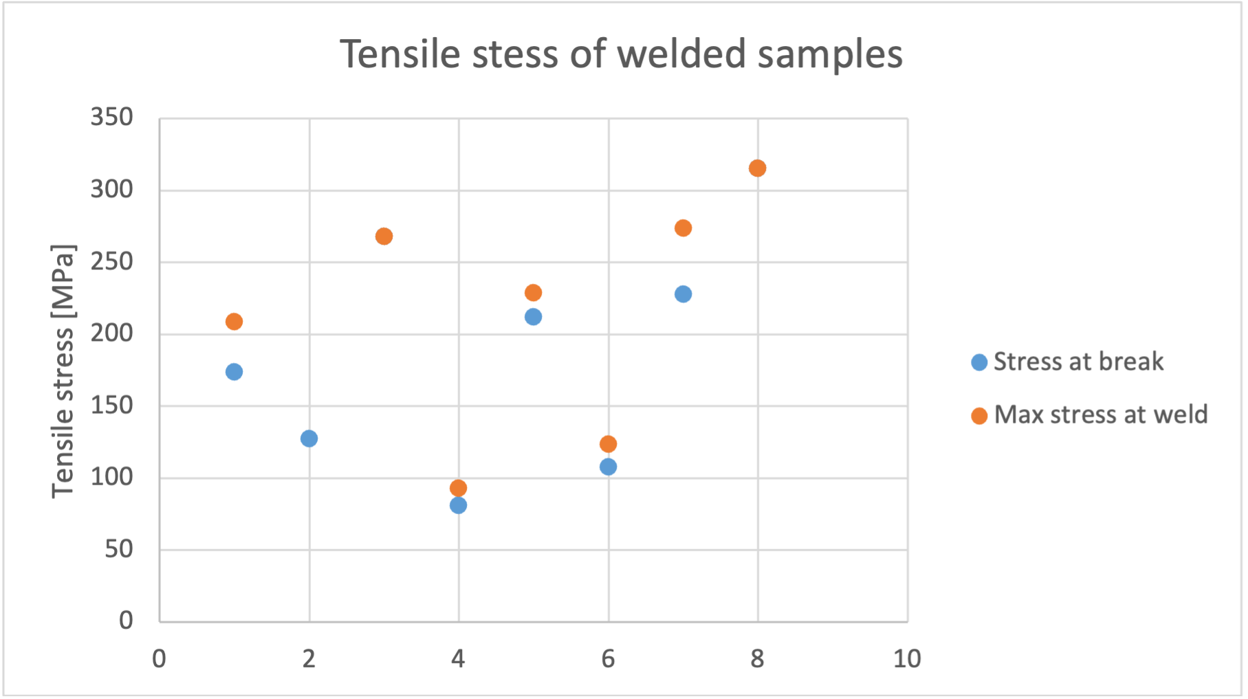
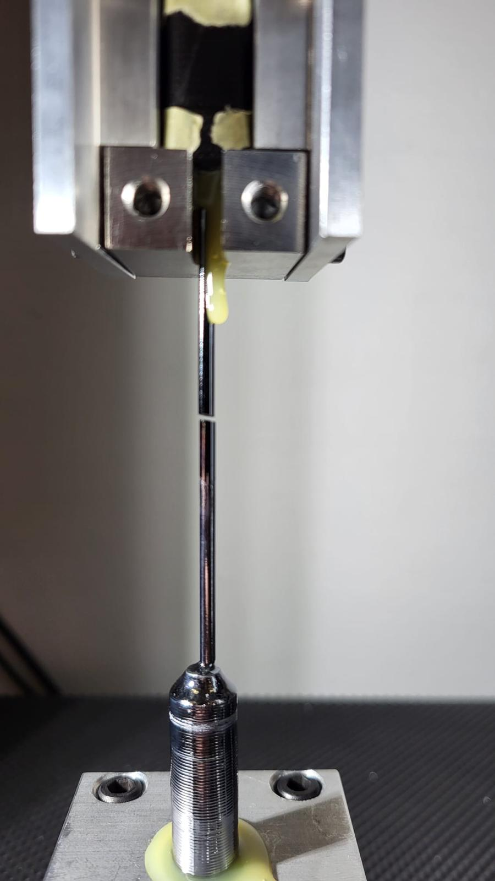
Tensile tests
The good news is that fibers don’t break at the welding point
Data dispersion on tensile tests is most likely due to imperfection on the fibers (microcracks) caused by a not optimal shipping and handling technique
  Michele Arcangelo Dicorato and Nicolò Baldicchi, PAS Rome meeting 2026

Slide 10
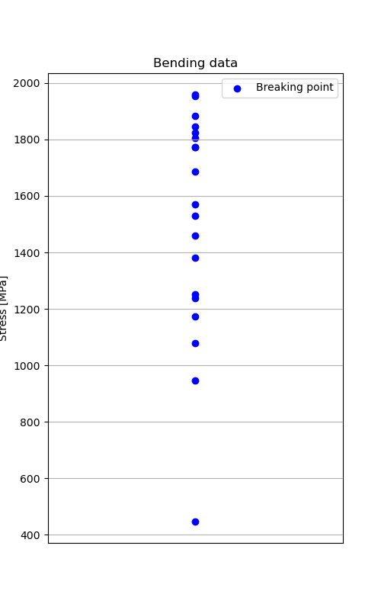
Bending tests
Lower dispersion but still some outliers
From the high speed camera we can see that the break is due to a microcrack on the surface of the fiber
  Michele Arcangelo Dicorato and Nicolò Baldicchi, PAS Rome meeting 2026

Slide 11
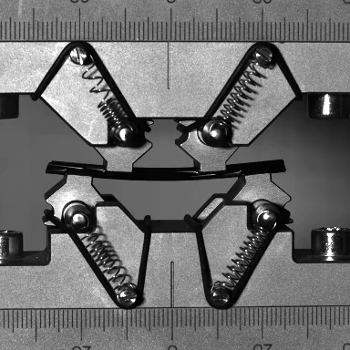
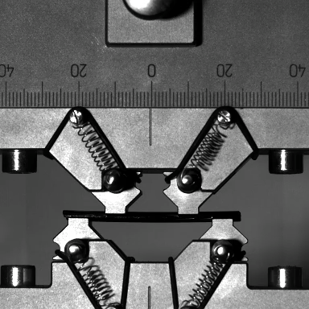
Bending tests
GOOD SAMPLE
OUTLIER
  Michele Arcangelo Dicorato and Nicolò Baldicchi, PAS Rome meeting 2026

Slide 12
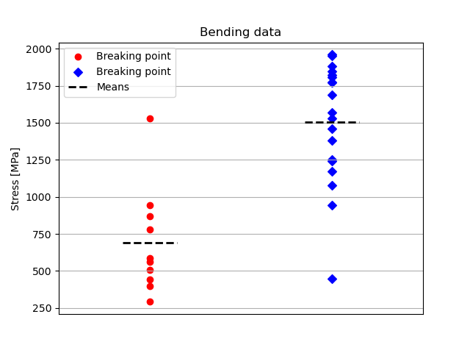
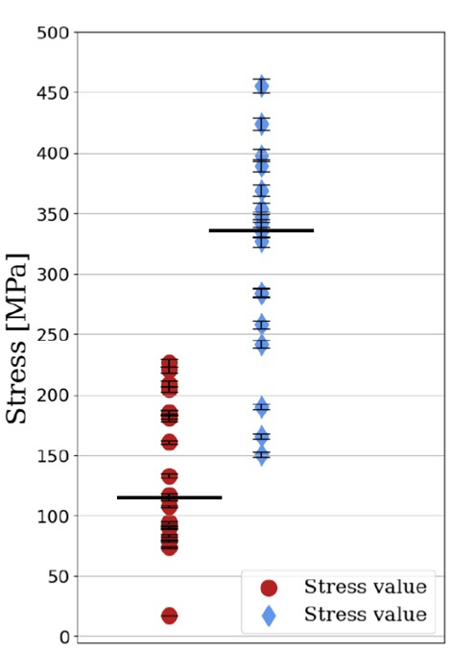
Handling comparison
Tensile data
Same production process but different handling and shipping:
red data = old, blue data = new
  Michele Arcangelo Dicorato and Nicolò Baldicchi, PAS Rome meeting 2026

Slide 13
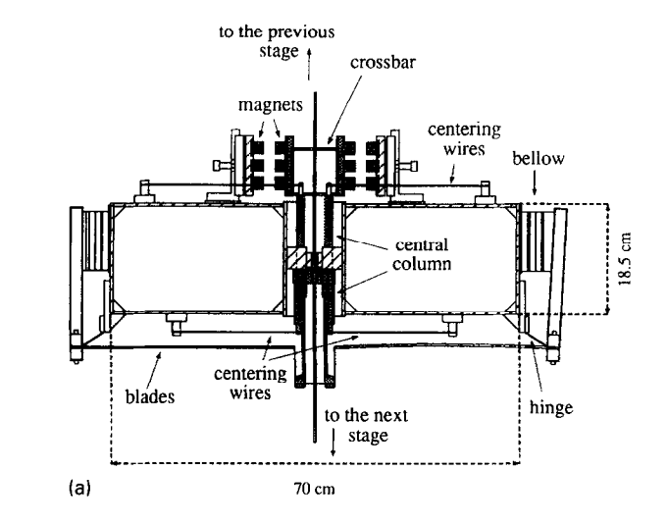
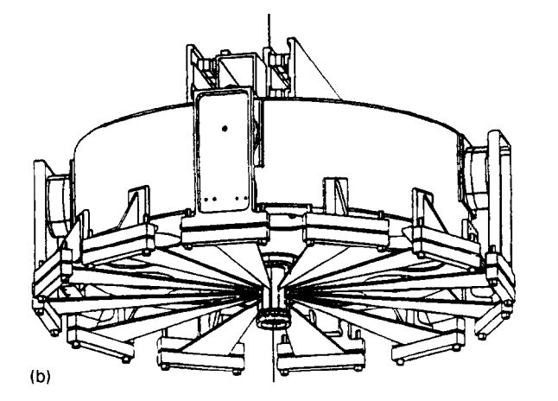
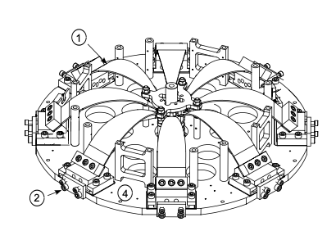
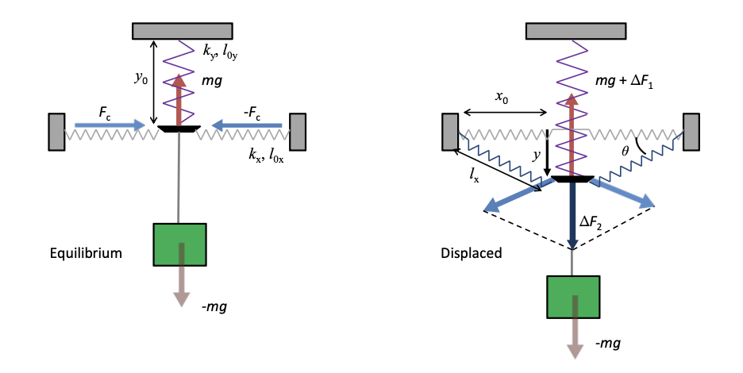
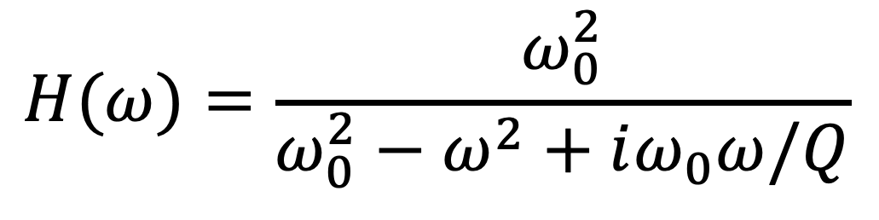
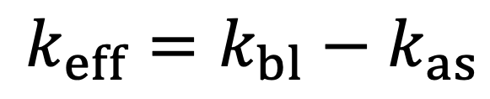
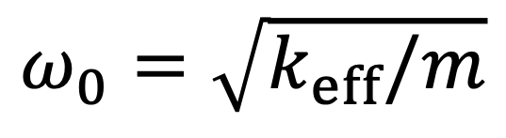
Blades
Why? Attenuation of noises that causes the vertical displacement of the test mass
How? Magnetic anti spring (MAS) or geometric anti spring (GAS)
[Extending the VIRGO gravitational wave detection band
down to a few Hz: metal blade springs and magnetic antisprings, M. Beccaria et al. ]
Future? Monolithic geometric anti spring
$$H(ω)=\frac{ω_{0}^{2}}{ω_{0}^{2}−ω^{2}+iω_{0}ω/Q}$$
$$ω_{0}=\sqrt{k_{eff}/m}$$
$$k_{eff}=k_{bl}−k_{as}$$
[Mathieu Blom PhD Thesis]
  Michele Arcangelo Dicorato and Nicolò Baldicchi, PAS Rome meeting 2026

Slide 14
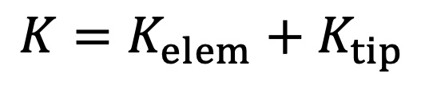
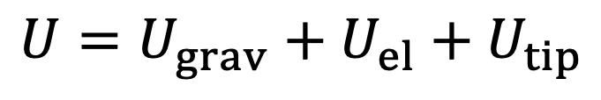
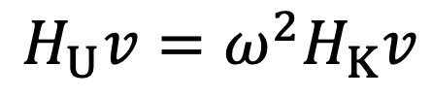
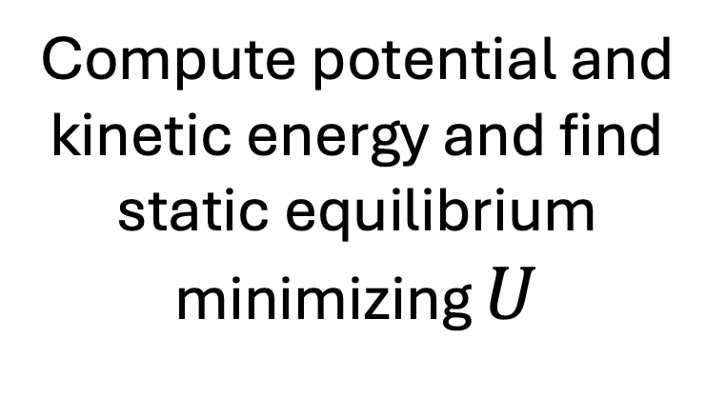
Blades
Finite Linear Element Connected in Series (FLECS): a simulation tool for geometric anti-springs
(with P.Chessa)
θ_f
$$U=U_{grav}+U_{el}+U_{tip}$$
θ_i
$$K=K_{elem}+K_{tip}$$
x
Divide the blade in N finite elements and set the geometric constraints
Compute potential and kinetic energy and find static equilibrium minimizing $U$
Output:
Blade profile at equilibrium
Maximum stress in each element
Modal frequencies
Eigenmodes
$$H_{U}v=ω^{2}H_{K}v$$
Build Hessians and solve the generalized eigenvalue problem
  Michele Arcangelo Dicorato and Nicolò Baldicchi, PAS Rome meeting 2026

Slide 15
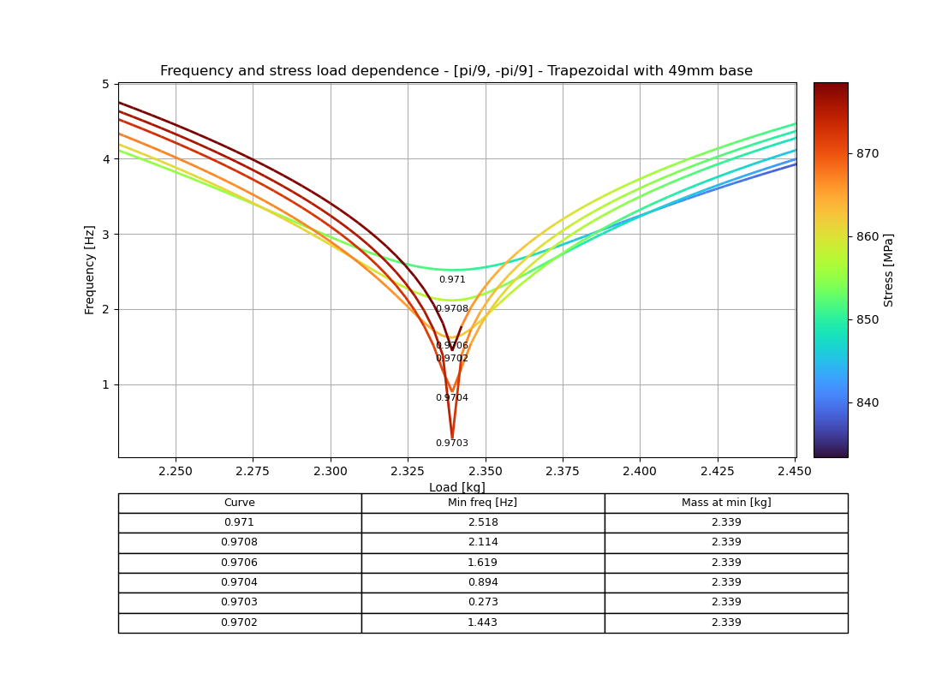
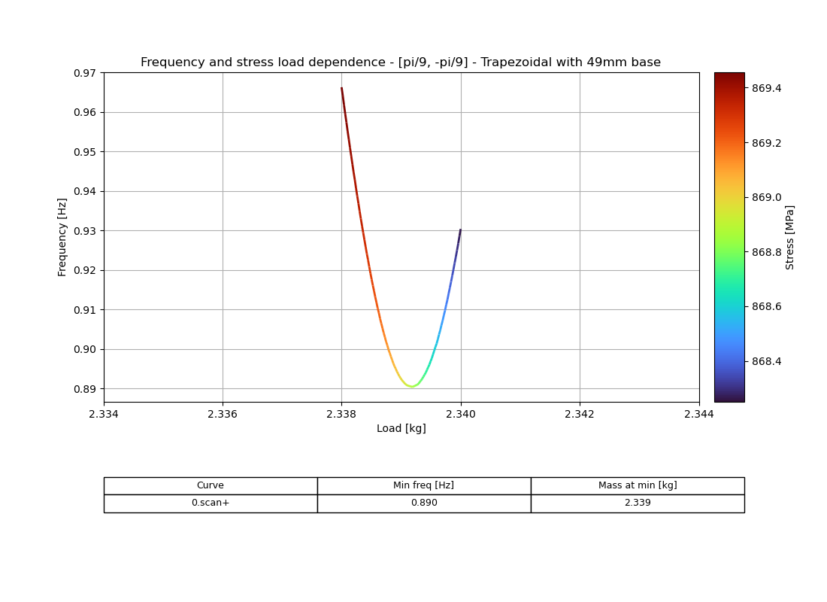
Blades
This allows to do parametric scans for blade prototyping
  Michele Arcangelo Dicorato and Nicolò Baldicchi, PAS Rome meeting 2026

Slide 16
Conclusions
A big international effort is being put into research and development of suspension components for ET-LF
The float zone has been proven to be a very reliable production technique for silicon fibers
Breaking tests have improved but samples handling and shipping methods need to be improved
The collaboration is starting to work also on research and development of spring blades
The nexts step will be to experimentally characterize alternative spring blades arrangements in geometric anti spring configurations
  Michele Arcangelo Dicorato and Nicolò Baldicchi, PAS Rome meeting 2026

Slide 17
Thank you for your attention!
  Michele Arcangelo Dicorato and Nicolò Baldicchi, PAS Rome meeting 2026

Slide 18
Supplementary slides

Slide 19
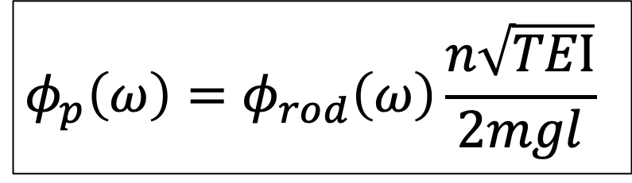
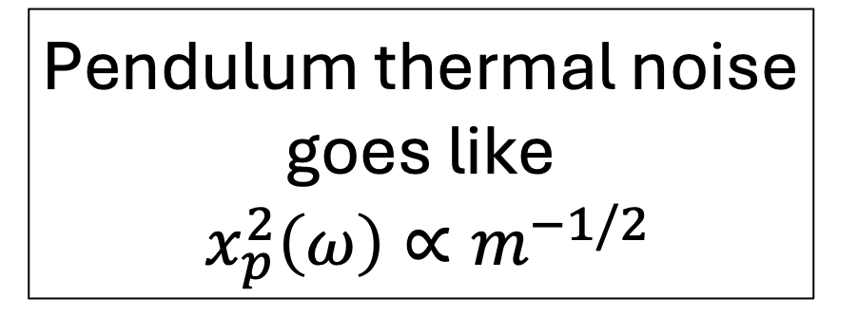
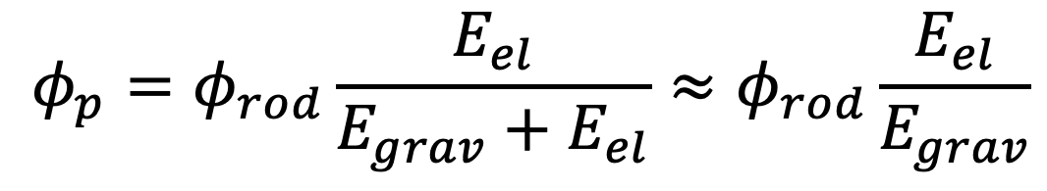
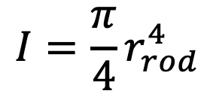
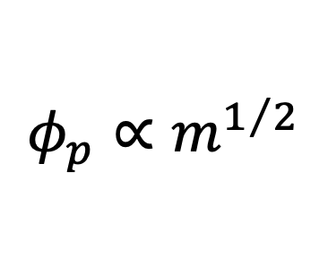









Losses in a pendulum
The energy stored in gravity is lossless and dominates in heavily loaded suspension fibers. This implies that the pendulum loss is lower than that of the material used for the suspension fiber: the only mechanical loss in each cycle is $2πφ\left(ω\right)$ of the total energy stored in the oscillating rod.
$$φ_{p}=φ_{rod}\frac{E_{el}}{E_{grav}+E_{el}}≈φ_{rod}\frac{E_{el}}{E_{grav}}$$
Dilution factor
n: number of wires
E: Young’s modulus
T: tension of the wire
$$D=\frac{E_{el}}{E_{grav}}=\frac{k_{el}}{k_{grav}}$$
$$k_{grav}=\frac{mg}{l}$$
$$k_{el}=\frac{n\sqrt{TEI}}{2l^{2}}$$
$$I=\frac{π}{4}r_{rod}^{4}$$
$$φ_{p}\left(ω\right)=φ_{rod}\left(ω\right)\frac{n\sqrt{TEI}}{2mgl}$$
In the high frequency limit $x^{2}\left(ω\right){∝m}^{−1}$
$$T∝m$$
$$φ_{p}∝m^{1/2}$$
$$I∝m^{2}$$
Pendulum thermal noise goes like
$$x_{p}^{2}\left(ω\right){∝m}^{−1/2}$$
$$φ_{p}\left(ω, n=4\right)=φ_{rod}\left(ω\right)\frac{1}{l}\sqrt{\frac{EI}{mg}}$$
$$if ω≫ω_{p} x_{STN}^{2}\left(ω\right)=\frac{4k_{B}Tω_{p}^{2}φ_{p}}{mω^{5}}$$
A similar analysis shows that goes also like$n^{−1/2}$
Why large and heavy mirrors?
To keep the radiation pressure effect low
To allow large-sized beam spots on the mirror surfaces for lowering thermal noise

Slide 20




Suspension thermal noise
Bulk loss-angle at 10 K:
Silicon <100> $φ_{bulk}: from 1×{10}^{−9} to 5×{10}^{−9}$
4 wires
Length: 1,2 m
Diameter: 3 mm
Mirror mass: 211 kg
Average temperature: 15 K
Pendulum mode $≃0,5 Hz$
First violin mode $≃70 Hz$
$$if ω≫ω_{p} x_{STN}^{2}\left(ω\right) =\frac{4k_{B}Tω_{p}^{2}Dφ_{bulk}}{mω^{5}}$$
Notes:
These are the current baseline parameters, with which the suspension thermal noise is actually below the required sensitivity curve of ET.

Slide 21


Sensitivity of ET
ET sensitivity curve
ET-LF sensitivity curve
Notes:
On the left is shown the expected sensitivity curve of ET, as the sum of the curves of the two interferometers. On the right is shown the ET-LF sensitivity curve as a dark line, which is the sum of all the noise contributions that are marked in color.
Thanks to the multistage pendulum suspensions the influence of seismic noise can be limited to the frequency range below 2 Hz.
The operation at cryogenic temperatures reduces the influence of suspension thermal noise in the frequency range above 7 Hz to below the quantum noise
Below 7 Hz the sensitivity is limited by quantum noise, newtonian noise, and suspension thermal noise.

Slide 22

Rod sizing
Mirror temperature as a function of marionette temperature for some rod diameters, considering 4 silicon rods of length 1,2 m and a heat load of 0,5 W
CURRENT DIAMETER BASELINE CHOICE: d = 3 mm
Notes:
Increasing suspension diameters results in better heat extraction and a lower mechanical stress, despite a higher suspension thermal noise. The current choice for the rods is a diameter of 3 mm.
Considering a heat load of 0,5 W, to keep the mirror within a temperature range between 15 K and 20 K, the marionette must be within a temperature range between 7.5 K and 15.5 K.

Slide 23
Rod sizing
BREAKING STRENGTH
4 wires of 3 mm diameter
211 kg mirror
Stress on each wire = 73 MPa
High variability in the breaking strength measurements
Safety factor of 6
439 MPa tensile strength
Improvement of production process and breaking strength measurements to reduce the safety factor.
LENGTH
A decreasing length yields a reduction of temperature of the mirror, but also shift all the modes to higher frequencies.
Constraint imposed by the tower dimensions and cryostat dimensions
CURRENT REFERENCE LENGTH: 1,2 m
Notes:
With 4 wires of 3 mm diameter supporting a 211 kg mirror, the stress on each wire is 73 MPa. Since there is still high variability in the measurements of breaking strength, in order to consider strength uncertainties, we apply a safety factor of 6. In this case we must have a tensile strength of at least 439 MPa. Improving the production process and the breaking strength measurements the reliability of the fibers would increase and the safety factor could be reduced.

Slide 24

Profiler

