Slide 1
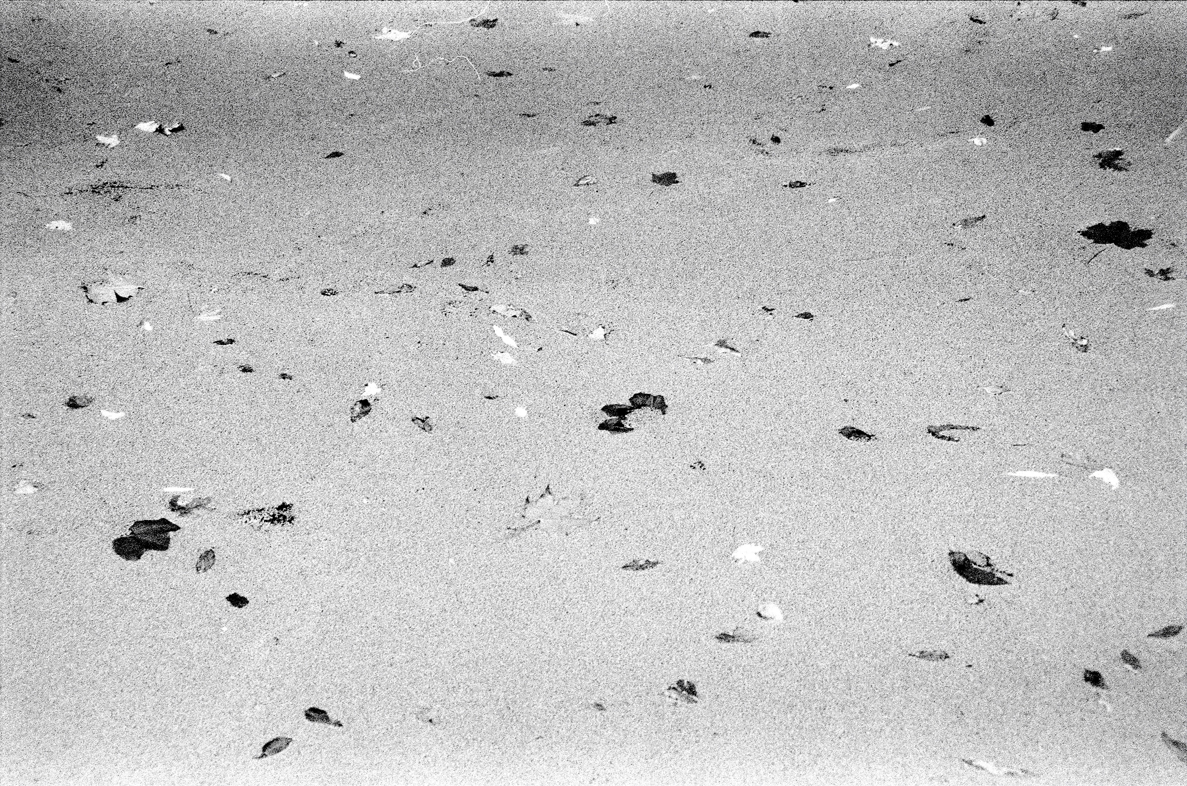
ET design ∩ Optimal control
Multi-scale optimal control for ET active seismic isolation
Pooya Saffarieh, Nathan A. Holland, Michele Valentini, Jesse van Dongen, Alexandra Mitchell, Sander Sijtsma, Armin Numic, Abhay Karia, Wouter Hakvoort, Conor Mow-Lowry
ET Annual meeting, Croatia, November 2025

Slide 2
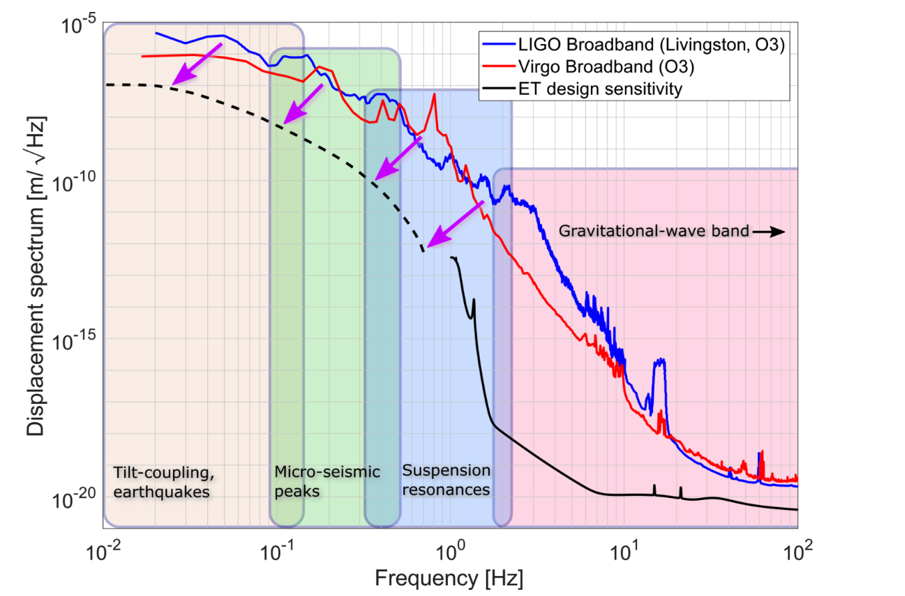


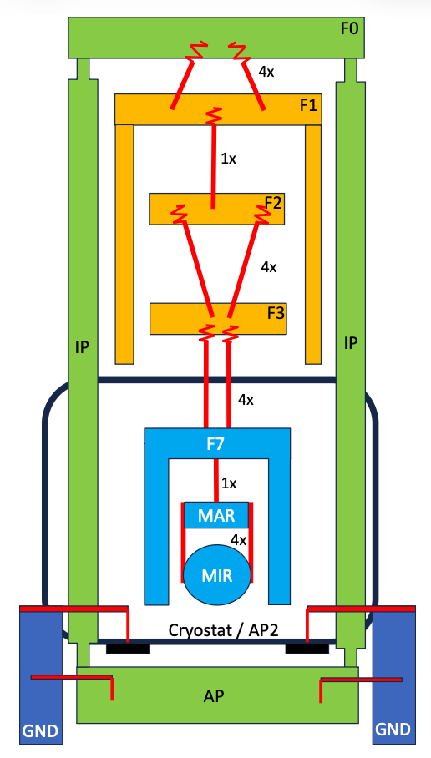


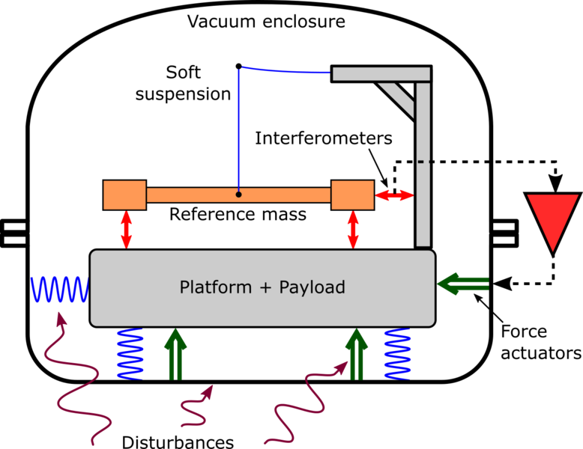

ET requirement
design performance
Subsystem
(e.g suspension)
Design cycle
Active platform

Slide 3
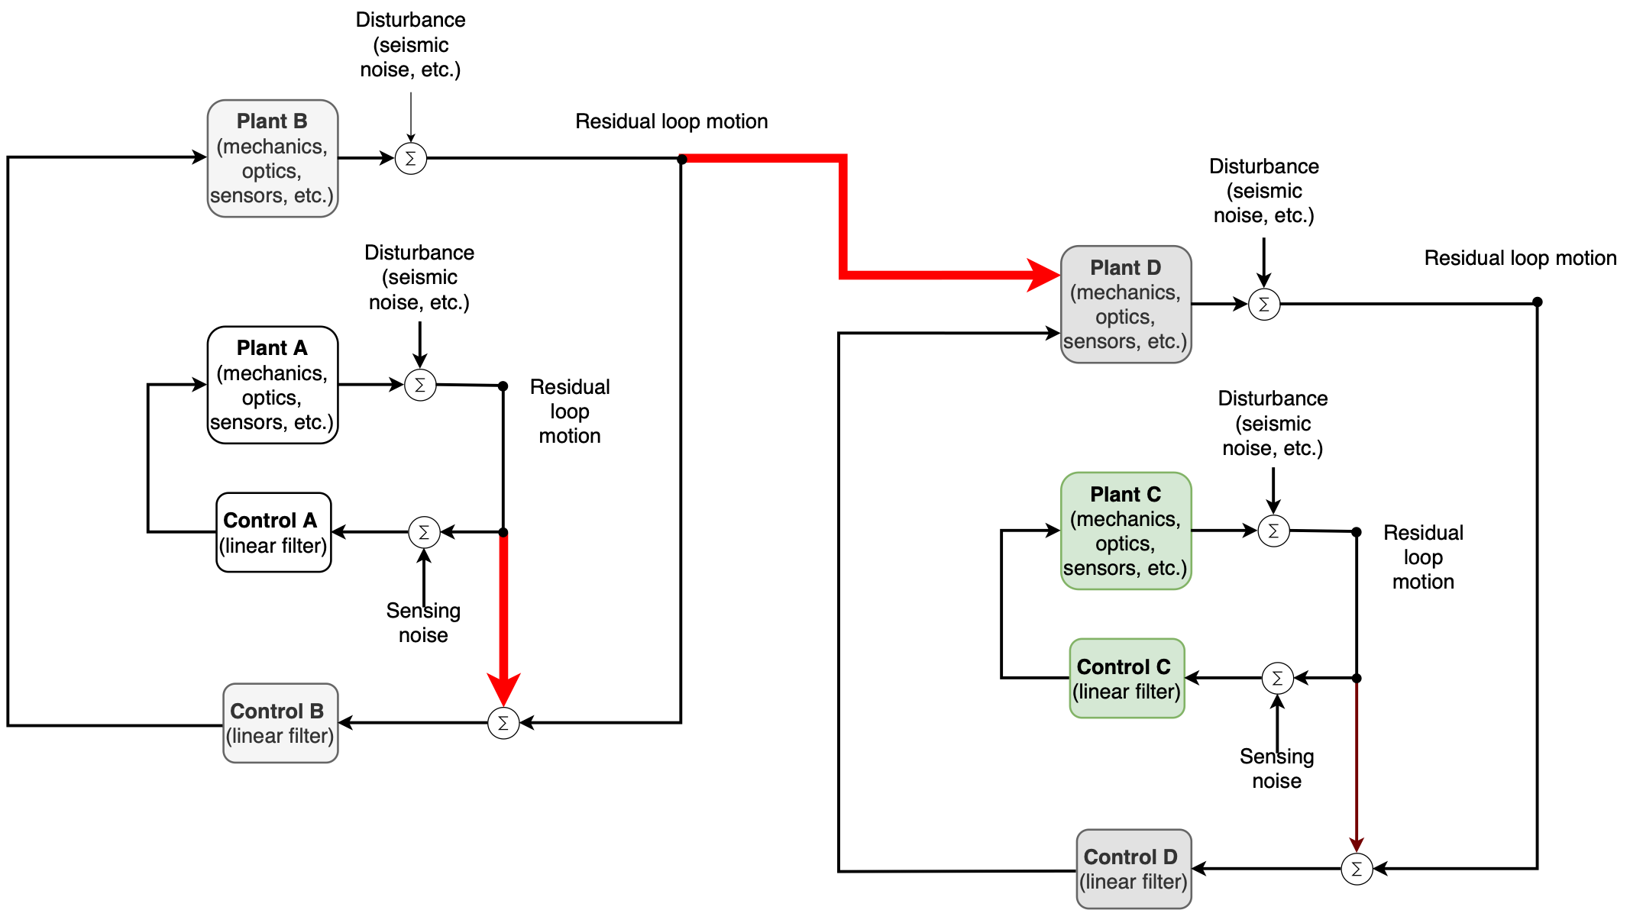
Cross coupling
Multi-scale

Slide 4
Multi scale optimal control
Modeling the plant and noise inputs
Forming acasual optimum and cost function
Optimisation and predicted performance

Slide 5
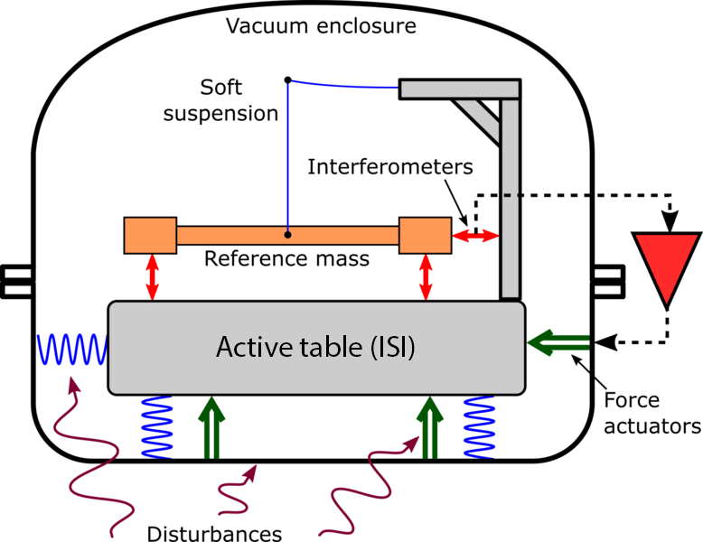
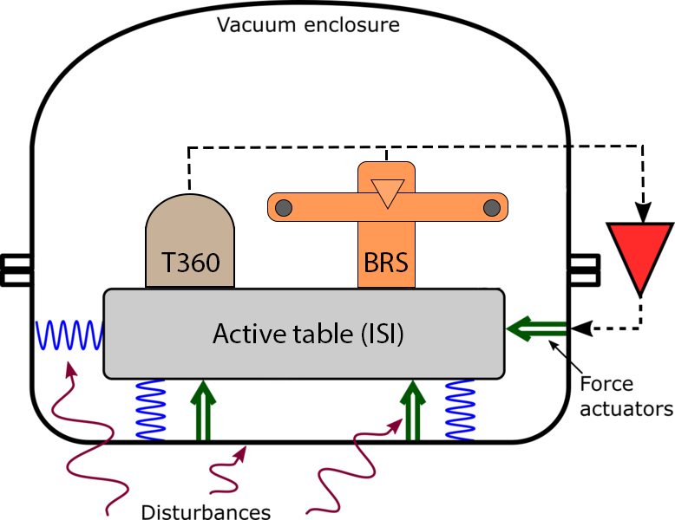
Case study
OmniSens
Softly suspended reference mass with HoQi readout on the reference mass
BRS-T360
Updated Beam Rotation Sensor (BRS) with HoQi readout and T360 seismometer.
Both configurations use same table design ( ISI ) with HoQi readout and seismic modeled noise from LNGS (Italy)

Slide 6
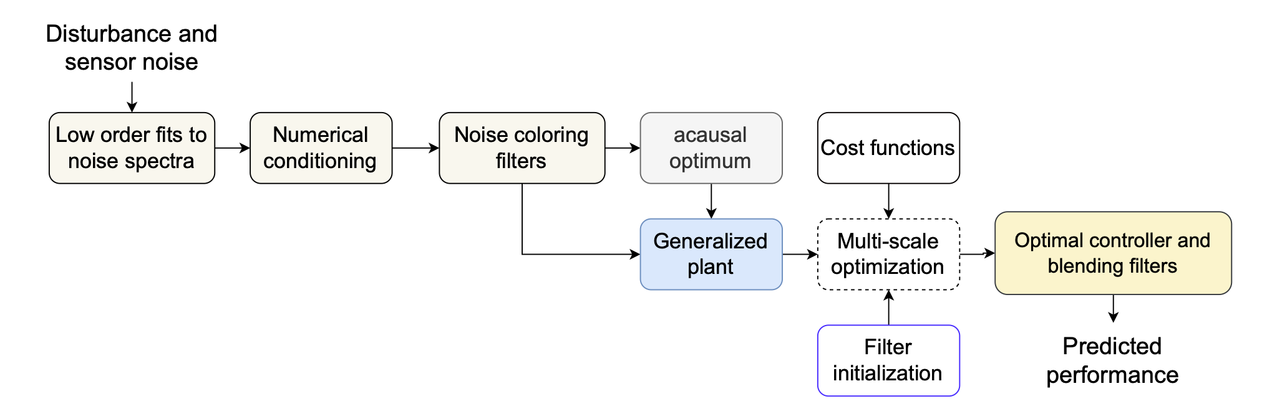
Implementing optimal control
Numerical conditioning:
Acceleration domain reduces dynamic range (whiter spectra)
Sub-gradient algorithm rather than Riccati equation solver

Slide 7

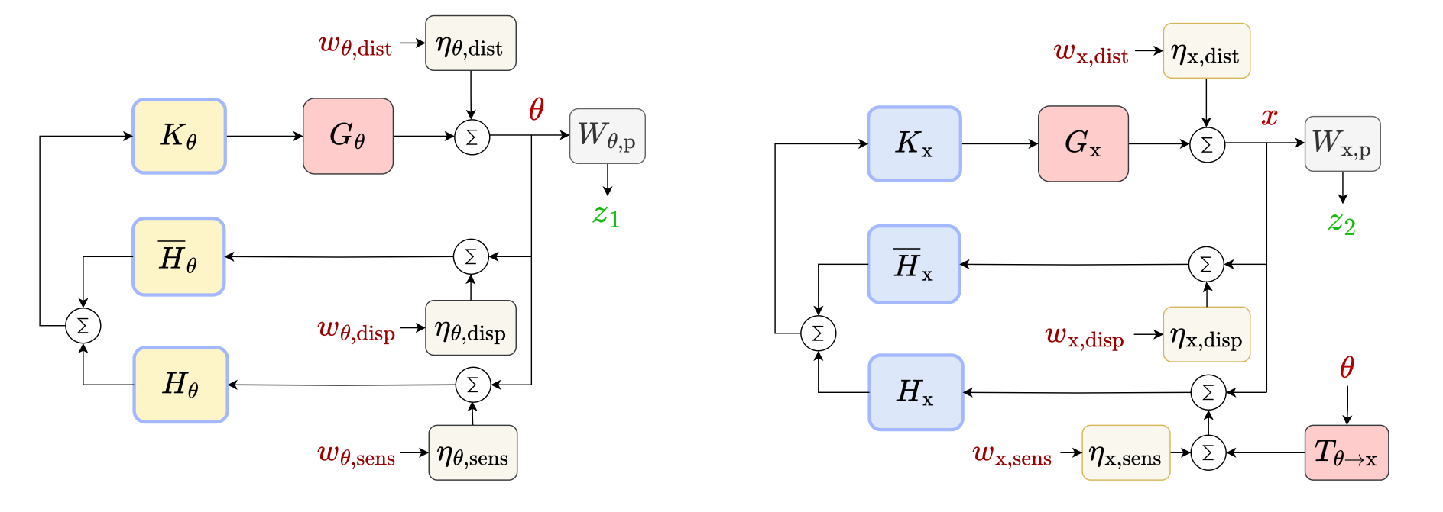







Control block schematic
dist: Disturbance sensor noise
W: weighting function
K: Control filter
z: performance output
H: Blending filter
disp: Displacement sensor noise
sens: Inertial sensor noise
Cross coupling from rotation to translation
Rotatation loop (Ry)
Translation loop (X)

Slide 8
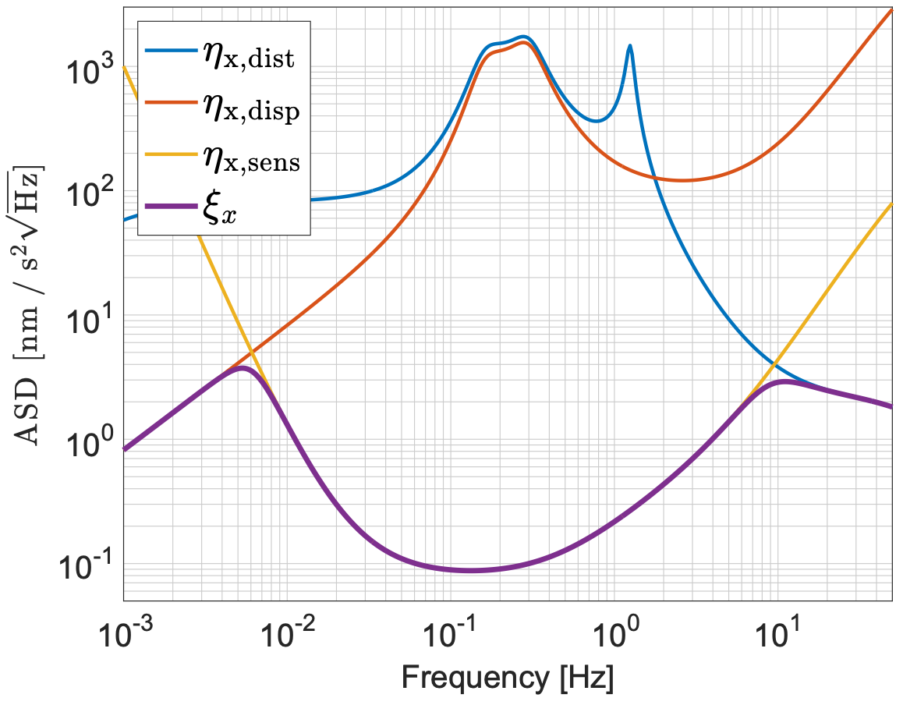






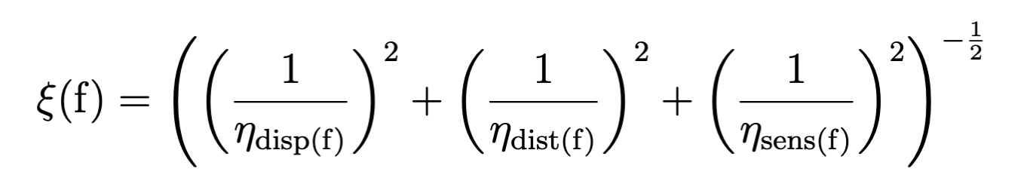
OmniSens acausal optimum decomposition x
free running plant
displacement sensor
inertial sensor
Formal definition acausal curve (optimum):
Fundamental limit on suppression in LTI feedback loop.

Slide 9


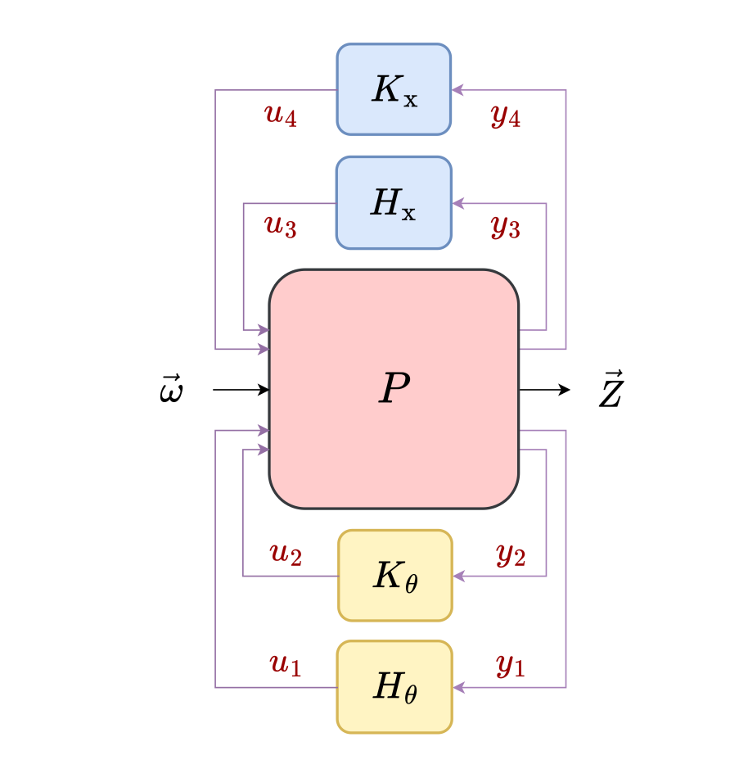
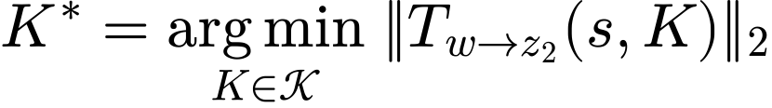





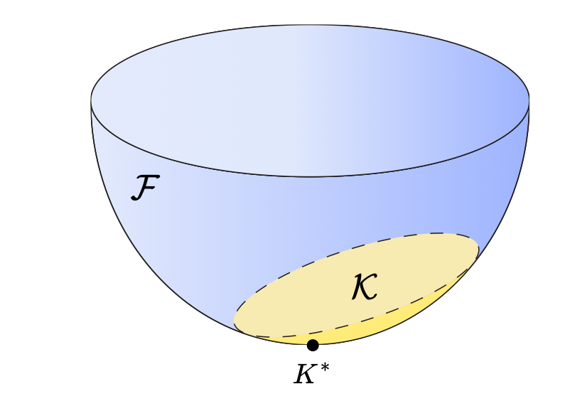
Cost function
weighted closed loop transfer function from input to output
Optimal control filter
H-2 / RMS norm
Set of all filters which satisfy H-infinity criteria
H-infinity / max deviation norm
Input (white noise)
Output (weighted motion)
Generalised plant

Slide 10
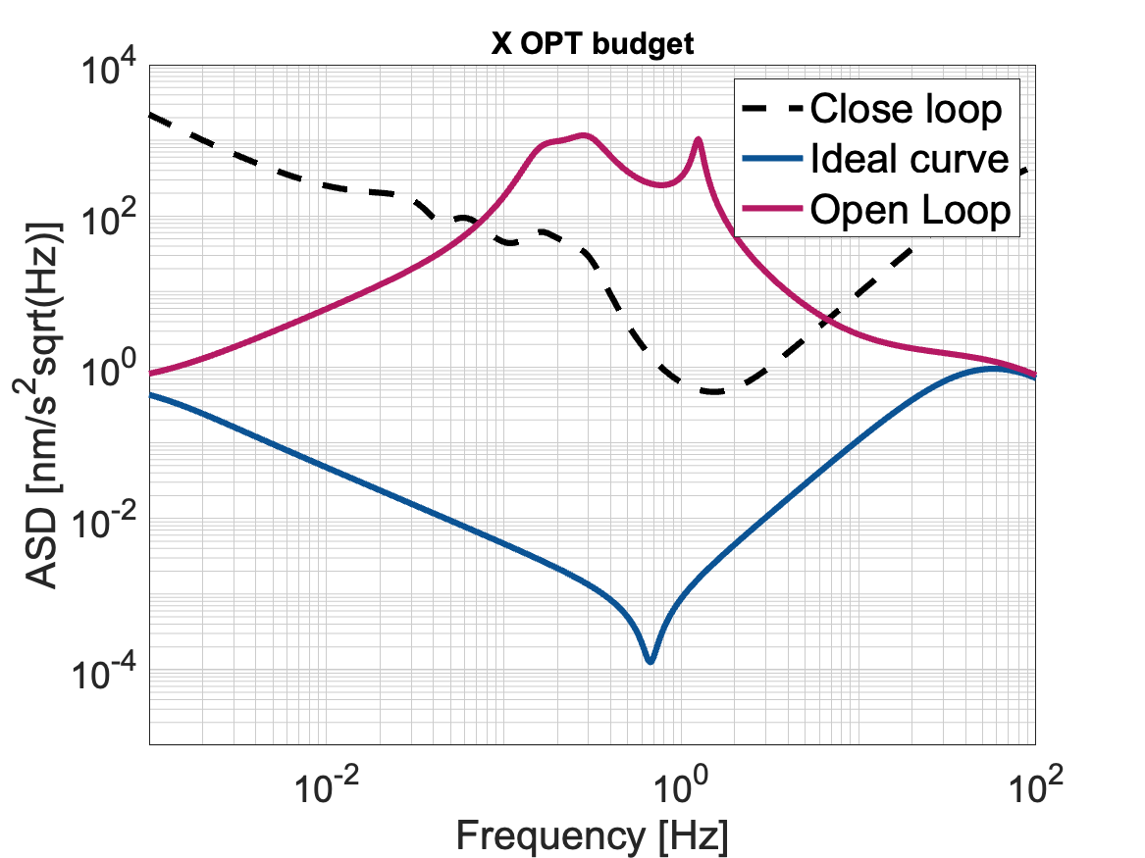
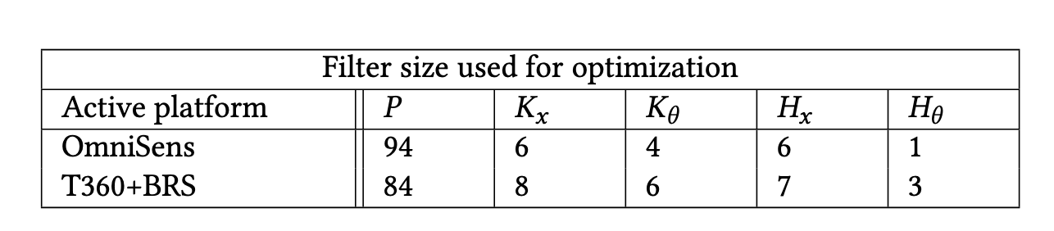
Algorithm
Example optimisation process:
Optimization Method: Sub-Gradient Descent
Filter size and structure are predefined (a priori)
Robust to numerical noise and high dynamic range
No guarantee of reaching a global optimum
Supports complex, multi-objective cost functions

Slide 11
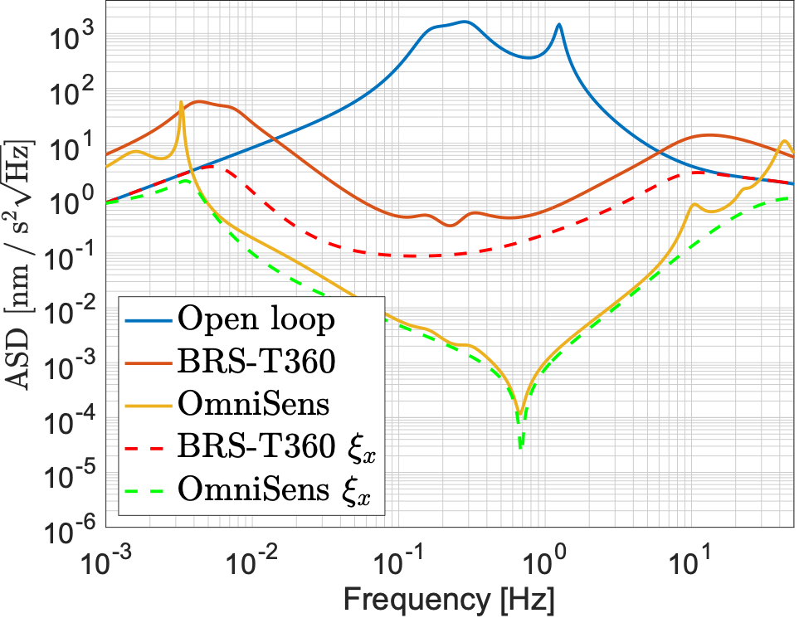
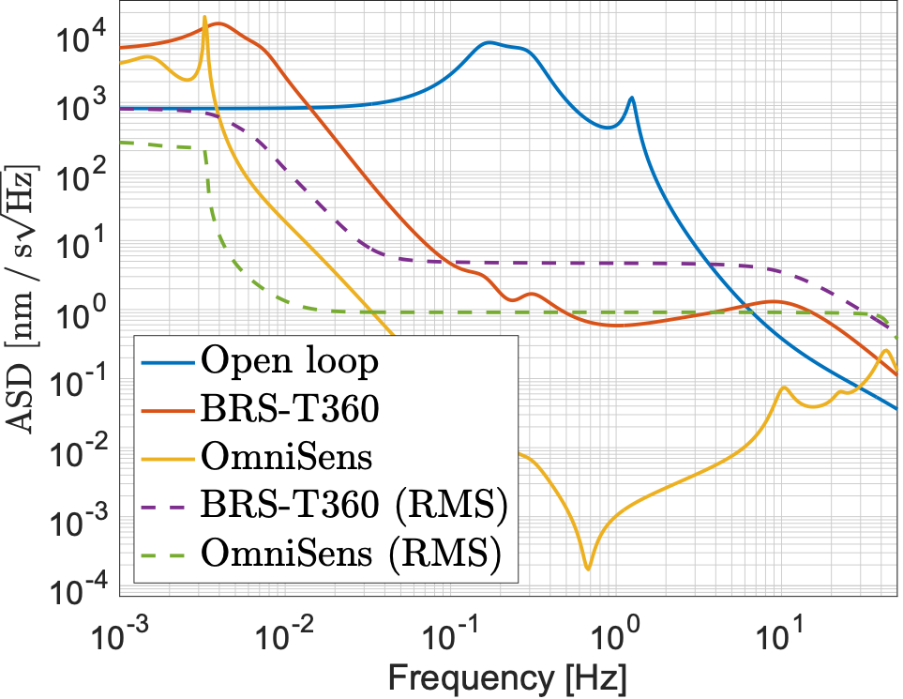
Results: OmniSens vs. BRS-T360
Accelaration
Velocity

Slide 12
Summary
We have solved the problem of defining optimality for seismic isolation, and developed an implementation that resolves numerical noise issues. This method can be directly applied to solutions for ET and it can be readily updated for different sensors, platforms, and input seismic spectra.
ET design necessiates iterative design
Each design relies on active feedback loops involving control filters
Loop structures are multi-scale and coupled
We presented a framework and a fundamental metric, acasusal optimum, which universally solves optimal control problem
We applied the method on two candidate sensor configurations: OmniSens and BRS-T360
OmniSens yeilds lower residual motion as predicted by the closed loop model

Slide 13
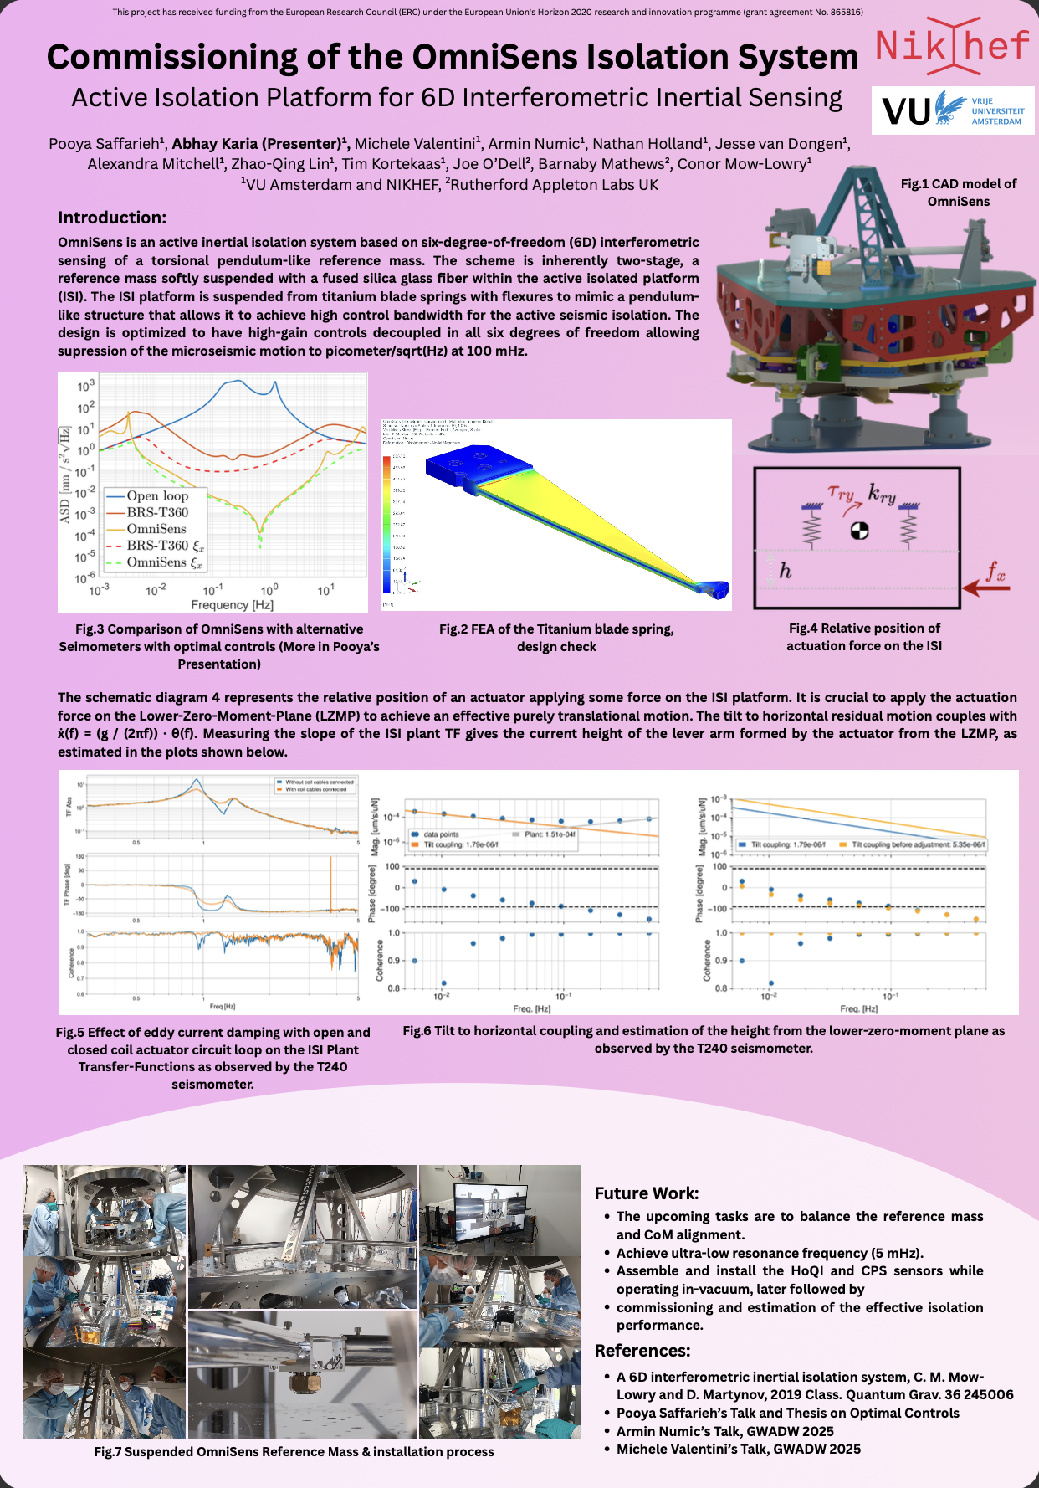
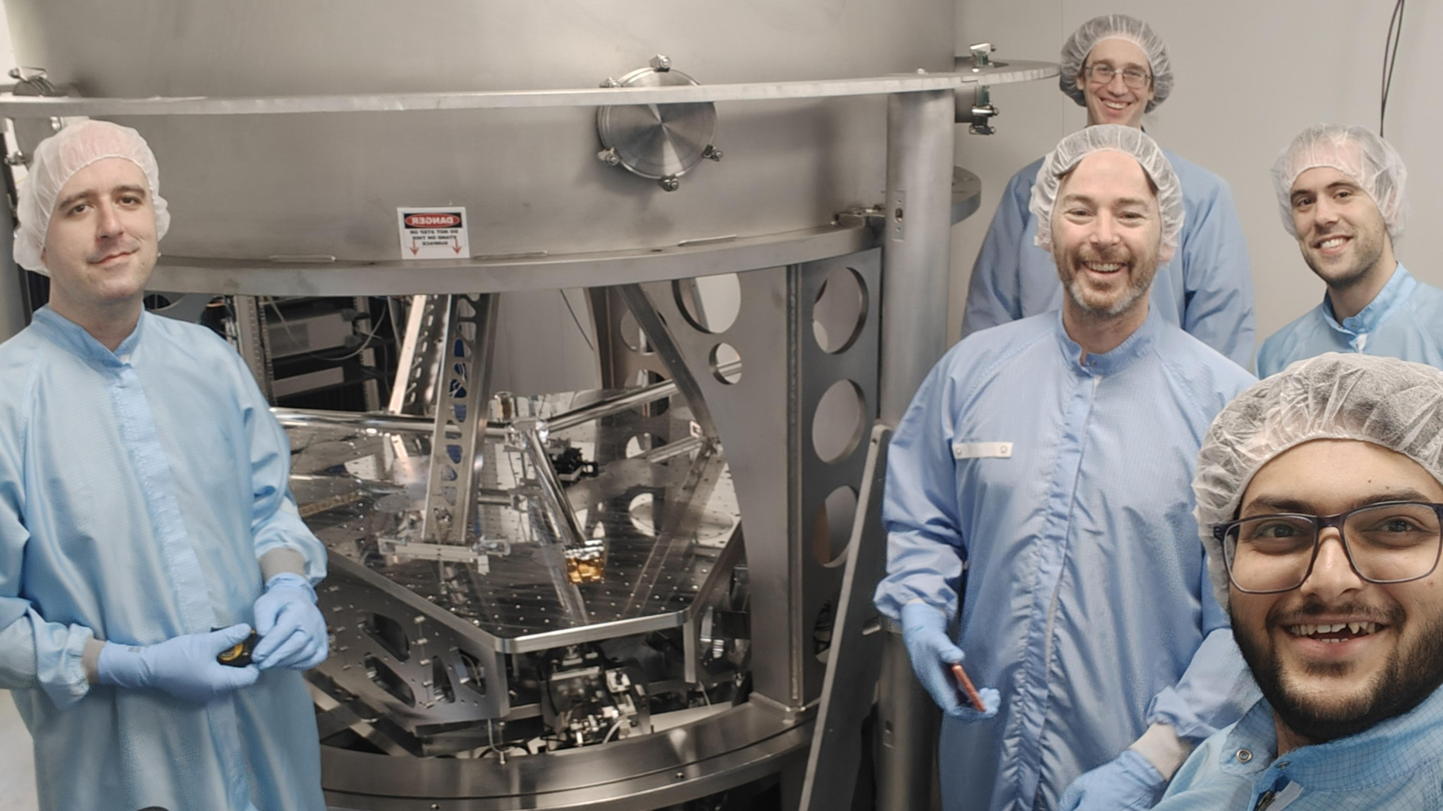
Check out
Abhay Karia poster presentation on OmniSens commissioning

Slide 14
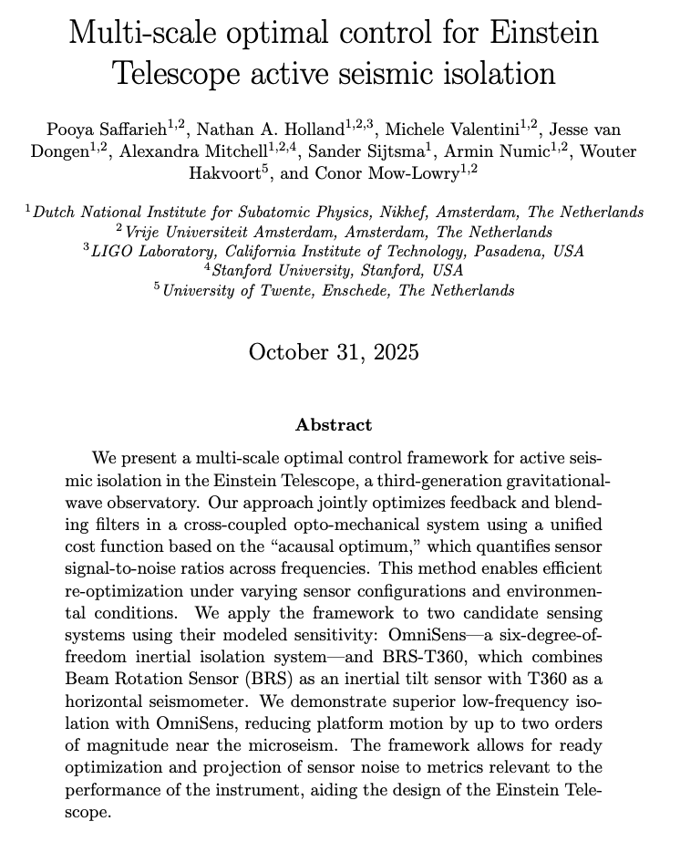
Details and open source code:
Thank you!
https://arxiv.org/abs/2507.15398

