Slide 1
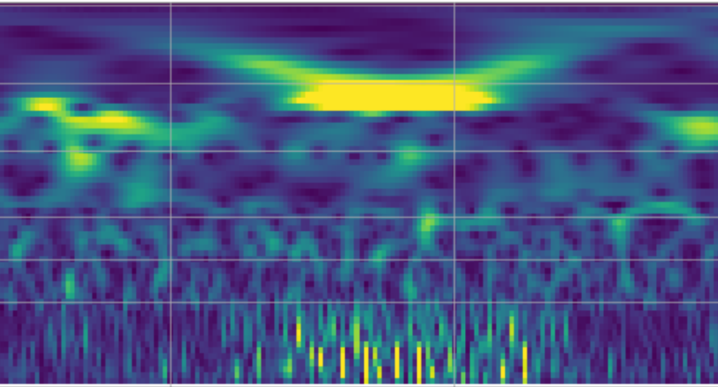
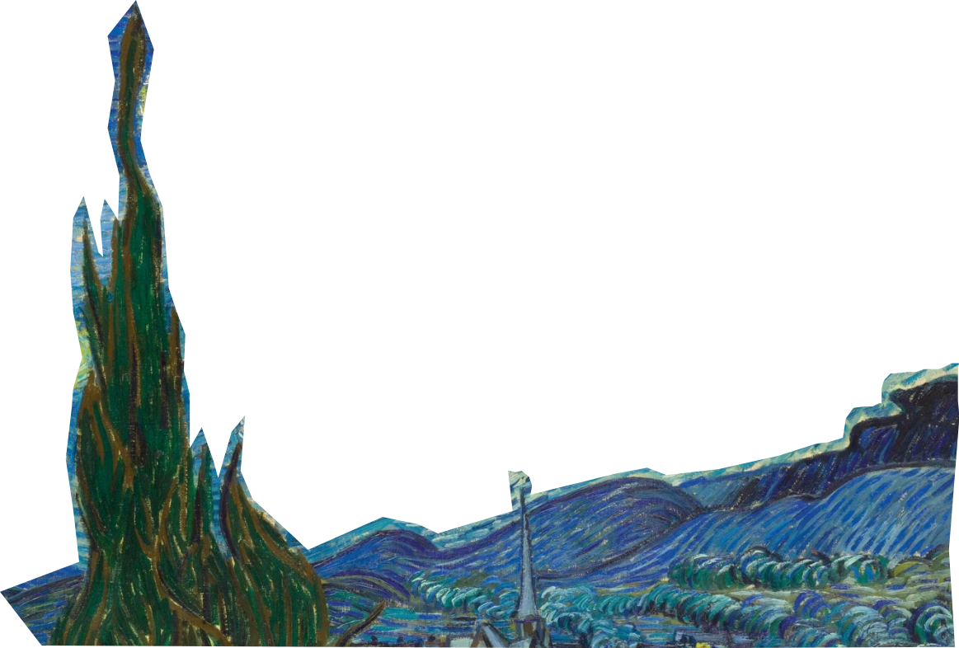
QTAM: Qtransform
Amplitude Modulation
Lorenzo Asprea
INFN Torino ET Group
12/11/25 Opatija, 4th Annual ET Meeting

Slide 2


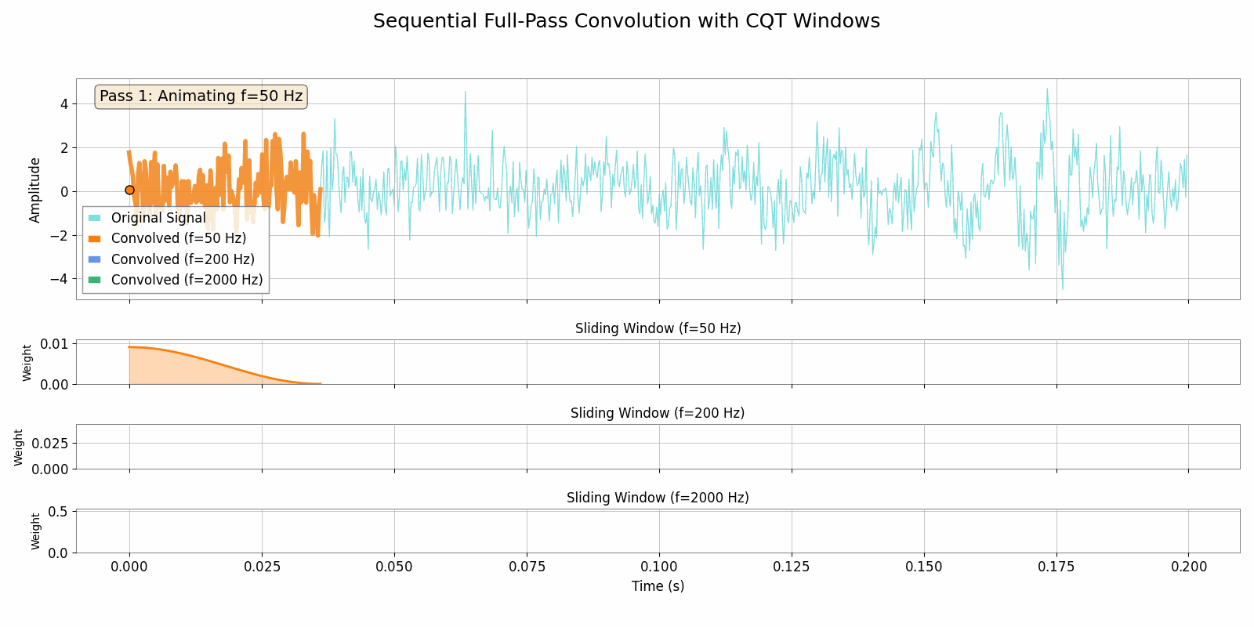
Qtransform: definition

Slide 3

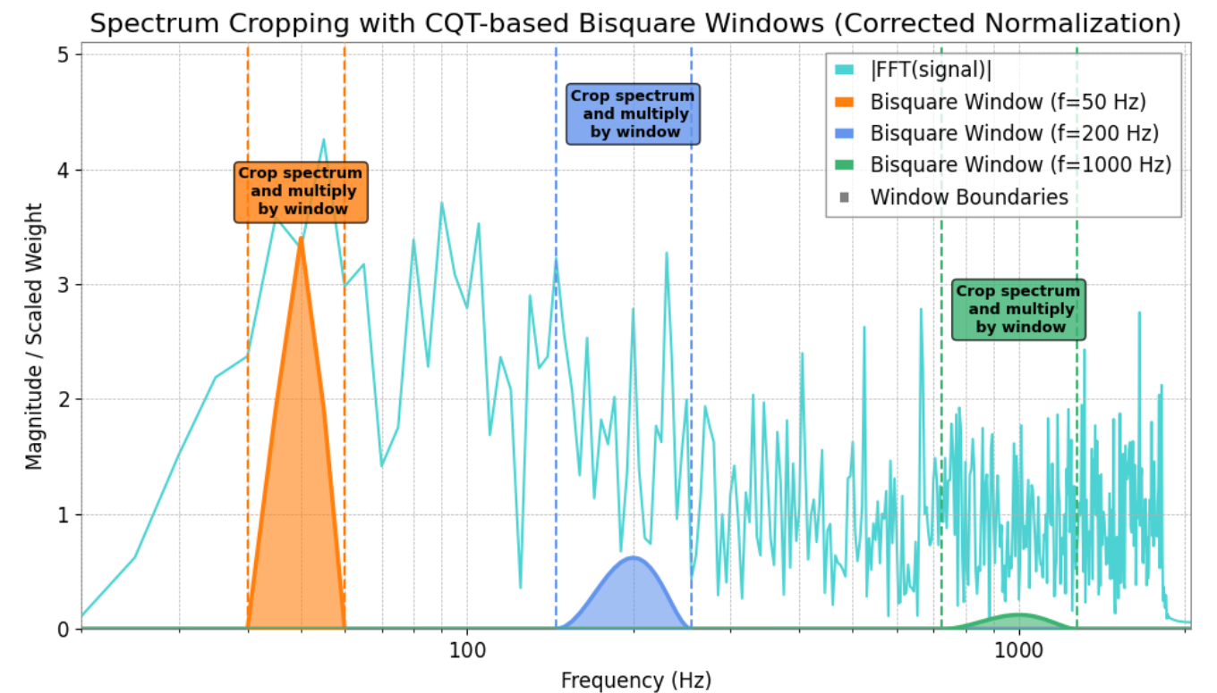
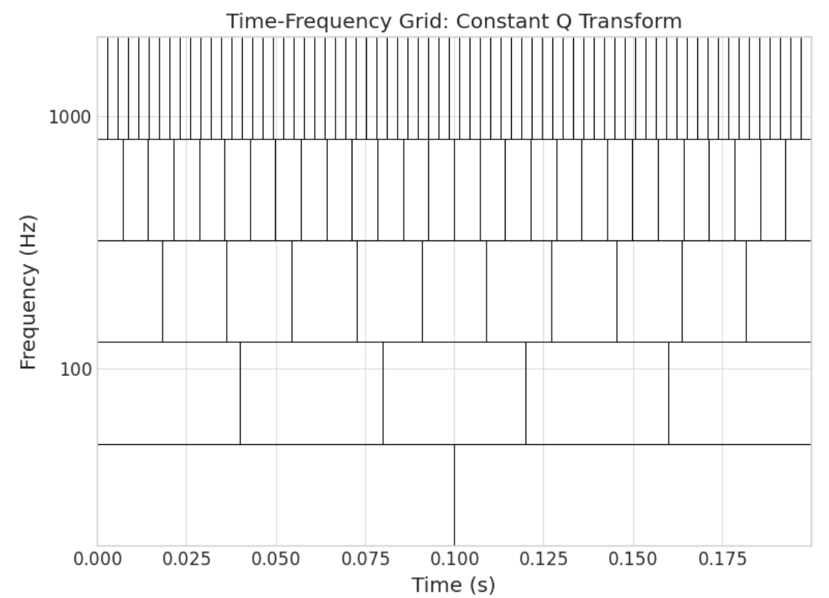

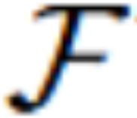





Qtransform: implementation (gwpy)
Convolution theorem
QTile
QTile
QTile
, : Fast Fourier Transform (FFT)
Windows computed in frequency domain:
Energy preservation:
QTile Median Normalization:

Slide 4
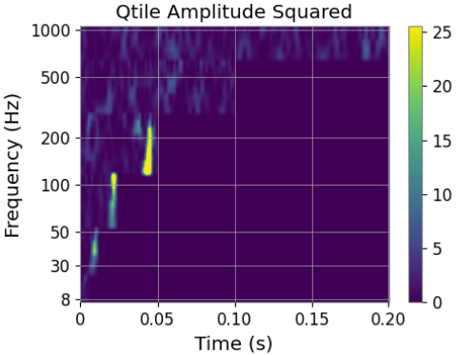
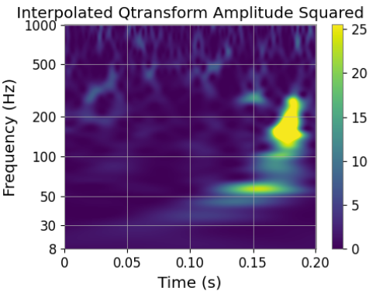
Qtransform: visualization
Complex output → Amplitude squared (Normalized Energy)
QTiles have different length → Bi-spline interpolation

Slide 5
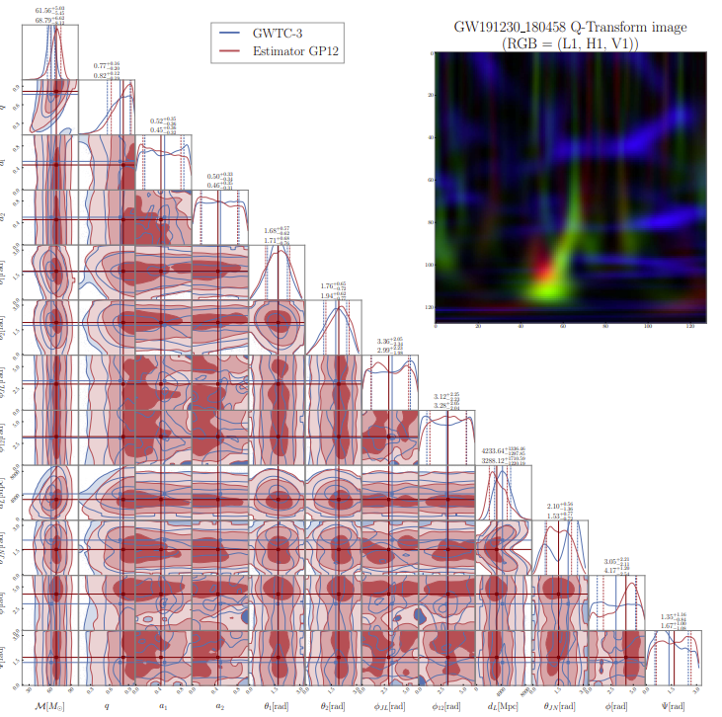
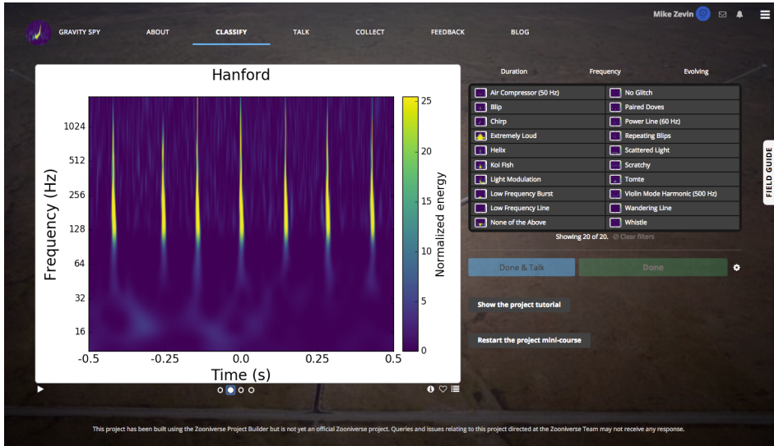
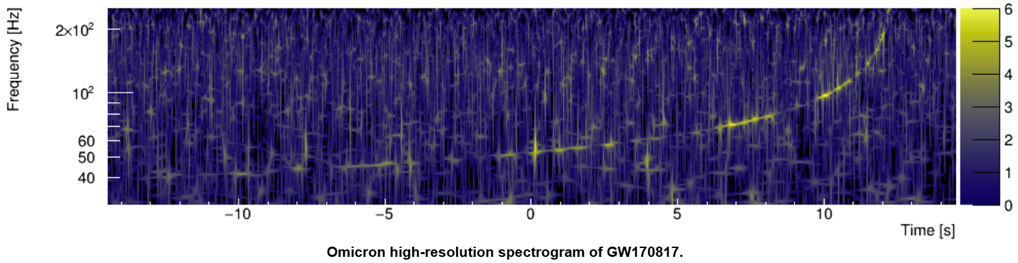
Qtransform: applications
Glitch classification and characterization (Gravity spy, VIGILant, many others...)
Parameter estimation (GP12, cWB,...)
Detection and data analysis (Omicron, UPV, many others)

Slide 6
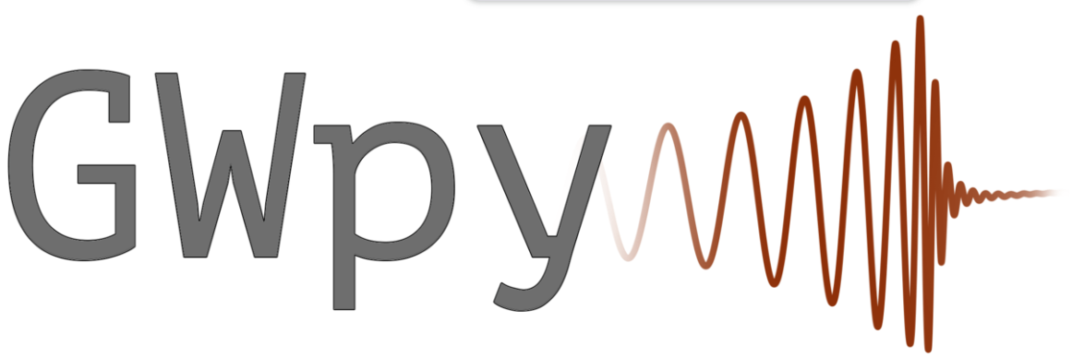


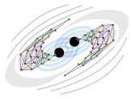

Qtransform: implementations and challenges
 | GPU | Inverse | Multi resolution | Phase | downsample | Invertible after downsample
ML4GW
Qp-transform
cmorlet-tensorflow CWT
ML applications need small input:
Whitening short time series produces artefacts
Interpolation needed at the cost of invertibility
Interpolation introduces artefacts (like unphysical negative values in energy)
Interpolation is unreliable for phase at high frequency
Physical representation of data
Phase must be kept
Physical information in phase is hidden behind fast oscillations at high frequency
Spectrogram cannot be treated as RGB image (typically 25.5 max normalized energy and viridis cmap)

Slide 7
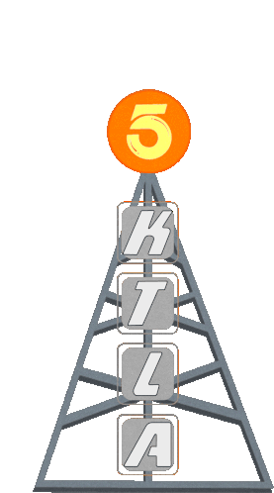
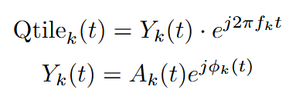



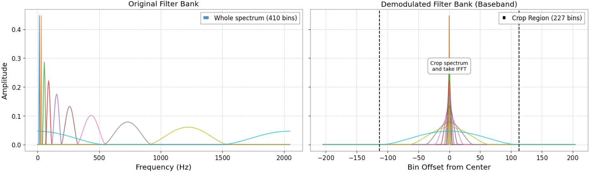
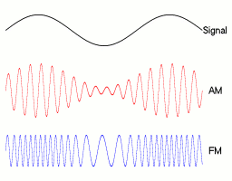
QTransform Amplitude Modulation (QTAM): demodulation
Borrow idea from radio broadcasting ([1906 R. Fessender] & [1933 E. Armstrong] AM & FM radio)
Physical content of the signal
“Carrier term”: a deterministic, high-frequency component fully described by the center frequency fk
Amplitude
Fine-grained phase modulation
Max window size determines max downsampling possible. For less aggressive downsampling crop wider region
(Optional) after demodulation, cropping and IFFT apply remodulation to get downsampled Qtile

Slide 8
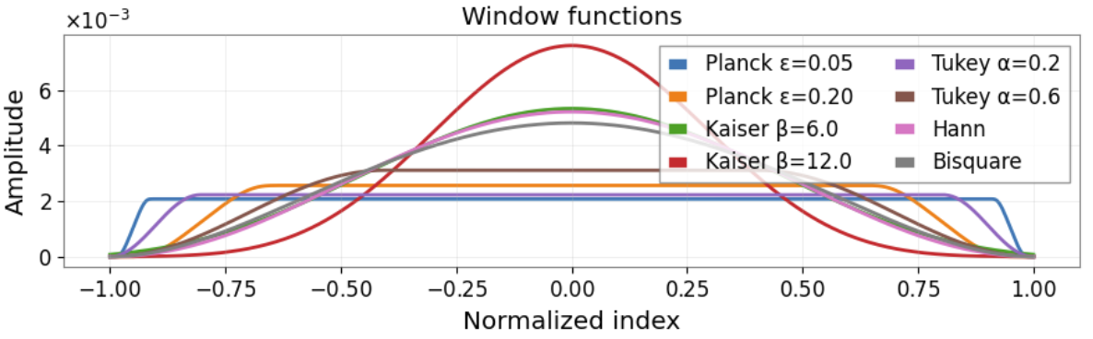
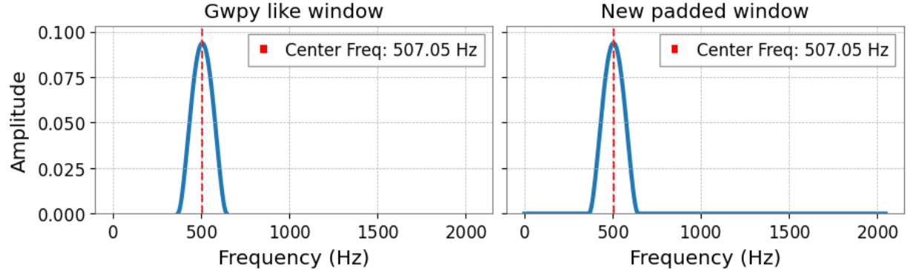
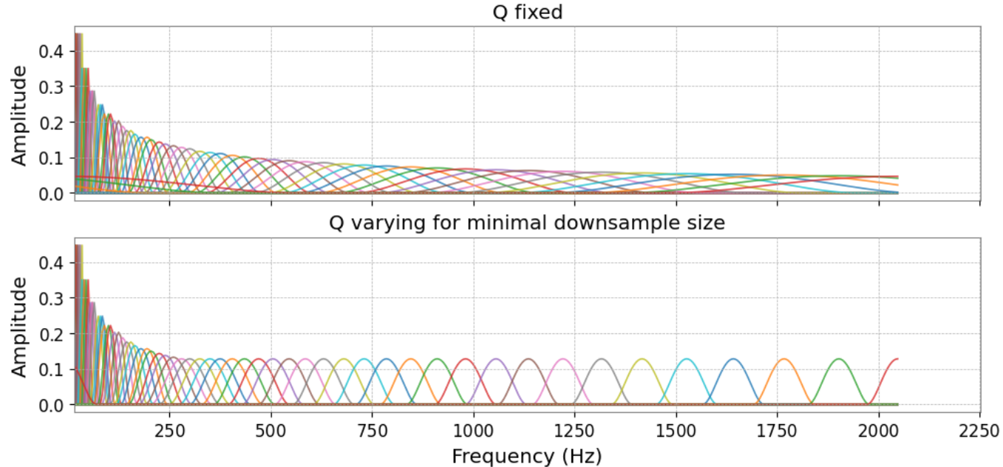
QTAM: implementation details
Customizable window types and parameters
Possibility to scan for best window configuration and Q value
Windows defined over the whole spectrum:
  Tiles have same length (no interpolation needed for visualization)
  Spectrogram is maximally redundant: only one Tile is needed for analytical inversion formula
(if no downsampling)
Downsampling can be made more aggressive by increasing Q value
or by allowing Q to vary for high frequencies (optimal configuration chosen automatically) and
increasing the number of central frequencies

Slide 9
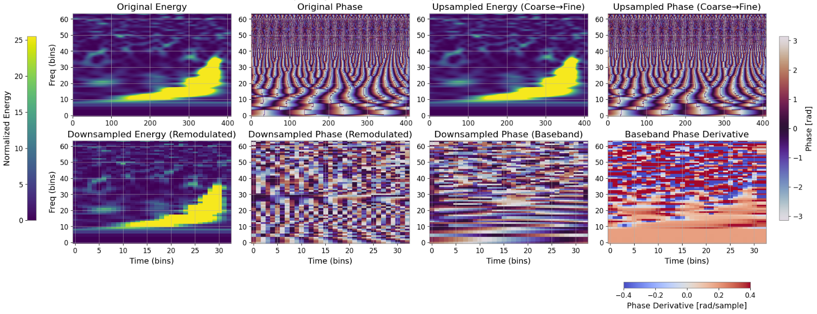
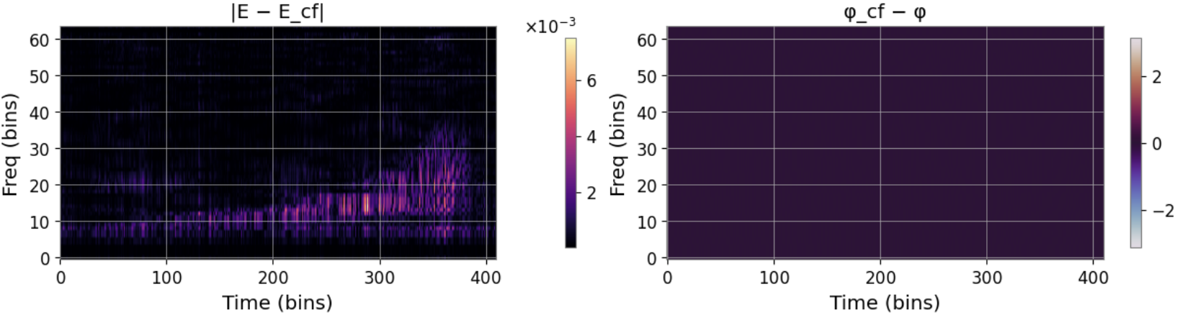
QTAM results: down/up-sampling with AM
signal visible (sort of) in phase as well…
more visible in phase derivative

Slide 10
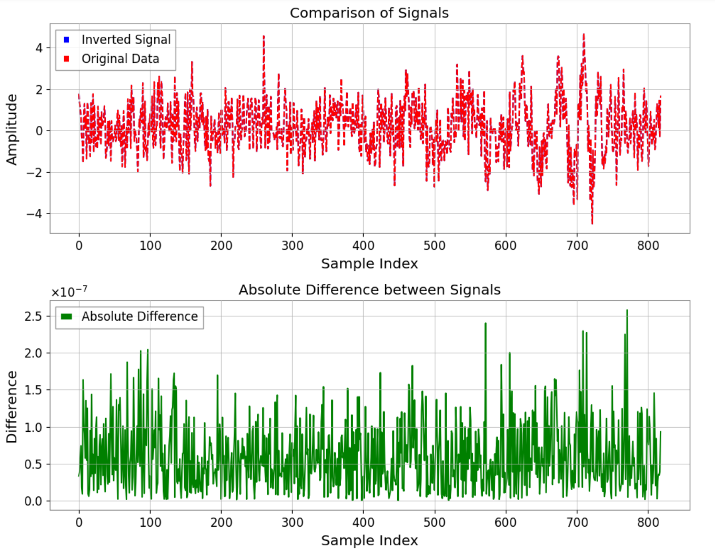
QTAM results: inversion

Slide 11
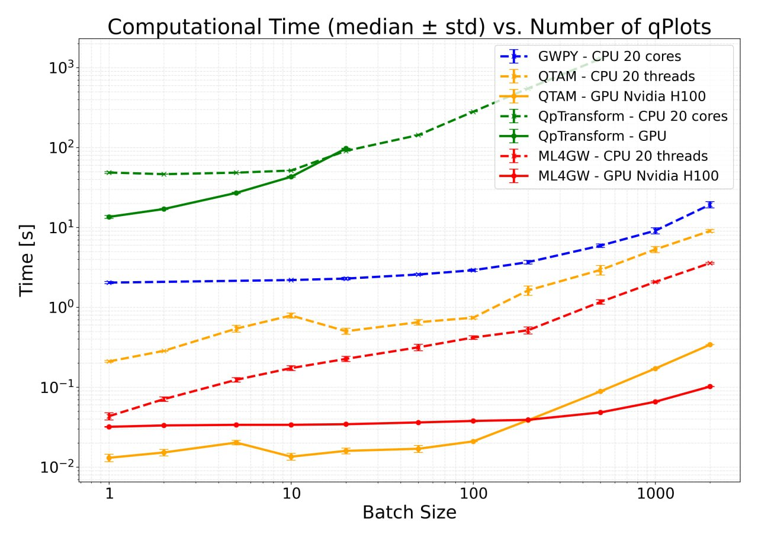
QTAM results: speed test
duration:6s
sr: 4096Hz

Slide 12
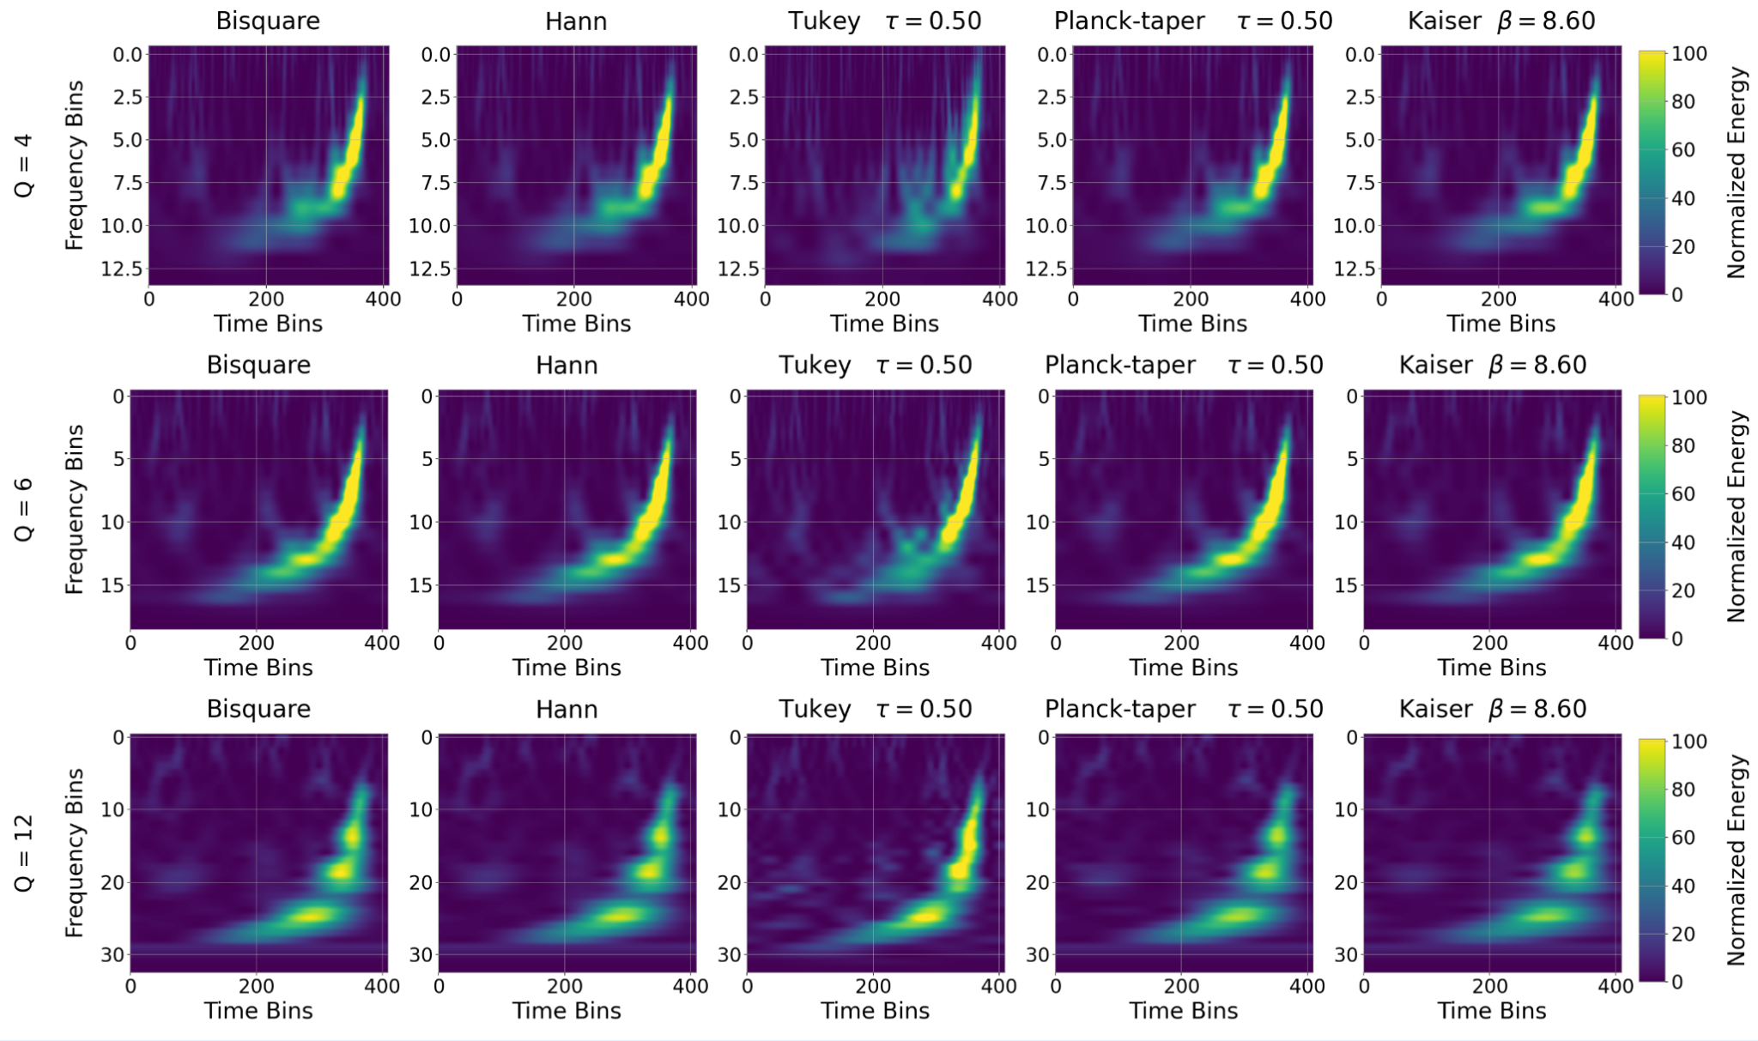
QTAM results: multi scan

Slide 13
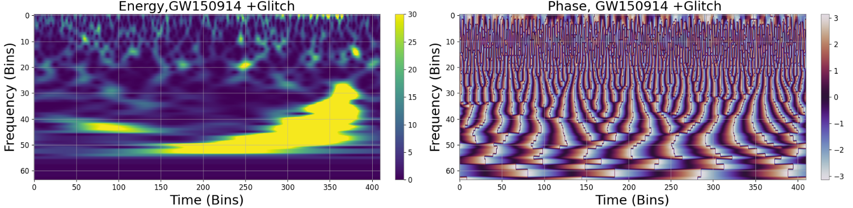
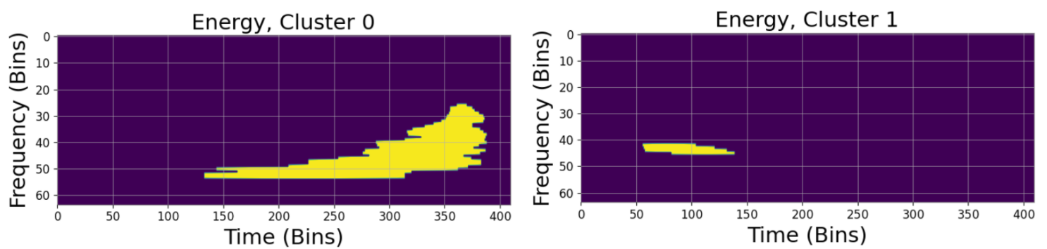
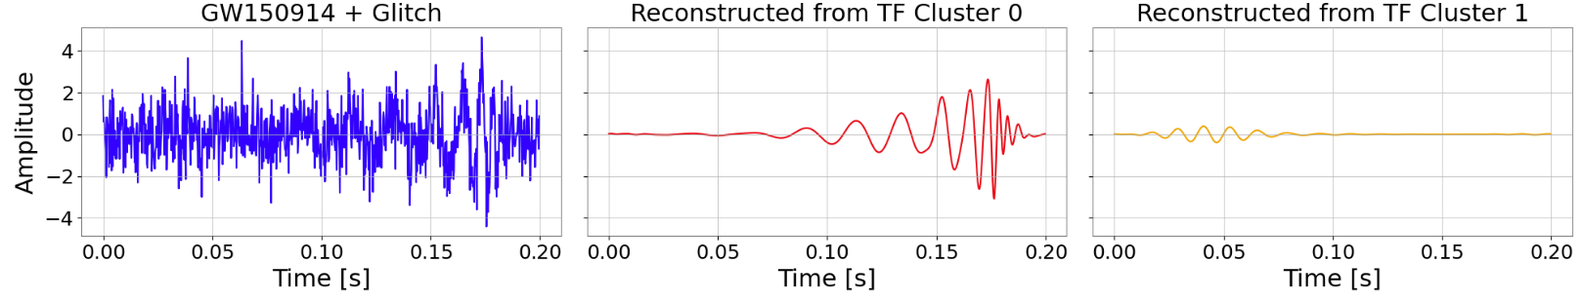
QTAM results: decoupling of signals in TF domain

Slide 14

Conclusions
GPU | Inverse | Multi resolution | Invertible & linear down/up sampling | Meaningful values after down/up sampling | Better physical representation
Allows Time-Frequency pipelines to work within low latency (O(1s)) bounds
Provides a more physically faithful data representation for Glitch Classification
Enables inclusion of the phase in data analysis and noise studies
Paves the way for future hybrid Time and Time-Frequency analyses (third gen detectors?)

Slide 15


Code and tutorial at:
https://github.com/dottormale/Qtransform_torch/tree/main/QTAM

