Slide 1
Resource planning

Slide 2
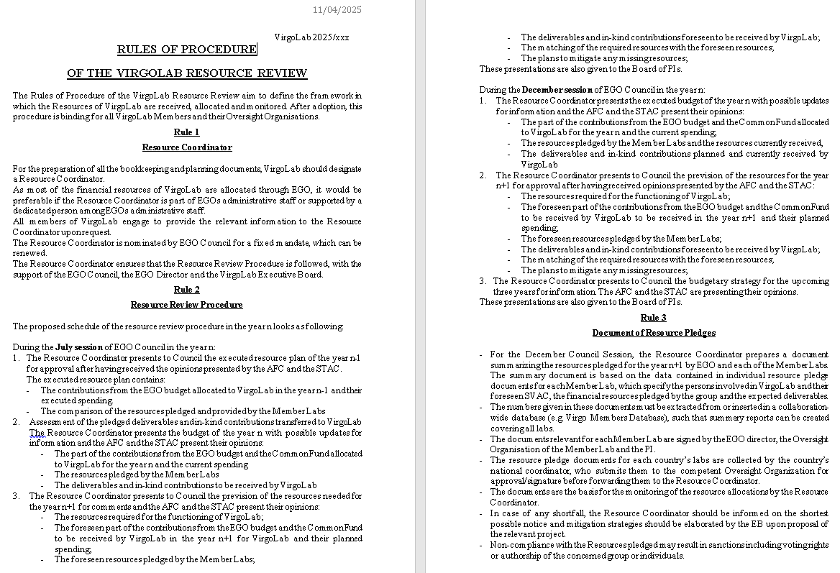
Resource Review
Resource pledge documents
Budget forecast
December Council Session
Review Procedure
July Council Session

Slide 3
Resource Review Procedure

Slide 4
Required information
Executed resource plan of year N
  No such plan yet for past year
Resource needs from the VirgoLab projects
  Budget
  Workforce
Resource availability
  Budget
    Funding agencies
    Cash
    In-kind (“deliverables”)
    From EGO
    VirgoLab members
    Common funds
  Workforce
Mitigation for any discrepancies pledged vs. needed
Opinions from STAC and AFC

Slide 5
Workforce
Workforce information comes from VMD
  Procedure already in place
  Extraction of data for reports possible
VMD setup
  Tagging Virgo activities as “VirgoLab” already foreseen
  Activity structure under the 3 projects exists, to be updated for 2026
  Will be used for pledging and next year reporting
Workforce pledges start 25 October
  Activity list to be consolidated by then
Information comes from individuals
  Approval from agencies,… through Pledge Documents
Problem
  VMD period: October 1st to September 30th
  Discrepancy with calendar year to be solved
  Base the Resource Report on VMD year (Oct-Sep)?
  Extrapolate from VMD year to calendar year?
  Ask that pledges cover Jan – Dec?

Slide 6
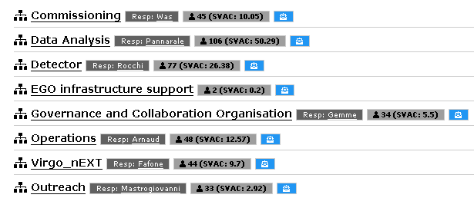
VMD Projects
3 VirgoLab projects relevant for the Resource Review

Slide 7
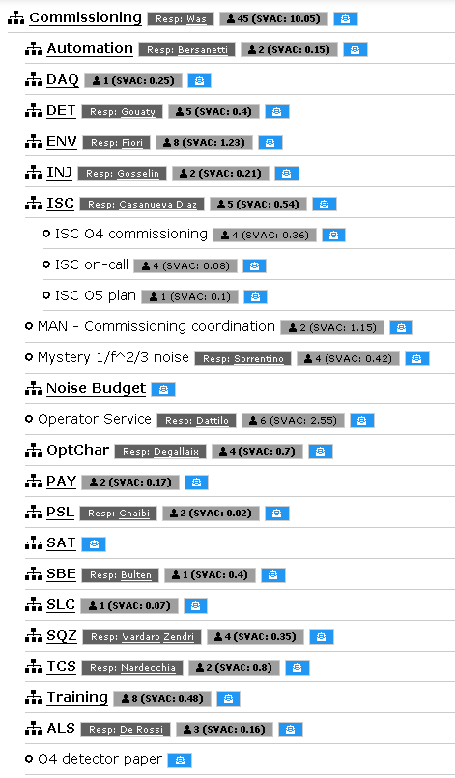
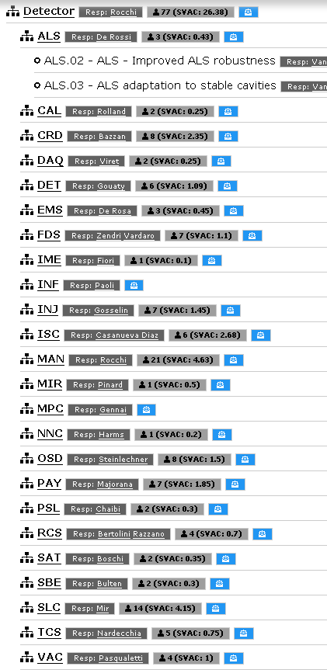
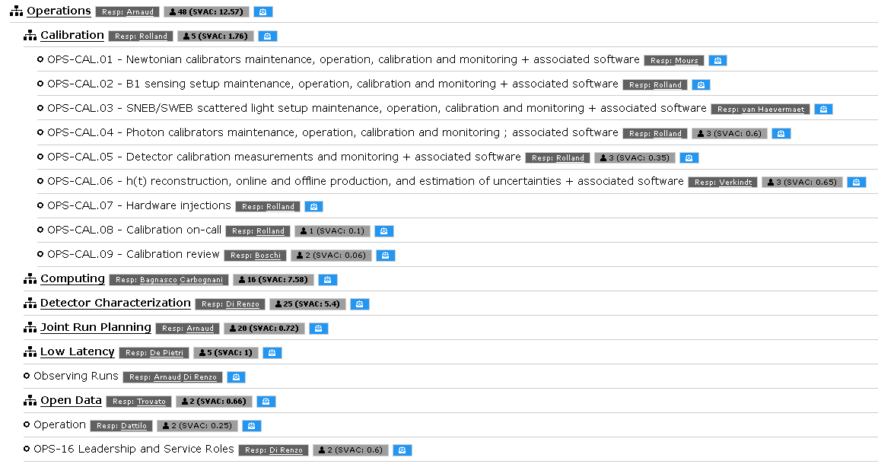
VMD – 2025 Project structure

Slide 8
Budget information
Budget pledging/reporting
  There is presently no collaboration-wide budget database
  Extraction by hand from documents inefficient/error-prone
We need a VMD-like tool for collecting the budget information
  Many requirements are the same as in the VMD
  Definition of project needs
  Pledging
  Reporting
  Validating by the project coordinators
  Project structure (WBS) must be the same as in existing VMD
  Accessibility by collaboration members (PI’s)
  Extraction of reports (automatically build Resource Pledge docs?)
  “VirgoLab Budget Database (VBD)” ?

Slide 9
Resource Pledge Documents

Slide 10
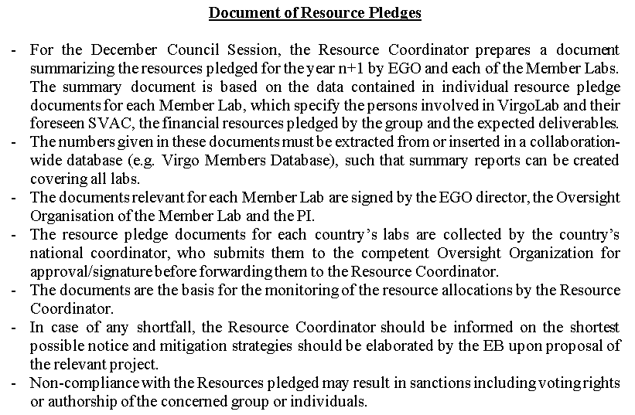
Resource pledge document

Slide 11
Generation of Resource Pledge Documents
Generating Member Labs’ Pledge Documents
  Build semi-automatically from pledges in VMD and “VBD”, like the yearly activity report?
    => Data is certain to be coherent between database and documents
  Must be signed by PI, National Organization and EGO director
  In time for December Council?
Global resource pledge document
  Extract data from VMD and “VBD”
  Build global document semi-automatically as above
Information collection
  National representatives to coordinate collection of data

Slide 12
Budget strategy

Slide 13
Budget strategy
Needed budget
  Upgrades: can be derived from the upgrade planning (under development)
  Commissioning: TBD
  Operations: TBD, must include maintenance budget
Available budget
  Waiting for Council outcome (October 24 for 2026; December 11 for next years)
  Member Labs’ contributions?
  EGO budget, common funds, … ?
  In-kind contributions?
To be sent to STAC and AFC
Will we have the data in time for the Council?

Slide 14
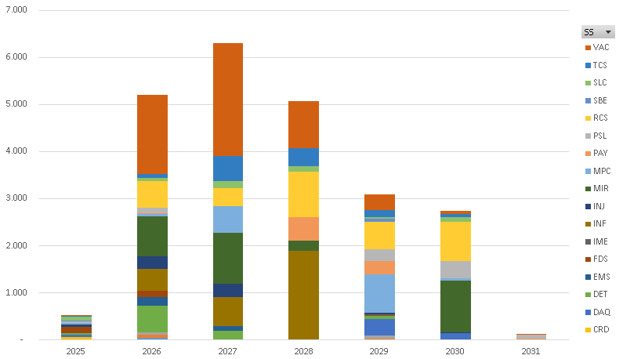
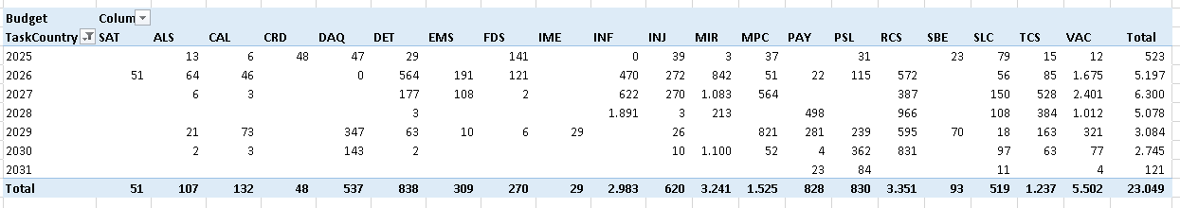
Current estimate of AdV+ budget profile

Slide 15
Conclusion

Slide 16
To clarify
Budget flow
  Centrally collected, then distributed to the projects, as in the past?
    Funding agencies gave money to EGO
    EGO made the purchases
    EGO sent money to labs through conventions
    + in-kind contributions
  Other scenario: (some) budget given directly to the labs
    Bad experience in the past (Advanced Virgo)
    Reporting difficult
    Laborious reconstruction of budget flow from rumours and hearsay
    Money went back and forth CNRS <-> Lab each year => lost 200 kE
Common funds
  Go to EGO, VirgoLab, both?
    In the past: only for EGO running costs
  Global contributions, or earmarked for a single project, or even a single activity?
What is the calendar of the Member Lab resource pledge documents?
  Must be signed by national agency, PI, EGO director
  In time for December Council?
When will we know how much money will arrive when and from where?

Slide 17
To Do
Solve the issue “VMD year vs. calendar year”
VMD
  Prepare VMD structure for 2026 pledges (25/10 – 08/11)
  Add workforce needs in the VMD for comparing with pledges
Create a VMD-like budget database
  Could it be ready in time?
  And be filled in time?
  Use with VMD for creating members’ Resource Pledge Documents
Determine budget needs for 3 projects
  Upgrades: from AdV+ WBS
  Commissioning: any needs?
  Operations: add maintenance needs; anything else?
Set up mechanism for Member Labs’ Resource Pledge documents
Clarify budget availability
  Council contributions
  Member lab contributions / common funds
  In-kind contributions

Slide 18
Conclusion
Documents / presentations to be prepared
  Global resource pledge document
    Based on member lab resource pledge documents
    To be collected and signed
  Presentation to Council
    Needed resources
    Pledged resources
  Budget strategy for the next 3 years
General observation
  Having a complete/meaningful resource plan for the December Council is difficult
  Many questions to be clarified before going on
  Structures to be created, decisions to take or wait for, documents to be created and validated / signed / sent to committees …
Reconsider the usefulness of starting the resource review already for 2026

Slide 19
End

Slide 20
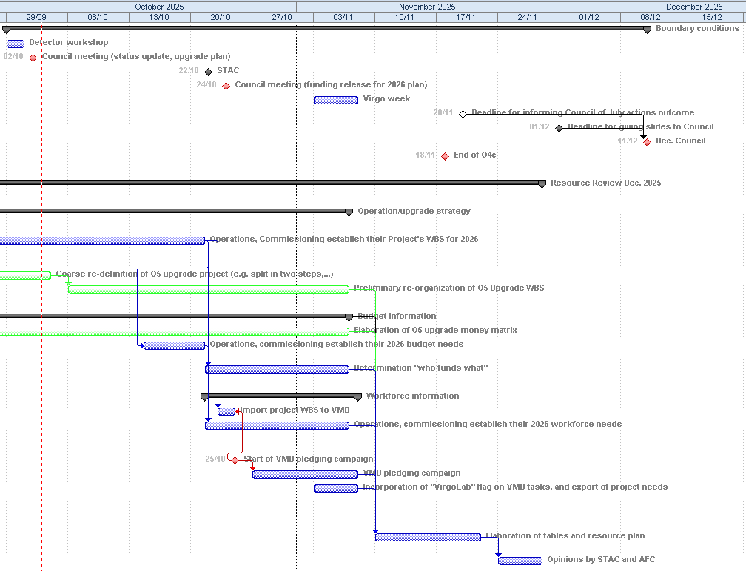
Resource review planning
25/10

