Slide 1
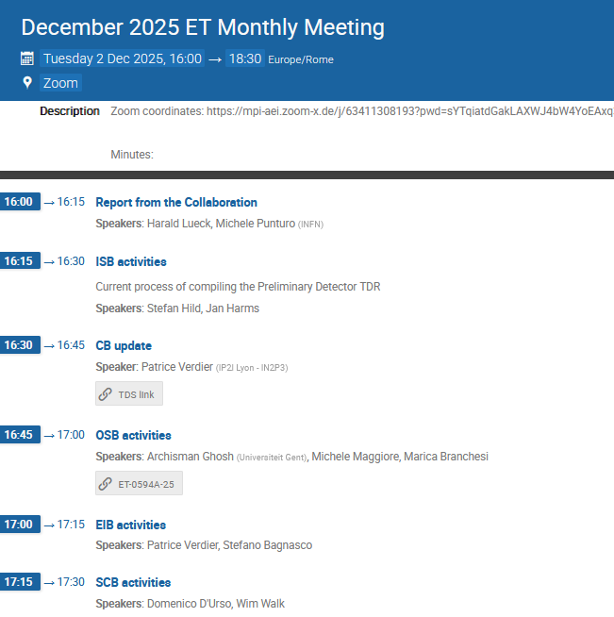

Slide 2
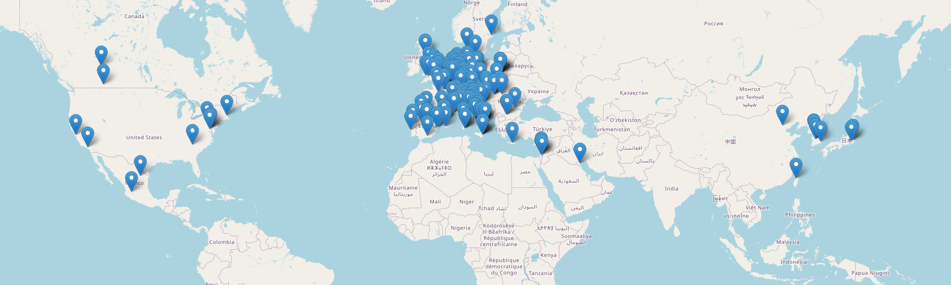
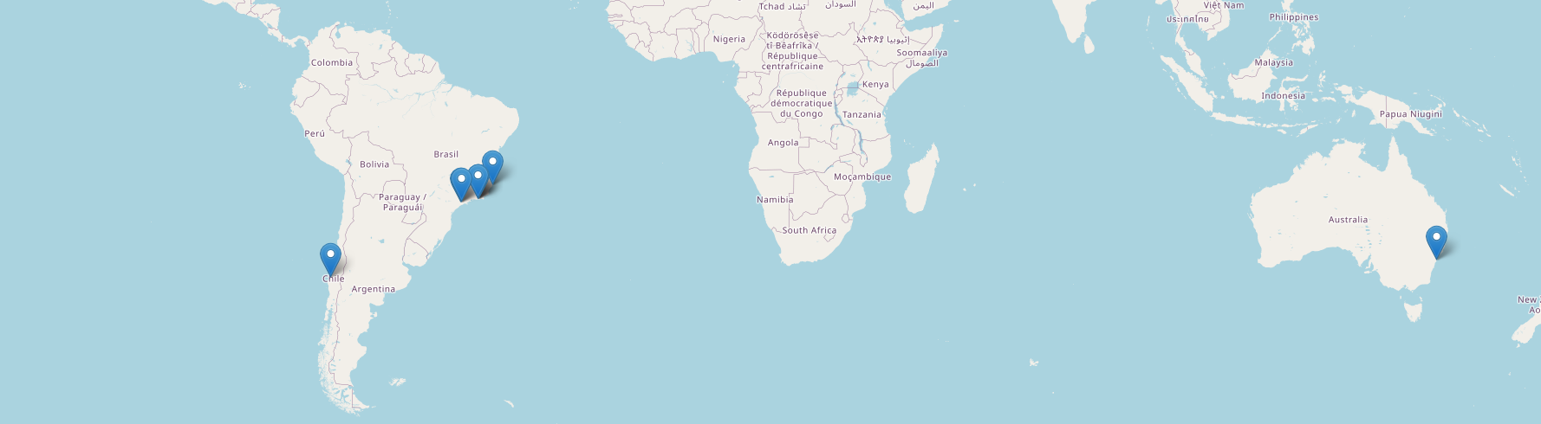
ET Institutions Map
1962 members (2.12.2025)
95 Research Units
Total: 284 Institutions
in 33 Countries
https://apps.et-gw.eu/etmd/

Slide 3
ET Executive Board
Detector Pre-TDR is an ET-PP deliverable with deadline of Spring 2026
ISB will report on the progress
ETC-ETO-LHC have taken up regular meetings again
Input from the Collaboration to SiSe Committee

Slide 4
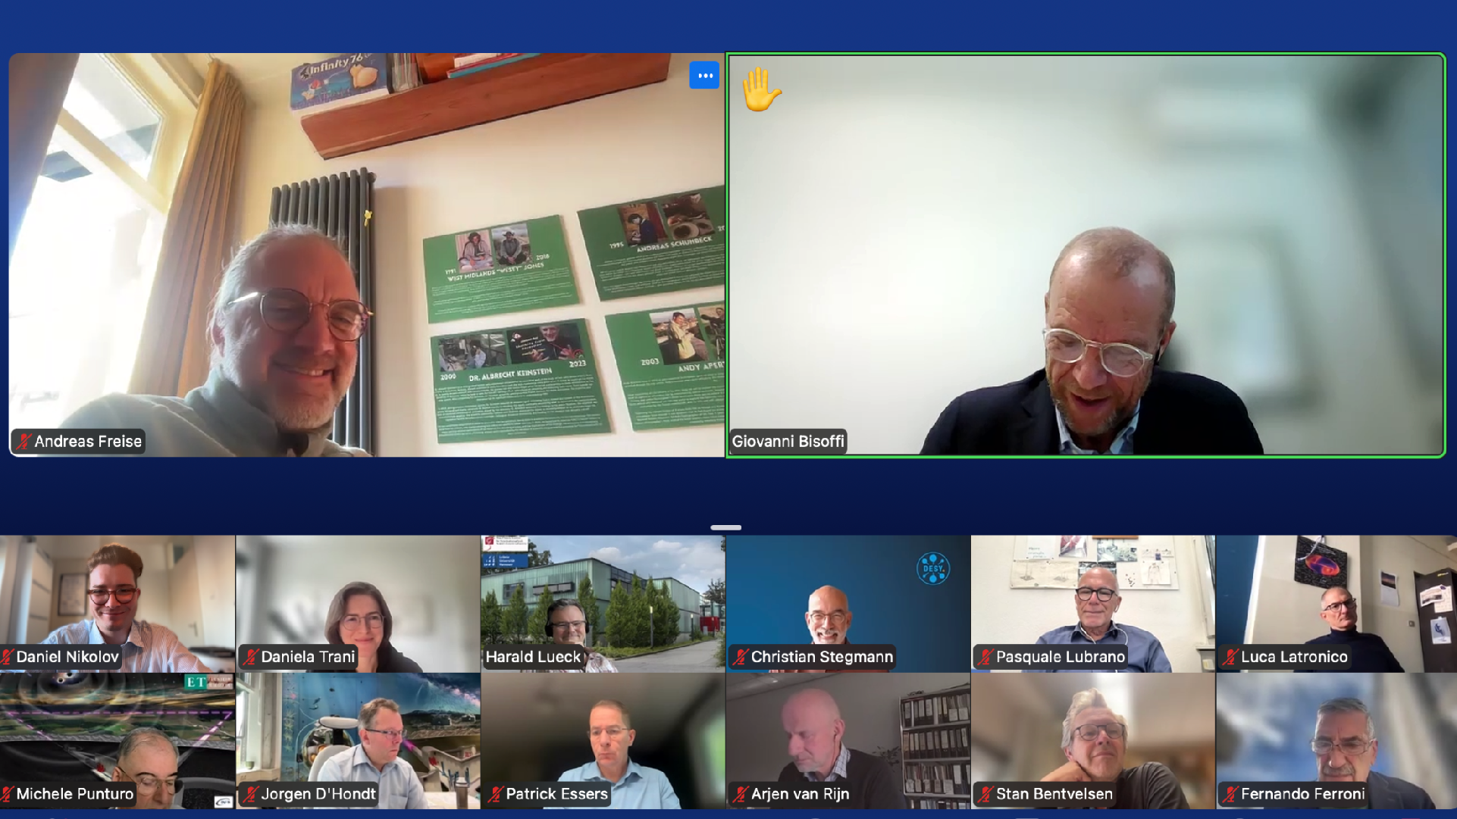








Bringing together the leadership from ETO, ETC and the ET HC
Ca. monthly meetings
Freise, Ferroni, ET annual meeting 13.11.2025

Slide 5
Meetings of ETO, ETC and Host Consortia Leadership
On 10 October, ETO kicked oﬀ the ﬁrst in a new series of meetings between the leadership of the ETO, ETC and ET Host Consortia
These meetings were proposed by ETO in a brieﬁng note shared to the leadership of the ETC and Host Consortia inviting an opportunity for shared information exchange and alignment on key activities requiring close collaboration.
ETO’s proposed a rhythm of bimonthly online meetings, one in-person meeting attached to the ET Annual Meeting and a yearly in-person retreat at one of the sites was endorsed.
HL: Next Meeting 10.12.2025
Freise, Ferroni, ET annual meeting 13.11.2025
12

Slide 6
Next ETO-ETC-LHC Meeting
Michele Punturo proposed to discuss these topics at the Dec. 10, 2025 ETO-ETC-LHC meeting:
Developing a Formal and Substantial MOU between ETC and ETO
Rationale: Strengthening collaboration between the stakeholders will increase the effective availability of human resources and improve the joint management of key tasks. In particular, coordinated oversight of critical items—such as the production of the Technical Design Report (TDR)—is essential to fully leverage the available expertise.
Key Question:
How can we establish an appropriate process and committee to develop an MOU between ETC and ETO that defines shared actions and joint management responsibilities?
Addendum:
The MOU should also formalize the use of ETC resources, including ETMD, TDS, and related tools or services.

Slide 7
Next ETO-ETC-LHC Meeting
Availability of Site Characterization Data
Rationale:
All data required to assess the scientific performance of ET at a candidate site should be provided by the NHTs to the ETC at an early stage, using the common tools established by the collaboration.
Any issues concerning data quality or validity should be discussed with the ETC to ensure clarity, mutual understanding, and effective support. Full transparency is essential.

Slide 8
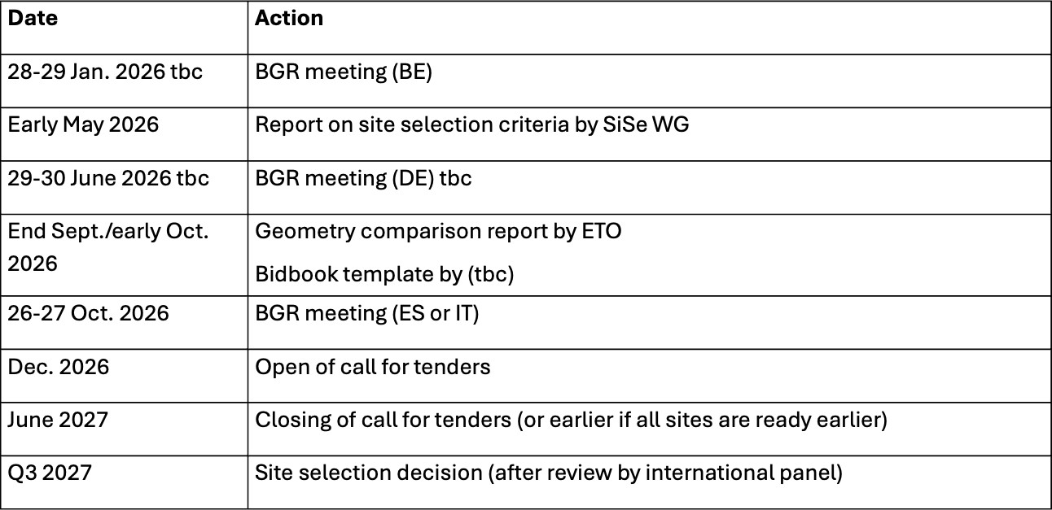
At the 10th meeting, ET-BGR has established The ET- Project timeline

Slide 9
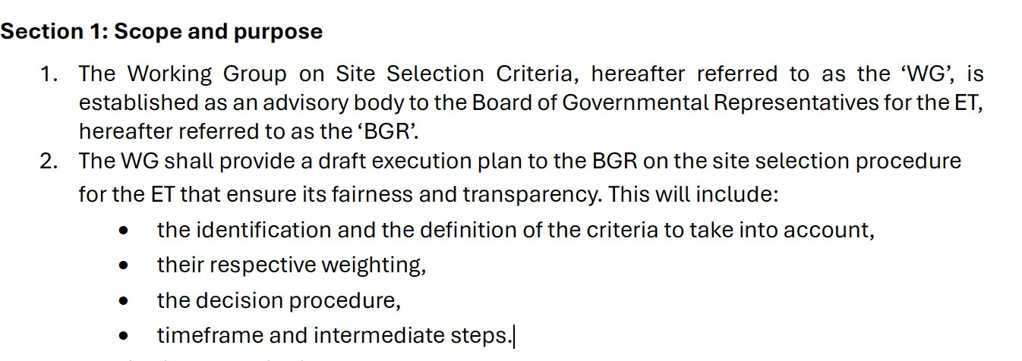
The ET-BGR has established a Site Selection Criteria Working Group
Slide by BGR Chairs shown @ Annual Meeting
Andrew Harrison, the chair of the WG will discuss it further.

Slide 10
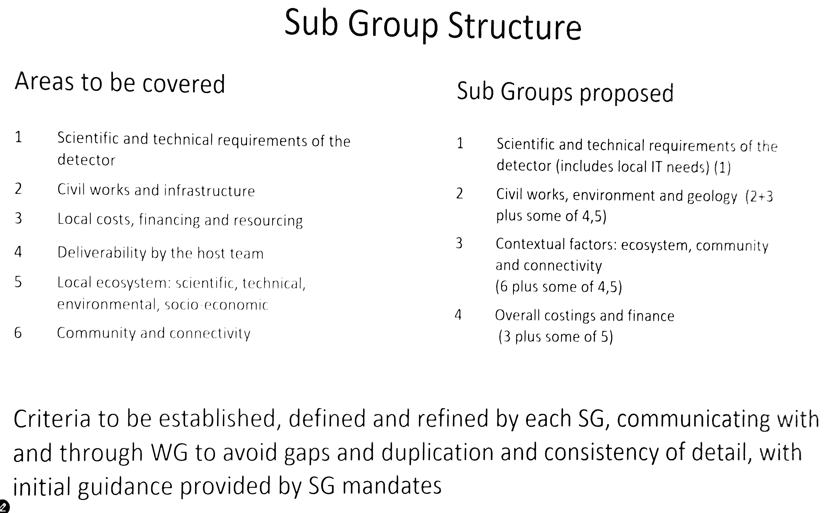
SiSe Committee
Chaired by Andrew Harrison
Slide: Andrew Harrison
Slide: Andrew Harrison

Slide 11

SiSe Committee
Chaired by Andrew Harrison
Slide: Andrew Harrison

Slide 12
Monthly Meetings
Please snd ideas on how to improve the
attractiveness of the monthly meeting
to go beyond an attendance of a few %

