Slide 1
Laser Technologies
Marco Galimberti
European Gravitational Observatory

Slide 2
Summary
Main Laser
Light Amplification and Laser Amplifier
Laser Oscillator
Amplification, Beam Cleaning & VIRGO Main Laser
Non Linear Optics
Second Harmonic Generation
Pockels Cell
Faraday Isolator
Sound and Light
Acousto-Optic modulator
Brillouin Instability
Laser Safety
Be Careful

Slide 3
Main Laser

Slide 4





Two Level System
E₁
E₁
With a two level system, an e⁻ at ground state can absorbe some light resonant with the transition and go to the excited state
$$ℏω$$
0
0
E₁
E₁
From the excited state it can emit some light at the transition frequency by spontaneous emission (QED)
$$ℏω$$
0
0
E₁
E₁
From the excited state, if there is some light resontant with the transition it can emit the same light, with stimulated emission
$$ℏω$$
$$ℏω$$
$$ℏω$$
0
0

Slide 5
Light Amplification
If there are more e⁻ on the upper state compared to the ground state, there is inversion of population and there is light amplification
If we pump a two level system with light, it is impossible to have population inversion
E₃
E₃
With optical pumping, at least 3 level are needed, 4 are better
e⁻
e⁻
E₂
E₂
Photon
Photon
Photon
Photon
Photon
Photon
E₁
Pumping with other method, like current on semiconductor junction (laser diode)
E₀
E₁
E₀

Slide 6
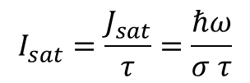
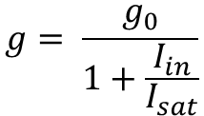
Small Signal Gain and Saturated Gain
The lifetime of excited state is called fluorescence time $τ$
The small signal gain $g_{0}$ of an amplifier is $g_{0}=\exp\left(\frac{J_{sto}}{J_{sat}}\right)$, where $J_{sto}$ is the store fluence in the amplifier, $J_{sat}=\frac{ℏω}{σ}$ is the saturation fluence and $σ$ is the transition cross section
If the intensity of the incoming light $I_{in}$ is not small, the gain $g$ is reduced by
$$g= \frac{g_{0}}{1+\frac{I_{in}}{I_{sat}}}$$
where
$$I_{sat}=\frac{J_{sat}}{τ}=\frac{ℏω}{σ τ}$$
Homogeneous Line
If the input intensity is comparable or higher then $I_{sat}$, the amplifier will be depleted

Slide 7
Amplification Bandwidth
Each absorbtion or emission line has a bandwidth
The laser line bandwidth is important for the type of the laser we want
Two different type of line:
Homogeneous
Inhomogeneous
The bandwidth is defined by the transition
The overall bandwidth is defined by the material
All the excited atoms will resonate at the same light frequency
There are different population of atoms, with the transition line shifted (by Stark Effect, Doppler, etc)
Different atoms will resonate at different light frequency

Slide 8
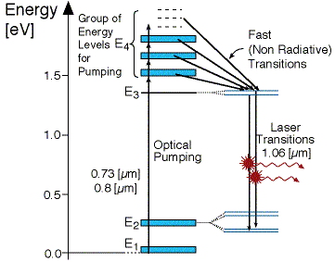
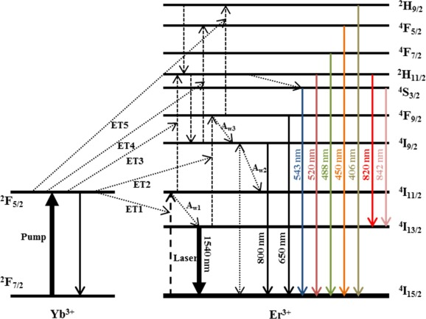














Laser Materials
Nd:YAG at 1% of doping
$$I_{sat}≈2 {10}^{7} \frac{W}{m^{2}}$$
$$τ≈250 μs$$
$$σ≈4 {10}^{−23} m^{2}$$
$$P_{sat}^{1mm}≈16 W$$
Inhomogenous Line
$$λ≈1064nm$$
$$δν≈150 GHz$$
$${δν}_{HOM}≈600 Hz$$
Er:Yb Glass
$$I_{sat}∼1.3 {10}^{7} \frac{W}{m^{2}}$$
$$τ∼10 ms$$
$$σ∼{10}^{−24} m^{2}$$
$$P_{sat}^{1mm}∼10 W$$
Inhomogenous Line
$$λ≈1550nm$$
$$δν≈4 THz$$
$${δν}_{HOM}≈10 Hz$$

Slide 9
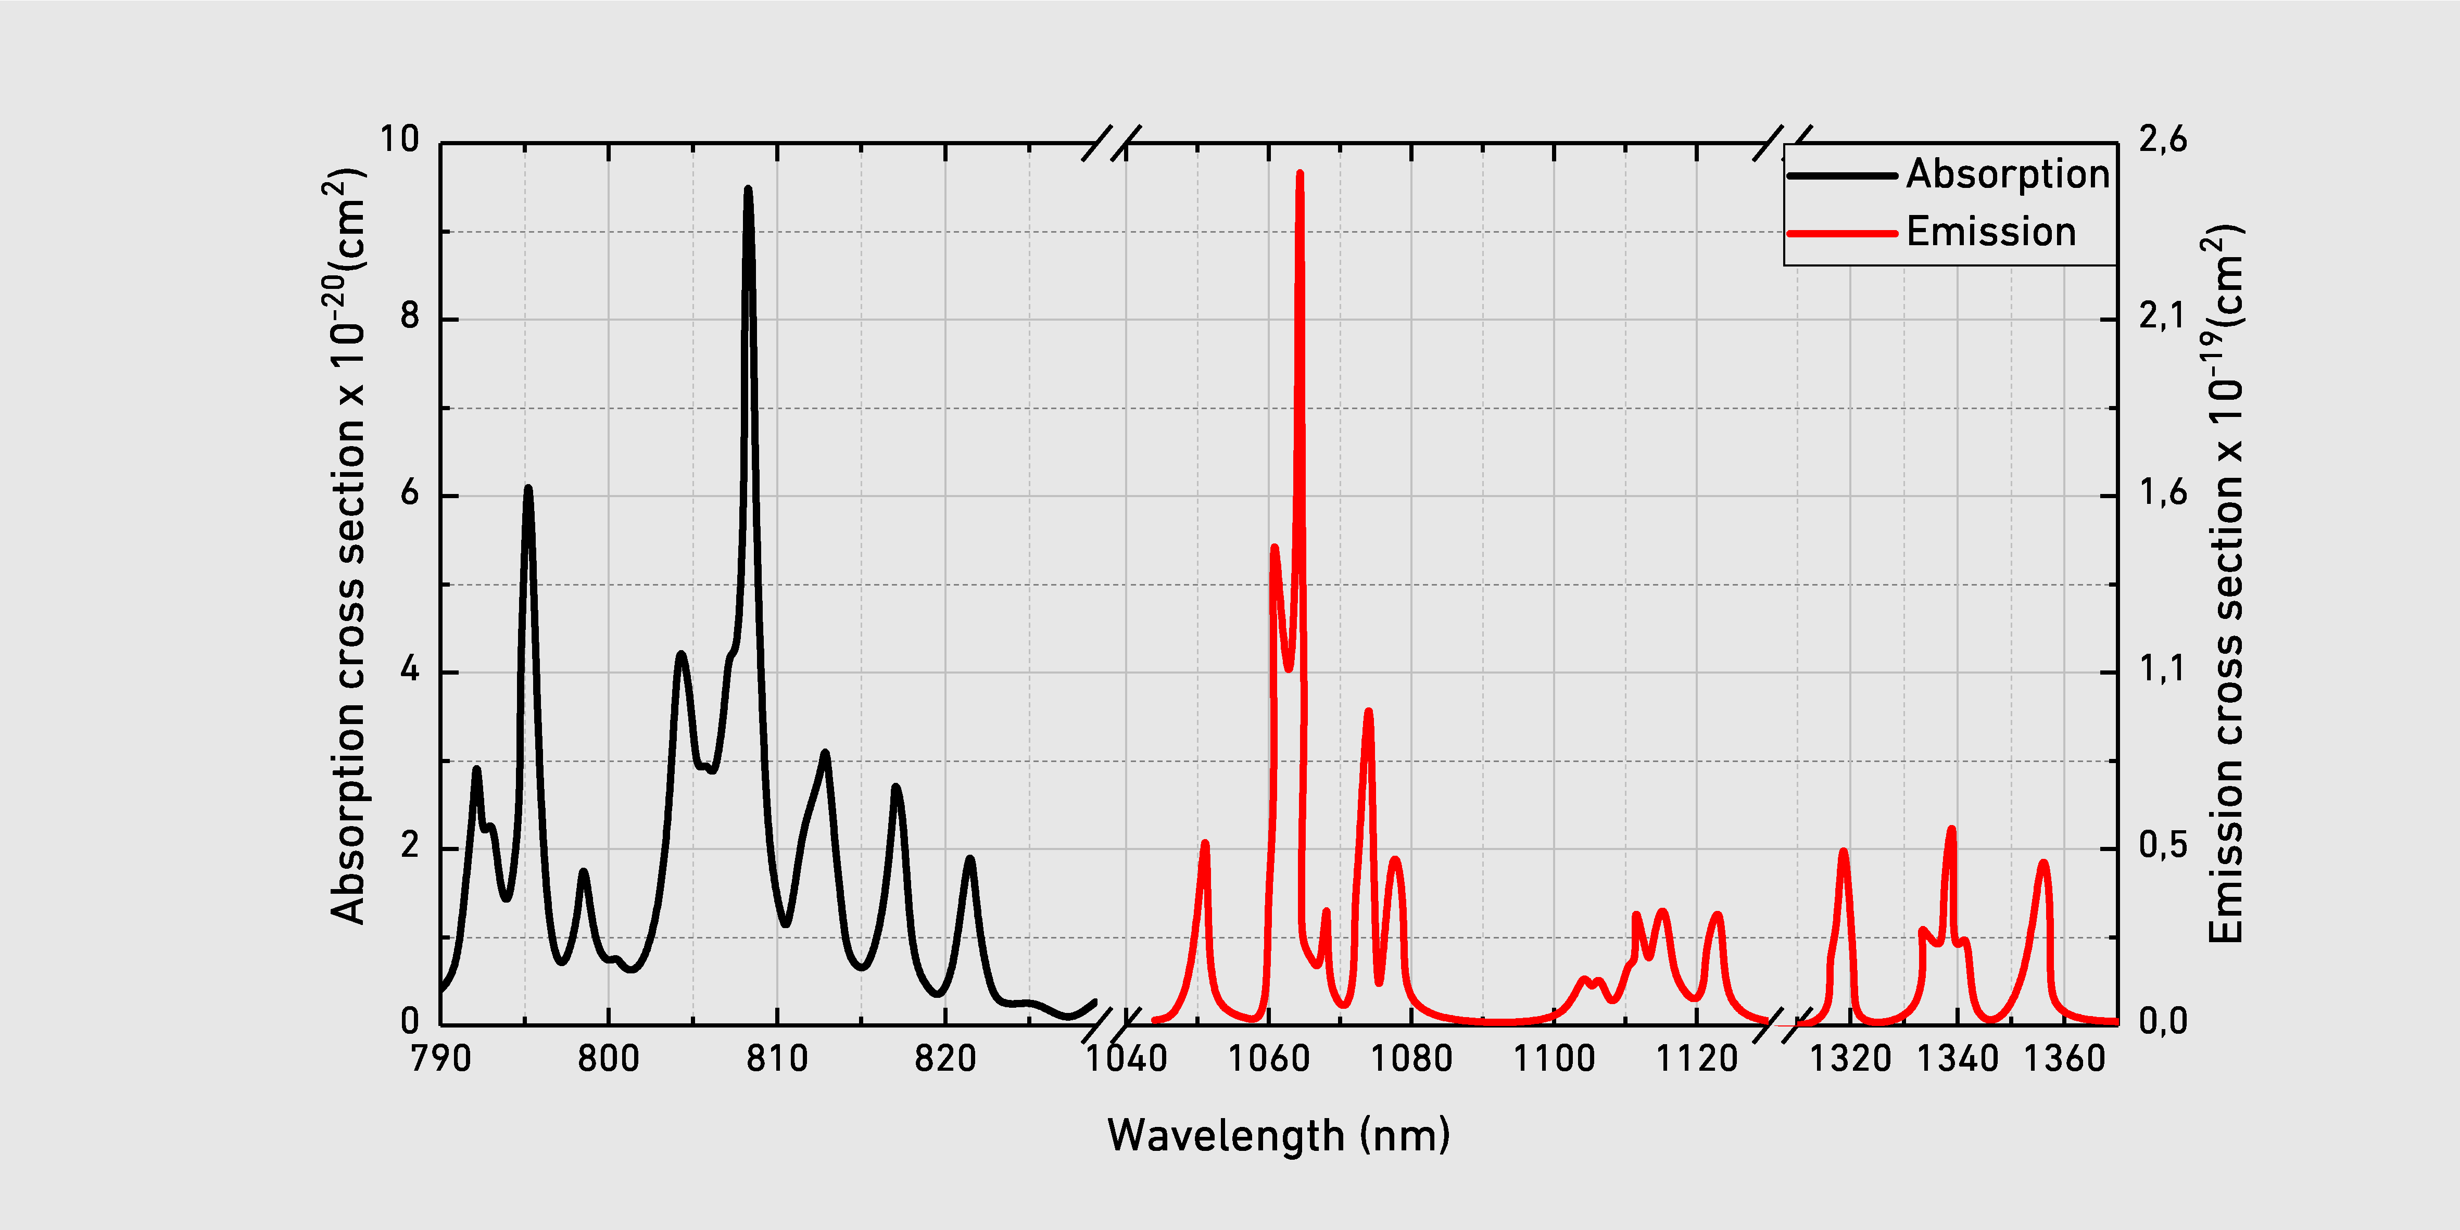
Nd:YAG
Absorption and emission spectra for Nd:YAG took online
Laser Lines
946 nm
1064 nm
1123 nm
1319 nm
1338 nm
1415 nm
1444 nm
Not all the emission lines are laser lines!

Slide 10
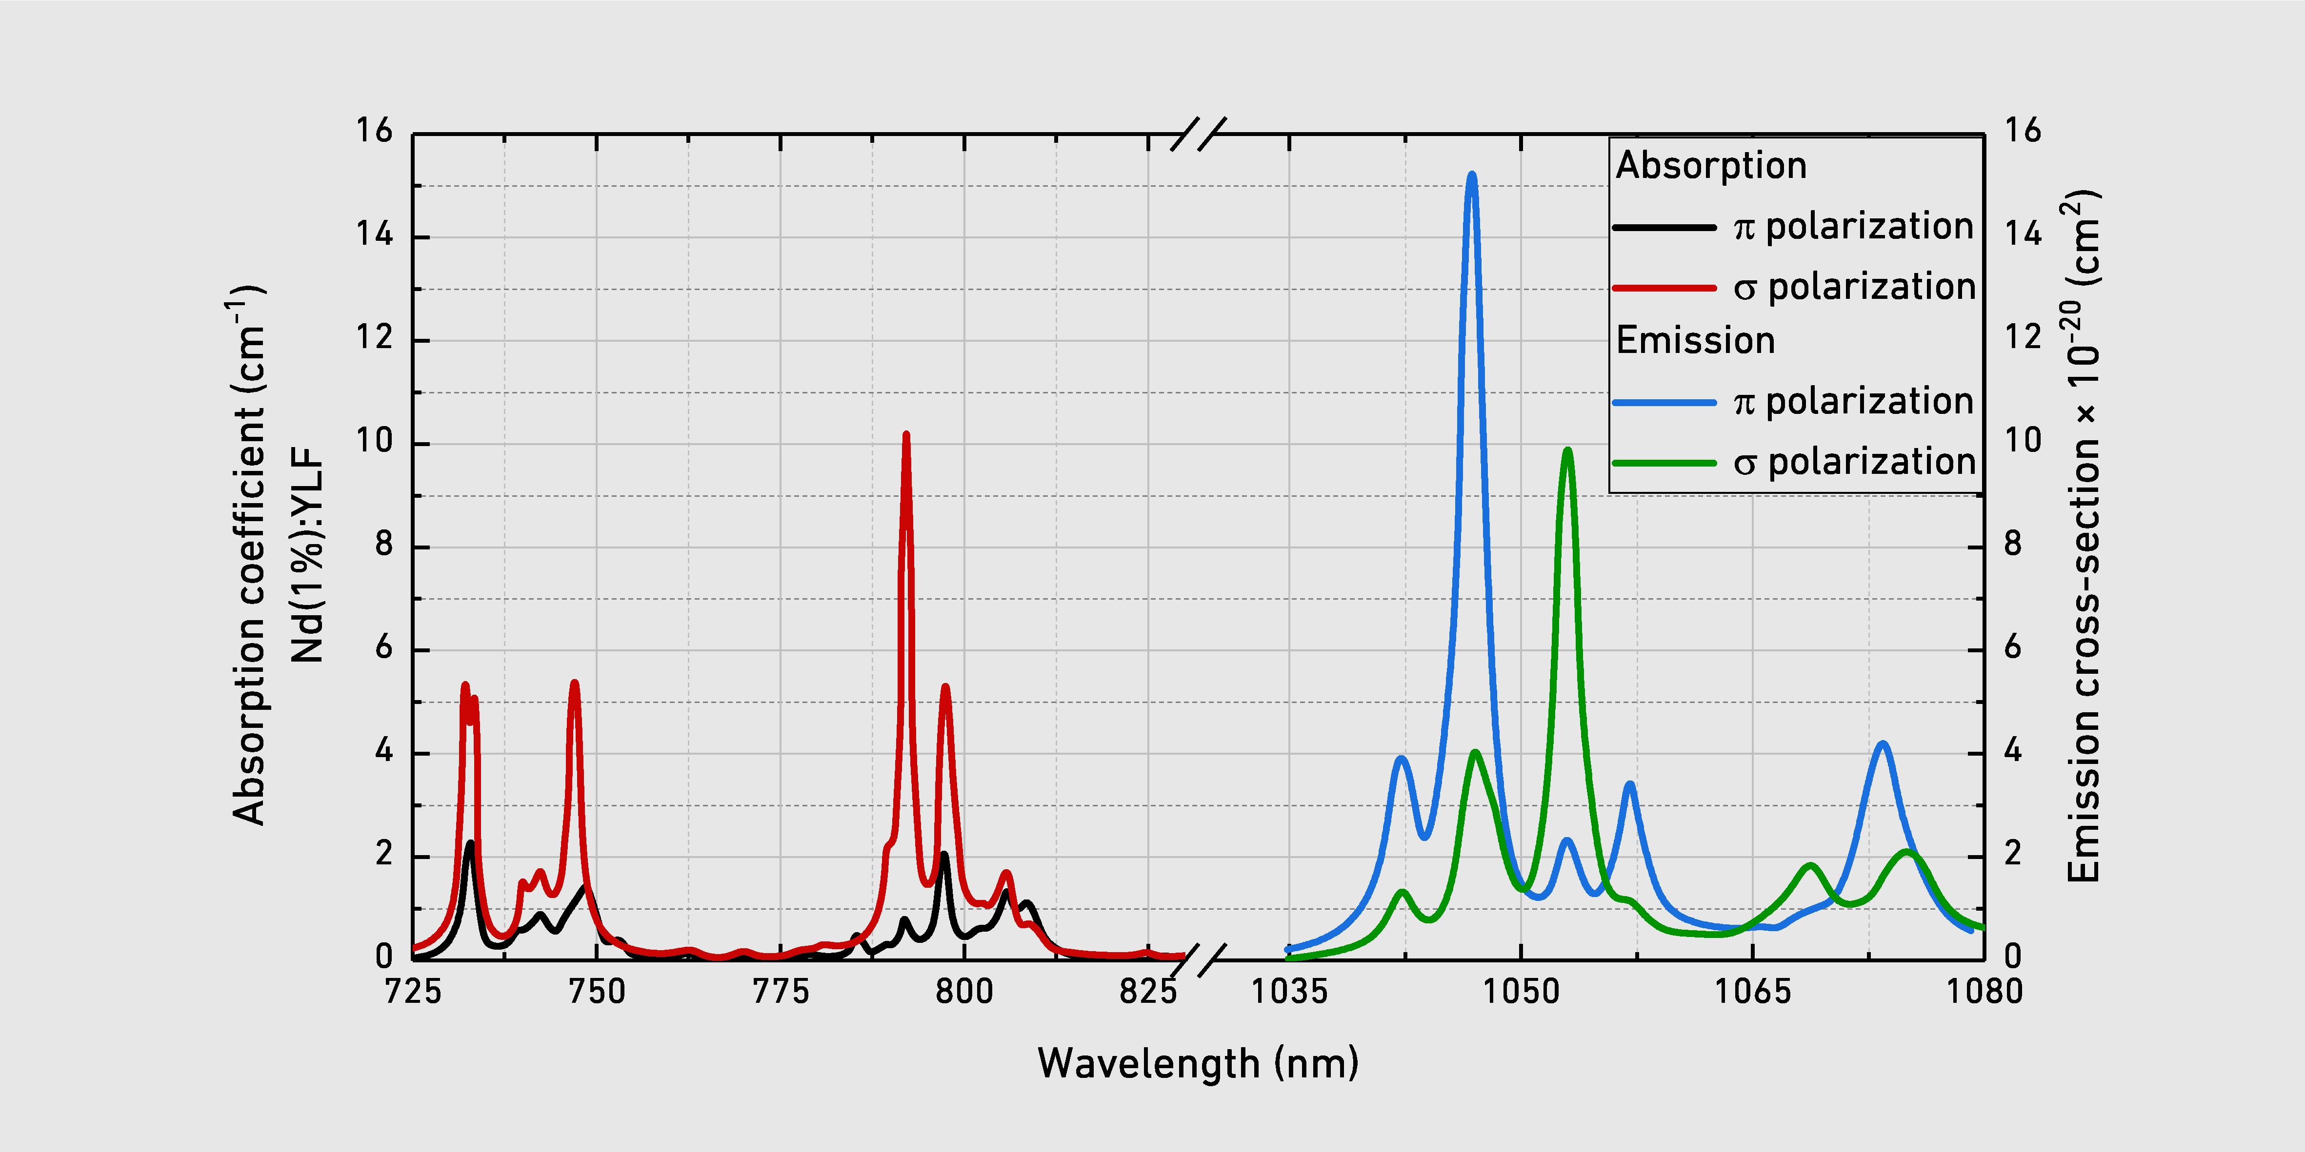
Nd:YLF
Absorption and emission spectra for Nd:YLF took online
Laser Lines
1047 nm
1053 nm
1313 nm
1324 nm
1370 nm
Not all the emission lines are laser lines!

Slide 11
Laser Amplifier
Power
Active Medium
Input beam
Output beam
Power

Slide 12
Optical Pump Scheme
Flash (or arc lamp)
Laser pump (diode or another laser)
Only good for high energy pulse laser
High efficiency, optimal pumping wavelenght
No efficiency, high thermal load
Diode
Diode
Diode
Flash
Diode
Diode
Flash
Head on pumping
Side pumping
Diode
There is gain only where the medium is pumped
fibre
The gain depend on the intensity of the pump
Fibre Amplifier

Slide 13
MOPA Architecture
MOPA: Master Oscillator Power Amplifier
Oscillator
FR
Amplifier
Amplifier
The Oscillator create the laser beam with the desired parameters at low power
The Amplifiers increase the power up to the desired level
Telescopes are required to increase the beam size to avoid damages
Back propagating light needs to be blocked to avoid damages and/or malfuctioning by using a Faraday isolator
FR

Slide 14
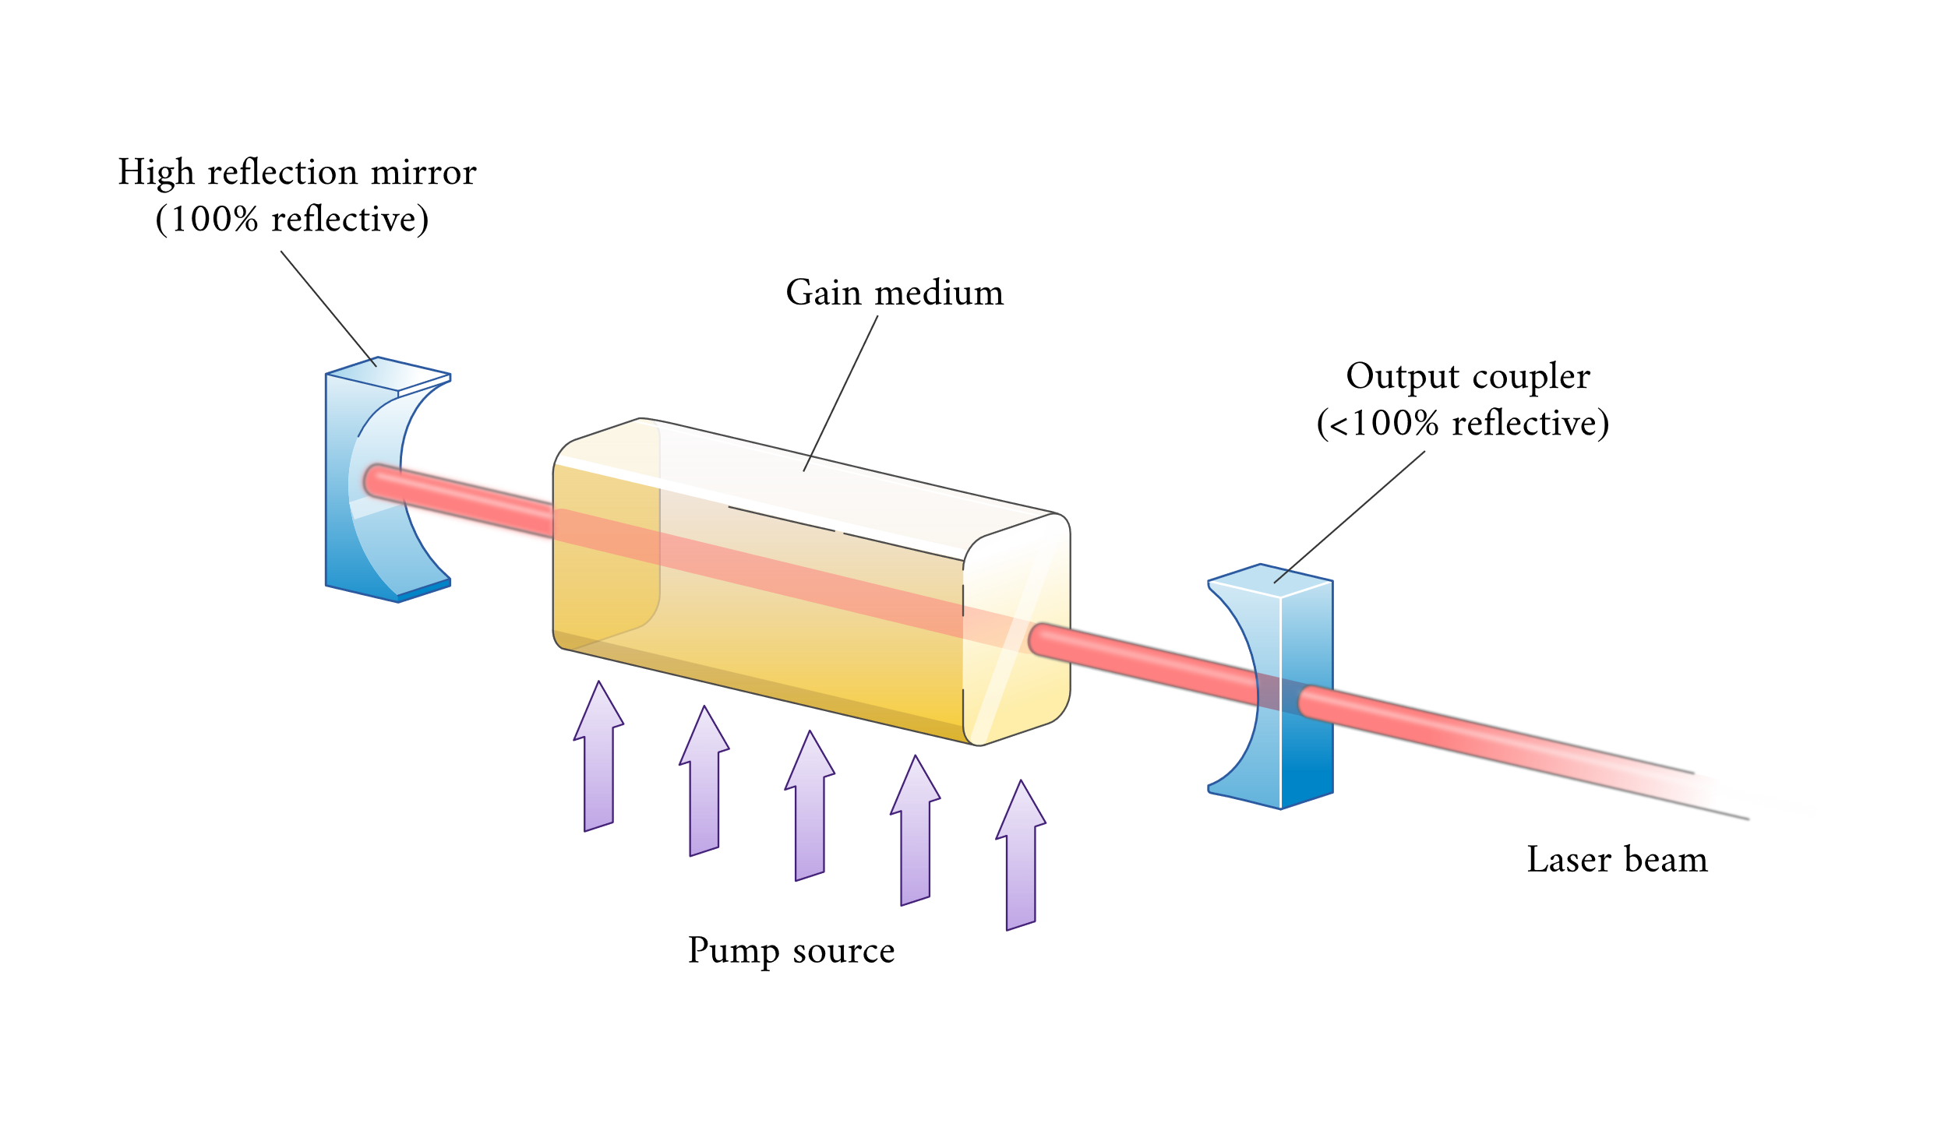
Laser Oscillator
A laser oscillator is a laser amplifier in a cavity
For a nice laser beam (single mode) the cavity needs to be stable
From the saturation intensity, it is almost impossible to have a laser oscillator with high power output (tens of W)

Slide 15
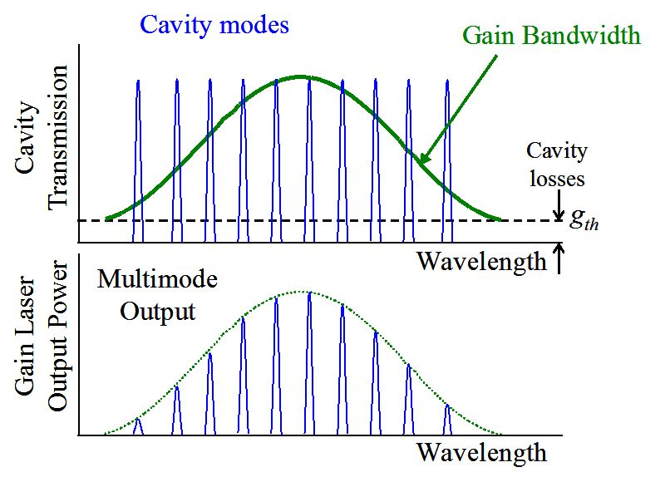


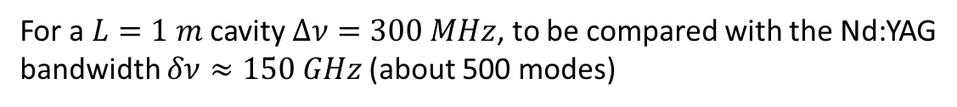
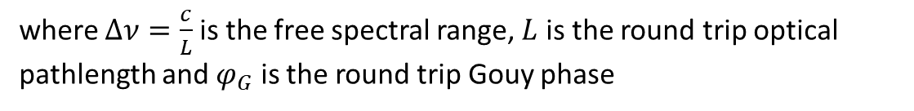
Cavity and Modes
A stable cavity allows many modes to oscillate
$ν_{nmq}=ν_{0}+q Δν+\left(n+m\right) δν$
$$δν =−Δν \frac{φ_{G}}{2π}$$
where $Δν=\frac{c}{L}$ is the free spectral range, $L$ is the round trip optical pathlength and $φ_{G}$ is the round trip Gouy phase
For a $L=1 m$ cavity $Δν=300 MHz$, to be compared with the Nd:YAG bandwidth $δν≈150 GHz$ (about 500 modes)
Trasversal mode could also oscillate, unless they are suppressed by spatial filtering

Slide 16
Homogenous Medium
At the start many mode can oscillate because the gain of the medium is high and the light intensity inside the cavity is small compared to the I_{sat}
Increasing the intensity of the light, the gain is reduced by the saturation for all the mode
Only few modes (or one) could be mantained on the steady state

Slide 17
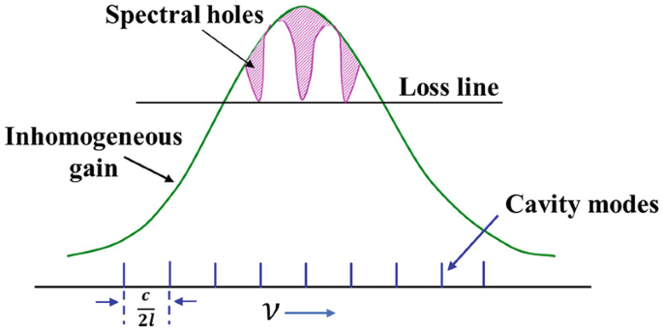
Inhomogeneous Medium
At the start many mode can oscillate because the gain of the medium is high and the light intensity inside the cavity is small compared to the I_{sat}
Increasing the intensity of the light, the gain is reduced by the saturation almost independently for each mode. Each atom population resonating with the mode frequencies will be depleted creating a hole in the gain spectrum
Many mode can oscillate

Slide 18
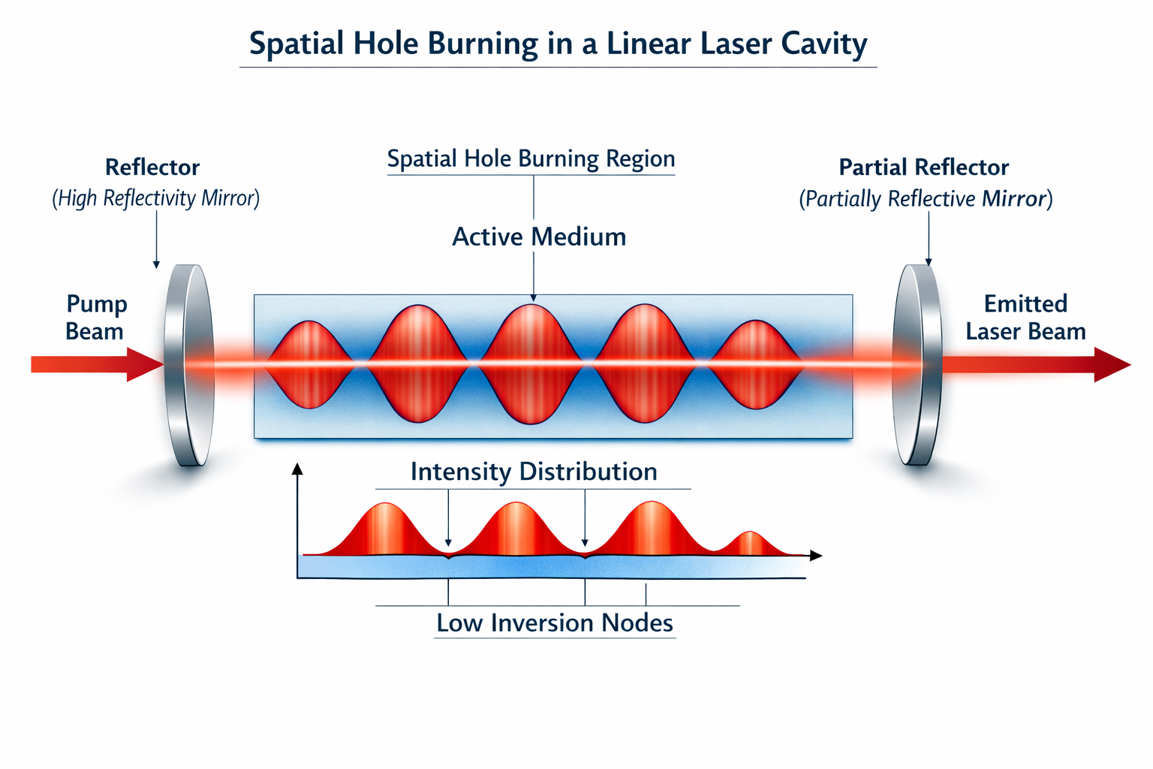
Spatial Hole Burning
In a linear cavity, the field is a standing wave inside the laser medium
The laser medium will saturate where there is constructive interference
Gain remain high on the node, promoting other modes

Slide 19
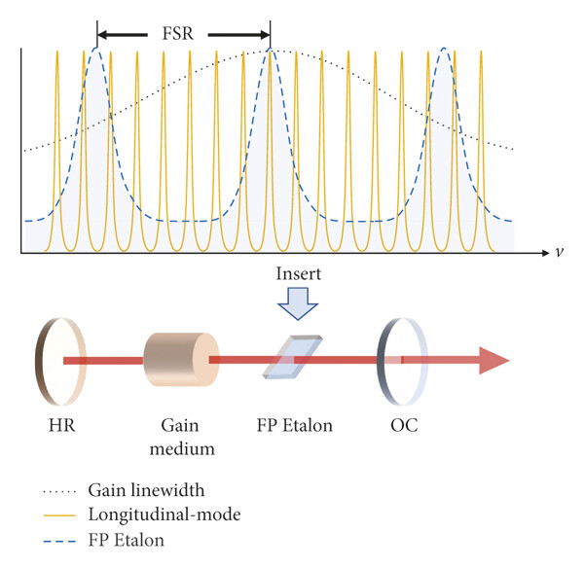
Single Longitudinal Mode Laser
To avoid multiple longitudinal modes to oscillate it is necessary to:
reduce the number of mode inside the gain bandwidth by increasing the free spectral range, i.e. short cavity;
reduce the small signal gain;
suppress unwanted modes, i.e. adding an etalon in the cavity
avoid hole burning by using ring cavity
International Journal of Optics, Volume: 2021, Issue: 1, First published: 28 July 2021, DOI: (10.1155/2021/6667015)

Slide 20
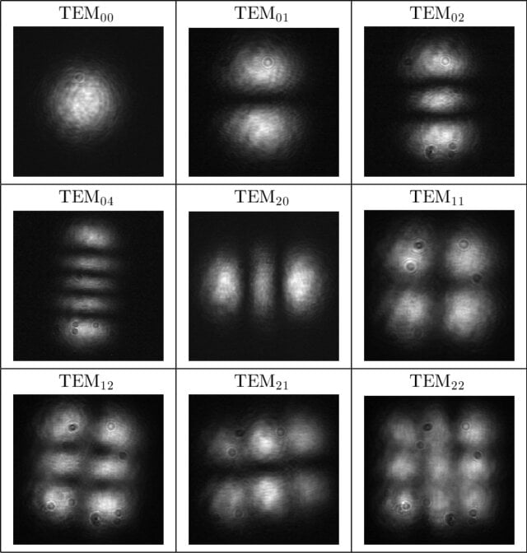
And for the Transversal Modes?
Higher transversal mode can oscillate in a cavity
Depending of the Gouy phase, they can have different frequency so they can be suppressed as the other longitudinal mode
They are in general larger than the TEM00 mode
They can be suppressed by:
an aperture inside the cavity (hard spatial filtering);
pump the active medium only for the area used by the TEM00 (soft spatial filtering).
Holgado, Warein & Sola, I. & Jarque, Enrique & Jarabo, Sebastián & Roso, Luis. (2012). Q-switching in a neodymium laser. EUROPEAN JOURNAL OF PHYSICS. 33. 265-278. 10.1088/0143-0807/33/2/265.

Slide 21
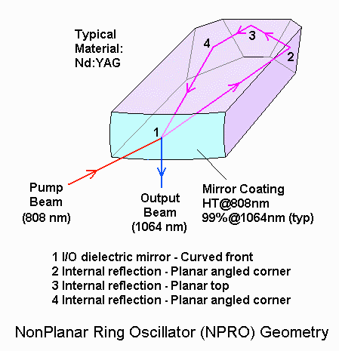
Nonplanar Ring Oscillator
Commercial Nd:YAG single mode oscillator uses ring cavity
Compact monolitic design ($\sim 1 cm$ and $ν_{FSR}\sim 16 GHz$)
Pumped by a diode laser
The laser can only oscillate on one direction by the 3D geometry and the reflections on 2, 3 and 4, at Brewster angle.
Frequency is controlled by pressing the Nd:YAG on the side and/or changing the temperature
Output power $\sim 500 mW$

Slide 22
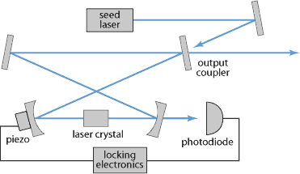
Slave Laser
A free space amplifier can amplify a laser beam but it can not filter higher modes
An oscillator can provide a nice beam but it is limited by the power
A low power oscillator can be used to seed an high power slave oscillator
The mode in the slave is forced by the seed (on a small range spectral range)
The slave cavity provides good beam quality and power ($\sim 20W$) while the seed provides spectral quality

Slide 23
Beam Cleaning
The beam at the end of the laser system is not perfect
Power fluctuation: the power could be stabilized using a feedback loop
Spatial and spectral beam quality: a filter cavity can be use to filter only the TEM00 and the main spectral line
Beam position and pointing: automatic alignment of two mirrors
On other laser system, phase front quality could be improved by a deformable mirror

Slide 24
VIRGO Main laser
Nd:YAG
NPRO Oscillator
Slave Oscillator
Amplifier
Pre Mode Cleaner

Slide 25
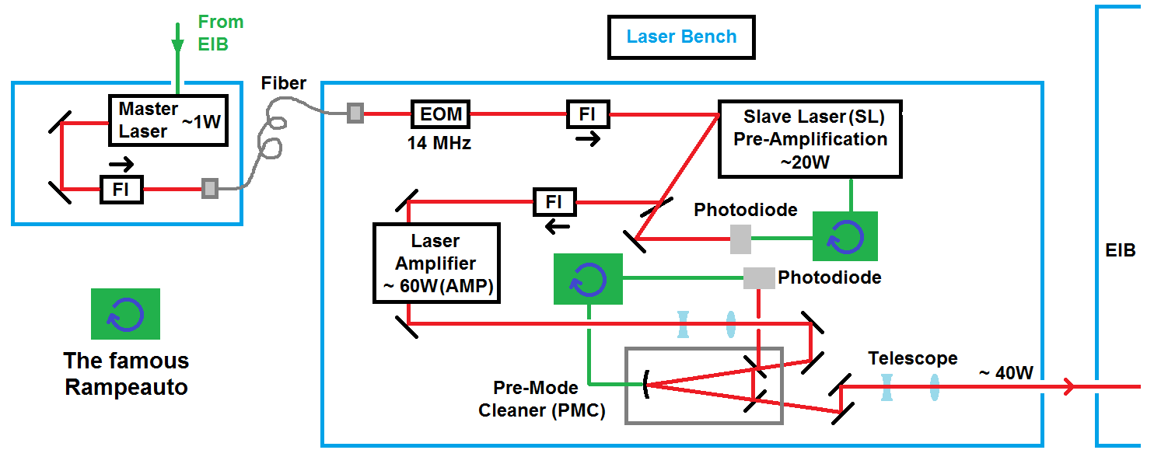
VIRGO Main Laser

Slide 26
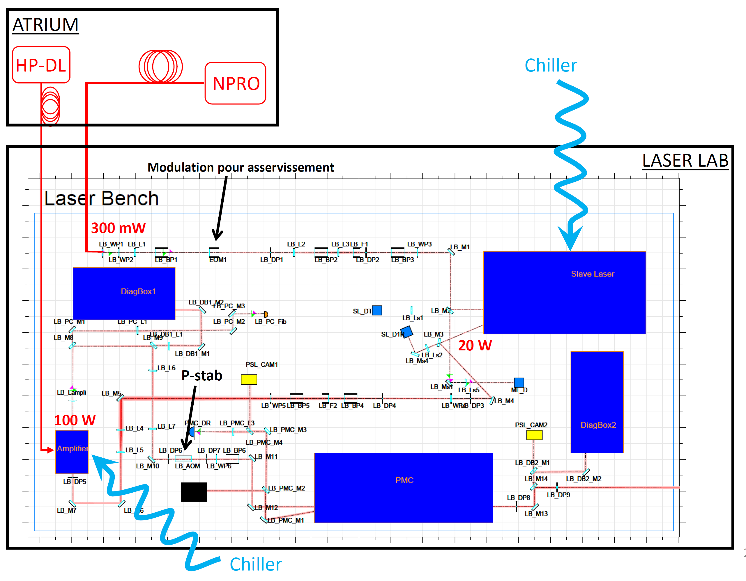
VIRGO Main laser

Slide 27
And for Higher Power?
The main problems are:
Provide pump power: for a 1kW laser you need to provide around 2kW of pump
Thermal managment: high power imply more thermal lenses, stronger cooling system is needed
Avoid damages: larger beams are needed, around 10mm (Thorlabs), more space, alignment more critical, etc
Beam quality: more optical components can degradate the beam quality
Reliability: complex system are more difficult to mantain

Slide 28
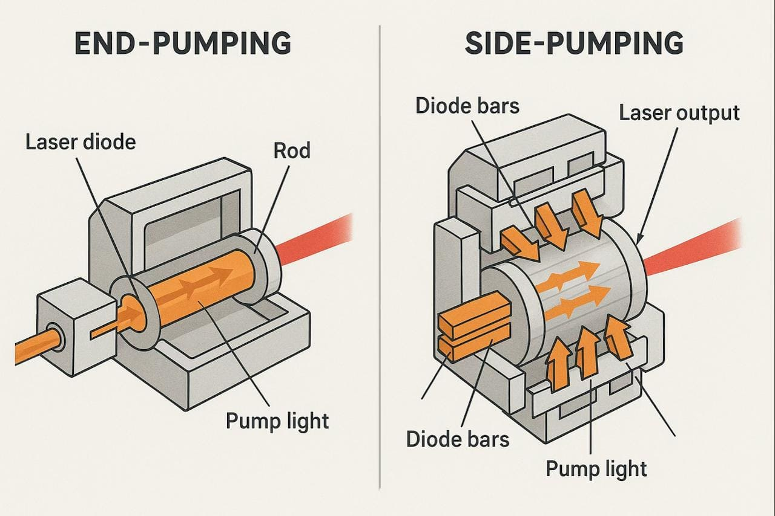
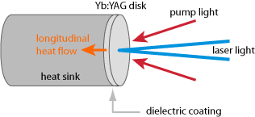
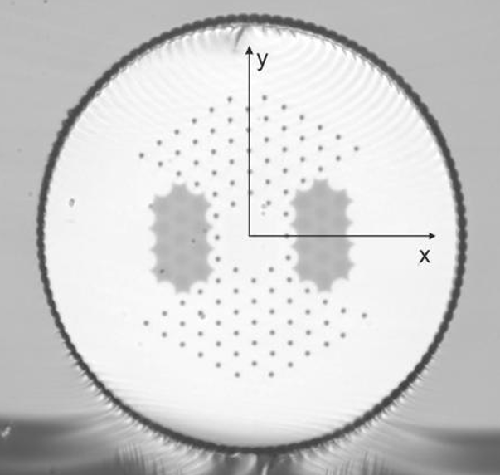
Possible Technologies
DC-200/40-PZ-Yb fiber
NKT Photonics
Thin disk laser amplifier
Large Area Fibre Amplifier: amplification in special fibre, photonic crystal
Diode pumped rod amplifier
PID
φ
Amp
PMC
OSC
Preamp
Amp
Coherent beam recombination: add the power from many amplifiers

Slide 29
Non Linear Optic

Slide 30

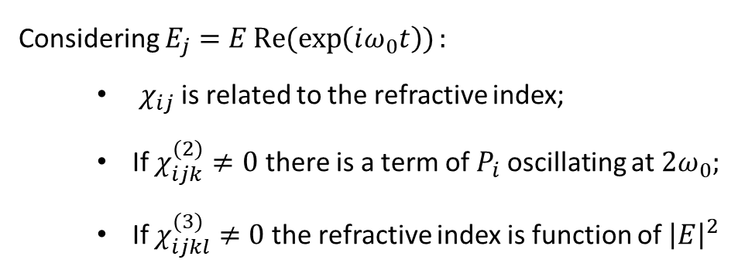
Theoretical Framework
Maxwell equations in a material are linear, most of the time
In general, the polarization $\vec{P}$ is not necessary linear with respect the electrical field $\vec{E}$
$$P_{i}=ε_{0}\left(χ_{ij} E_{j}+χ_{ijk}^{(2)} E_{j}E_{k}+χ_{ijkl}^{(3)} E_{j}E_{k}E_{l}+⋯\right)$$
Any material has $χ_{ijkl}^{(3)}≠0$ while only material without inversion symmetry has $χ_{ijk}^{(2)}≠0$
Considering $E_{j}=ERe(exp\left(iω_{0}t\right)):$
$χ_{ij}$ is related to the refractive index;
If $χ_{ijk}^{(2)}≠0$ there is a term of $P_{i}$ oscillating at $2ω_{0};$
If $χ_{ijkl}^{(3)}≠0$ the refractive index is function of ${\left|E\right|}^{2}$

Slide 31






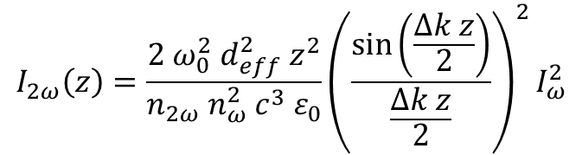
Second Harmonic Generation
$E=A_{1}(z)\exp\left(i k_{1}z−iω_{0}t\right)$+ $A_{2}(z)\exp\left(i k_{2}z−i{ 2ω}_{0}t\right)+c.c.$
NLO
$${2 ω}_{0}$$
$$∇^{2}E−\frac{n^{2}}{c^{2}}\frac{∂^{2}E}{∂t^{2}}=\frac{1}{ε_{0}c^{2}}\frac{∂^{2}P^{NL}}{∂t^{2}}$$
$$ω_{0}$$
$$P^{NL}=2ε_{0}d_{eff}E^{2}$$
$$ω_{0}$$
With slow varing approximation and${\left|A_{1}\right|}^{2}≫{\left|A_{2}\right|}^{2}$
z
$$I_{2ω}\left(z\right)=\frac{{2 ω}_{0}^{2} d_{eff}^{2} z^{2}}{n_{2ω} n_{ω}^{2} c^{3}{ ε}_{0}}{\left(\frac{\sin\left(\frac{Δk z}{2}\right)}{\frac{Δk z}{2}}\right)}^{2}I_{ω}^{2}$$
$$Δk= \frac{4π}{λ_{0}}(n_{2ω}−n_{ω})$$

Slide 32
Second Harmonic Generation - 2
When $dn=0$, the conversion is quadratic with the length of the crystal

Slide 33
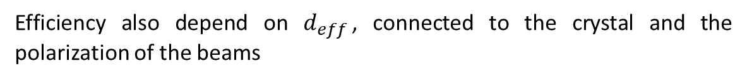
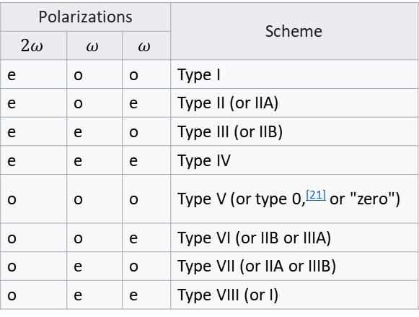
Phase Matching
The have high SHG efficiency it is necessary to have $dn=0$, i. e. $n_{2ω}=n_{ω}$
This condition is called phase matching
All the SHG crystals are at least birefringent. By having the fundamental and the second harmonics with different polarization it is possible to tune one of the two refractive index by changing the angle of the crystal
Polarizations |  |  | Scheme
$$2ω$$ | $$ω$$ | $$ω$$
e | o | o | Type I
e | o | e | Type II (or IIA)
e | e | o | Type III (or IIB)
e | e | e | Type IV
o | o | o | Type V (or type 0,^{[21]} or "zero")
o | o | e | Type VI (or IIB or IIIA)
o | e | o | Type VII (or IIA or IIIB)
o | e | e | Type VIII (or I)
For some crystals, the phase matching can be done by changing the temperature (non critical phase matching)
Efficiency also depend on $d_{eff}$, connected to the crystal and the polarization of the beams
Or…

Slide 34
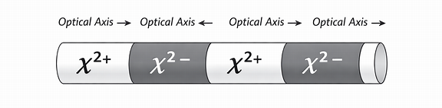
Quasi Phase Matching
Out of the phase matching, the conversion is periodic.
If after half of the oscillation we turn the crystal by 180°, the second harmonic is no going out of phase
Those crystals are called Periodically Poled Crystals
Different crystals can be used, with less requirement on the phase matching and potentially higher non linearity
Tuning is done by changing the temperature

Slide 35
Crystals
Crystal | Phase‑matching type | deff (pm/V) | nω (1064 nm) | n2ω (532 nm) | PM angle (°)
KTP (KTiOPO₄) | Type II (most common) | ~3.4 | 1.8296 | 1.8873 | ~23° (θ, z‑type II)
LBO (LiB₃O₅) | Type I | ~0.8 | 1.606 | 1.622 | ~90° (xz‑plane)
BBO (β‑BaB₂O₄) | Type I | ~2.0 | 1.657 | 1.681 | ~22°
LiNbO₃ (LN) | Type I | ~4.5 | 2.223 | 2.286 | ~44°
KDP (KH₂PO₄) | Type II | ~0.4 | 1.505 | 1.520 | ~41°
CLBO (CsLiB₆O₁₀) | Type I | ~0.9 | 1.606 | 1.622 | ~75°
BIBO (BiB₃O₆) | Type I | ~3.2 | 1.79 | 1.83 | ~168°

Slide 36
PP Crystals
Crystal | Poling Period Λ (µm) | deff (pm/V) | Damage Threshold | Temperature Range
PPKTP (Periodically Poled KTP) | ≈ 9.0 µm | ~9–10 (QPM‑enhanced) | Very high | Wide (room temp OK)
PPLN (Periodically Poled LiNbO₃) | ≈ 6.9 µm | ~15–17 (QPM‑enhanced) | Medium | Needs temp control (≈ 80–120 °C)
MgO:PPLN | ≈ 6.9 µm | ~14–16 | High | 50–150 °C
PPLT (Periodically Poled LiTaO₃) | ≈ 8.2 µm | ~10–12 | High | 30–200 °C
PPRbTiOPO₄ (PPRTP) | ≈ 8–9 µm | ~8–9 | Very high | Wide
PPMgSLT (Periodically Poled Mg‑stoichiometric LiTaO₃) | ≈ 8.0 µm | ~11–12 | Very high | 30–200 °C

Slide 37
How to Improve the SHG Efficiency?
To increase the SHG, it is necessary to increase the pump intensity
The pump beam could be focused on the crystal, but the intesity is high only in the focal region
The SHG crystal could be placed inside a cavity with high Q for the pump
HR 1064nm
HR 532nm
HR 1064nm
AR 532nm
SHG

Slide 38


Pockels Cell
Let consider again a non linear crystal with $χ_{ijk}^{(2)}≠0$ but with a static Electric field and a plane wave
${\tilde{E}}_{i}=A_{i}\exp{(i k z−iω_{0}t)}$ + $E_{i}+c.c.$
$$P_{i}=ε_{0}\left(χ_{ij} +χ_{ijk}^{(2)} E_{k}\right) A_{j}$$
The static electric field, if strong enough, can change the refractive index of the material for the plane wave
More important, it can change the refractive index for one polarization

Slide 39
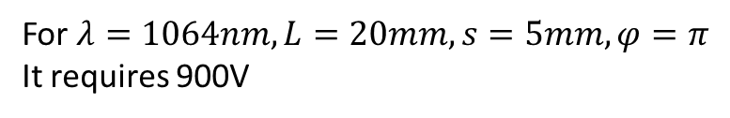



Pockels Cell - 2
Let suppose that $n_{x}=n$ and $n_{y}=n+δn B$
If the polarization of the light is on the y axis, it can be used to change the phase of the beam
LiNdO₃
$$φ$$
E
For $λ=1064nm, L=20mm, s=5mm, φ=π$
It requires 900V
s
L
If the polarization of the light is at 45° with respect the y axis, it can be used change the polarization, up to turn it of 90°, and to modulate the amplitude
DKDP
E
For $λ=1064nm, L=10mm$It requires 8kV
L

Slide 40
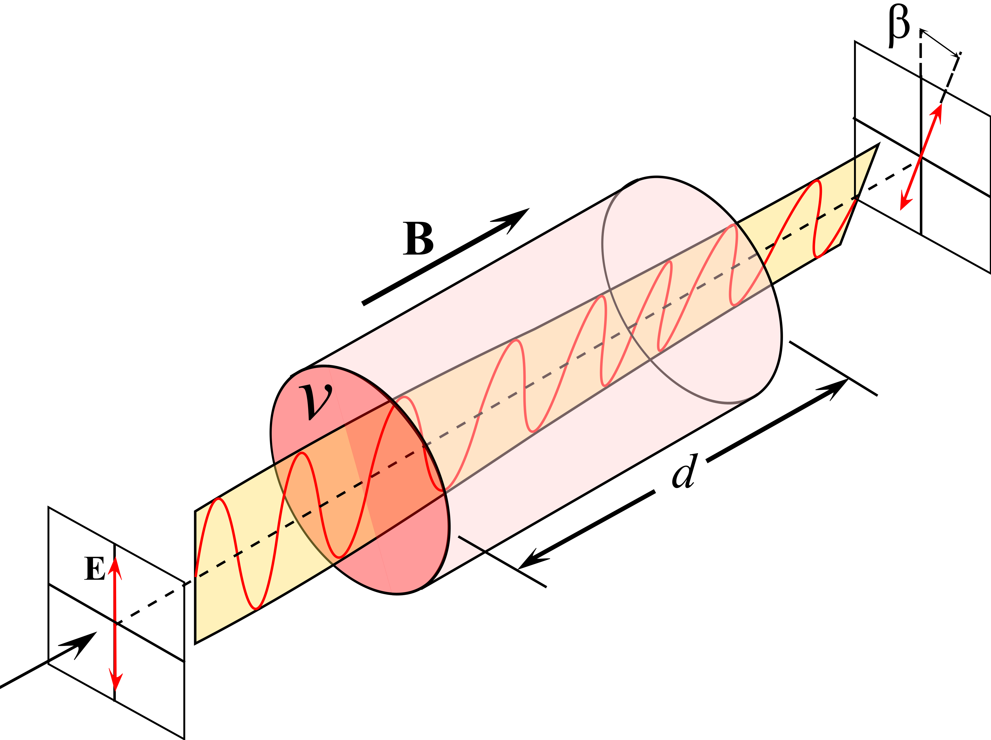
Faraday Effect
Most of the optical devices are not able to stop back reflection
Back reflection can be dangerous for:
amplified laser system: back propagating beams can still be amplified;
oscillator and cavities: unwanted coupled cavities
Some material, with a strong magnetic field, turn the polarization of the light
The amount of rotation is proportional to the length of propagation and to the amplitude of the magnetic field

Slide 41
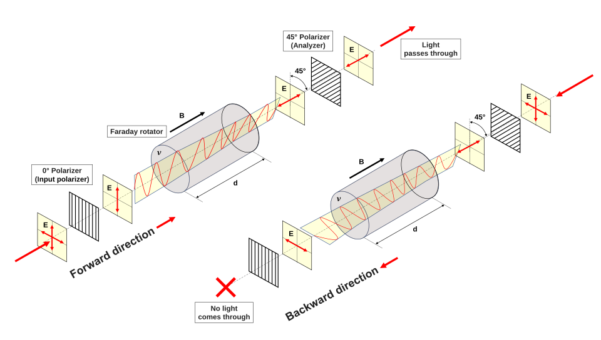
Faraday Isolator
The magnetic field is a Psedo-vector, a back propagating beam will have the polarization turned by the same amount
By turning the polarization by 45° and using two polarizers, back reflection can be blocked

Slide 42
Sound and Light

Slide 43



Interaction Light – Sound
The density $ρ$ of a material with a sound wave of amplitude ${\tilde{A}}_{s}$, pulsation $ω_{s}$and speed $v_{s}$can be describe as
x
Acustic wave
$$ρ=ρ_{0}+{\tilde{A}}_{s}\cos{({k_{s}x−ω}_{s}t)} {with v}_{s}=\frac{ω_{s}}{k_{s}}$$
z
The refractive index $n$ is proportional to the density $ρ$
$$E_{0}$$
$$n=n_{0}+{Δn}_{s}\cos{(k_{s}x−ω_{s}t)}$$
A periodic variation of the refractive index act as a grating
L

Slide 44



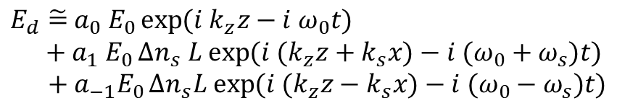



Acousto Optic Modulator
Considering a plane wave of light into the sound wave
x
Acoustic wave
$$E=E_{0}\exp{(i k_{z}z−i ω_{0}t+i φ)}$$
where
$$φ={Δn}_{s}k_{z}L\cos{(k_{s}x−ω_{s}t)}$$
z
For small signal
$$a_{1} E_{0}$$
$$E_{0}$$
$$a_{0} E_{0}$$
$E_{d}\tilde{=}$ $a_{0} E_{0}\exp{(i k_{z}z−i ω_{0}t)}$
$${{ + a}_{1} E}_{0}{Δn}_{s} L exp{(i {(k}_{z}z+k_{s}x)−i (ω_{0}+ω_{s})t)}$$
$+ {a_{−1}E}_{0}{Δn}_{s}L exp{(i {(k}_{z}z−k_{s}x)−i (ω_{0}−ω_{s})t)}$
$$a_{−1} E_{0}$$
We have 3 wave, the transmitted beam and 2 diffracted beams with different frequency
L

Slide 45



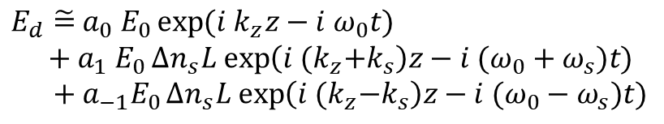




Longitudinal Acoustic Waves
The acustic wave can also be collinear to the light propagation
$$E=E_{0}\exp{(i k_{z}z−i ω_{0}t+i φ)}$$
where
$$φ={Δn}_{s}k_{z}L\cos{(k_{s}z−ω_{s}t)}$$
x
In this case we have a volume Bragg grating
Acoustic wave
z
For small signal
$$a_{1} E_{0}$$
$E_{d}\tilde{=}$ $a_{0} E_{0}\exp{(i k_{z}z−i ω_{0}t)}$
$${{ + a}_{1} E}_{0}{Δn}_{s}L exp\left(i {(k}_{z}+k_{s}\right)z−i (ω_{0}+ω_{s})t)$$
$+ {a_{−1}E}_{0}{Δn}_{s}L exp\left(i {(k}_{z}−k_{s}\right)z−i (ω_{0}−ω_{s})t)$
$$E_{0}$$
$$a_{0} E_{0}$$
$$a_{−1} E_{0}$$
If $k_{s}$=2 $k_{s}$ the light is reflected back
L

Slide 46
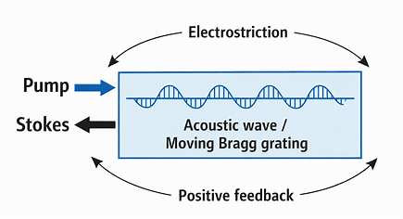
Brillouin Instability
With foward and backward light wave there is a standing wave, with periodic local intensity in z
If there is a gradient of the intensity there is a radiation pressure on the material
A periodic and oscillating force on the material can create or amplify a sound wave
The sound wave can reflect back the incoming light wave

Slide 47
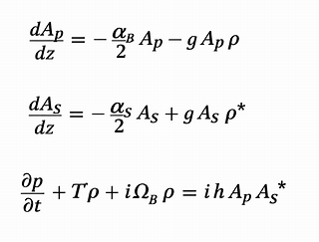
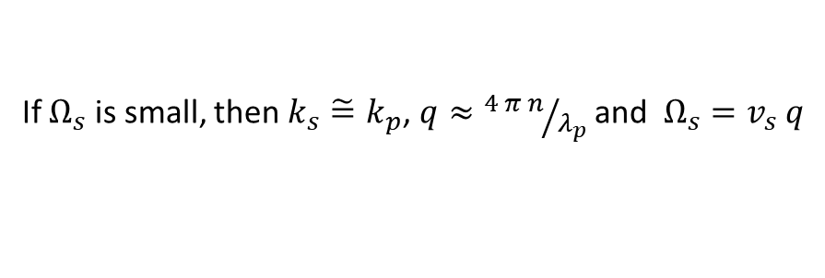
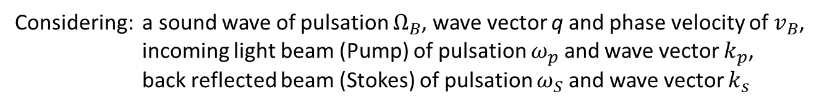


Phase Matching and Brillouin Shift
Considering: a sound wave of pulsation $Ω_{B}$, wave vector q and phase velocity of $v_{B}$,
incoming light beam (Pump) of pulsation $ω_{p}$ and wave vector $k_{p}$,
back reflected beam (Stokes) of pulsation $ω_{S}$ and wave vector $k_{s}$
$$ω_{s}=ω_{P}−Ω_{B}$$
and
$$k_{s}=q−k_{p}$$
If $Ω_{s}$ is small, then $k_{s}\tilde{=}k_{p}$, $q≈{4 π n}/{λ_{p}}$and $Ω_{s}=v_{s} q$
The process is described by those equations, including absorption of the light and the sound wave

Slide 48




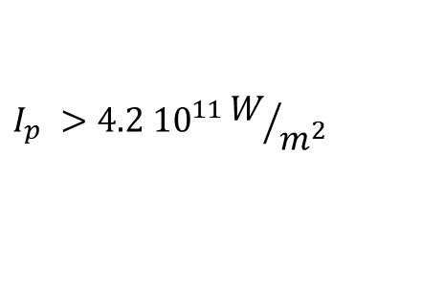



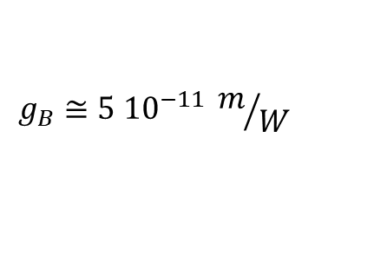


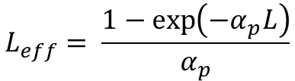
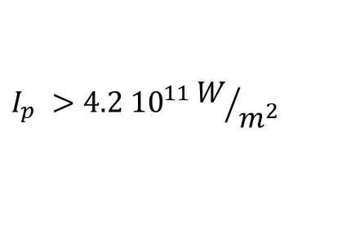
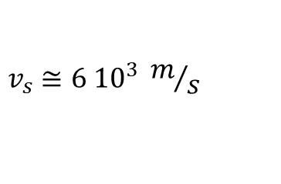
Instability Threshold and Effects
The instability is started by the noise. If the gain is enough, the process evolves to a steady state
Longer is the material, more is the gain; more is the Pump intensity, more is the gain
Threshold formula
$$L_{eff}= \frac{1−\exp\left(−α_{p}L\right)}{α_{p}}$$
“Stimulated Brillouin Scattering Threshold in Presence of Modulation Instability for Optical Pulse in Long Optical Fiber”, Applied Sciences, 2022 (MDPI).
$$g_{B} I_{p} L_{eff}>21$$
Some numbers for single mode Fused Silica fibre, core diameter of $5 μm$
$$g_{B}≅\text{5 }{10}^{−11} m/W$$
$$L_{eff}=1 m$$
$$L_{eff}=3 km$$
$$v_{s}≅6 {10}^{3} m/s$$
$$λ_{p}≅1064 nm$$
$$I_{p} >4.2 {10}^{11}W/{m^{2}}$$
$$I_{p} >4.2 {10}^{11}W/{m^{2}}$$
$$Ω_{s}≅100 GHz$$
$$A_{eff}=2 {10}^{−11} m$$
$$P_{p} >8.4 W$$
$$P_{p} >3 mW$$
$$f_{s}≅16 GHz$$

Slide 49
Laser Safety

Slide 50
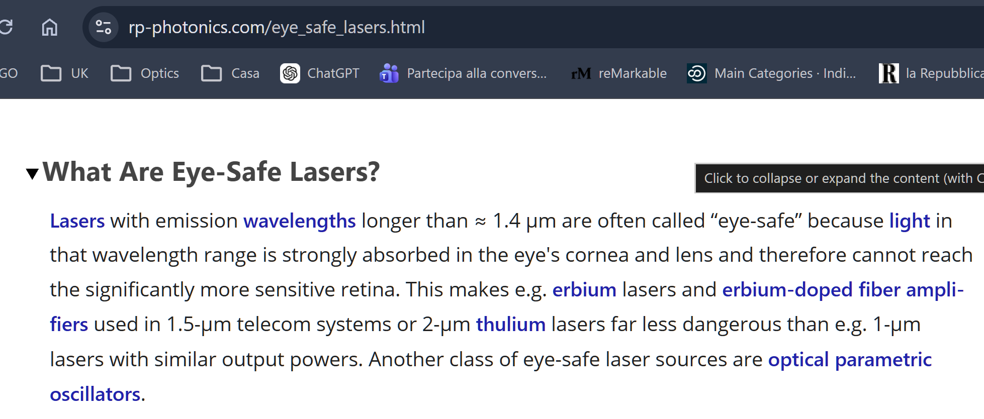
Be Careful on Web Info

Slide 51
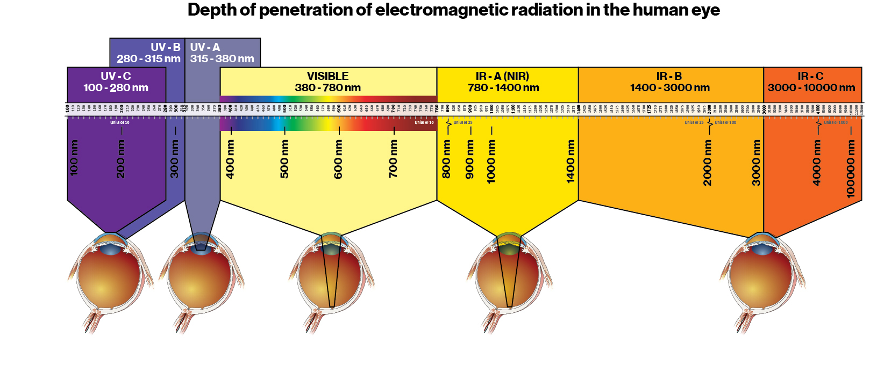
It Is Not Really True

Slide 52
Conclusions
Overview on laser oscillator, amplification and MOPA system
Common optical devices
SHG and nonlinear crystals
Brillouin Instability

